Slide 1
A Comparison of Airborne Data Processing Methods on Single Scattering Properties of Cloud Ice Habits
Shawn Wagner
Committee:
David Delene
Andrew Detwiler
Mark Ray

Slide 2
Background
Ice induction in high altitude jets reducing thrust / extinguishing exhaust
  “The Ice Particle Threat to Engines in Flight” (Mason, Strap, Chow; 2006)
FAA regulations on “ice crystal icing (ICI)” conditions
  Airworthiness Directive 2013-24-01
    Issued and effective 2013/11/27
    Applies to several Boeing models
    ICI conditions must be detectable by aircraft with a notification system
Ice habits have individual scattering and absorption properties
    Yang et al. 2000, 2005, 2015, etc.
Backscatter can be used for detection and/or classification of ice particles

Slide 3
Goal/Purpose
“… will compare aircraft probe derived backscatter to the backscatter from a LIDAR system.”
Method of LIDAR verification
  Must know size distributions and habits
    What are the uncertainty levels in sizing and habit classification?
    Which is the dominant factor?

Slide 4
Methodology
Compare 3 Optical Array Probe data processing methods
  Reconstruction, All-In, Center-In
    Differentiated by how they handle partially captured particles
    “A Computational Technique for Increasing the Effective Sampling Volume…”
      (Heymsfield and Parrish; 1978)
    Processed using Community Packages for Airborne Science (CoPAS)
  Each should produce at least slightly different size distributions
    Poisson counting statistics for uncertainty in sizing
    sqrt(# particles) / (total # particles observed)
  Determine the resulting difference in calculated backscatter
  Repeat the process assuming different monodispersed habit structures for habit related uncertainty

Slide 5
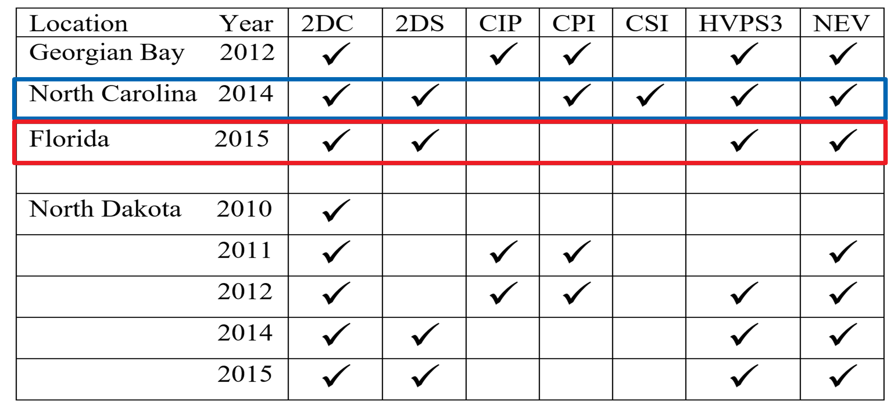
Data

Slide 6
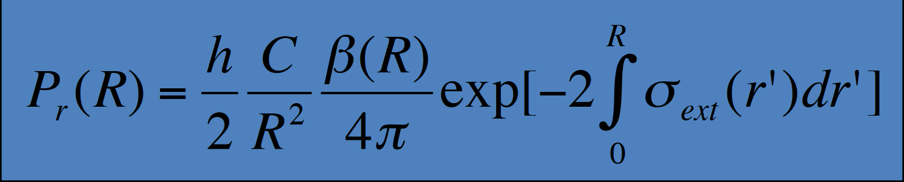
Equation(?)
http://reef.atmos.colostate.edu/~odell/at652/lecture_2013/lecture8b.pdf
Need to find original source of equation

Slide 7
Expected Results
Reconstruction should produce more small particles than center-in and all-in
  More small particles should theoretically increase the amount of calculated backscattered radiation
  Reconstruction should produce consistently higher amounts of backscatter
Since cirrus clouds are more likely to be of a consistent habit the particle size-distribution will likely be more influential than the habit assumption.
  Habit assumption is of secondary importance and can be disregarded

