Slide 1

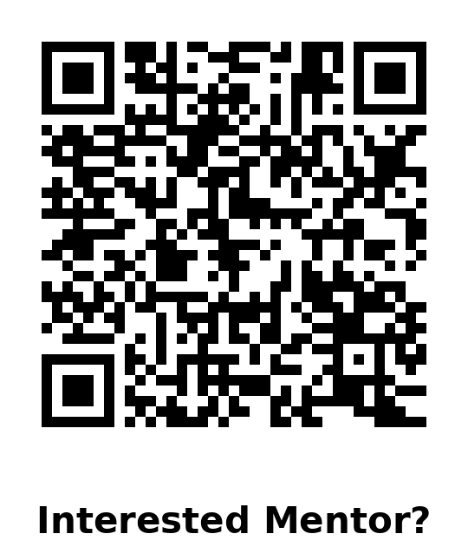
UND Data Skills Pathway: Call For Projects Ideas
Need/Problem
Apparatus/Facility
Objective
Data is everywhere, but many students never practice the full workflow employers expect.
Real-world data is messy (gaps, noise, sensor issues), not “perfect” class datasets.
The pathway gives a clear, supported path into strong data skills and paid research and internships.
Authentic instruments + model datasets
Live visualization via CHORDS + Grafana dashboards.
Python/Jupyter templates for metadata and quality checks.
Build job-ready skill: students learn to clean data, check quality, analyze, visualize, and communicate results using reproducible workflows and documentation.
Advancement
Full data workflow: Students demonstrate the full data lifecycle
Project-based assessment: Students assessed through faculty/industry-proposed research projects that uses real datasets, and strong mini-projects may continue into paid research or internships.
Concept
15-week, for-credit pathway with 4 stages:
Orientation (data careers + expectations)
Tools Bootcamp (Python + workflows)
Guided Project (mentored project with weekly check-ins and feedback)
Final Mini-Presentation (report + slides students can use as portfolio deliverables).
Data Skills Microcredential (in development): student can use to show verified skills to employers.
End Users
UND undergrads across majors building data careers.
Employers seeking trained students with data skills.
Faculty: have a data question that could support a paper, a proposal, students can take it on as a mini-project.
Applicability: Any Data-driven Field, Data Skills Microcredential, Project-based Assessment, Paid Internship Pathways
02/11/2026

