Slide 1
Precipitation Evaluation of the North Dakota Cloud Modification Project
Matthew E. Tuftedal^{1,2}, David J. Delene¹, and Andrew G. Detwiler¹
¹Department of Atmospheric Science, University of North Dakota, Grand Forks, ND
²Radiometrics Corporation, Boulder, CO

Slide 2
Overview
Motivation and Objective
Background
Data Set
Methodology
Results
Conclusion

Slide 3
Motivation and Objective
The North Dakota Cloud Modification Project (NDCMP) costs the state of North Dakota approx. $1.0 million per year or approx. 13 cents per acre (NDCMP 2018).
The last study performed on the NDCMP was conducted in 2005 (Wise 2005).
Analyzing the effectiveness of the NDCMP can help future economic cost/benefit ratio studies and are important so sponsors and the public are well informed.
Determining the effectiveness of the NDCMP at increasing rainfall within the project area.

Slide 4
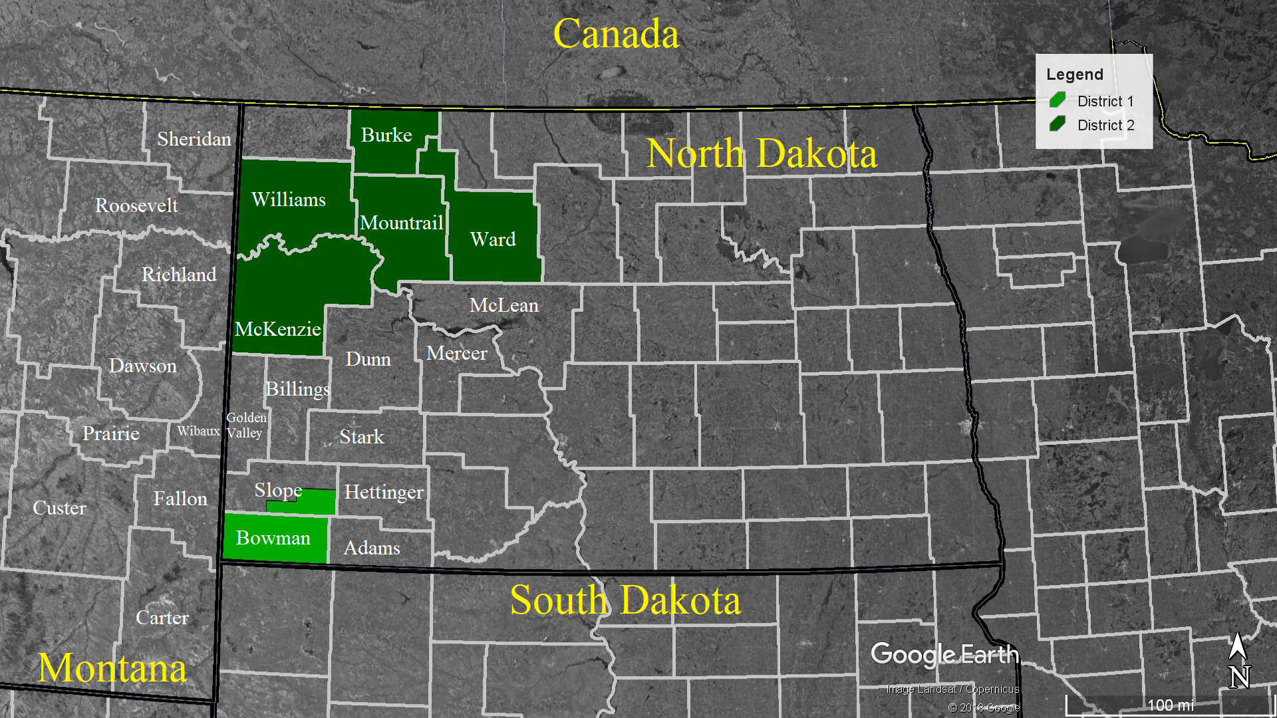
Project Background
The NDCMP has ran a non-randomized cloud seeding operation in ND since 1976.
(Schneider and Langerud 2011)
Primary goal of the program is hail suppression to reduce crop loss, but precipitation enhancement was quickly added.
Operations are conducted in two districts during June, July, August and occasionally early September.
(NDARB 2018)

Slide 5
Previous Evaluations of the NDCMP
By using National Weather Service (NWS) Cooperative Observer Program (COOP) rain gauges, Smith et al. (2004) studied whether a cloud seeding effect was present.
A target/control methodology consisting of 11 stations in the NDCMP target area and 25 stations in eastern Montana as the control was used.
Results showed little to no increase in rainfall in this analysis and a p-value of 0.32.

Slide 6
Previous Evaluations of the NDCMP
Wise (2005) analyzed the effects of the NDCMP using a target, downwind and control approach.
The control/downwind region was determined by daily storm motion from 1999 to 2002.
North Dakota Atmospheric Resource Board Cooperative Observer Network (NDARBCON) rain gauges were used for 1977 to 2003.
Results found an increase in rainfall of at least 5 % in four out of seven cases.
Of those four, only two were determined statistically significant
(p-value < 0.05)

Slide 7
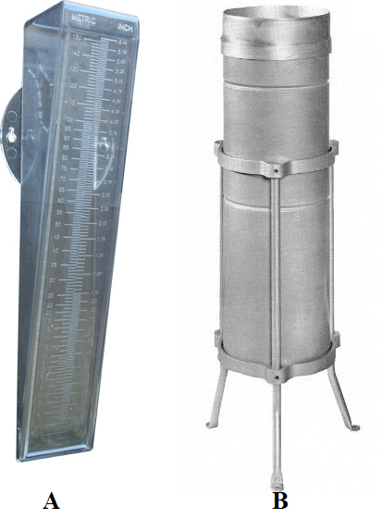
Combining Data
Langerud and Gilstad (2003) compared NDARBCON and NWS COOP gauges over a 23-year period from 1977-1999.
Rain gauges were compared multi-annually and annually.
Results showed rainfall totals within approx. a half an inch per year and a correlation of 0.998.

Slide 8
Methodology: Target/Control
The target regions are determined by the years active in the NDCMP.
Bowman, Slope, McKenzie, and Ward Counties were selected.
Controls were designated as counties that have not participated in the NDCMP or only participated in a relatively short period.
Downwind effects proved challenging for selecting controls
DeFelice et al. (2014) found that downwind effects from cloud seeding increases rainfall by 5 – 15 %, and Wise (2005) found a 13% increase in downwind rainfall within the NDCMP.
Counties | District | Years Participated | Total Years
Adams | 1 | 1977-1980 | 4
Bowman | 1 | 1977-2018 | 42
Hettinger | 1 | 1977-1988 | 12
Slope | 1 | 1977-2018 | 42
Burke | 2 | 2015-2018 | 4
McKenzie | 2 | 1977-2018 | 42
McLean | 2 | 1977-1984 | 8
Mountrail | 2 | 1977-2018 | 42
Ward | 2 | 1977-2018 | 42
Williams | 2 | 1997-2018 | 22

Slide 9
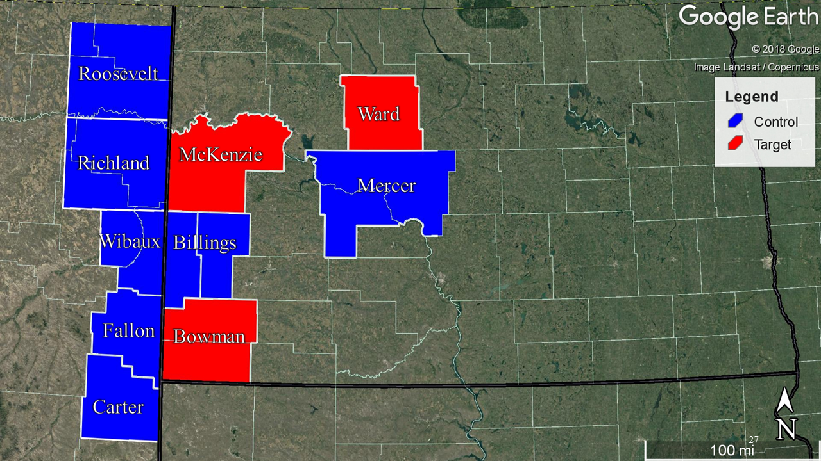
Methodology: Target/Control
Storms in western ND move W to E
Control areas were created to mitigate downwind effects
Bowman
Bowman and Slope Counties
“Billings”
Billings and Golden Valley County
Wibaux
Wibaux and part of Dawson County
Mercer
Mercer and Mclean County
Richland and Roosevelt
Parts of several MT counties
Fallon, Ward, Carter and McKenzie
Political boundaries

Slide 10
Methodology: Monthly Rainfall for a Single Station
$$M_{s}=\sum_{d=1}^{N}{{Rain}_{d}}$$
$M_{s}$ = the calculated monthly rainfall for a given station
$Rain$= the rainfall amount recorded on a given day
N = the number of days in the given month

Slide 11
Methodology: Area Averaged Monthly Rainfall
$${\overline{T}}_{area}=\frac{\sum_{s=1}^{n}{M_{s}}}{n}$$
${\overline{T}}_{area}$ = area averaged rainfall
$M_{s}$ = the calculated monthly rainfall for a given station
$n$ = number of valid stations within the area

Slide 12
Methodology: Statistical Methods
To analyze the target and control rainfall differences, the following statistical methods were used:
Single ratio
Double Ratio
Bootstrapping

Slide 13
Methodology: Single Ratio
Once the rainfall for a given evaluation was completed, a single ratio between target and control were calculated for the pre-NDCMP and NDCMP periods.
Each target was assigned to different control areas based on the proximity of their location.
McKenzie was paired with:
Richland, Roosevelt, Wibaux, and Billings
Bowman was paired with:
Carter, Fallon, Wibaux and Billings

Slide 14
Methodology: Single Ratio
$$SR=\frac{\sum_{n=1}^{years}{ {{\overline{T}}_{target}}^{June, July, August, or Seasonal}} }{\sum_{n=1}^{years}{ {{\overline{T}}_{control}}^{June, July, August,or Seasonal}}}$$
$SR$= single ratio
$\overline{T}$ = area averaged rainfall

Slide 15
Methodology: Double Ratio
$$DR=\frac{{SR}_{1977−2018}}{{SR}_{1950−1975}}$$
$SR$= single ratio for the given time period
$DR$ = Double ratio given ins decimal form

Slide 16
Methodology: Bootstrapping and One-Tailed Statistical Test
Bootstrapping is used to randomly resample the data set multiple times to enable calculation of uncertainty, confidence intervals, and significance (Hesterberg et al. 2005).
Bootstrapping does not assume a Gaussian, or any specific distribution type, for the data set population
One-tailed statistical test is used to determine whether the double ratio for a particular target/control pair is statistically significant.
A one-tailed statistical test checks if the critical area of a distribution is greater than or less than a specified value (Lane et al. 2003).
Notes:
For example, a double ratio above 1.0 from bootstrapping indicates the likelihood of an increase in precipitation due to cloud seeding. If 95% of a bootstrapped sample of double ratios are above 1.0 this indicates a 95% likelihood of a precipitation increase, which is taken here to be statistically significant.

Slide 17
Results: Single Ratio
Target/Control | June |  | July |  | August |  | Seasonal
 | 1950-1975 | 1977-2018 | 1950-1975 | 1977-2018 | 1950-1975 | 1977-2018 | 1950-1975 | 1977-2018
McKenzie/Billings | 0.84 | 1.00 | 0.95 | 1.03 | 0.92 | 0.89 | 0.89 | 0.98
McKenzie/Richland | 1.13 | 1.17 | 1.06 | 1.12 | 1.04 | 1.17 | 1.09 | 1.15
McKenzie/Wibaux | 0.88 | 1.05 | 0.98 | 1.09 | 0.96 | 0.94 | 0.92 | 1.03
McKenzie/Roosevelt | 1.21 | 1.12 | 1.09 | 1.06 | 1.02 | 1.20 | 1.12 | 1.12
Bowman/Billings | 0.89 | 1.01 | 0.96 | 0.89 | 0.84 | 0.88 | 0.90 | 0.94
Bowman/Wibaux | 0.93 | 1.06 | 0.99 | 0.94 | 0.88 | 0.93 | 0.94 | 0.99
Bowman/Carter | 0.94 | 0.91 | 0.95 | 0.96 | 1.01 | 0.88 | 0.96 | 0.92
Bowman/Fallon | 1.20 | 1.19 | 1.20 | 1.28 | 1.25 | 1.23 | 1.21 | 1.23
Ward/Mercer | 0.99 | 1.01 | 0.96 | 0.93 | 1.04 | 0.93 | 0.99 | 0.96

Slide 18
Results: Double Ratios
Target/Control Pair | June | July | August | Seasonal
McKenzie/Billings | 1.19 | 1.08 | 0.97 | 1.10
McKenzie/Richland | 1.04 | 1.06 | 1.13 | 1.06
McKenzie/Wibaux | 1.19 | 1.24 | 0.96 | 1.12
McKenzie/Roosevelt | 0.93 | 0.97 | 1.18 | 1.00
Bowman/Billings | 1.13 | 0.93 | 1.05 | 1.04
Bowman/Wibaux | 1.14 | 0.95 | 1.06 | 1.05
Bowman/Carter | 0.97 | 1.01 | 0.87 | 0.95
Bowman/Fallon | 0.99 | 1.07 | 0.98 | 1.01
Ward/Mercer | 1.02 | 0.97 | 0.89 | 0.97

Slide 19
Results: Bootstrapping
Target/Control Pair | Double Ratio | 95% Confidence | Significance > 1.0
McKenzie/Billings | 1.10 | 0.99 - 1.22 | 96.5%
McKenzie/Wibaux | 1.12 | 1.01 - 1.23 | 98.5%
McKenzie/Richland | 1.06 | 0.98 - 1.15 | 94.0%
McKenzie/Roosevelt | 1.00 | 0.90 - 1.10 | 46.5%
Bowman/Billings | 1.04 | 0.93 - 1.16 | 75.0%
Bowman/Wibaux | 1.05 | 0.94 - 1.17 | 85.0%
Bowman/Fallon | 1.01 | 0.91 - 1.12 | 60.0%
Bowman/Carter | 0.95 | 0.86 - 1.05 | 19.0%
Ward/Mercer | 0.96 | 0.87 - 1.07 | 27.5%

Slide 20
Results: Bootstrapping McKenzie/Wibaux

Slide 21
Conclusions
Six out of nine Target/Control pairs have targets receiving at least 2% or more seasonal rainfall than expected based on corresponding controls
Out of six double ratios, two are statistically signification at 95% confidence level
Three are statistically significant at the 90% confidence level
Average increase in seasonal rainfall for all target areas was 1.03
Results regarded as lower limits due to contamination of the pre-project period data
Result offers support for a claim of modest, compared to yearly variability, precipitation increases in western North Dakota

Slide 22
References
DeFelice, T. P., J. Golden, D. Griffith, W. Woodley, D. Rosenfeld, D. Breed, M. Solak, and B. Boe, 2014: Extra area effects of cloud seeding — An updated assessment. Atmospheric Research, 135–136, 193–203, https://doi.org/10.1016/j.atmosres.2013.08.014.
Hesterberg, T., S. Monaghan, D. S. Moore, A. Clipson, and R. Epstein, 2005: BOOTSTRAP METHODS AND PERMUTATION TESTS. W. H. Freeman and Company, 85 pp.
Lane, D. M., D. Scott, M. Hebl, R. Guerra, D. Osheron, and H. Zimmer, 2003: Online Statistics Education: A Multimedia Course of Study. 692 pp.
NDARB, 2018: 2018 Final Operations Report North Dakota Cloud Modification Project. North Dakota Atmospheric Resource Board, http://www.swc.nd.gov/arb/ndcmp/pdfs/finalreport.pdf (Accessed January 15, 2019).
Schneider, M. D., and D. Langerud, 2011: Operational Improvements on the North Dakota Cloud Modification Project. Journal of Weather Modification, 43, 84–88.
Smith, P. L., P. W. Mielke, Jr, and F. J. Kopp, 2004: Exploratory Analysis of Climatic Raingage Data For Evidence of Effects of the North Dakota Cloud Modification Project on Rainfall in the Target Area. North Dakota Atmospheric Resource Board, http://www.swc.nd.gov/arb/ndcmp/pdfs/ExplorAnalysisClimaticRainDataNDCMPEffects_2004.pdf.
Wise, E., 2005: Precipitation evaluation of the North Dakota Cloud Modification Project (NDCMP). University of North Dakota, 63 pp.

Slide 23
Questions?

Slide 24
Extra Slides

Slide 25
Missing Data
Despite having vast amounts of rain gauges available throughout the history of the NDCMP, time consistency (e.g. year-to-year reporting) of rain gauge observations were an issue.
To handle missing data for the NDARBCON gauges, gauges were checked to see if a complete record for June, July, or August were available.
If a gauge had a complete record for at least one of the months, it was used towards the calculation of monthly total rainfall for the year.

Slide 26
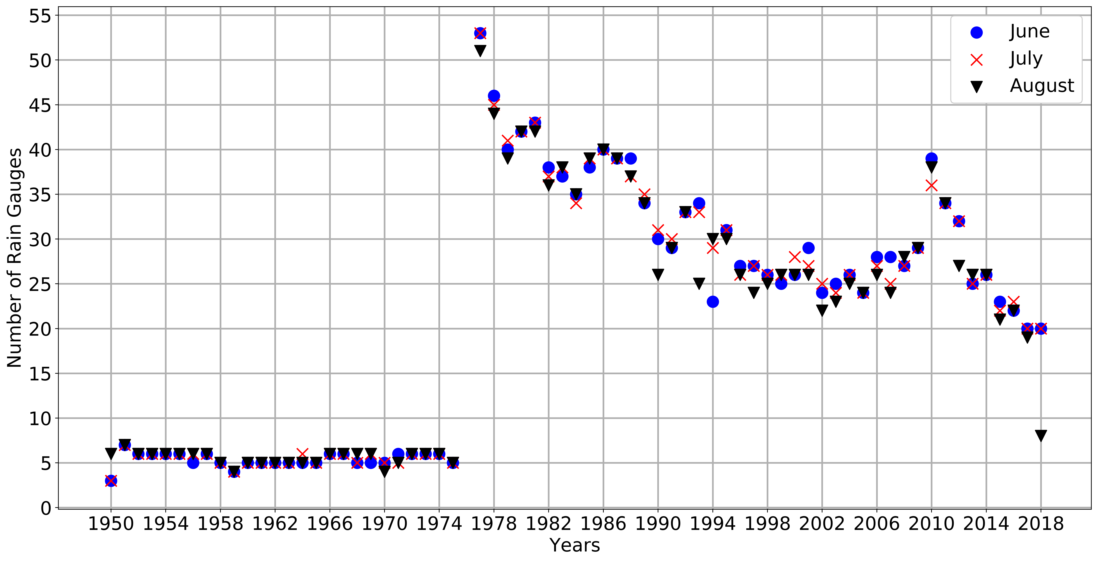
McKenzie County Rain Gauges 1950-2018

