Slide 1
Committee Meeting 03/18/2019
Matt Tuftedal

Slide 2
Overview
Weiss 2005 flow regime discussion
New control circles in MT to compare seeded regions
Time series of rainfall for each seeded/control area from 1919-2018
Number of gauges per year per county
Single and double ratio results
Proposed bootstrapping method

Slide 3
Mean Storm Flow for 1999-2002
Figure from Weiss, 2005

Slide 4
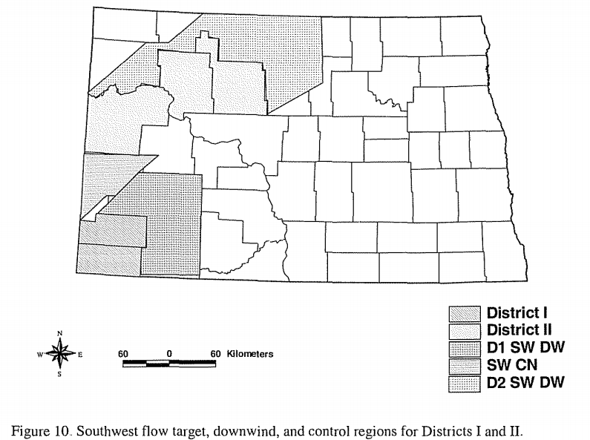
Weiss (2005) Target/control based on storm flow

Slide 6
Rain gauge data
Rain gauge data used for single and double ratio consists of NOAA COOP rain gauge data and NDARBCON rain gauge data.
NDARBCON data only available from 1977-2018
NOAA COOP available from 1919-2018

Slide 17
Weighted rain gauges
$$w=\frac{R^{2}−d^{2}}{R^{2}+d^{2}}$$
w =Weight of rain gauge to central location
R =Radius of influence (40km)
d =Distance of the gauge from grid point
Reference: Wise 2005

Slide 18
County Circle weighted rainfall amount
$$f_{d}=\sum_{i=1}^{n}{w\left(i\right)∗f_{o}(i)}$$
$f_{d}$ =Calculated rainfall at grid point
$f_{o}$ =24 hour measured rainfall
w= Weighed calculation
n=Number of gauges within radius of influence
Reference: Wise 2005

Slide 19
Normalizing County Circle weighted rainfall amount
$$f_{d normalized}=\frac{f_{d}}{\sum_{i=1}^{n}{{w(i)}_{year}}}$$
$f_{d normalized}$ =Calculated rainfall at grid point after being normalized
$f_{d}$ = Calculated rainfall at grid point
w= Weighed calculation
n=Number of gauges within radius of influence

Slide 20
Single Ratio Test
To calculate single ratio test the equation
$$\frac{\sum_{n=1}^{(years)}{ f_{d}^{June, July, August, and all}(seeded circle)}}{\sum_{n=1}^{ (years)}{ f_{d}^{June, July, August, and all}(control circle)}}$$
Single ratio tests will be done for June, July, and August for each year between 1919 and 2018 using weighed rain gauge amounts

Slide 21
Double Ratio Test
To calculate single ratio test the equation
$${\frac{\sum_{n=1}^{1977−2018}{ f_{d}^{June, July, August, and all}(seeded circle)}}{\sum_{n=1}^{1977−2018}{ f_{d}^{June, July, August, and all}(control circle)}}}/{\frac{\sum_{n=1}^{1919−1976}{ f_{d}^{June, July, August, and all}(seeded circle)}}{\sum_{n=1}^{1919−1976}{ f_{d}^{June, July, August, and all}(control circle)}}}$$
Double ratio tests were conducted for June, July, August, and All using single ratios from the 1977-2018 single ratio test and the 1919-1976 singe ratio test.

Slide 22
Single Ratio Results
Seeded/Control Counties | McKenzie/Billings | Bowman/ Billings | Ward/Mercer | McKenzie/ Roosevelt | McKenzie/ Richland | McKenzie/ Wibaux | Bowman/ Carter | Bowman/ Fallon | Bowman/ Wibaux
1919-1976 Single Ratio June | 0.96 | 1.01 | 0.95 | 1.12 | 1.13 | 0.99 | 1.13 | 1.18 | 1.05
1919-1976 Single Ratio July | 1.04 | 1.03 | 1.00 | 1.06 | 1.03 | 1.06 | 1.16 | 1.16 | 1.05
1919-1976 Single Ratio Aug | 0.99 | 1.03 | 1.08 | 1.03 | 1.01 | 1.02 | 1.17 | 1.28 | 1.06
1919-1976 Single Ratio All | 0.99 | 1.02 | 0.99 | 1.08 | 1.07 | 1.03 | 1.14 | 1.23 | 1.05
1977-2018 Single Ratio June | 1.04 | 1.05 | 0.99 | 1.14 | 1.16 | 1.13 | 1.09 | 1.20 | 1.14
1977-2018 Single Ratio July | 1.06 | 0.92 | 0.90 | 1.06 | 1.12 | 1.17 | 1.14 | 1.29 | 1.01
1977-2018 Single Ratio Aug | 0.91 | 0.93 | 0.98 | 1.14 | 1.17 | 0.95 | 1.09 | 1.21 | 0.97
1977-2018 Single Ratio All | 1.01 | 0.98 | 0.96 | 1.11 | 1.13 | 1.09 | 1.10 | 1.23 | 1.06

Slide 23
Double Ratio Results
Seeded/Control Counties | McKenzie/Billings | Bowman/ Billings | Ward/Mercer | McKenzie/ Roosevelt | McKenzie/ Richland | McKenzie/ Wibaux | Bowman/ Carter | Bowman/ Fallon | Bowman/ Wibaux
Double Ratio June | 1.08 | 1.04 | 1.05 | 1.01 | 1.02 | 1.13 | 0.95 | 1.02 | 1.09
Double Ratio July | 1.02 | 0.89 | 0.90 | 0.99 | 1.08 | 1.10 | 0.98 | 1.11 | 0.96
Double Ratio Aug | 0.90 | 0.90 | 0.90 | 1.11 | 1.11 | 0.93 | 0.92 | 0.94 | 0.92
Double Ratio All | 1.02 | 0.95 | 0.96 | 1.02 | 1.06 | 1.07 | 0.96 | 1.03 | 1.00

Slide 24
Bootstrapping
Proposed method will be to take every rain gauge from seeded/non-seeded areas and have their monthly rainfall total be randomly selected.
Each randomly selected value will then be calculated for a single and double ratio if possible using the normalized rainfall value determined from its observation.
Each circle will select between 5-10 stations each year, can be more if there are enough stations available.
Bootstrapping will be difficult for 1919-1976 due to some areas only have 1-2 rain gauges during that time.

Slide 25
Summary
Comparing Seeded regions to control regions within ND may have too much contamination from downwind effects to enable a proper analysis.
Depending on the storm flow, using different Montana counties may help draw useful information from noise.
Bootstrapping analysis will give the possible natural variation in rainfall, which will determine whether or not observed ratios are within natural variation or potentially a product of the NDCMP.

Slide 26
References
Wise, E., 2005: PRECIPITATION EVALUATION OF THE NORTH DAKOTA CLOUD MODIFICATION PROJECT (NDCMP). University of North Dakota, 63 pp. http://www.swc.nd.gov/arb/ndcmp/pdfs/PrecipEvalNDCMP_2005.pdf.

