Slide 1
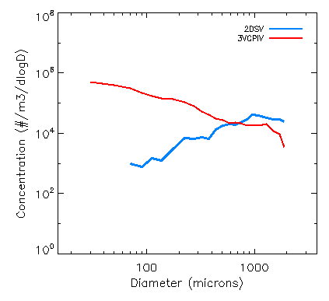










A Controlled Pylon System for Accurate Airborne Cloud Ice Crystal Sampling
- Shawn Wagner
Need/Problem
Apparatus/Facility
Objective
Current pylon-mounted cloud probes are installed at fixed angles to compensate for average flight pitch. This does not account for pitch changes during speed or altitude adjustments.
Probes are tilted during climbs, descents, and flight legs with adjusted speeds, leading to the shattering of large ice crystals.
The result is skewed particle size distributions toward higher (lower) concentrations of smaller (larger) crystals.
The improved system will consist of a modified aircraft wing pylon with an embedded gimbal like device and control electronics. Flight testing will eventually occur using research aircraft equipped with duplicated in-situ cloud microphysics probes on both the newly designed, and the previously utilized pylons to compare results.
To design, evaluate through simulations, and eventually manufacture and test a gimbaled pylon system capable of dynamically adjusting pitch and roll angles during flight. By incorporating pre-programmed flight path information, the gimbal can maintain probe orientation for accurate microphysical measurements.
Advancement
The developed system will reduce artifacts caused by crystal shattering and improve size distribution accuracy, advancing both the engineering of modern pylons and data quality for cloud crystal microphysics analyses.
Concept
A controlled, adjustable pylon system to maintain optimal probe orientation during varying aircraft pitch conditions. By incorporating an actively controlled gimbal-like device, the system will ensure probes remain aligned normal to the Earth, minimizing artifacts that bias particle sampling.
End Users
Researchers acquiring cloud microphysical data, agencies such as NASA, NSF, and NOAA, cloud instrumentation manufacturers, and research aircraft producers / technicians.
Applicability: Quality-Control, Airborne Instrumentation, In-situ Microphysical Measurements
11/12/2025

