Slide 1
PhD Prospectus
Christian Nairy
University of North Dakota – Department of Atmospheric Sciences
21 November 2025
Committee Members:
Dr. David Delene (Chair) – UND Department of Atmospheric Sciences
Dr. Andrew Detwiler – UND Department of Atmospheric Sciences
Dr. Hallie Chelmo – UND Department of Mechanical Engineering
Dr. John Yorks – NASA Goddard, Earth Sciences Division

Slide 2
Table of Contents
Introduction (Chapter 1)
Big Picture
Background
Motivation
Dissertation Objectives
Main Hypotheses
Paper 1 (Chapter 2): In situ Observations of Ice Crystal Chain Aggregates in Winter Storms
Brief Overview
Data & Methods
Results
Discussion
Conclusion
Status

Slide 3
Table of Contents
Paper 2 (Chapter 3): Machine Learning Classification of Ice Crystal Chain Aggregates in Aircraft-Collected Cloud Particle Imagery
Objectives
Data & Methods
Preliminary Results
Research Contributions
Status
Paper 3 (Chapter 4): Ice Crystal Chain Aggregates in Cold-Season Storms: Campaign-Scale Mapping and Contextualization* or Investigating the Spatio-Temporal Distribution of Ice Crystal Chain Aggregates in Winter Storms: Findings from the NASA IMPACTS Campaign*
Objectives
Data & Methods
Research Questions
Preliminary Results
Research Contributions
Collaborations (Non-Dissertation)
Timeline to Graduation
* Subject to change

Slide 4
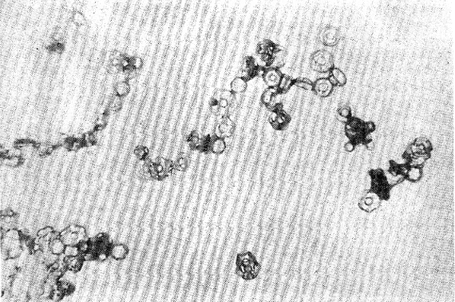
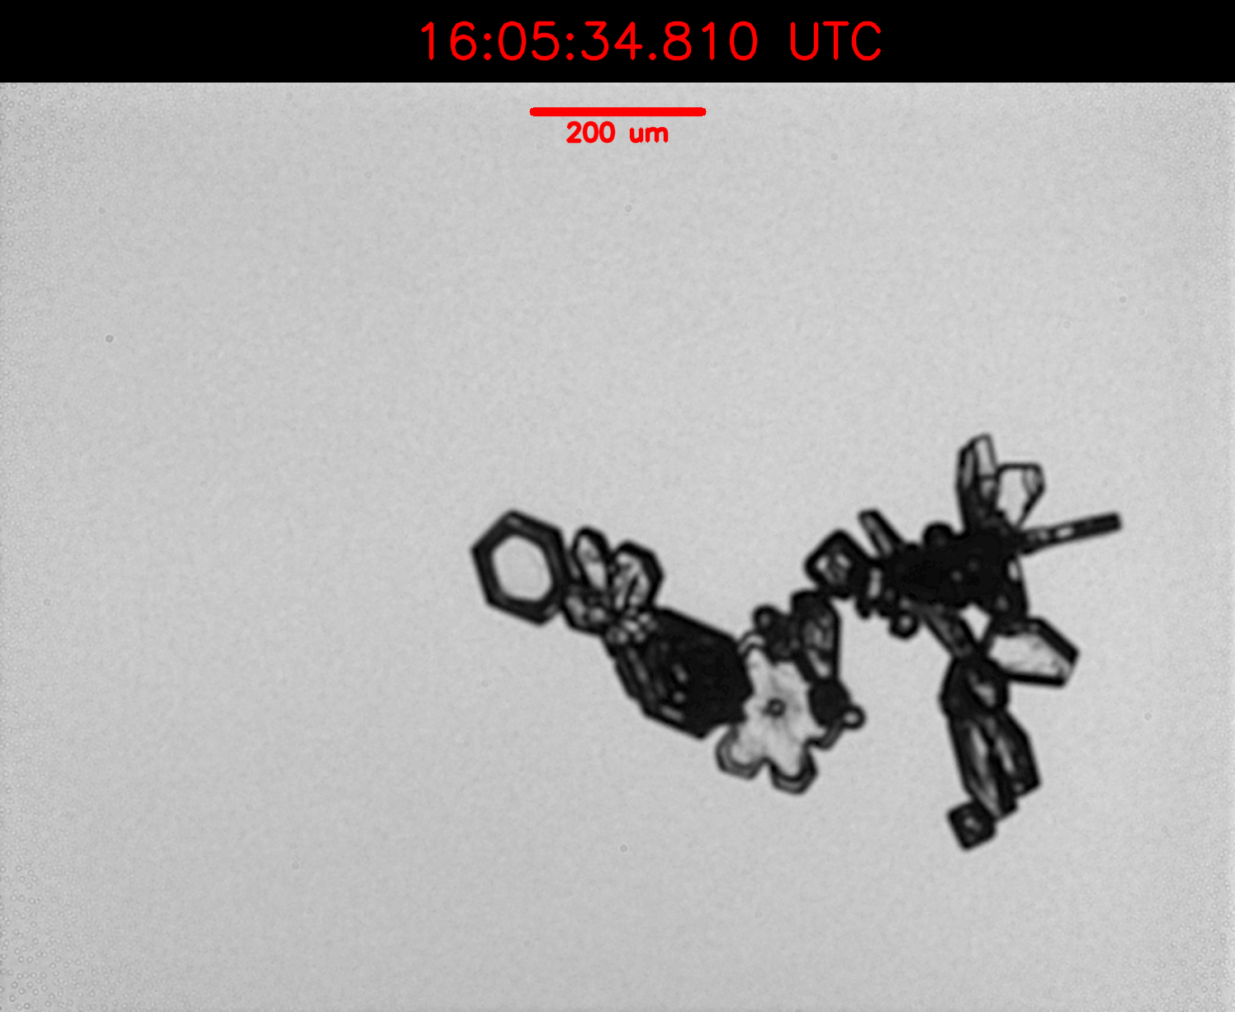
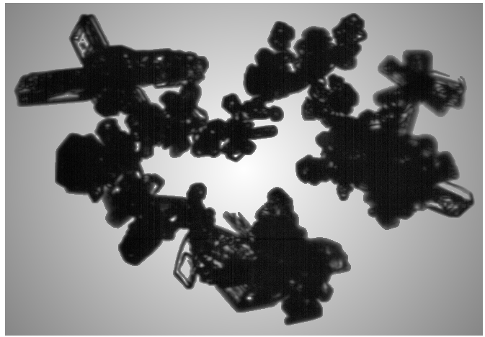
Introduction – Big Picture
Ice aggregates form through aerodynamic, inertial, and gravitational interactions (Finnegan & Pitter, 1988).
Lab work shows elongated chain aggregates when strong electric fields are applied (Fig. 1).
Recent in-situ observations show chain aggregates (Fig. 2) across diverse cloud regimes and regions, in both summer and winter storms.
Gap in understanding: Strong E-Field lab result ≠ broad winter occurrence in observations → our current picture is incomplete.
We still don’t know when/where they form in cloud systems or how to recognize them reliably at scale.
Fig. 1) Chains of ice crystals formed in the Manchester cloud chamber at –12 °C under a high (120 kV m⁻¹) electric field. Adapted from Saunders and Wahab, 1975.
(a)
(b)
200 µm
500 µm
Fig. 2) Ice crystal chain aggregates observed in-situ during (a) the CapeEx19 Field Campaign on 3 August 2019 and (b) the Investigation of Microphysics and Precipitation for Atlantic Coast-Threatening Snowstorms (IMPACTS) on 15 February 2023.

Slide 5
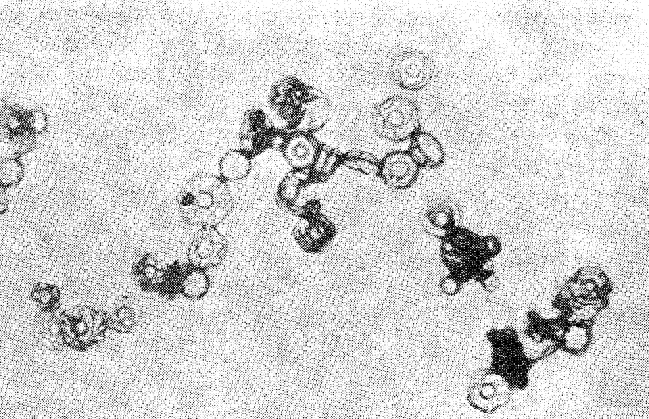
Background (More Specifics)
Chain Aggregate: Unusually elongated, quasi-linear ice crystal aggregate consisting of three or more discernable ice monomers joined together end-to-end or by small joints (Nairy, 2022).
Laboratory experiments show that chain aggregation occurs in the presence of strong electric fields (>60 kV m⁻¹) between -5 and -37 °C (Maximum efficiency at -8 °C) [Saunders & Wahab, 1975].
Chain aggregation efficiency found to be temperature depended.
Chains are observed in mid- to upper-level tropical, subtropical, and midlatitude summertime storms.
Cirrus anvils during CapeEx19 (Florida) where in-situ E-Fields < 60 kV m⁻¹.
Deep stratiform cirrus anvils during ABFM-II (Florida) where in-situ E-Fields < 60 kV m⁻¹.
Cirrus outflow during EMERALD-II (Darwin)
Convective cloud tops during CIRCLE-II (western Europe)
Overshooting tops during DC3 (eastern Colorado)
200 μm

Slide 6
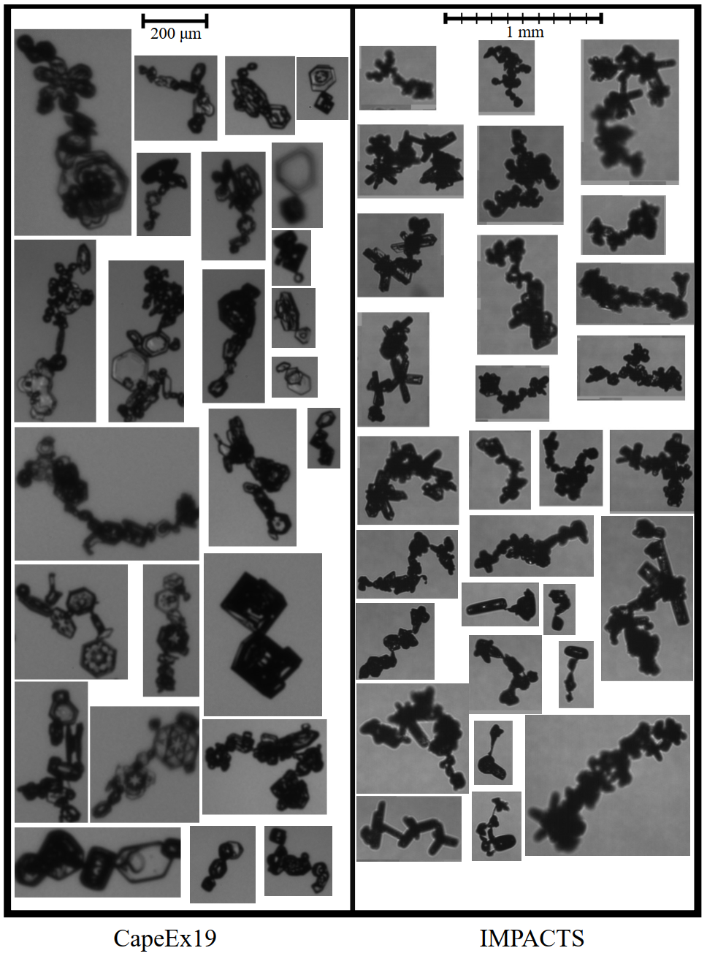
Motivation
Hawkeye-CPI Images
The chain aggregation process is still not well understood.
Where and how do these aggregates form?
Laboratory results and aircraft observations are not in agreement.
Chain aggregates are not represented in current cloud models.
Recent observations of chain aggregates in cold-season storms (NASA IMPACTS) challenge existing theories and add uncertainty to our understanding.

Slide 7
Motivation
Precipitation Formation
Aggregation changes size/shape/fall speed → affects SIP, snowfall rates, and precipitation efficiency (Pasquier et al. 2023).
Radiative Impacts
Elongated chains may have distinct optical properties vs. compact aggregates & single crystals → If so, can alter cloud radiative transfer and atmospheric energy balance (Baran, 2012; Um & McFarquhar, 2009).
Remote Sensing Interpretation
The unique morphology of chains impacts radar and lidar retrievals, introducing biases in cloud microphysical retrievals (Westbrook et al. 2007).
Forecasting Uncertainties
NWP microphysics schemes partition ice among a few assumed habits; if chains occur, fall-speed and scattering assumptions are incomplete, leading to systematic bias (Hashino, 2007; Karrer et al., 2021).

Slide 8
Dissertation Objectives
Document in-situ evidence of chain aggregates in winter storms and clarify observational signatures. (Paper 1)
Build and validate an automated classifier for chain vs. Non-chain aggregates in CPI imagery. (Paper 2)
Map and contextualize chain aggregate occurrence across the IMPACTS campaign: along-track, 3-D placement with ER-2 context, storm lifecycle, and environment. (Paper 3)

Slide 9
Main Hypotheses
Paper 1 (Chapter 2): In situ Observations of Ice Crystal Chain Aggregates in Winter Storms
In situ chain aggregates occur commonly in weakly electrified winter storms, not just in strongly electrified deep convection.
Chain aggregates appear across a wide temperature/altitude range and show consistent plate/column morphology (i.e., they're not confided to a narrow/specific cloud regime).
Paper 2 (Chapter 3): Machine Learning Classification of Ice Crystal Chain Aggregates in Aircraft-Collected Cloud Particle Imagery
A CNN trained on CPI imagery can reliably distinguish chain aggregates from other particle habits.
The CNN’s performance and probability calibration hold on unseen flights/years, enabling threshold tuning to minimize missed detections without a disproportionate rise in false positives.
Paper 3 (Chapter 4): Ice Crystal Chain Aggregates in Cold-Season Storms: Campaign-Scale Mapping and Contextualization
Chains peak in specific winter-storm regimes and storm-relative zones, largely independent of strong electrification (lightning).
High chain frequency aligns with coherent ER-2 radar/lidar signatures usable for contextual prediction.
Notes:
Maybe think about changing the title for second paper to just say machine learning and then be able to compare XGBoost to CNN
"Machine Learning Classification"

Slide 10
In situ Observations of Ice Crystal Chain Aggregates in Winter Storms
Paper 1 (Chapter 2)

Slide 11
Paper 1 - Overview
Unveiling observations of chain aggregates in winter storms (during IMPACTS).
*First acknowledgment of chain aggregates within winter storms in literature*
Purpose: Document in-situ winter occurrences of ice crystal chain aggregates and establish a clear working definition.
Scope: Survey across the IMPACTS campaign (multi-year, multi-storm), using CPI and PHIPS imagery for cross-validation.
Provides a standardized identification protocol and a curated set of time/altitude/temperature contexts for chain occurrences.
We don’t quantify mechanisms or storm-wide frequencies; this paper is an observational baseline.
Creates the labeled foundation for automated detection (Paper 2) and campaign-scale mapping/context (Paper 3).

Slide 12
Paper 1 – Data & Methods
Data: CPI IMAGES FROM ALL IMPACTS FLIGHTS
Targeted review: Image sequences selected using the cloud-probe operator’s flight notes indicating approximate times of aggregate sightings.
CPI collages (1-min): For each flagged period, generated 1-minute CPI collages (4×3 grid of particle images over 5-s intervals).
Manual identification protocol: Reviewed all 1-min collages; any 5-s interval with ≥3 identifiable chains was marked as a chain occurrence.
Recorded context: For each occurrence, logged flight date, 5-s interval, temperature, and altitude range.

Slide 13
Paper 1 – Results
Chain aggregates are identified on 28 of 34 IMPACTS flights
Cover approximately 1,242 minutes of the 12,943 minutes of total P-3 flight time (~10%; Table 1)
3,360 minutes in 2020
4,166 minutes in 2022
5,417 minutes in 2023
Flight times include in-cloud sampling, transits between sampling segments (legs), and ferry time.
*Likely an Upper-bound*
Table 1. Summary of chain aggregate observations during the 2020, 2022, and 2023 IMPACTS field deployments. Columns indicate the number of flights in which chain aggregates were observed, total observation time when chains were observed (minutes), the respective temperature range and average temperature, altitude range and average altitude, and the number of collocated P-3 and ER-2 flight legs where chain aggregates were present.
Year | Flights (#) w/ Chains | Approx. # of Minutes | T_{min} - T_{max}, T̅ [°C] | Z_{min} - Z_{max}, Z̅ [km] | # of Collocated Legs (Chains)
2023 | 11 | 386.8 | -30.8 to -1.2, -17.7 | 2.0 - 9.7, 5.5 | 10
2022 | 9 | 425.8 | -38.2 to 0.8, -22.7 | 1.5 - 9.0, 5.8 | 6
2020 | 8 | 429.0 | -32.2 to 2.5, -10.6 | 1.5 - 7.7, 4.5 | 5

Slide 14
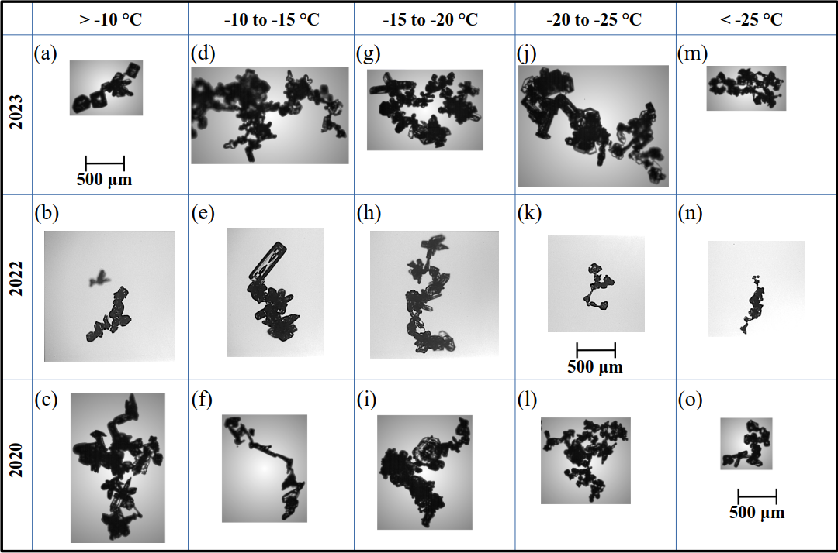
Paper 1 – Results
Observed across the full range of temperatures and altitudes (Fig. 4).
Composed of a variety of individual crystal habits (primarily columnar and plate-like).
Consistent with previous field studies (Connolly et al. 2005; Nairy, 2022).
Predominantly D_{max} > 500 µm
Similar to cirrus anvil observations (Nairy et al. 2022).
Composed of pristine ice crystals, others show signs of sublimation
Similar to cirrus anvil observations (Nairy et al. 2022).
Figure 4. Illustration showing representative chain aggregate images observed during the NASA IMPACTS field campaign grouped by deployment year and temperature intervals. The image labels give the UTC date and time. The 2023 and 2020 rows contain Hawkeye Cloud Particle Imager (CPI) images, while the 2022 row contains PHIPS probe images.
Notes:
others show signs of sublimation, indicated by rounded crystal edges, especially in diffuse clouds or near cloud-ambient boundaries. These signs of sublimation are consistent with observations from CapeEx19 (Nairy, 2022), where chain aggregates located farther from the convective core also exhibited evidence of sublimation.

Slide 15
Paper 1 – Discussion
Example of using collocated dataset.
19 Jan 2022 Flight Segment
12:30 – 12:55 UTC
~ 6 km AGL
9,315 CPI Images Classified
Chain Aggregates Observed:
–31.5 to –29.5 °C
Relatively weak dBZ_{e} (−16.07 ± 5.53 dBZ_{e})
Minimal V (−0.38 ± 0.91 m s⁻¹)
Moderate CPL β₅₃₂ (−2.38 ± 0.37 km⁻¹ sr⁻¹)
Modest CPL δ and CRS LDR (0.34 ± 0.06 and −17.38 ± 2.34 dB, respectively)
No LIP electric field data for this pass.
Figure 5. Plots showing collocated in-situ and remote sensing observations obtained by the NASA P-3 and ER-2 aircrafts on 19 January 2022.

Slide 16
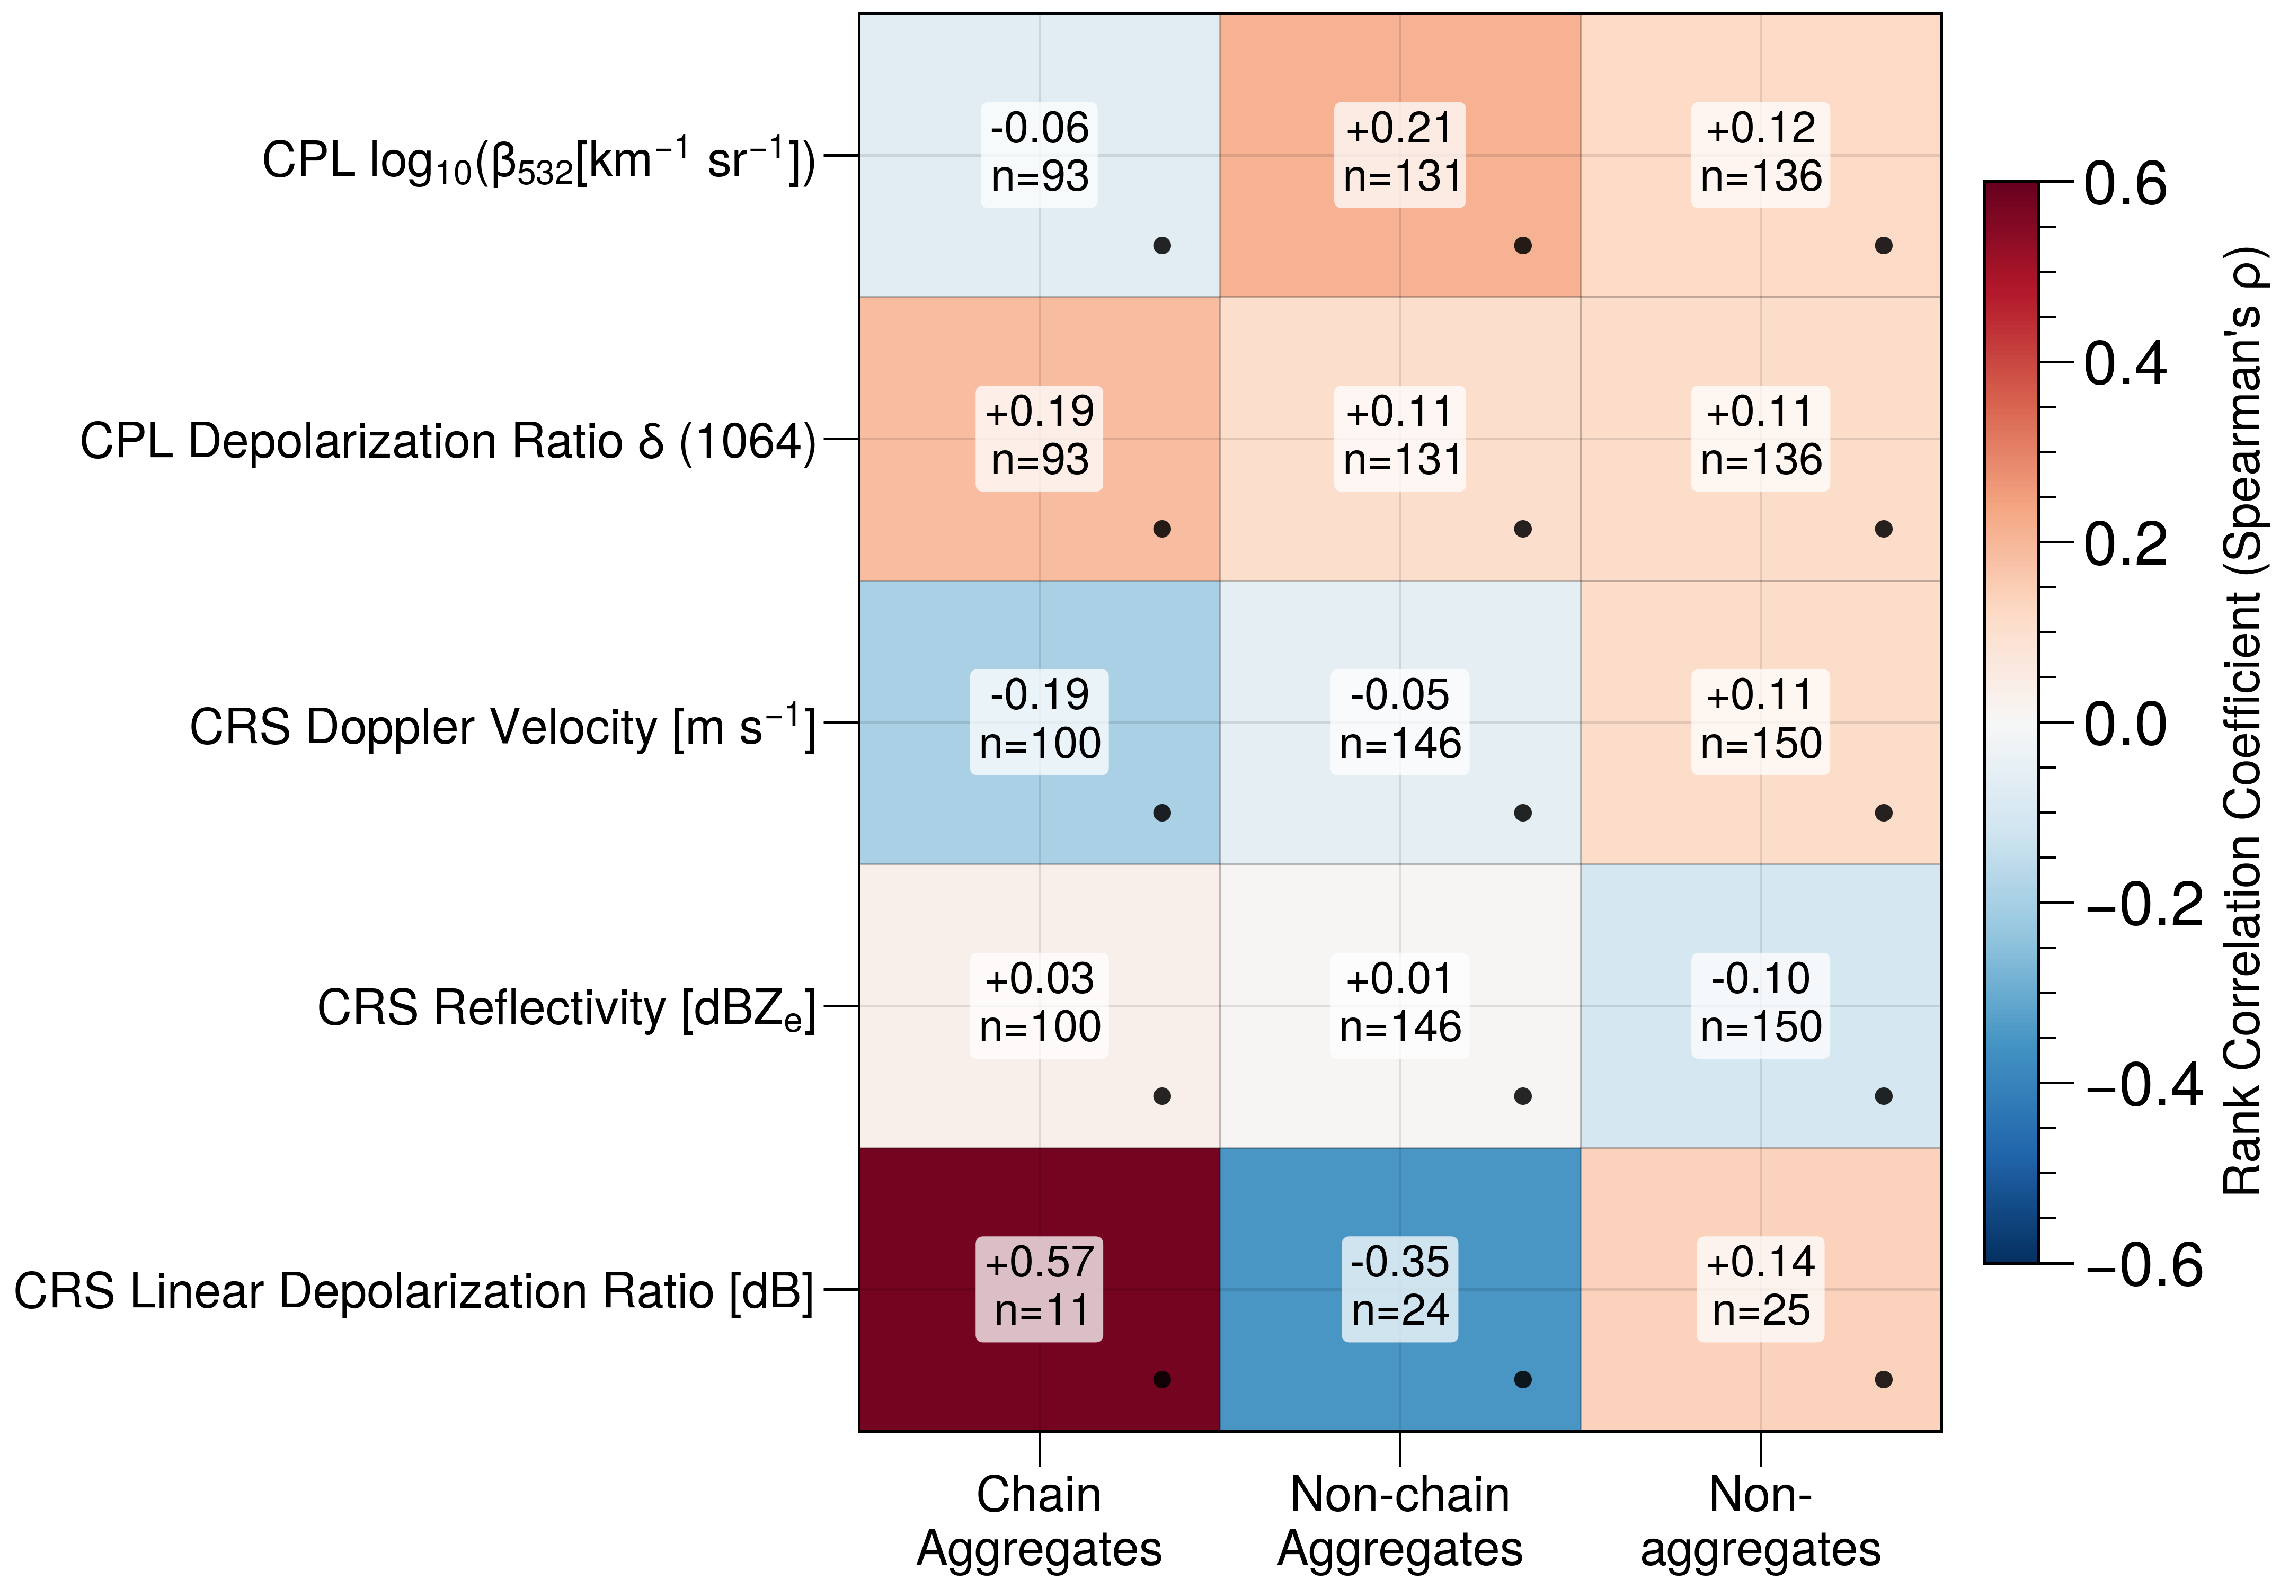
Paper 1 – Discussion
This single-case analysis shows no simple correlation between chain aggregate occurrence and the available remote-sensing parameters on the ER-2.
Underscores the need to analyze additional IMPACTS cases (ideally stratified by environment/altitude) to assess whether relationships emerge under different conditions or scales.
Figure 6. Rank correlation coefficients (Spearman’s ρ) between 5-second particle counts and collocated remote-sensing metrics for the 2022-01-19 ER-2/P-3 matched segment. Rows show: CPL β₅₃₂, CPL depolarization ratio (δ, 1064 nm), CRS Doppler velocity [m s⁻¹], CRS equivalent reflectivity [dBZ_{e}], and CRS linear depolarization ratio [dB]. Columns separate Chain Aggregates, Non-chain Aggregates, and Non-aggregates. Each cell lists linear correlation (Spearman ρ) and the number of 5-second bins (n); only bins with ≥1 particle in that class are included. Bullets indicate values that are not statistically significant after Benjamini–Hochberg false-discovery-rate correction (q = 0.05).

Slide 17
Paper 1 – Status
23 July 2025 - Submitted to American Geophysical Union (AGU) - Geophysical Research Letters (GRL)
Accepted pending minor revisions (04 November 2025)
Revisions submitted 17 November 2025

Slide 18
Machine Learning Classification of Ice Crystal Chain Aggregates in Aircraft-Collected Cloud Particle Imagery
Paper 2 (Chapter 3)

Slide 19
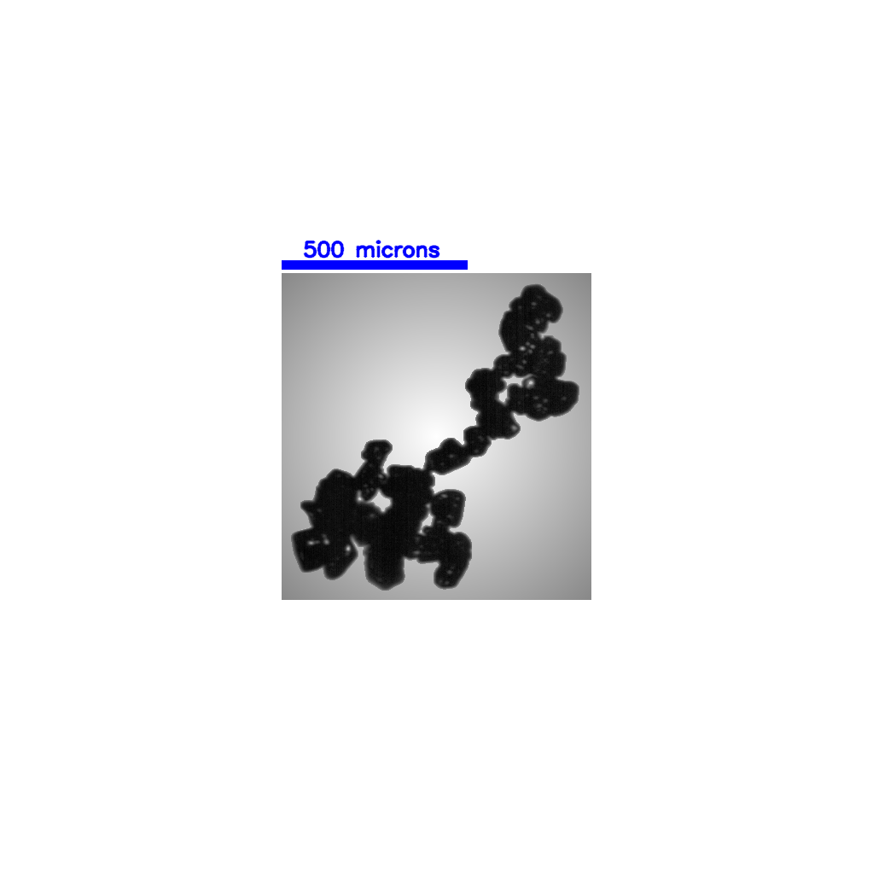
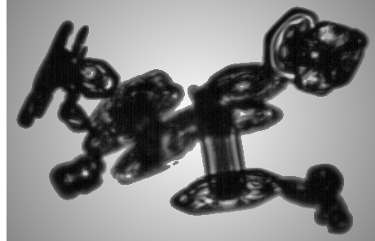
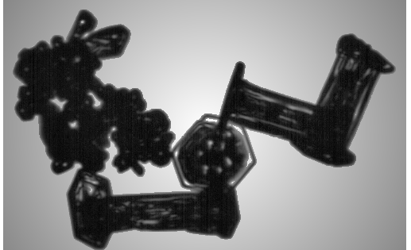
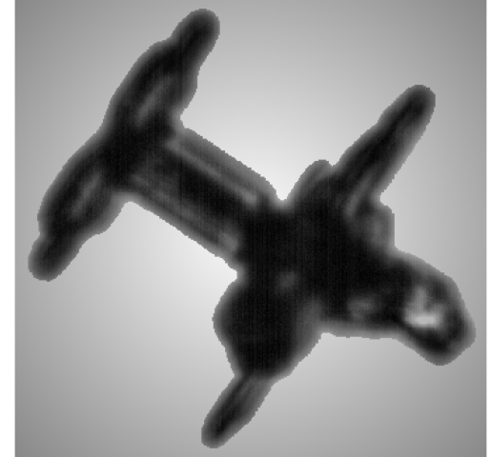
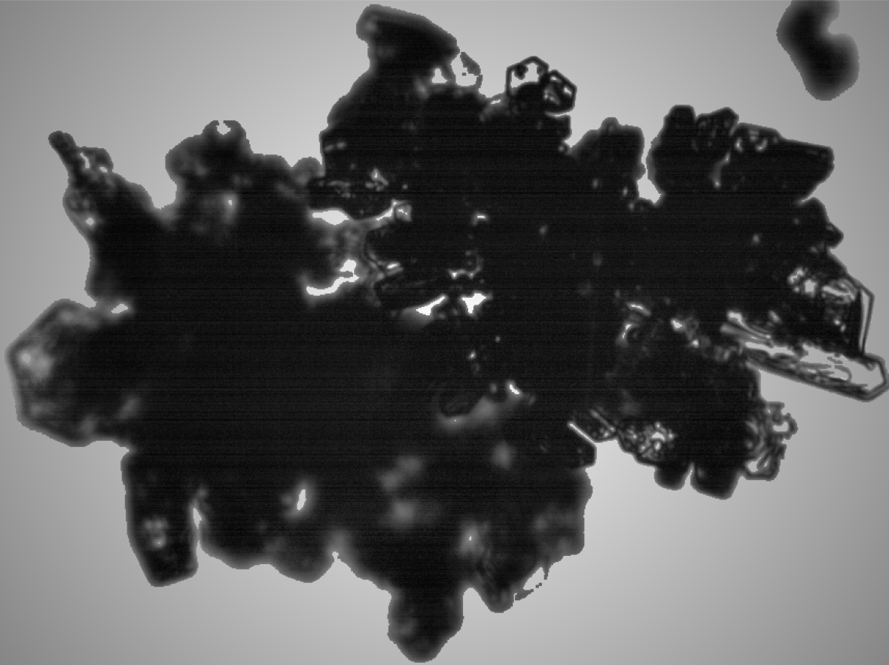
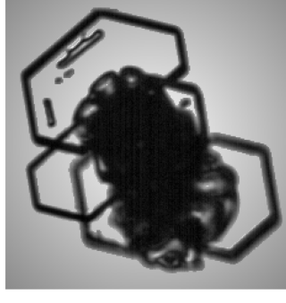
Paper 2 – Objective
Understanding chain aggregate formation within cloud systems requires contextual analysis, but manual classification of cloud particles is extremely time-consuming.
Objective: Employ a supervised Convolutional Neural Network (CNN) to differentiate ice crystal chain aggregates from non-chain aggregates.
Convolutional Neural Network

Slide 20
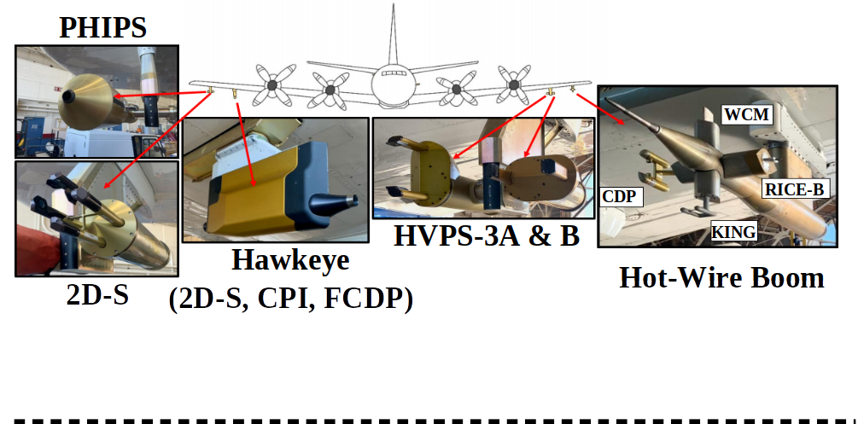
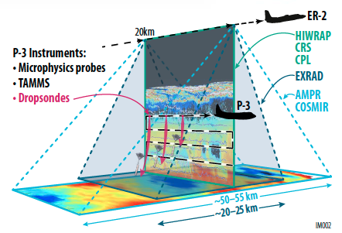
Paper 2 – Data & Methods
Utilize 56,193 manually classified ice crystals (D_{max} > 150 µm) obtained from Cloud Particle Imager (CPI) observations during NASA’s IMPACTS field campaign.
Train, validate, and evaluate multiple CNN architectures.
Identify the most effective CNN for distinguishing chain aggregates.
Apply the best CNN model to classify CPI data from other IMPACTS flights.
Hawkeye-CPI
Figure 7. Plots showing collocated in-situ and remote sensing observations obtained by the NASA P-3 and ER-2 aircrafts on 19 January 2022.

Slide 21
Paper 2 – Data & Methods
Transfer Learning in Convolutional Neural Networks for Image Classification
What it is: Reusing a model trained on a large, related dataset and fine-tuning it for your new task instead of starting from scratch.
Why it helps: You inherit useful features and good initial weights, so you typically need less data, converge faster, and get better accuracy.
Get Pretrained Network
(ResNet18/34/50/101
VGG16/19)
Modify Network
Retrain Modified Network
Predict on New Data
Training Data
Validation Data
Prepare New Data

Slide 22
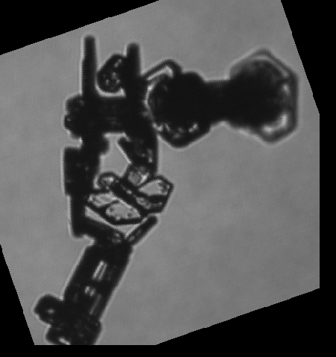
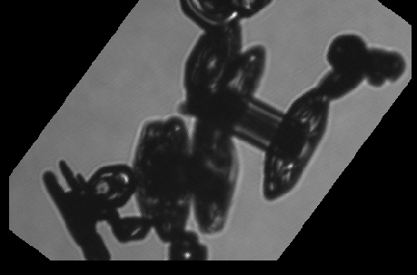
Paper 2 – Data & Methods
End-to-End CNN Pipeline for Chain Aggregate Classification
Classified Images
Class Balancing
Input
80/20 Train/Validation
Split
Training Dataset
Non-chains: 55,161
Chains:
1,030
Non-chains: 55,161
Chains:
55,161
Non-chains: 44,128 Chains: 44,128
Chain Agg. Image
Augmentation
Validation Dataset
Non-chains: 11,033 Chains: 207
Training
Evaluation on Test Dataset
CNN Architecture
Epoch Validation
Non-chains: 5,520; Chains: 110
ResNet18/34/50/101
VGG16/19
Epochs: 30
6 Warmup Epochs
LR (Head): 1e-4
LR (Backbone): 5e-5
Batch Size: 64
Optimizer: AdamW
Weight Decay = 2e-4
AND SEVERAL MORE
Model Calibration Analysis
F1 Threshold Tuning
Save All & Best Model Epochs
Accuracy, Precision, Recall, F1 Scores
ROC-AUC
Error & Statistical Analysis
Prediction Metrics
Notes:
ResNet:
Base recipe + seasoning
Plain CNN: Every chef invents the dish from scratch: ingredients, base, spices, everything.
ResNet: You always start with a solid base recipe (the input xxx) and each stage only decides:
“How should I tweak the seasoning?” (that’s F(x)F(x)F(x))
Final dish = base recipe + tweaks. If a stage can’t think of a useful tweak, it just does nothing (learns F(x)≈0F(x) \approx 0F(x)≈0), and the dish passes through unchanged. That’s residual learning.
The skip connection is literally “keep the base recipe on the counter and pass it along,” not throw it away at each step. VGG vs ResNet: 3. A telephone game with one long chain
Think of the classic whisper game:
VGG is one long chain of people. The message passes through every person, one by one.
Each person can only hear the previous person and then must rephrase the entire message.
Errors tend to accumulate down the chain and the original message can be distorted or lost.
ResNet is more like a game where you periodically check back with the original written message so the meaning does not drift too far.

Slide 23
Paper 2 – Data & Methods
How will we know if a CNN is "good" enough?
Primary: High precision on the chain aggregate class in external validation.
Secondary: Strong precision rate-area under curve (PR-AUC) and ROC-AUC across folds.
Reliability: Low log-loss and low Brier score, plus good calibration.
Model choice is based on precision first, then stability (spread across folds), then threshold-free metrics (F1-score; recall).
Notes:
Precision–Recall AUC (PR-AUC)
Curve: Precision vs. Recall as the decision threshold sweeps.
Area: Single number summarizing the curve (higher = better).
Why it matters (class imbalance): Focuses on performance on the positive (chain) class; insensitive to the large number of true negatives—so it’s usually the right metric when positives are rare and precision is your priority.
ROC AUC
Curve: True Positive Rate vs. False Positive Rate as the threshold sweeps.
TPR (Recall) = TP / (TP + FN)
FPR = FP / (FP + TN)
Area: Probability a random positive is ranked above a random negative (0.5 = chance, 1.0 = perfect).
Why it matters: Threshold-independent view of ranking quality across all operating points.
Caveat (imbalance): Can look very high even when precision is mediocre, because negatives dominate FPR’s denominator. Use alongside PR-AUC when positives are rare.

Slide 24
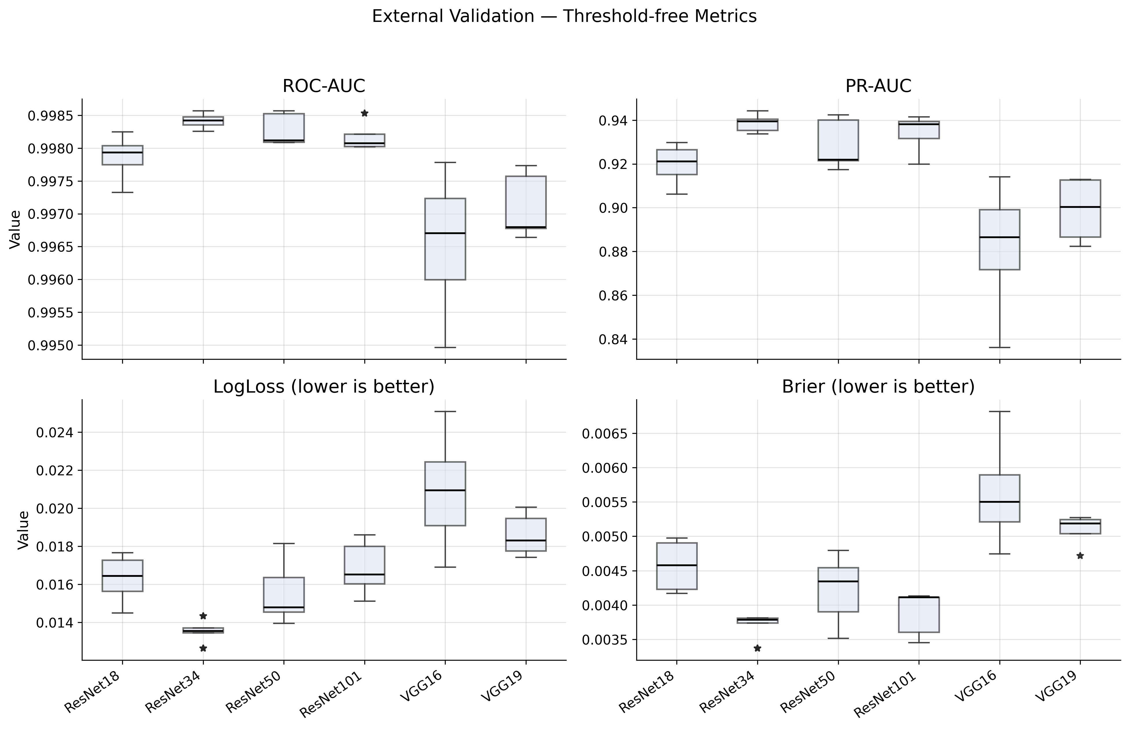
Paper 2 – Results
ResNet34 leads on PR-AUC and shows the lowest LogLoss and Brier, with tight variability → best calibrated and most reliable.
ResNet50/ResNet101 post strong ROC-AUC and competitive PR-AUC, with moderate calibration (LogLoss/Brier) and small spread.
Lagging models: VGG16 (and to a lesser extent VGG19) show higher LogLoss/Brier and lower PR-AUC with wider spread → weaker calibration and precision–recall performance.
Figure 5. Validation boxplots comparing six CNNs across folds for (top-left) ROC-AUC, (top-right) PR-AUC, (bottom-left) LogLoss (lower is better), and (bottom-right) Brier score (lower is better). Boxes show IQR with median lines; whiskers denote non-outlier ranges.
Notes:
Precision–Recall AUC (PR-AUC)
Curve: Precision vs. Recall as the decision threshold sweeps.
Area: Single number summarizing the curve (higher = better).
Why it matters (class imbalance): Focuses on performance on the positive (chain) class; insensitive to the large number of true negatives—so it’s usually the right metric when positives are rare and precision is your priority.
ROC AUC
Curve: True Positive Rate vs. False Positive Rate as the threshold sweeps.
TPR (Recall) = TP / (TP + FN)
FPR = FP / (FP + TN)
Area: Probability a random positive is ranked above a random negative (0.5 = chance, 1.0 = perfect).
Why it matters: Threshold-independent view of ranking quality across all operating points.
Caveat (imbalance): Can look very high even when precision is mediocre, because negatives dominate FPR’s denominator. Use alongside PR-AUC when positives are rare.

Slide 25
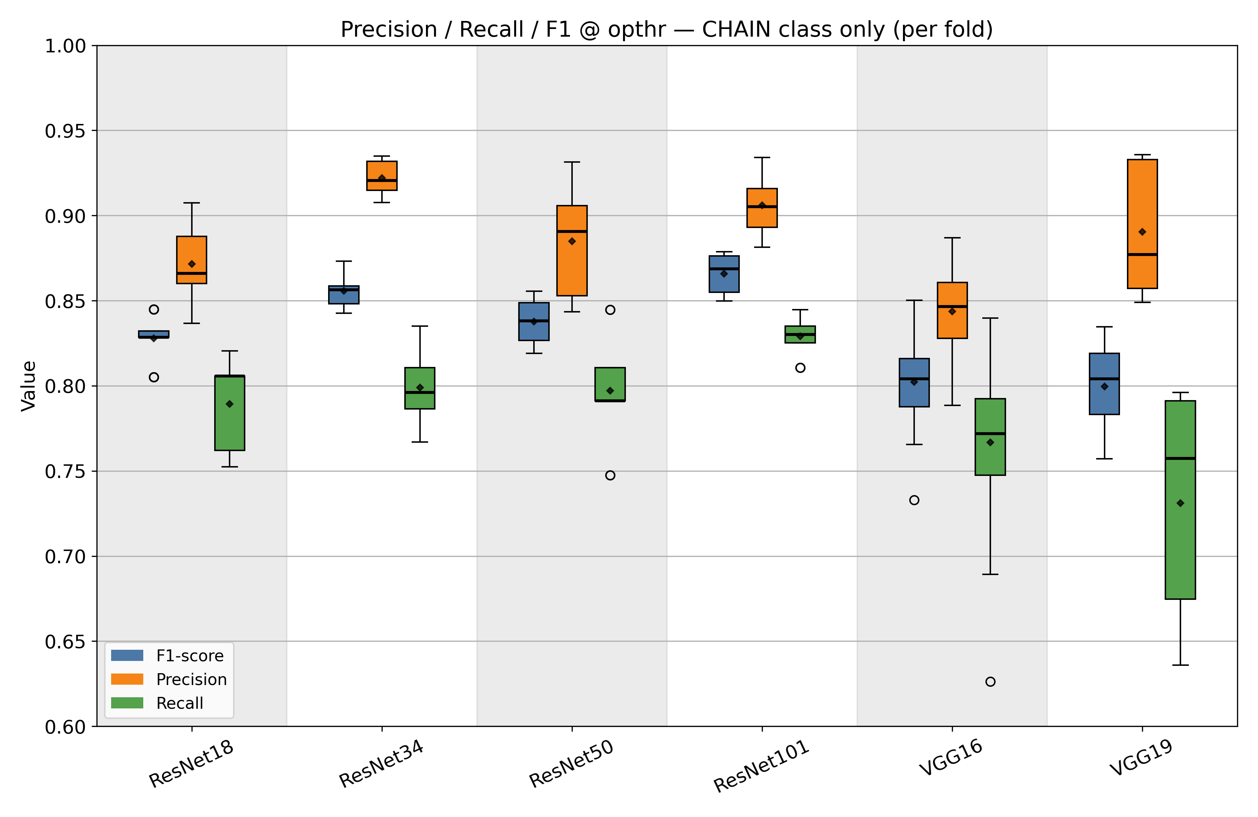
Paper 2 – Results
Priority: Precision
ResNet34: highest mean/median precision (~0.92–0.93) with tight spread.
VGG19: high precision but wider variability; center is a bit lower than ResNet34.
ResNet101: slightly below ResNet34 in precision (~0.90–0.92).
Best Balance
ResNet101 gives the best precision–recall tradeoff and tightest spread → more reliable across folds.
Middle Tier.
ResNet/18/50: solid precision (~0.85–0.91), mid recall, moderate spread.
Lower Performer.
VGG16: lower precision and the widest spread → least dependable for minimizing false positives.
Figure 8. Boxplots of precision, recall, and F1 for the CHAIN class at the operating threshold (opthr) from external validation across folds for each CNN (ResNet18/34/50/101, VGG16/19). Boxes show the interquartile range with medians, whiskers extend to 1.5×IQR, and outliers are plotted as points; light bands alternate by model.

Slide 26
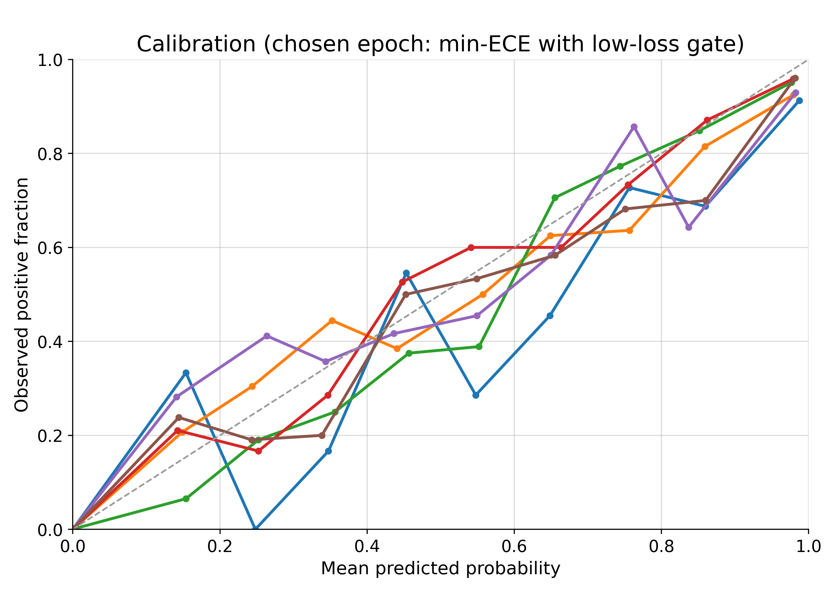
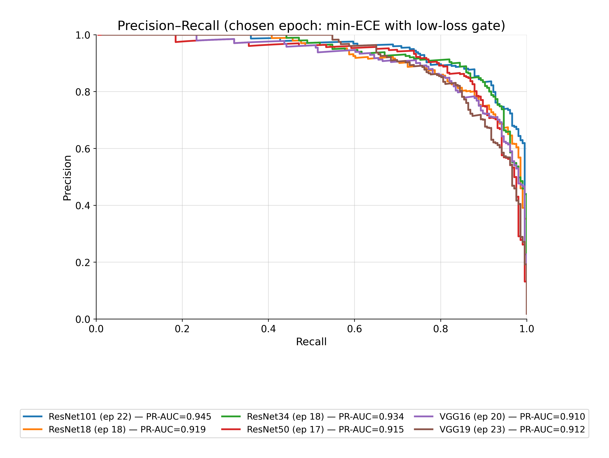
Paper 2 – Results
Figure 9. Model comparison at the chosen epoch (minimum ECE within 10% of each model’s lowest validation loss). Left: Calibration curves (binwise predicted probability vs. observed positive fraction); proximity to the 1:1 dashed line indicates better calibration. Right: Precision–Recall curves for the same epochs
ResNet101 (and closely ResNet34) delivers the strongest discrimination (highest PR-AUC) while staying closest to the 1:1 calibration line at the chosen low-loss.
ResNet101 and ResNet34 keep precision >0.85 up to ~0.85–0.9 recall, while VGG16/19 lose precision earlier (~0.8 recall falls to ~0.7–0.8). ResNet50 is mid-pack.

Slide 27
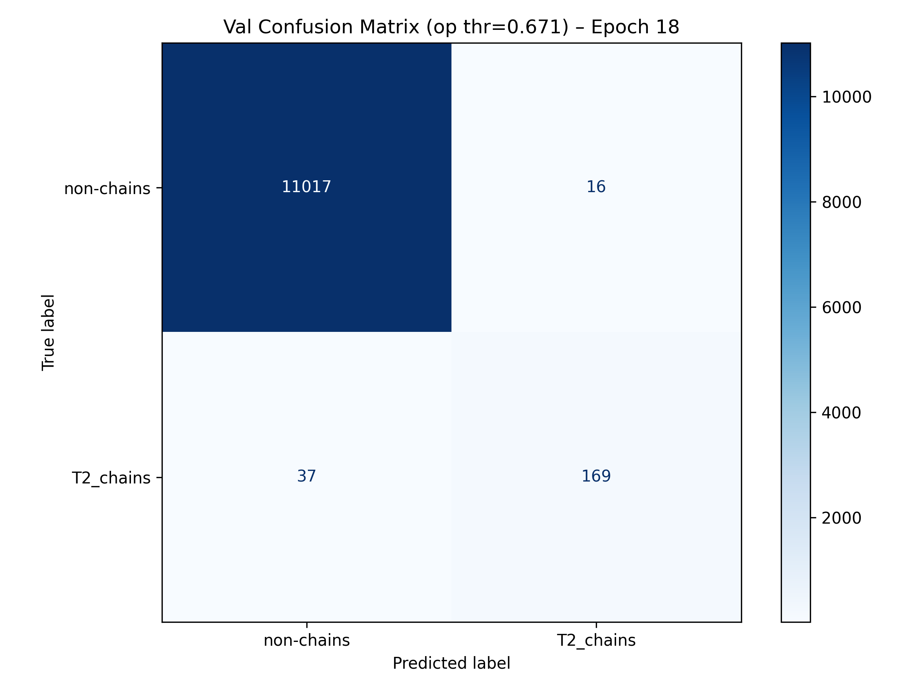
Paper 2 – Results
Emphasizes high precision on the CHAIN class (few false positives).
Missed detections are limited relative to total positives (balanced with your “minimize missed detections” priority).
Numbers align with PR curve shape (strong precision into high recall).
At the chosen threshold (> 0.671), ResNet34 delivers few false alarms while retaining strong CHAIN detection.
Figure 10. Confusion matrix of the best performing epoch of ResNet34 using an operational threshold (op thr) > 0.671.

Slide 28
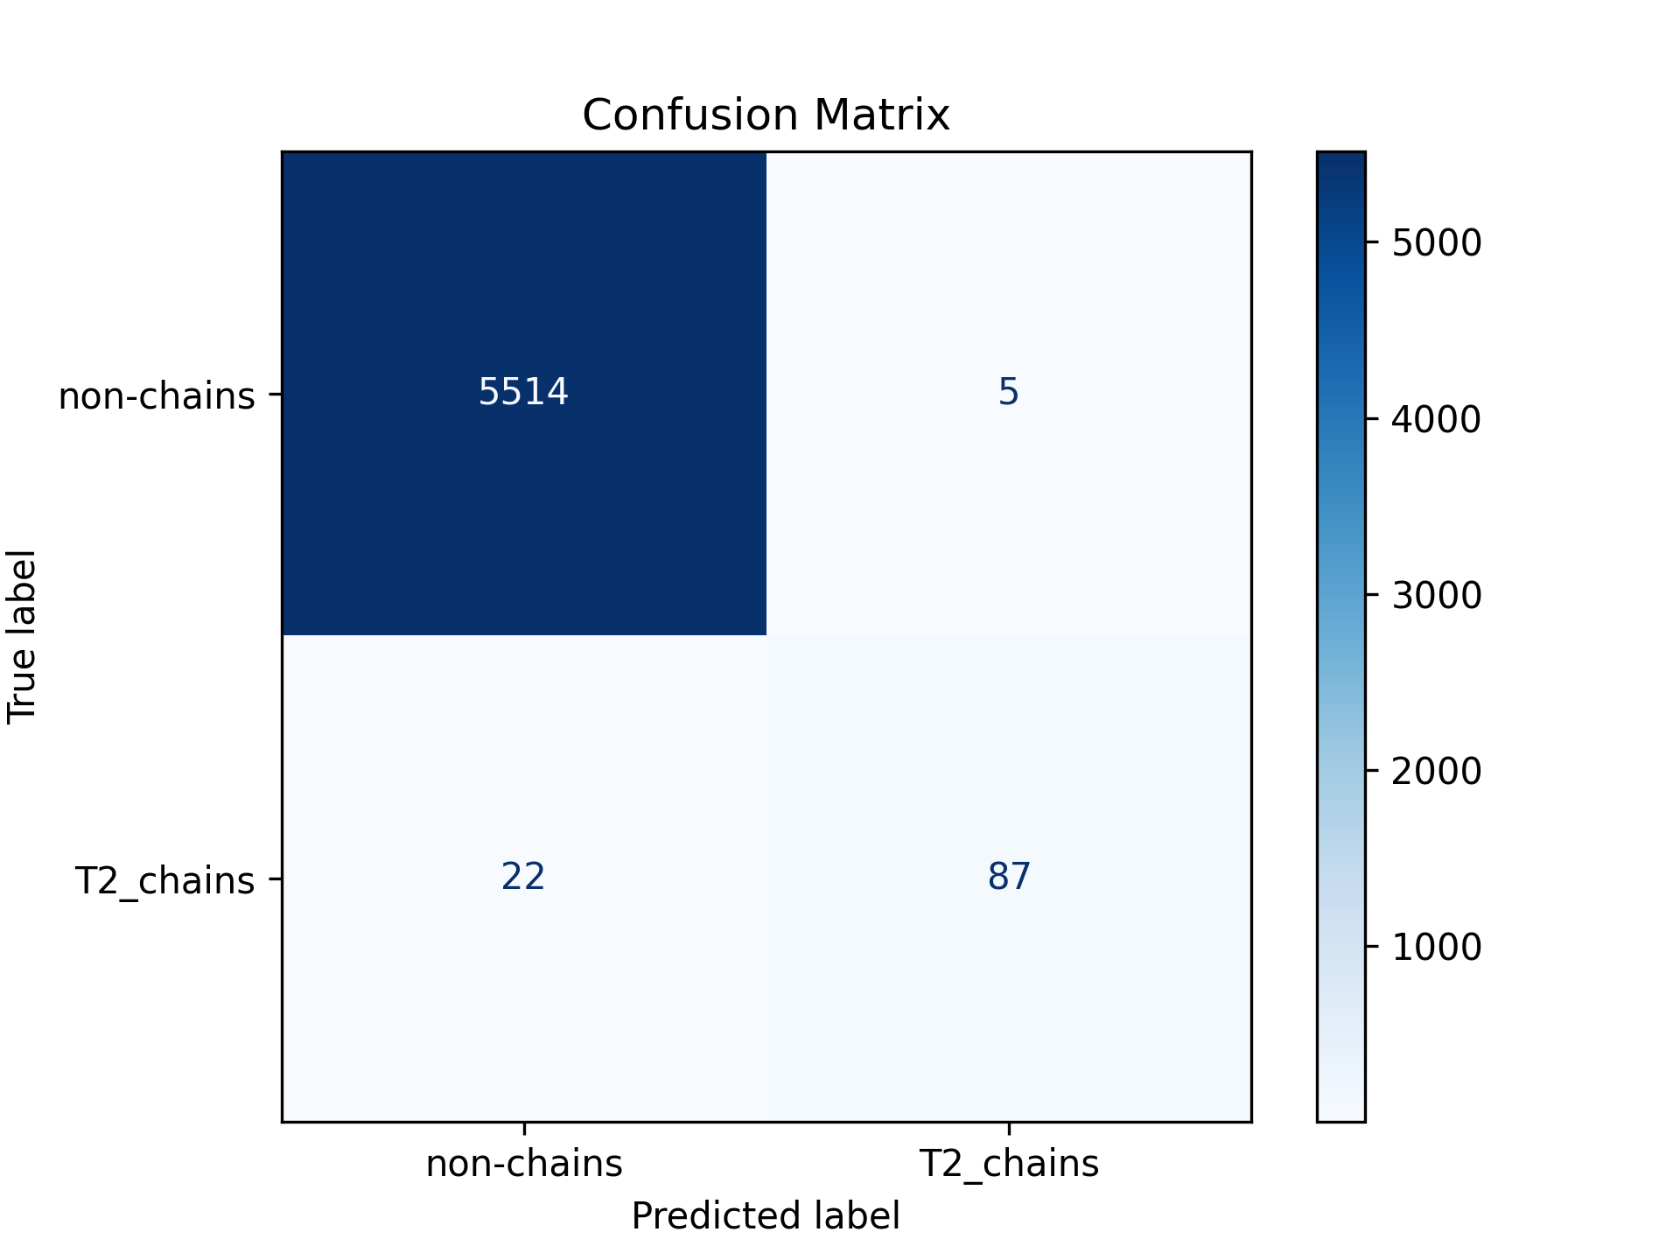
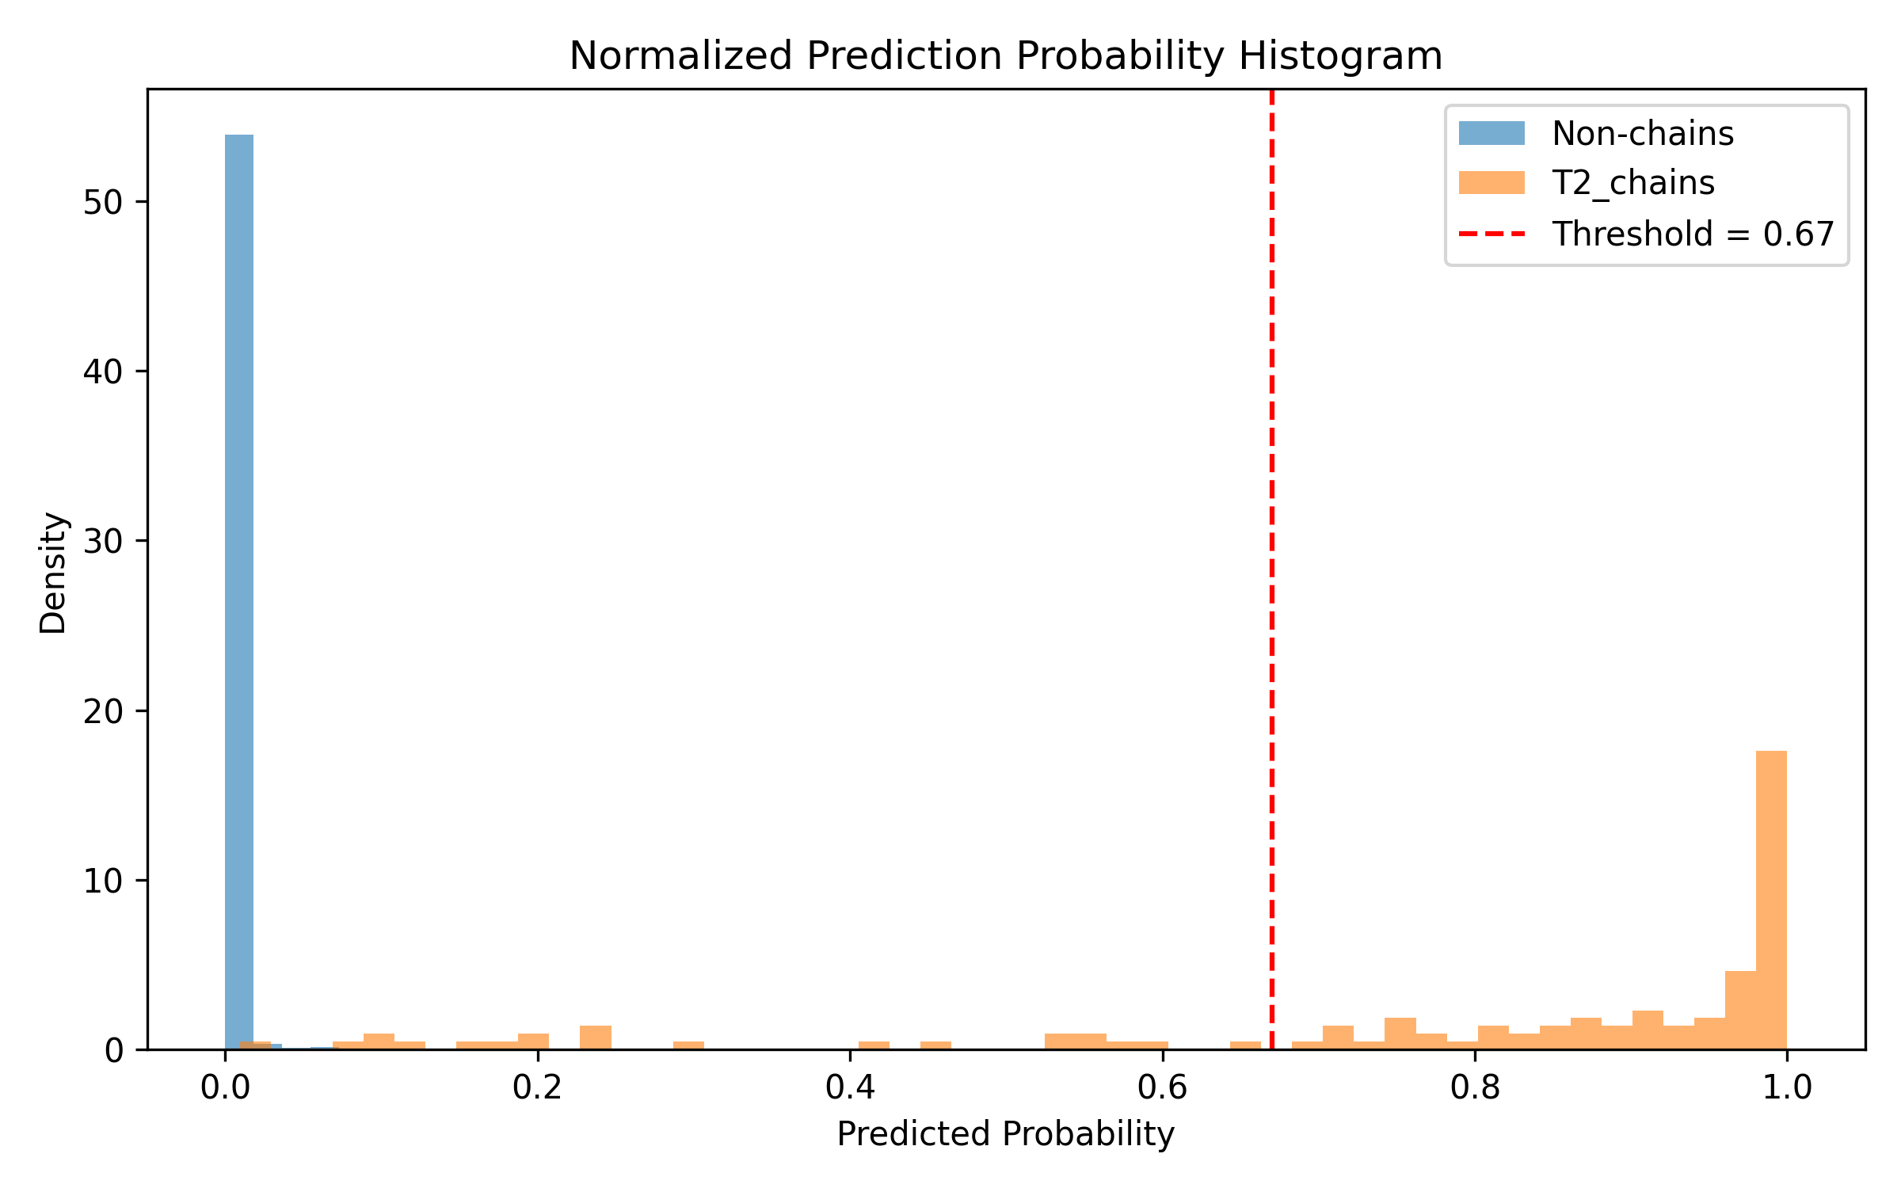
Paper 2 – Results
Results on Test (Unseen) Data: (Non-chains: 5,519; Chains: 109)
 | Precision | Recall | F1-Score | Support
Non-chains | 100 % | 100% | 100% | 5519
Chain Aggregates | 95% | 80% | 87% | 109
Macro Avg. Accuracy | 97% | 90% | 93% | 5628

Slide 29
Paper 2 – Discussion
Calibration & reliability: ResNet34 has the lowest LogLoss/Brier and tight spread → most reliable across folds.
Discrimination: ResNet101 edges highest PR-AUC in several runs; ResNet34 is a close second but steadier.
Operational implication: For minimizing false positives, both ResNet34 and ResNet101 are suitable; ResNet34’s stability + calibration makes it the safer default.
Why ResNet > VGG?
Residual connections make deeper models easier to train, preserve important fine-scale CPI features, and reduce overfitting, giving better generalization on our limited, highly specialized dataset.
Why ResNet34?
ResNet18 Over Generalization
> ResNet34 Too Complex (Deep)

Slide 30
Paper 2 – Conclusion
A CNN can reliably separate chain aggregates vs. non-chain CPI images using transfer learning.
ResNet34 shows best overall reliability (LogLoss/Brier) with competitive PR-AUC.
Calibration-aware selection (min-ECE under a low-loss gate) yields well-tuned epochs for robust external validation.
Results from testing the trained ResNet34 model on unseen data verifies that we can be confident in its output.

Slide 31
Paper 2 – Research Contribution
Validated, calibration-aware CNN pipeline for chain aggregate detection in aircraft CPI imagery.
The CNNs are readily available and can be reused by anyone interested in identifying chain aggregate occurrences from CPI images.
Work is being done to allow the CNN to be active for real-time in situ sampling.
This work establishes a dependable, well-calibrated classifier that unlocks campaign-scale chain aggregate analysis.

Slide 32
Paper 2 – Status
Manuscript Status:
Introduction, Methods, and Data sections are written.
Skeleton of the results, discussion, and conclusion sections
All figures for results and discussion sections have been generated.
Estimate date of first draft completed: February 2026
Plan to submit manuscript to Journal of Atmospheric and Oceanic Technology (JTECH). Estimate submission date is March 2026.

Slide 33
Ice Crystal Chain Aggregates in Cold-Season Storms: Campaign-Scale Mapping and Contextualization
Paper 3 (Chapter 4)

Slide 34
Paper 3 – Objectives
Use the calibrated CNN from Paper 2 to classify all IMPACTS CPI images as “chain” or “non-chain” and build a campaign-wide database of chain aggregate occurrences.
Merge CNN-identified chains with P-3 in situ measurements, ER-2 radar and lidar, and ancillary fields to place each occurrence in its storm-relative and environmental context.
Map and analyze chain aggregate frequency and characteristics across meteorological scales from synoptic to particle scale to determine where, when, and under what conditions chains are most common.

Slide 35
Paper 3 – Data
IMPACTS dataset: 33 Intensive Operating Periods (IOPs); 34 including flight to WP-AFB
CNN inputs: All CPI particle images from 2020, 2022, and 2023, including periods with and without chain aggregates.
Collocated ER-2 remote sensing: CRS radar reflectivity, Doppler velocity, and linear depolarization ratio; CPL backscatter and depolarization ratio.
Environmental fields: Thermodynamic and kinematic fields from reanalysis (temperature, RH, vertical motion, frontogenesis, shear).
Storm-scale context: Radar mosaics and satellite imagery (e.g., NEXRAD composites, GOES) to identify cyclone structure, snow bands, and storm phase for each case.

Slide 36
Paper 3 – Methods
Synoptic (Large-scale)
Midlatitude cyclone type/pattern
Jet configuration; conveyor belts (WCB/CCB)
Run the CNN (Paper 2) on all IMPACTS CPI images to get chain/non-chain labels and probabilities.
Analyze chain occurrence and properties within a nested meteorological scale framework.
Map detections into storm-relative coordinates (cyclone center, fronts, conveyor belts; warm sector, wrap-around, dry slot).
Bin detections in space and time for P3/ER-2 collocation analysis (Mesoscale-γ to Microscale-β.
Sub-synoptic/Mesoscale-α (Cyclone Relative)
• Quadrants (warm sector, wraparound/comma head, dry slot) • Frontal/deformation/TROWAL zones; baroclinic corridors
Mesoscale-β (20–200 km, 1–6 h)
• Snow band width/spacing; multiband vs. single-band structure • Frontogenesis & secondary circulations
Mesoscale-γ (2–20 km, 10–60 min)
• Embedded Cells, Stratiform flanks
• Local Shear/Eddies
Microscale-α (200 m–2 km; 1–10 min)
• Cloud-layer Turbulence & Mixing Structure
• Entrainment Interfaces; Up/Downdraft Structure
Microscale-β (2–200 m; 1–300 s)
T; RH; Particle Concentration Fluctuations
Particle Scale (1 µm – 1 cm, ~ms–mins)
Habit; Number of Monomers
Pristine? Sublimating?
Particle Morphology

Slide 37
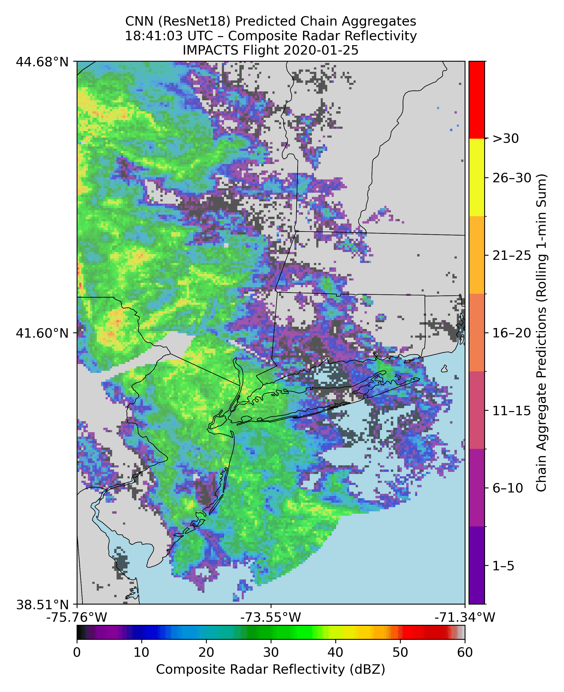
Paper 3 – Preliminary Results

Slide 38
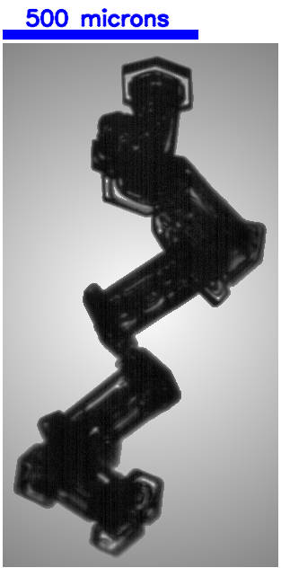
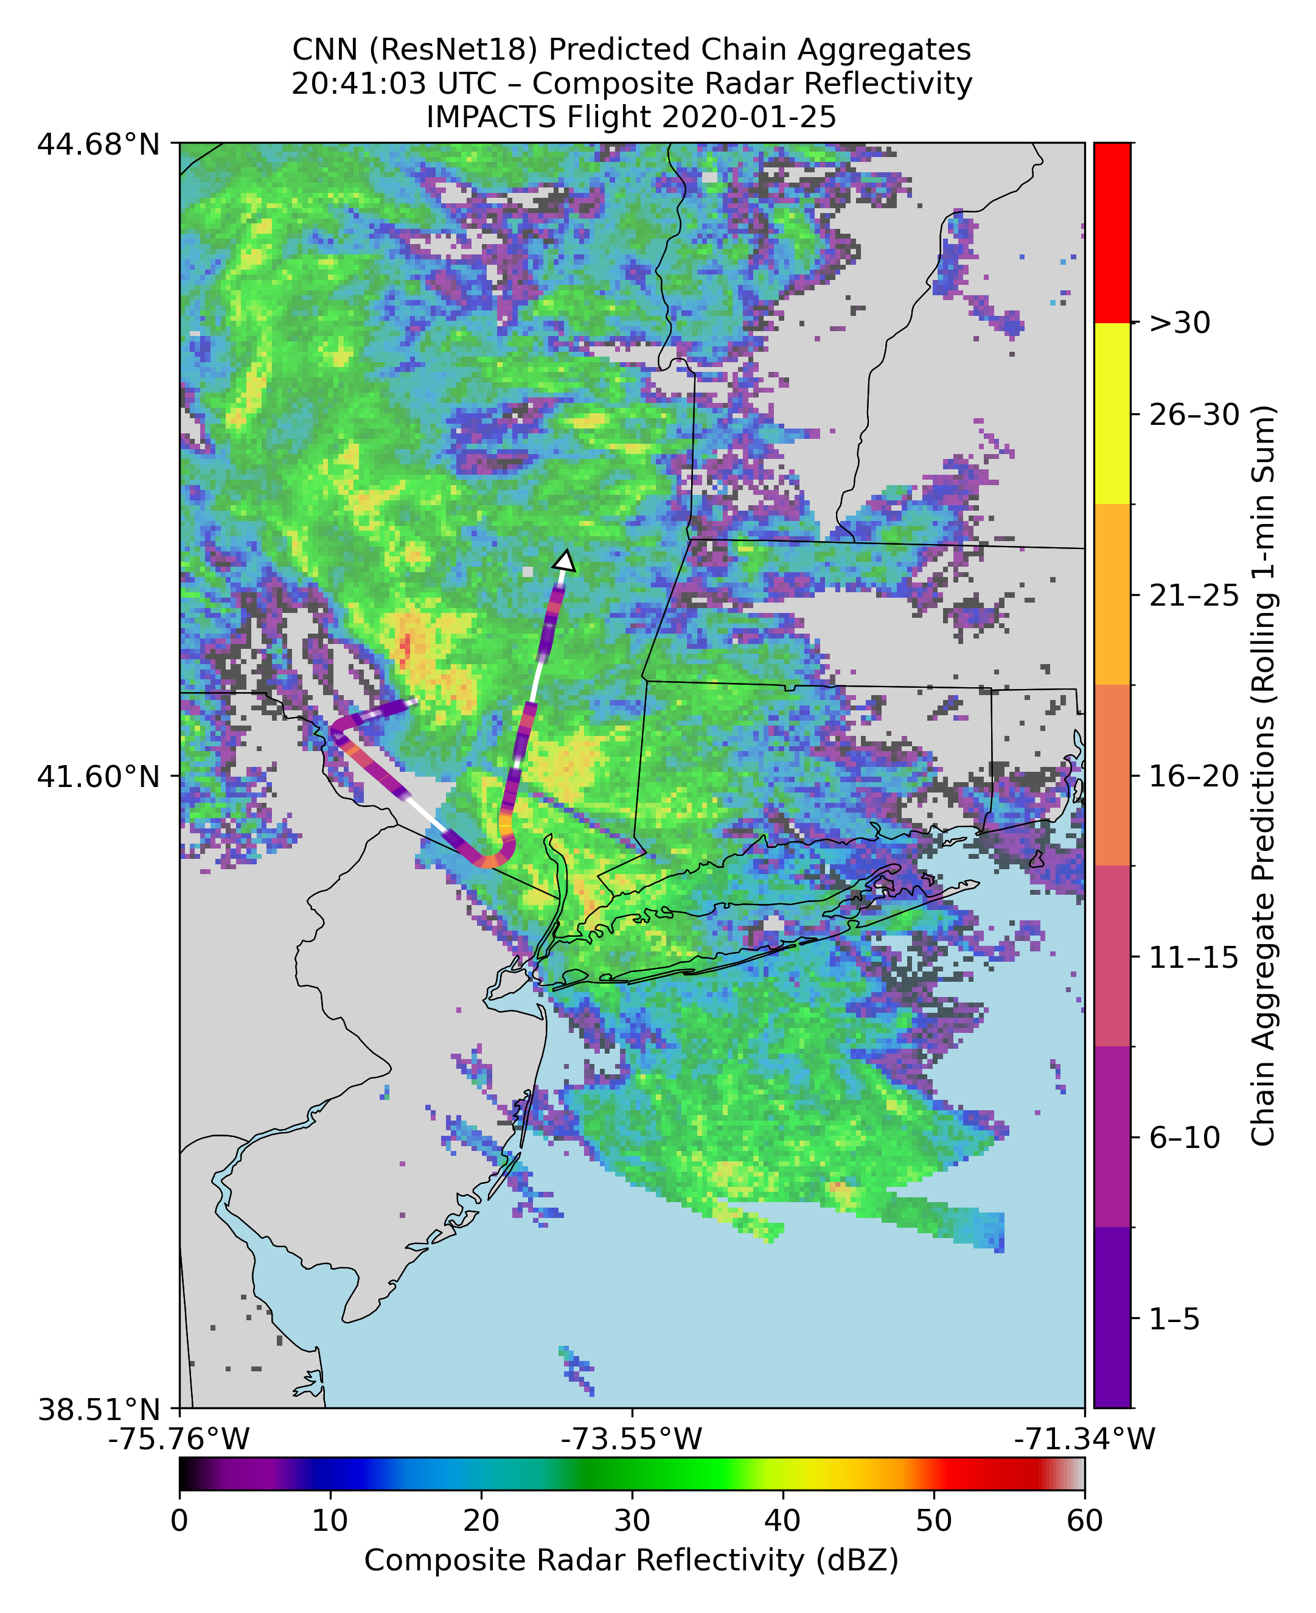
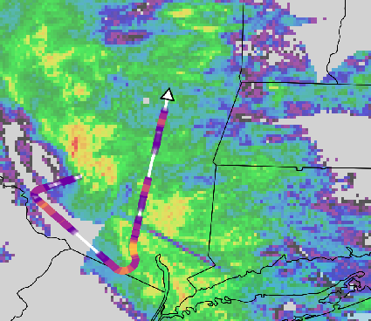
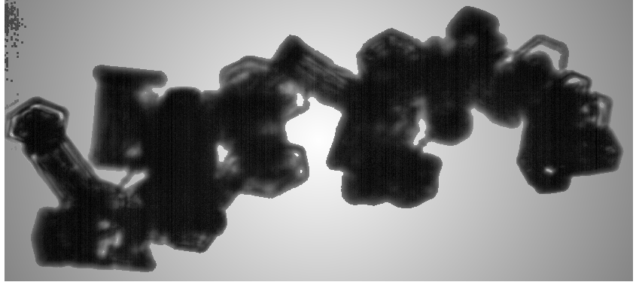
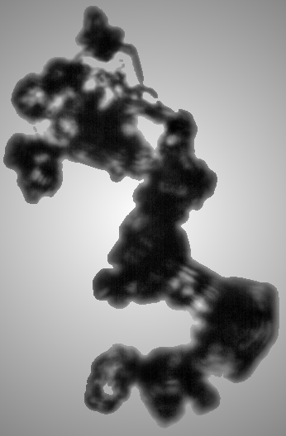
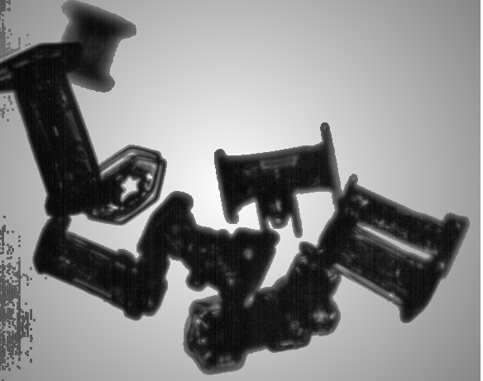
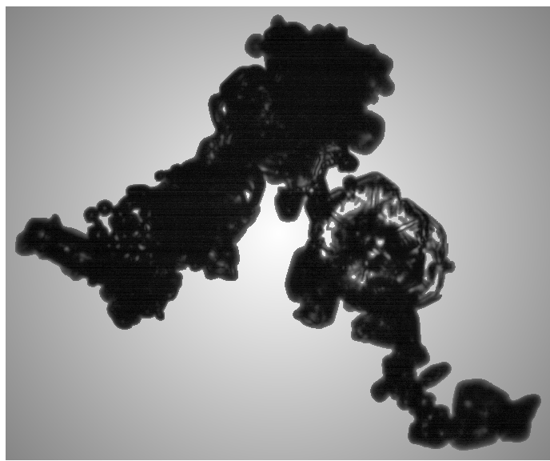
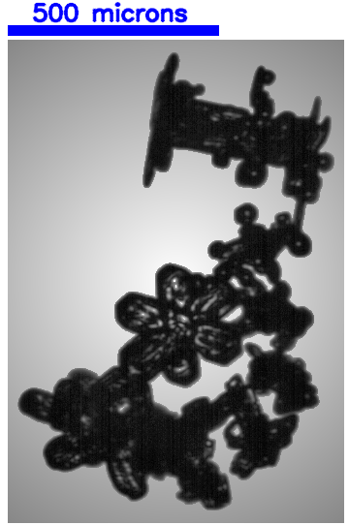
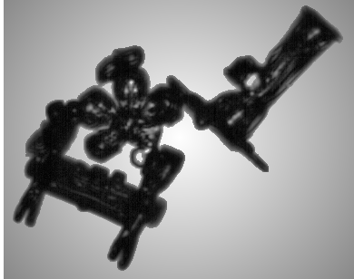
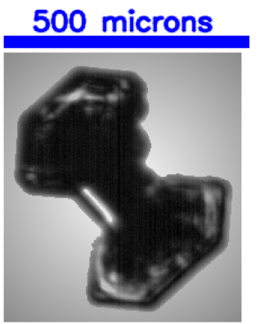
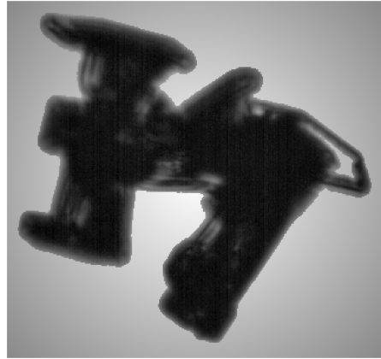
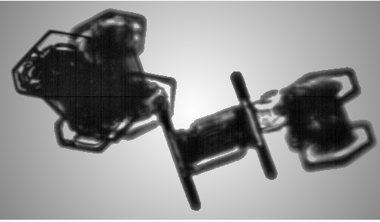
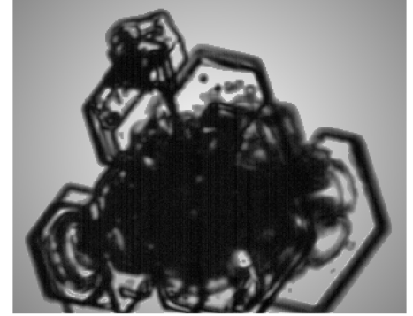
Applying CNN on IMPACTS Flight

Slide 39
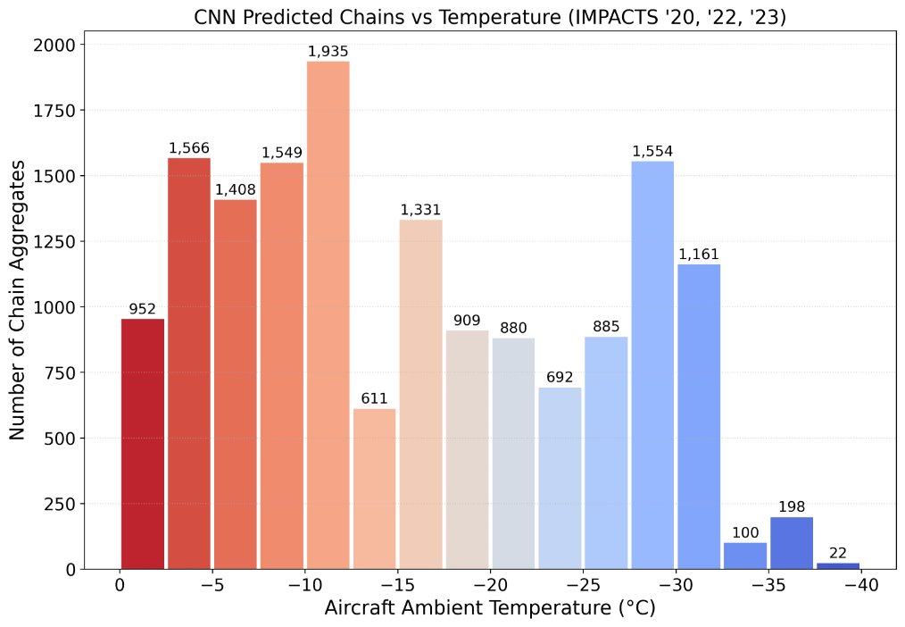
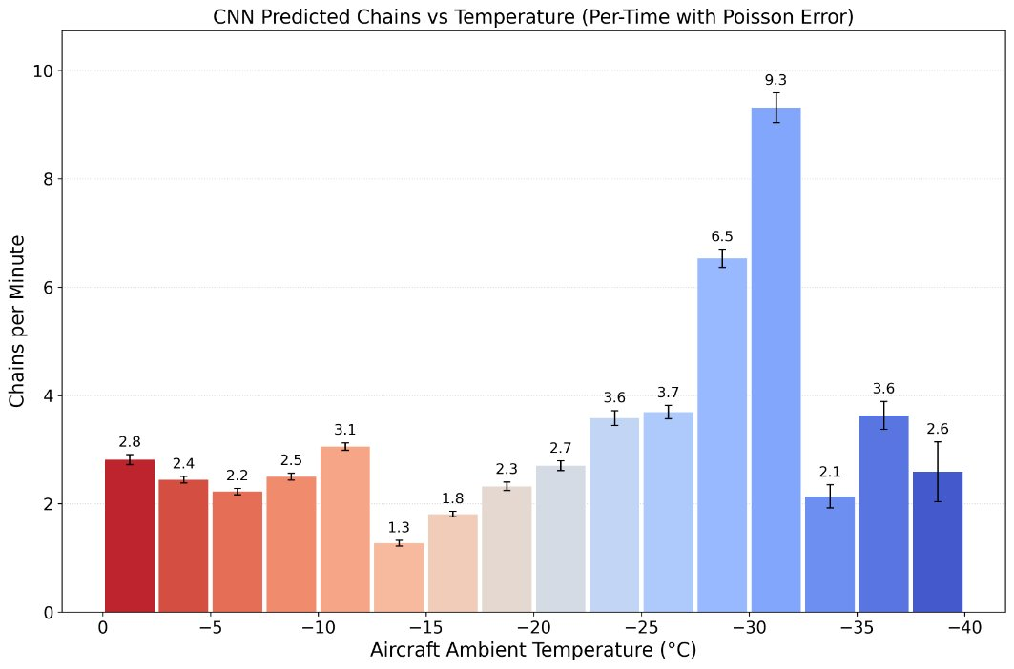
Paper 3 – Preliminary Results
CNN normalized chain aggregate rates w.r.t. temperature show peaks at ~ 30 °C.

Slide 40
Paper 3 – Research Contributions
Demonstrate a transferable workflow that combines CNN classification with in-situ and remote sensing data for cloud microphysics studies.
Link chain aggregate occurrence to storm-relative structure.
Advance understanding of (chain) aggregation processes to support better ice microphysics parameterizations in models.

Slide 41
Summary
Document in situ evidence of chain aggregates in winter storms and clarify observational signatures. (Paper 1)
Foundational paper motivating further analysis.
Build and validate an automated classifier for chain vs. Non-chain aggregates in CPI imagery. (Paper 2)
Tools Paper
Map and contextualize chain aggregate occurrence across the IMPACTS campaign: along-track, 3-D placement with ER-2 context, storm lifecycle, and environment. (Paper 3)
Meteorological Paper

Slide 42
Collaborations – Non-dissertation Research
2022
Delene et al. (2022). Particle Shattering Analysis of Airborne Microphysical Probes Using IMPACTS Observations
Majdi et al. (2022). An Evaluation of a Convolutional Neural Network for Classifying Images from In-situ Cloud Probes
2023
Finlon et al (2023). Relating Lidar Measurements to Cloud Microphysical Properties During IMPACTS
2024
Finlon et al. (2024). Disentangling Cloud Microphysical Properties from Lidar Backscatter and Depolarization Measurements in Winter Storms During the IMPACTS Field Campaign
McFarquhar et al. (2024). Use of In-Situ Airborne Measurements of Cloud Microphysical Properties to Quantify Processes Occurring in Wintertime Snow Storms
Dunnavan et al. (2024). Improving Understanding of Ice Particle Shapes and Orientations: Reconciling 2D-S Cloud Probe Observations with Theoretical Simulations – In Prep
Co-authored NASA MOSAICS proposal. Unveiling Ice Crystal Chain Aggregates in Winter Storms: Contextualization using In-situ and Remote-sensing Observations – Funded, Dollar Value - $399,995; Project Duration 05/16/2025 - 05/15/2027
2025
Osmani et al. (2025). Investigating Atmospheric Ice Crystal Formation and Their Impacts on Hypersonic Vehicles – Published
Finlon et al. (2025). Influence of Cloud Microphysical Properties on Airborne Lidar Measurements: Results from the IMPACTS Field Campaign – Published
Delene et al. (2025). Cloud Microphysical Observations of Seeded Clouds during the Saudi Arabia AeRosol-Cloud-Precipitation Enhancement Campaign (SARPEC) - In Review
Ojo et al. (2025). A Low Temperature Dual Balance Electrodynamic Trap (LT-DBET) for Atmospheric Ice Crystal Aggregation
Delene et al. (2025). Quantification of Chain Aggregate Morphology in Recent Field Campaigns

Slide 43
Collaborations – Non-dissertation Research
For complete listing see:
Full List of Collaborations

Slide 44
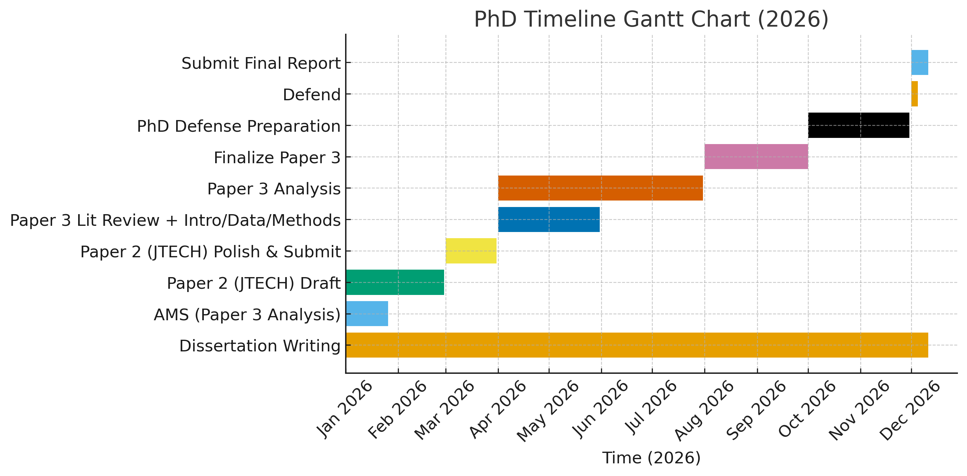
Timeline to Graduation

Slide 45
References
Baran, A. J. (2012). From the single-scattering properties of ice crystals to climate prediction: A way forward. Atmospheric Research, 112, 45–69. https://doi.org/10.1016/j.atmosres.2012.04.010
Connolly, P. J., Saunders, C. P. R., Gallagher, M. W., Bower, K. N., Flynn, M. J., Choularton, T. W., et al. (2005), Aircraft observations of the influence of electric fields on the aggregation of ice crystals. Quarterly Journal of the Royal Meteorological Society, 131(608), 1695–1712. https://doi.org/10.1256/qj.03.217.
Dye, J. E., Bansemer A. (2019), Electrification in Mesoscale Updrafts of Deep Stratiform and Anvil Clouds in Florida. Journal of Geophysical Research: Atmospheres, 124(2), 1021–1049, https://doi.org/10.1029/2018JD029130
Dye, J. E., Bateman, M. G., Christian, H. J., Defer, E., Grainger, C. A., Hall, W. D., et al. (2007), Electric fields, cloud microphysics, and reflectivity in anvils of Florida thunderstorms. Journal of Geophysical Research: Atmospheres, 112(D11). https://doi.org/10.1029/2006JD007550
Finnegan, W. G., & Pitter, R. L. (1988), A postulate of electric multipoles in growing ice crystals: Their role in the formation of ice crystal aggregates. Atmospheric Research, 22(3), 235–250. https://doi.org/10.1016/0169-8095(88)90019-1
Gayet, J.-F., Mioche, G., Bugliaro, L., Protat, A., Minikin, A., Wirth, M., et al. (2012), On the observation of unusual high concentration of small chain-like aggregate ice crystals and large ice water contents near the top of a deep convective cloud during the CIRCLE-2 experiment. Atmospheric Chemistry and Physics, 12(2), 727–744. https://doi.org/10.5194/acp-12-727-2012
Nairy, C. M. (2022), Observations of Chain Aggregates in Florida Cirrus Cloud Anvils on 3 August 2019 during CAPEEX19 (Master’s thesis), Dept. of Atmospheric Sciences, University of North Dakota, Grand Forks, North Dakota. Retrieved from https://commons.und.edu/theses/4363/
NCAR/EOL. (2020). IMPACTS 2020 Field Catalog. https://catalog.eol.ucar.edu/impacts_2020/
NCAR/EOL. (2022). IMPACTS 2022 Field Catalog. https://catalog.eol.ucar.edu/impacts_2022/
NCAR/EOL. (2023). IMPACTS 2023 Field Catalog. https://catalog.eol.ucar.edu/impacts_2023/
Pasquier, J. T., Henneberger, J., Korolev, A., Ramelli, F., Wieder, J., Lauber, A., et al. (2023). Understanding the History of Two Complex Ice Crystal Habits Deduced From a Holographic Imager. Geophysical Research Letters, 50(1). https://doi.org/10.1029/2022GL100247
Um, J., & McFarquhar, G. M. (2009). Single-scattering properties of aggregates of plates. Quarterly Journal of the Royal Meteorological Society, 135(639), 291–304. https://doi.org/10.1002/qj.378

