Slide 1
Testing Nucleation Effectiveness and Type of AgI Flares Using the Pi-Cloud Chamber
Notes:
Research on testing efficiency have been done before. Goal of this project is to verify past results conducted using the Colorado State, Expansion type Cloud Chamber

Slide 2
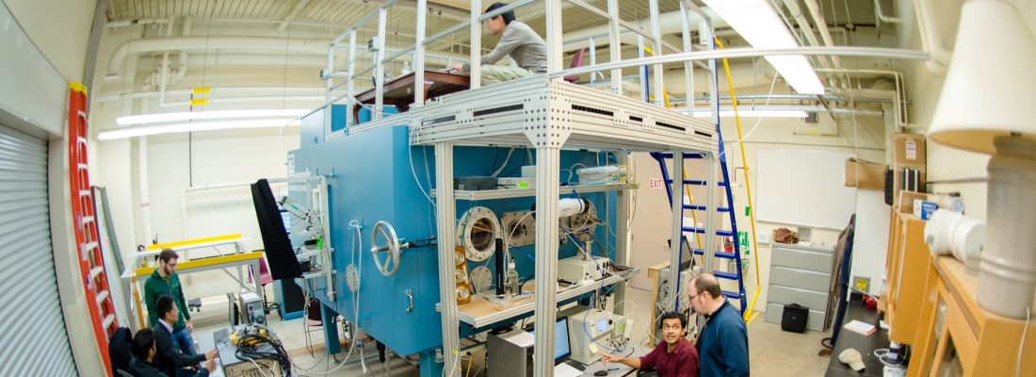
Experiments done using the Pi-Cloud Chamber located at Michigan Technological University.
Capable of generating clouds in two different ways
  Adiabatic expansion
  Temperature differencing
(Chang et al. 2016)
Notes:
Adiabatic expansion simulates a parcel rising in the atmosphere
Temperature differencing is the method of forcing a temperature difference between the top and the bottom of the chamber. This allows a simulated cloud to be maintained for a much greater amount of time. This project was done using this method

Slide 3
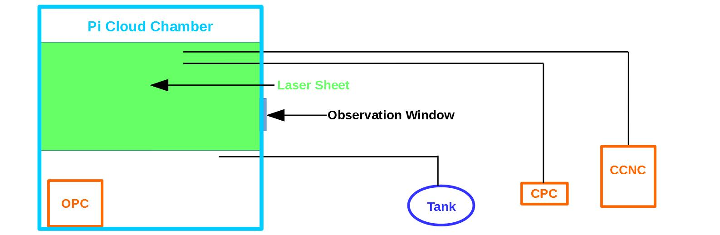
The Tank represents the Particle Injection system
Three instruments used to measure particle, droplet, and ice concentration in the Pi-Cloud Chamber
OPC (Optical Particle Counter)
  Measures Ice & droplet Concentration
CPC (Condensation Particle Counter
CCNC (Cloud Condensation Nuclei Counter)
  Measures Particle Concentration
Notes:
Particle injection system developed to burn an AgI flare and collect its particles in a collection tank

Slide 4
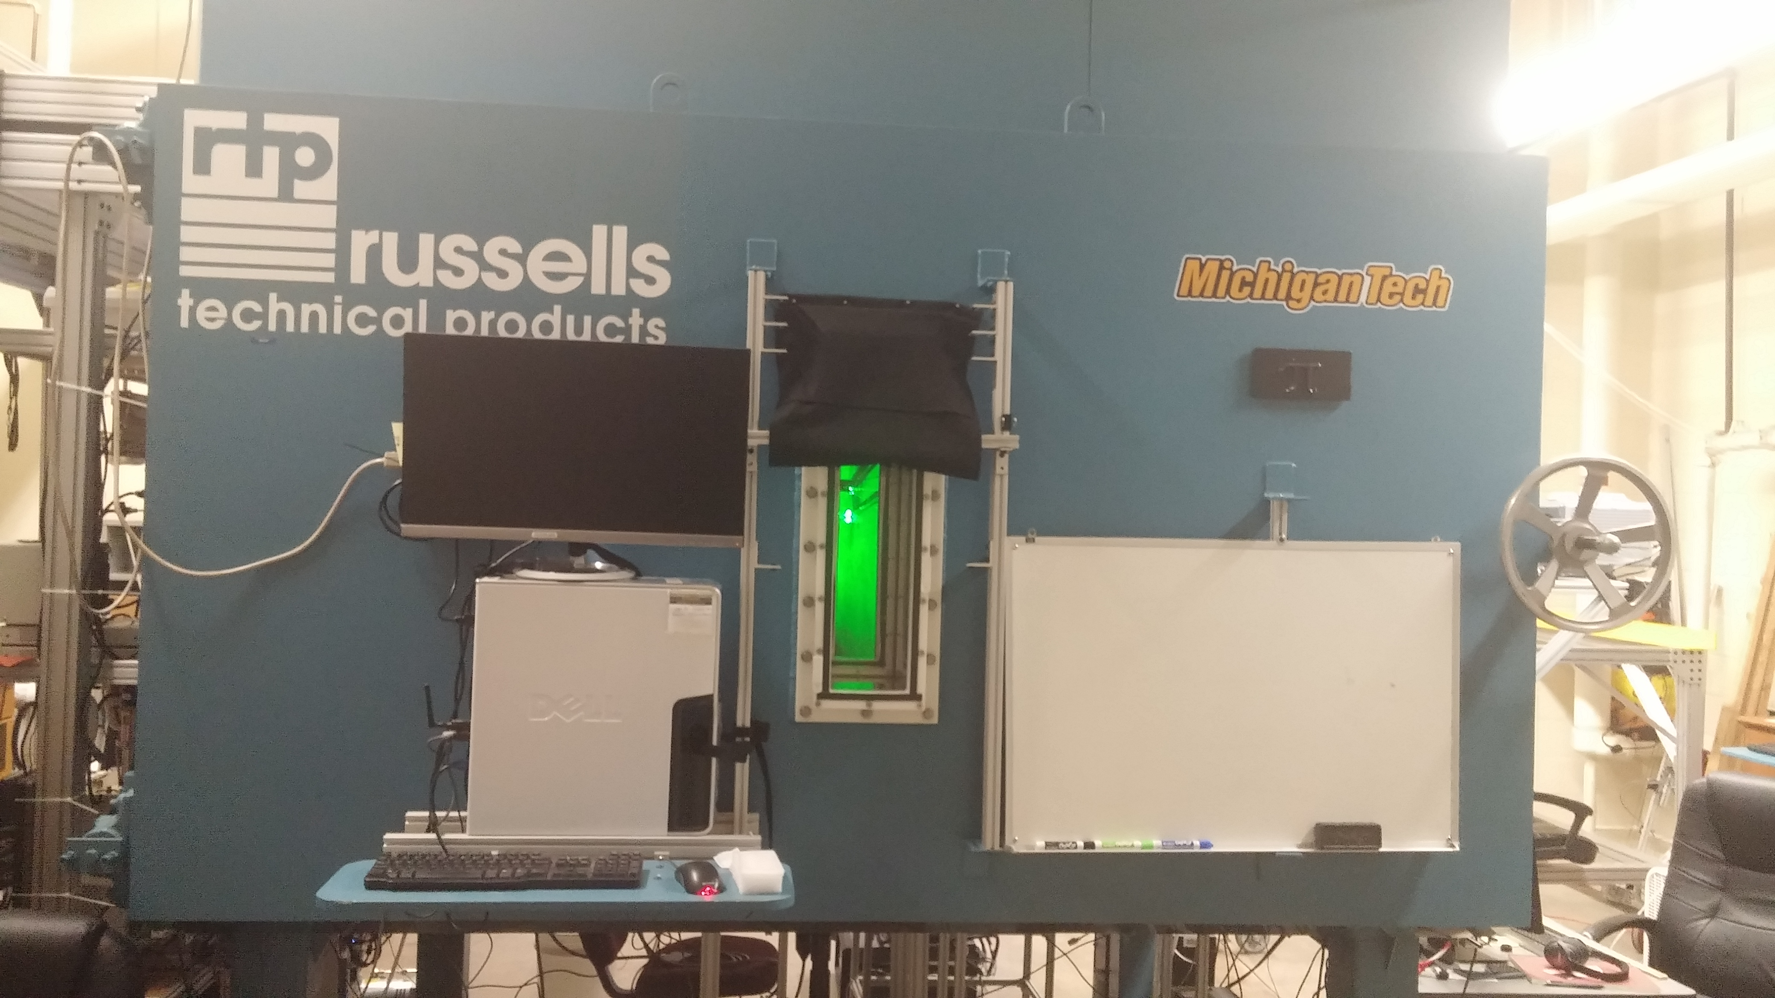

Slide 5
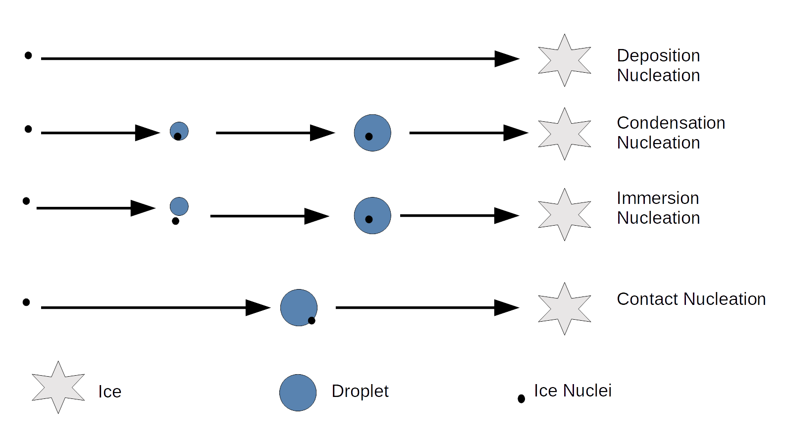
Heterogenous Nucleation Methods
Notes:
Deposition Nucleation is the process of water vapor condensing onto an IN(ice nuclei)
Condensation/Immersion Nucleation occurs when an condensed water droplet contains an IN and activates upon reaching cold enough temp.
Contact Nucleation is the process of an IN colliding with a super-cooled drop causing it to freeze

Slide 6
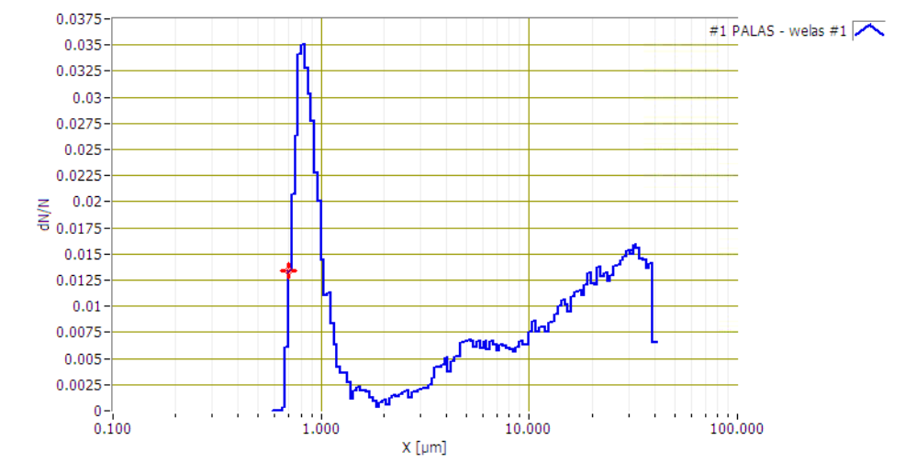
Methodology
Burn flares in particle collection system
Data analysis
  10 min AgI injection duration
  Cloud chamber temperatures of -11˚C & -5.8˚C
  High initial cloud droplet concentration of 500/cm^3
  low initial cloud droplet concentration 80/cm^3
Water drops considered to be between 2 – 10 µm
Ice Crystals considered to be between 20 – 105 µm
Notes:
High 500/cm^3 Low 80/cm^3

Slide 7
Methodology
Nucleation effectiveness determined by a time constant
  Time constant is the time it takes for a system to react to 63.2% of a change
  Evaluated from AgI injection start time to first data point above 9/cm^3
Time constant evaluated for ice concentration by the OPC
If exponential growth in ice concentration is evident, an exponential growth equation can be applied to the ice concentration growth period

Slide 8
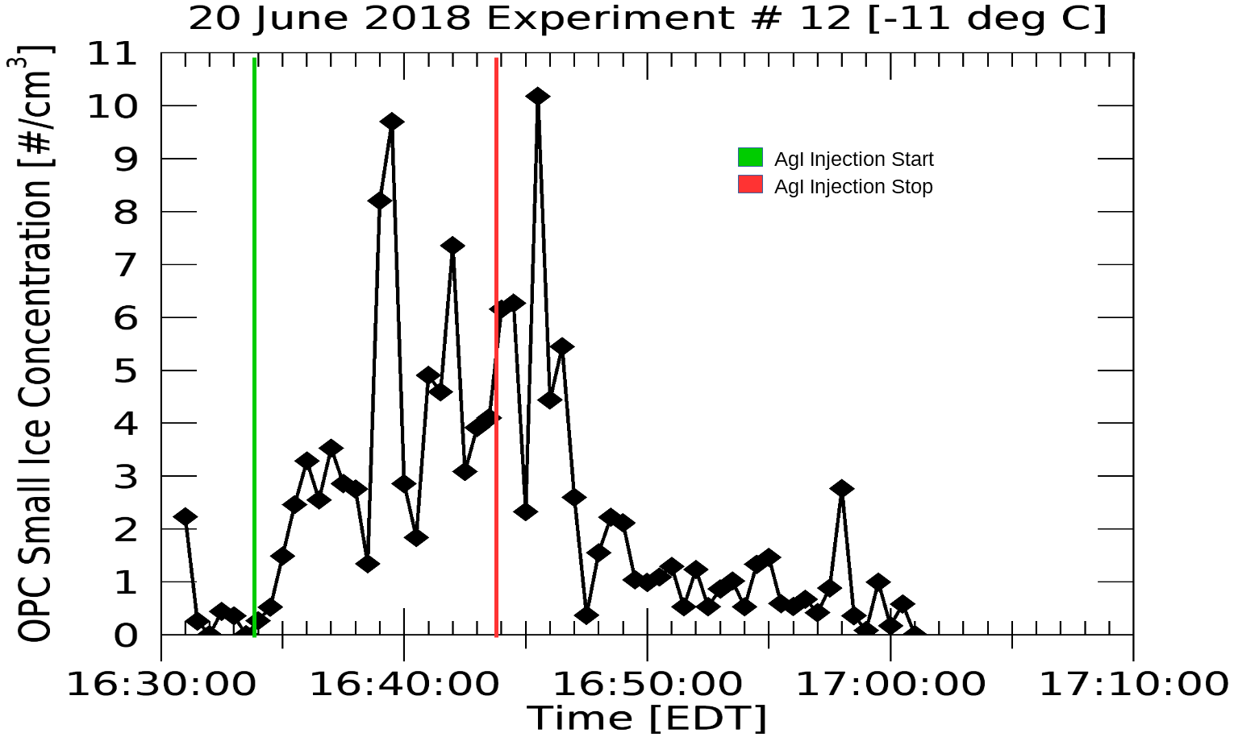
Results: high initial cloud droplet concentration case (500/cm^3)
Notes:
Ice sizes 20-45µm

Slide 9
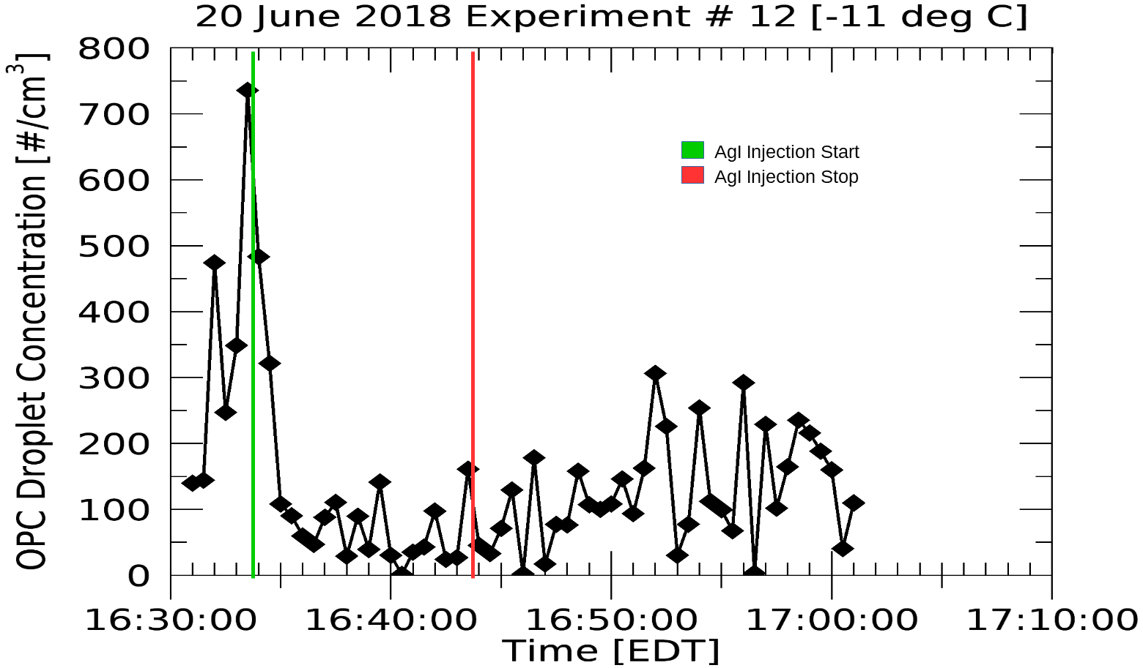
Results: high initial cloud droplet concentration case (500/cm^3)
Notes:
Droplet seizes 2 µm and 10 µm

Slide 10
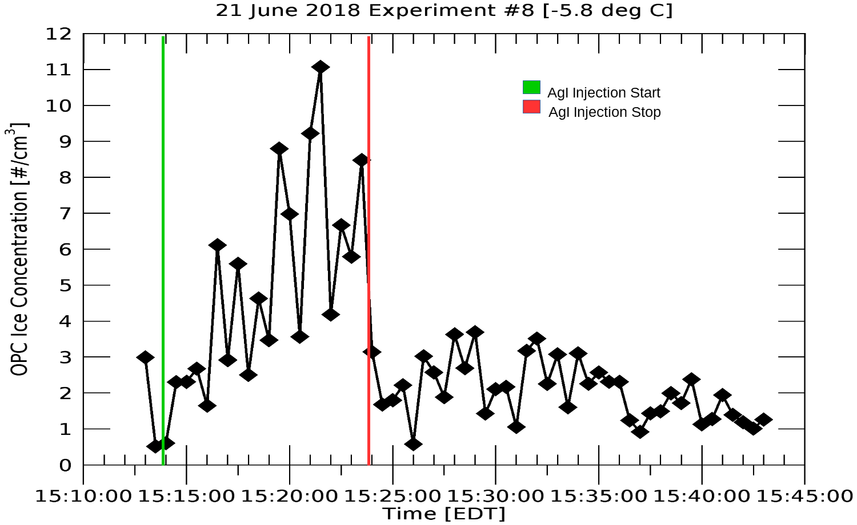
Results: high initial cloud droplet concentration case (500/cm^3)
Notes:
30 µm to 105 µm.

Slide 11
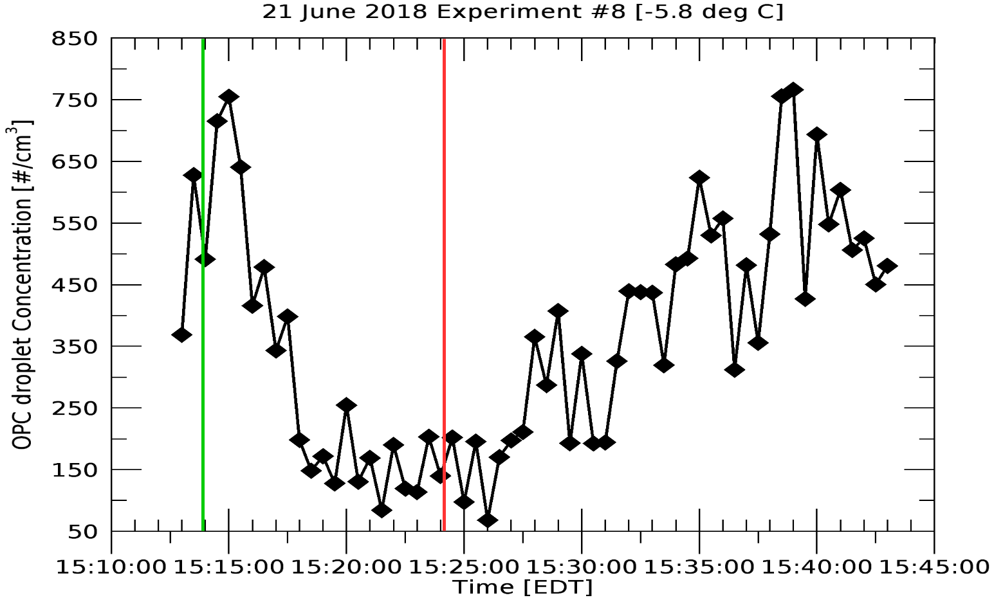
Results: high initial cloud droplet concentration case (500/cm^3)
Notes:
2 µm to 10 µm

Slide 12
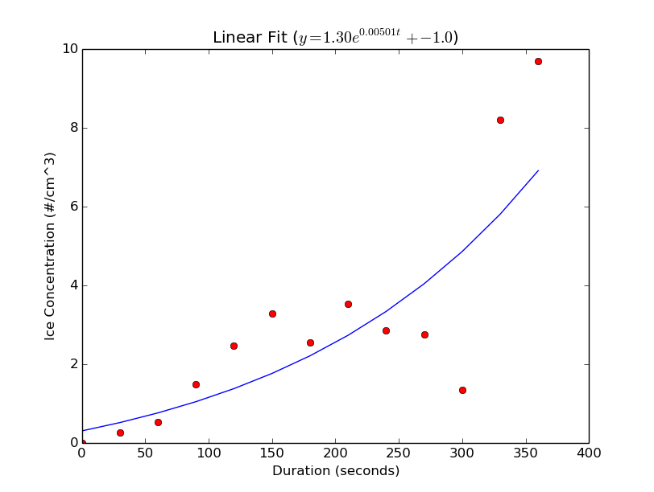
Results: curve fitting of ice concentration growth period
Time Constant for -11˚C case
199 seconds

Slide 13
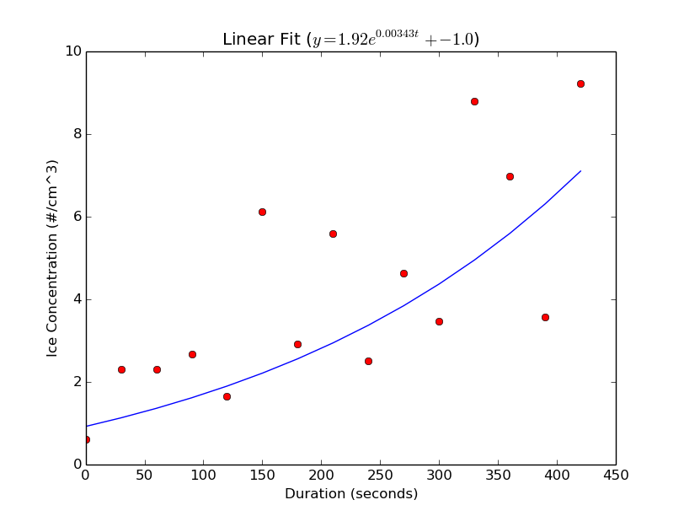
Results: curve fitting of ice concentration growth period
Time Constant for -5.8˚C case
291 seconds

Slide 14
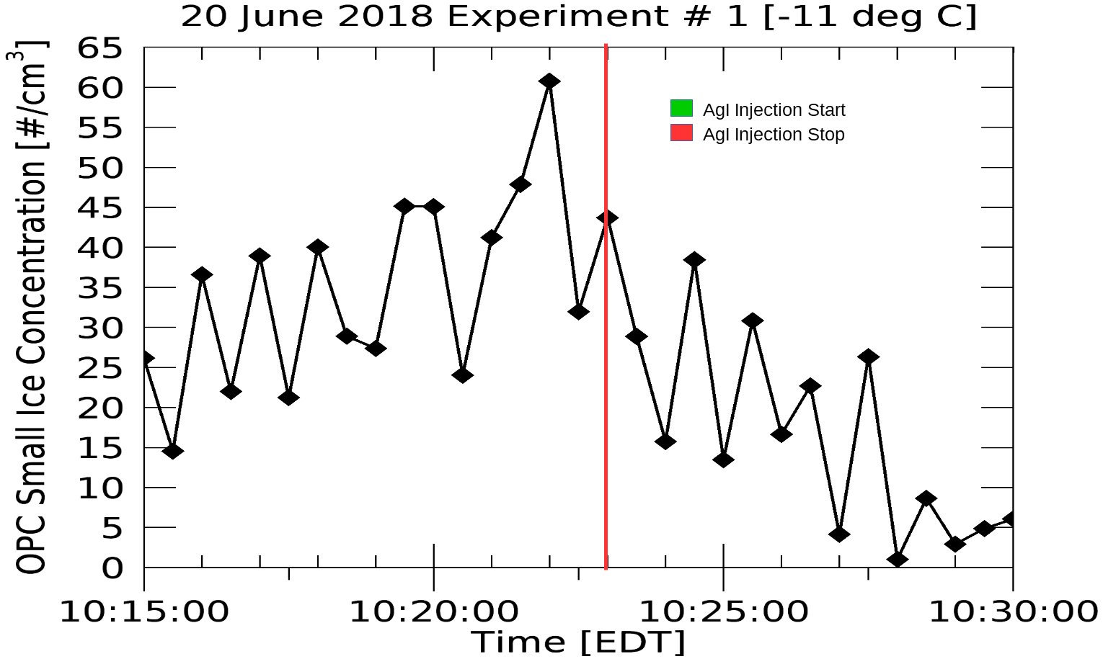
Results: low initial cloud droplet concentration case (80/cm^3)

Slide 15
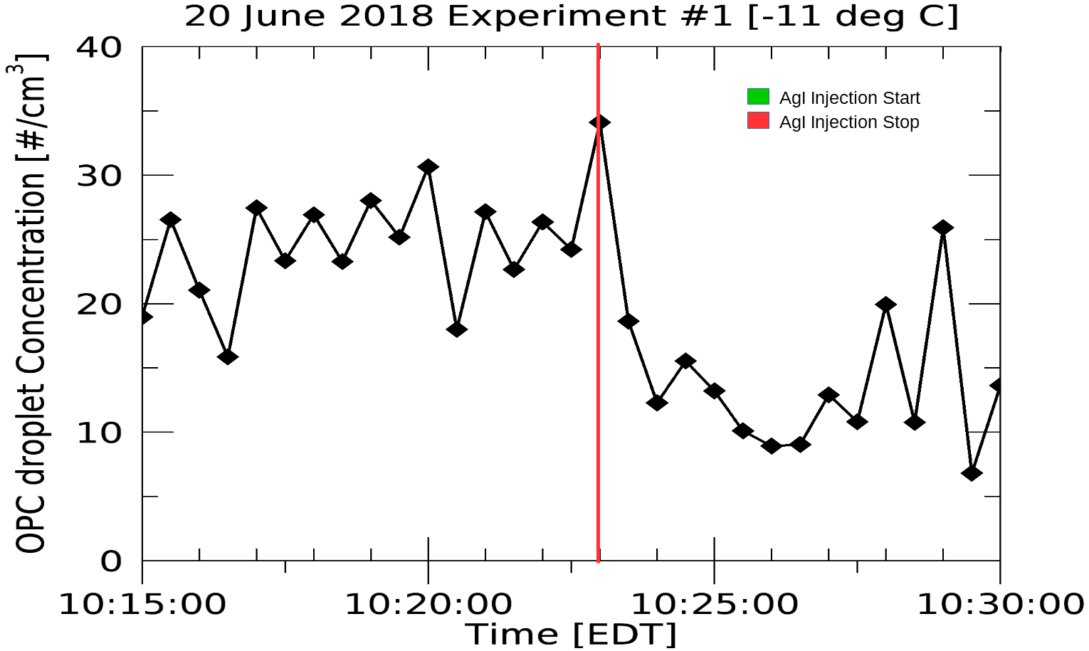
Results: low initial cloud droplet concentration case (80/cm^3)

Slide 16
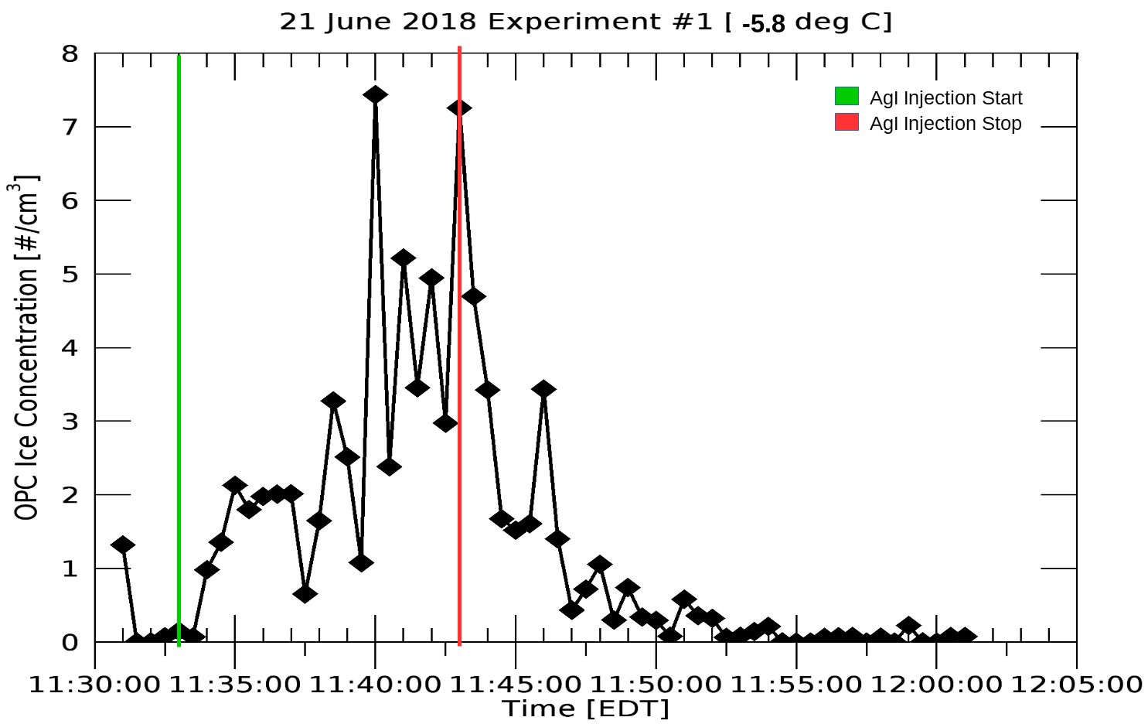
Results: low initial cloud droplet concentration case (80/cm^3)

Slide 17
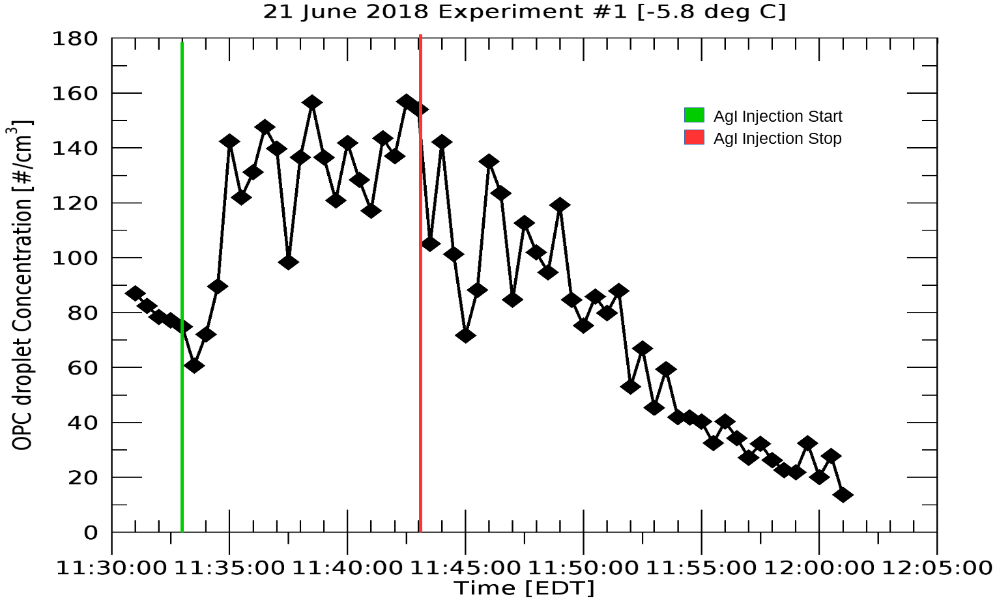
Results: low initial cloud droplet concentration case (80/cm^3)

Slide 18
Conclusions
Contact nucleation appears to be the main nucleation mechanism occurring
High initial cloud droplet concentration cases
  Quick rise in ice concentration
  Fast drop in droplet concentration
Low initial cloud droplet concentration cases
  Slower, and almost linear Ice growth
  No drop in droplet concentration
Demot 1983 used Colorado States Expansion type cloud Chamber
  Found that contact nucleation is the dominate mode for AgI nuclei at temperature warmer than -16˚C

Slide 19
Conclusions
AgI ice nucleation is more effective at -11˚C than at -5.8˚C
  -11˚C time constant = 199 seconds
  -5.8˚C time constant = 291 seconds
Turbulent mixing may be causing variability in the data

Slide 20
Future Work & Recommendations for next project
Analyze Experiments done with a cloud chamber temperatures of -3.2˚C
  What would be AgI nucleation effectiveness?
  Is contact nucleation still evident?
Use a better instrument to measure ice concentration
  WEALS Optical Particle Counter is better for measuring water concentration
  Difficulties affording better instruments

Slide 21
References
Blair, D. N., B. L. Davis, and A. S. Dennis, 1973: Cloud Chamber Tests of Generators Using Acetone Solutions of AgI-NaI, AgI-KI and AgI-NH4I. J. Appl. Meteorol., 12, 1012–1017, doi:10.1175/1520- 0450(1973)012<1012:CCTOGU>2.0.CO;2.
Chang, K., and Coauthors, 2016: A laboratory facility to study gas-aerosol-cloud interactions in a turbulent environment: The Π Chamber. Bull. Am. Meteorol. Soc., doi:10.1175/BAMS-D-15-00203.1. http://journals.ametsoc.org/doi/10.1175/BAMS-D-15-00203.1 (Accessed May 2, 2016).
DeMott, P. J., W. G. Finnegan, and L. O. Grant, 1983: An Application of Chemical Kinetic Theory and Methodology to Characterize the Ice Nucleating Properties of Aerosols Used for Weather Modification. J. Clim. Appl. Meteorol., 22, 1190–1203, doi:10.1175/1520-0450(1983)022<1190:AAOCKT>2.0.CO;2.
——, and Coauthors, 2011: Resurgence in Ice Nuclei Measurement Research. Bull. Am. Meteorol. Soc., 92, 1623–1635, doi:10.1175/2011BAMS3119.1.
Young, K. C., 1974: The Role of Contact Nucleation in Ice Phase Initiation in Clouds. J. Atmospheric Sci., 31, 768–776, doi:10.1175/1520-0469(1974)031<0768:TROCNI>2.0.CO;2.

Slide 22
Additional Slides

Slide 23
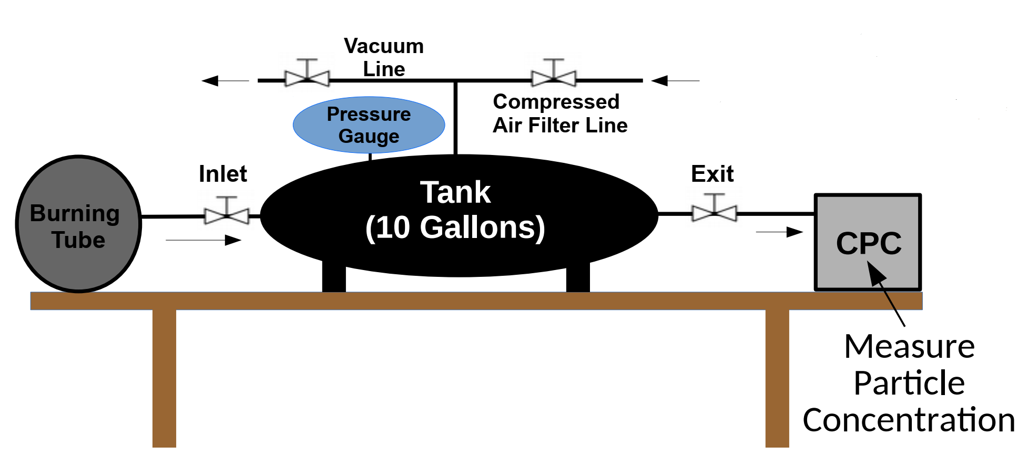
AgI flare collection tank system

Slide 24
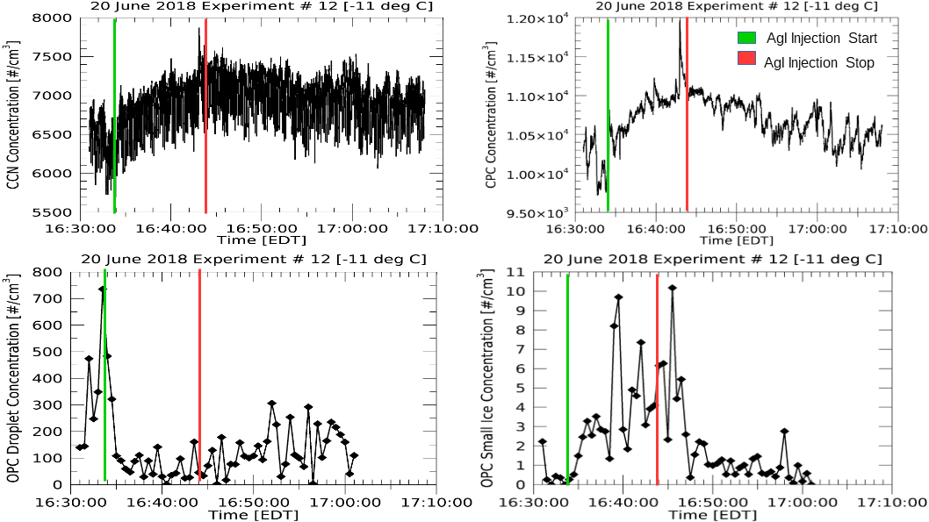

Slide 25
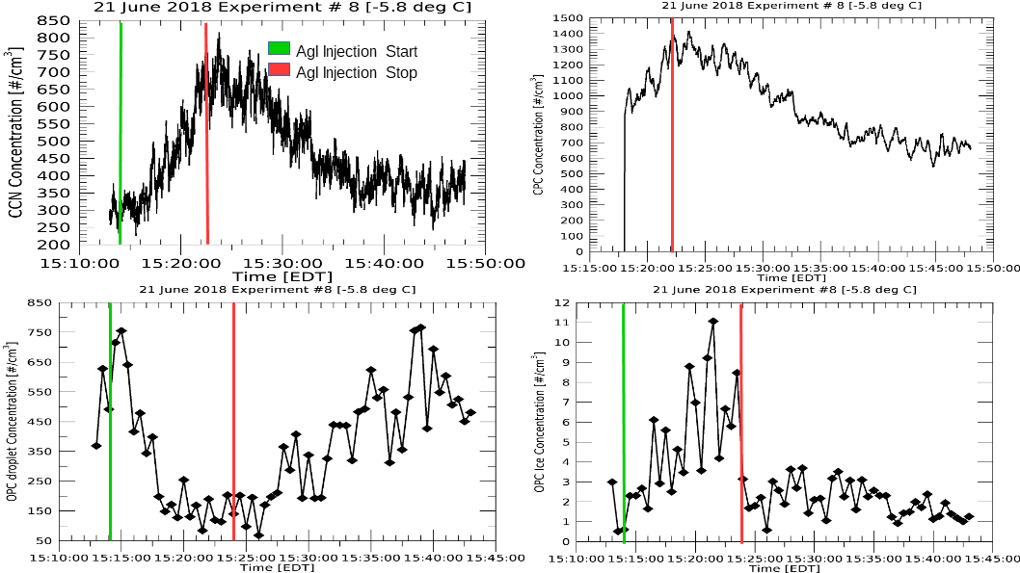

Slide 26
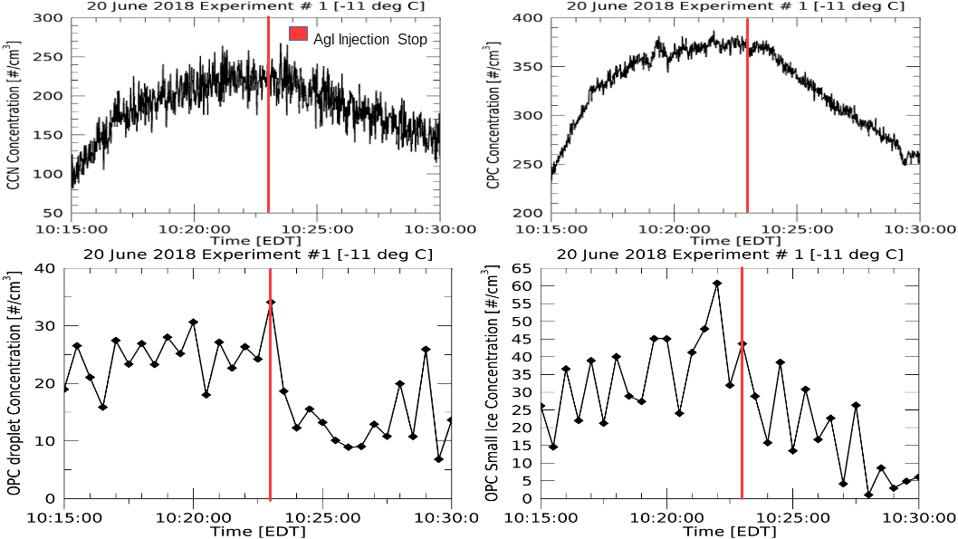

Slide 27
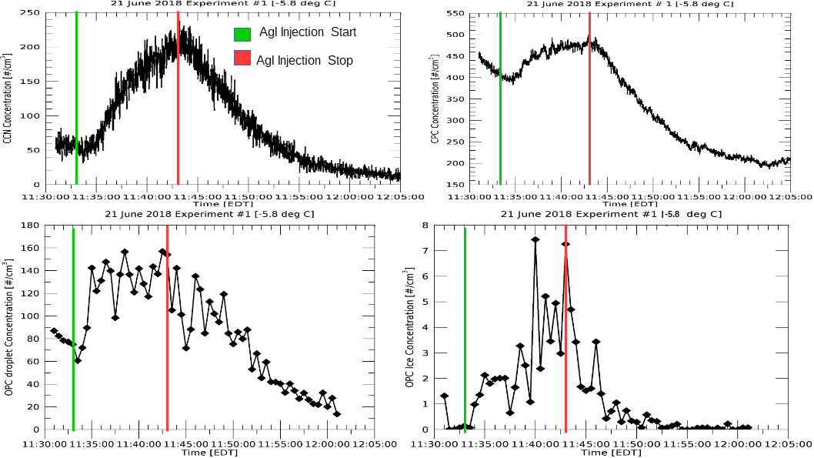

Slide 28
Chamber Liquid Water Content
LWC for High initial cloud droplet concentration cases\
  .016755 g/m^3
LWC for Low initial cloud droplet concentration cases
  .0026808g/m^3

Slide 29
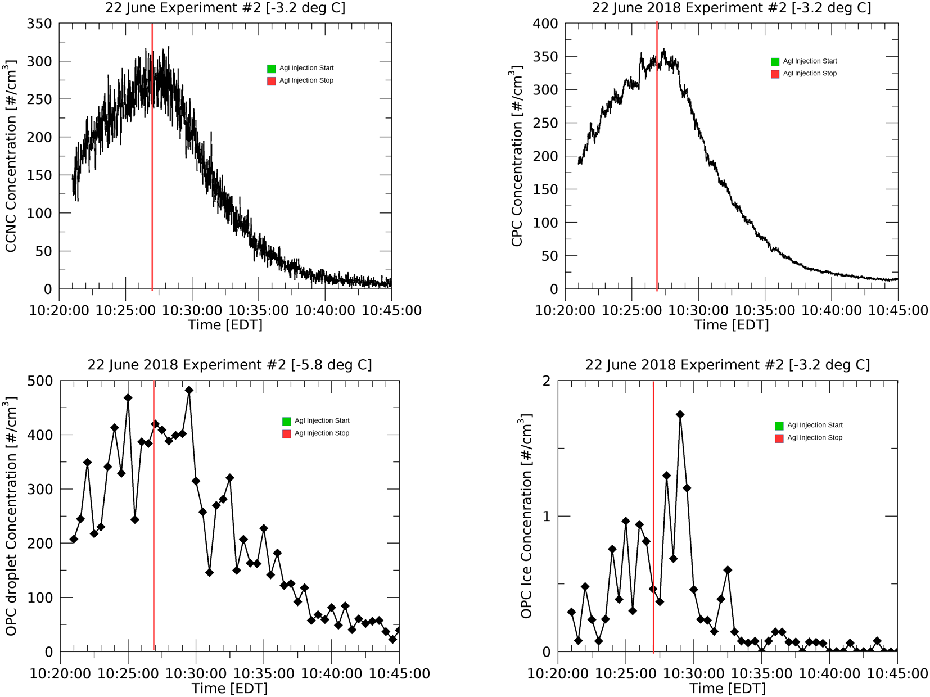
Initial results to -3.2˚C Case

Slide 30
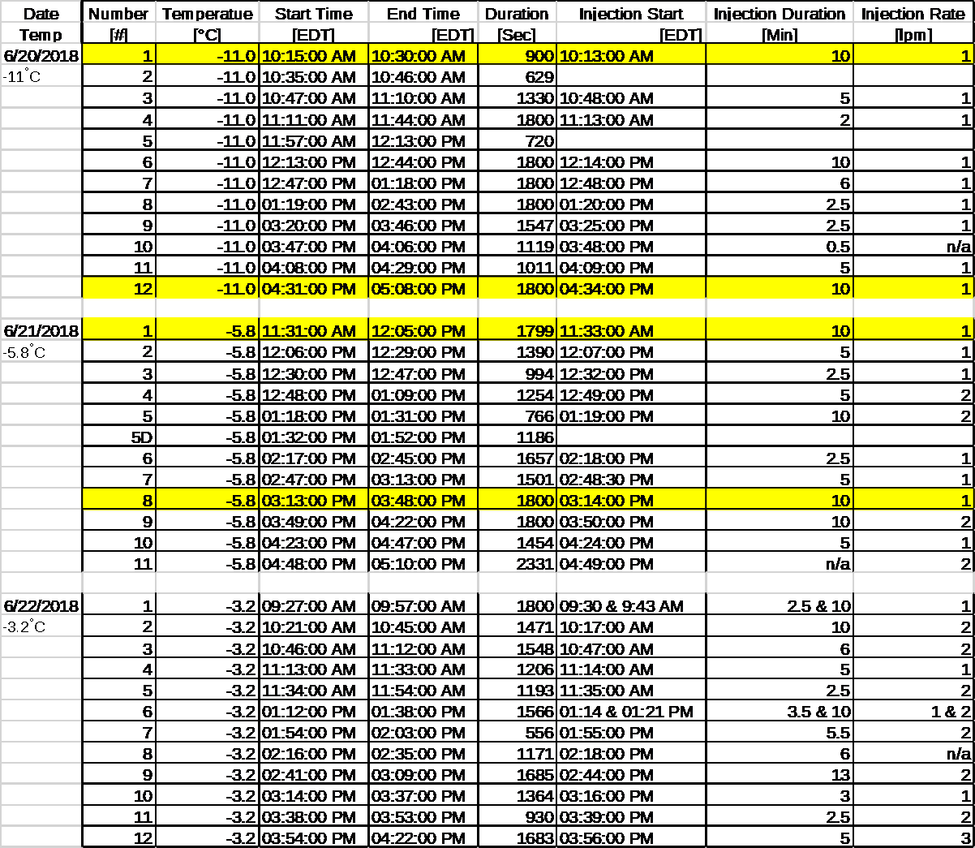
Experimental table

