Slide 1
The Impacts of Airborne Cloud Microphysical Instrumentation Mounting Location on Measurements Made During Observations of Aerosols Above Clouds and Their Interactions (ORACLES)
Joe O’Brien
Dissertation Defense
Friday, 23 June 2023
Grand Forks, North Dakota

Slide 2
Outline
ORACLES Project Description
NASA P-3 Pylon Designs
Computational Fluid Dynamics with OpenFOAM
Simulations of ORACLES Cloud Sampling Profiles
Recommendations and Future Work
2

Slide 3
NASA ORACLES ObseRvations of Aerosols above Clouds and their Interactions
A five-year NASA investigation into the climate impacts of Southern Africa’s biomass burning aerosols (Redemann et al. 2021).
Three separate field experiments were conducted off the coast of Africa.
September 2016 – Walvis Bay, Namibia
August 2017 - São Tomé and Príncipe
October 2018 - São Tomé and Príncipe
Primary platform:
NASA P-3 Orion - Wallops Flight Facility
NASA ER-2
Photo from NASA ORACLES: https://espo.nasa.gov/ORACLES/content/ORACLES
3

Slide 4
Biomass Burning Aerosols
Southern Africa accounts for almost one third of the Earth’s total biomass burning emissions.
With burned areas in southern Africa increasing even with the decreasing trend in global biomass burning (Andela et al. 2017; Redemann et al. 2021).
Biomass burning aerosol emissions from southern Africa are routinely transported west off the continent and over one of the world’s three semi-permanent marine stratocumulus cloud decks.
NASA's Fire Information for Resource Management System (FIRMS) (https://earthdata.nasa.gov/firms), part of NASA's Earth Observing System Data and Information System (EOSDIS); 15 June 2023
4
Notes:
Burning of vegetation over large tracts of land (AMS Glossary)
Key practice in tropical agriculture, as it restores nutrients to the soil
Produces emissions that contain partially burnt grasses, smoke and particles

Slide 5
Southern Atlantic Marine Stratocumulus
Stratocumulus (Wood 2012)
Class of low clouds composed of an ensemble of individual convective elements .
Earth’s most common cloud type.
Susceptible to perturbations in atmospheric aerosols.
Southern Atlantic Ocean
40-60% annual cloud coverage within this region (Wood 2012).
Profound impact on Earth’s radiation budget.
We acknowledge the use of imagery provided by services from NASA's Global Imagery Browse Services (GIBS), part of NASA's Earth Observing System Data and Information System (EOSDIS).
5

Slide 6
Aerosol Indirect Effect
Twomey (1977) found that with increasing cloud condensation nuclei, smaller, more numerous cloud droplets were formed.
Albrecht (1989) argued that the result of the Twomey effect is a decrease in the variability of the cloud droplet distribution, with results in the reduction of collision-coalescence and precipitation efficiency.
Series of papers by Dr. Sid Gupta investigates aerosol indirect effects for ORACLES.
Gupta, S et al. (2021) Impact of the variability in vertical separation between biomass burning aerosols and marine stratocumulus on cloud microphysical properties over the Southeast Atlantic, Atmos. Chem. Phys., 21, 4615–4635, https://doi.org/10.5194/acp-21-4615-2021
6
Notes:
Twomey (1977) - The increase in cloud droplets resulted in increased cloud albedo, enhancing the reflectance of solar radiation and producing a slight negative radiative forcing at the top of the atmosphere
Albrecht (1989) - decrease in precipitation efficiency would increase cloud liquid water and fractional cloudiness, resulting in brighter, longer lasting marine stratocumulus.
Our results of the aerosol indirect effect are found in a series of papers by Dr Sid Gupta (now of Brookhaven National Laboratory)
MAKE SURE I MENTION WE NEED TO MEASURE CLOUDS DIRECTLY

Slide 7
`Cloud Probes` Team
Instrument | Main Parameter | Sampling Frequency | Measurement Range
Cloud Droplet Probe (CDP) | Cloud Droplet Number Distribution n(D) | 10 Hz | 2 – 50 μm
Cloud and Aerosol Spectrometer | Droplet Images, Cloud Droplet Number Distribution n(D) | 10 Hz n(D); Asynchronous images | 0.5 – 50 μm 25-1600 μm
Two-Dimensional Stereo Probe | Droplet Images, Droplet Number Distribution n(D) | Asynchronous images; 1 Hz n(D) | 10 – 1280 μm
High Volume Precipitation Spectrometer | Droplet Images, Droplet Number Distribution n(D) | Asynchrones images; 1 Hz n(D) | 150 – 19200 μm
Passive Cavity Aerosol Spectrometer | Aerosol Number Distribution n(D) | 10 Hz | 0.1 – 3 μm
CSIRO King Hotwire | Bulk Liquid Water Content | 25 Hz | 0.05 – 3 g m⁻³
UND, CIWRO, OU, and UIUC investigated cloud microphysical properties within the African Marine Stratocumulus.
Operated a suite of microphysical instrumentation to observe aerosol and cloud distributions from 0.1µm to 19.2 cm.
Primary focus is the Aerosol Indirect Effect.
7

Slide 8
Cloud Profiles – ‘Sawtooths’
Cloud and aerosol in-situ sampling were separated into two distinct maneuvers:
‘Sawtooth’ profiles
Constant altitude in-cloud legs
In total, the NASA P-3 Orion aircraft flew 350.6 flight hours in 44 science operations flights between ORACLES-2016 and ORACLES-2018.
329 cloud profiles transecting the vertical distribution of marine stratocumulus (Redemann et al. 2021; Gupta et al. 2022)
Photo Courtesy of Sid Gupta
8
Notes:
Key point: lots of vertical profiles

Slide 9
Cloud Profiles – ‘Sawtooths’
Cloud and aerosol in-situ sampling were separated into two distinct maneuvers:
‘Sawtooth’ profiles
Constant altitude in-cloud legs
In total, the NASA P-3 Orion aircraft flew 350.6 flight hours in 44 science operations flights between ORACLES-2016 and ORACLES-2018.
329 cloud profiles transecting the vertical distribution of marine stratocumulus (Redemann et al. 2021; Gupta et al. 2022)
Gupta, S et al. (2021) Impact of the variability in vertical separation between biomass burning aerosols and marine stratocumulus on cloud microphysical properties over the Southeast Atlantic, Atmos. Chem. Phys., 21, 4615–4635, https://doi.org/10.5194/acp-21-4615-2021
9
Notes:
Key point: lots of vertical profiles

Slide 10
Cloud Droplet Instrument Intercomparisons
Following ORACLES-2016, we had concerns that the mounting location of the instruments was influencing the observations.
The intercomparison showed the relationship between Nd between the CAS and PDI were dependent on the pitch angle of the aircraft during sawtooth maneuvers.
Concern was that particle trajectories may be altered by the Navy pylon
10

Slide 11
Aircraft Instrument Placement
Beard (1983) studied the orientation of OAP images due to the tilting of images in the direction of flight.
Norment (1988) found that the PMS FSSP under-sampled cloud droplets (5-50 microns diameter) between 10-13% at 0 degrees angle of attack, and 18-24% at 4 degrees angle of attack.
Angle of attack:
The angle at which the chord of an aircraft’s wing meets the relative wind.
MacPherson and Baumgardner (1988) conducted extensive wind tunnel tests of the King Air pylon assembly with chalk and oil.
O’Brien, J.R., "Sensitivity Of Two-Dimensional Stereo (2DS) Probe Derived Parameters To Particle Orientation" (2016). Theses and Dissertations. 2056.
https://commons.und.edu/theses/2056
11

Slide 12
Angle of Attack Dependence
Beard (1983) studied the orientation of OAP images due to the tilting of images in the direction of flight.
Norment (1988) found that the PMS FSSP under-sampled cloud droplets (5-50 microns diameter) between 10-13% at 0 degrees angle of attack, and 18-24% at 4 degrees angle of attack.
Angle of attack:
The angle at which the chord of an aircraft’s wing meets the relative wind.
MacPherson and Baumgardner (1988) conducted extensive wind tunnel tests of the King Air pylon assembly with chalk and oil.
Norment, H. G., 1988: Three-Dimensional Trajectory Analysis of Two Drop Sizing instruments: PMS*OAP and PMS* FSSP. J. Atmos. Oceanic Technol., 5, 743–756, https://doi.org/10.1175/1520-0426(1988)005<0743:TDTAOT>2.0.CO;2.
12
Notes:
MacPherson and Baumgardner (1988) - calculating velocity ratios and side flow angles for multiple angles of attack at two sample locations (inboard and outboard)

Slide 13
Recent Advancements
Bennett et al. (2019) conducted numerical simulations to understand the aerodynamics around their pylon assembly.
Only considered the effect of longitudinal and lateral velocity components on the sizing of hydrometeors within the DMT Cloud Imaging Probe (CIP-100).
Spanu et al. (2020) conducted numerical simulations investigate flow around wing-mounted instruments on board the DSR Dassault Falcon 20E.
Determined the sampling efficiency (i.e. concentration of particles within the sample volume compared to free steam concentrations).
Cloud droplets less than 100 microns in diameter were shown to have a sampling efficiency of 77%.
UK Met Office – BAe FAAM Research Aircraft
Barrett, P. A., and Coauthors, 2022: Intercomparison of airborne and surface-based measurements during the CLARIFY, ORACLES and LASIC field experiments. Atmospheric Meas. Tech., 15, 6329–6371, https://doi.org/10.5194/amt-15-6329-2022.
13

Slide 14
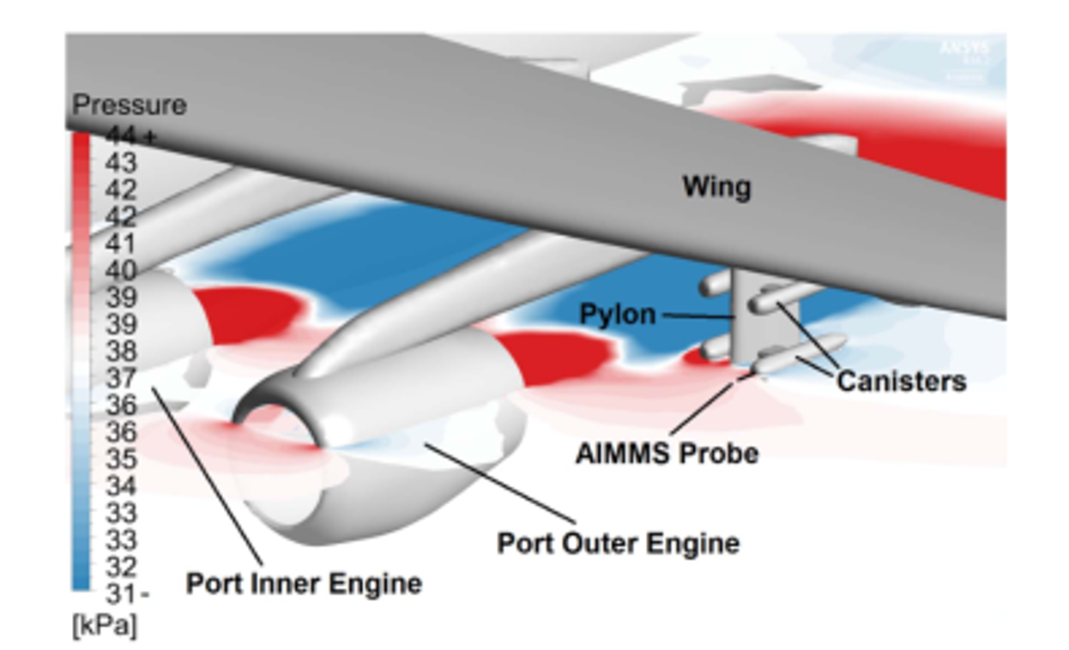
Recent Advancements – FAAM Aircraft
Bennett et al. (2019) conducted numerical simulations to understand the aerodynamics around their pylon assembly.
Only considered the effect of longitudinal and lateral velocity components on the sizing of hydrometeors within the DMT Cloud Imaging Probe (CIP-100)
Spanu et al. (2020) conducted numerical simulations investigate flow around wing-mounted instruments on board the DSR Dassault Falcon 20E.
Determined the sampling efficiency (i.e. concentration of particles within the sample volume compared to free steam concentrations)
Cloud droplets less than 100 microns in diameter were shown to have a sampling efficiency of 77%
UK Met Office – BAe FAAM Research Aircraft
Bennett, C. J., G. J. Nott, A. Wellpott, N. Lawson, M. Delise, B. Woodcock, and G. B. Gratton, 2019: Characterizing Instrumentation Canister Aerodynamics of FAAM BAe-146-301 Atmospheric Research Aircraft. J. Aerosp. Eng., 32, 04019047, https://doi.org/10.1061/(ASCE)AS.1943-5525.0001044.
14
Notes:
cloud droplets less than 100 microns in diameter were shown to have a sampling efficiency of 77%

Slide 15
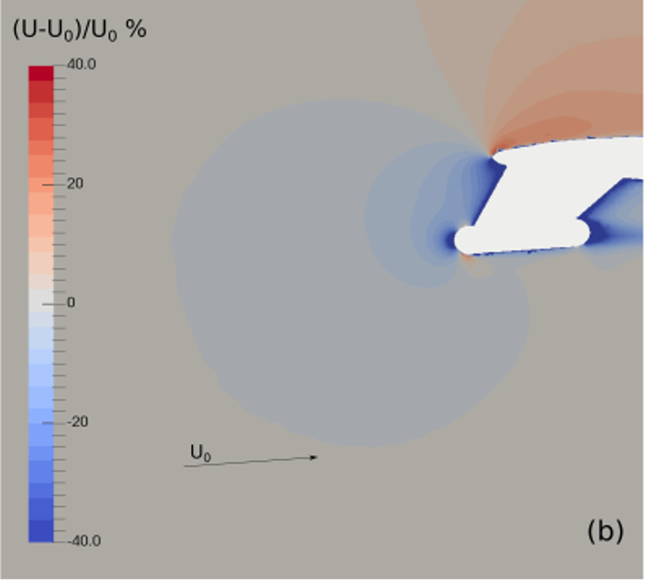
Recent Advancements – DSR Falcon
Bennett et al. (2019) conducted numerical simulations to understand the aerodynamics around their pylon assembly.
Only considered the effect of longitudinal and lateral velocity components on the sizing of hydrometeors within the DMT Cloud Imaging Probe (CIP-100).
Spanu et al. (2020) conducted numerical simulations investigate flow around wing-mounted instruments on board the DSR Dassault Falcon 20E.
Determined the sampling efficiency (i.e. concentration of particles within the sample volume compared to free steam concentrations)
Cloud droplets less than 100 microns in diameter were shown to have a sampling efficiency of 77%
DSR Dassault Falcon 20E
Spanu, A., M. Dollner, J. Gasteiger, T. P. Bui, and B. Weinzierl, 2020: Flow-induced errors in airborne in situ measurements of aerosols and clouds. Atmospheric Meas. Tech., 13, 1963–1987, https://doi.org/10.5194/amt-13-1963-2020.
15

Slide 16
Instrument Placement – NASA P-3
Typically assumed that the sampling locations are approximately freestream.
Freestream: air far upstream of an aerodynamic body, before the body has a chance to deflect, slow down, or compress the air.
Recommended new pylon configuration place instruments as far ahead and beneath the wing as possible.
Should wing-mounted instruments sample ahead or behind of the leading edge of the aircraft wing?
Navy
Extended
Navy - NASA P-3 Original Pylon Configuration
Extended - NASA P-3 New Pylon Configuration
16
Notes:
Navy Pylon Design – Accommodated from the original P-3 ordinance brackets – designed to hold ordinances
Extended Pylon Design – As far ahead and beneath the wing as possible

Slide 17
ORACLES CDP Comparison
Determine CDP placement through comparison of simultaneous observations.
ORACLES-2017:
UND CDP failure due to optical misalignment.
ORACLES-2018:
Brought three separate CDPs to Sao Tome.
Results did not provide evaluation of freestream conditions.
Navy
Extended
Navy - NASA P-3 Original Pylon Configuration
Extended - NASA P-3 New Pylon Configuration
17
Notes:
Needed flow field around our instrumentation to assist our observational datasets

Slide 18
Computational Fluid Dynamics
A computer aided engineering tool designed around the Navier-Stokes equations to accurately model physical phenomena.
Robust solutions with numerous applications:
Stress tests
Aerodynamics
Combustion
Open Source Field Operation and Manipulation (OpenFOAM) package.
18
Notes:
Navier-Stokes equation – exact solutions
Combination of physically known solutions with open source software that allow anyone to run them (with appropriate computers)

Slide 19
Software - OpenFoam
OpenFOAM is open source CFD software owned by the OpenFOAM foundation, distributed under a General Public license and was created in the C++ programming language with an object-oriented coding approach (Jasak et al. 2007).
The open-source nature of OpenFOAM allows for the development of community code and tutorials for researchers starting out with CFD analysis and removes the cost barrier of commercial software fees for many university researchers.
Thank you CFD-Online.com!
Core numerical method used is the finite volume method.
A technique to transform physical properties represented as partial differential equations over a domain into discrete algebraic equations over finite volumes (Moukalled et al. 2016a)
19
Notes:
The open-source nature of OpenFOAM also allows for the processing of simulations on high performance computing resources without the restrictions of commercial licenses.

Slide 20
Procedure Outline
Define all physical parameters that influence what you are modeling.
Domain Discretization
The domain is subdivided into discrete non-overlapping elements that yield a grid or mesh system, which is defined by a set of vertices and bounded by faces.
Structured grids:
Ease in computation of gradients and the flux due to implicit mapping between elements.
Unstructured grids:
Flexibility in type of element used.
20
Notes:
structured meshes there is limited geometric flexibility due to implicit communication between elements (Moukalled et al. 2016c).
unstructured meshes offer increased flexibility in the type of element used, such as polygons with triangular and quadrilateral faces for three-dimensional finite volume mesh.
As shown in Fig. 3c, this unstructured discretization allows for the increased concentration of computational nodes around the simplified building geometry compared to the structured mesh.

Slide 21
Governing Equations
Transform Navier Stokes equations into algebraic equations that can be solved numerically
Numerical solutions to the finite volume method employ an iterative method, which repeatedly solves the discrete system of equations across the domain by:
Initial guess of discrete values of ϕ across the domain at each grid element
At each grid element C, update discrete value utilizing
Iterate across the domain, with updated values of C influencing F
Check if appropriate convergence criterion has been met. Otherwise, repeat.
21
Notes:
These algebraic equations at each node are then assembled into a global matrix, and a direct solution is possible through matrix inversion, though computationally expensive
The convergence criterion is dependent on the physical property ϕ that is modeled, with a typical requirement of a less than one percent maximum change in the grid point values for that iteration.
Very possible a solution is never found; iterates indefinently

Slide 22
What Equations Are We Solving?
ORACLES Environmental Parameters
Incompressible flow
Assumes density of the fluid is constant
Compressible flow
Density requires explicit calculation
Need to know thermodynamics of the flow fluid (i.e. Energy Equation)
When can does the density of the fluid become variable?
~0.3 Mach Number
Subsonic aerodynamic flow
Disturbances propagate both upstream and downstream through domain
Mach Number
2016
2017
2018
Sawtooth
Cloud
Sawtooth
Cloud
Sawtooth
Cloud
22
Notes:
What form of the Navier Stokes equations are we solving? Incompressible or compressible?
Red line = mean; black line = median
Mach Number - Ratio of speed of an object moving through a fluid and the local speed of sound
Spanu et al. (2020) using Benouli’s equation for incompressible flow leads to a 10% overestimation of air speed.

Slide 23
How Are We Defining the Domain?
A simplistic three-dimensional cubic domain is first created with the OpenFoam blockMesh utility
300m x 300m x 300m domain
Three-dimensional computer-aided design (CAD) models of the NASA P-3 pylon configurations, with associated instrument canisters and instruments, were provided by the NASA Wallops Island Flight Facility
the OpenFOAM utility snappyHexMesh is used to conform the volume mesh to the CAD model surface
Computer Aided Design Models
23
Notes:
Utilizing FreeCAD, incorporated these pylons into the CAD model of the NASA P-3 at the outboard port side station

Slide 24
Mesh Geometry
snappyHexMesh chisels the volume mesh to the geometry surface.
A) The edges of the CAD object are first defined with the surfaceFeatureExtract utility.
B) Cell splitting is performed on the edges specified by this utility and then across the surface of the geometry.
C) Removal of volume mesh cells that are contained within the CAD object.
D) ‘Snap’ CAD features into the volume mesh.
Greenshields, C., 2017: OpenFOAM User Guide: CFD Direct, Architects of OpenFOAM. CFD Direct,. https://cfd.direct/openfoam/user-guide/ (Accessed March 16, 2021)
24
Notes:
Only need accurate CAD models and this can be done for other modeling questions – like a mobile mesonet

Slide 25
Simulations Freestream Configuration
Pylon Type | Velocity [m/s] | Temperature [K] | Pressure [mb] | Angle of Attack [°]
Extended | 120 140 | 303 293 | 900 800 | -4, 0, +4 -4, 0, +4
Navy | 120 140 | 303 293 | 900 800 | -4, 0, +4 -4, 0, +4
Simulations of both pylon configurations at multiple initial conditions are performed.
Initial conditions are determined from observational values during ORACLES cloud profiles.
`Sawtooth` profiles are simulated through the altering of angle of attack of the aircraft.
25
Notes:
Freestream Velocity, Temperature, and Pressure determined from mean values during ORACLES cloud profiles.
Did not have an angle of attack probe at the instrument location, took maximum defined in Norment (1984)
~12 Simulations were performed

Slide 26
Navy Pylon
Initialized with 120 ms⁻¹ freestream velocities (white within figure).
1. Deceleration ahead of pylon assembly primarily due to leading edge of wing.
CDP is near freestream
2. Wake extends well behind (and ahead of) the pylon assembly.
Expected for subsonic aerodynamic flow
120 m/s contour
Airflow direction
P-3 Wing
1.
2.
CDP
26
Notes:
Basic Wing Design – Acceleration of airflow above the Wing
Backs up our Initial consideration that freestream conditions are further ahead and beneath the wing

Slide 27
Extended Pylon
Initialized with 120 ms⁻¹ freestream velocities (white within figure).
1. Extent of deceleration ahead of pylon assembly is similar to the Navy Pylon.
Greater departure from freestream conditions at the CDP location than Navy Pylon
2. Tight gradient is associated with larger, longer, and wider Extended Pylon mount.
120 m/s contour
Airflow direction
P-3 Wing
2.
1.
CDP
27
Notes:
It matters how the pylon is manufactured!!

Slide 28
Navy Pylon – Varying Angle of Attack
P-3 Wing
P-3 Wing
Airflow direction
Airflow direction
1.
2.
CDP
CDP
Sawtooth Up
Sawtooth Down
1. Larger Departure from Freestream at the CDP location compared to level flight.
2. Near freestream conditions sampled at the CDP location.
28

Slide 29
Extended Pylon – Varying Angle of Attack
P-3 Wing
P-3 Wing
Airflow direction
Airflow direction
1.
2.
CDP
CDP
Sawtooth Up
Sawtooth Down
1. Velocity departure from freestream ahead of pylon similar to level flight.
2. Extent of airflow deceleration ahead of pylon increased compared to level flight.
29

Slide 30
Navy Pylon – Velocity Ahead of CDP
Subset of 3D velocity field from cells through the CDP sample volume.
Flow deceleration contained to within a meter ahead of the instrument.
1. Spread with flow deceleration due to angle of attack.
2. Downward velocity component at the probe location.
3. Outboard velocity component.
1.
3.
2.
30
Notes:
3 lines per velocity component for the various angle of attacks

Slide 31
Extended Pylon – Velocity Ahead of CDP
Flow deceleration contained to within a meter ahead of the instrument.
‘Two moment’ deceleration within velocity component along flight direction
1. Increased departure from freestream compared to Navy Pylon. Little variation due to sawtooth profiles.
2. Similar downward and outboard velocities between pylons.
1.
2.
31

Slide 32
Velocity within CDP Sample Volume
2.
1.
All twelve simulations shown.
1. Across all angle of attacks, Navy pylon is much closer to freestream conditions than Extended Pylon.
2. Navy pylon is dependent on angle of attack.
3. Departure from freestream conditions is independent of initial configuration.
3.
32

Slide 33
Summary
As expected for subsonic aerodynamic flow, both NASA P-3 Orion pylon configurations result in deceleration of airflow in front of and behind the pylon locations.
Successfully simulated NASA P-3 vertical cloud profiling maneuvers
Known as Sawtooths
The Navy Pylon configuration results in closer to freestream conditions within the CDP sample volume.
However, dependent on the angle of airflow at the instrument location.
The Extended Pylon configuration resulted in larger departure from freestream conditions.
However, independent on the angle of the airflow at the instrument location.
33

Slide 34
Conclusions
Computational Fluid Dynamics software and tools have progressed to the point researchers are capable of conducting this analysis for their own observing platforms.
Need three-dimensional computer aided design (CAD) models
Open source software (access to Docker; OpenFOAM, FreeCAD, PyVista)
Server/Cluster with sufficient memory
Analysis of the airflow around aircraft in-situ microphysical instrumentation should be performed before manufacturing of mounts.
Recommended that in-situ atmospheric instrumentation be placed ahead of the leading edge of the aircraft wing with acknowledgement that significant departure from freestream conditions are to be expected and corrected for within the dataset.
34

Slide 35
Recommendations
As indicated within this study, wing-mounted instrumentation will affect the relative airflow at the sampling location, regardless of the placement ahead or behind the leading edge of the aircraft.
Recommended that in-situ atmospheric instrumentation be placed ahead of the leading edge of the aircraft wing with acknowledgement that significant departure from freestream conditions are to be expected and corrected for within the dataset.
It is also critical to model standard sampling profiles, as the results of this analysis show the placement of instruments can be influenced by these profiles.
It is recommended that every moving observational platform undergo computational fluid dynamic analysis to understand the airflow around any potential mounting position before pylon is manufactured.
It is recommended that the placement of total temperature probes and pitot static probes accompany in-situ instrumentation on the pylon assembly, as these observations will give support to any computational fluid dynamics analysis.
35

Slide 36
Acknowledgments
Thank you to family and friends for support these many years.
Thank you to the dissertation committee for support and resources to explore this topic.
Thank you to Mike and Dave for the opportunity to conduct airborne research onboard the UND Citation II and NASA P-3 Orion.
Thank you to everyone who showed attended a dissertation defense on a late summer Friday afternoon!
36

Slide 37
Extra Slides

Slide 38
CDP Sample Volume

Slide 39
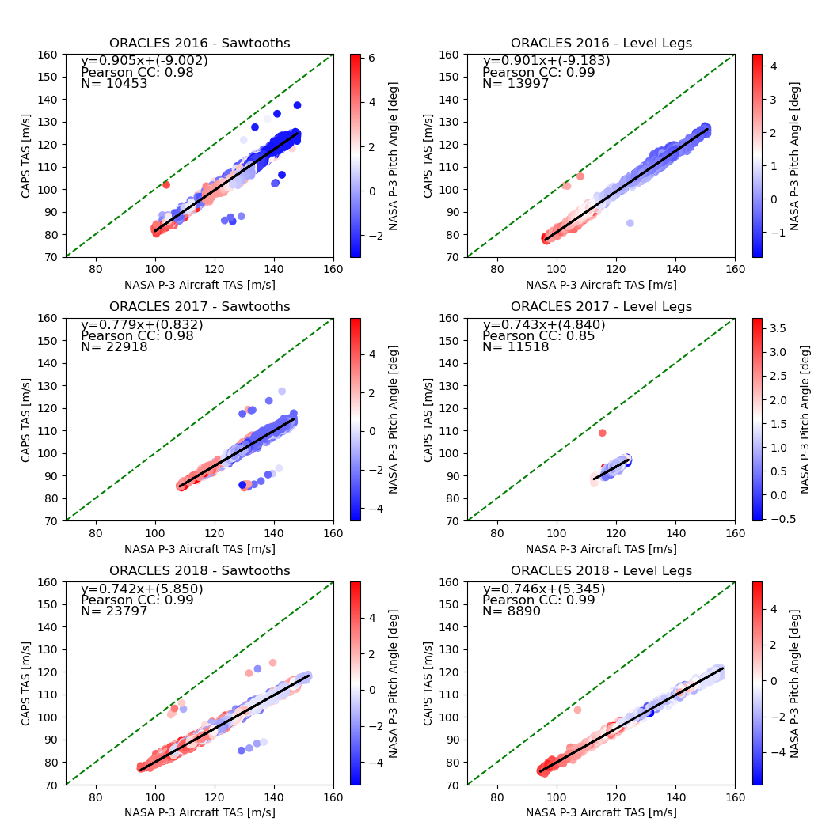

Slide 40
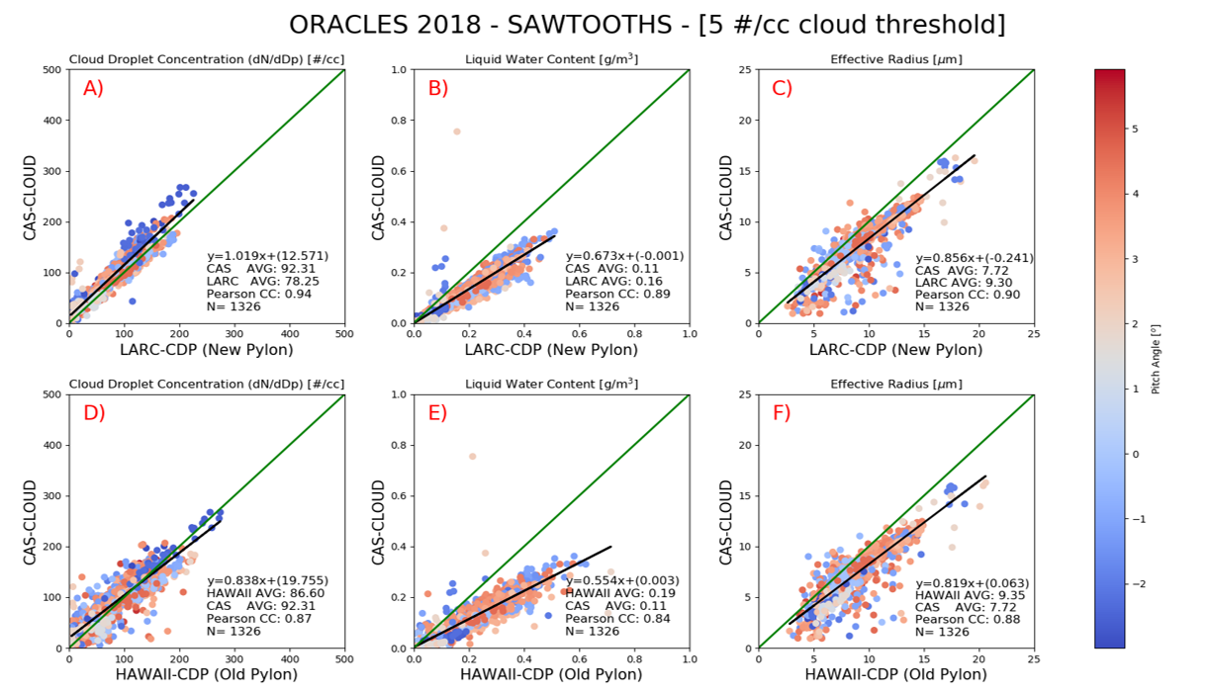

Slide 42
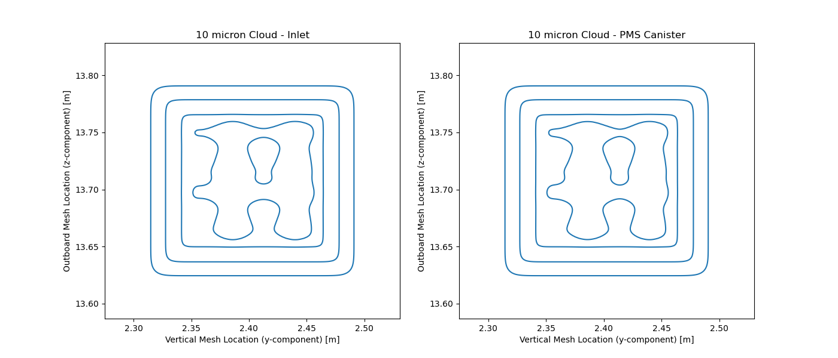
Navy Pylon – Zero Angle of Attack; 120 m/s initialization
50K simulated particles, 100#/cc, 10 microns
90% Sampling Efficiency

Slide 43
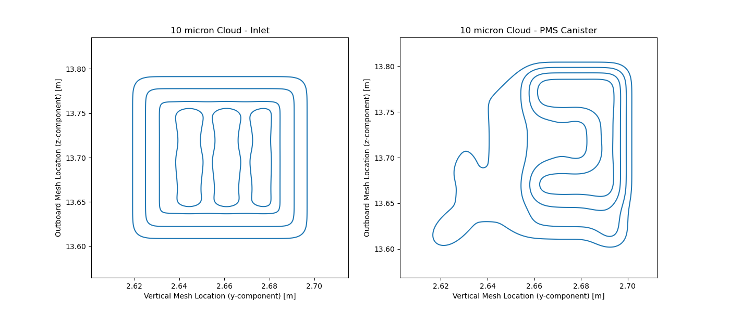
Extended Pylon – Zero Angle of Attack; 120 m/s initialization
50K simulated particles, 100#/cc, 10 microns
~70% Sampling Efficiency

