Slide 1
Visibility Comparison of the Unmanned Aircraft System Deployable MiniOFS to a Present Weather Sensor
Isaiah Nault

Slide 2
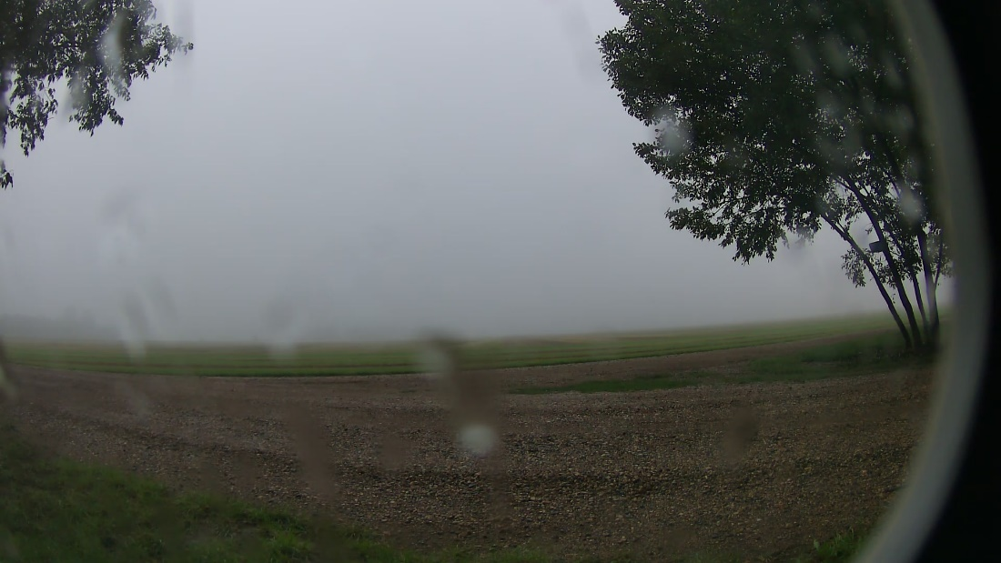
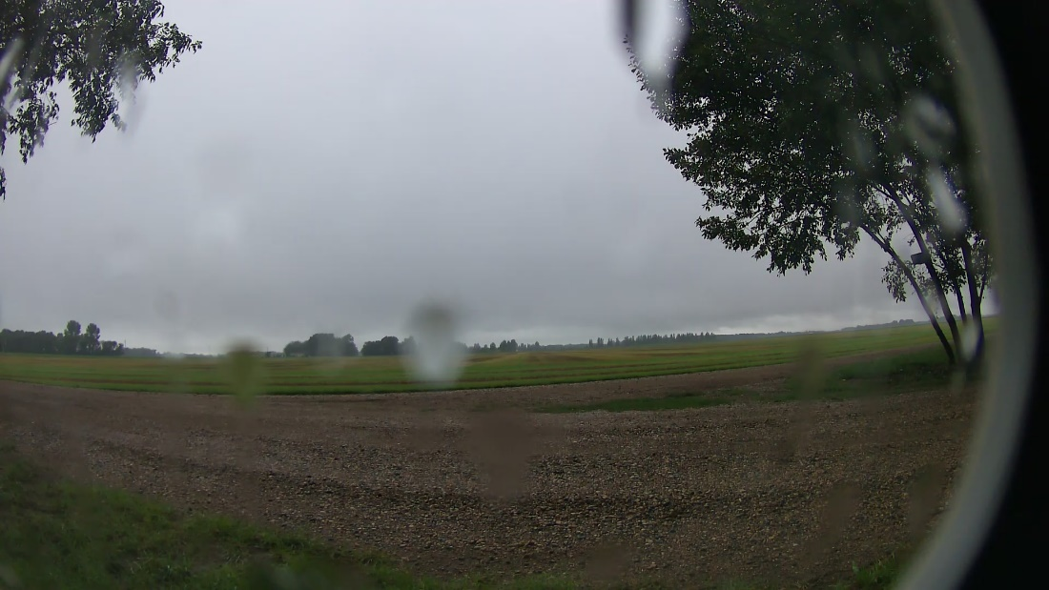
Introduction
Problem: fog is a hazard to aircraft > causes poor visibility
Small aircraft are impacted more due to lower flying patterns (Leung et al, 2020)
Purpose: Compare a UAS deployable sensor to a ground based present weather sensor
Research and data analysis of a fog event in the Grand Forks area
This research will help determine if the Miniofs is reliable for deployment on UAS
UND Mettrailer Deeplens Camera 2: 1435 UTC
UND Mettrailer Deeplens Camera 2: 1505 UTC

Slide 3
Introduction
Fog is commonly formed when moist air is cooled - after rain events - early morning
Visibility threshold causing danger - 800 m (Leung et al. 2020)
October 4th, 2010 - 96 people died in Smolensk, Russia - President of Poland
Improper soundings available at the time led to the crash (Cosmin-Liviu et al. 2021)
UAS can take readings anywhere in the fog
Easily deployable, no human factors, can fly lower

Slide 4
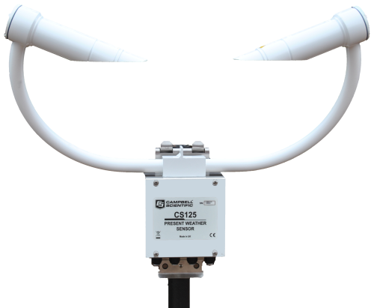
CS-125 Present Weather Sensor
Calculates average every minute & reports
Can identify precipitation type
Uses forward scatter method at 42 degrees
Readings from 0.005 km to 75 km
Weighs 4 kg with mounting plate
(Campbell Scientific, 2013)

Slide 5
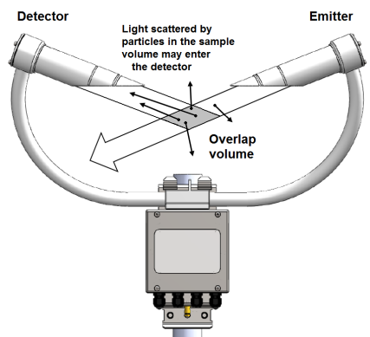
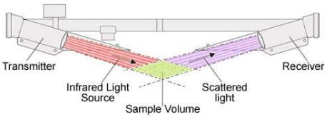
Forward Scatter Method
Forward Scatter Method: light is scattered in a forward direction
Collides with particles scattering light in all directions > peak scatter angle is 42 degrees > more sensitive
The sensor uses a receiver to collect the light
Uses IR with a wavelength of 850 nm
(Azzawi et al. 2016)
(Campbell Science, 2013)

Slide 6
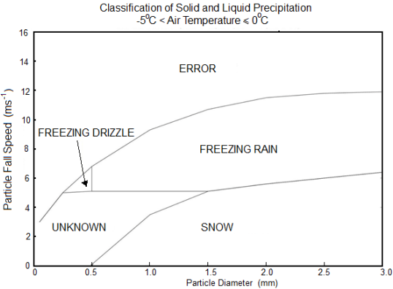
CS-125 Precipitation Detection
Uses algorithms to determine precipitation type
Uses the amplitude of the signal received as a guide to the particle size and speed as it represents the time taken to fall through the scan area
The CS-125 also has a temperature sensor
The figure shows how these outputs are used to determine precipitation type
The UAS deployable sensor does not have this ability

Slide 7
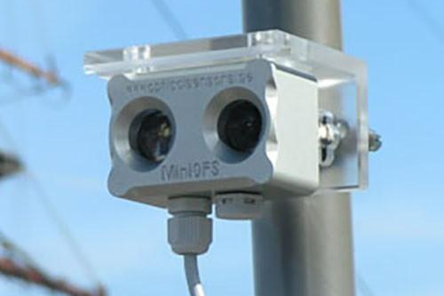
MiniOFS Deployable Sensor
Ideal for use on UAS
- Calculates the average over 30 seconds & reports
Weighs only 0.17 kg
Cheaper
Visibility range of 0.02 km - 4 km
Uses 180-degree back scatter method - 0.25 m ahead of sensor
(Optical Sensors, 2013)

Slide 8
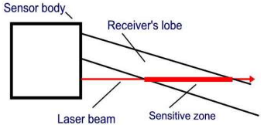
Backscatter Method
Back scatter method: light is scattered in the backward direction and received by a sensor
Uses a 3 mW IR led with a wavelength of 850 nm
Much more compact
Severely underestimate visibility in snow > false scattering
Less light is scattered at 180 degrees than 42 > not as sensitive
(Azzawi et al. 2016)

Slide 9
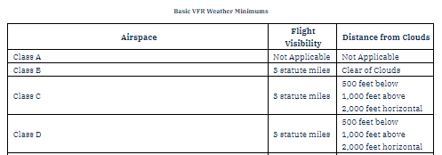
Flight Rating Requirements
Grand Forks International Airport is a Class D airspace
(FAA, 2022)

Slide 10
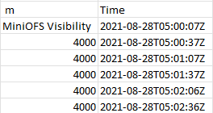
Methodology
Radiation fog event - 28 August 2021 0.2 km visibility
Data was downloaded from CHORDS-UND database

Slide 11
Methodology
Mean, and standard deviation was calculated from different periods in the event to compare the MiniOFS to the CS-125
- Periods include the start of low visibility period, Lowest visibility period, and the spike in visibility period
Mean used to determine agreeance over a given period
Standard deviation to determine variance

Slide 12
Methodology
$$V=\left((x_{1}\right)∗(\frac{y}{60}))+(\left(x_{2}\right)∗(\frac{60−y}{60}))$$
V: Average visibility over a one-minute period
X₁: Visibility reading at the beginning of a one-minute period
Y: Number of seconds past the minute that the first visibility reading was taken
X₂: Second visibility reading at the end of the one-minute period

Slide 13
Methodology
Iterated Value From the Population
Population Average
$$σ= \sqrt{\frac{{\sum{\left|x_{i}− x_{avg}\right|}}^{2}}{n}}$$
Standard Deviation
Number of Data Points

Slide 14
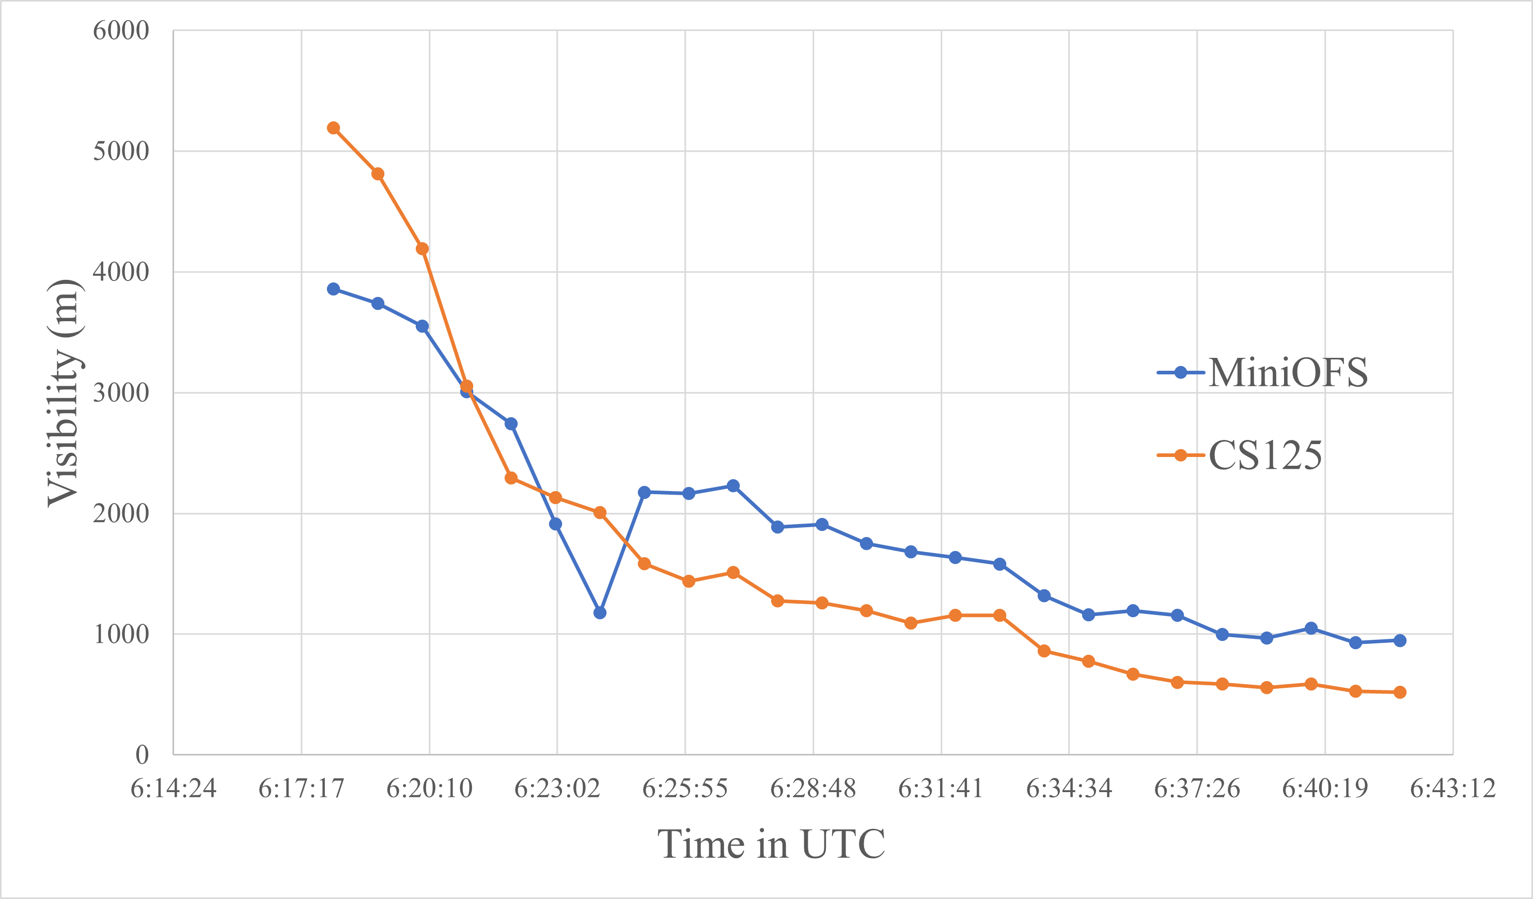
Start of Low Visibility
MiniOFS: 1957 +/- 1017
CS-125: 2132 +/- 1778
Mean Difference: 175 m MiniOFS under CS-125 by 8.2%​

Slide 15
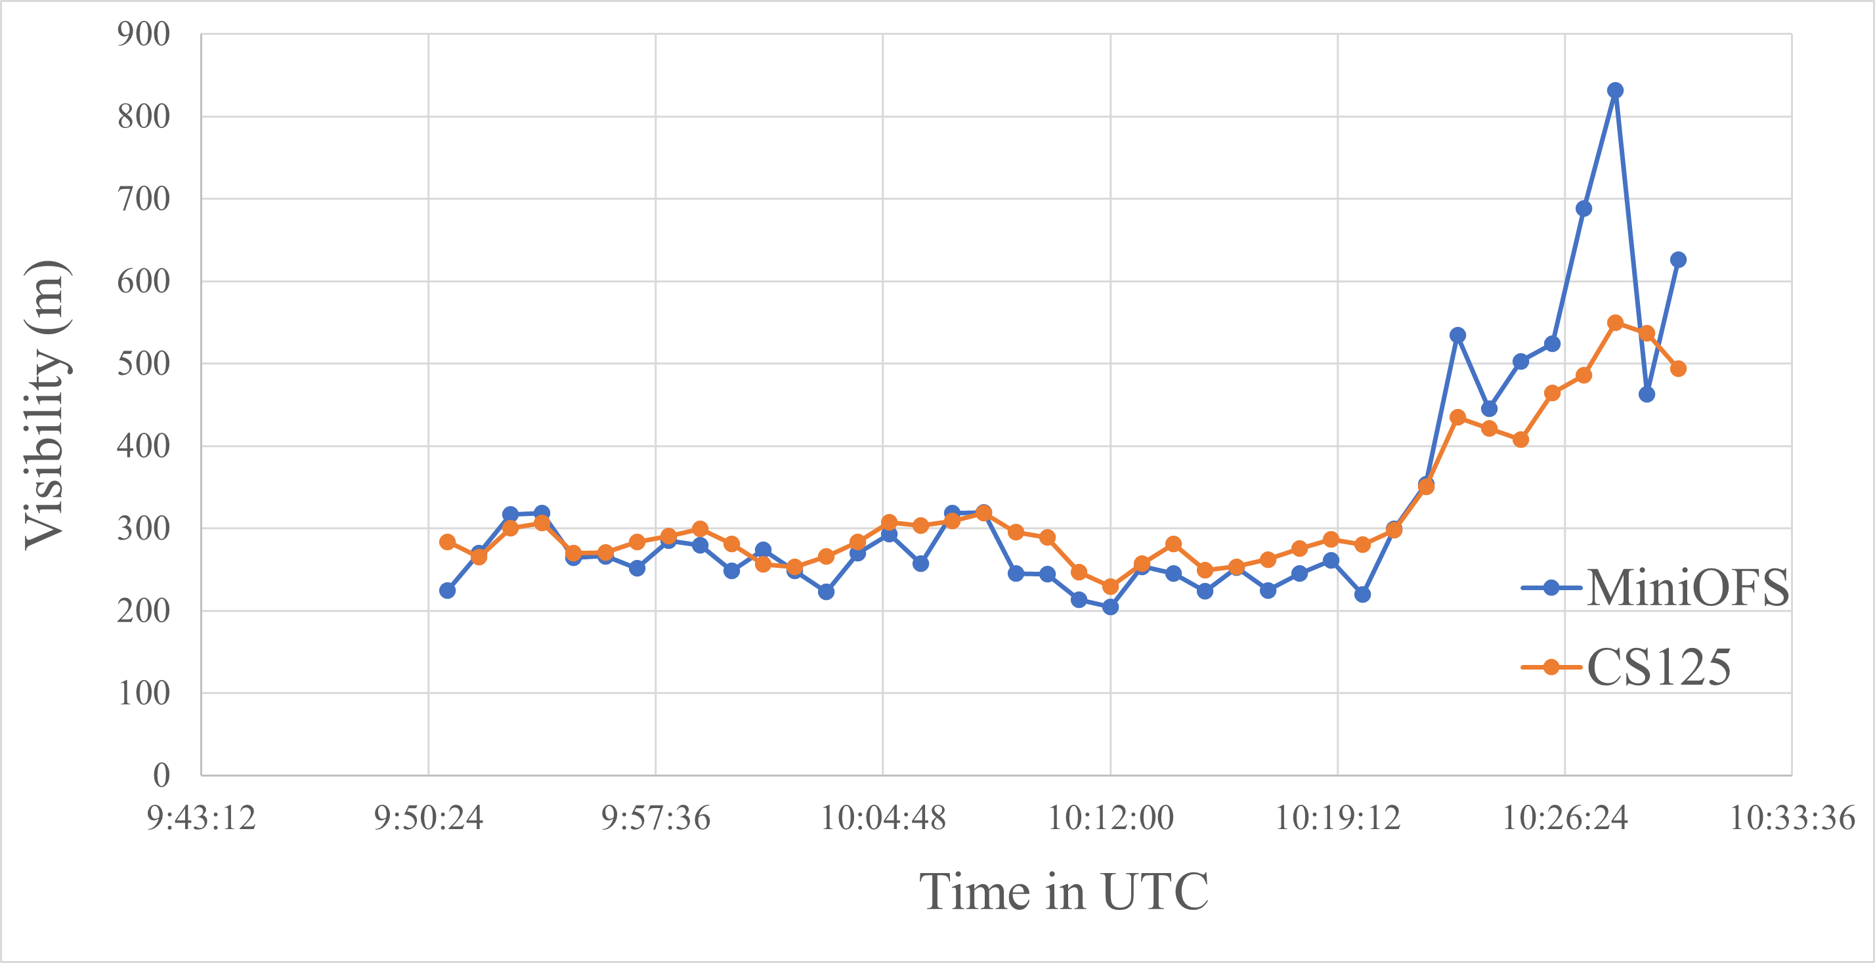
Lowest Visibility
MiniOFS: 290 +/- 87
CS-125: 300 +/- 59
Mean Difference: 10 m MiniOFS under CS-125 by 3.3%​

Slide 16
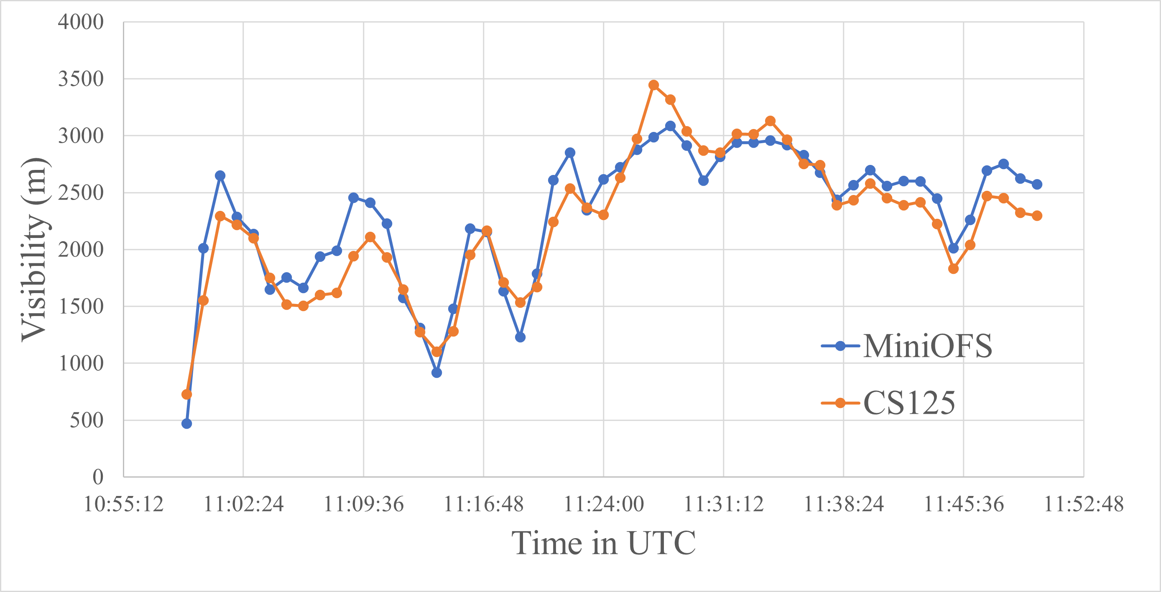
Spike in Visibility
MiniOFS: 2282 +/- 636
CS-125: 2185 +/- 663
Mean Difference: 97 m MiniOFS over CS-125 by 4.3%

Slide 17
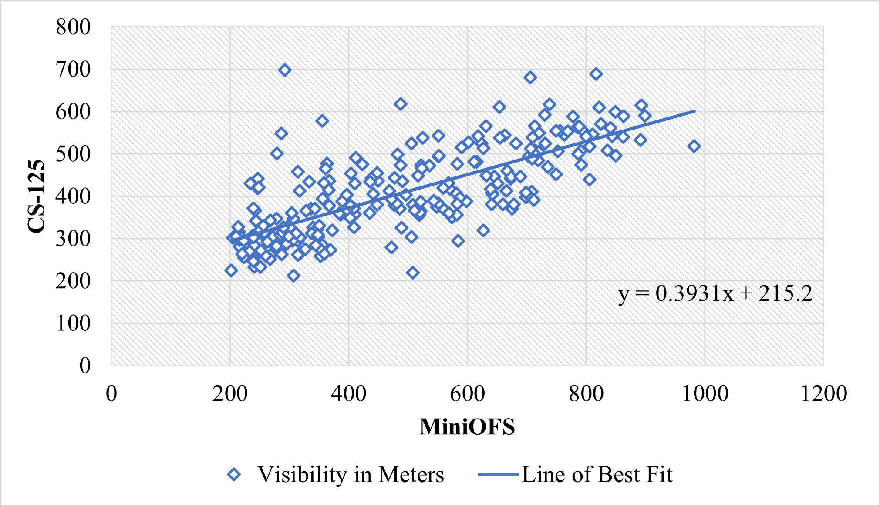
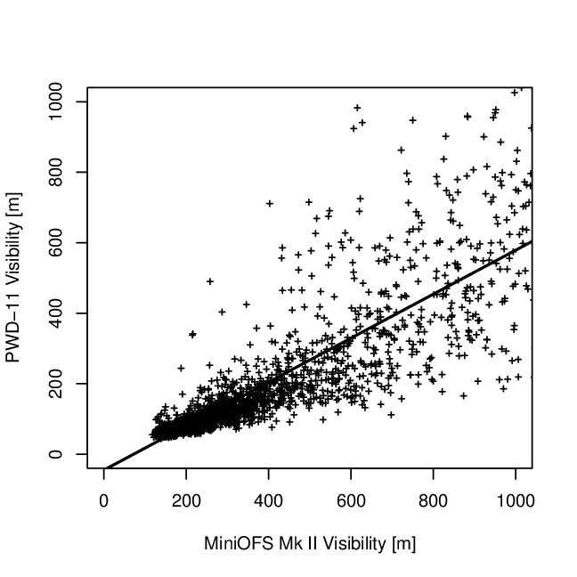
Study Comparison
248 datapoints from 0649 UTC - 1056 UTC
MiniOFS is known to overestimate visibilities under 1km in comparison to the Vaisala PWD-11 sensor (Michna et al. 2007)
This study showed a better result in comparison > different sensors > calibration
(Michna et al. 2007)

Slide 18
Conclusion
MiniOFS did not overestimate greatly under 1km in comparison to the CS-125 > better result than with the PWD-11 sensor used for the Michna et al. study
Areas of consideration for the MiniOFS:
More scattered readings while visibility is rapidly changing
Records only up to 4 km visibility > VFR/IFR covered
Lightweight, small, and affordable > ideal for FAA regulations

Slide 19
Conclusion
Over 513 data points from 0618 UTC - 1459 UTC
MiniOFS overestimated by 74 m on average which is a 9.9% increase compared to the CS-125 mean of 751 m
This error is relatively small if in use for low visibility purposes
Use of the MiniOFS can build the foundation for better atmospheric picture

Slide 20
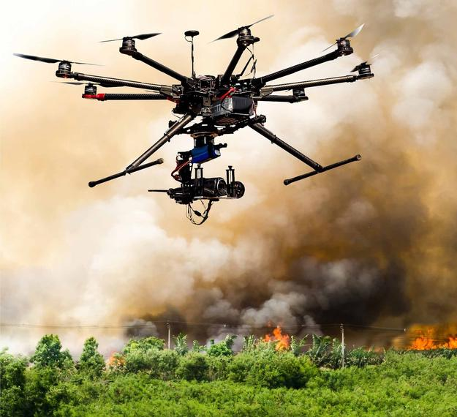
Conclusion
Additional Research:
Accuracy of the MiniOFS while deployed on UAS due to rotor wake
Comparison of MiniOFS & CS-125 under different visibility restricting events such as smoke, and haze
Accuracy of MiniOFS after calibrating the MiniOFS and one other sensor > Michna et al. did not mention a calibration

Slide 21
References
Available per request

