Slide 1
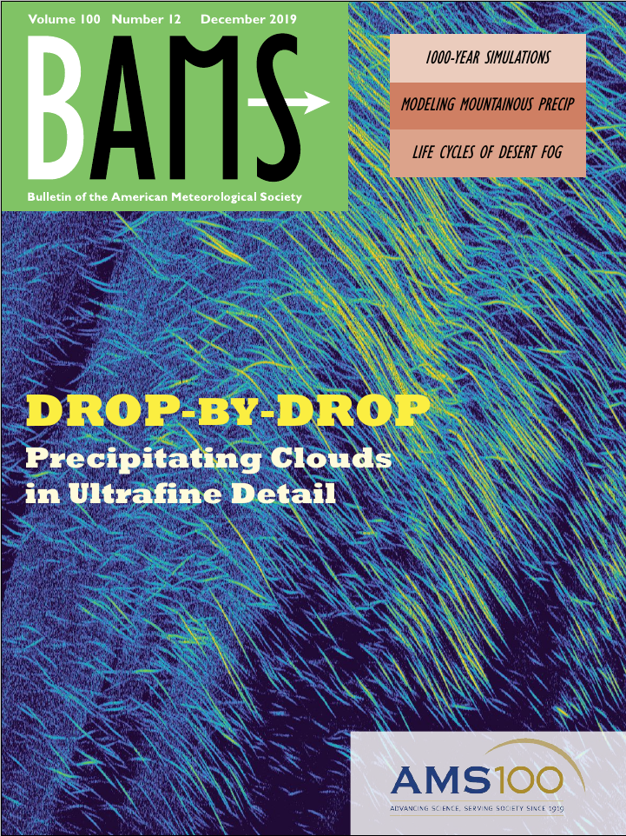
Cape Experiment 2019 (CapeEx19) / CAPE 2015
Team
Objectives
Naval Research Laboratory (NRL)
Jerome Schmidt
University of North Dakota (UND)
Weather Modification International
Pat Sweeney
University of Alabama Huntsville
Hugh Christian
The Navy’s interests is in
evaluating the CPR-HD Radar.
development and validation of cirrus cloud model.
The scientific interests is in
observations of cloud and electric fields for new discovery.
Funding
Outcomes
Naval Surface Warfare Center
Dhlgren Division
Mark Anderson
Joshua Hoover
7 Funded Projects, plus Extensions
$1,519,745.10 Total
$974,135.10 UND
Many students involved with the field projects and research activities.
3 Students Master Thesis
3 UND First Author Papers
1 Published, 1 Accepted, 1 Under Review
1 Follow on UND Funded Proposal
Notes:
For the 12/18/2024 NSI Networking Event:
1) Please use this template if you choose to use a slide to present your project.
2) Space is available in the middle of this slide in case you would like to include figures/images.
3) Since the amount of time available for each project is small (2-3 minutes), please keep a presentation for any single project to 1 slide.
4) Please direct questions to Gabriela Tovia (veronica.toviah@und.edu) or Mark Askelson (mark.askelson@und.edu).

