Slide 1

Observations of Chain Aggregates in Florida Cirrus Cloud Anvils on 3 August 2019 during CapeEx19
Christian Nairy
Master’s Thesis Defense
University of North Dakota
14 July 2022
Committee Members:
Dr. David Delene*, UND
Prof. Michael Poellot, UND
Dr. Jerome Schmidt, NRL-MRY
Dr. Paul Harasti, NRL-MRY
* - Committee Chair

Slide 2
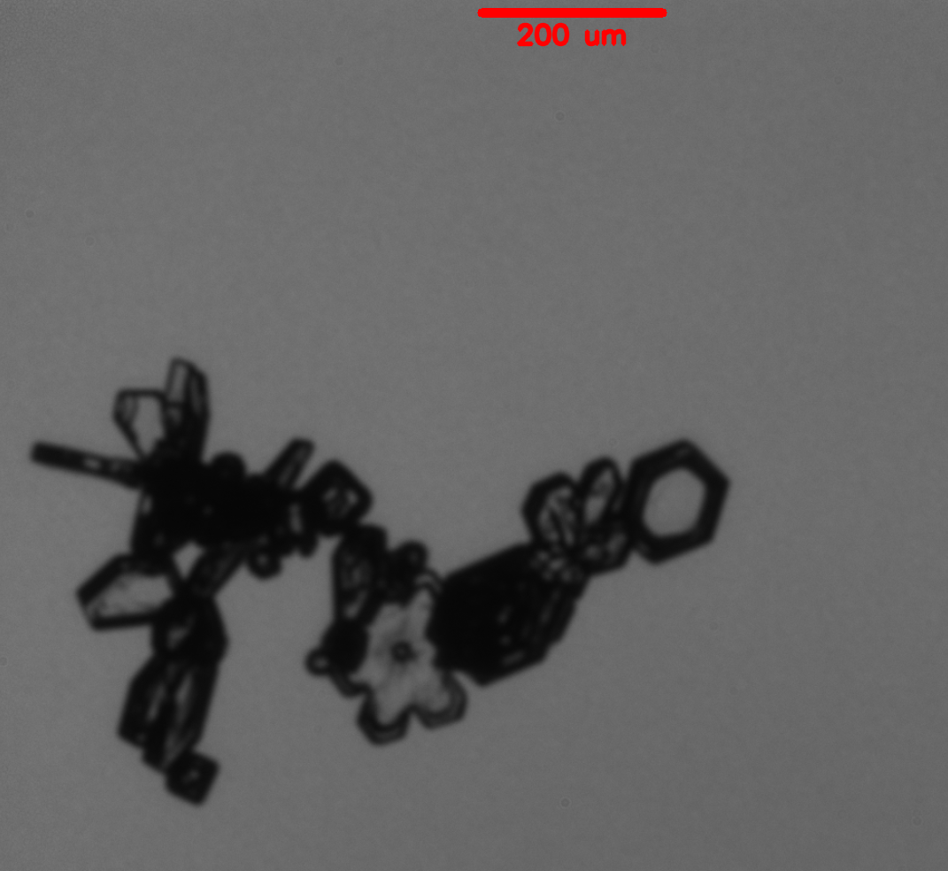
Objective
Is chain aggregation occurring in the cirrus cloud anvil region of Florida thunderstorms on 3 August 2019?
PHIPS image of a chain aggregate

Slide 3
Motivation for Research
The chain aggregation process is still not well understood.
  ⎼ Where/How?
  ⎼ Inconsistencies between cloud chamber experiments and aircraft observations.
  ⎼ Lack of representation in atmospheric cloud models.
Cirrus Clouds are Important.
Influence on radiative transfer properties of cirrus clouds (Liou 1973; Stephens et al. 1990; Baran 2009).
Notes:
Inconsistencies: Cloud chamber experiments have different environmental parameters than where the chain aggregates are observed in the real atmosphere.
Cirrus clouds have global and regions climatological influences
To accurately measure their impacts on the climate, we must figure out and analyze the particle types found in these clouds. This is because it is known that cirrus cloud radiative impacts are based on many different parameters, but more importantly the particle sizes found in the cirrus, and their asymmetry factor.
The relative change in asymmetry factor is about 5% when going from the initial monomer to the three- and six-component hexagonal column aggregate. This decrease in asymmetry factor would imply an instantaneous local flux shortwave error of about 15 W m⁻² and the difference in reflected incident solar radiation could be as much as 20%.

Slide 4
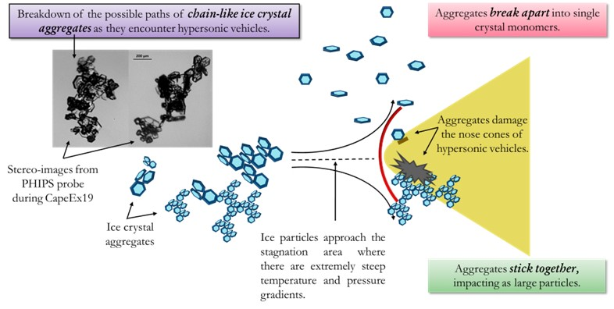
Motivation for Research
Chain aggregates may alter supersonic projectile trajectories (Lin and Thyson 1977; Meng and Ludema 1995; Barnes Jr. 1982).
Image obtained courtesy of Hallie Chelmo from the University of North Dakota’s Mechanical Engineering Department.
Notes:
Since cirrus clouds cover large areas, there is a higher possibility of projectiles intersecting these clouds
Dynamical models show that relatively large (with more mass than small) ice particles can pass through the bow-shock layer and impact nose cones.
As a quick assessment to see how impactful chain aggregates might be to a hypersonic vehicle nose cone we can assume a circular intercontinental ballistic missile (ICBM) nose cone has a diameter of 3 m and an area of approximately 7 m² and traverses through a 5 km thick cirrus cloud; where in the region where the ICBM transverses through contains 10,000 chain aggregates per m³. This gives an estimate of 350,000,000 possible impacts with chain aggregates.

Slide 5
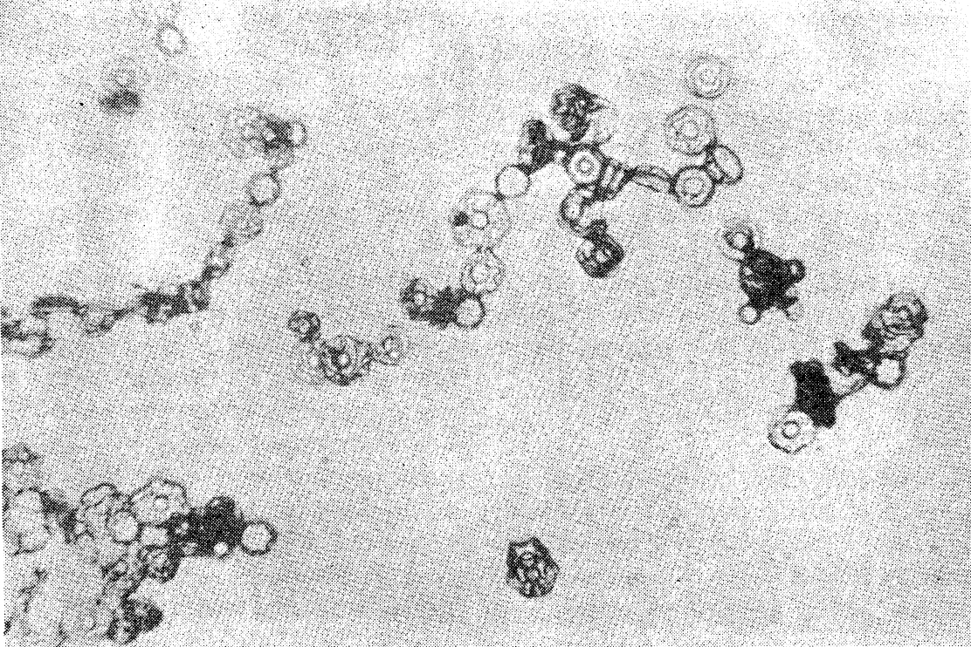
Cloud Chamber Experiments
Several cloud chamber experiments have investigated the chain aggregation process.
Chain Aggregates Where Generated:
⎼ In high Electric Fields (Minimum Threshold: 60 kV m⁻¹)
⎼ In Temperatures Between -5 and -37 °C
⎼ Ice Crystal Concentrations Between 3 and 4 ✕ 10⁶ m⁻³
⎼ Ice Crystals Sizes Between 30 to 50 μm
Aggregation increases 30% in electric fields (10² kV m⁻¹) at T = -8 °C (Maximum effect).
Aggregation found to be temperature dependent with electric fields.
Adapted from Saunders and Wahab, 1975.
Notes:
Main take-away: minimum threshold for chain aggregation was 60 kV/m
Maximum effect at -8 C with really high electric fields.

Slide 6
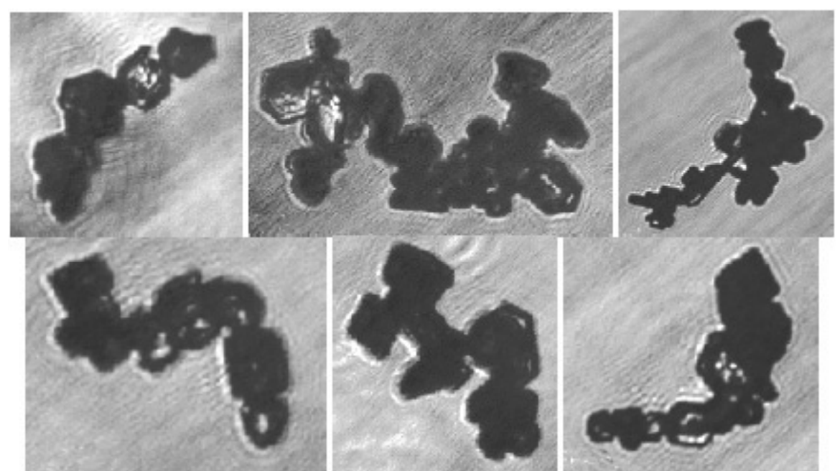
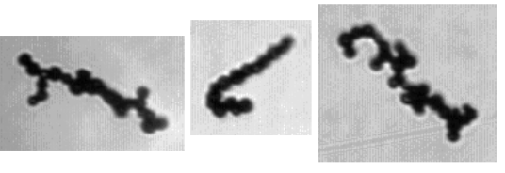
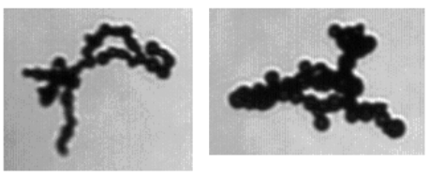
Previous Aircraft Observations
Chain Aggregates of Pristine Ice Crystals Observed
  Continental convection (with some maritime influence) in the tropics and sub-tropics.
  -25 to -65 °C
Chain Aggregates of Frozen Droplets Observed
  Continental Convection in the Midlatitudes.
  -13 to -60 °C
Chain aggregates observed near updraft region of a Florida thunderstorm
  -8 °C
  Some Riming Present
Chain aggregates comprised of ice crystals imaged during the EMERALD-II experiment. Adapted from Connolly et al. 2005.
Chain aggregates comprised of frozen droplets observed in mid-latitude cirrus anvil clouds. Adapted from Stith et al. 2014.
Notes:
Main take-away: chains found in many different regions around the globe in mid-to-upper levels of convection. Mainly in the cirrus cloud anvil region

Slide 7
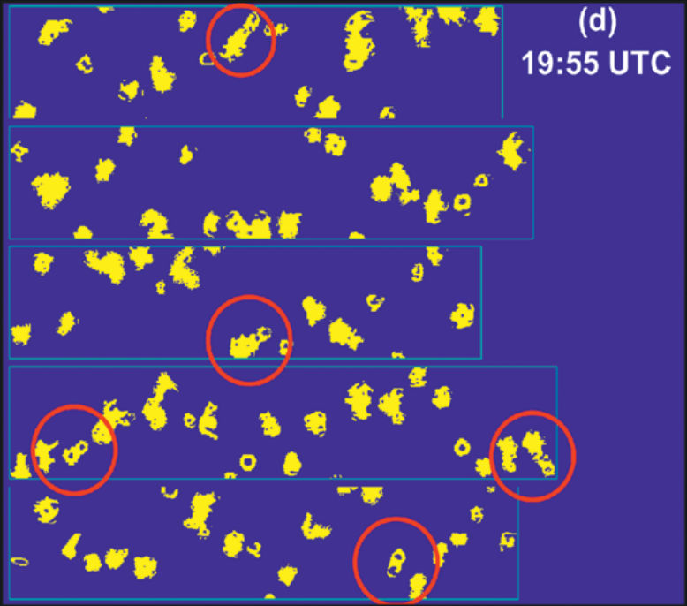
CAPE Experiment 2015 (CAPE2015)
Performed near Cape Canaveral, Florida, from 28 July to 11 August 2015.
Airborne sampling of Florida convection-induced, cirrus anvils.
Chain-like Aggregates Observed.
Chains appear to have plate-like elements.
  Altitudes ~11 km and Temperatures of ~ -43 °C.
Poor Resolution and Image Quality of the 2D-S
  Difficult visualizing each chain aggregate element and discerning the exact crystal habits.
Adapted from Schmidt et al. 2019.
Notes:
2D-S images of chain aggregates (red circle) while sampling through cirrus anvil clouds. Each panel represents less than one second in time and has a vertical width of 1,280 μm.
This experiment provided motivation to investigate the presence of chain aggregates even further!

Slide 8
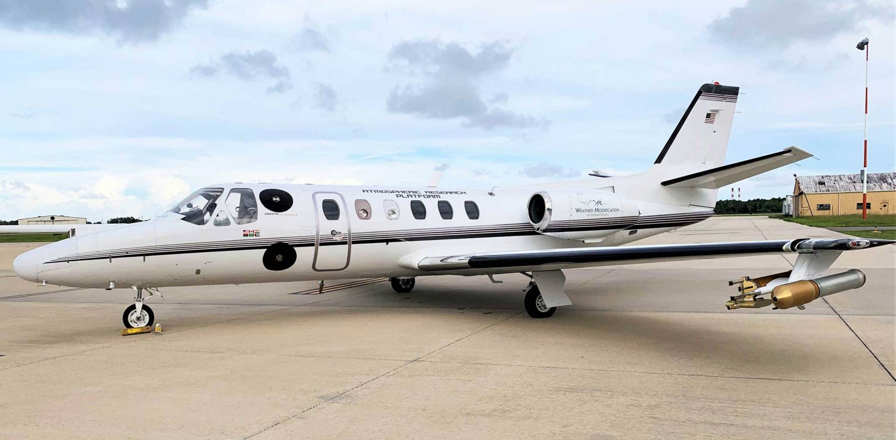
CAPE Experiment 2019 (CapeEx19)
Sampled convection-induced, cirrus cloud anvils
Concurrent measurements between in-situ (aircraft) and remote-sensed platforms (radar).
Goals:
  Investigate the presence of chain aggregates/chain aggregation
  Improve radar interpretation
  Improve cirrus cloud modeling
Near Cape Canaveral, Florida, from 22 July to 3 August 2019
The North Dakota Citation II Research Aircraft at the Space Coast Regional Airport in Titusville, Florida.

Slide 9
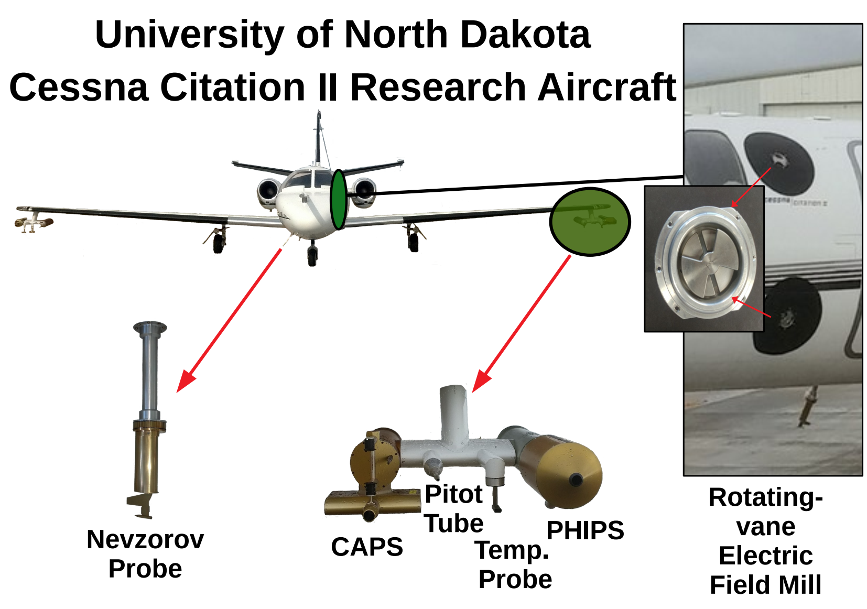
Instrumentation
Notes:
CAPS – Cloud, Aerosol, and Precipitation Spectrometer – contains the CIP, CAS (Cloud and Aerosol Spectrometer), and the Hotwire Liquid Water content sensor
All six of the electric field mills are positioned on fuselage ports around the perimeter of the aircraft. Four of the electric field mills are positioned around the body of the aircraft adjacent to the doors/entrances and cockpit windows, while the remaining two electric field mills are positioned on the tail of the aircraft.

Slide 10
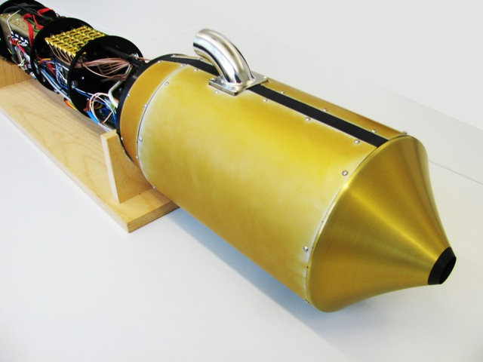
Particle Habit Imaging and Polar Scattering (PHIPS) Probe
Provide clarity into the link between the microphysical characteristics of individual ice particles and their respected angular light scattering function (Schnaiter et al. 2018).
Hybrid between the airborne polar nephelometer (PN) and the Cloud Particle Imager (CPI) probe.
High definition, stereographic images of the same cloud particle
  two viewing angles separated by an angular distance of 120 °
Optical magnifications from low (1.4 ×) to high (9.0 ×) with an optical resolution range from 7.2 to 2.35 μm, respectively.
Image of the PHIPS (KIT 2022).
Notes:
Intro: developed by researchers at the Karlsruhe Institute of technology (KIT)
Bullet 2: Polar nephelometer measures the light scattering function; CPI is the imaging
Bullet 3: two camera-telescope assemblies (CTAs) and a pulsing illumination laser.
At 4 × magnification, particle sizes can range from 3 μm to 1.5 mm.
Maximum sampling rate of the PHIPS is 20 Hz – don’t include
Citation: https://www.imk-aaf.kit.edu/55.php

Slide 11
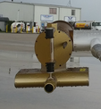
Cloud Imaging Probe (CIP)
One of the instruments associated with the Cloud, Aerosol, and Precipitation Spectrometer (CAPS).
Provides shadow images of cloud particles.
Particle size range of 12.5 μm – 1.55 mm (resolution of 25 μm) with a sample area of 10 cm x 1.55 mm.
Processing of particle data obtained by the CIP performed using the System for Optical Array Probe Data Analysis Version 2 (SODA2) software package (Bansemer 2013).
CIP
Image of the CAPS probe.
Notes:
Much faster sampling rate than the PHIPS
Probe is much better at obtaining particle concentration data as compared to the PHIPS.

Slide 12
Rotating-vane Electric Field Mills
Total of 6 electric field mills on the aircraft.
  Provided by the University of Alabama in Huntsville (UAH)
The electric field values are calculated as a result of the time-varying charge induced on the sensing plates by the ambient electric field (Bateman et al. 2007).
The reference coordinate system:
⎼ x-axis (E_{x}) along the fuselage of the aircraft (roll axis), where E_{x} is positive in the direction of flight
⎼ y-axis (E_{y}) being along the wings of the aircraft (pitch axis), where E_{y} is positive out the left wing (port)
⎼ z-axis (E_{z}) being perpendicular to the fuselage and the wings of the aircraft, where during level flight, E_{z} is positive up.
Image of port side electric field mills.
Notes:
While in operation, the open gaps of the rotating shield electrode periodically expose the sensing plates to the electric field outside of the aircraft. The electric field values are then calculated as a result of the time-varying charge induced on the sensing plates by the ambient electric field.
The amount and positioning of the field mills allows for calculation of Ex, Ey, and Ez.

Slide 13
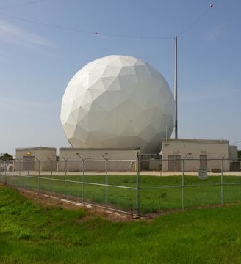
Remote-sensed Platforms and Datasets
Melbourne, Florida National Weather Service (NWS) Next-Generation Radar (NEXRAD) WSR-88D (KMLB)
Cloud and Precipitation Radar with Discrete Hydrometeor Detection (CPR-HD)
National Lightning Detection Network (NLDN)
Kennedy Space Center’s (KSC) Lightning Mapping Array (LMA)
Image of the CRP-HD at the KSC
Notes:
KMLB is S-band
CPR-HD is C-band dual-pol doppler radar with real-time Aircraft tracking capabilities. Maximum resolution of 37 meters in the narrowband
LMA: The system detects the various segments of the lightning channel as it develops, revealing the evolution of the lightning structure during discharge. In general, the LMA provides additional information into storm morphology and electrical charge structure.

Slide 14
Methods
Case Study for the 3 August 2019 Flight Day
Classify Chain Aggregates
Analyze the distribution of chain aggregates in the cirrus anvil
Chain Aggregate Concentrations
  Calculate a relative chain aggregate concentrations
Electric Field Analysis
Put the in-situ microphysical and electrical observations into context by using the remote-sensed datasets.

Slide 15
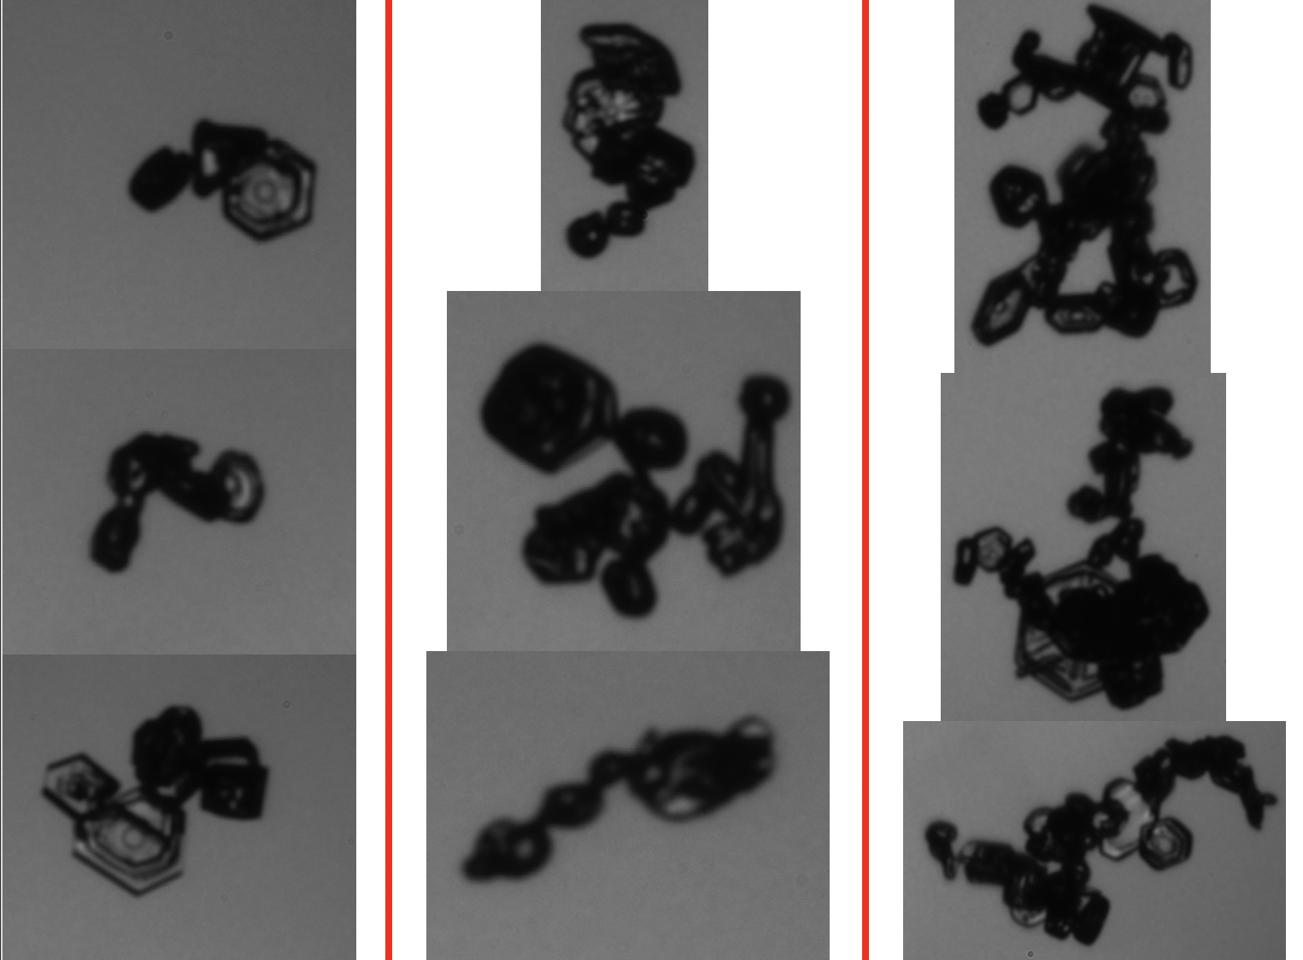
Chain Aggregate Definition
Chain Aggregates are defined by:
Three or more discernable particles oriented in a quasi-linear fashion.
Particles joined together by small joints.
Links of particles that are unusually elongated.
Confidence is determined by the classifier:
Low confidence (1): One of the three definitions observed.
Moderate confidence (2): Two of the three definitions observed.
High confidence (3): All three definitions observed.
(NOT TO SCALE)
Confidence of 1
Confidence of 2
Confidence of 3
Notes:
Classified thousands of particle images taken by the PHIPS.
Large meaning it takes up a significant portion of the PHIPS FOV
Important to note that the manual classification is subjective and has subjective confidence levels; however, high confidence levels should provide less subjective differences

Slide 16
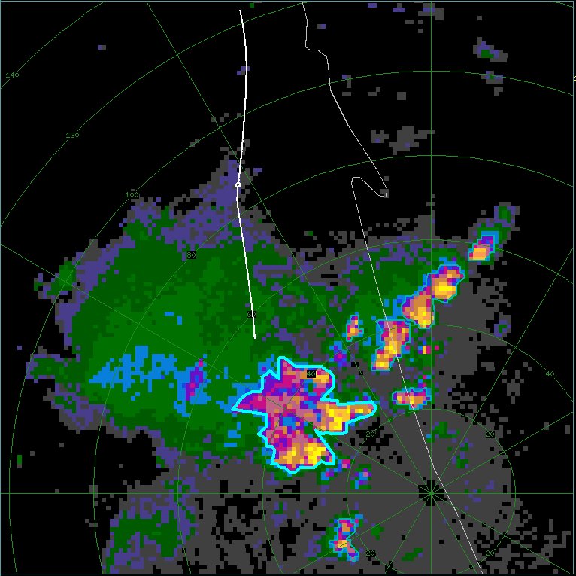
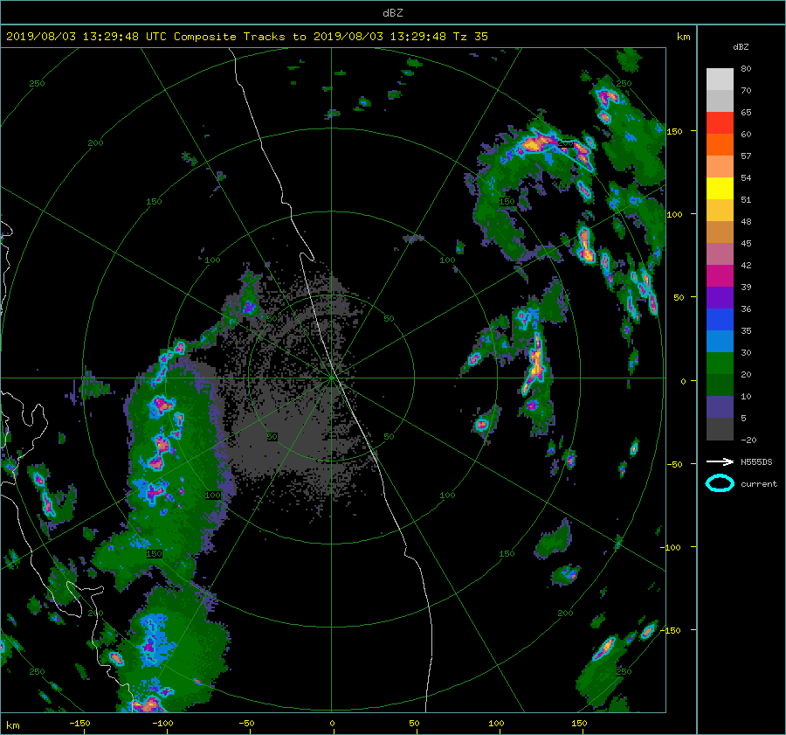
LROSE-TITAN
KMLB: 15:56:16 UTC
Lidar Radar Open Software Environment software package (LROSE) Thunderstorm Identification Tracking And Nowcasting (TITAN)
A 35 dBZ threshold is used to identify and track individual thunderstorms.
Latitude and Longitude coordinates of the reflectivity centroid is computed by TITAN.
Composite radar reflectivity (dBZ) from the KMLB radar with TITAN cell tracking (blue outline).
Notes:
developed by the Earth Observing Laboratory at the National Center for Atmospheric Research (NCAR/EOL) and Colorado State University is utilized (LROSE 2021)
Must mention the bold blue outlines the storm of interest, otherwise known as the TITAN CELL.
Calculation of aircraft distance from storm core (DFC) is then computed per radar scan.
⎼ Using the Haversine distance formula

Slide 17
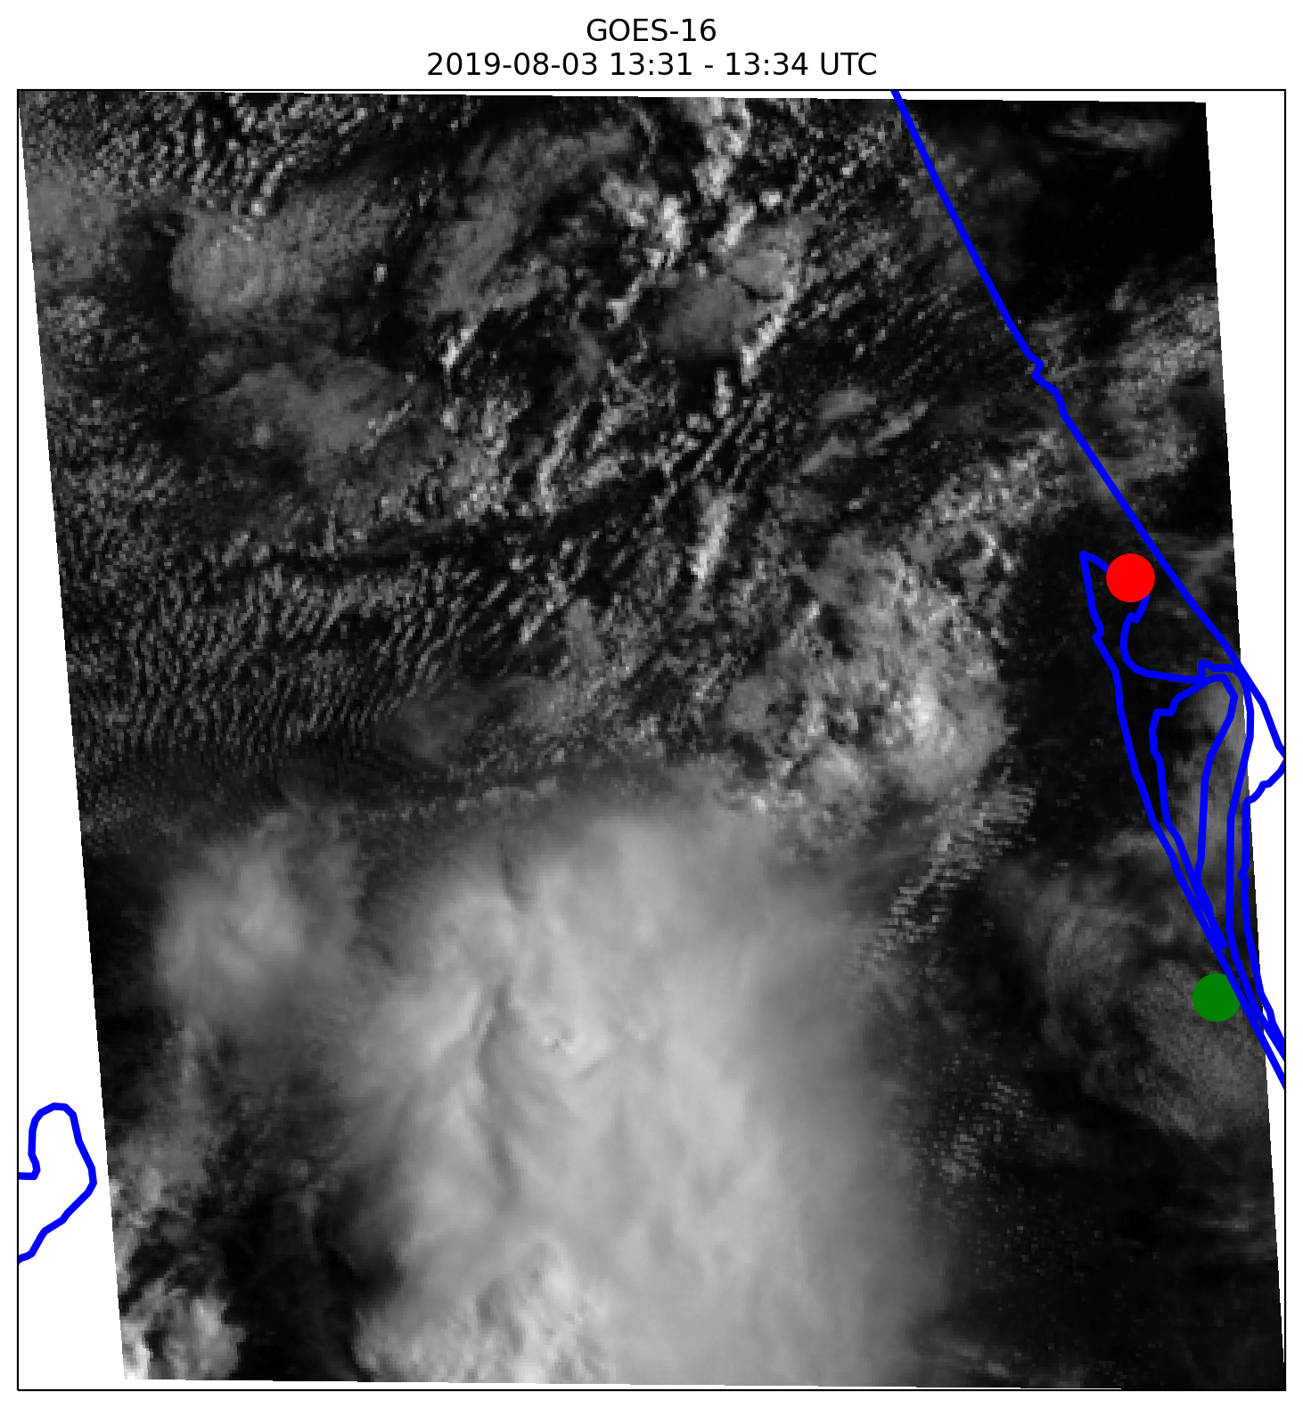
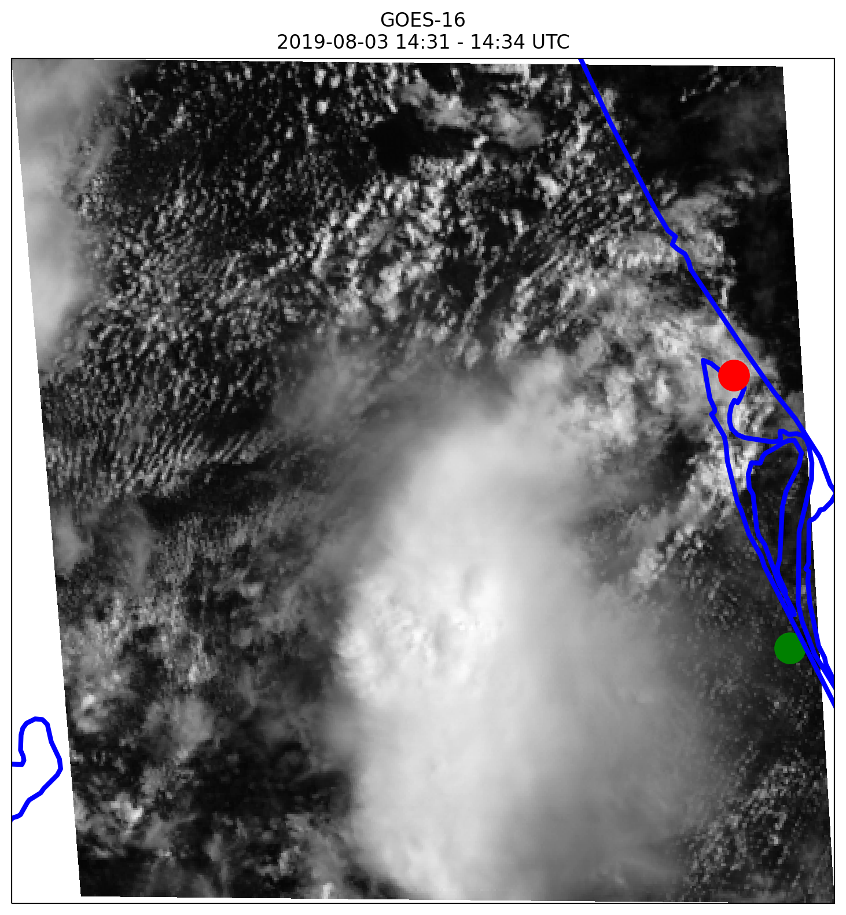
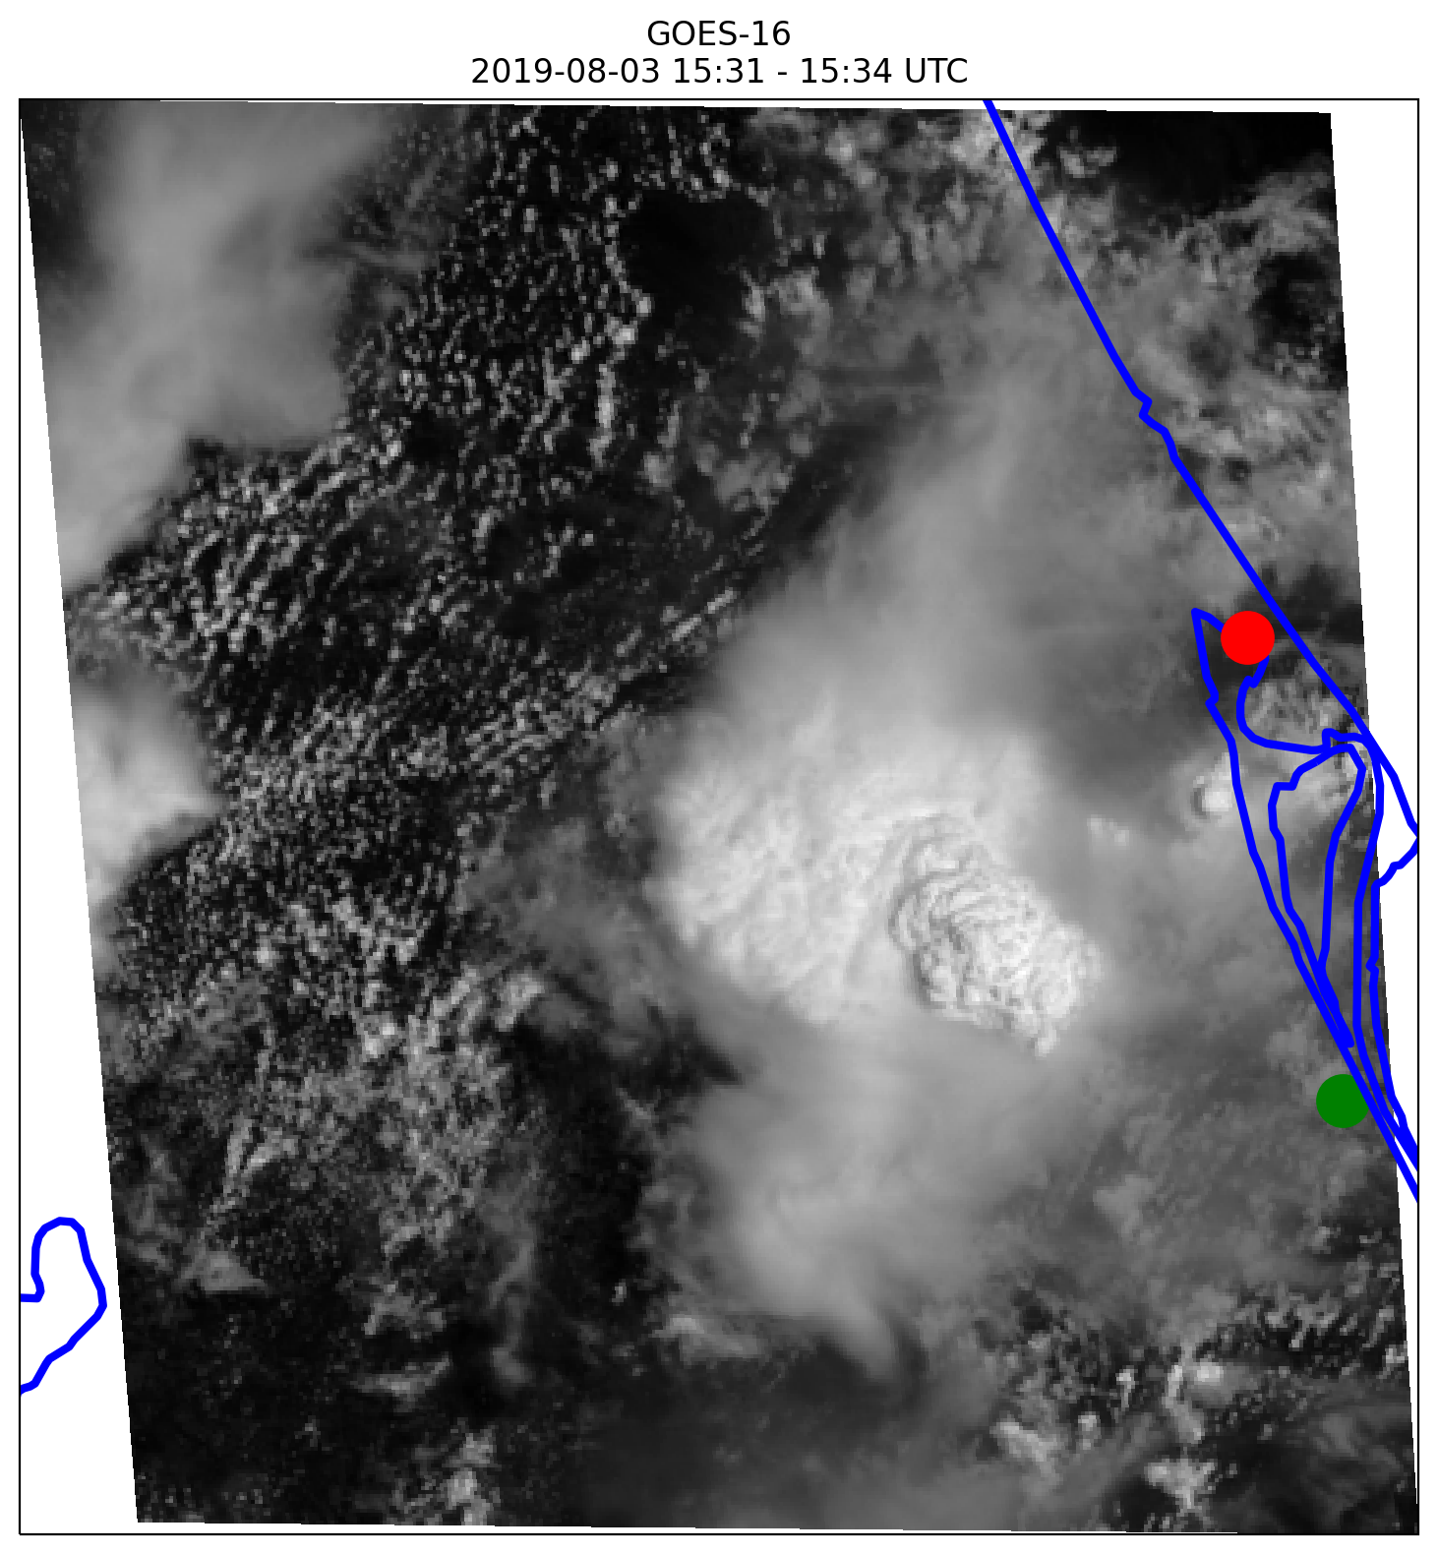
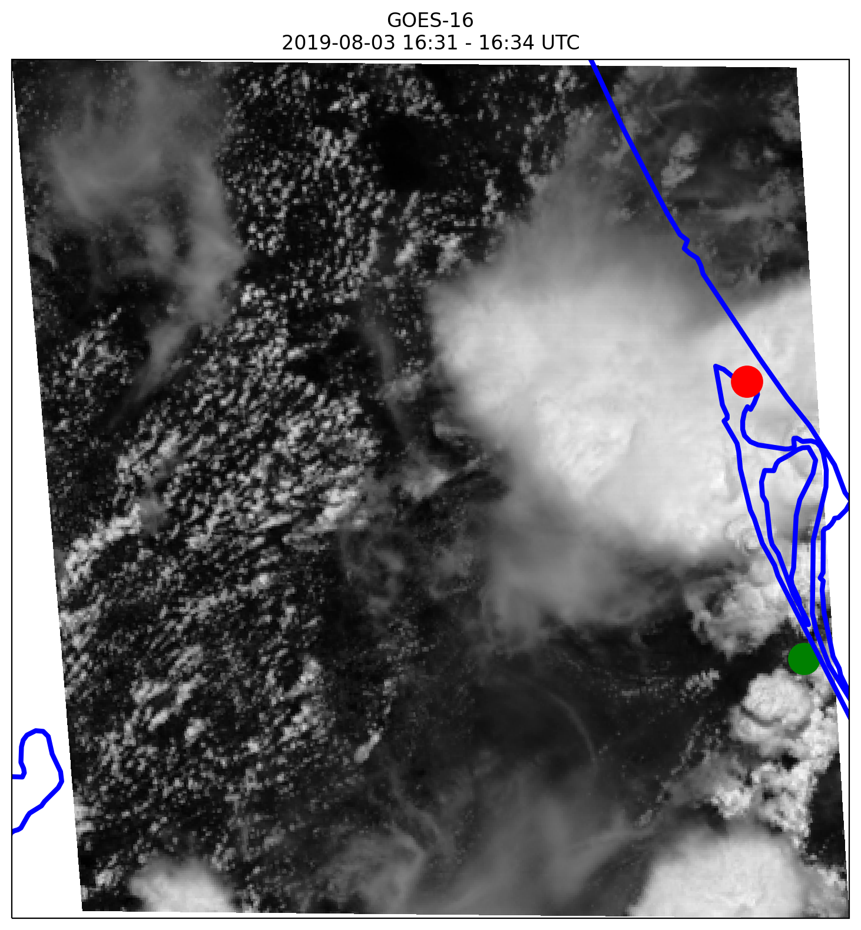
Storm Evolution
13:31 UTC Visible Satellite
14:31 UTC Visible Satellite
CapeEx
Field Station
Deteriorating convection prior to 15:00 UTC.
Cell is re-enhanced by a surface boundary at 15:00 UTC.
  Electrically Active
OST seen at 15:30 UTC.
Aircraft sampling begins at 15:51:15 UTC
  Ends at 16:26:00 UTC
Storm merges with other initiated cells over Cape Canaveral, Florida at 16:30 UTC.
Storms deteriorate over the Atlantic at 17:30 UTC.
KMLB
15:31 UTC Visible Satellite
16:31 UTC Visible Satellite
Notes:
mention storm is electrically active from 15:00 to 16:01 UTC
Aircraft samples cirrus anvil produced from the re-enhanced cell from 15:51 to 16:27 UTC.
Mention blue border

Slide 18
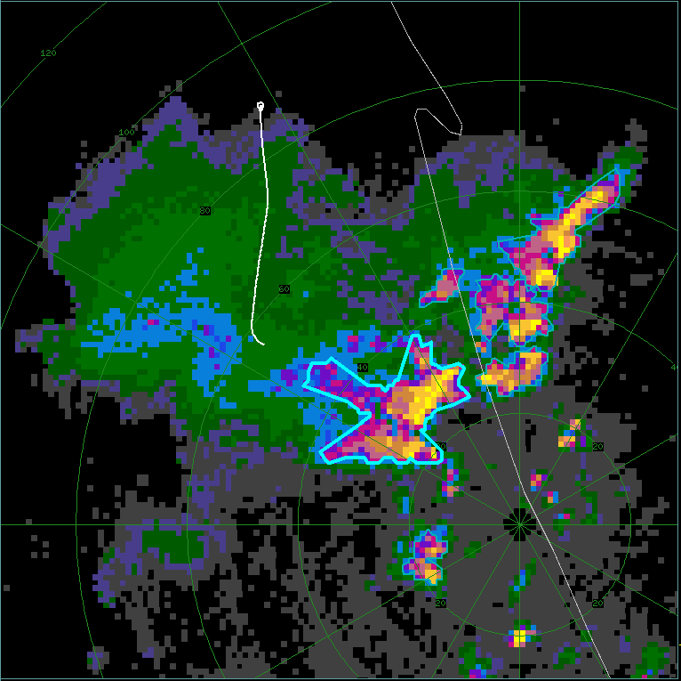
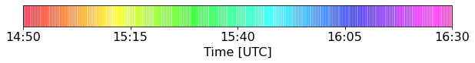
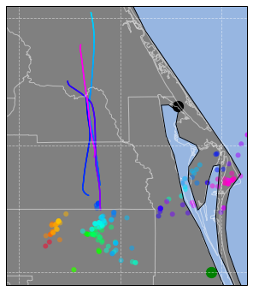
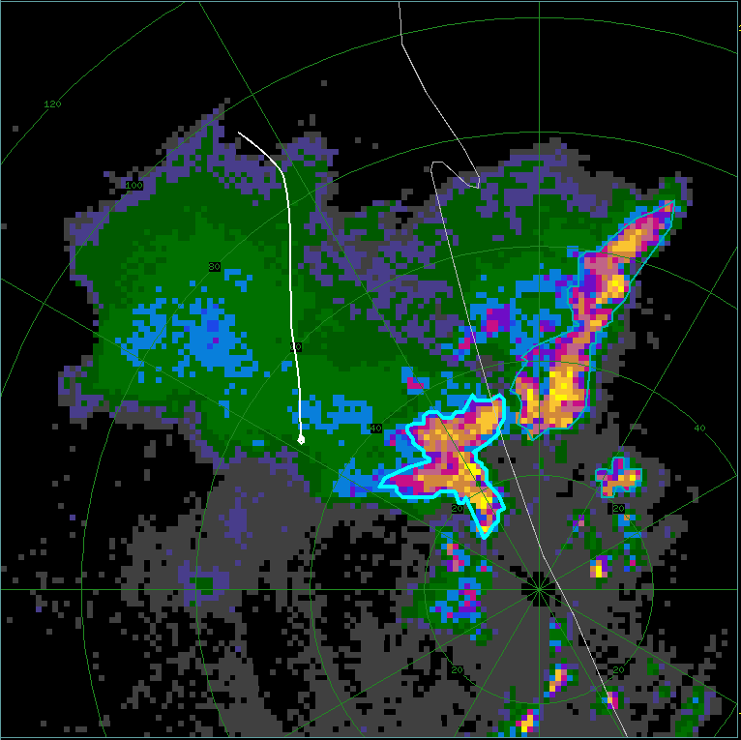
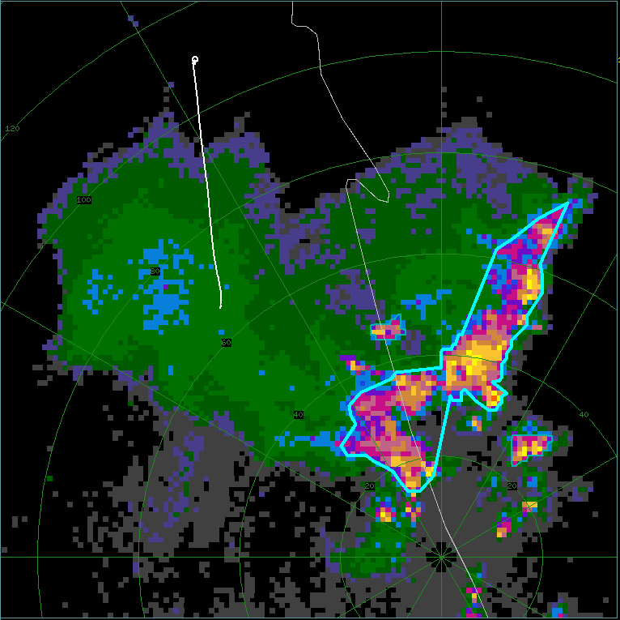
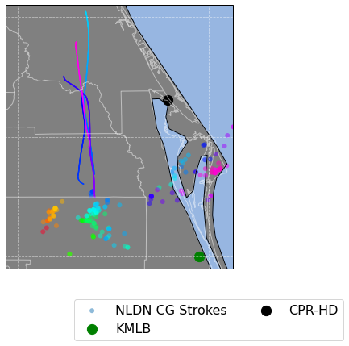
FL1
FL2
-20
20
30
35
36
39
42
45
48
51
54
57
60
65
70
80
5
10
dBZ
20 km
FL4
KMLB: 15:56:16 UTC
FL2
KMLB: 16:07:52 UTC
FL3
FL4
FL1
FL3
KMLB: 16:19:25 UTC
200 mb Wind Direction
KMLB: 16:28:16 UTC
Notes:
Start Middle plot:
The time scale represents the colors of the aircraft tracks and CG lightning (depicted by the NLDN)
Black dashed lines indicate the approx. 200 mb wind direction depicted by the sounding launch at 15 00 UTC at the field site
Corner plots:
show KMLB radar reflectivity
White lines indicate the flight track and direction.
FL1 and FL3 are southbound legs
FL2 and FL4 are northbound legs
All flight legs samples at 10 km AGL at a temperature around -30 C
Bold blue outline indicates the location of the TITAN Cell used for the distance from core calculation

Slide 19
In-situ Microphysical Observations

Slide 20
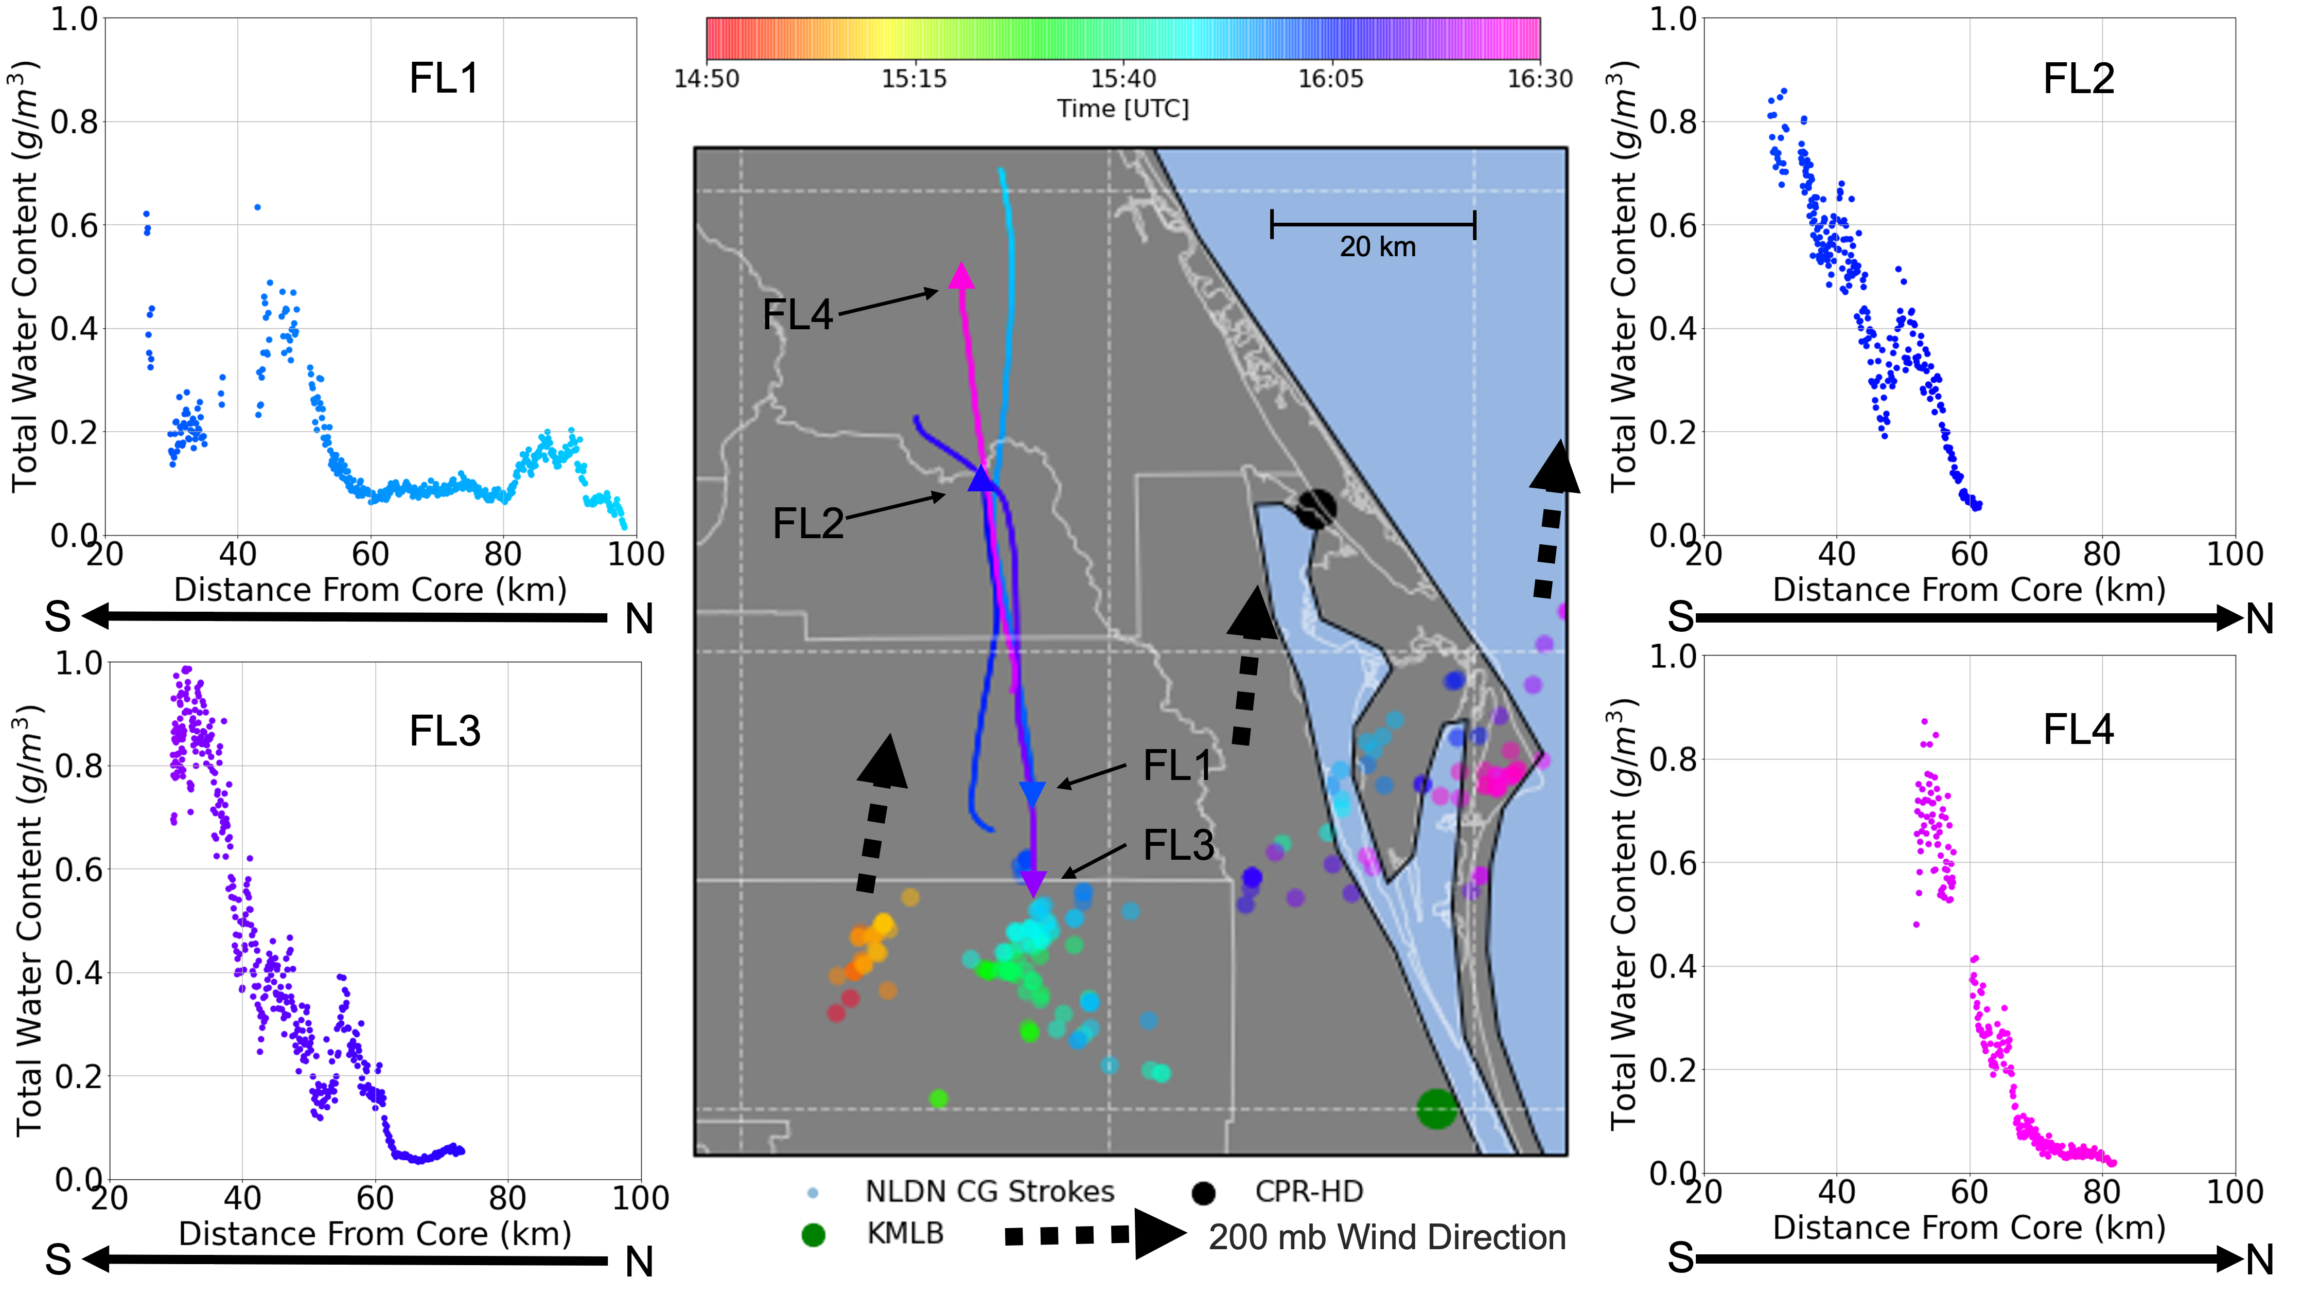
Notes:
For each flight leg, the total water content (TWC) increases closer to the storm core
FL1 is slightly different from FL2-4 with a section of lower TWC values between 30 and 42 km from the TITAN cell’s storm core, which is due to sampling a slightly more diffuse region of the cirrus anvil
MAIN TAKE AWAY
Decrease in TWC heading away from the core.
The Nevzorov, King, and RICE Probes indicate no liquid water is present during FL1 and FL2; therefore, the TWC measurement is of ice. FL3 and FL4 had small amounts of liquid water (<0.1 g m⁻³) at 30 to 35 km (FL3) and 50 to 55 km (FL4) from the TITAN core.

Slide 21
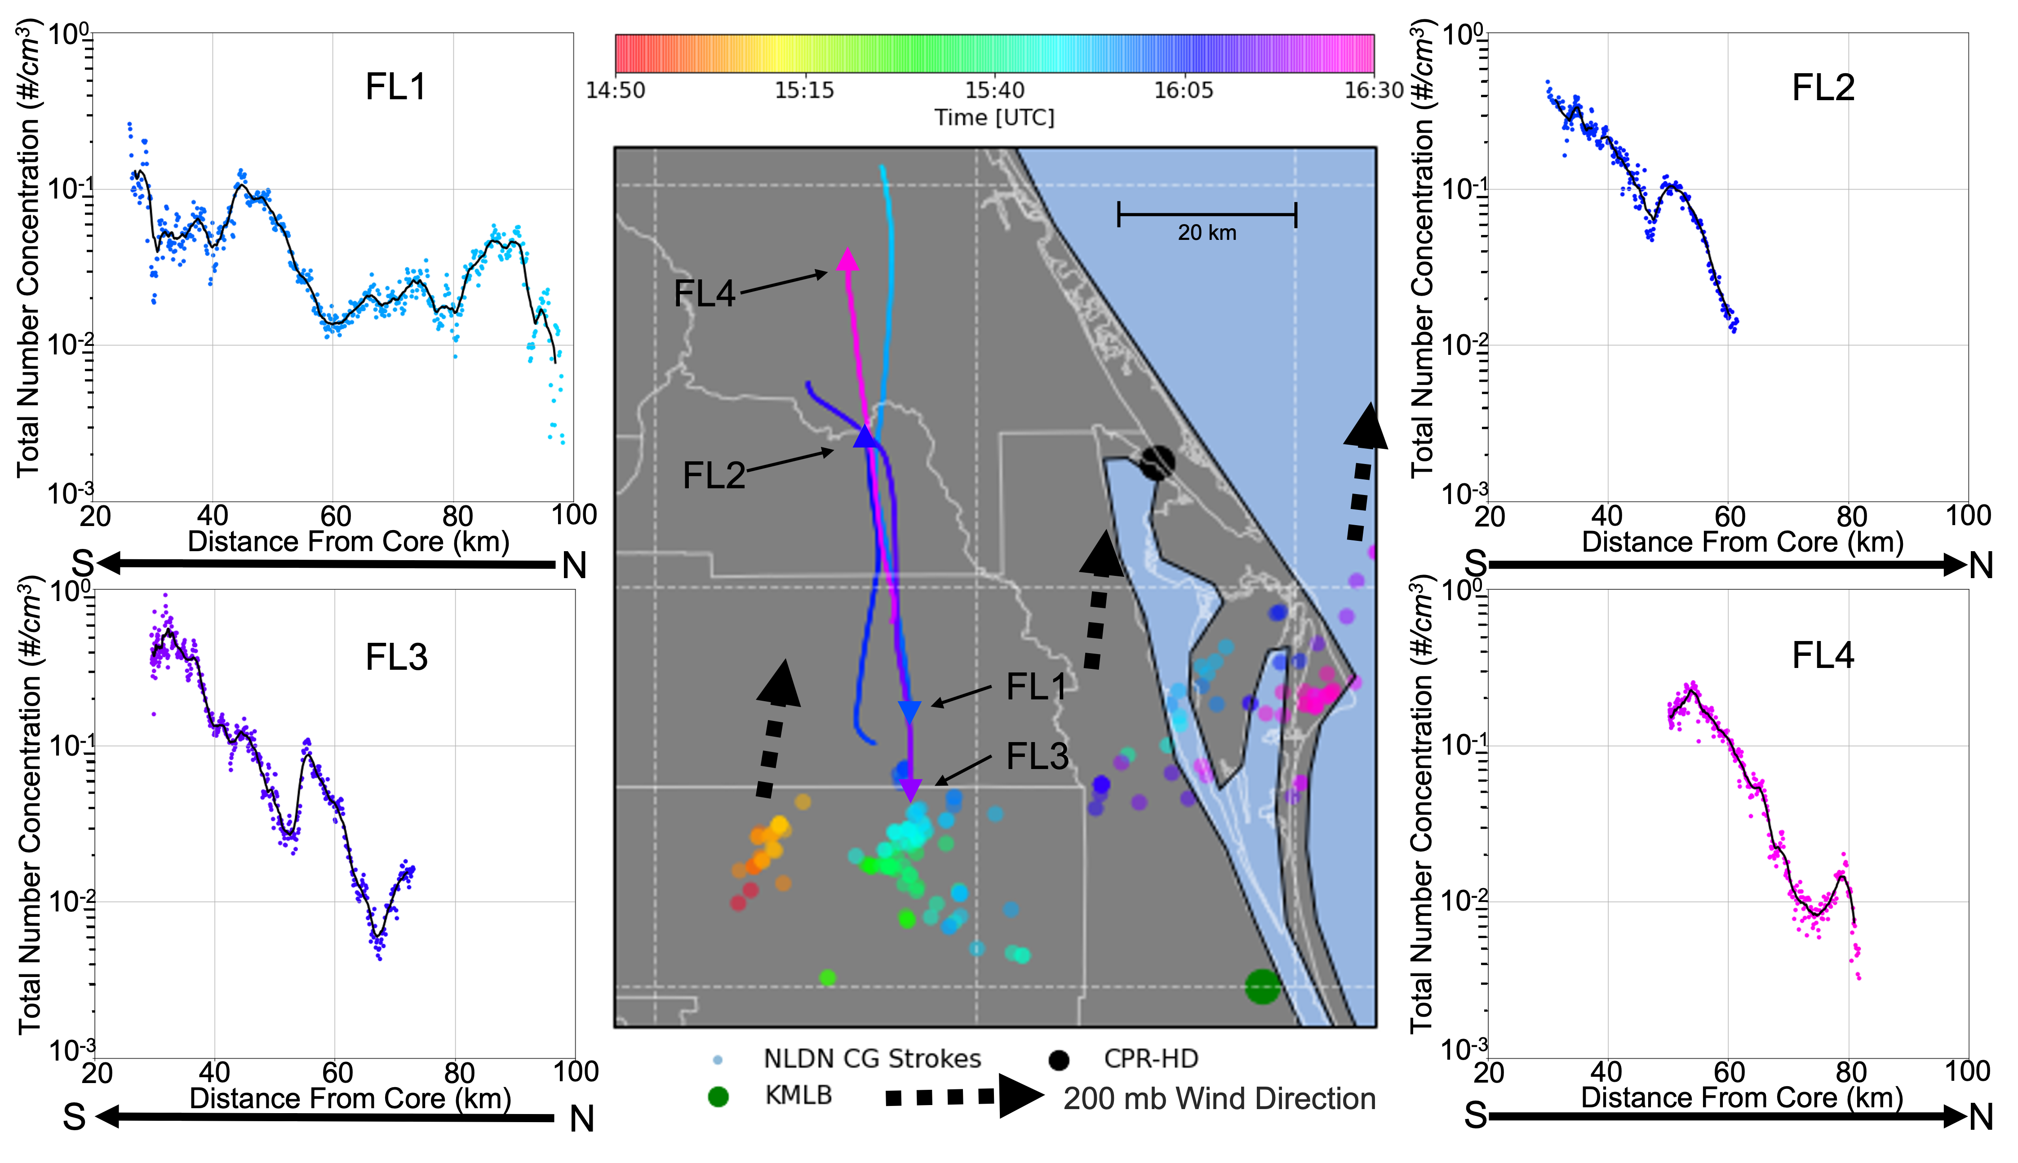
Notes:
Note that black solid line is the centered 20 –point Moving Average.
Main take away - Highest total number concentrations always when the aircraft is closest to the core Except for FL1!

Slide 22
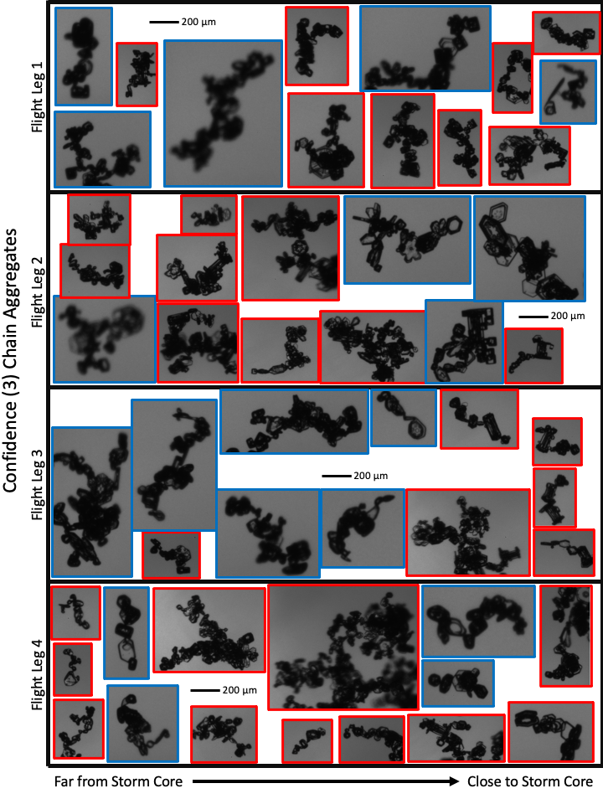
Observed Chain Aggregates
(PHIPS)
Complex Structures and Orientations
Mostly consist of hexagonal plates, sectored plates, columns, and capped columns.
Only 10% (N = 66) contained some evidence of riming.
Signs of sublimation of the chains far from the storm core (40 to 100 km).
Legs | Number of Images | Confidence of 1 | Confidence of 2 | Confidence of 3 | All Confidences
FL1 | 1,507 | 4.6 (N=69) | 5.3 (N=80) | 4.6 (N=69) | 14.5 (N=218)
FL2 | 917 | 4.3 (N=39) | 5.2 (N=48) | 3.4 (N=31) | 12.9 (N=118)
FL3 | 1,375 | 4.7 (N=64) | 6.5 (N=89) | 2.8 (N=38) | 13.9 (N=191)
FL4 | 855 | 4.0 (N=33) | 7.7 (N=67) | 4.8 (N=41) | 16.5 (N=141)
TOTAL | 4,654 | 4.4 (N=205) | 6.1 (N=284) | 3.8 (N=179) | 14.4 (N=668)
Notes:
Observed individual particle elements are from different temperature regimes.
Many of the chains are so big they don’t fit in the FOV of the PHIPS.
In total 668 chain aggregates (from all confidences) observed out of 4,654 PHIPS images (14.4%)

Slide 23
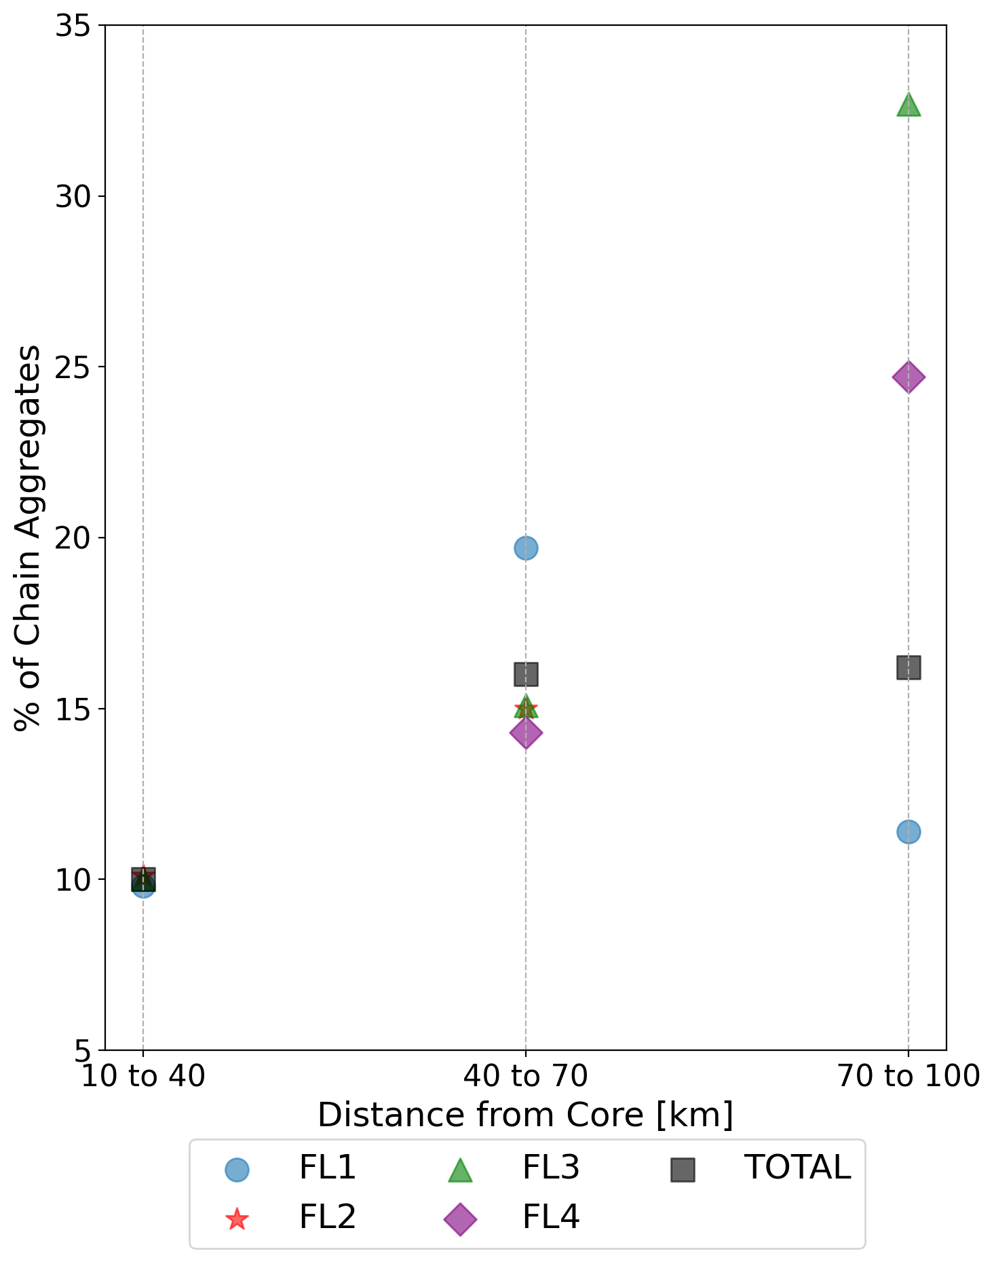
Chain Aggregates vs. Distance from Core
Total # of Images
1,283
2,628
743
Highest concentrations are between 70 and 100 km from the TITAN cell’s core (16.2%).
Smallest concentrations are between 10 and 40 km from the TITAN cell’s core (10%).
Highest number of chains observed between 40 and 70 km from the TITAN cell’s core.
Notes:
NOTE: No data from FL4 in the 10-40 km range
NOTE: No data from FL2 in the 70-100 km range
Main take away: The total percentage of chain aggregates increase with respect to the distance from the storm core (10%, 16%, 16.2%)

Slide 24
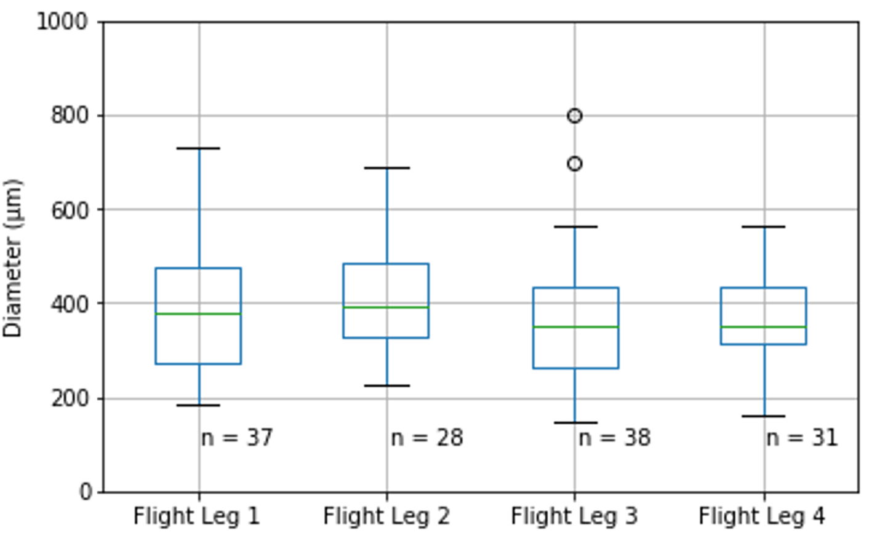
‘All In’ Chain Aggregate Sizes
Sizes (max diameter) range from approximately 150 to 800 μm.
Average 25th Percentile = 293 μm
Average 50th Percentile = 367 μm
Average 75th Percentile = 458 μm
The size distribution of the chain aggregates is similar between FL1-4.
⎼ Indicating that storm evolution does not impact chain aggregate sizes.
75th Percentile
50th
Percentile
25th Percentile
Box and whisker plot depicting ‘all in’ chain aggregate sizes (max diameter) measured by the PHIPS per flight leg with a moderate-to-high level of confidence.
Notes:
One might notice the smaller number of chain aggregates per flight leg in the plot. This is due to only ‘all-in’ particles obtaining a diameter attribute from the PHIPS.
There is likely more larger chains not considered in this plot due to being cut off out of the PHIPS’s FOV.

Slide 25
PHIPS Chain Aggregate Percentiles
Legs | Particles > 495 µm | Chains > 495 µm | Chain Percentage | Confidence
FL1 | 7 | 7 | 100% | 2.71
FL2 | 11 | 8 | 73% | 2.38
FL3 | 8 | 7 | 88% | 2.00
FL4 | 10 | 8 | 80% | 1.88
TOTAL | 36 | 30 | 83% | 2.24
Found that 83% of particles > 495 μm imaged by the PHIPS are chain aggregates.
  With an average confidence between moderate and high (2.24).
Found that 9.5% of particles between 105 and 315 μm imaged by the PHIPS are chain aggregates (not in table).
  With an average confidence between low and moderate (1.38).
Notes:
Took the average chain aggregate sizes using the 75% percentile from the previous plot and applied that to the nearest corresponding CIP particle size bin (which was 495 um)
Mention the sizing ranges don’t correspond to the percentiles but to the CIP particle bins that

Slide 26
PHIPS Chains to CIP Concentrations
Simplifications:
⎼ Particles > 495 μm measured by the CIP is considered the chain aggregate concentration.
⎼ Particles between 105-315 μm is the non-chain aggregate concentration.
⎼ Particles between 315-495 μm is the buffer zone between the two concentrations.
Notes:
The CIP is utilized for particle concentrations because of its much faster sampling rate compared to the PHIPS
Mention CIP particles less than 105 microns are disregarded from this work due to the problematic nature of fragmentation due to shattering from the probe tips and the particles near the probe’s depth of field .
Main Take-away: This assumption enables using the CIP concentration of greater than 495 μm particles to be used as an accurate concentration measurement of chain aggregates.

Slide 27
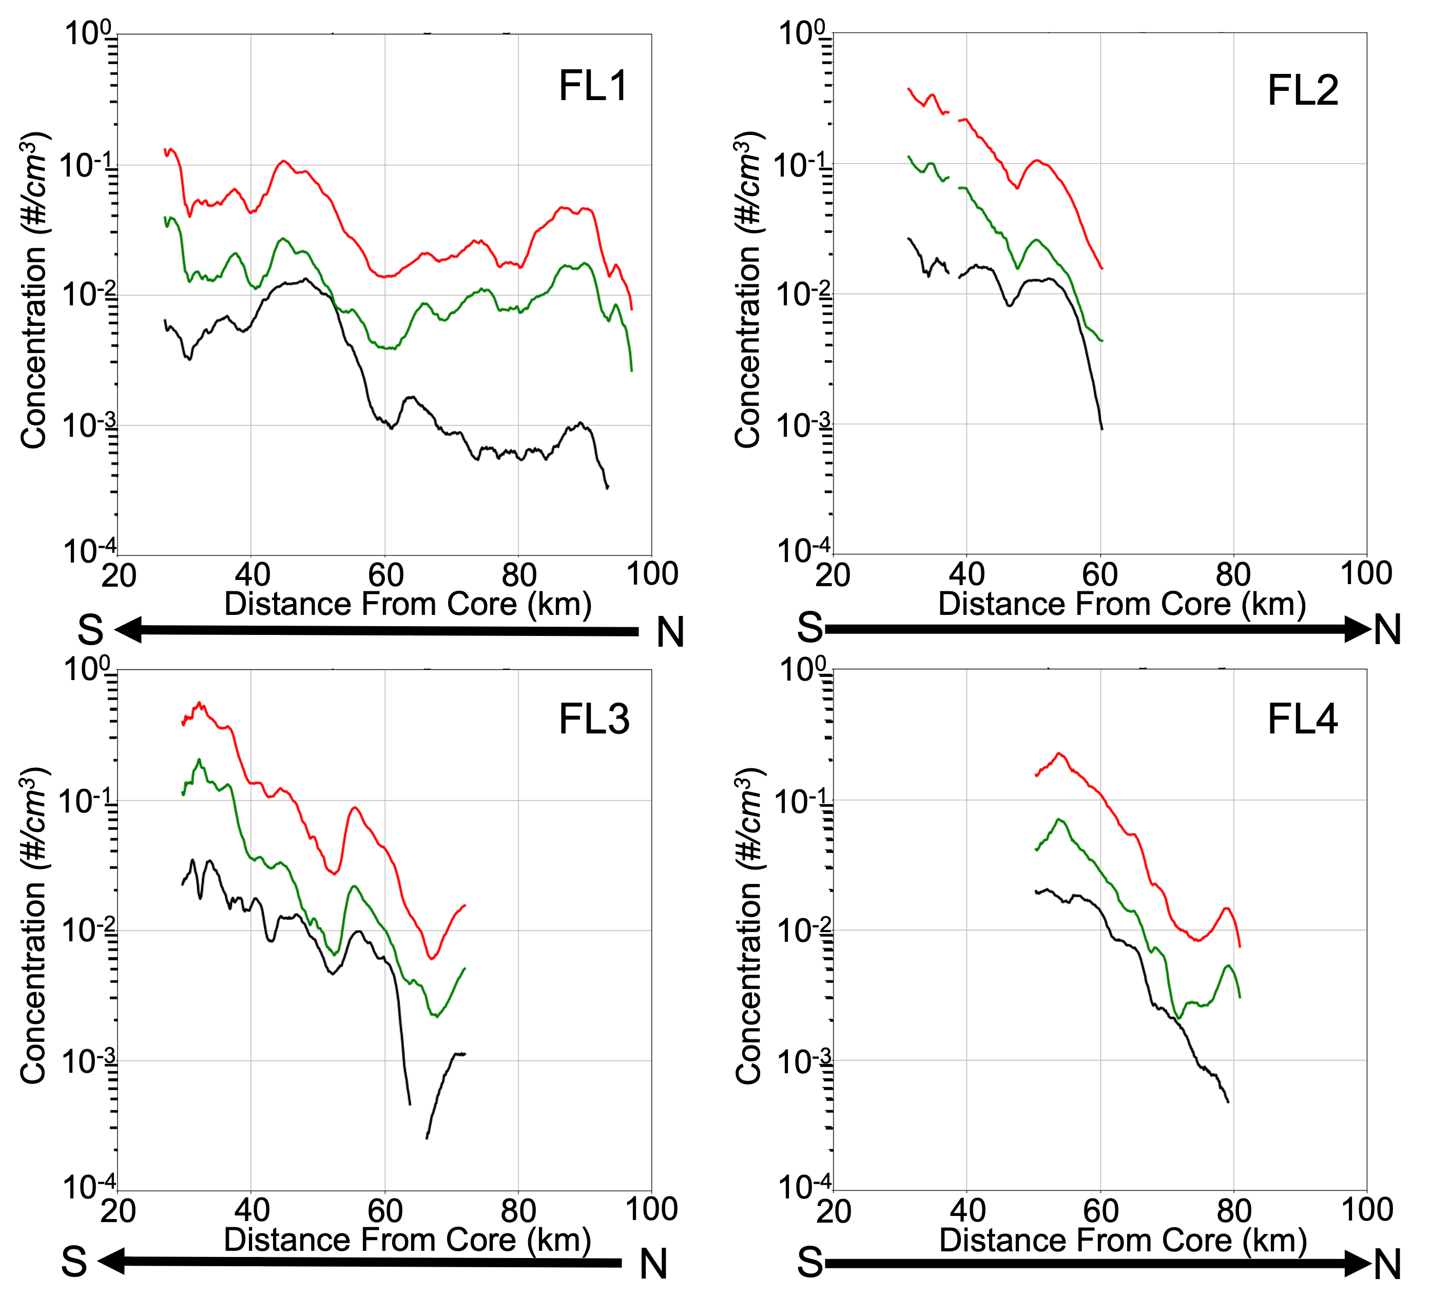
Concentrations
More non-chain aggregates than chain aggregates.
Highest chain aggregate concentrations nearest to core.
  Except for FL1
Convergence between the chain and non-chain aggregate concentrations.
NOTE: Points of convergence are never at the closest point to the storm core!
Chain Aggregate Concentration
Non-chain Aggregate Concentration
Total Number Concentration
Notes:
it is observed that the aircraft is sampling in a region of more non-chain aggregates than chain aggregates.
However, for all of the flight legs, the chain and non-chain aggregate concentrations converge at a certain distance from the TITAN cell’s core.
For FL1, the concentrations of chain aggregates and non-chain aggregates converge at approximately 53 km from the core.
According to the CIP measurements, at 55 km from the core the concentrations of chain and non-chain aggregates are virtually the same.
For FL2, the concentrations of chain aggregates and non-chain aggregates converge at approximately 58 km from the core.
Similar to FL1 and FL2, FL3 shows the concentrations of chain aggregates and non-chain aggregates converge but at two distance points from the core.
The first being approximately 55 km from the core and the second being around 61 km from the core.
For FL4, the concentrations of chain aggregates and non-chain aggregates converge at approximately 70 km from the core.
Transition to RCACn-c: discuss how and why we determine this parameter!

Slide 28
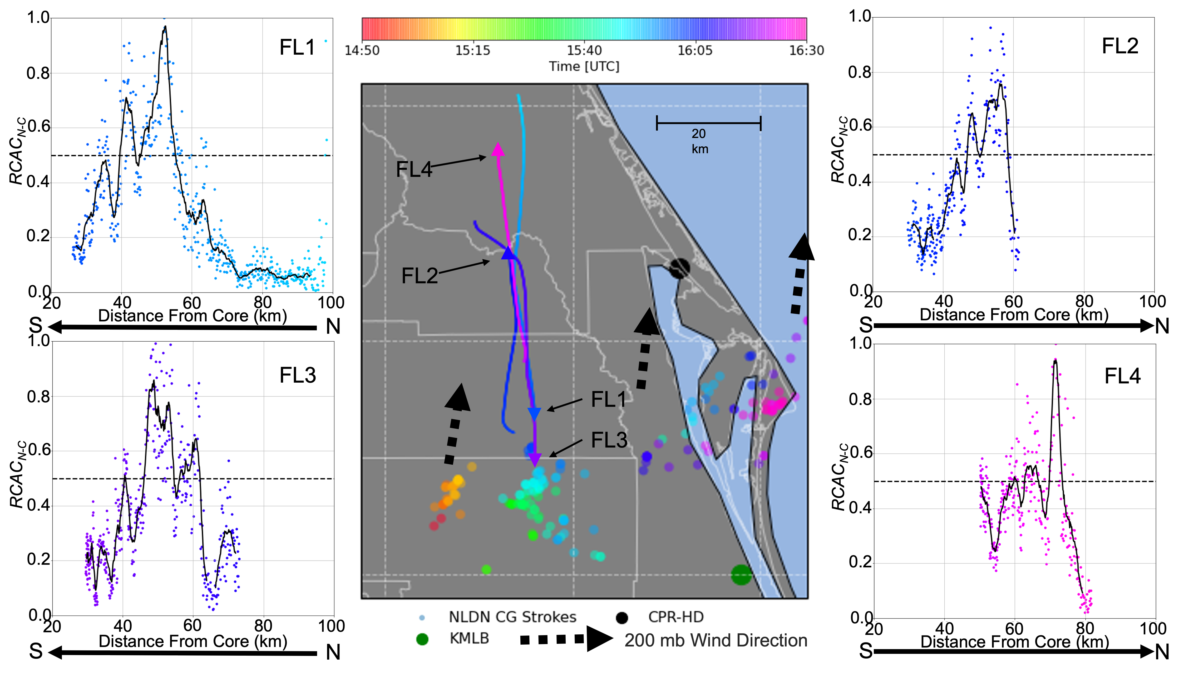
Notes:
0.5 is considered high RCAC
areas of convergence (and divergence)
The peaks in RCAC_{N–C} indicates the points where the chain and non-chain aggregate concentrations converge
When the RCAC_{N–C} is below 0.5, this indicates where the chain and non-chain aggregate concentrations are not similar; in this case, higher concentrations of non-chain aggregates relative to chain aggregates.
Main take-away: For all of the flight legs, the RCAC_{N–C} is lower while closer to the TITAN cell’s core and increases up to a certain distance before quickly dropping off.
Can the reason for the increase of RCACn-c be due to electric influences?

Slide 29
Electrical Field Observations
Notes:
Can the reason for the increase of RCACn-c be due to electric influences?

Slide 30
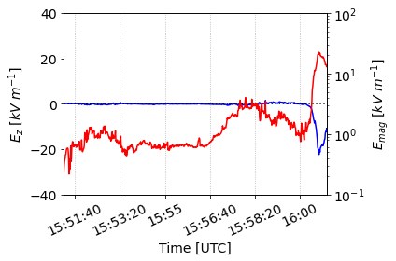
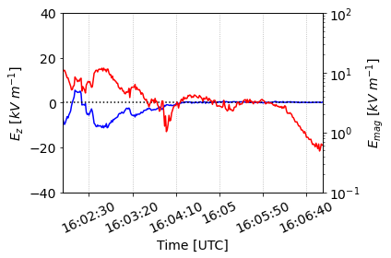
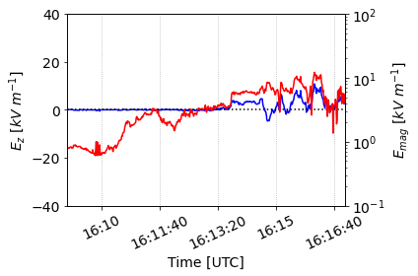
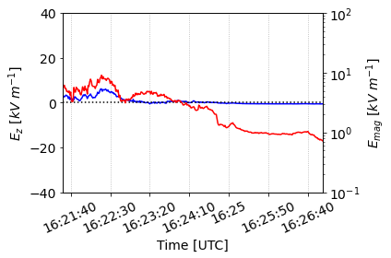
Electric Field Observations
All flight legs have electric field magnitude (E_{mag}) on the order of 10¹ kV m⁻¹
Strongest in relatively close proximity to the TITAN cell’s core
FL1 (E_{z} peaked at -22.37 kV m⁻¹)
Do not reach 60 kV m⁻¹ Threshold
FL1
FL2
FL3
FL4
E_{z}
E_{mag}
Notes:
All flight legs have electric field magnitude (E_{mag}) on the order of 10¹ kV m⁻¹
The electric fields are largest when the aircraft is in relatively close proximity to the TITAN cell’s core
When near the reflectivity core, the vertical electric field (E_{z}) is mainly on the order of 10⁰ kV m⁻¹.
There is a strong E_{z} increase at the end of FL1 (E_{z} peaked at -22.37 kV m⁻¹) that is an order of magnitude higher than the typical cirrus cloud E_{z}
This increase in E_{z} is likely due to the aircraft entering a relatively high electric field charge region and not caused by lightning. The temporal span of the peak is on the order of seconds, while electric discharges are on the order of micro-seconds (Rakov 2016). Additionally, the diverging electric field vectors indicate this peak is caused by the aircraft entering a high electric field region

Slide 31
Radar and Satellite
Notes:
So, where in the radar and satellite data do we see these peaks in RCAC

Slide 32
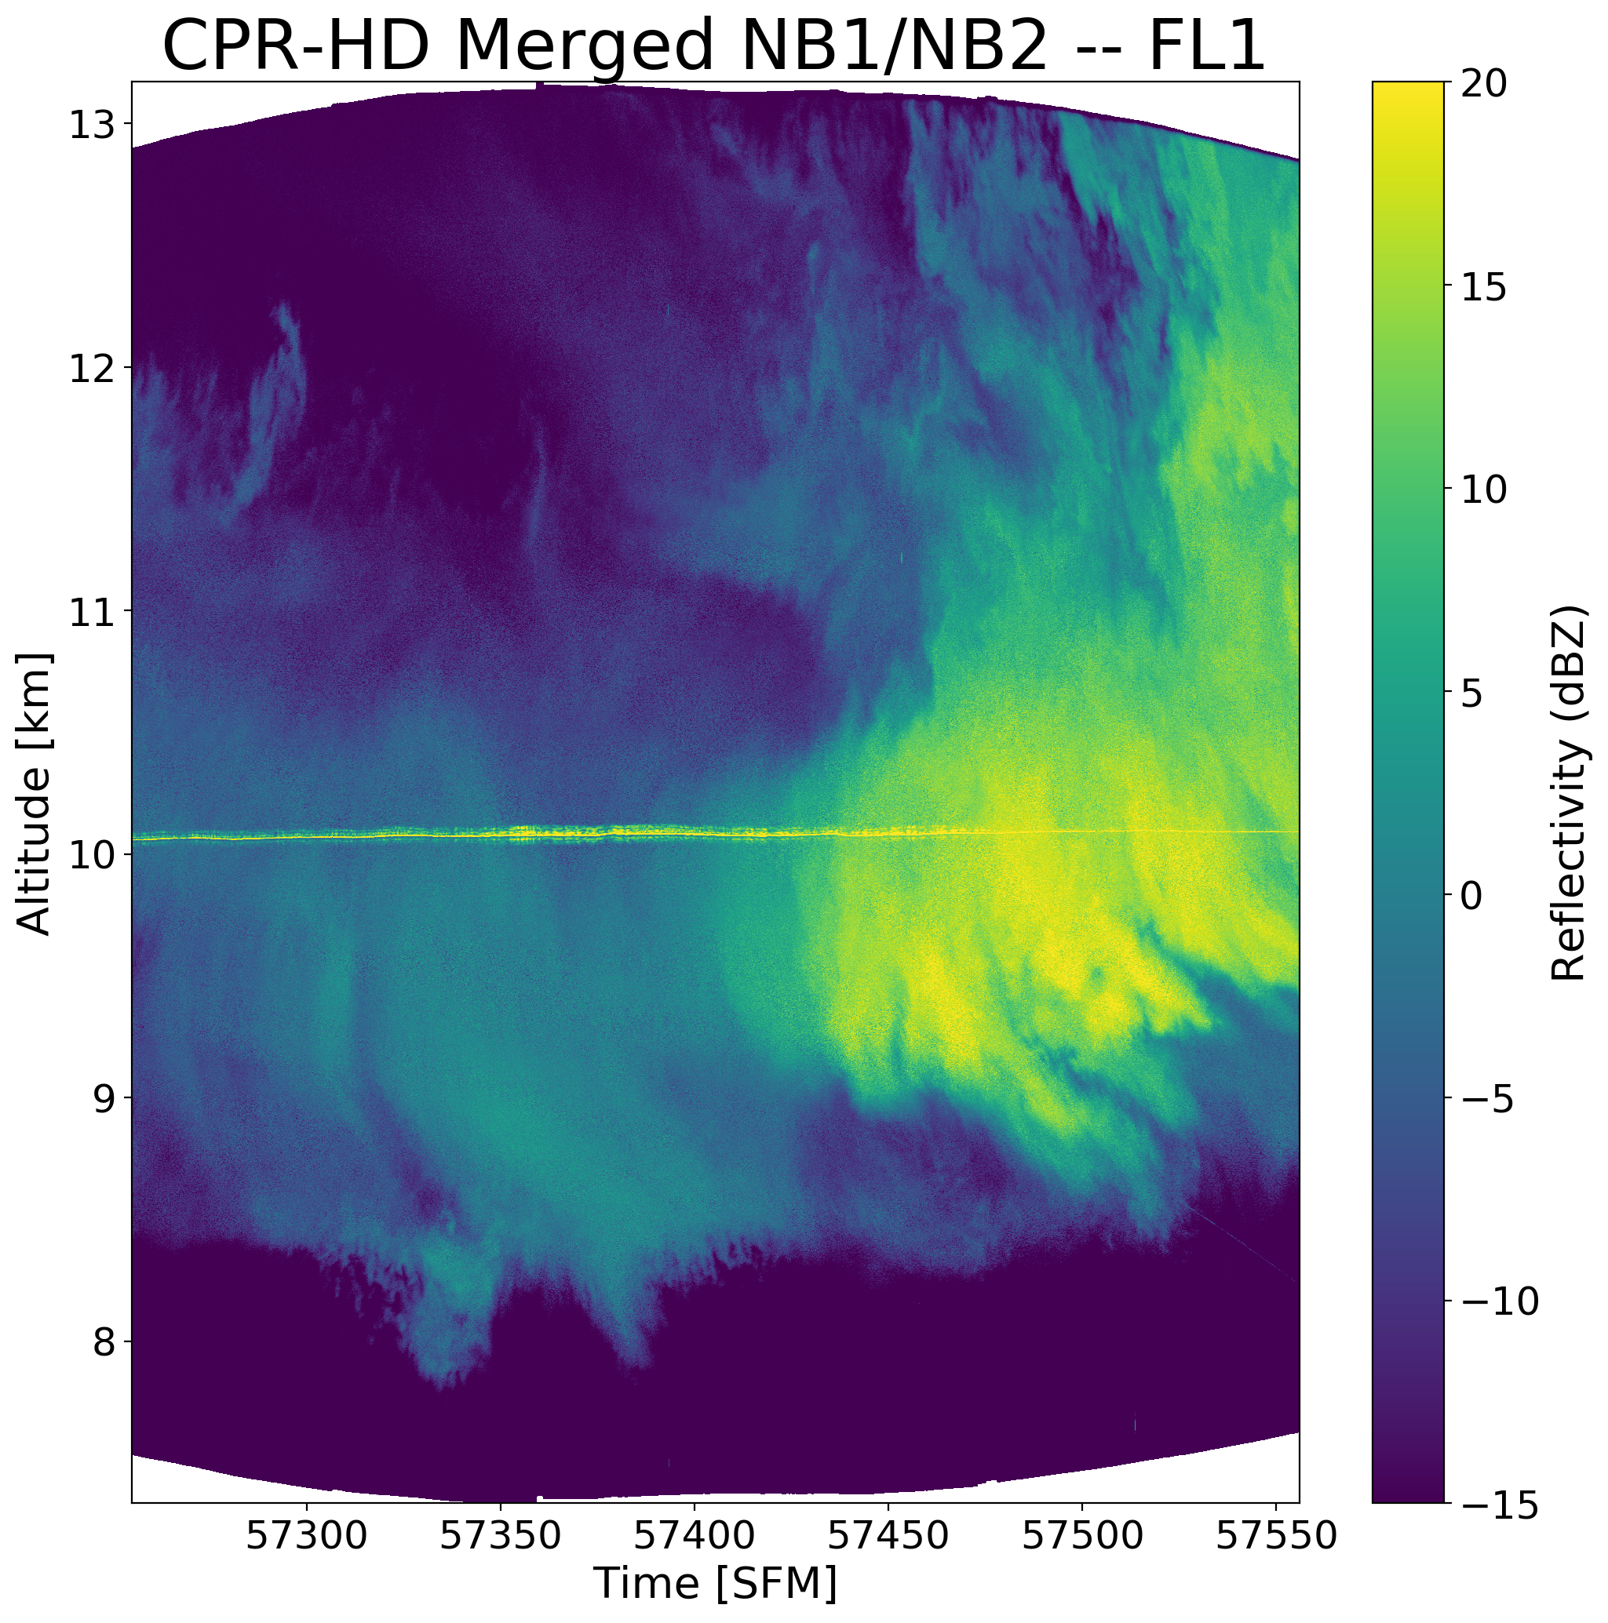
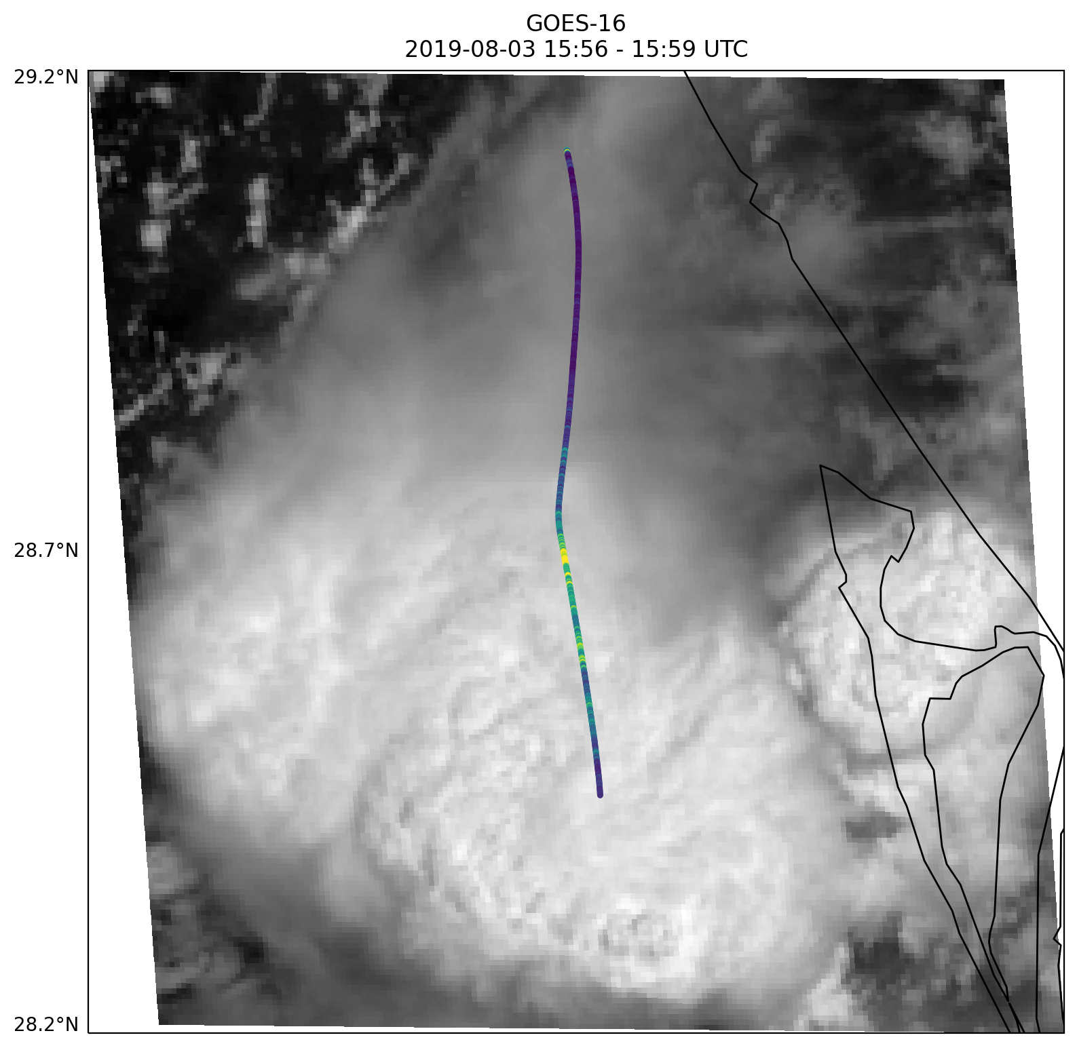
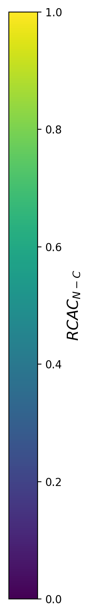

CPR-HD – FL1
GOES-16 Visible Satellite
2019-08-03 15:56 – 15:59 UTC
35 km
CPR-HD
RCAC_{N-C}
FL1
Aircraft Flight Track
(Contamination)
N
W
E
15:55:00
15:55:50
15:56:40
15:57:30
15:58:20
15:59:10
Time [UTC]
S
N
S
Notes:
Start with left panel and end with right.
NOTE: the aircraft sampled more diffuse and old cirrus anvil regions from convection that occurred before the enhanced convection associated with the titan cell.
NOTE: diminishing over-shooting cloud top at the end of reflectivity scan.
Main take-away: highest concentrations of chain aggregates observed on the edge between the old and new cirrus anvil.

Slide 33
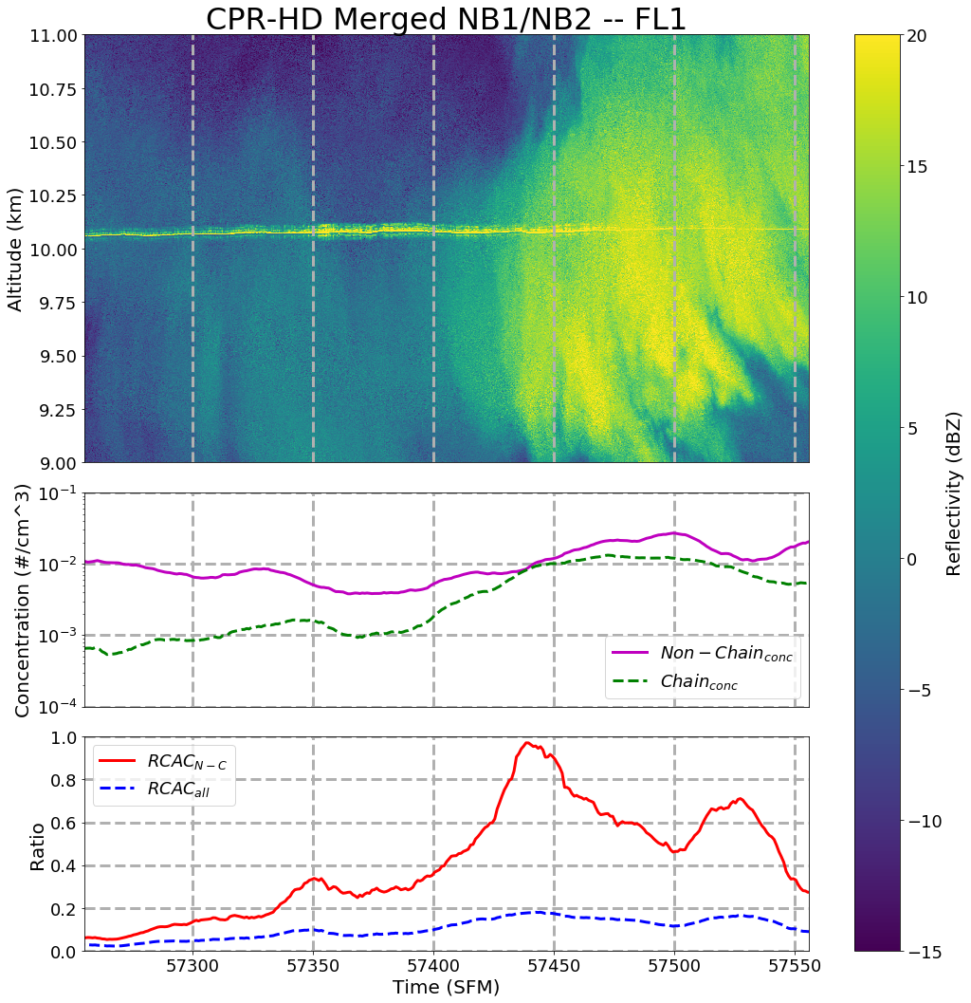
CPR-HD – FL1
GOES-16 Visible Satellite
2019-08-03 15:56 – 15:59 UTC
35 km
CPR-HD
RCAC_{N-C}
FL1
N
W
E
15:55:00
15:55:50
15:56:40
15:57:30
15:58:20
15:59:10
S
Time [UTC]
N
S
Notes:
Main take-away: highest concentrations of chain aggregates observed on the edge between the old and new cirrus anvil.

Slide 34
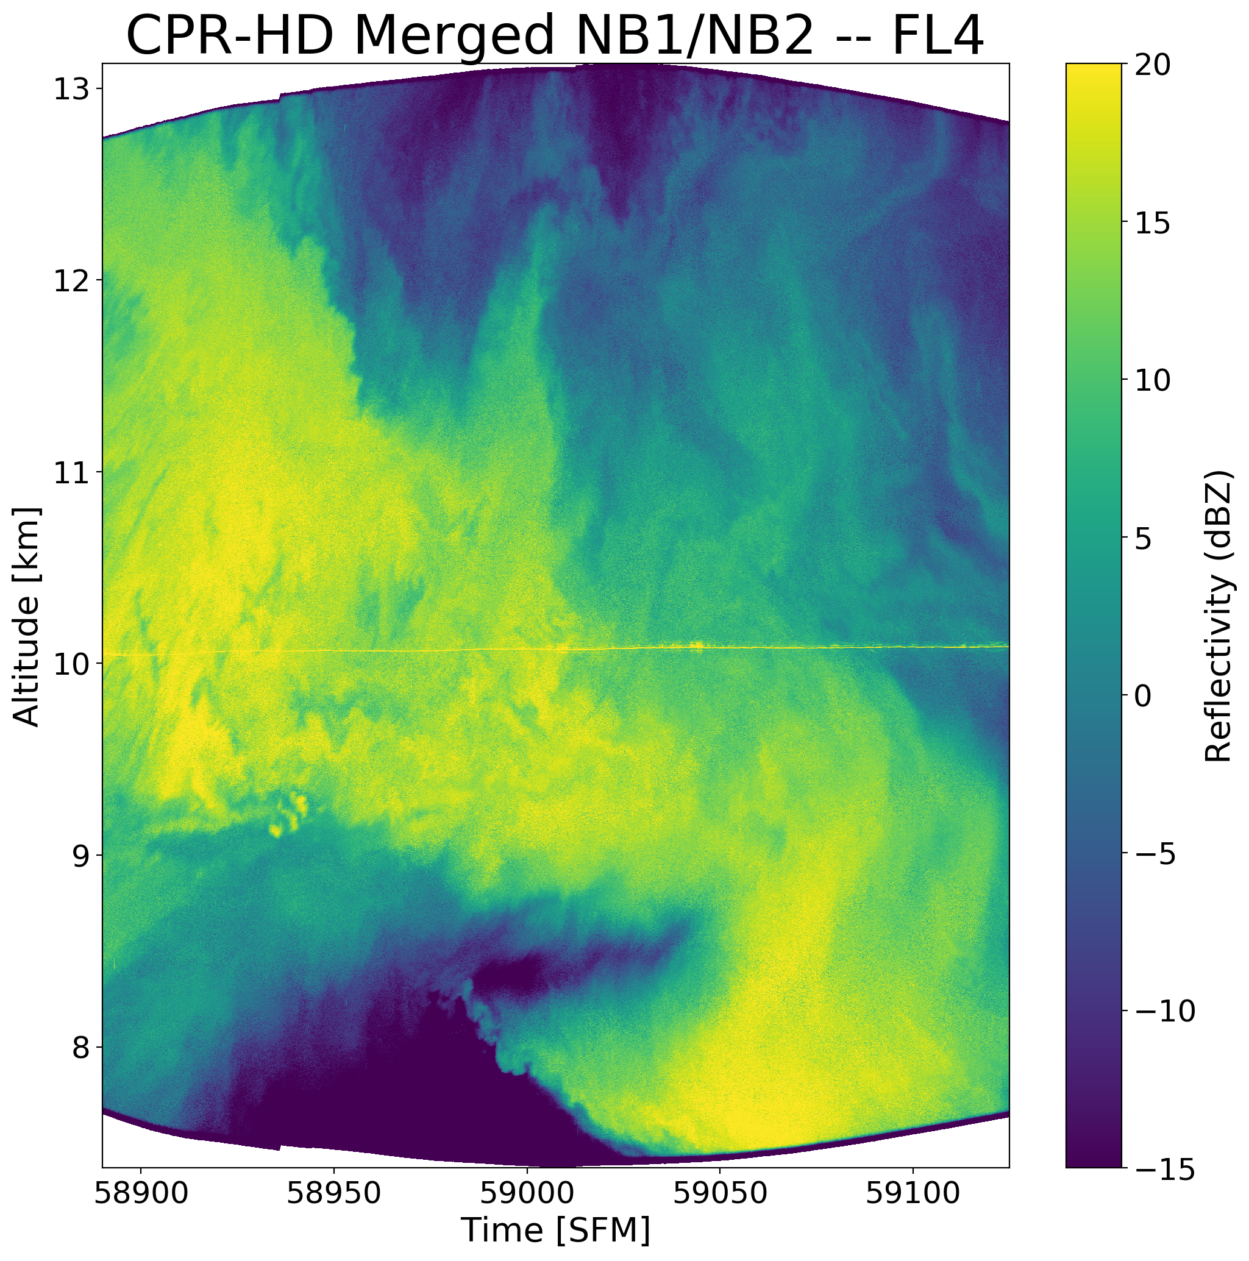
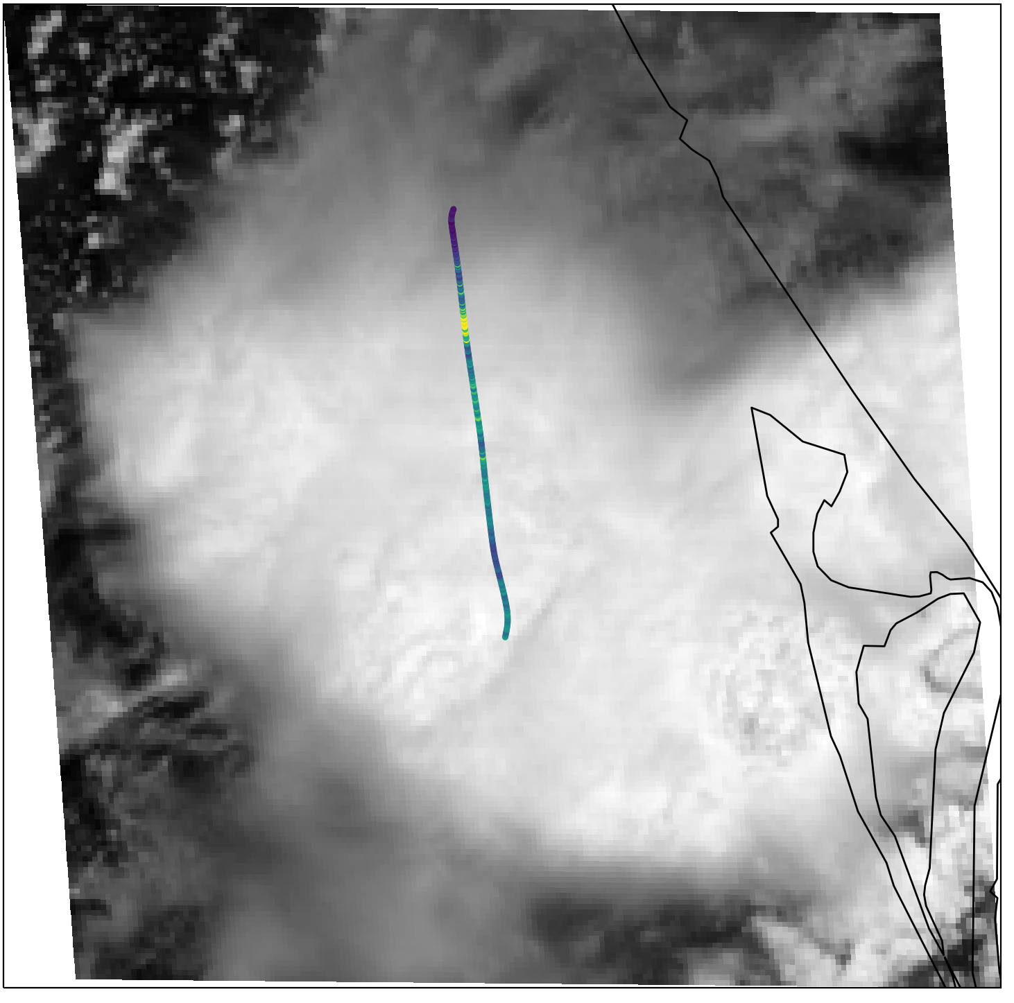
CPR-HD – FL4
GOES-16 Visible Satellite
2019-08-03 16:21 – 16:24 UTC
35 km
FL4
CPR-HD
RCAC_{N-C}
Aircraft Flight Track
(Contamination)
N
W
E
16:21:40
16:22:30
16:23:20
16:24:10
16:25:00
Time [UTC]
S
S
N
Notes:
NOTE: As time progresses, the cirrus anvil associated with the TITAN cell has expanded further to the North allowing for more sampling of the newer anvil. Different from FL1
NOTE: cirrus anvil reflectivity shows complexity and isn’t uniform.
NOTE: wave like features at the top of the anvil

Slide 35
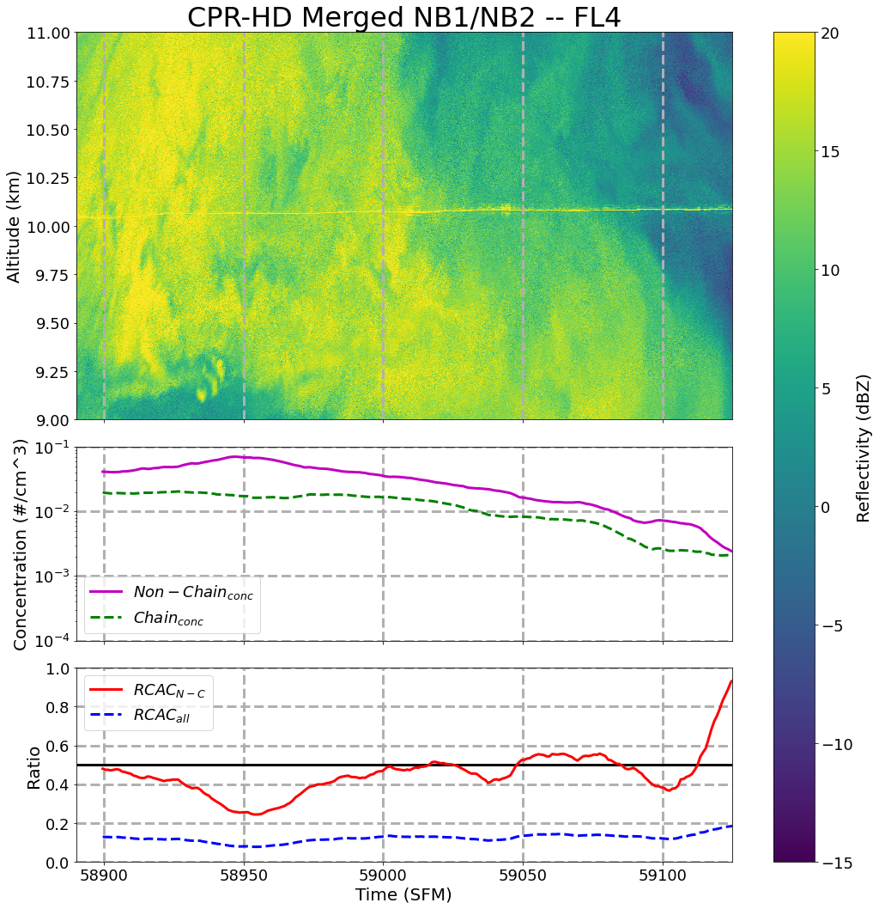
CPR-HD – FL4
GOES-16 Visible Satellite
2019-08-03 16:21 – 16:24 UTC
35 km
FL4
CPR-HD
RCAC_{N-C}
N
W
E
16:21:40
16:22:30
16:23:20
16:24:10
16:25:00
S
S
Time [UTC]
N
Notes:
Main take-away: There is a positive slope in the RCACn-c heading away from the core as chain and non-chain aggregate concentrations decrease. The RCACn-c peaks at the end of the flight leg!

Slide 36
Conclusions
Chain aggregates show similar complexity to previous experiments.
  14.4% of PHIPS images classified as chain aggregates.
Flight leg 1 provides evidence that chain aggregation is occurring in the main convective region of the storm.
  Highest RCAC_{N-C} near storm core at boundary between old and new cirrus anvil.
  Lack of sublimated particle elements.
  Particle elements from different temperature regimes (-5 to -40 °C).
  Lack of rimed chains – suggesting aggregation above the homogenous freezing level.
Notes:
FL1:
The reason why the chain aggregate concentration and the ratio (RCAC_{N–C}) decreases from approximately 50 to 20 km from the TITAN cell’s core when entering the cirrus anvil produced from the TITAN cell during FL1 remains unknown. Although, it is theorized that the peak in RCAC_{N–C} and the chain aggregate concentration occurs when the aircraft transects through a high concentration ‘pocket’ of chain aggregates originating from the overshooting-top produced by the TITAN cell.

Slide 37
Conclusions
CPR-HD – FL4
Flight legs 2-4 provides evidence that chain aggregation is continuing in the cirrus anvil.
  Positive slope of the RCAC_{N-C} heading away from the storm core as overall concentrations decrease.
Electric field strengths never surpass the laboratory tested threshold for chain aggregation to occur (60 kV m⁻¹).
  Strongest near the core
  (Maximum E_{mag}: 22.5 kV m⁻¹)
16:21:40
16:22:30
16:23:20
16:24:10
16:25:00
S
Time [UTC]
N

Slide 38
Future Work
Further analysis on the other research flights during CapeEx19
Future Campaigns:
  Adjust Sampling Methods
  Sample cirrus cloud anvils in other geographical regions.
Perform more Cloud Chamber Experiments
  Test if chain aggregation can occur using electric fields < 60 kV m⁻¹ at temperatures less than -30 °C.

Slide 39
Acknowledgements
Thesis Committee
Naval Research Laboratory (NRL)
  Mentor: Jerry Schmidt
Special Thanks:
  Josh Hoover, NSWC
  Andy Detwiler, UND
  Hugh Christian, UAH
  Jeff Stith, NCAR
  Ron Holle, Vaisala
  Nick Gapp, UND/SAIC
  Jake Mulholland, UND
  Friends
  Family

Slide 40
References
Abdelmonem, A., E. Järvinen, D. Duft, E. Hirst, S. Vogt, T. Leisner, and M. Schnaiter, 2016: PHIPS–HALO: the airborne Particle Habit Imaging and Polar Scattering probe – Part 1: Design and operation. Atmos. Meas. Tech., 9, 3131–3144, https://doi.org/10.5194/amt-9-3131-2016.
Barnes Jr., A. A., 1982: The Sub-visible Cirrus Background. Air Force Geophysics Laboratory. Date Accessed: 04-15-2021. https://apps.dtic.mil/dtic/tr/fulltext/u2/a117389.pdf.
Bateman, M. G., M. F. Stewart, S. J. Podgorny, H. J. Christian, D. M. Mach, R. J. Blakeslee, J. C. Bailey, and D. Daskar, 2007: A Low-Noise, Microprocessor-Controlled, Internally Digitizing Rotating-Vane Electric Field Mill for Airborne Platforms. J. Atmos. Oceanic Technol., 24, 1245–1255, https://doi.org/10.1175/JTECH2039.1.
Baumgardner, D., H. Jonsson, W. Dawson, D. O’Connor, and R. Newton, 2001: The cloud, aerosol and precipitation spectrometer: a new instrument for cloud investigations. Atmospheric Research, 59–60, 251–264, https://doi.org/10.1016/S0169-8095(01)00119-3.
Connolly, P. J., C. P. R. Saunders, M. W. Gallagher, K. N. Bower, M. J. Flynn, T. W. Choularton, J. Whiteway, and R. P. Lawson, 2005: Aircraft Observations of the Influence of Electric Fields on the Aggregation of Ice Crystals. Quarterly Journal of the Royal Meteorological Society, 131, 1695–1712, https://doi.org/10.1256/qj.03.217.
﻿Crowther, A. G. and C. P. R. Saunders, 1973: On the Aggregation and Fragmentation of Freely-Falling Ice Crystals in an Electric Field. J. Met. Soc. Japan, 51, 490-493.
Dye, J. E., and A. Bansemer, 2019: Electrification in Mesoscale Updrafts of Deep Stratiform and Anvil Clouds in Florida. Journal of Geophysical Research: Atmospheres, 124, 1021–1049, https://doi.org/10.1029/2018JD029130.
Dye, J. E., and Coauthors, 2007: Electric fields, cloud microphysics, and reflectivity in anvils of Florida thunderstorms. Journal of Geophysical Research: Atmospheres, 112, https://doi.org/10.1029/2006JD007550.
Dye, J. E., and J. C. Willett, 2007: Observed Enhancement of Reflectivity and the Electric Field in Long-Lived Florida Anvils. Monthly Weather Review, 135, 3362–3380, https://doi.org/10.1175/MWR3484.1.
Gapp, N. J., 2019: Comparison of Concurrent Radar and Aircraft Measurements in Cirrus Clouds. M.S. thesis, Dept. of Atmospheric Sciences, University of North Dakota, 54 pp.
Garrett, T. J., and Coauthors, 2005: Evolution of a Florida Cirrus Anvil. Journal of the Atmospheric Sciences, 62, 2352–2372, https://doi.org/10.1175/JAS3495.1.
Gayet, J.-F., and Coauthors, 2012: On the observation of unusual high concentration of small chain-like aggregate ice crystals and large ice water contents near the top of a deep convective cloud during the CIRCLE-2 experiment. Atmospheric Chemistry and Physics, 12, 727–744, https://doi.org/10.5194/acp-12-727-2012.
Jensen, E., D. Starr, and O. B. Toon, 2004: Mission investigates tropical cirrus clouds. Eos, Transactions American Geophysical Union, 85, 45–50, https://doi.org/10.1029/2004EO050002.
40

Slide 41
References
Latham, J., 1969: Experimental studies of the effect of electric fields on the growth of cloud particles. Quarterly Journal of the Royal Meteorological Society, 95, 349– 361, https://doi.org/10.1002/qj.49709540408.
Latham, J., and C. P.R. Saunders, 1964: Aggregation of Ice Crystals in Strong Electric Fields, Nature, 204, 1293 – 1294.
Latham, J., and C. P. R. Saunders, 1970: Experimental measurements of the collection efficiencies of ice crystals in electric fields. Quarterly Journal of the Royal Meteorological Society, 96, 257–265, https://doi.org/10.1002/qj.49709640808.
Lawson, R. P., B. A. Baker, and B. L. Pilson, 2003: In Situ Measurements of Microphysical Properties of Mid-latitude and Anvil Cirrus. Date Accessed: 04-25-2021. http://www.specinc.com/sites/default/files/pdfs/Cirrus_Anvil_paper_Rev2_.pdf
Lin, T. C., and N. A. Thyson, 1977: Ice-crystal/shock-layer interaction in hypersonic flight. AIAA Journal, 15, 1511–1514, https://doi.org/10.2514/3.7446.
Liou, K. N., 1973: Transfer of Solar Irradiance through Cirrus Cloud Layers., J. Geophys. Res., 78, 1409–1418.
﻿Meng, H.C. and K.C. Ludema, 1995: Wear models and predictive equations: their form and content, WEAR, 181-183, 443-457.
NCAR, 2021a: MDV Format Interface Control Document (ICD). Accessed 10 June 2020, https://www.github.com/NCAR/lrose-titan/blob/master/docsa/pdf/MDV_format_ICD.pdf.
NCAR, 2021b: TITAN. Accessed 10 June 2020, https://www.github.com/NCAR/lrose-titan.
O’Shea, S. J., J. Crosier, J. Dorsey, W. Schledewitz, I. Crawford, S. Borrmann, R. Cotton, and A. Bansemer, 2019: Revisiting particle sizing using grayscale optical array probes evaluation using laboratory experiments and synthetic data. Atmos. Meas. Tech. Discuss., 1–29, https://doi.org/10.5194/amt-2018-435.
Probstein, R. F.; Fassio, F. Dusty Hypersonic Flows. AIAA J. 1970, 8 (4), 772–779. https://doi.org/10.2514/3.5755.
Rakov, V. A., 2016, General picture, Fundamentals of Lightning, Cambridge University Press, 52-65.
Saunders, C. P. R., and N. M. A. Wahab, 1975: The Influence of Electric Fields on the Aggregation of Ice Crystals. Journal of the Meteorological Society of Japan, 53, 121–126, https://doi.org/10.2151/jmsj1965.53.2_121
41

Slide 42
References
Schmidt, J. M., and Coauthors, 2019: Radar Detection of Individual Raindrops. Bulletin of the American Meteorological Society, 100, 2433–2450, https://doi.org/10.1175/BAMS-D-18-0130.1.
Schnaiter, M., E. Järvinen, A. Abdelmonem, and T. Leisner, 2018: PHIPS-HALO: the airborne particle habit imaging and polar scattering probe – Part 2: Characterization and first results. Atmos. Meas. Tech., 11, 341–357, https://doi.org/10.5194/amt-11-341-2018.
Smith, P. L., D. J. Musil, A. G. Detwiler, and R. Ramachandran, 1999: Observations of Mixed-Phase Precipitation within a CaPE Thunderstorm. Journal of Applied Meteorology and Climatology, 38, 145–155, https://doi.org/10.1175/1520-0450(1999)038<0145:OOMPPW>2.0.CO;2.
Stith, J. L., J. E. Dye, A. Bansemer, A. J. Heymsfield, C. A. Grainger, W. A. Petersen, and R. Cifelli, 2002: Microphysical Observations of Tropical Clouds. J. Appl. Meteor., 41, 97–117, https://doi.org/10.1175/1520-0450(2002)041<0097:MOOTC>2.0.CO;2.
Stith, J. L., J. A. Haggerty, A. Heymsfield, and C. A. Grainger, 2004: Microphysical Characteristics of Tropical Updrafts in Clean Conditions. Journal of Applied Meteorology and Climatology, 43, 779–794, https://doi.org/10.1175/2104.1.
Stith, J. L., and Coauthors, 2014: Ice particles in the upper anvil regions of midlatitude continental thunderstorms: the case for frozen-drop aggregates. Atmos. Chem. Phys., 14, 1973–1985, https://doi.org/10.5194/acp-14-1973-2014.
Um, J., and Coauthors, 2018: Microphysical characteristics of frozen droplet aggregates from deep convective clouds. Atmospheric Chemistry and Physics, 18, 16915–16930, https://doi.org/10.5194/acp-18-16915-2018.
Waldman, G. D.; Reinecke, W. G. Particle Trajectories, Heating, and Breakup in Hypersonic Shock Layers. AIAA J. 1971, 9 (6), 1040–1048. https://doi.org/10.2514/3.6328.
Whiteway, J., and Coauthors, 2004: Anatomy of cirrus clouds: Results from the Emerald airborne campaigns. Geophysical Research Letters, 31, https://doi.org/10.1029/2004GL021201.
42

Slide 43

Questions?

Slide 44
EXTRA SLIDES

Slide 45
Flight Legs (FL)
Four total FL defined on the 3 August 2019 research flight.
dBZ
-20
20
30
35
36
39
42
45
48
51
54
57
60
65
70
80
5
10
FL1
FL2
FL3
FL4
KMLB: 15:56:16 UTC
KMLB: 16:07:52 UTC
KMLB: 16:19:25 UTC
KMLB: 16:28:16 UTC
Legs | Time Span (hh:mm:ss) | Heading | Altitude | Temperature
FL1 | 15:51:15-16:01:00 UTC | Southbound | 10,029 (± 4) m | -33.7 (± 0.4) °C
FL2 | 16:02:00-16:07:00 UTC | Northbound | 10,034 (± 5) m | -33.4 (± 0.3) °C
FL3 | 16:09:00-16:17:00 UTC | Southbound | 10,035 (± 5) m | -32.6 (± 0.9) °C
FL4 | 16:21:30-16:26:55 UTC | Northbound | 10,021 (± 7) m | -29.8 (± 0.3) °C
Notes:
The North Dakota Citation II Research Aircraft does not sample in the convective core (highest reflectivity region between 2 and 7 km AGL) during the CapeEx19 field project but focused on sampling in the anvil out flow region. Sampling in the convective core can be problematic as aircraft lightning strikes can damage instruments.
Aircraft sampling legs occurred with little fluctuations in temperature between -29 °C and -35 °C (Table 2), which is slightly warmer than the homogenous freezing level.

Slide 46
Electric Field Reference Coordinates
+ E_{z}
+ E_{x}
+ E_{y}
46

Slide 47
 | 70 – 100 km from Storm Core |  | 40 – 70 km from Storm Core |  | 10 – 40 km from Storm Core
Legs | # of Images | All Confidences | # of Images | All Confidences | # of Images | All Confidences
FL1 | 510 | 11.4 ± 1.0% (N=58) | 631 | 19.7 ± 1.0% (N=124) | 366 | 9.8 ± 1.1% (N=36)
FL2 | N/A | N/A | 520 | 15.0 ± 1.0% (N=78) | 397 | 10.1 ± 1.1% (N=40)
FL3 | 55 | 32.7 ± 3.3% (N=18) | 800 | 15.1 ± 0.8% (N=121) | 520 | 10.0 ± 1.0% (N=52)
FL4 | 178 | 24.7 ± 1.9% (N=44) | 677 | 14.3 ± 0.9% (N=97) | N/A | N/A
TOTAL | 743 | 16.2 ± 0.9% (N=120) | 2,628 | 16.0 ± 0.5% (N=420) | 1,283 | 10.0 ± 0.6% (N=128)

Slide 48
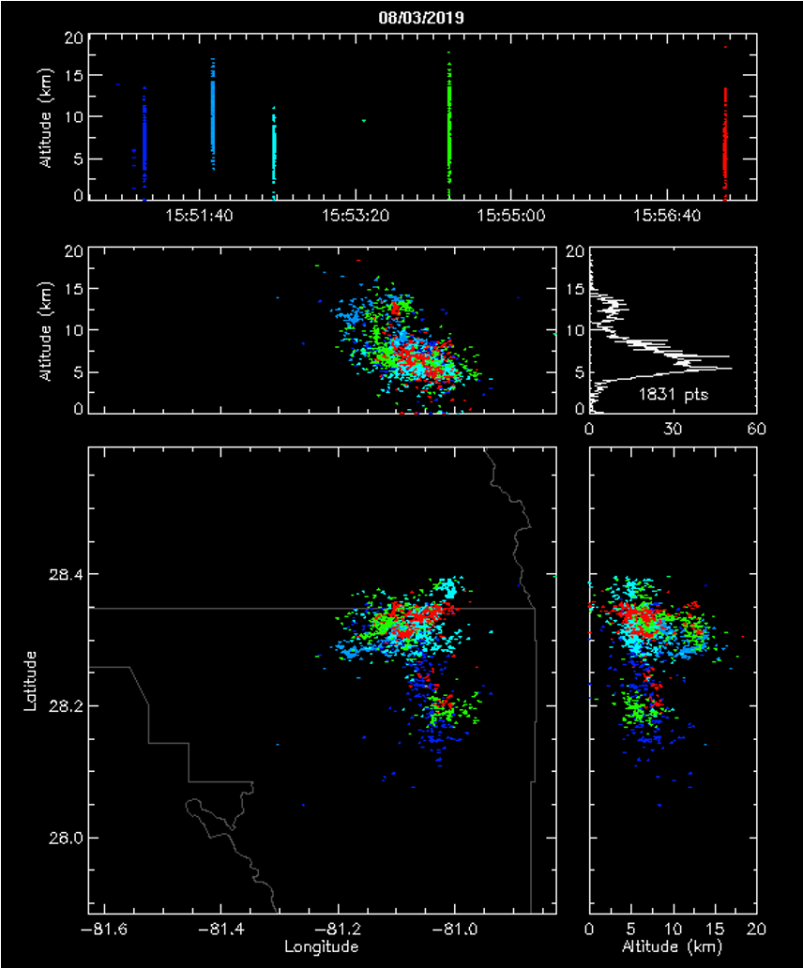
LMA Observations
LMA – 15:50:00 – 16:00:00 UTC

Slide 49
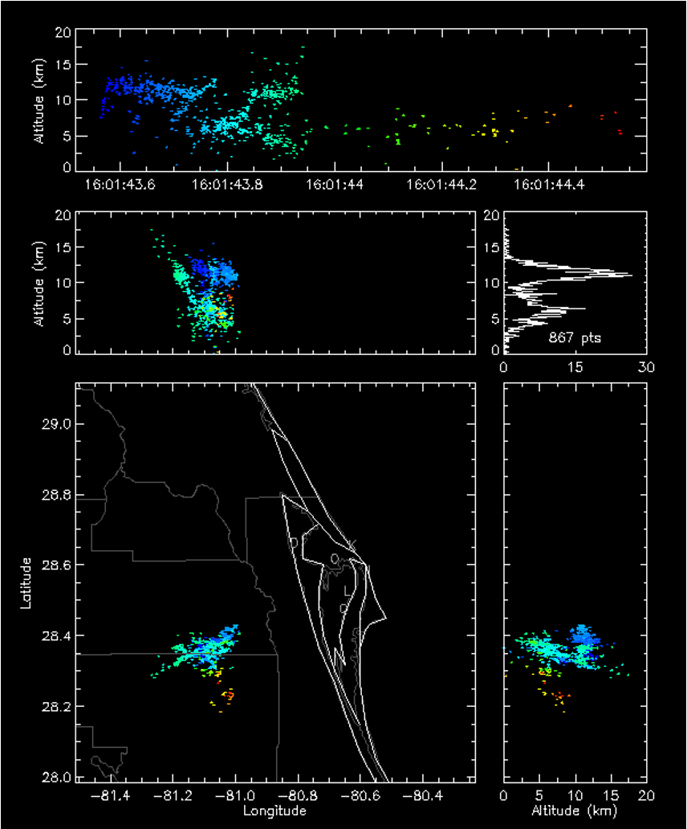
LMA Observations

Slide 50
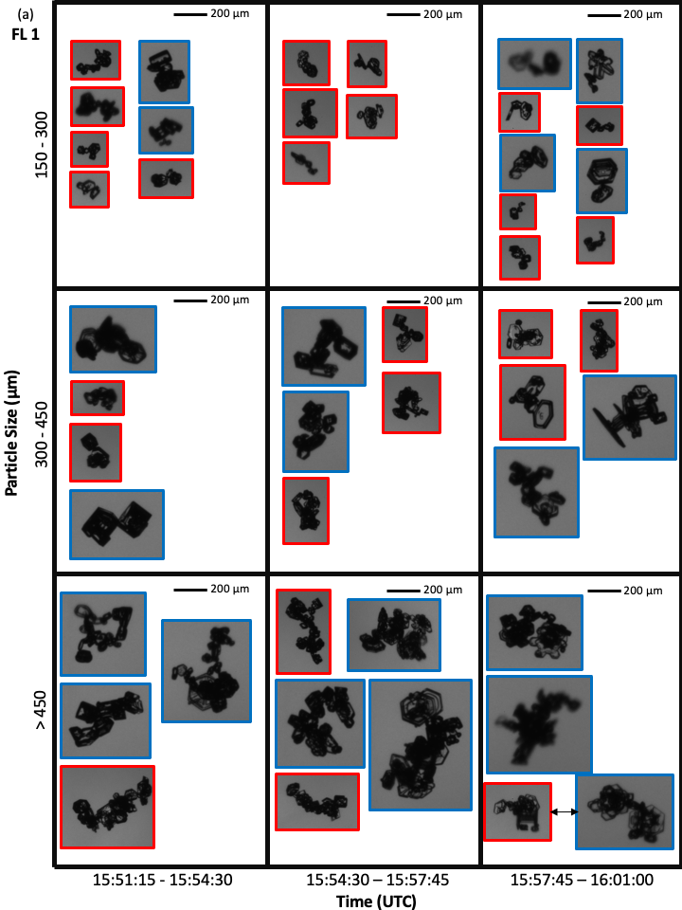
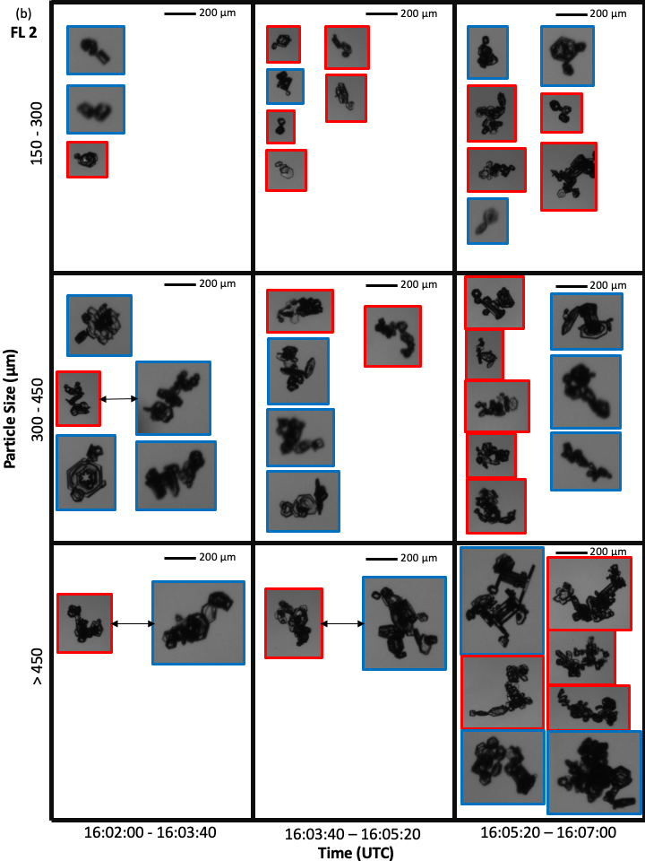

Slide 51
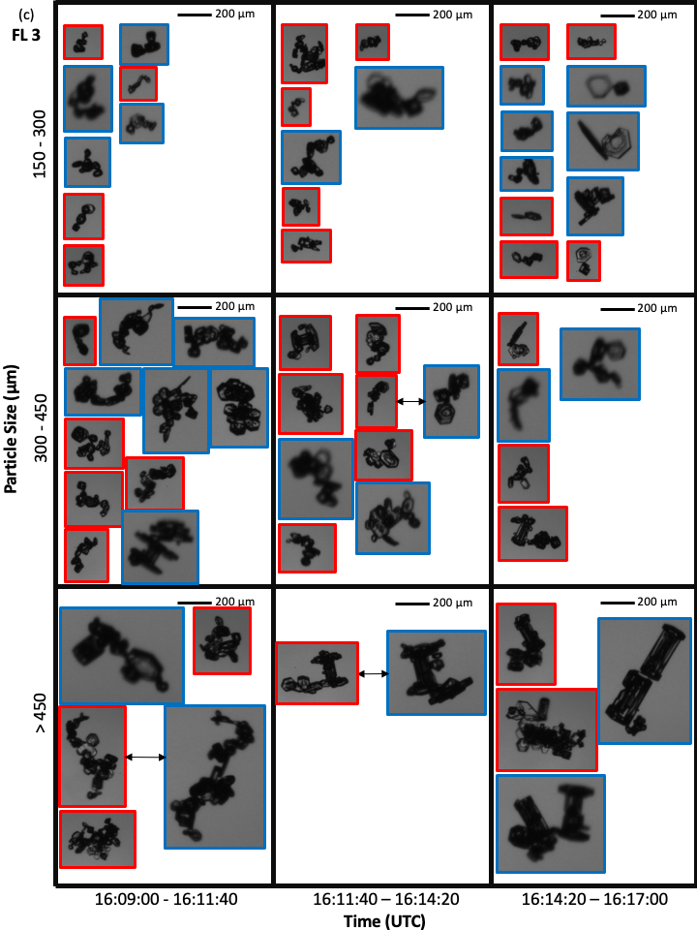
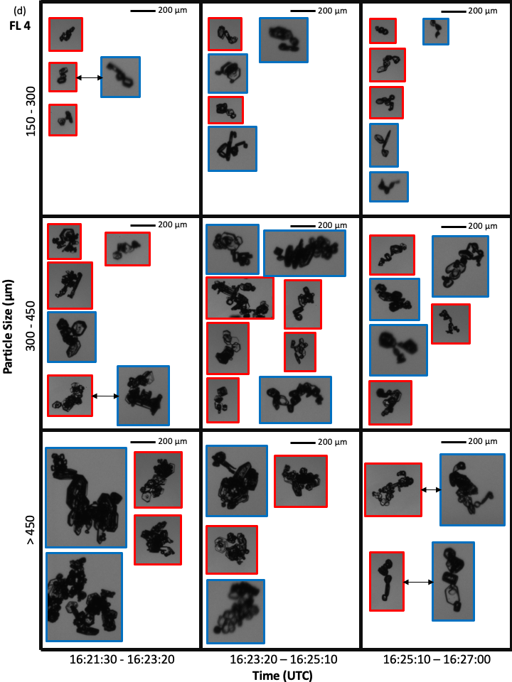

Slide 52
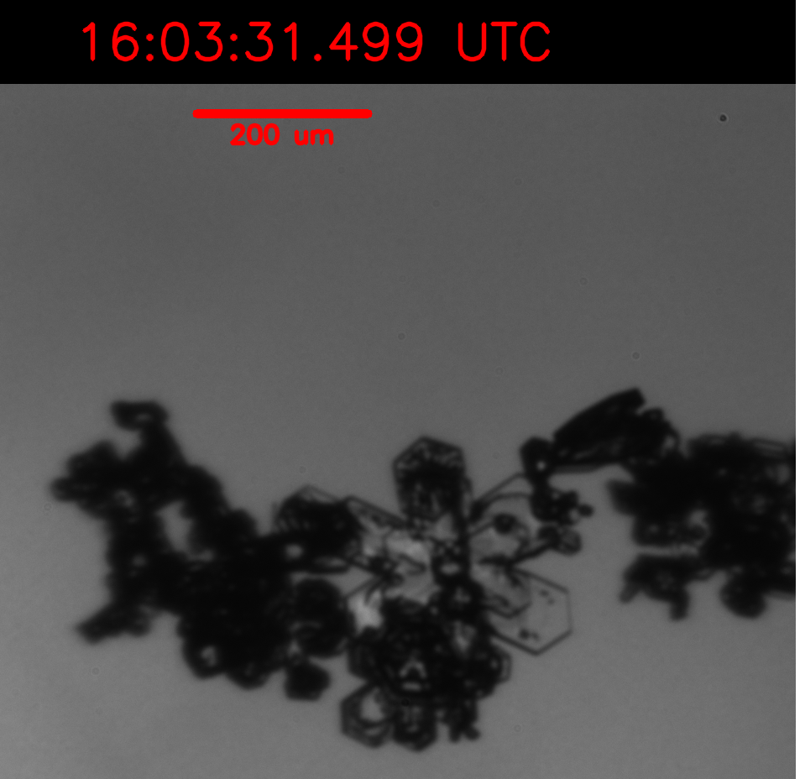
Rimed Chain Example

Slide 53


Slide 54

15:00 UTC Sounding from Cape Canaveral, Florida

Slide 55


Flight Leg 1 (FL1)
15:51:15 – 16:01:00
KMLB Vol Scan: 15:50:30
10 km CAPPI
B
A

Slide 56


16
14
12
10
Altitude (km)
8
6
4
2
A
B

Slide 57



16
14
12
10
Altitude (km)
8
6
4
2
A
B

Slide 58

Uncertainty Analysis (PHIPS chains) – Baird 1994
Product of Two or More Variables (SEC 2-9)
a.) $z= \frac{Chains}{Total \# Particles}$ = $\frac{x}{y}=xy^{−1}$ ; $x^{a}, y^{b}$ ;$δx=\sqrt{x} , δy=\sqrt{y}$
b.) $\log\left(z\right)=a∗\log\left(x\right)+b ∗log⁡(y)$
c.) $\log\left(z\right)=a∗\log\left(x\right)−b ∗log⁡(y)$
d.) $\frac{δz}{z}=a\frac{δx}{x} −b\frac{δy}{y}$
e.) $δz=z(a\frac{δx}{x} −b\frac{δy}{y}$)

Slide 59

PHIPS Classification Software

