Slide 1

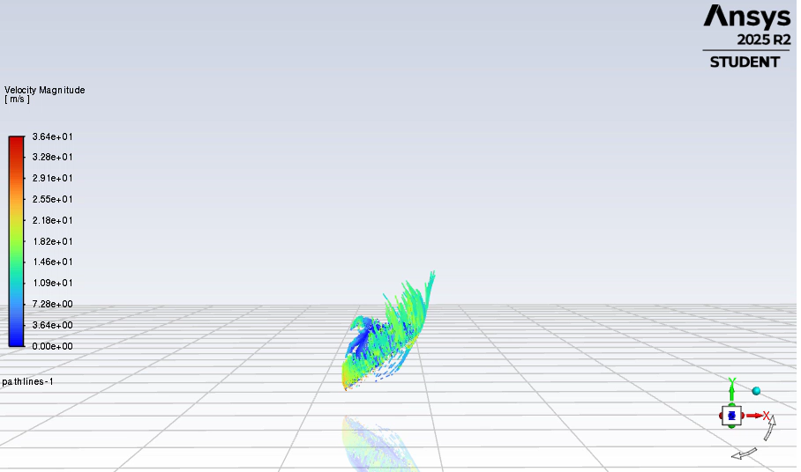
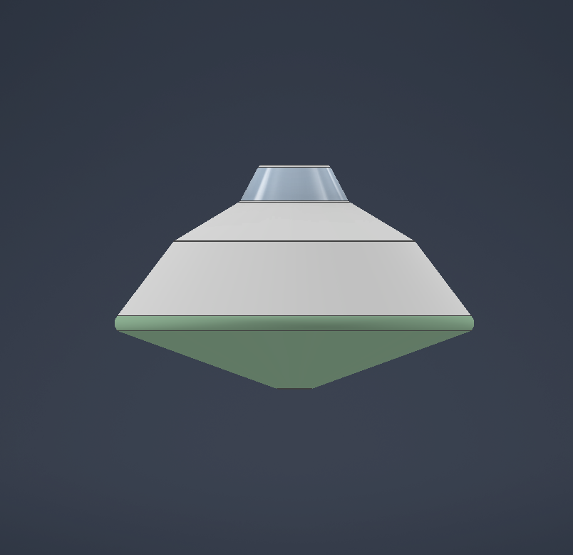
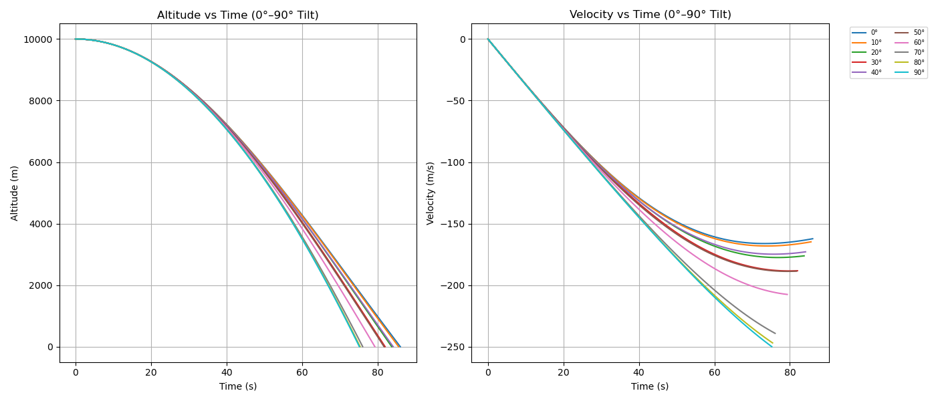
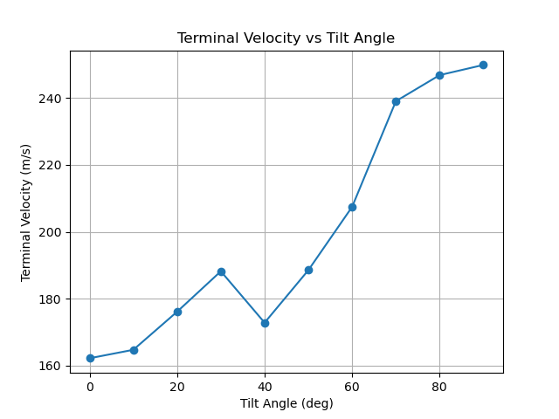
Naimul Hasan* , Terry Trevino, Marcos Fernandez-Tous
Department of Space Studies
Reinforcement Learning Oriented Descent Modeling for a Mars Lander Using Physics-Based Simulation
Need / Problem
Current Mars landing systems rely on pre-defined control logic with limited ability to adapt to uncertain atmospheric conditions.
Autonomous decision-making is required during descent due to communication delays and the strong ties between vehicle attitude, drag, and thermal behavior.
This project addresses this challenge by developing a physics-based Mars descent python simulation that enables reinforcement learning based
control of lander descent.
Apparatus / Facility
An axisymmetric blunt-body Mars lander geometry is modeled using Autodesk inventor design tool. Aerodynamic and thermal simulations are performed using ANSYS Fluent at selected descent conditions. A physics-based descent simulation and reinforcement learning framework are implemented in Python.
Objectives
Multi-phase simulation and modeling effort focused on hypersonic Mars lander descent using a physics-based Python framework and reinforcement learning.
Design an axisymmetric blunt-body lander geometry and perform CFD simulations to characterize aerodynamic drag and thermal behavior across representative hypersonic descent conditions.
Integrate CFD-derived aerodynamic and thermal data into a physics-based Python descent simulation and train a reinforcement learning controller to regulate lander attitude and thrust during descent.
Concept
High-fidelity aerodynamic and thermal behavior is first characterized using computational fluid dynamics at selective hypersonic descent conditions.
These physics-based results are embedded in a fast, Python-based descent simulation. Reinforcement learning is first trained within this simulation and is then used to control lander attitude and thrust during descent.
Current Status
Project is currently in the modeling and simulation development phase.
Lander geometry finalized and aerodynamic CFD simulations completed.
Thermal modeling underway to characterize heat-shield behavior during hypersonic descent.
Physics-based Python descent simulation will be implemented, and the reinforcement learning controller will be trained for descent control.

