Slide 1
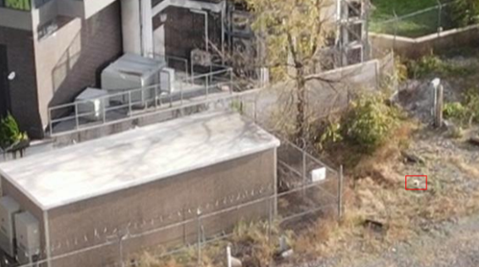
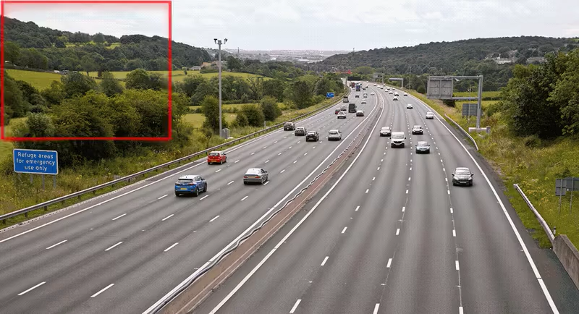
Adaptive Hyper Inference for Enhanced Long-Range UAS Detection
Need/Problem
Data/Facility
Objective
Long-range detection accuracy impacts decision-making in airspace surveillance.
Conventional models lose accuracy over distance, and waste computation on clear scenes. Detecting small, distant objects in low-visibility or complex weather, background clutter, remains challenging (low data diversity).
Early identification of small objects significantly increases the available response window (Counter-UAS decision chain).
- Building a diverse dataset combining real and synthetic imagery (small distanced UASs).
- Synthetic datasets includes low-visibility conditions (fog, haze, snow, and night scenes).
Accurately detect small objects from long distances using camera imagery under variable visibility.
Detect UAS at long ranges at operationally relevant times
Recognize small objects using camera (e.g. UAS vs Birds)
Advancement
Collecting datasets to expand coverage of challenging environments and small distanced UASs.
Concept
Adaptive hyper-inference performs multiple adaptive inference operations
Guided by image content and context.
Balances detection accuracy with computational efficiency.
End Users
Transportation safety and Airspace monitoring agencies.
Autonomous and assisted vehicle systems.
Defense stakeholders
Applicability: Autonomous systems, Artificial Intelligence, Counter-UAS, Computer-vision, National Security
11/12/2024

