Slide 1


Evaluation of the Water Content Measurement Model 3000 Probe
(WCM-3000)
Using the NASA IMPACTS Dataset
Jennifer Moore
Master’s Thesis Defense
University of North Dakota
1 December 2023
Committee Members: Dr. David Delene, Dr. Jared Marquis, Prof. Michael Poellot
Notes:
TIPS:
Check out the Layout Dropdown for more layout design options
It’s recommended not going below 24-point font size for presentations
If your text overflows a placement text box it’s recommended to edit/delete down text content instead of increasing size of text box to accommodate more text
Guides for are available under View tab > check Guides checkbox

Slide 2

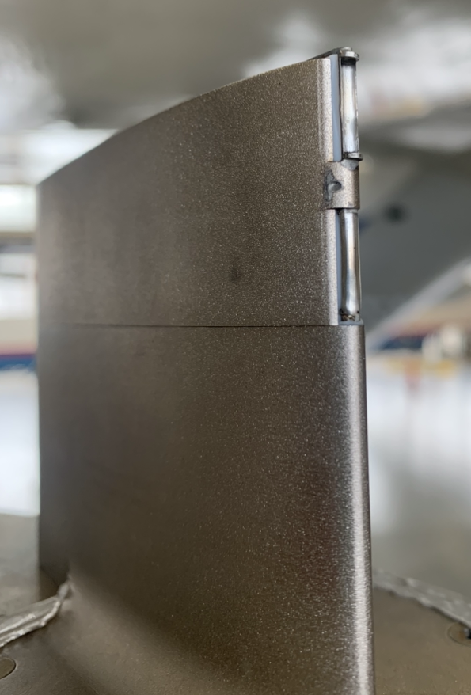
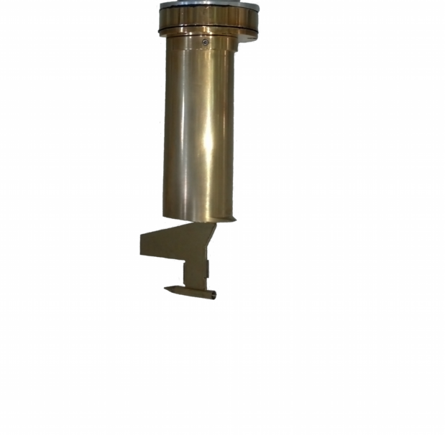
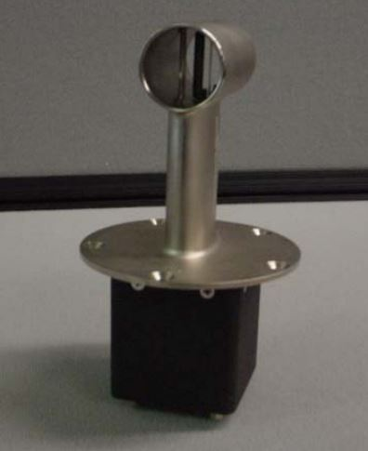
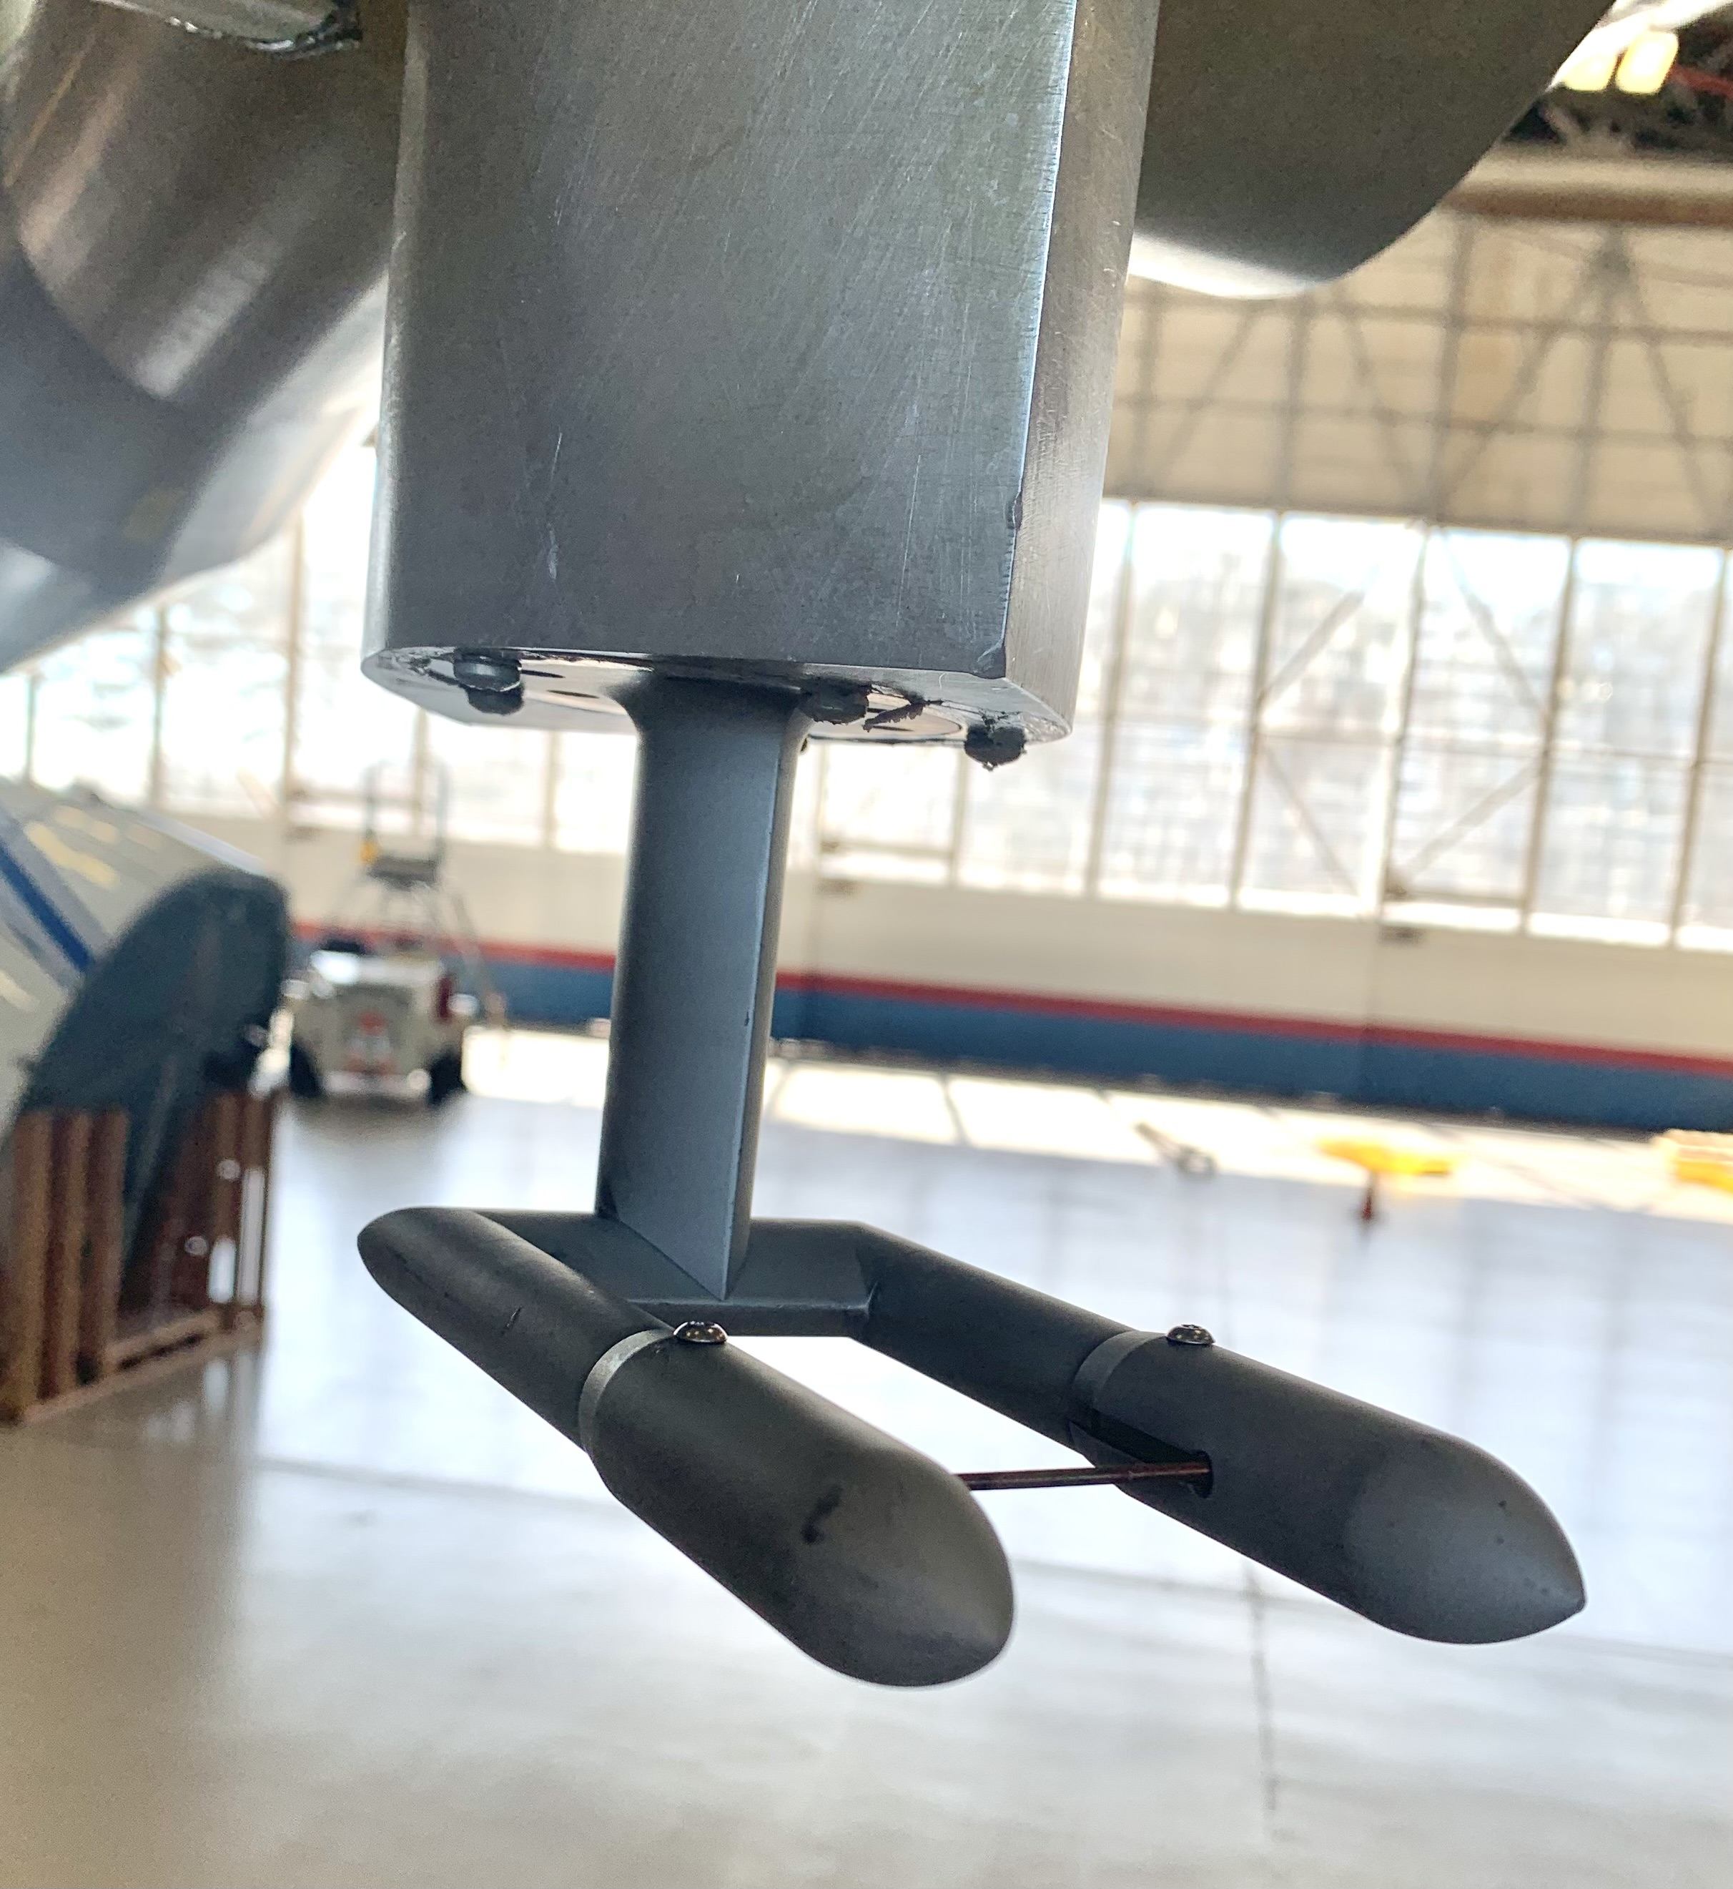
LIQUID WATER CONTENT (LWC)
The amount of liquid water contained in a unit volume of air
Units: g/m³
History of Hot-wire Probes
Izmeritel Vodnosti Oblakov (IVO)
‘1st generation Nevzorov’
Johnson-Williams Probe
Nevzorov
‘2nd generation’
SEA WCM-3000
1950’s
1970’s
1990’s
2000’s
2010’s
PMS King Probe
Other instrumental methods used to measure LWC:
Forward Scattering Probes
Optical Imaging Probes
Evaporative Probes
SEA WCM-2000
©Science Engineering Assoc.
Notes:
JW – Bacharach Instrument Company
One of the ways to measure LWC is by the use of hot-wire probes

Slide 3
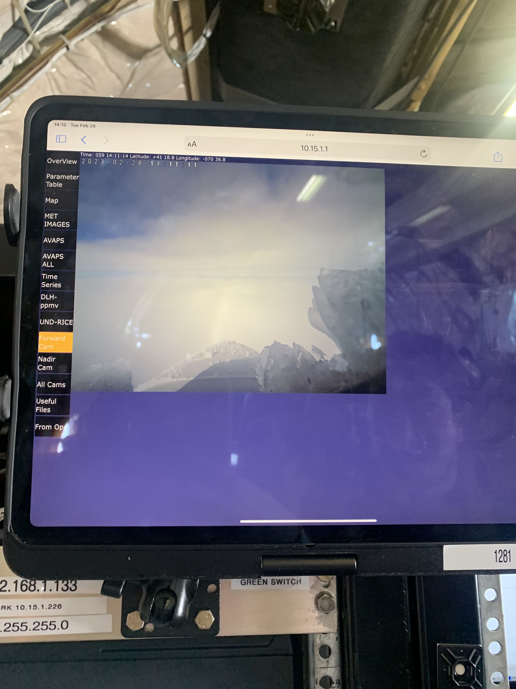
MOTIVATION
What are LWC measurements used for?
Aviation
  Aircraft icing
  Performance testing
Icing Tunnel Research
Verification purposes
  Model studies
  Remote sensing instruments
Cloud Process Studies
  IMPACTS data users
Ice accumulating on the nose of the NASA P-3 aircraft | Feb. 28, 2023
Notes:
Fatal aircraft accidents due to icing
Aircraft frame and engine using hot-wire probes and other microphysical instruments
IMPACTS is studying winter storms, so you want to have lwc to see what is going on in the clouds you are studying

Slide 4
THESIS OBJECTIVE
To determine if the WCM-3000 values agree with the other probes within their measured uncertainties?
What are some reasons to have instrument comparisons?
  Determining instrument limitations
  Interpreting measurements from different probes
  Historical preservation
Comparison is made using the NASA IMPACTS data set

Slide 5
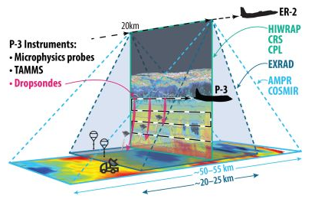
IMPACTS FIELD CAMPAIGN
Investigation of Microphysics and Precipitation in Atlantic Coast Threatening Snowstorms
NASA ER-2 – remote sensing
NASA P-3 – microphysical/environmental
Ground observations
Coordinated flight legs
McMurdie et al., 2022
Goal: To better understand the precipitation process of winter storms (McMurdie et al., 2022)
Notes:
Coordinated flight legs - sample the same region of clouds from different viewpoints

Slide 6
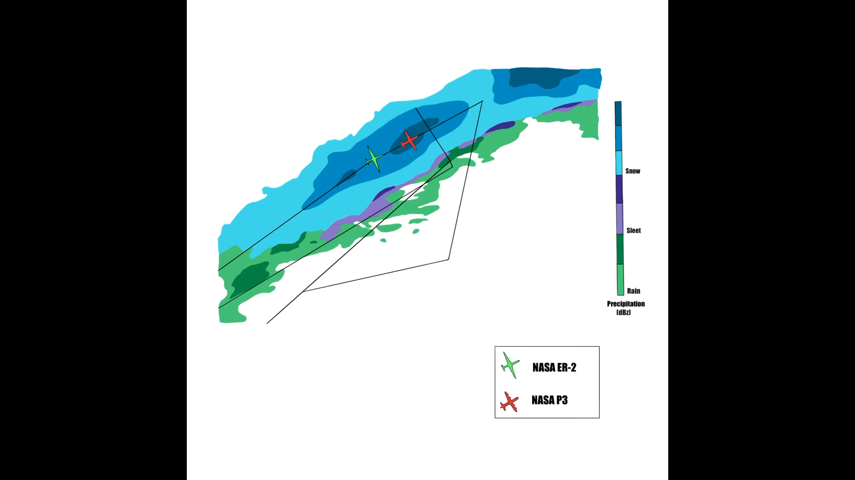
VISION:
Inspiring a sense of wonder, a love of discovery,
and a commitment to serve.
Notes:
TIPS:
Check out the Layout Dropdown for more layout design options
It’s recommended not going below 24-point font size for presentations
If your text overflows a placement text box it’s recommended to edit/delete down text content instead of increasing size of text box to accommodate more text
Guides for textboxes are available under View tab > check Guides checkbox

Slide 7
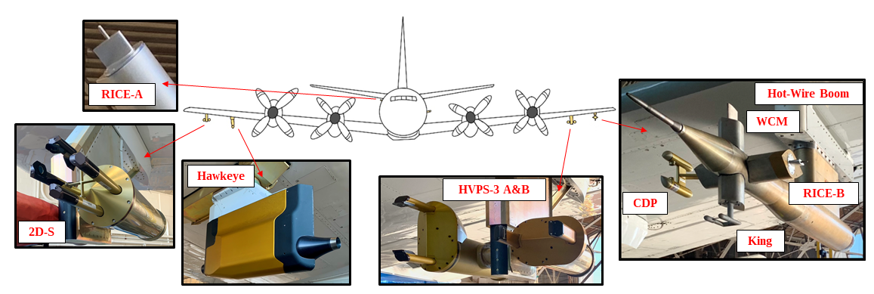
P-3 MICROPHYSICAL INSTRUMENTS
2D-S – Two Dimensional stereo probe
RICE – Rosemount Icing Detector
HVPS – High Volume Precipitation Spectrometer
CDP – Cloud Droplet Probe
Measurement size range overlap from 2 µm – 19.2 mm
Measurement Methods: Forward scattering, hot-wire, optical imaging, vibrating cylinder
Notes:
TIPS:Measure a range of microphysical parameters
Check out the Layout Dropdown for more layout design options
It’s recommended not going below 24-point font size for presentations
If your text overflows a placement text box it’s recommended to edit/delete down text content instead of increasing size of text box to accommodate more text
Guides for are available under View tab > check Guides checkbox

Slide 8
HOT-WIRE PROBES
Droplet size range: 5 – 200 µm
Wire is heated to a specific temperature
  King : 185 °C
  WCM : 140 °C
Wire is maintained at the specific temperature by supplying enough power
Wire is cooled by airflow, water evaporating, radiation, etc.
Derive LWC from power
KING
In this study, the WCM-3000 is compared to the King and CDP
WCM-3000
Notes:
TIPS:
Check out the Layout Dropdown for more layout design options
It’s recommended not going below 24-point font size for presentations
If your text overflows a placement text box it’s recommended to edit/delete down text content instead of increasing size of text box to accommodate more text
Guides for are available under View tab > check Guides checkbox

Slide 9
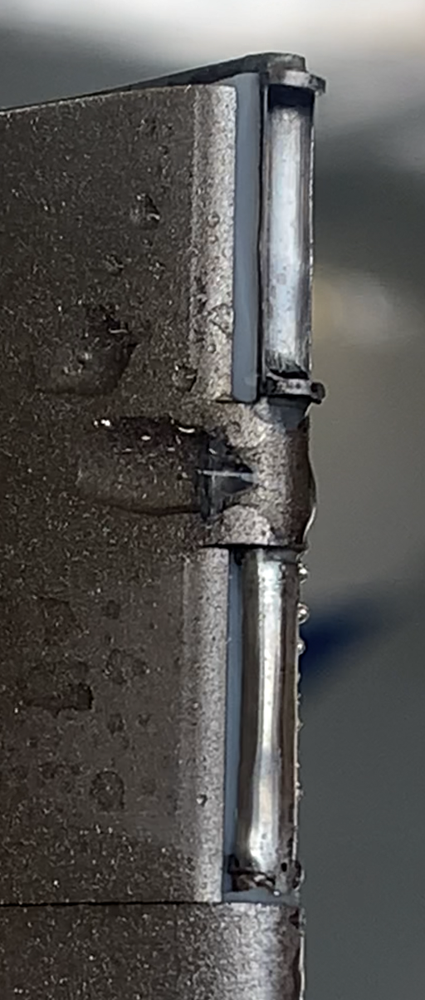
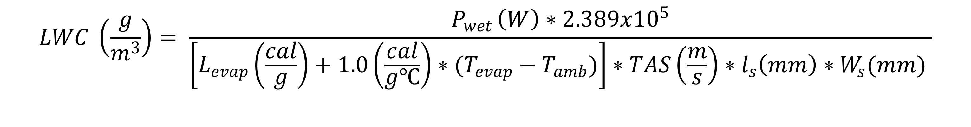
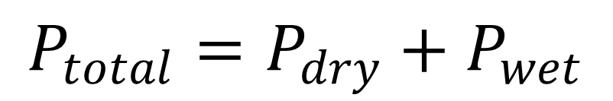
HOT-WIRE PROBE THEORY
Heat Transfer: heat loss from conduction, convection, and/or radiation
Power supplied to the wire is represented by a dry term (P_{dry}) and wet term (P_{wet})
Dry term – heat loss from mechanisms that cool the wire other than the evaporation of water
Wet term – heat loss from the evaporation of water
$$P_{total}=P_{dry}+P_{wet}$$
$$LWC \left(\frac{g}{m^{3}}\right)= \frac{P_{wet }\left(W\right)∗2.389x{10}^{5}}{\left[L_{evap}\left(\frac{cal}{g}\right)+1.0\left(\frac{cal}{g℃}\right)∗(T_{evap}−T_{amb})\right]∗TAS\left(\frac{m}{s}\right)∗l_{s}\left(mm\right)∗W_{s}(mm) }$$
L_{evap} - latent heat of evaporation, T_{evap} - evaporative temperature, T_{amb} - ambient temperature, TAS - true air speed, l_{s} - length of the sensor, and W_{s} - width of the sensor
Close up of WCM-3000 elements
Notes:
TIPS:
Check out the Layout Dropdown for more layout design options
It’s recommended not going below 24-point font size for presentations
If your text overflows a placement text box it’s recommended to edit/delete down text content instead of increasing size of text box to accommodate more text
Guides for are available under View tab > check Guides checkbox

Slide 10
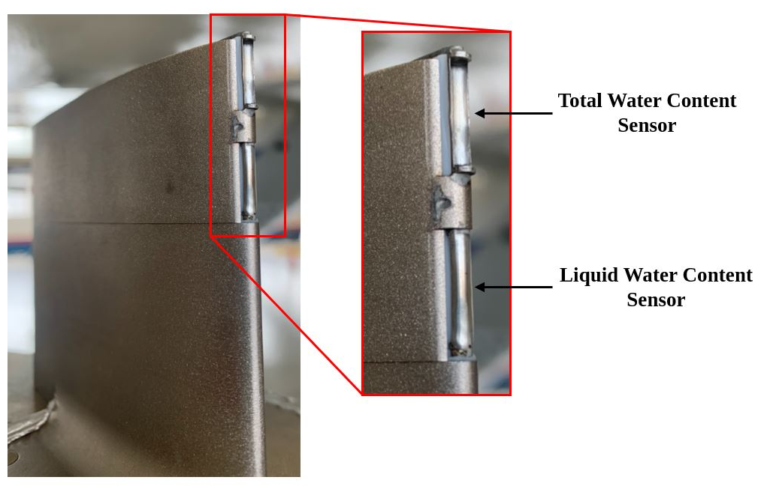
WCM-3000
Concave Sensor – TWC
  Measures both liquid droplets and ice particles
  Cannot aerodynamically contain all ice particles
Convex Sensor – LWC
  Measures liquid droplets
  Residual sensitivity to ice particles
Notes:
TIPS:
Check out the Layout Dropdown for more layout design options
It’s recommended not going below 24-point font size for presentations
If your text overflows a placement text box it’s recommended to edit/delete down text content instead of increasing size of text box to accommodate more text
Guides for are available under View tab > check Guides checkbox

Slide 11
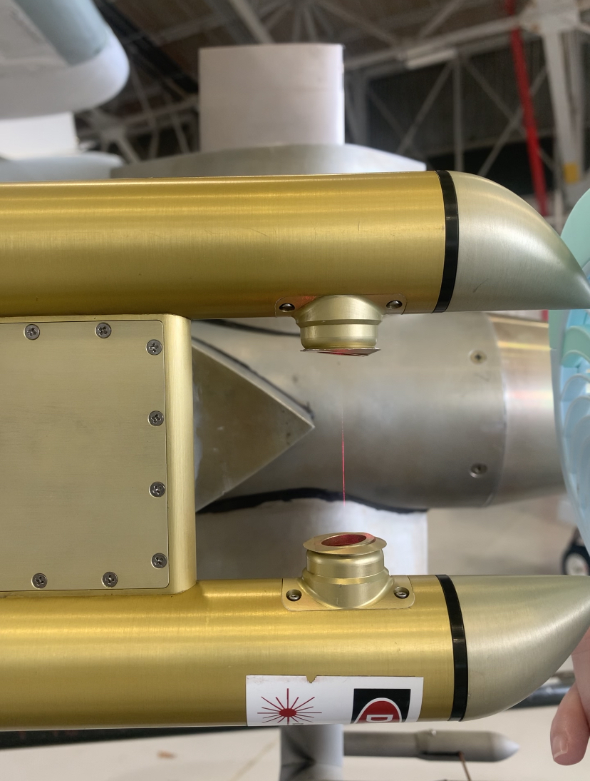
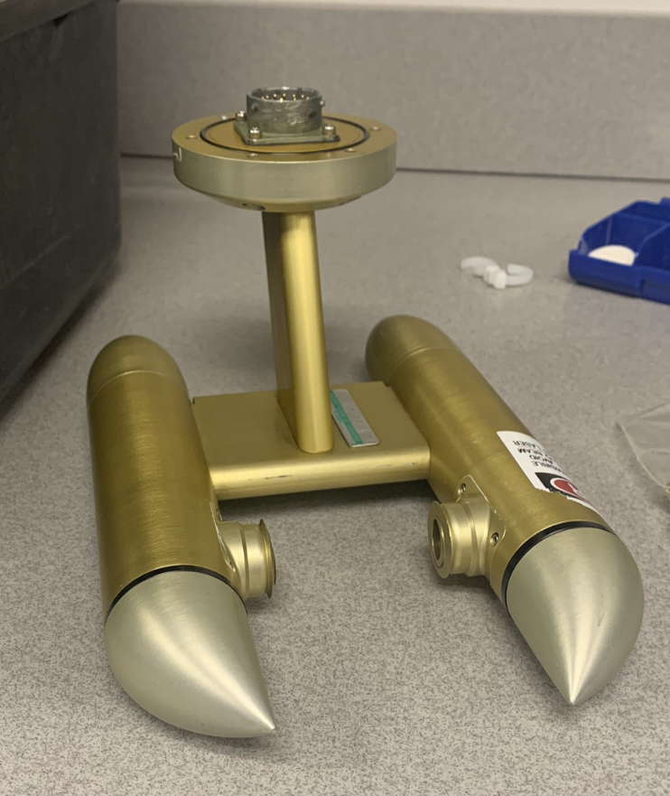
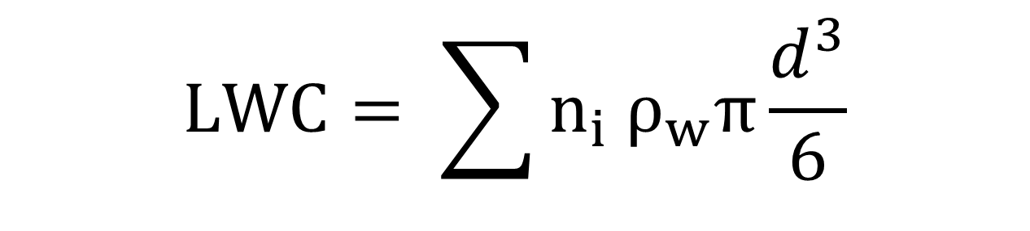
CLOUD DROPLET PROBE (CDP)
Forward Scattering Probe
Measures droplets between 2 – 50 µm
Droplets scatter the laser’s light within a range of 4 –12° into the detector
Integrating droplet distribution to get LWC
$$LWC= \sum{n_{i} ρ_{w}π\frac{d^{3}}{6}}$$
The CDP will be used in this study for:
Comparison with WCM and King
Droplet size distribution
CDP measuring small liquid droplets
CDP on lab bench
Notes:
TIPS:
Check out the Layout Dropdown for more layout design options
It’s recommended not going below 24-point font size for presentations
If your text overflows a placement text box it’s recommended to edit/delete down text content instead of increasing size of text box to accommodate more text
Guides for are available under View tab > check Guides checkbox

Slide 12
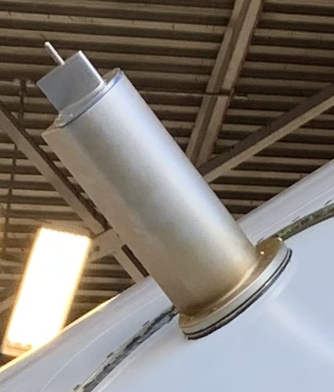
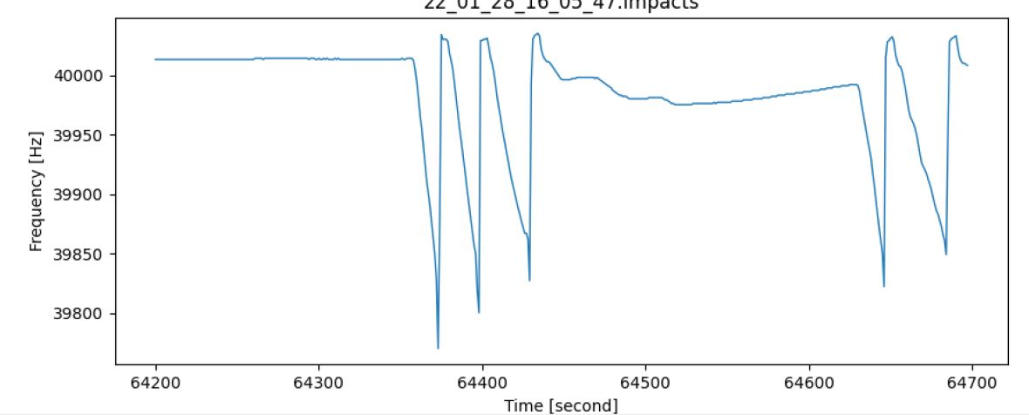
ROSEMOUNT ICING DETECTOR (RICE)
Vibrating Cylinder
Measures supercooled liquid water (SCLW)
SCLW freezes on contact with the metal vibrating cylinder
As SCLW accretes, it dampens the frequency of the RICE
RICE shedding accreted ice
RICE is used in this study to verify periods of SCLW
SCLW Accreting
RICE Probe on NASA P-3 fuselage
Notes:
TIPS:
Check out the Layout Dropdown for more layout design options
It’s recommended not going below 24-point font size for presentations
If your text overflows a placement text box it’s recommended to edit/delete down text content instead of increasing size of text box to accommodate more text
Guides for are available under View tab > check Guides checkbox

Slide 13
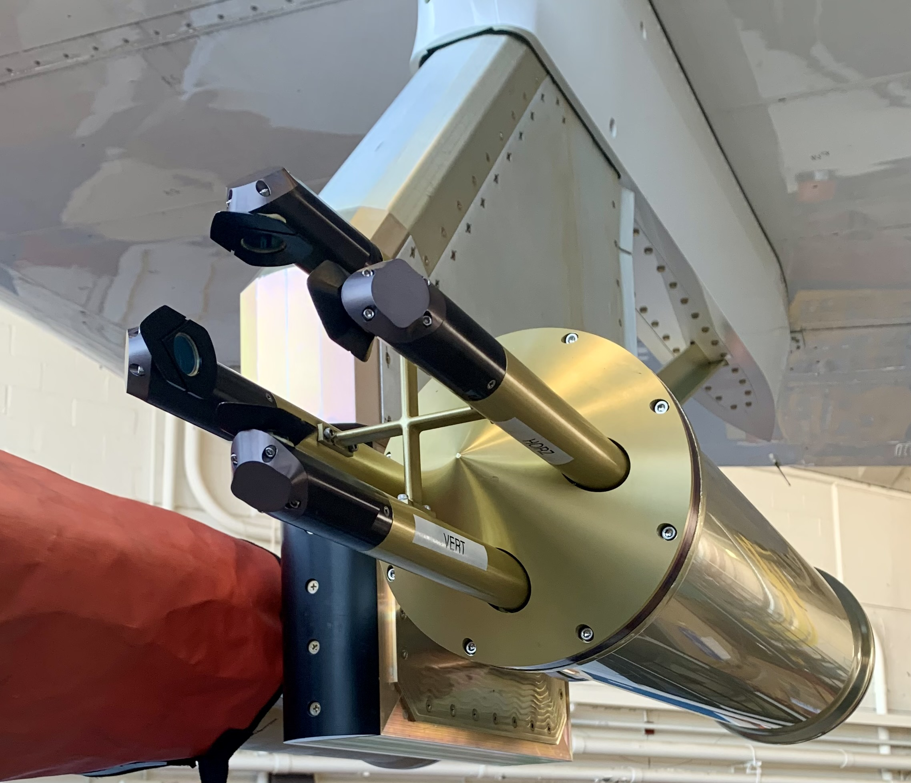
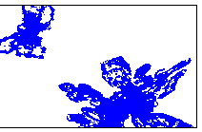
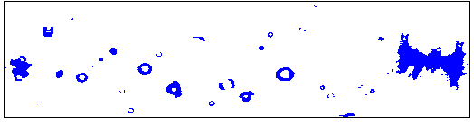
2-DIMENSIONAL STEREO PROBE (2D-S)
Optical Imaging Probe
Size Range 10 µm – 1.280 mm
Orthogonal lasers sample cloud particles
As cloud particles pass in front of the laser beam, a shadow is casted on the 128-photodiode array resulting in an image
In this study the 2D-S will be used to verify particle types and droplet diameter sizes
Images from 2D-S
Notes:
TIPS:
Check out the Layout Dropdown for more layout design options
It’s recommended not going below 24-point font size for presentations
If your text overflows a placement text box it’s recommended to edit/delete down text content instead of increasing size of text box to accommodate more text
Guides for are available under View tab > check Guides checkbox

Slide 14
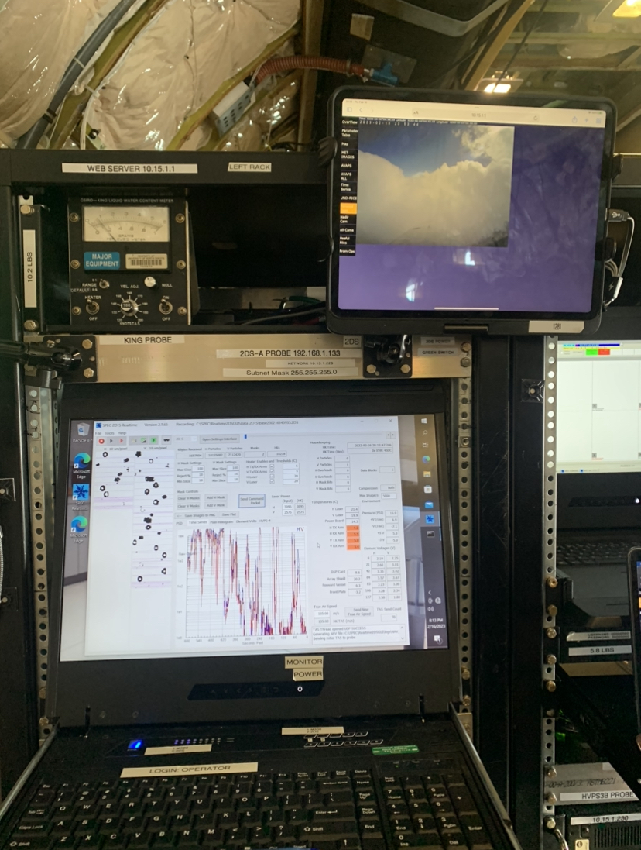
DATA PROCESSING
Airborne Data Processing and Analysis (ADPAA) software package (Delene, 2011)
Takes the instrument observations and processes them to derive analysis parameters
  Calibrations (i.e. speed run calibrations, bead tests)
  Correction (i.e. dry power term correction)
  Quality Assurance
UND Instrument Rack on the NASA P-3
Notes:
TIPS:
Check out the Layout Dropdown for more layout design options
It’s recommended not going below 24-point font size for presentations
If your text overflows a placement text box it’s recommended to edit/delete down text content instead of increasing size of text box to accommodate more text
Guides for are available under View tab > check Guides checkbox

Slide 15
METHODOLOGY
Evaluation of the WCM-3000 is done by comparing the LWC measurements to measurements taken by the CDP and King probe
Flight conditions are defined to compare instruments in:
  Cloud environments where probe measurements should agree
  A typical cloud environment in IMPACTS science flights
Uncertainty calculation
Notes:
TIPS:
Check out the Layout Dropdown for more layout design options
It’s recommended not going below 24-point font size for presentations
If your text overflows a placement text box it’s recommended to edit/delete down text content instead of increasing size of text box to accommodate more text
Guides for are available under View tab > check Guides checkbox

Slide 16
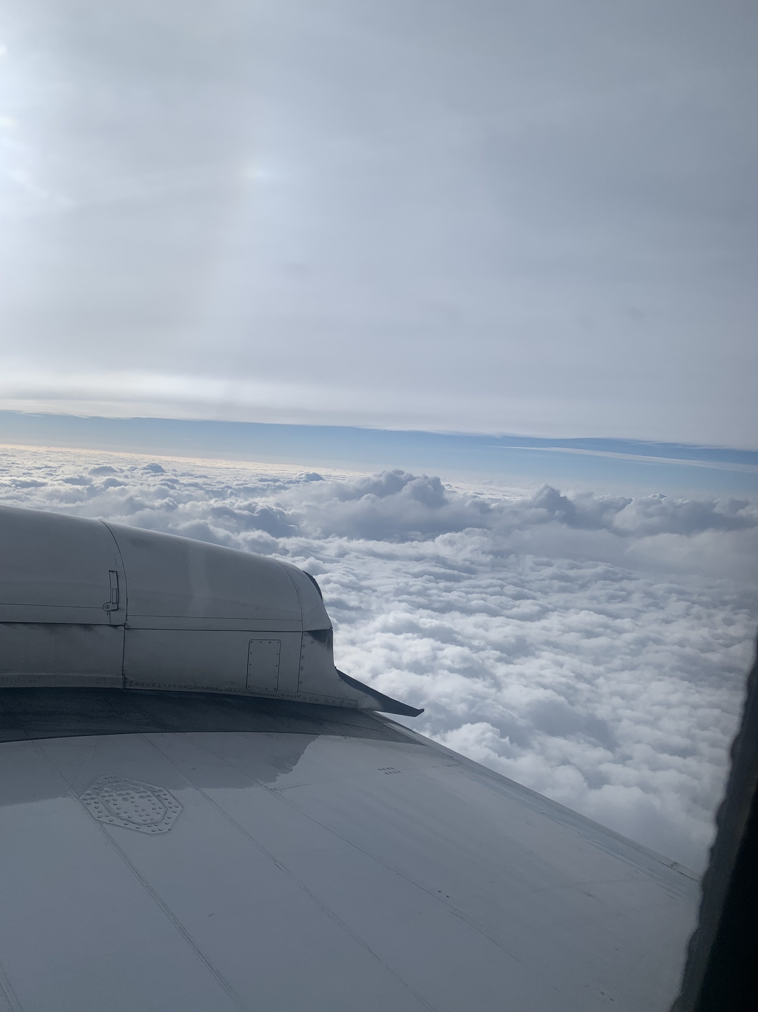
CLOUD CONDITIONS
Relatively constant environmental parameters during time periods (i.e. TAS and altitude)
Liquid Water Cloud
  Temperatures > 0 °C
  No SCLW and no ice particles
  Droplet sizes < 50 µm
Supercooled Liquid Water Cloud
  Temperatures < 0 °C
  No ice particles
  Droplet sizes < 50 µm
Mixed Phase Cloud
  Temperatures < 0 °C
  WCM TWC > LWC
  Droplet sizes < 200 µm
Notes:
TIPS:
Check out the Layout Dropdown for more layout design options
It’s recommended not going below 24-point font size for presentations
If your text overflows a placement text box it’s recommended to edit/delete down text content instead of increasing size of text box to accommodate more text
Guides for are available under View tab > check Guides checkbox

Slide 17
UNCERTAINTY CALCULATION
$$Absolute Error=Measured Value∗Relative Error$$
Calculating the absolute error (uncertainty)
Relative error – 10%
Overlap in uncertainty shows agreement in probe measurements
Where does error come from?
  Hot-wires : dry term
  CDP : limitation in sizing and counting of droplets
0.66 g/m³
0.60 g/m³
0.54 g/m³
Abs error = (0.60 g/m³) * 10%
Abs error = ± 0.06 g/m³
Notes:
TIPS:
Check out the Layout Dropdown for more layout design options
It’s recommended not going below 24-point font size for presentations
If your text overflows a placement text box it’s recommended to edit/delete down text content instead of increasing size of text box to accommodate more text
Guides for are available under View tab > check Guides checkbox

Slide 18
LIQUID WATER CLOUD FLIGHT SEGMENT
Notes:
TIPS:
Check out the Layout Dropdown for more layout design options
It’s recommended not going below 24-point font size for presentations
If your text overflows a placement text box it’s recommended to edit/delete down text content instead of increasing size of text box to accommodate more text
Guides for textboxes are available under View tab > check Guides checkbox

Slide 19
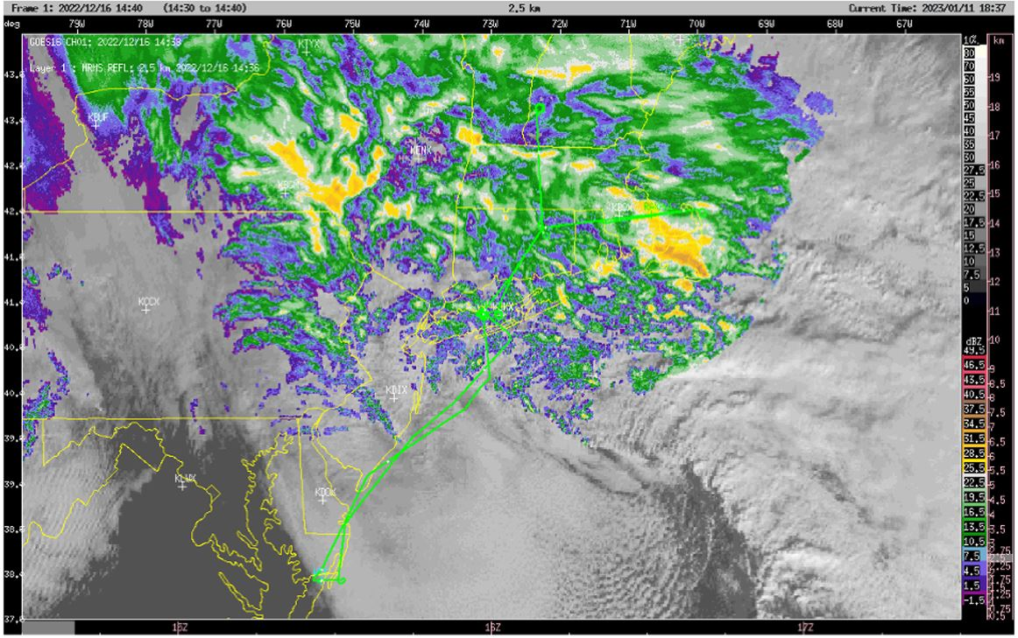
ENVIRONMENT
16 December 2022
Flight over Long Island, NY
Low pressure system
Observed clouds and precipitation
Multiple segments of above freezing temperatures
16 December 2022 Flight Track with GOES visible imagery and composite MRMS reflectivity overlaid © McMurdie
Notes:
TIPS:Flight conducted to sample precipitation over Long Island, NY
Above freezing temperatures sampled at 12:41:10 – 13:12:51 UTC
P-3 performs
Downward spiral from 5000 m to 900 m
Transits at 900 m
Upward spiral from 900 m to 3750 m
RICE probe confirms no SCLW
Check out the Layout Dropdown for more layout design options
It’s recommended not going below 24-point font size for presentations
If your text overflows a placement text box it’s recommended to edit/delete down text content instead of increasing size of text box to accommodate more text
Guides for are available under View tab > check Guides checkbox

Slide 20
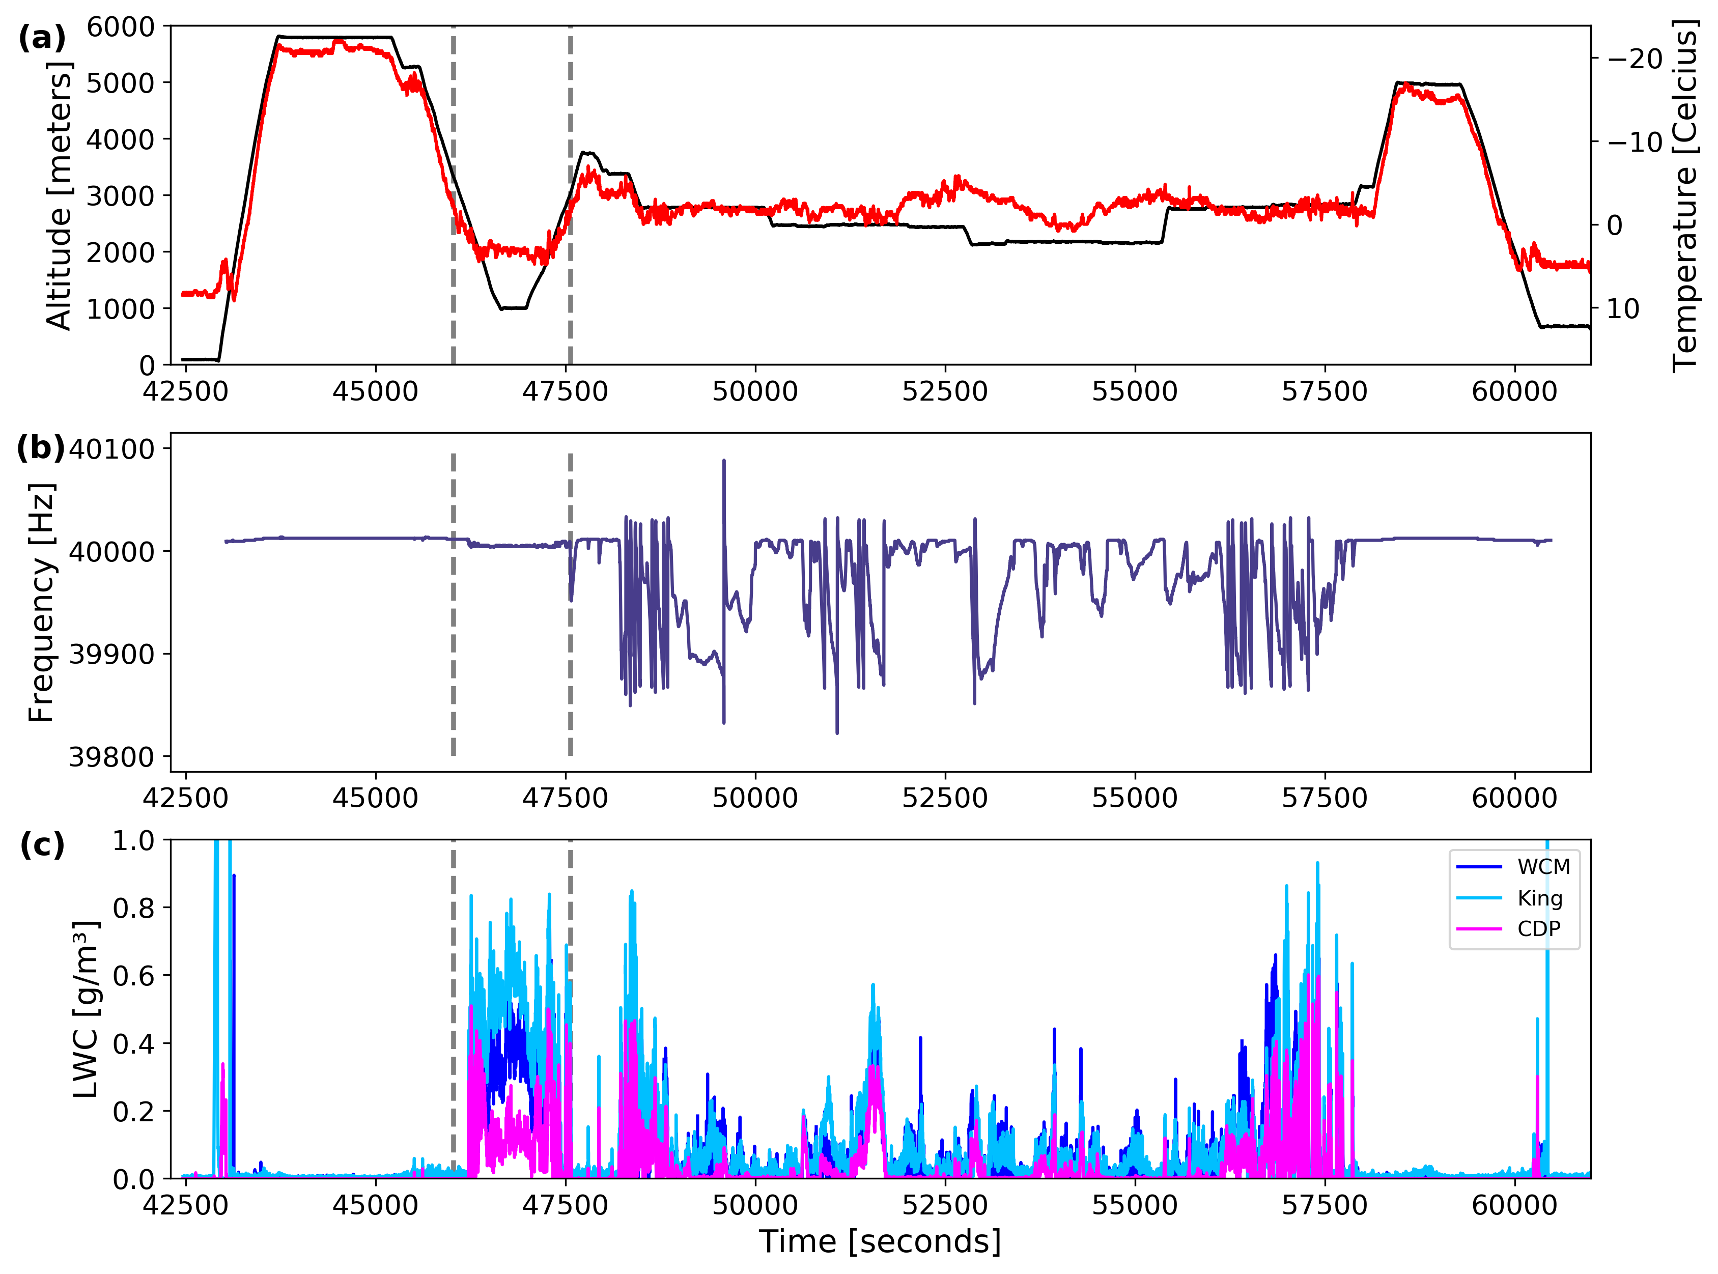

AIRCRAFT OBSERVATIONS
Liquid Water Cloud Criteria:
Constant altitude
Temperatures > 0 °C
No SCLW and no ice particles
Droplet sizes < 50 µm
Notes:
TIPS:Flight conducted to sample precipitation over Long Island, NY
Above freezing temperatures sampled at 12:41:10 – 13:12:51 UTC
P-3 performs
Downward spiral from 5000 m to 900 m
Transits at 900 m
Upward spiral from 900 m to 3750 m
RICE probe confirms no SCLW
Check out the Layout Dropdown for more layout design options
It’s recommended not going below 24-point font size for presentations
If your text overflows a placement text box it’s recommended to edit/delete down text content instead of increasing size of text box to accommodate more text
Guides for are available under View tab > check Guides checkbox

Slide 21
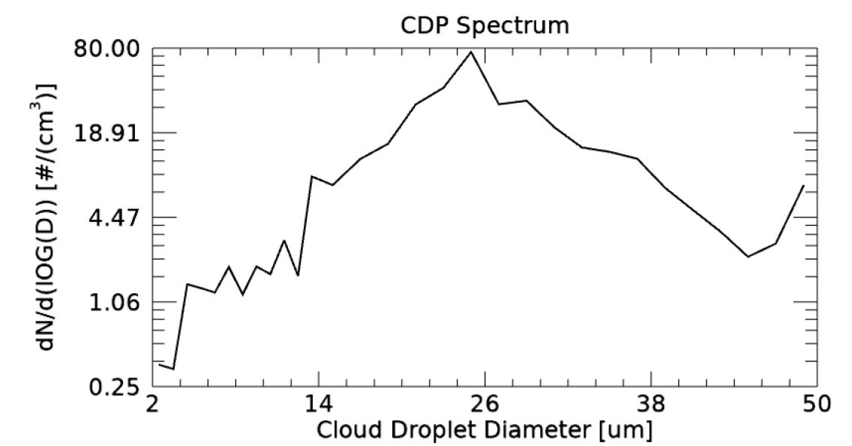
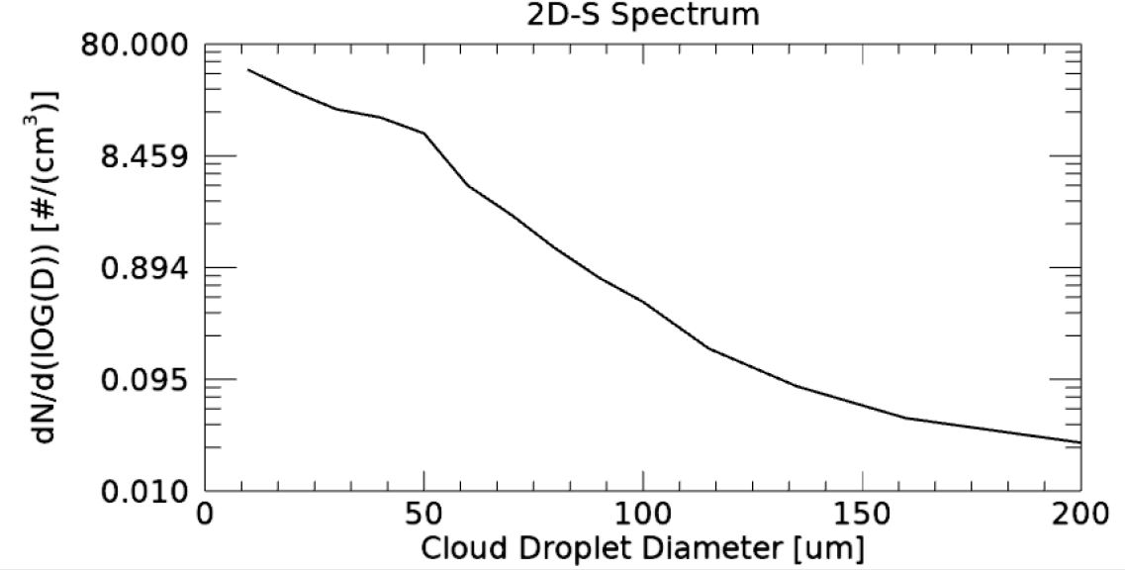
CLOUD DROPLET DIAMETERS
Liquid Water Cloud Criteria:
Constant altitude
Temperatures > 0 °C
No SCLW and no ice particles
Droplet sizes < 50 µm
Notes:
TIPS:
Check out the Layout Dropdown for more layout design options
It’s recommended not going below 24-point font size for presentations
If your text overflows a placement text box it’s recommended to edit/delete down text content instead of increasing size of text box to accommodate more text
Guides for are available under View tab > check Guides checkbox

Slide 22
CLOUD DROPLET DIAMETERS
Liquid Water Cloud Criteria:
Constant altitude
Temperatures > 0 °C
No SCLW and no ice particles
Small droplet sizes
  2D-S shows particles up to 200 µm
  Limited on above freezing cases
Notes:
TIPS:
Check out the Layout Dropdown for more layout design options
It’s recommended not going below 24-point font size for presentations
If your text overflows a placement text box it’s recommended to edit/delete down text content instead of increasing size of text box to accommodate more text
Guides for are available under View tab > check Guides checkbox

Slide 23
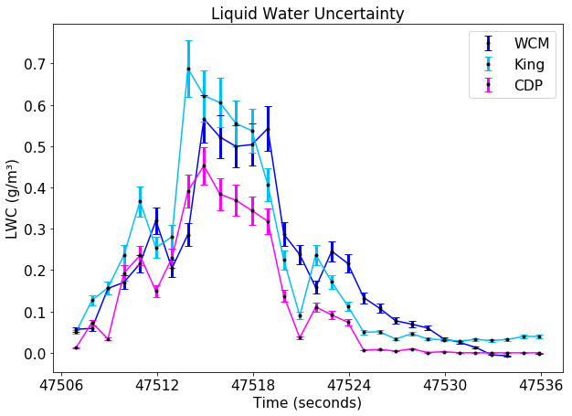

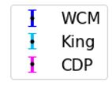
LIQUID WATER TIME SERIES
Some overlap in uncertainties
General trend
WCM – Gradual decline in LWC once out of cloud
CDP – Measuring less LWC
  Larger droplets present
  Calibration
Abs. error = (measured value) * 10%
Takeaway:
King and WCM do not always agree within measured uncertainty
Notes:
TIPS:
Check out the Layout Dropdown for more layout design options
It’s recommended not going below 24-point font size for presentations
If your text overflows a placement text box it’s recommended to edit/delete down text content instead of increasing size of text box to accommodate more text
Guides for are available under View tab > check Guides checkbox

Slide 24
SUPERCOOLED LIQUID WATER CLOUD
FLIGHT SEGMENT
Notes:
TIPS:
Check out the Layout Dropdown for more layout design options
It’s recommended not going below 24-point font size for presentations
If your text overflows a placement text box it’s recommended to edit/delete down text content instead of increasing size of text box to accommodate more text
Guides for textboxes are available under View tab > check Guides checkbox

Slide 25
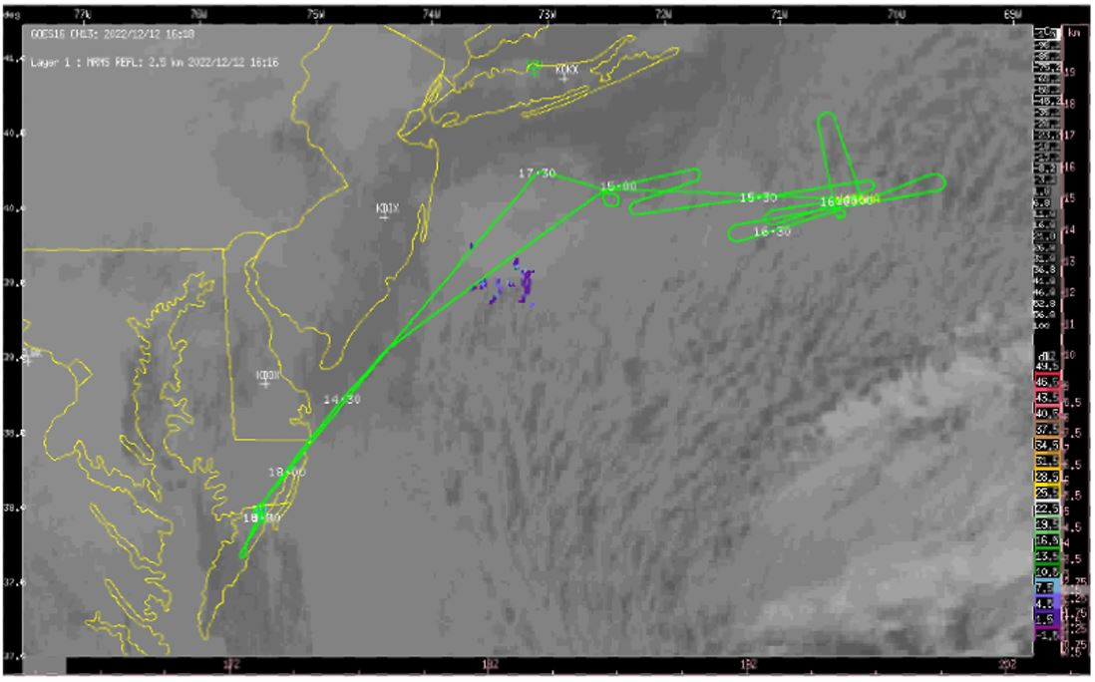
ENVIRONMENT
12 December 2022
Flight off the New Jersey Coastline
Observed stratocumulus clouds
Clear air flight maneuvers
12 December 2022 Flight Track with IR channel 13 brightness temperatures overlaid © McMurdie
Notes:
TIPS:Flight conducted to sample precipitation over Long Island, NY
Above freezing temperatures sampled at 12:41:10 – 13:12:51 UTC
P-3 performs
Downward spiral from 5000 m to 900 m
Transits at 900 m
Upward spiral from 900 m to 3750 m
RICE probe confirms no SCLW
Check out the Layout Dropdown for more layout design options
It’s recommended not going below 24-point font size for presentations
If your text overflows a placement text box it’s recommended to edit/delete down text content instead of increasing size of text box to accommodate more text
Guides for are available under View tab > check Guides checkbox

Slide 26
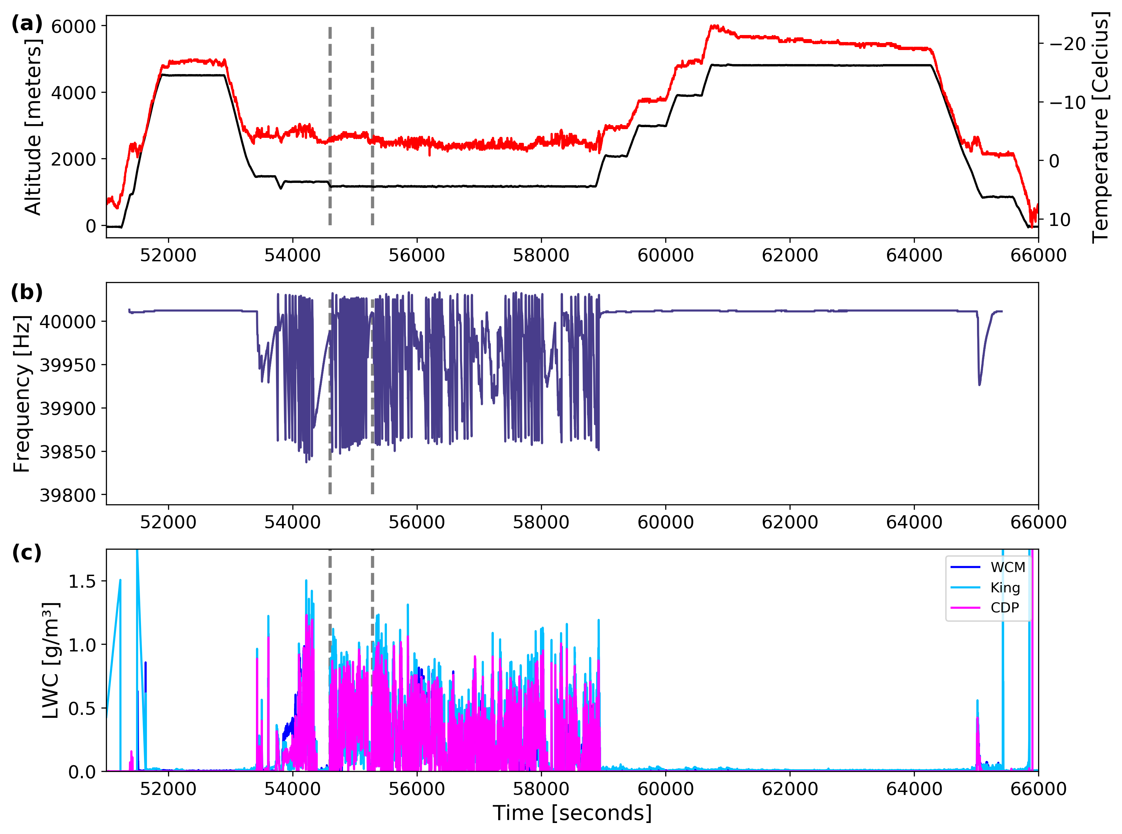
AIRCRAFT OBSERVATIONS
SCLW Cloud Criteria:
Constant altitude
Temperatures < 0 °C
SCLW
No ice particles
Droplet sizes < 50 µm
Notes:
TIPS:Flight conducted to sample both in cloud and clear air for calibrations
Stratocumulus clouds off the shore of New Jersey
Droplets less than 50 µm
P-3 is at 11 km
Temperature is -3 °C
RICE probe indicates supercooled liquid water
Check out the Layout Dropdown for more layout design options
It’s recommended not going below 24-point font size for presentations
If your text overflows a placement text box it’s recommended to edit/delete down text content instead of increasing size of text box to accommodate more text
Guides for are available under View tab > check Guides checkbox

Slide 27
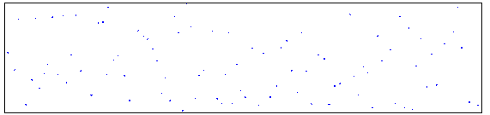
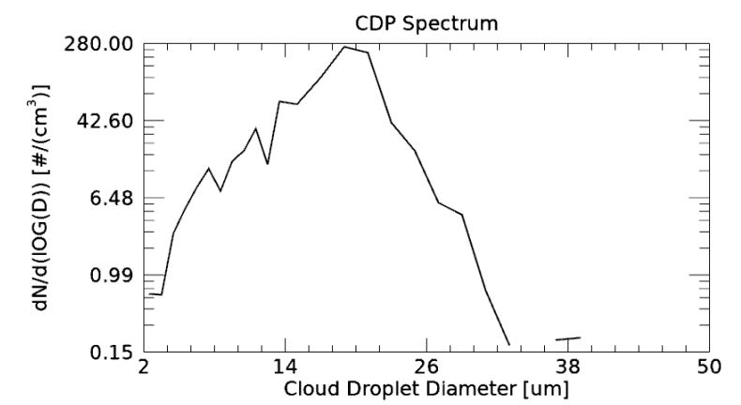
CLOUD DROPLET DIAMETERS
SCLW Cloud Criteria:
Constant altitude
Temperatures < 0 °C
SCLW
No ice particles
Droplet sizes < 50 µm
2D-S
Only SCLW droplets
1.280 mm
Notes:
TIPS:
Check out the Layout Dropdown for more layout design options
It’s recommended not going below 24-point font size for presentations
If your text overflows a placement text box it’s recommended to edit/delete down text content instead of increasing size of text box to accommodate more text
Guides for are available under View tab > check Guides checkbox

Slide 28
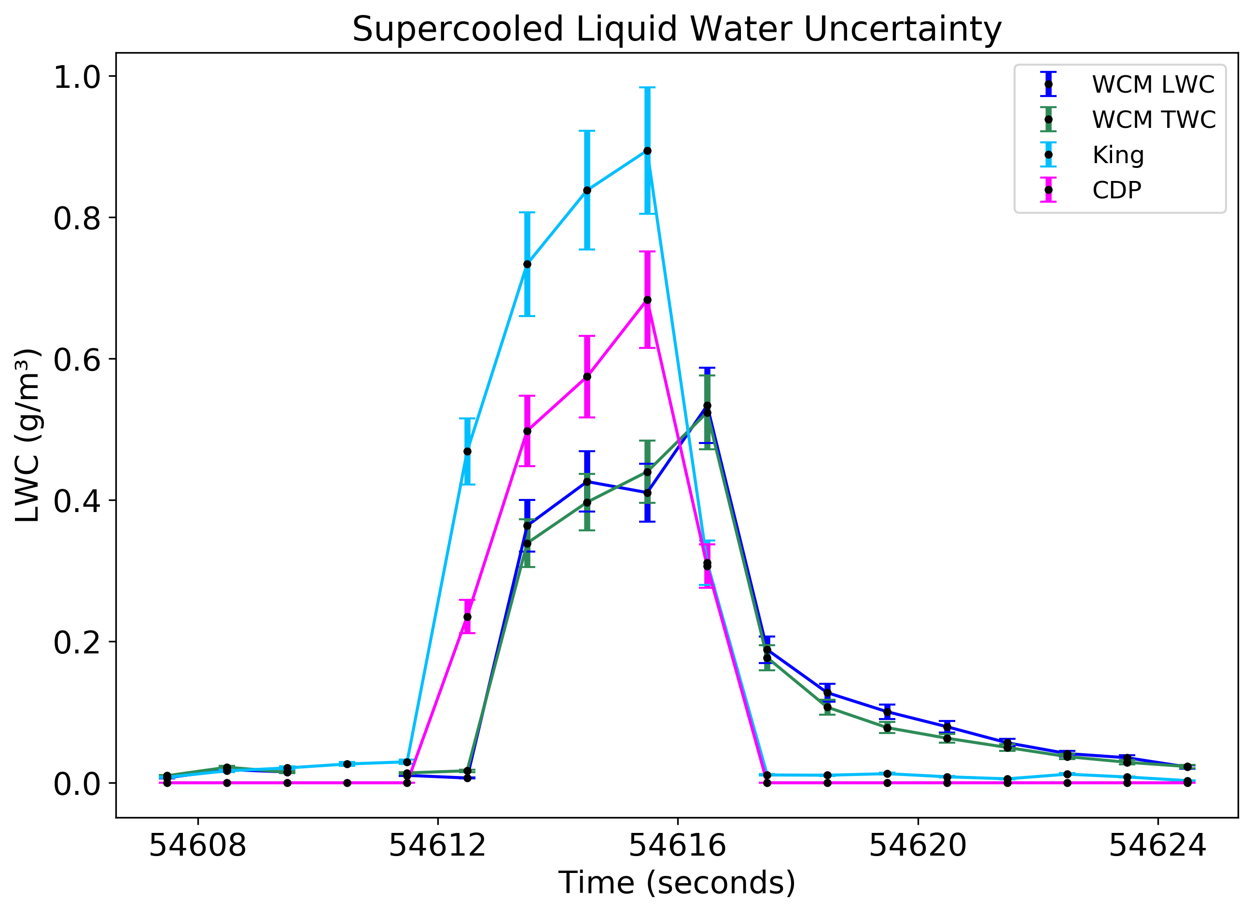

SCLW TIME SERIES
General trend
WCM – Delay in response
WCM – Gradual decline in LWC once out of cloud
Abs. error = (measured value) * 10%
Takeaways:
Instruments do not agree within measured uncertainty
Notes:
TIPS:
Check out the Layout Dropdown for more layout design options
It’s recommended not going below 24-point font size for presentations
If your text overflows a placement text box it’s recommended to edit/delete down text content instead of increasing size of text box to accommodate more text
Guides for are available under View tab > check Guides checkbox

Slide 29
MIXED PHASE CLOUD
FLIGHT SEGMENT
Notes:
TIPS:
Check out the Layout Dropdown for more layout design options
It’s recommended not going below 24-point font size for presentations
If your text overflows a placement text box it’s recommended to edit/delete down text content instead of increasing size of text box to accommodate more text
Guides for textboxes are available under View tab > check Guides checkbox

Slide 30
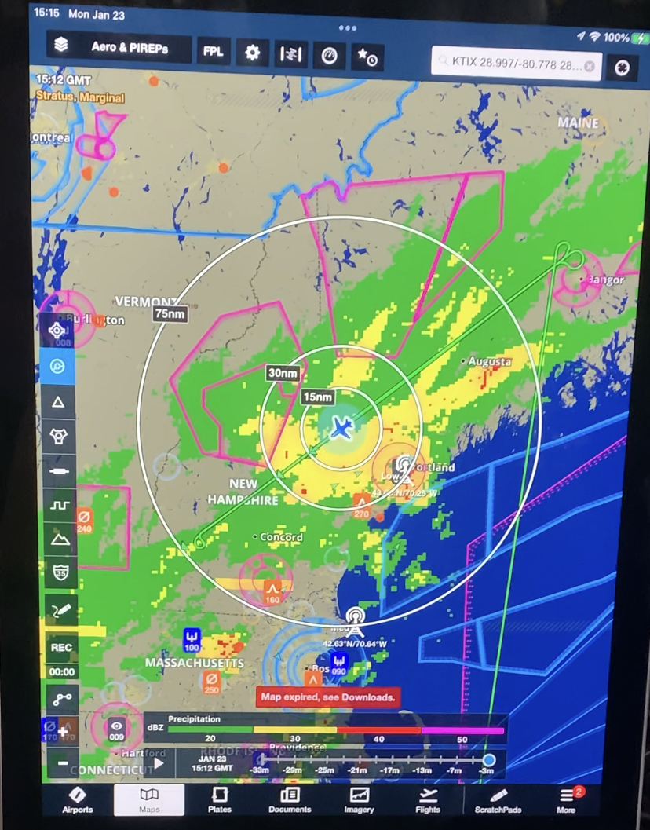
ENVIRONMENT
23 January, 2023
Flight sampled a winter storm system over New England and Gulf of Maine
Deepening surface low
23 January 2023 Flight Track with Radar Reflectivity overlaid

Slide 31
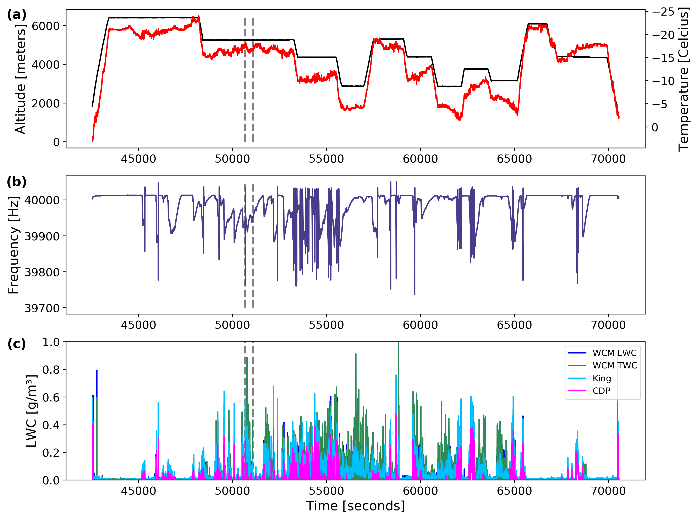
AIRCRAFT OBSERVATIONS
Mixed Phase Cloud Criteria:
Constant altitude
Temperatures < 0 °C
TWC > LWC
Droplet sizes < 200 µm
Notes:
TIPS:
Check out the Layout Dropdown for more layout design options
It’s recommended not going below 24-point font size for presentations
If your text overflows a placement text box it’s recommended to edit/delete down text content instead of increasing size of text box to accommodate more text
Guides for are available under View tab > check Guides checkbox

Slide 32
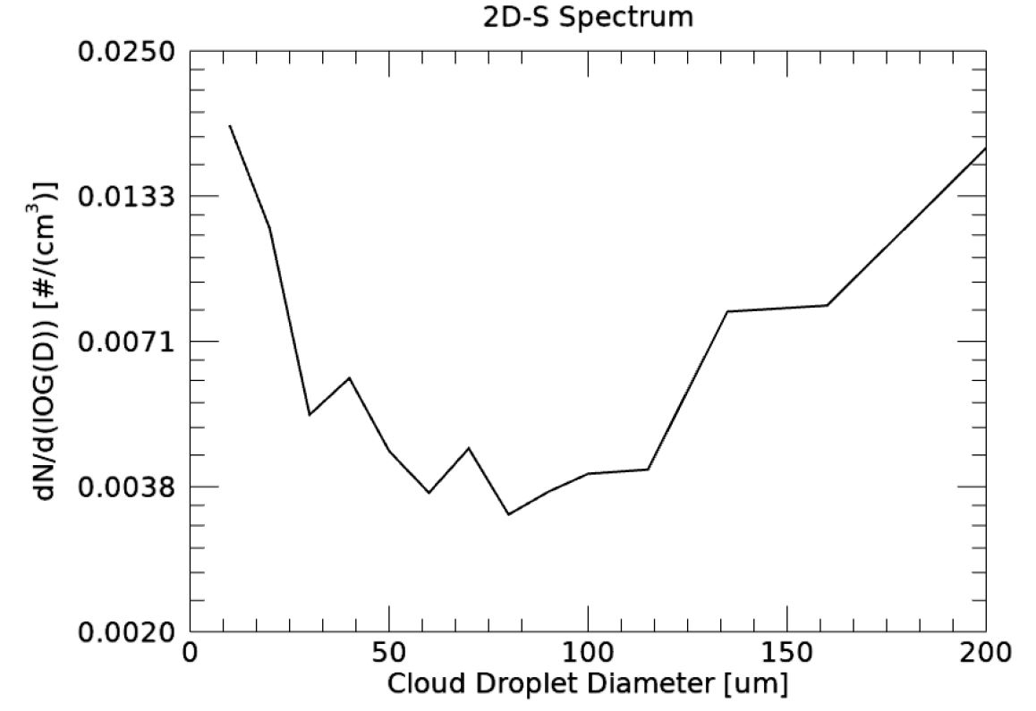
DROPLET DIAMETERS
Mixed Phase Cloud Criteria:
Constant altitude
Temperatures < 0 °C
TWC > LWC
Droplet sizes < 200 µm
Notes:
TIPS:
Check out the Layout Dropdown for more layout design options
It’s recommended not going below 24-point font size for presentations
If your text overflows a placement text box it’s recommended to edit/delete down text content instead of increasing size of text box to accommodate more text
Guides for are available under View tab > check Guides checkbox

Slide 33
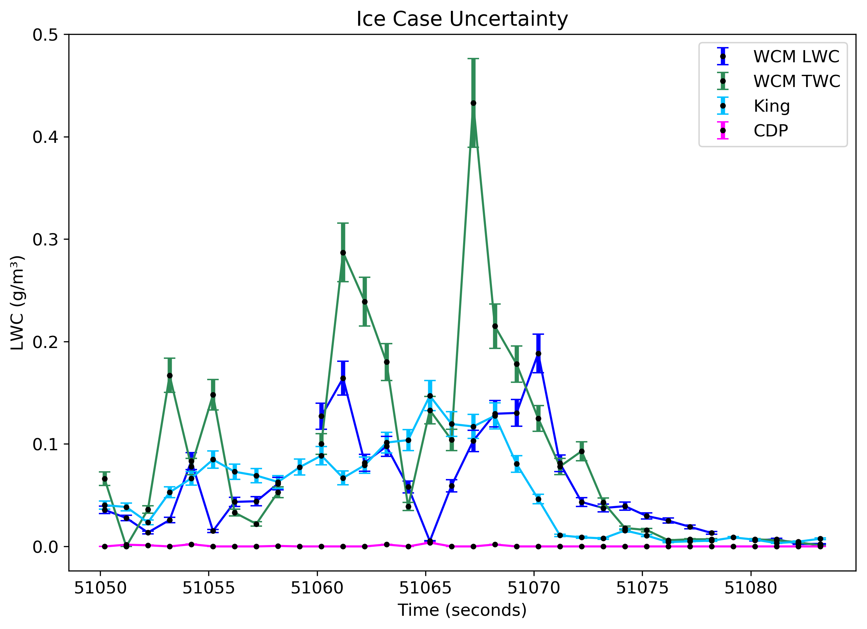

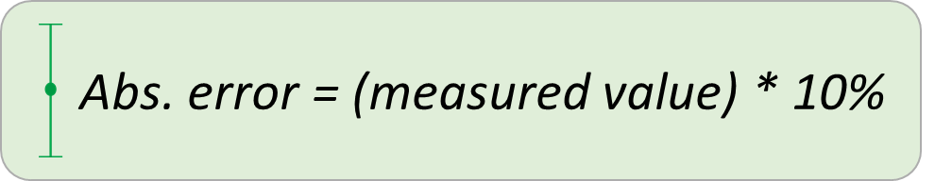

MIXED PHASE TIME SERIES
1 Hz data
CDP is measuring no LWC
King and WCM LWC – measuring small amounts of LWC
WCM TWC is measuring the most amount of water contents
Takeaway:
WCM - Slow decline in water contents once out of cloud
Notes:
TIPS:
Check out the Layout Dropdown for more layout design options
It’s recommended not going below 24-point font size for presentations
If your text overflows a placement text box it’s recommended to edit/delete down text content instead of increasing size of text box to accommodate more text
Guides for are available under View tab > check Guides checkbox

Slide 34
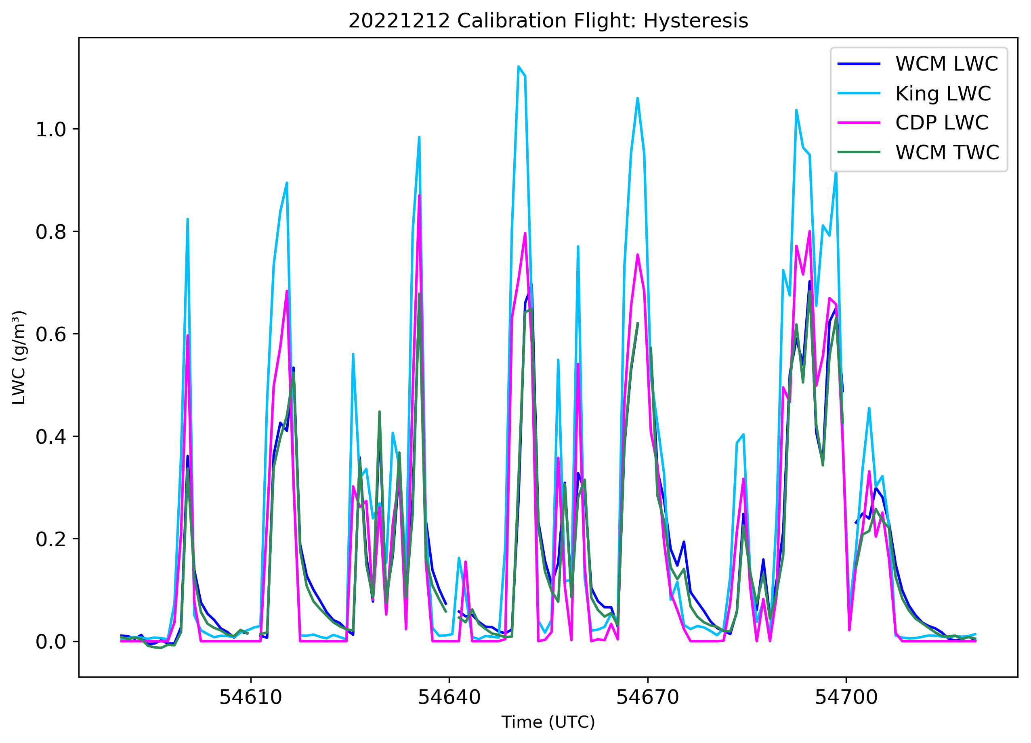
SUMMARY OF RESULTS
Little agreement in measurement uncertainties
Delay in WCM measurements once in cloud
WCM - Slow decline in LWC once out of cloud
King probe measures the most LWC
CDP underrepresenting LWC
  Calibrations
  Measurement size range
Example of multiple cloud passes where WCM has slow decline in LWC once out of cloud
Notes:
TIPS:
Check out the Layout Dropdown for more layout design options
It’s recommended not going below 24-point font size for presentations
If your text overflows a placement text box it’s recommended to edit/delete down text content instead of increasing size of text box to accommodate more text
Guides for are available under View tab > check Guides checkbox

Slide 35
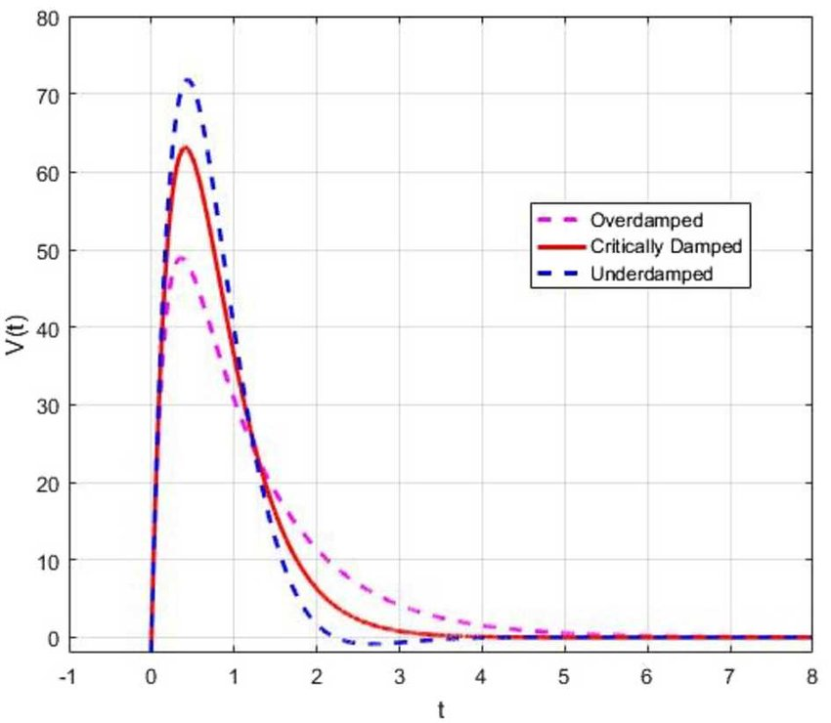
DISCUSSION
What could be causing WCM performance issues?
Time offset
  Time series plot don’t show a simple shift in time
Hysteresis effect
  Residual water not evaporating fast enough
    Gap in wire
Software issue
  Tried different software, sensor heads, see on raw data
Overdamped control system
Alizadeh et al. 2020
Notes:
Time offset – simple shift in time, but we see the decline in LWC that indicates its more than an offset issue
Hysteresis – the decline in lwc after out of cloud due to residual water not evaporating – lab testing/and discussing with manufacuter likely not the cause
Software issue – could this be outdated software version? Or in lwc calculation?
Overdamped control system – this has to do with the input control for the power distribution
We have liquid water coming in contact with the probe, the power should increase to evaporate the lw, but in an overdamped system, the control is not supplying enough power to evaporate the water. So it takes longer for the liquid to evaporate – and we have a smaller peak in lwc – as we see in the cases
Talking with experts at the SEA manufacturer as well as other electrical control system experts this is likely the cause.

Slide 36
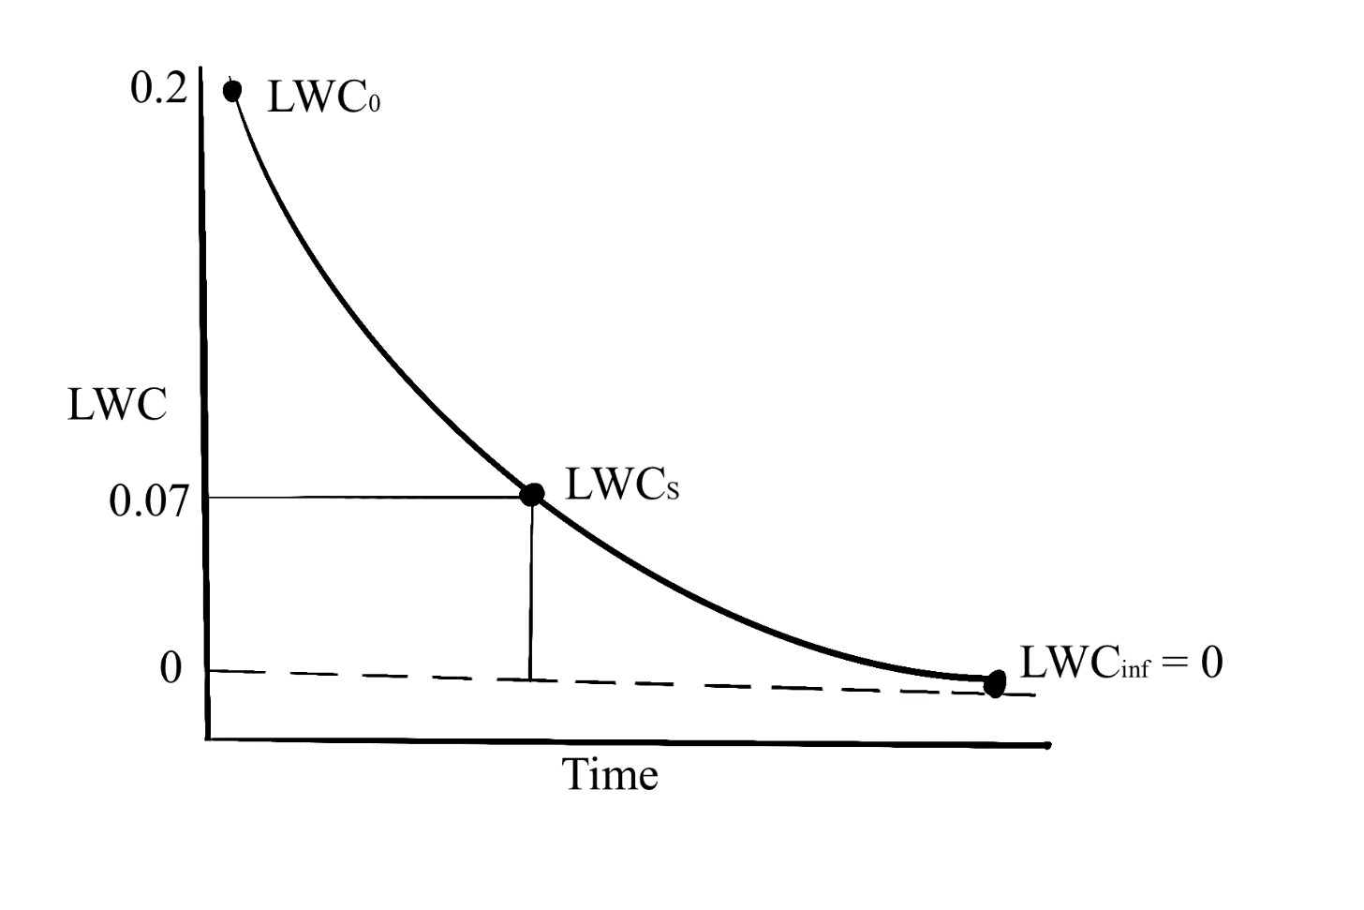
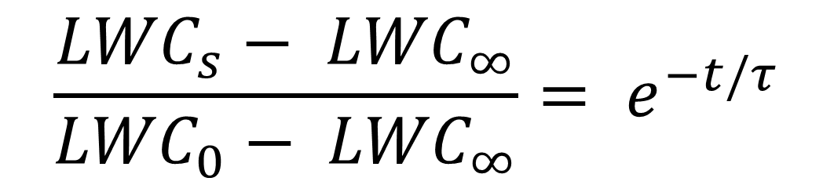
OVERDAMPED SYSTEM
Time Constant (τ)
Is there consistency in the duration of the slow response time?
LWC: τ = 3.4 s
SCLW: τ = 3.4 s
Mixed: LWC τ = 3.6 s, TWC τ = 2.9 s
37%
$$\frac{{LWC}_{s}− {LWC}_{∞}}{{LWC}_{0}− {LWC}_{∞}}= e^{−t/τ}$$
Out of cloud
τ ~ 3 seconds
Notes:
time constant (exponential decay!!)
Measuring the time it takes to get to zero once out of cloud
So when the King and CDP measure no LWC (out of cloud) - LWCo
You are computing the time it takes for the WCM to measure 0 LWC

Slide 37
CONCLUSIONS
To determine if the WCM-3000 values agree with the other probes within their measured uncertainties?
  No, they do not agree
Cases provide evidence that the WCM-3000 has performance issues
  Slow WCM response upon entering cloud
  WCM measures LWC after exiting cloud
Time constant τ ~ 3 s
Most likely an overdamped control system
Notes:
TIPS:
Check out the Layout Dropdown for more layout design options
It’s recommended not going below 24-point font size for presentations
If your text overflows a placement text box it’s recommended to edit/delete down text content instead of increasing size of text box to accommodate more text
Guides for are available under View tab > check Guides checkbox

Slide 38
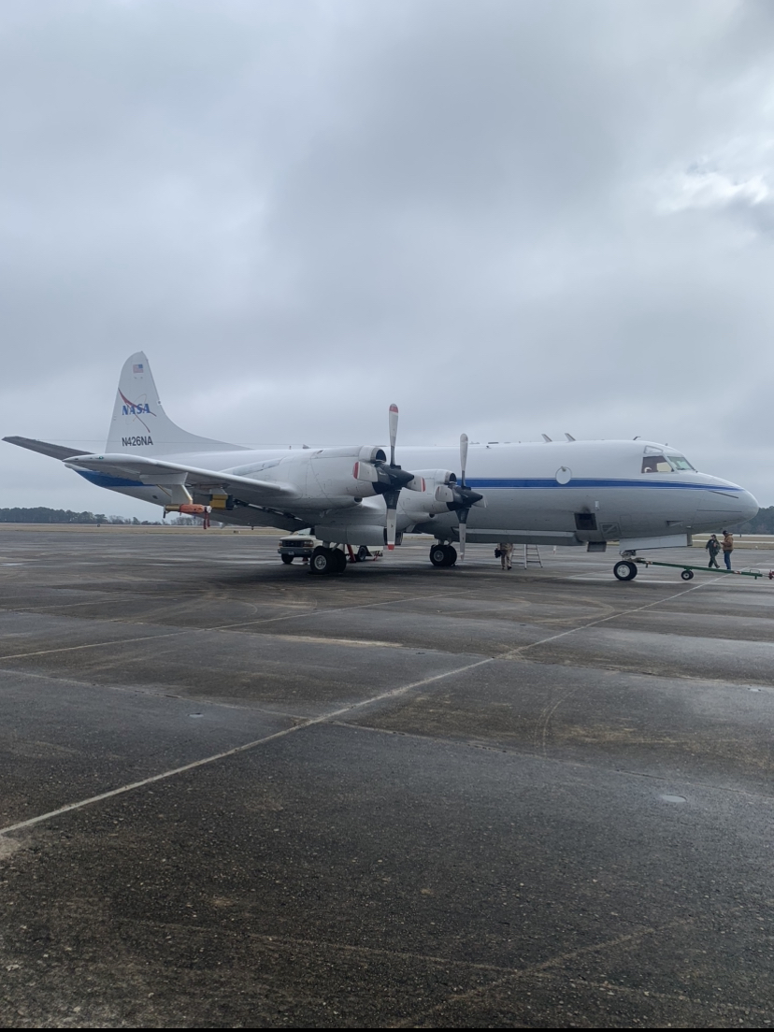
FUTURE WORK
Improve WCM performance
IMPACTS dataset
  Process WCM dataset
    As is, missing value codes, or correction algorithm
Notes:
TIPS:
Check out the Layout Dropdown for more layout design options
It’s recommended not going below 24-point font size for presentations
If your text overflows a placement text box it’s recommended to edit/delete down text content instead of increasing size of text box to accommodate more text
Guides for are available under View tab > check Guides checkbox

Slide 39
ACKNOWLEDGMENTS
Thank you to Dr. David Delene, Mike Poellot and Dr. Jared Marquis
Christian Nairy, Michael Willette, Kendra Sand, Greg Sova, and Andy Detwiler
P-3 Crew
IMPACTS group
AtSci Department
Wanda and Sue
Family and Friends
Notes:
TIPS:
Check out the Layout Dropdown for more layout design options
It’s recommended not going below 24-point font size for presentations
If your text overflows a placement text box it’s recommended to edit/delete down text content instead of increasing size of text box to accommodate more text
Guides for are available under View tab > check Guides checkbox

Slide 40
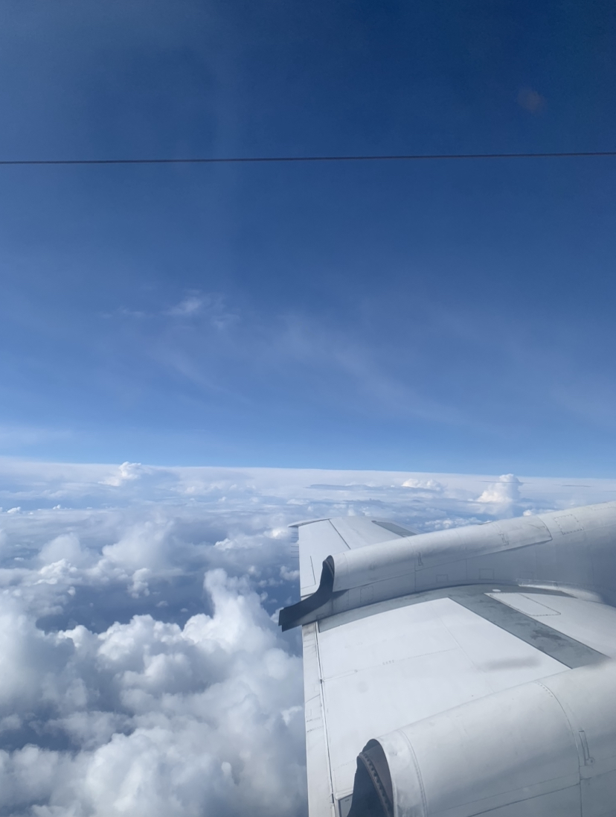
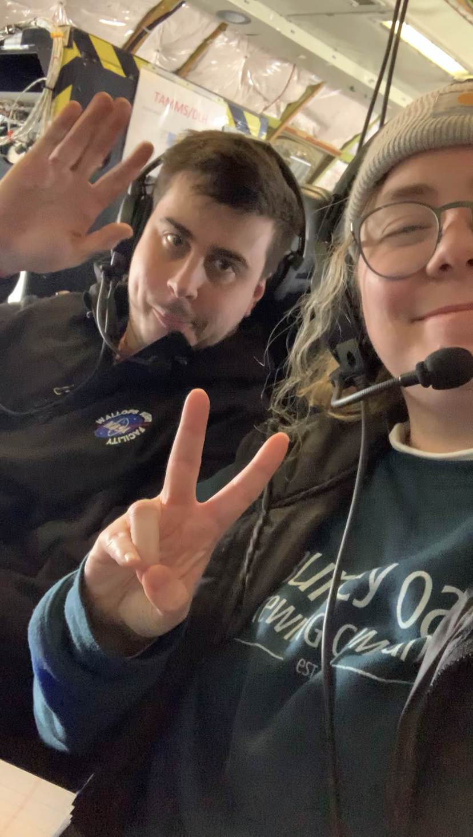
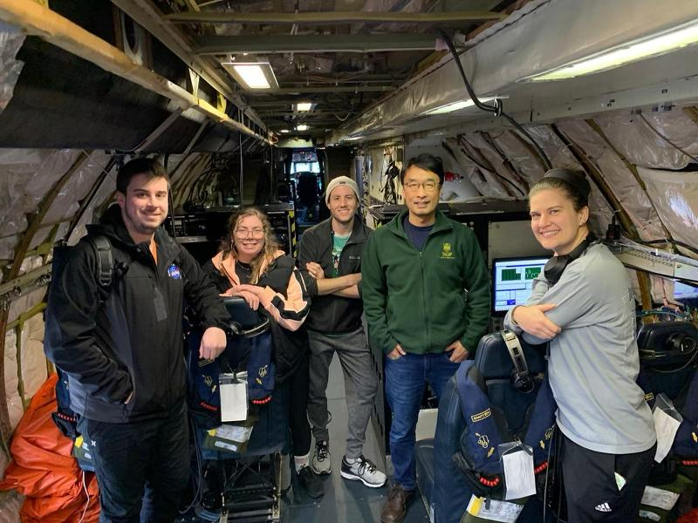
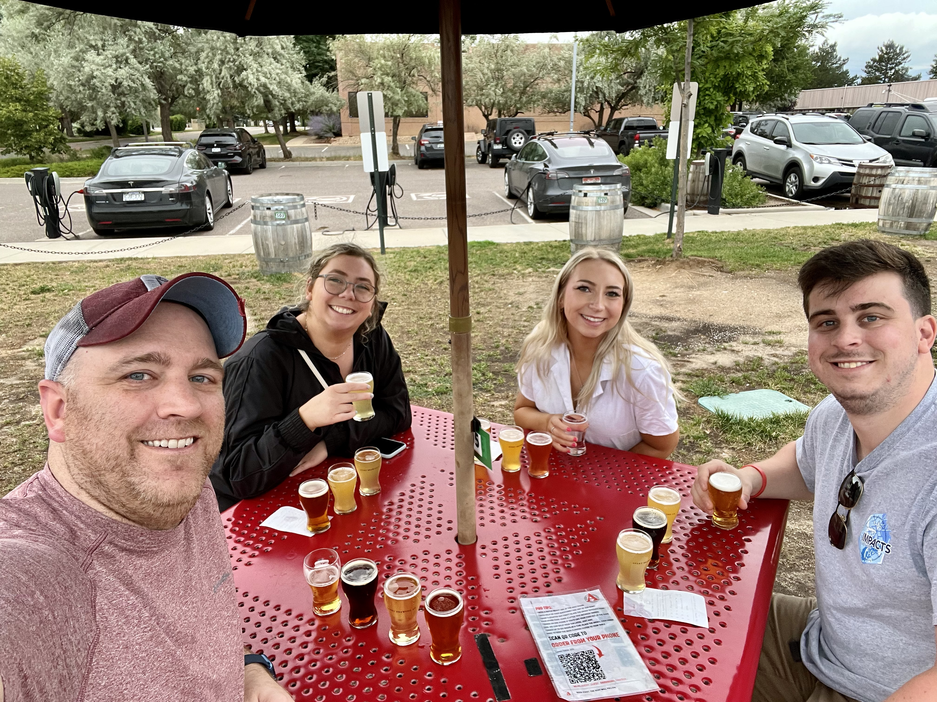

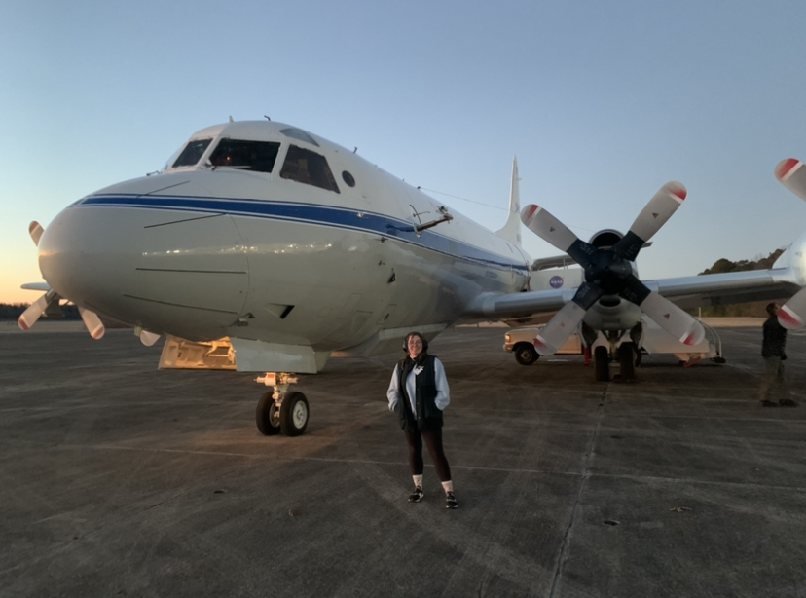
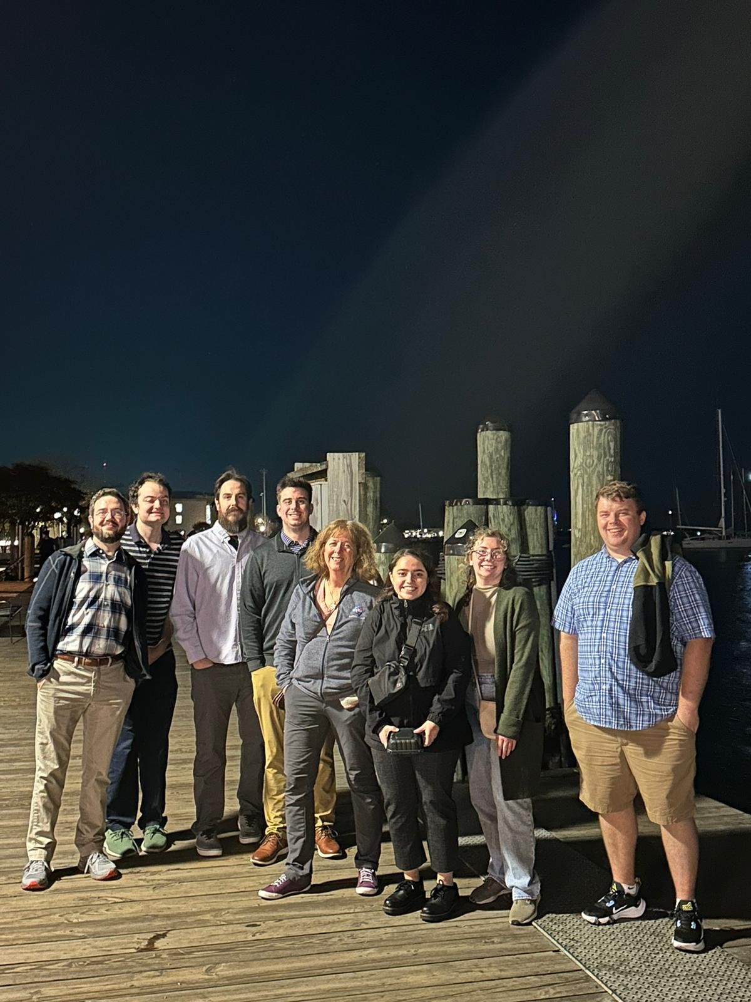
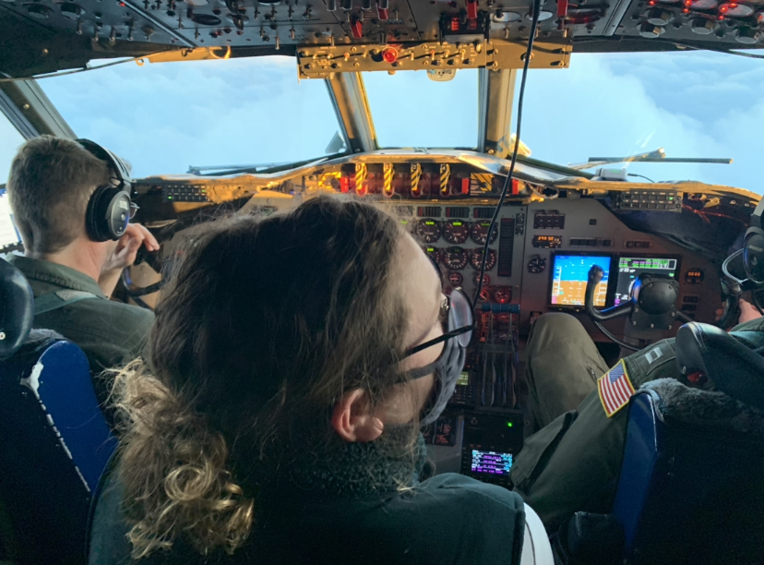


















Slide 41
REFERENCES
Alizadeh, S., Baleanu, D. & Rezapour, S. Analyzing transient response of the parallel RCL circuit by using the Caputo–Fabrizio fractional derivative. Adv Differ Equ 2020, 55 (2020). https://doi.org/10.1186/s13662-020-2527-0
Brown, P. R. A., & Francis, P. N. (1995). Improved Measurements of the Ice Water Content in Cirrus Using a Total-Water Probe. Journal of Atmospheric and Oceanic Technology, 12(2), 410–414. https://doi.org/10.1175/1520-0426(1995)012<0410:IMOTIW>2.0.CO;2
Claffey, K. J., Jones, K. F., & Ryerson, C. C. (1995). Use and calibration of Rosemount ice detectors for meteorological research. Atmospheric Research, 36(3), 277–286. https://doi.org/10.1016/0169-8095(94)00042-C
Delene, D. J. (2011). Airborne data processing and analysis software package. Earth Science Informatics, 4(1), 29–44. https://doi.org/10.1007/s12145-010-0061-4
Duchon, C., & Hale, R. (2012). Time Series Analysis in Meterology and Climatology: An Introduction. Wiley-Blackwell.
Dye, J. E., & Baumgardner, D. (1984). Evaluation of the Forward Scattering Spectrometer Probe. Part I: Electronic and Optical Studies. Journal of Atmospheric and Oceanic Technology, 1(4), 329–344. https://doi.org/10.1175/1520-0426(1984)001<0329:EOTFSS>2.0.CO;2
Faber, S., French, J. R., & Jackson, R. (2018). Laboratory and In-flight Evaluation of a Cloud Droplet Probe (CDP). https://doi.org/10.5194/amt-2017-479
King, W. D., Parkin, D. A., & Handsworth, R. J. (1978). A Hot-Wire Liquid Water Device Having Fully Calculable Response Characteristics. Journal of Applied Meteorology, 17(12), 1809–1813. https://doi.org/10.1175/1520-0450(1978)017<1809:AHWLWD>2.0.CO;2
Korolev, A., & Isaac, G. (2003). Phase transformation of mixed-phase clouds. Quarterly Journal of the Royal Meteorological Society, 129(587), 19–38. https://doi.org/10.1256/qj.01.203
Notes:
TIPS:
Check out the Layout Dropdown for more layout design options
It’s recommended not going below 24-point font size for presentations
If your text overflows a placement text box it’s recommended to edit/delete down text content instead of increasing size of text box to accommodate more text
Guides for are available under View tab > check Guides checkbox

Slide 42
REFERENCES
Korolev, A. V., Strapp, J. W., Isacc, G. A., & Nevzorov, A. N. (1998). The Nevzorov Airborne Hot-Wire LWC-TWC Probe: Principle of Operation and Performance Characteristics. Journal of Atmospheric and Oceaninc Technology, 15(6), 1495–1510. https://doi-org.ezproxy.library.und.edu/10.1175/1520-0426(1998)015<1495:TNAHWL>2.0.CO;2
Lance, S., Brock, C. A., Rogers, D., & Gordon, J. A. (2010). Water droplet calibration of the Cloud Droplet Probe (CDP) and in-flight performance in liquid, ice and mixed-phase clouds during ARCPAC. Atmospheric Measurement Techniques, 3(6), 1683–1706. https://doi.org/10.5194/amt-3-1683-2010
Lawson, R. P., O’Connor, D., Zmarzly, P., Weaver, K., Baker, B., Mo, Q., & Jonsson, H. (2006). The 2D-S (Stereo) Probe: Design and Preliminary Tests of a New Airborne, High-Speed, High-Resolution Particle Imaging Probe. Journal of Atmospheric and Oceanic Technology, 23(11), 1462–1477. https://doi.org/10.1175/JTECH1927.1
Lilie, L. E., Bouley, D. B., Sivo, C. P., Ratvasky, T. P., & Van Zante, J. F. (2021). Test Results for the SEA Ice Crystal Detector (ICD) under SLD Conditions at the NASA IRT. p.2654.
Lilie, L. E., Emery, E., Strapp, J. W., & Emery, J. (2005, January). A Multiwire Hot-Wire Device for Measurement of Icing Severity, Total Water Content, Liquid Water Content, and Droplet Diameter. 43rd AIAA Aerospace Sciences Meeting and Exhibit, Reno, Nevada, American Institute of Aeronautics and Astronautics. https://arc.aiaa.org/doi/pdf/10.2514/6.2005-859
Lilie, L. E., Sivo, C. P., & Bouley, D. B. (2016). Description and Results for a Simple Ice Crystal Detection System for Airborne Applications. 4058.
Notes:
TIPS:
Check out the Layout Dropdown for more layout design options
It’s recommended not going below 24-point font size for presentations
If your text overflows a placement text box it’s recommended to edit/delete down text content instead of increasing size of text box to accommodate more text
Guides for are available under View tab > check Guides checkbox

Slide 43
REFERENCES
McMurdie, L. A., Heymsfield, G. M., Yorks, J. E., Braun, S. A., Skofronick-Jackson, G., Rauber, R. M., Yuter, S., Colle, B., McFarquhar, G. M., Poellot, M., Novak, D. R., Lang, T. J., Kroodsma, R., McLinden, M., Oue, M., Kollias, P., Kumjian, M. R., Greybush, S. J., Heymsfield, A. J., … Nicholls, S. (2022). Chasing Snowstorms: The Investigation of Microphysics and Precipitation for Atlantic-Coast Threatening Snowstorms (IMPACTS) Campaign. Bulletin of the American Meteorological Society, 103(5), 1243–1269. https://doi-org.ezproxy.library.und.edu/10.1175/BAMS-D-20-0246.1
Merceret, F. J., & Schricker, T. L. (1975). A New Hot-Wire Liquid Cloud Water Meter. Journal of Applied Meteorology, 14(3), 319–326. https://doi.org/10.1175/1520-0450(1975)014<0319:ANHWLC>2.0.CO;2
Personne, P., Brenguier, J. L., Pinty, J. P., & Pointin, Y. (1982). Comparative Study and Calibration of Sensors for the Measurement of the Liquid Water Content of Clouds with Small Droplets. Journal of Applied Meteorology and Climatology, 21(2), 189–196. https://doi.org/10.1175/1520-0450(1982)021<0189:CSACOS>2.0.CO;2
Sandvik, A., Biryulina, M., Kvamstø, N. G., Stamnes, J. J., & Stamnes, K. (2007). Observed and simulated microphysical composition of arctic clouds: Data properties and model validation. Journal of Geophysical Research: Atmospheres, 112(D5). https://doi.org/10.1029/2006JD007351
Strapp, J. W., Oldenburg, J., Ide, R., Lilie, L., Bacic, S., Vukovic, Z., Oleskiw, M., Miller, D., Emery, E., & Leone, G. (2003). Wind Tunnel Measurements of the Response of Hot-Wire Liquid Water Content Instruments to Large Droplets. Journal of Atmospheric and Oceanic Technology, 20(6), 791–806. https://doi.org/10.1175/1520-0426(2003)020<0791:WTMOTR>2.0.CO;2
Notes:
TIPS:
Check out the Layout Dropdown for more layout design options
It’s recommended not going below 24-point font size for presentations
If your text overflows a placement text box it’s recommended to edit/delete down text content instead of increasing size of text box to accommodate more text
Guides for are available under View tab > check Guides checkbox

Slide 44
EXTRA SLIDES
Notes:
TIPS:
Check out the Layout Dropdown for more layout design options
It’s recommended not going below 24-point font size for presentations
If your text overflows a placement text box it’s recommended to edit/delete down text content instead of increasing size of text box to accommodate more text
Guides for are available under View tab > check Guides checkbox

Slide 45

POWER : LIQUID WATER
Same delay in the increase of power
Same gradual decline in power
Takeaway:
This provides insight into the performance issue being a probe issue and not a calculation issue in post processing
Notes:
TIPS:
Check out the Layout Dropdown for more layout design options
It’s recommended not going below 24-point font size for presentations
If your text overflows a placement text box it’s recommended to edit/delete down text content instead of increasing size of text box to accommodate more text
Guides for are available under View tab > check Guides checkbox

Slide 46
FLIGHT SEGMENTS OF INTEREST
Type | Date | Time Span (hh:mm:ss) | Temp. | Altitude | Diam.
LW | 20221216 | 13:11:38 – 13:12:14 UTC | -0.6 ±0.4 °C | 2864 ±34.6 m | < 50 µm
SCLW | 20221212 | 15:10:11 – 15:10:25 UTC | -3.5 ±0.3 °C | 1154 ±3.7 m | < 50 µm
Mixed | 20230123 | 14:09:38 – 14:11:30 UTC | -16.8 ±0.2 °C | 5250 ±3.1 m | < 200 µm
Notes:
TIPS:Flight conducted to sample precipitation over Long Island, NY
Above freezing temperatures sampled at 12:41:10 – 13:12:51 UTC
P-3 performs
Downward spiral from 5000 m to 900 m
Transits at 900 m
Upward spiral from 900 m to 3750 m
RICE probe confirms no SCLW
Check out the Layout Dropdown for more layout design options
It’s recommended not going below 24-point font size for presentations
If your text overflows a placement text box it’s recommended to edit/delete down text content instead of increasing size of text box to accommodate more text
Guides for are available under View tab > check Guides checkbox

