Slide 1
Measured Atmospheric Change In Lead Particulate Matter From UL94 Fuel Switch by Major Aerospace College
Alex Mendez
Advisor: David J. Delene, PhD

Slide 2
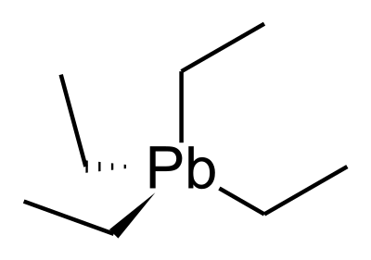
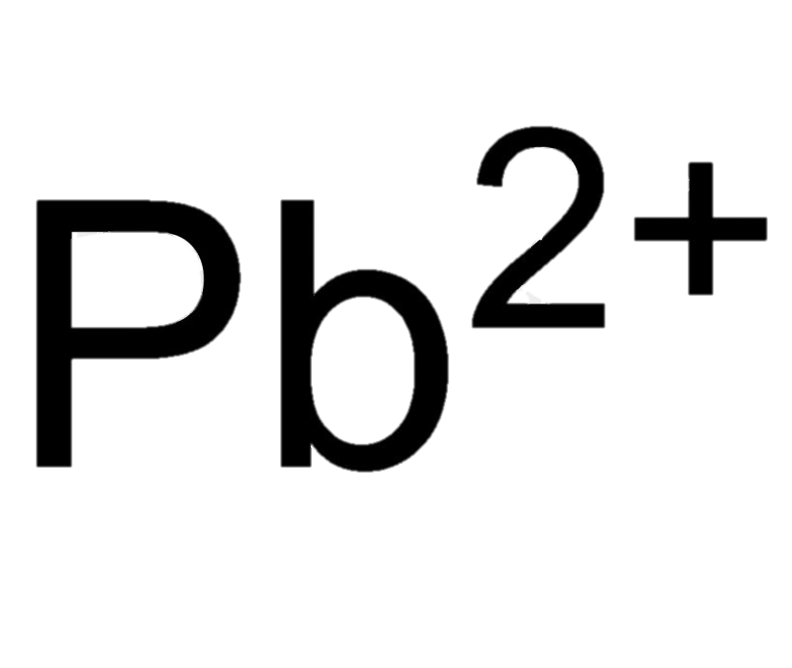
Why is lead emission important?
Children:
Behavior and Learning Problems
Lower IQ and Hyperactivity
Slowed Growth
Hearing Problems
Anemia
Adults:
Cardiovascular effects
Hypertension
Decreased Kidney Function
Reproductive Issues (Men and Women)
Tetraethyl Lead
Notes:
-In general aviation, piston powered engine aircraft commonly use leaded fuel.
-This leaded fuel contains an additive known as ”Tetraethyl Lead”. This increases octane rating or makes it more stable to resist compression and prevent spontaneous combustion.
-It as well, helps with knock and engine issues.
-Some aircrafts won’t be able to operate without this leaded fuel due to having such a low octane rating.
-As fuel is burned, the lead will exist or involve into lead(ll) ion. Where it will travel long distances in the air before going into the soil and possibly ground water depending on the lead compound and characteristics of the soil.
-The sources of exposure involving Lead(ll) Ions is very expensive to remediate and politics surrounding this issue are at a stalemate.
-Ingestion, Inhalation of lead at any amount will be toxic.
-Lead is founded to affect the function and regulation of Calcium and Zinc sites because of its stronger binding affinity compared to calcium and zinc.
-

Slide 3
Current State Of Research
Lack of quantification of the amount of lead pollutants within local, airport environment.
94 Octane Rated, Unleaded Aviation Fuel
100 Octane Rated, Unleaded Aviation Fuel
https://www.faa.gov
Notes:
-Newer built aircrafts are able to operate with unleaded aviation fuel.
-FFA has authorized the use of 100 and 94 Octane rated unleaded aviation fuel.
-The issue that is holding back the usage by general aviation with newer aircrafts is the lack of quantification of the amount of lead pollutants within local, airport environment.
-There is a must to qualify airport pollution in order to start the discussion on unleaded fuel adaption in general aviation.

Slide 4
Approach
Aerospace college will switch from 100 Octane Low Lead Fuel (100LL) to 94 Octane Rated, Unleaded Aviation Fuel (UL94).
Aerospace college has placed for UL94 fuel on May 24th and will start using as soon as the current supplies are exhausted (2-4 weeks).
University of North Dakota Aerospace College
Notes:
-A rare measurement opportunity to approach this problem is thanks to UND Aerospace.
-They will switch its entire aircraft and helicopter fleet to 94 rated octane unleaded aviation fuel.
-We will observe particulate matter measurements before and after the switch to unleaded fuel by primarily using particle filter samples.

Slide 5
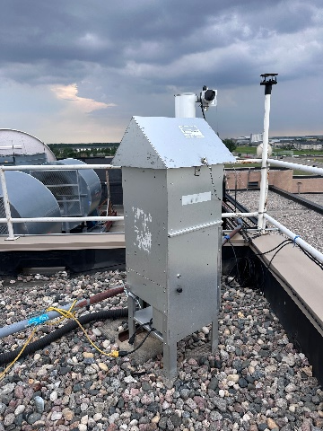
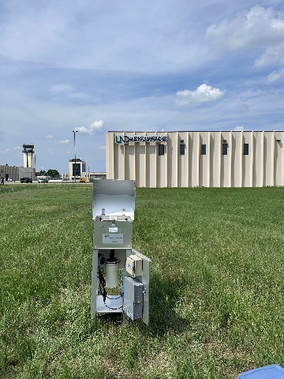
Aerosol Measurements Using Filter Samples
Doing 24-hour filter samples with high volume filter samples. (Figure 1 and Figure 2)
Using two different locations to measure lead concentrations (GFK and Clifford Hall) to compare concentrations of lead.
We will use X-Ray Fluorescence to measure amount of concentration of lead in each sample.
Figure 1. High Volume Filter sample. Located in Clifford Hall.
Figure 2. High Volume Filter sample. Located at Grand Forks International Airport.
Figure 3. Sample collected from high volume filter sample. Located at Grand Forks International Airport.
Notes:
-These Filter will be used to collect aerosol particle samples.
-X-ray Florescence will be the instrument used to determine the amount of lead in each sample.

Slide 6
Acknowledgments
Funding:
We would like to acknowledge support from the National Science Foundation (NSF) under the IREC
REU program CHE-2244530. Any opinions, findings, and conclusions or recommendations expressed in this
material are those of the author(s) and do not necessarily reflect the views of the NSF.
Dr. David J. Delene
I would like to thank University of North Dakota Aerospace for allowing us to collect aerosol samples to help further our project.

