Slide 1
Precipitation Evaluation of the North Dakota Cloud Modification Project (NDCMP) Using Rain Gauge Observations
Matthew Tuftedal
M.S. Thesis Defense, University of North Dakota
09 July 2019
Committee Members:
Dr. David Delene*, UND
Dr. Andrew Detwiler, UND
Dr. Aaron Kennedy, UND
*Committee Chair

Slide 2
Motivation and Objective
The North Dakota Cloud Modification Project (NDCMP) costs the state of North Dakota approx. $1.0 million per year or approx. 13 cents per acre (NDMP 2018).
The last study performed on the NDCMP was conducted in 2005 (Wise 2005).
Analyzing the effectiveness of the NDCMP can help future economic cost/benefit ratio studies and are important so sponsors and the public are well informed.
Determining the effectiveness of the NDCMP at increasing rainfall within the project area.

Slide 3
Project Background
The NDCMP has ran a non-randomized cloud seeding operation in ND since 1976.
(Schneider and Langerud 2011)
Primary goal of the program is hail suppression to reduce crop loss, but precipitation enhancement was quickly added.
Operations are conducted in two districts during June, July, August and occasionally early September.
(NDARB 2018)

Slide 4
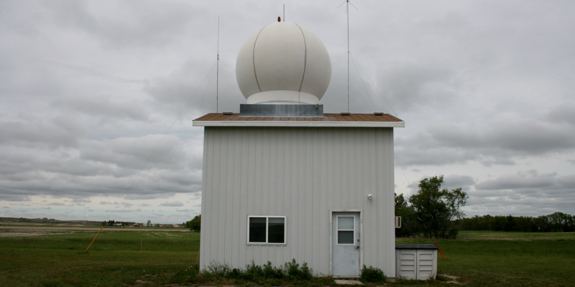
Radar and Aircraft
Two C-Band Radars are located in Bowman and Stanley, ND.
Eight aircrafts have been used in recent years, with planes located in Bowman, McKenzie, Williams, Mountrail and Ward County.
Source: (NDARB 2018)
Photo Credit: NDCMP

Slide 5
Cloud Seeding
Seeding agents are released at cloud base and direct injection at the cloud top.
Cloud base seeding uses wing-mounted ice nucleus generators and burn-in-place flares.
Direct injection uses ejectable flares and dry ice.
Source: (NDARB 2014; Delene 2016)

Slide 6
Previous Evaluations of the NDCMP
By using National Weather Service (NWS) Cooperative Observer Program (COOP) rain gauges, Smith et al. (2004) studied whether a cloud seeding effect was present.
A target/control methodology consisting of 11 stations in the NDCMP target area and 25 stations in eastern Montana as the control was used.
Results showed little to no increase in rainfall in this analysis and a p-value of 0.32.
Notes:
The period used for climate data ran from 1950 to 1975
The NDCMP period was 1976 to 2002.

Slide 7
Previous Evaluations of the NDCMP
Wise (2005) analyzed the effects of the NDCMP using a target, downwind and control approach.
The control/downwind region was determined by daily storm motion from 1999 to 2002.
North Dakota Atmospheric Resource Board Cooperative Observer Network (NDARBCON) rain gauges were used for 1977 to 2003.
Results found an increase in rainfall of at least 5 % in four out of seven cases.
Of those four, only two were determined statistically significant
(p-value < 0.05)

Slide 8
NDARBCON Data
NDARBCON uses a “Tru-Chek” wedge-shaped rain gauge.
NDARBCON rain gauges measure rainfall to the nearest hundredth of an inch.
Rainfall measurements are taken at 0800 AM everyday.
The observational period for the NDARBCON observers is April 1st through September 30th each year.
Notes:
READ AFTER RAINFALL MEASUREMENTS ARE
Daily rainfall typically encompasses the previous day
THE OBSERVATIONAL PERIOD STUFF
However, some observers don’t start until June 1st.

Slide 9
NWS COOP Data
NWS COOP observers are supplied with an 8-inch rain gauge.
The 8-inch gauge is a simple non recording gauge consisting of four parts:
Measuring stick
Measuring tube
Collector funnel
Overflow can
Rainfall can be measured within a tenth of an inch and can hold 20 inches of rainfall.
Source: (NWS 1999)

Slide 10
Data
Langerud and Gilstad (2003) compared NDARBCON and NWS COOP gauges over a 23-year period from 1977-1999.
Rain gauges were compared multi-annually and annually.
Results showed rainfall totals within approx. a half an inch per year and a correlation of 0.998.

Slide 11
Project Evaluation
The rainfall in this study was evaluated by using a target and control analysis.
Target and control method provides a statistical analysis of the rainfall and not a physical process evaluation.
A target is an area where something is being applied.
A control is an area where conditions are left untreated or untouched.
Notes:
A target region is an area where something is being applied. In this case that is a cloud seeding agent. The target area isn’t designed for one storm, but for a lot of storms. This is why the rainfall is analyzed on a monthly and seasonal basis in target/control studies.

Slide 12
Target Region
The target regions are determined by the years active in the NDCMP.
Of those counties, Bowman, Slope, McKenzie, and Ward Counties were selected.
Counties | District | Years Participated | Total Years
Adams | 1 | 1977-1980 | 3
Bowman | 1 | 1977-2018 | 41
Hettinger | 1 | 1977-1988 | 11
Slope | 1 | 1977-1998, 1999-2018 | 41
Burke | 2 | 2015-2018 | 3
McKenzie | 2 | 1977-2018 | 41
McLean | 2 | 1977-1984 | 7
Mountrail | 2 | 1977-2018 | 41
Ward | 2 | 1977-2018 | 41
Williams | 2 | 1997-2018 | 21
Notes:
Target counties that have participated for the entire duration were selected from District 1 and 2.
Bowman and Slope Counties was combined to create a larger area of analysis. This will be shown in up coming slides.

Slide 13
Control Region
Controls were designated as counties that have not participated in the NDCMP or only participated in a relatively short period.
However, selecting a control area that may not be affected by downwind effects proved to be difficult.
DeFelice et al. (2014) found that downwind effects from cloud seeding increases rainfall by 5 – 15 %, and Wise (2005) found a 13% increase in downwind rainfall within the NDCMP.

Slide 14
Notes:
Once the target and control areas were set, the NWS COOP and NDARBCON rain gauges were combine. Combining the networks provided dense observations across the study domain from 1950 to 2018.
However the density of the network has drastically decreased over the 41-year project, each target and control area had at least 6 rain gauges per year.

Slide 15
Climatology Data
NWS COOP rain gauges were available within all target/control locations in both ND and MT dating back to before 1950.
This provided enough data to perform a target/control analysis for 1950-1975 and 1977-2018.
The amount of rainfall for 1950-1975 may not be representative of current climate in western ND, however the amount is not essential for this study.
It is assumed that ratios calculated for this period were representative of ratios during the study period without the effects of seeding.
Notes:
The year 1950 was determined by Smith et al. 2004 as the best starting point for any pre-NDCMP analysis.
It was noted in this paper, that going back ever two years would decrease the amount of usable rain gauges by half.
From this point in the presentation on, 1950-1975 will be referred to as pre-NDMCP period and 1977-2018 as NDCMP period
THESE assumptions are acknowledged as possible contributions to the uncertainty in this study.

Slide 16
Missing Data
Despite having vast amounts of rain gauges available throughout the history of the NDCMP, time consistency (e.g. year-to-year reporting) of rain gauge observations were an issue.
To handle missing data for the NDARBCON gauges, gauges were checked to see if a complete record for June, July, or August were available.
If a gauge had a complete record for at least one of the months, it was used towards the calculation of monthly total rainfall for the year.
Notes:
Each year less rain gauges reported rainfall over the season, and even a variation of rain gauges reported each month.
This inconsistency in reporting was observed in both the NDARBCON and NWS COOP observer networks, with the NWS COOP having considerable amounts of missing data.

Slide 17
McKenzie County Rain Gauges 1950-2018
Notes:
Having stations with all three months on record was preferred, but keeping that standard limited the number of gauges that could be used by an average of 4 rain gauges per year in the target regions. This graph shows the variation in the number of rain gauges per month per year that had at least one month of complete data.
For an example of how much the rain gauges could vary, assuming all 8 rain gauges in August 2018 must also include June and July, the number of gauges would go from 20 in June and July down to 8. However, it could decease more if those gauges did not have those months.
Issues with using the month to month rain gauges, was it was almost impossible to know the reliability of these gauges outside of the quality control/assurance done by the NCEI or NDCMP.

Slide 18
McKenzie County Rain Fall 1950-2018

Slide 19
Rainfall Evaluation
Precipitation amounts for each target and control region were calculated for the full study period (1977-2018) and for the pre-NDCMP period (1950-1975).
All gauge data within each target and control region were combined to obtain a monthly rainfall amount.

Slide 20
Monthly Rainfall for a Single Station
$$R_{station}=\sum_{i=1}^{n_{days}}{r_{g}\left(i\right)}$$
$R_{station}$ = the calculated monthly rainfall for a given station
$r_{g}$ = the rainfall amount recorded on a given day by the rain gauge
$n_{days}$ = the number of days in the given month

Slide 21
Monthly Rainfall for an Area
$$R_{monthly}=\sum_{i=1}^{n_{stations}}{R_{station}\left(i\right)}$$
$R_{monthly}$ = the total monthly rainfall
$R_{station}$ = the calculated monthly rainfall for a given station
$n_{station}$ = the number of stations in the given month
Notes:
This value is not the average rainfall in the county, but the total rainfall. The average monthly rainfall changes based on each type of analysis. So a more detailed explanation with be shown later.

Slide 22
Seasonal Rainfall
$$R_{seasonal}=\sum_{i=1}^{n_{months}}{{\overline{R}}_{monthly}\left(i\right)}$$
$R_{seasonal}$ = the sum of the average monthly rainfall
$R_{monthly}$ = the calculated average monthly rainfall for June, July and August
$n_{months}$ = the number of months in the season

Slide 23
County Circles Method
This was done to create specific areas to analyze and a way to weight the rain gauge data to a specific point within that circle.
Circles with radii of 40 km, centered on a given point for each county are overlaid on the target and control region.
The radius of 40 km was chosen to avoid overlap between target and control areas and to keep rain gauge observations to a centralized location within the county, but also to encompass as many rain gauges as possible.

Slide 24
North Dakota
Montana
South Dakota
Notes:
The most notable area with cross over is between Billings and Wibaux Circles. These two circles shared a common county of Golden Valley County in North Dakota, since these are both control areas, this was considered acceptable.
The second area of overlap is Fallon and Carter Circles. Unlike Billing and Wibaux, no rain gauges were present in this area of overlap.

Slide 25
County Circles
$$w=\frac{R^{2}−d^{2}}{R^{2}+d^{2}}$$
w = Weight of rain gauge to central location
R = Radius of influence (40 km)
d = Distance of the gauge from grid point
Reference: Wise 2005
Notes:
Using this Cressman weighting scheme give rain gauges closer to the central point more weight than gauges near the edges of the circle.

Slide 26
County Circles Weighted Rainfall
$$f_{d}=\sum_{i=1}^{n}{w\left(i\right)∗f_{o}(i)}$$
$f_{d}$ = Calculated rainfall at grid point
$f_{o}$ = Monthly rainfall for a given station
w = Weight of the given rain gauge
n = Number of gauges within radius of influence
Reference: Wise 2005

Slide 27
County Circles Monthly Weighted Rainfall
$$f_{d normalized}=\frac{f_{d}}{\sum_{i=1}^{n}{{w(i)}_{year}}}$$
$f_{d normalized}$ = Monthly average rainfall averaged by the sum of the weights at a central point
$f_{d}$ = Calculated rainfall at grid point
w = Sum of the weights
n = Number of gauges within radius of influence
Notes:
From this, an area with more gauges will have a higher sum of weights. The higher sum of weights acted in a similar fashion to a general averaging function, but instead of dividing by the number of stations, it depends on how much influence a single station has overall.
Therefore a county with less rain gauges would be weighted less but would still have a rainfall close to an observed average. This calculation was applied to the NDCMP and pre-NDCMP period.

Slide 28
County Based Method
To account for all possible rain gauges within a county, a county-based evaluation of rain gauges were done.
Some counties were combined to create a larger county area than were within the given political county borders.
The inclusion of more rain gauges could provide a better insight into the observed average rainfall over the entire county.
Using the circle-based method may remove any visible effects seen on the outer edges of the circle.
Notes:
READ AFTER 3rd DOT
With a better representation of the county average rainfall, the effects of cloud seeding may be more obvious.
AFTER 4th DOT
Therefore it is important to use all available rain gauges within the entire county without any weighting effect.

Slide 29
Roosevelt
Ward
Richland
McKenzie
Mercer
Wibaux
Billings
Fallon
Bowman
Carter
Notes:
Bowman and Slope Counties were combined to create one larger target county.
Rain gauges within eastern Montana were treated differently in the sense that entire counties were not used.
Some rain gauges in Montana were rejected due to the distance from the target region.
Much like the circular method, areas were assigned a blanket name despite housing two or more counties in it at a time.

Slide 30
County Based Monthly Rainfall
$${\overline{R}}_{monthly}=\frac{\sum_{i=1}^{n_{stations}}{R_{station}\left(i\right)}}{n_{stations}}$$
${\overline{R}}_{monthly}$ = the average monthly rainfall for the entire county
$R_{station}$ = the monthly rainfall for each station
$n_{stations}$ = the number of rain gauges within the county for the given month

Slide 31
North Dakota
South Dakota
Montana
Notes:
For this presentation, I’ll be covering just the County-Based methods as it encompasses more of the rain gauges used in the NDCMP.
This a comparison between the county-based method rain gauges vs what is encompassed in the circular method. This shows all rain gauges from 1950-2018. While the circular method captures a lot of the rain gauges, there are several rain gauges in the target areas of McKenzie and Bowman that aren’t included, as well as controls in Montana and North Dakota.

Slide 32
Statistical Methods
To analyze the target and control rainfall differences, the following statistical methods were used:
Single ratio
Double Ratio
Single and Multiple Linear Regression
Notes:
The single ratio calculates a percent different between the two rainfalls. This percent different does not account for natural variations due to geographical differences.
The double ratio takes the single ratios between two different time periods to normalize the observed single ratio. This method removes natural variations by normalizing the ratios.
The LR method was used to predict what the rainfall would be in the target region if cloud seeding hadn’t taken place. This is done by creating a Linear relationship between pre-NDCMP target and control rainfall. Once the equation is created, control rainfall for the NDCMP period is plugged in to predict the target’s rainfall. The SLR used one predictor, or one control county, where the MLR used two control counties to predict the rainfall for the target. This type of analysis is like doing the double ratio of the rainfalls.

Slide 33
Single Ratio
Once the rainfall for a given evaluation was completed, a single ratio between target and control were calculated for the pre-NDCMP and NDCMP periods.
Each target was assigned to different control areas based on the proximity of their location.
McKenzie was paired with:
Richland, Roosevelt, Wibaux, and Billings
Bowman was paired with:
Carter, Fallon, Wibaux and Billings
Notes:
The only target area that did not have multiple control areas to compare from was Ward. This was due to the location of ward relative to acceptable control areas. Most areas that could be considered useful for a control were either downwind of seeding or were in the seeding project itself. Mercer was determined to be the best possible control for Ward, although it may be contaminated due to downwind effects.

Slide 34
Single Ratio
$$SR=\frac{\sum_{n=1}^{(years)}{ f_{d}^{June, July, August, and all}(seeded circle)}}{\sum_{n=1}^{ (years)}{ f_{d}^{June, July, August, and all}(control circle)}}$$
SR = a single ratio from the sum of the target and control ratios
$f_{d}$ = the weighted average or county-based average rainfall
years = either 1950-1975 or 1977 to 2018
Notes:
The single ratio was calculated each year by dividing each monthly rainfall and seasonal in the target by the control, as well as summing the total rainfall in each month and seasonal over the two time periods and dividing them by each other.

Slide 35
Double Ratio
$$DR={\frac{\sum_{n=1}^{1977−2018}{ f_{d}^{June, July, August, and all}(seeded circle)}}{\sum_{n=1}^{1977−2018}{ f_{d}^{June, July, August, and all}(control circle)}}}/{\frac{\sum_{n=1}^{1950−1975}{ f_{d}^{June, July, August, and all}(seeded circle)}}{\sum_{n=1}^{1950−1975}{ f_{d}^{June, July, August, and all}(control circle)}}}$$
DR = a single value calculated from the single ratios from NDCMP and pre-NDCMP time periods
Notes:
By using the double ratio to normalize the NDCMP single ratio, any effect from cloud seeding should be more obvious. If there is a large ratio difference between pre-NDCMP and NDCMP single ratios, it can be suggested that cloud seeding may have contributed to an increase in rainfall.
However, any seasonal extremes in either observational period can skew the data in a way that can suggest an increase or decrease in rainfall in the target compared to the control.

Slide 36
Bootstrapping
Bootstrapping randomly resamples data to create a new data set from observed data.
Sampling with replacement was used in this study.
Notes:
Sampling with replacement selects a rain gauge and returns the rain gauge back into the pool of possible rain gauges to be sampled again. Theoretically an entire dataset can be made up of one rain gauge with resampling, but that is highly unlikely.

Slide 37
Bootstrapping
A Bootstrapping method was used in two different ways in this study.
The first way was to examine the natural variation of the single and double ratios.
The second way was to determine how many rain gauges were needed to get an adequate measurement in rainfall.
Notes:
Sampling with replacement selects a rain gauge and returns the rain gauge back into the pool of possible rain gauges to be sampled again. Theoretically an entire dataset can be made up of one rain gauge with resampling, but that is highly unlikely.
To determine if the observed single and double ratios are significant, the natural variation will give us an upper and lower bound 95% confidence interval. If our observed ratios are higher or lower than the 95% confidence intervals, this can be said that our data is not due to random change.

Slide 38
1950 - 1975 Single Ratios
County Pair (Target/Control) | June | July | August | Seasonal
McKenzie/Billings | 0.84 | 0.95 | 0.92 | 0.89
McKenzie/Richland | 1.13 | 1.06 | 1.04 | 1.09
McKenzie/Wibaux | 0.88 | 0.98 | 0.96 | 0.92
McKenzie/Roosevelt | 1.21 | 1.09 | 1.02 | 1.12
Bowman/Billings | 0.89 | 0.96 | 0.84 | 0.90
Bowman/Wibaux | 0.93 | 0.99 | 0.88 | 0.94
Bowman/Carter | 0.94 | 0.95 | 1.01 | 0.96
Bowman/Fallon | 1.20 | 1.20 | 1.25 | 1.21
Ward/Mercer | 0.99 | 0.96 | 1.04 | 0.99
Average | 1.00 | 1.02 | 1.00 | 1.00
Standard Deviation | 0.14 | 0.09 | 0.12 | 0.11
Notes:
The single ratios for 1950-1975 showed that three out of the 9 cases had the target region receiving more rainfall than the control in seasonal rainfall. The differences shown in this table can be attributed to natural variation in rainfall due to geographical differences.

Slide 39
1977 - 2018 Single Ratios
County Pair (Target/Control) | June | July | August | Seasonal
McKenzie/Billings | 1.00 | 1.03 | 0.89 | 0.98
McKenzie/Richland | 1.17 | 1.12 | 1.17 | 1.15
McKenzie/Wibaux | 1.05 | 1.09 | 0.94 | 1.03
McKenzie/Roosevelt | 1.12 | 1.06 | 1.20 | 1.12
Bowman/Billings | 1.01 | 0.89 | 0.88 | 0.94
Bowman/Wibaux | 1.06 | 0.94 | 0.93 | 0.99
Bowman/Carter | 0.91 | 0.96 | 0.88 | 0.92
Bowman/Fallon | 1.19 | 1.28 | 1.23 | 1.23
Ward/Mercer | 1.01 | 0.93 | 0.93 | 0.96
Average | 1.06 | 1.03 | 1.01 | 1.04
Standard Deviation | 0.09 | 0.12 | 0.15 | 0.11
Notes:
The single ratios for 1977-2018 showed an increase in the number of target areas receiving more rainfall than the control. Out of the 9 possible comparisons, 4 target regions had more rainfall. While this can be contributed to the natural variation due to geographic differences, you can still notice that the differences in rainfall between the control and target has decreased.

Slide 40
Double Ratios
County Pair (Target/Control) | June | July | August | Seasonal
McKenzie/Billings | 1.19 | 1.08 | 0.97 | 1.10
McKenzie/Richland | 1.04 | 1.06 | 1.13 | 1.06
McKenzie/Wibaux | 1.19 | 1.24 | 0.96 | 1.12
McKenzie/Roosevelt | 0.93 | 0.97 | 1.18 | 1.00
Bowman/Billings | 1.13 | 0.93 | 1.05 | 1.04
Bowman/Wibaux | 1.14 | 0.95 | 1.06 | 1.05
Bowman/Carter | 0.97 | 1.01 | 0.87 | 0.96
Bowman/Fallon | 0.99 | 1.07 | 0.98 | 1.02
Ward/Mercer | 1.02 | 0.97 | 0.89 | 0.97
Average | 1.07 | 1.03 | 1.01 | 1.04
Standard Deviation | 0.10 | 0.10 | 0.10 | 0.05
Notes:
These ratios show the differences in rainfall between the NDCMP and pre-NDCMP time period. Some notable differences seasonal rainfall can be seen in McKenzie/Billings and McKenzie/Wibaux. These were the largest increases between the target and control seasonal rainfall. Other counties did show a 2-6% increase in the target over the control, while some showed a small decrease in rainfall in the target versus the control.
Monthly rainfall also saw some notable differences, which could contribute to the overall change in seasonal rainfall.
Only one target/control pairing so no change in seasonal rainfall totals between the two time periods.

Slide 41
Bootstrapped Double Ratios
County Pair (Target/Control) | Observed Seasonal Double Ratio | 95 % confidence interval | P-value
McKenzie/Billings | 1.10 | 0.99-1.22 | 0.07
McKenzie/Richland | 1.06 | 0.98-1.15 | 0.14
McKenzie/Wibaux | 1.12 | 1.00-1.23 | 0.03
McKenzie/Roosevelt | 1.00 | 0.90-1.10 | 0.93
Bowman/Billings | 1.04 | 0.93-1.16 | 0.48
Bowman/Wibaux | 1.05 | 0.94-1.17 | 0.35
Bowman/Carter | 1.01 | 0.91-1.12 | 0.83
Bowman/Fallon | 0.95 | 0.86-1.05 | 0.37
Ward/Mercer | 0.96 | 0.87-1.07 | 0.54
Notes:
Each double ratio was bootstrapped 10,000 to determine the natural variation in ratios between the two time periods. The p-value was calculated to determine the statistical significance of the observed ratio compared to the bootstrapped mean. A predetermined p-value was 0.10 would be considered significant to remain consistent with Smith et al (2004), which also used 0.10 as a significant value. McKenzie/Billings and McKenzie/Wibaux had p-values below 0.10, therefore would be considered statistically significant.

Slide 42
Rain Gauges Needed
Rain gauges from McKenzie and Billings County for June 1977 were used to determine the minimum number of rain gauges needed to measure the average rainfall within a tenth of an inch and one hundredth of an inch.
95% confidence intervals were constructed around the average monthly rainfall for a varying number of rain gauges to determine the uncertainty in rainfall.
Each bootstrap sampled from the pool of 33 rain gauges 100,000 times.

Slide 43
Notes:
The blue shows the high end of the 95% confidence interval and the orange shows the lower bounds of it.
At 15 rain gauges, a tenth of an inch difference can be detected across McKenzie county, and at 30 gauges a 100th of an inch can be detected.
With the declining number of rain gauges present each year, the actual average rainfall becomes more uncertain with less gauges. For example, if only 5 rain gauges were present in June 1977, have an uncertainty of just under a half inch that year. Those uncertainties will add up over time. So it is important to have a consistent number of gauges each year.

Slide 44
Conclusions
To adequately sample rainfall, at least 15 rain gauges are needed in each county along with a proper spatial distribution of each rain gauge.
Six out of the nine target regions in the County-Based Method received at least 2% or more rainfall than the control region in the double ratio calculations.
The double ratio target/control pairs of McKenzie/Billings and McKenzie/Wibaux saw the largest increase of 10 to 12 % with p-values < 0.10.

Slide 45
Conclusions
Results for the Single Linear Regression showed an increase of 1 - 12 % in McKenzie and Bowman in cases with a standard error < 6 %.
Multiple Linear Regression showed an increase 3 - 7 % in cases with a standard error < 6 %.
Notes:
These results are consistent to what was seen in the double ratio calculation between the target and controls.

Slide 46
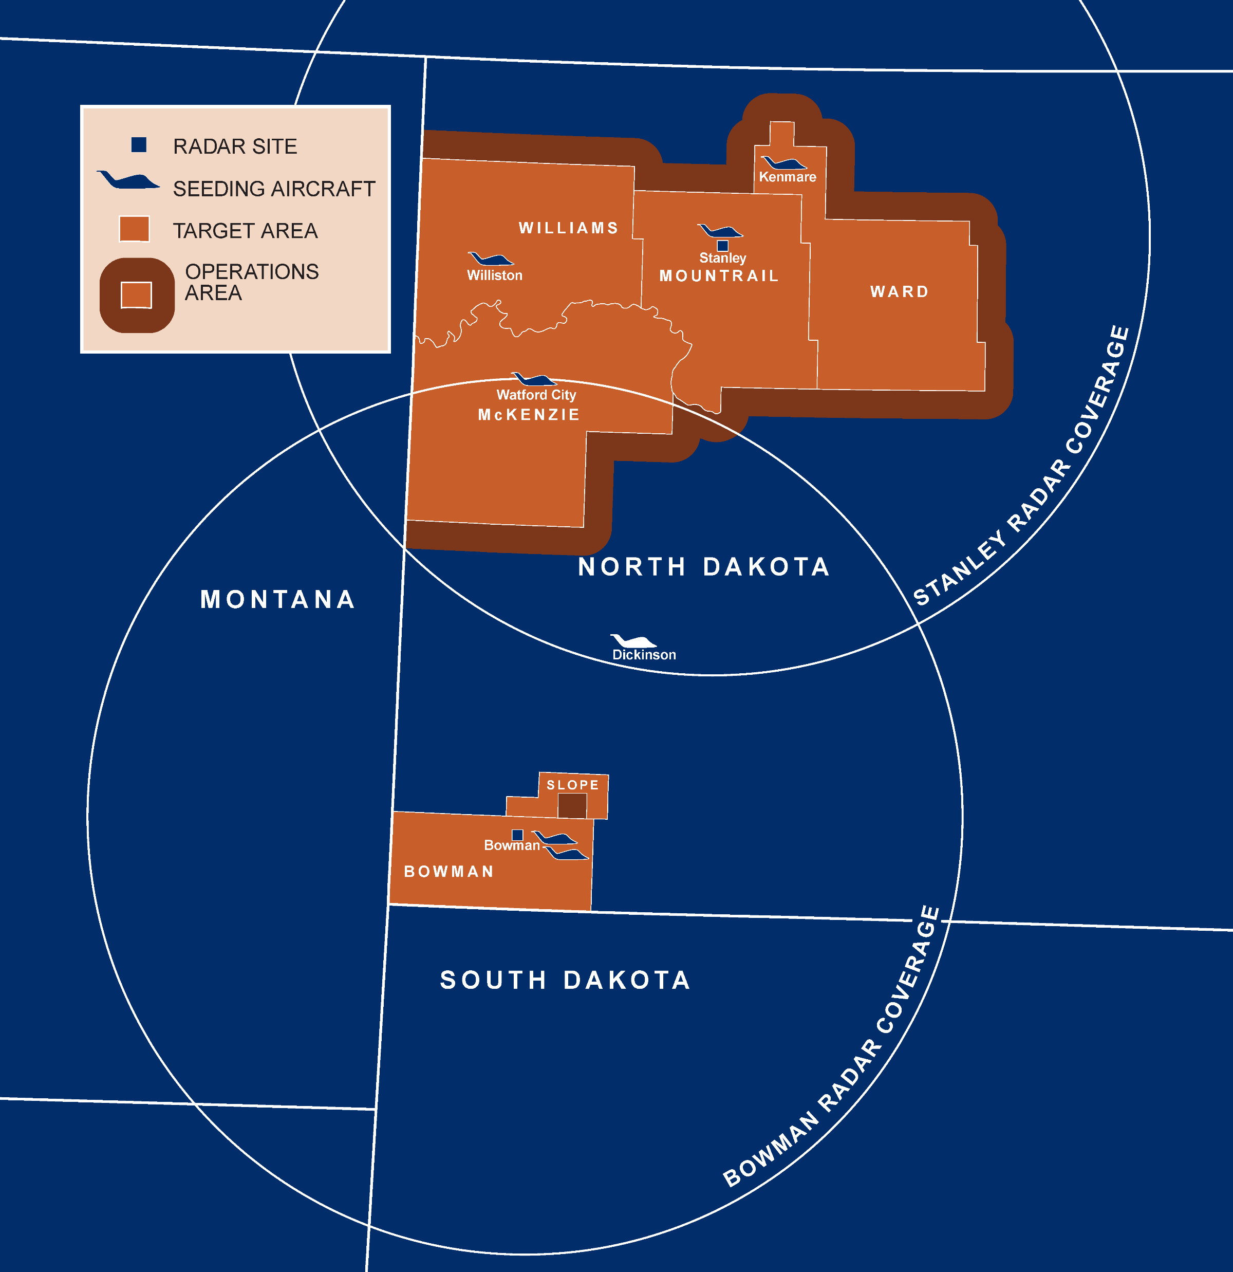
Discussion
Differences in increases between McKenzie and Bowman could be caused by a lack of a southern buffer zone on Bowman County.
Depending on where storms are seeded, Bowman may not be large enough to see the full effect of the rainfall enhancement, where McKenzie can.
Rainfall in Bowman may be affected by using rain gauges within Slope County that do not actively participate in the NDCMP, but previously have.
Using 1950 -1975 as a pre-NDCMP period has limitations.
Source: NDARB 2018
Notes:
Using 1950-1975 has limitations because cloud seeding operations were ongoing during that time period. While the effect of those efforts are unknown, it was assumed that they did not have a large impact on the calculated ratios. Also, the limited number of usable years and rain gauges causes additional limitations when using as a normalization factor. While additional years and more rain gauges can be added to the NDCMP years, the pre-NDCMP data can not be improved.

Slide 47
Future Work
Additional analysis needs to be conducted on the District I and II on differences in meteorology and project operations.
Incorporate radar observation into the analysis.
Analyzing the effects of cloud seeding in respect to wind direction, but using upwind controls, may provide a better target/control analysis than stationary controls.

Slide 48
Acknowledgements
North Dakota Water Resources Research Institute
Darin Langerud
My Committee
My Brother, Kris
Chelsea Augustine
My Mom
Everyone here

Slide 49
References
Bangsund, D. A., and F. L. Leistritz, 2009: Economic Impacts of Cloud Seeding on Agricultural Crops in North Dakota. North Dakota State University, Department of Agribusiness and Applied Economics, http://www.swc.nd.gov/arb/pdfs/SeedingEconImpact.pdf (Accessed January 28, 2016).
DeFelice, T. P., J. Golden, D. Griffith, W. Woodley, D. Rosenfeld, D. Breed, M. Solak, and B. Boe, 2014: Extra area effects of cloud seeding — An updated assessment. Atmospheric Research, 135–136, 193–203, https://doi.org/10.1016/j.atmosres.2013.08.014.
Delene, D. J., 2016: Suitability of North Dakota For Conducting Effective Hygroscopic Seeding. J. Wea. Modification, 48, 43–67.
Johnson, H. L., 1985: An Evaluation of the North Dakota Cloud Modification Project: 1976-1982.
NDARB, 2014: North Dakota Cloud Seeding Questions and Answers. North Dakota Water Commission and State Engineer,. http://www.swc.nd.gov/arb/ndcmp/pdfs/q_a.pdf (Accessed March 28, 2019).
——, 2018: 2018 Final Operations Report North Dakota Cloud Modification Project. North Dakota Atmospheric Resource Board, http://www.swc.nd.gov/arb/ndcmp/pdfs/finalreport.pdf (Accessed January 15, 2019).
Schaffner, L. W., J. E. Johnson, H. Vruegdenhill, and J. Enz, 1983: Economic Effects of Added Growing Season Rainfall on North Dakota Agriculture. Department of Agricultural Econmics, https://www.swc.nd.gov/arb/ndcmp/pdfs/EconEff_AddGrowRain_1983.pdf.
Schneider, M. D., and D. Langerud, 2011: Operational Improvements on the North Dakota Cloud Modification Project. Journal of Weather Modification, 43, 84–88.
Smith, P. L., L. R. Johnson, D. L. Priegnitz, and J. Paul W Mielke, 1992: A Target-Control Analysis of Wheat Yield Data for the North Dakota Cloud Modification Project Region. The Journal of Weather Modification, 24, 98–105.
——, ——, ——, B. Boe, and P. W. Mielke, Jr, 1997: An Exploratory Analysis of Crop Hail Insurance Data for Evidence of Cloud Seeding Effects in North Dakota. J. Appl. Meteor., 36, 463–473.
——, P. W. Mielke, Jr, and F. J. Kopp, 2004: Exploratory Analysis of Climatic Raingage Data For Evidence of Effects of the North Dakota Cloud Modification Project on Rainfall in the Target Area. North Dakota Atmospheric Resource Board, http://www.swc.nd.gov/arb/ndcmp/pdfs/ExplorAnalysisClimaticRainDataNDCMPEffects_2004.pdf.
Wise, E., 2005: Precipitation evaluation of the North Dakota Cloud Modification Project (NDCMP). University of North Dakota, 63 pp.

Slide 50
Questions?

Slide 51
Extra Slides

Slide 52
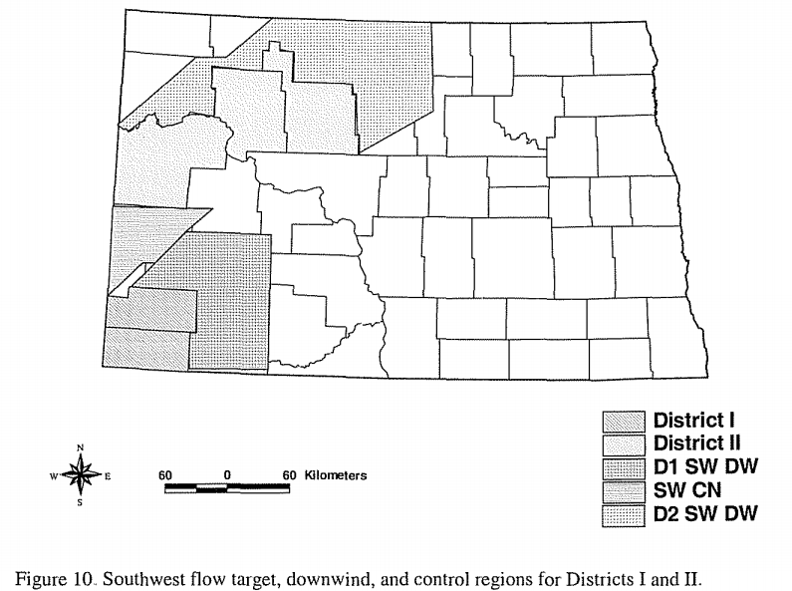
Weiss (2005) Target/Control Based on Storm Flow
Notes:
So using Wise (2005) as a basis for areas that could be contaminated by downwind effects, it was determined that having controls upwind from the cloud seeding operation could help mitigate any effects found within the North Dakota Counties.
Therefore, the control area was broken between counties within North Dakota and the eastern most portion of Montana.

Slide 53
Methodology: Missing Data
For months with no rainfall reported by the station, a “NaN” was placed in the record.
Most stations had had years labeled as “NaN”, with less than 40 % of all stations reporting the full 41 years.
Station | Year | June | July | August
451 | 1993 | 5.33 | 8.85 | 4.71
451 | 1994 | nan | nan | 0.33
451 | 1995 | 1.96 | 6.02 | 1.79
451 | 1996 | nan | 1.22 | 0.87
451 | 1997 | 2.42 | 4.76 | 1.84
451 | 1998 | 3.90 | 1.91 | nan
451 | 1999 | 2.89 | 2.15 | 0.60
451 | 2000 | 4.02 | 2.82 | 0.70
Notes:
How inconsistent data effects the calculated rainfall totals is unknown, but it is assumed to not have a significant impact on the overall analysis of this data.
It could be stated that having a rotating rain gauge network may eliminate any observer bias by but having some stationary gauges are useful to have a climatology of average rainfalls to compare with.

Slide 54
Methodology: p-value
P-values were calculated using Microsoft Excel’s data analysis package through its t-test: Two-Sample Assuming Unequal Variance test as well as by hand calculating the p-values using the standard error and z-score.
P-values were calculated for the single and double ratios during pre-NDCMP and NDCMP time periods.
A predetermined p-value of 0.10 was used to determine if a result was statistically significant.
Notes:
A p-value helps determine if the results are significant.
The p-value of 0.10 was set fourth by Smith Et Al 2004 to test the statistical significance of the NWS COOP data. This standard was used in this study as the significance threshold.

Slide 55
Weighted Rainfall With El Nino

Slide 56
Methodology: Control Region
ND Controls
‘Billings’: Billings and Golden Valley Counties
‘Mercer’: McLean and Mercer Counties
MT Controls
‘Richland’: Richland and northern Dawson Counties
‘Roosevelt’: Roosevelt and Sheridan Counties
‘Wibaux’: Golden Valley County, ND., Wibaux, and southeast Dawson Counties
‘Fallon’: Fallon County
‘Carter’: Carter County

Slide 57
Previous Evaluations of the NDCMP
Schaffner et al. (1983) conducted a three-section study on the economic benefit of additional growing season rainfall.
Results for western ND showed a gain of approx. $53.0 million or $3.63 per planted acre was found with 0.85-1.15 inches of additional rain from June-August.

Slide 58
Previous Evaluations of the NDCMP
Bangsund and Leistritz (2009) used a 5 and 10 % increase in rainfall to estimate value of growing season rainfall.
With an increase of 5 % increase, an economic benefit of $8.4 million or $3.58 per planted acre would be seen annually.
A 10 % increase in rainfall would result in $16 million annually or $6.84 per planted acre.

Slide 59
Previous Evaluations of the NDCMP
Johnson (1985) evaluated rainfall for 1976 to 1982 in the target, downwind of target, and control regions.
Results were found to not be statistically significant (p-value > 0.05) but showed an overall increase in rainfall downwind of the target site.
Overall, there was no evidence for a rainfall increase in the target area.

Slide 60
Previous Evaluations of the NDCMP
Smith et al. (1992) compared wheat yields for seeded and non-seeded counties before 1961 to wheats after 1975.
Results found a 6% increase in wheat yields; however no statistical significance was found suggestion NDCMP was the cause.

Slide 61
Previous Evaluations of the NDCMP
Smith et al. (1997) analyzed crop insurance claims from 1976 to 1988.
Results showed 11 out of 13 years experienced loss ratios below the mean loss ratio.
A multi-response permutation procedure two-sided p-values determined the 11 years were not due to random chance and likely a result of the NDCMP.

Slide 62
Methodology: Single Ratio
Single ratio values are given in a decimal range where a 1:1 ratio is given as 1.0.
Values such as 1.04 would suggest a positive 4 % difference in rainfall, which 0.96 would suggest a reduction 4 % difference in rainfall.

