Slide 1


MELTING LAYER ANALYSIS OF IN-SITU OBSERVATIONS OBTAINED FROM MULTIPLE FIELD PROJECTS
Logan Twohey
Master’s Thesis Defense
University of North Dakota
July 15th, 2022
Committee Chair:
Dr. David Delene, UND
Committee Members:
Dr. Michael Poellot, UND
Dr. Andrew Heymsfield, NCAR

Slide 2



Motivation
The melting layer is the transition from ice to liquid in cold precipitating cloud systems.
Most studies on the melting layer have been through remote sensing with radar, laboratory experiments, and numerical models.
Relatively few studies have used in-situ observations due to difficulties in direct measurements.
In-situ observations can improve the representation of melting layer microphysics.
MELTING LAYER
Notes:
Next slides: features of ML

Slide 3
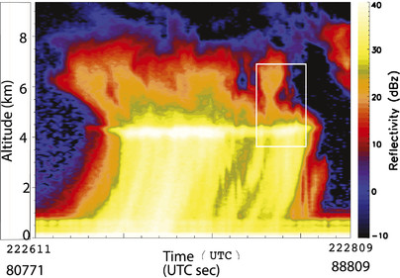
Radar Bright Band Signal
Magnitude up to 10 dBZ.
Contributing Factors
  Increase in dielectric constant of hydrometeors beginning to melt
  Nonsphericity of melting hydrometeors
  Enhanced aggregation
  Coupling of aggregation and breakup
Adapted from Heymsfield et al. (2015) Figure 2
Notes:
Magnitude depends on precipitation rate

Slide 4
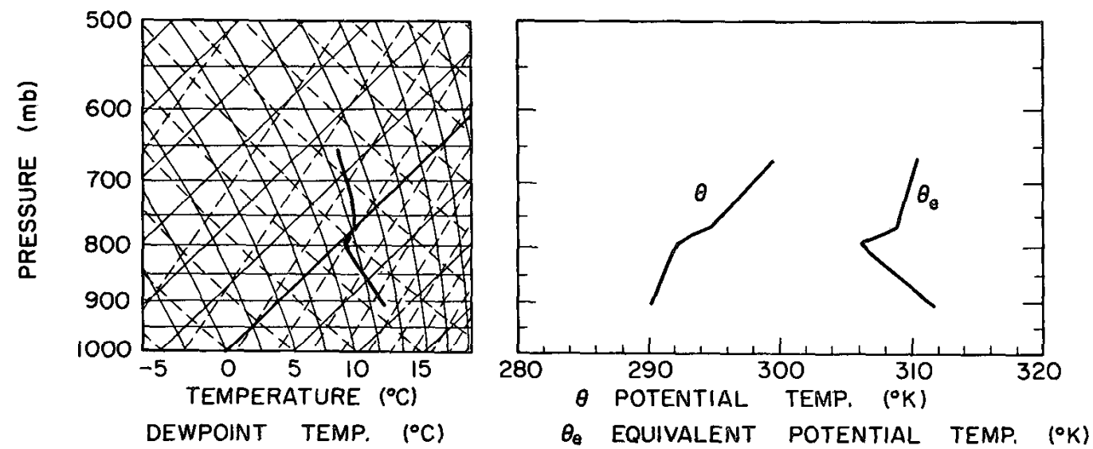
(Quasi)-isothermal Layer
Diabatic cooling due to melting associated with a 0 °C isothermal or quasi-isothermal layer:
  Deepens the melting layer
  Produces mesoscale circulations
  Enhances frontogenesis
  Processes are important in forecasting surface precipitation type
Adapted from Stewart et al. (1984) Figure 12
Notes:
Kain et al. (2000) studied a case where melting-induced cooling led to an unforecasted transition from rain to heavy snow.

Slide 5
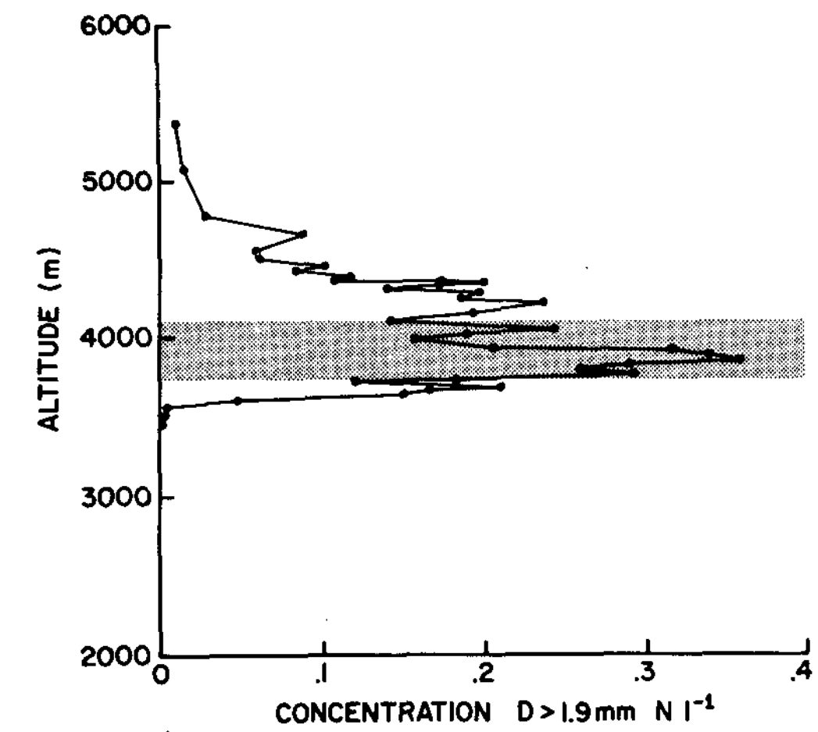
Summary of Findings From In-situ Studies
Large aggregates are the most common hydrometeor at 0 °C.
Aggregation is enhanced within the melting layer.
Adapted from Willis and Heymsfield (1989) Figure 9
Notes:
Shaded in gray is the isothermal layer.

Slide 6
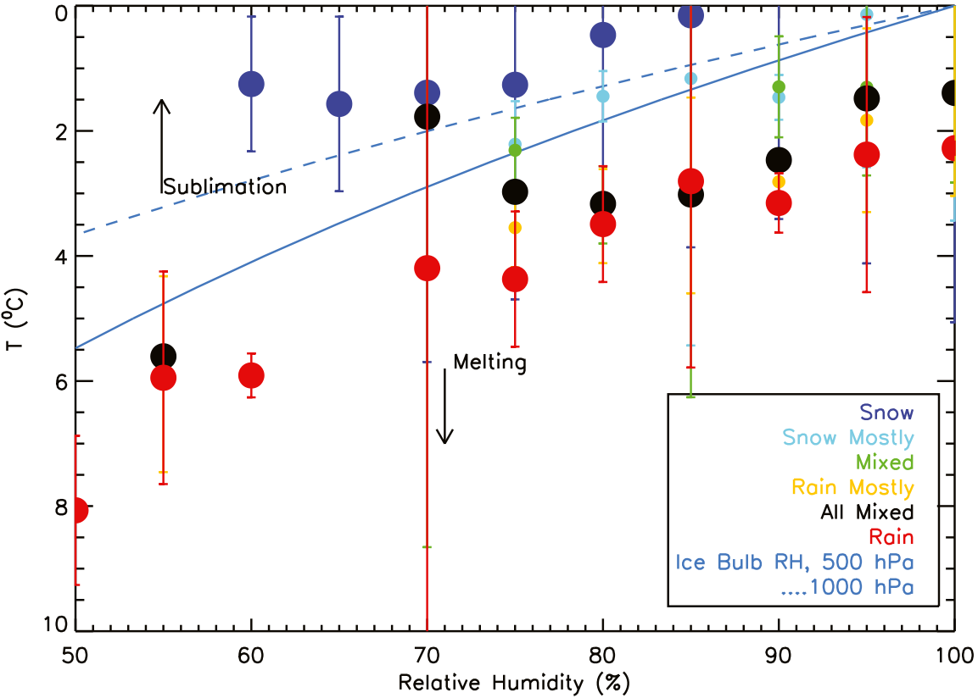
Summary of Findings From In-situ Studies
Large aggregates are the most common hydrometeor at 0 °C.
Aggregation is enhanced within the melting layer.
Relative humidity influences the melting process.
Adapted from Heysmfield et al. (2021) Figure 12

Slide 7
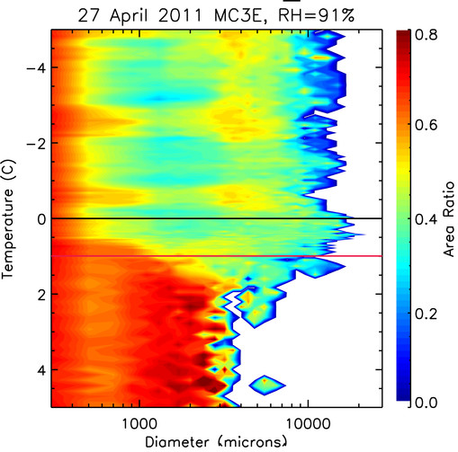
Summary of Findings From In-situ Studies
Large aggregates are the most common hydrometeor at 0 °C.
Aggregation is enhanced within the melting layer.
Relative humidity influences the melting process.
Melting causes an increase in hydrometeor area ratio.
Adapted from Heymsfield et al. (2015) Figure 19

Slide 8
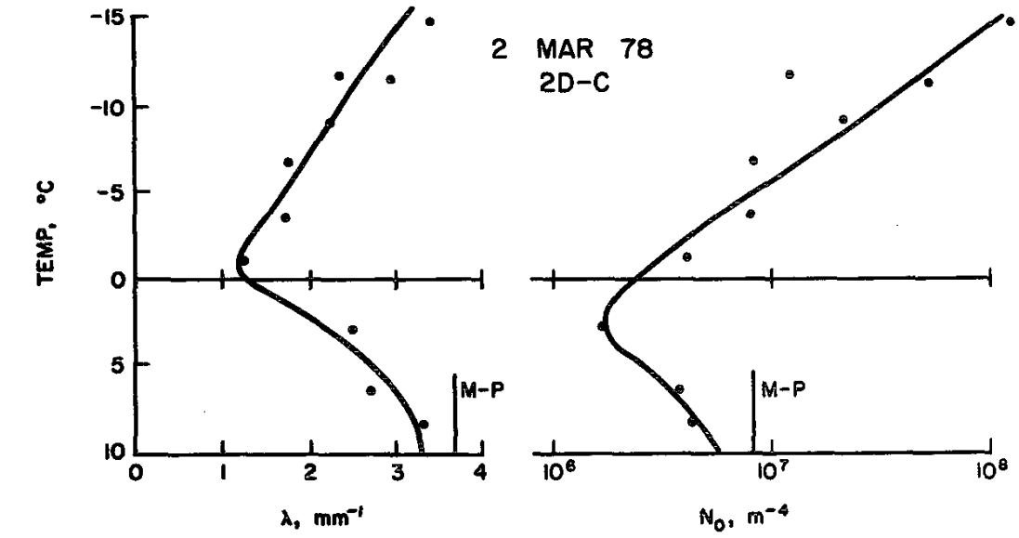
Summary of Findings From In-situ Studies
Large aggregates are the most common hydrometeor at 0 °C.
Aggregation is enhanced within the melting layer.
Relative humidity influences the melting process.
Melting causes an increase in hydrometeor area ratio.
Melting modifies the particle size distribution.
$$N\left(D\right)=N_{0}e^{−λD}$$
Temperature [°C]
λ [mm⁻¹] N₀ [m⁻⁴]
Adapted from Stewart et al. (1984) Figure 9

Slide 9






Objective
Extend previous in-situ analysis of the melting layer:
  Characterize the particle size distribution and area ratio.
  Determine the impact of relative humidity on the melting process.
Use direct observations from several recent NASA field campaigns which includes a variety of environments and storm types.
Notes:
How objectives can help:
* Relative humidity effects can be incorporated into numerical models to improve weather forecasts
* Understanding the evolution of the size distribution can improve rainfall estimates from radar observations

Slide 10
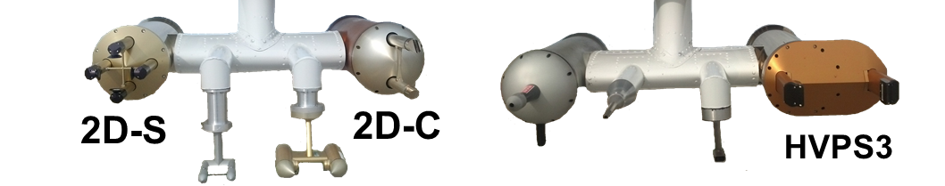
NASA Field Campaigns
Project | Year | Season | Location | Cloud | Precipitation
MC3E | 2011 | Spring | Great Plains | 2D-C | HVPS3
GCPEX | 2012 | Winter | Georgian Bay | 2D-C | HVPS3
IPHEX | 2014 | Spring | Southeast US | 2D-S | HVPS3
OLYMPEX | 2015* | Late Fall | Western Washington | 2D-S | (2) HVPS3
IMPACTS | 2020 | Winter | Northeast US | 2D-S | (2) HVPS3
Notes:
Technically 2015-2016, but all of our melting layer cases from olympex are from 2015.

Slide 11
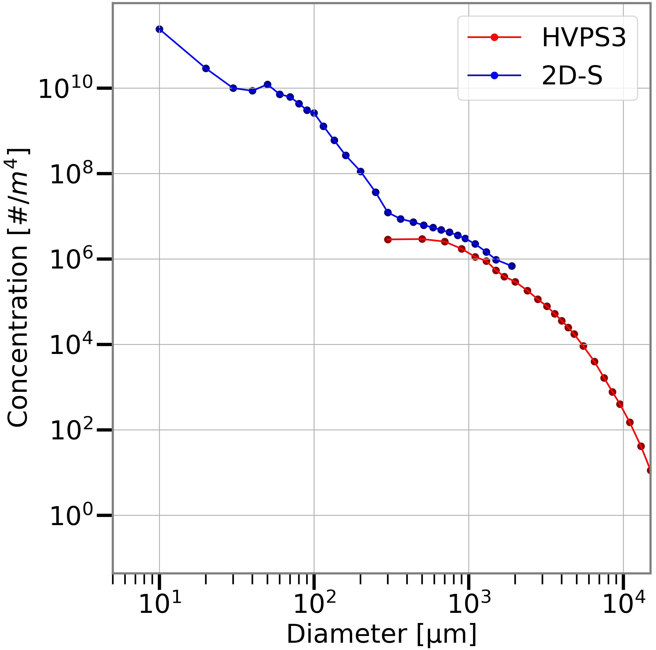
Imaging Probes
Two-Dimensional Stereo (2D-S) probe has 10 µm pixel resolution
High Volume Precipitation Spectrometer Version 3 (HVPS3) has 150 µm pixel resolution
Data processed with the ADPAA software package and utilizes the SODA2

Slide 12
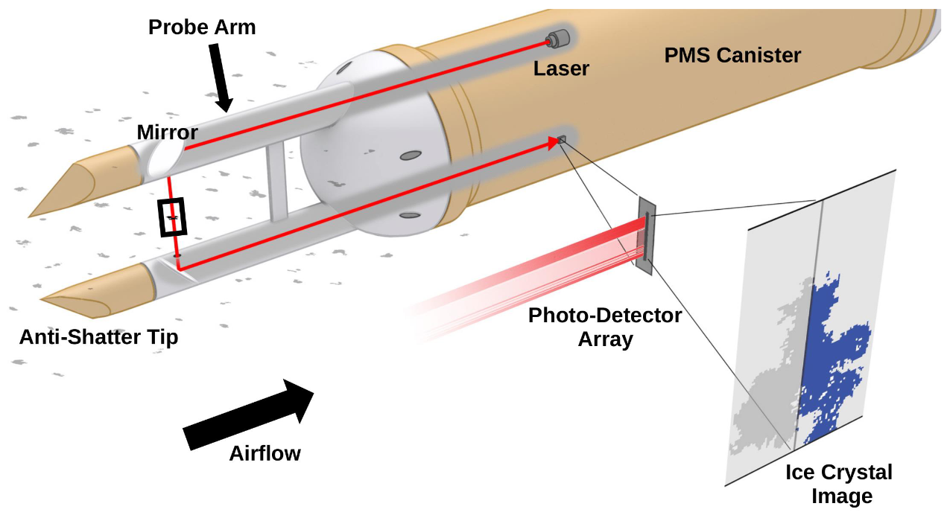
Imaging Probes
Adapted from Wagner and Delene (2022) Figure 1

Slide 13
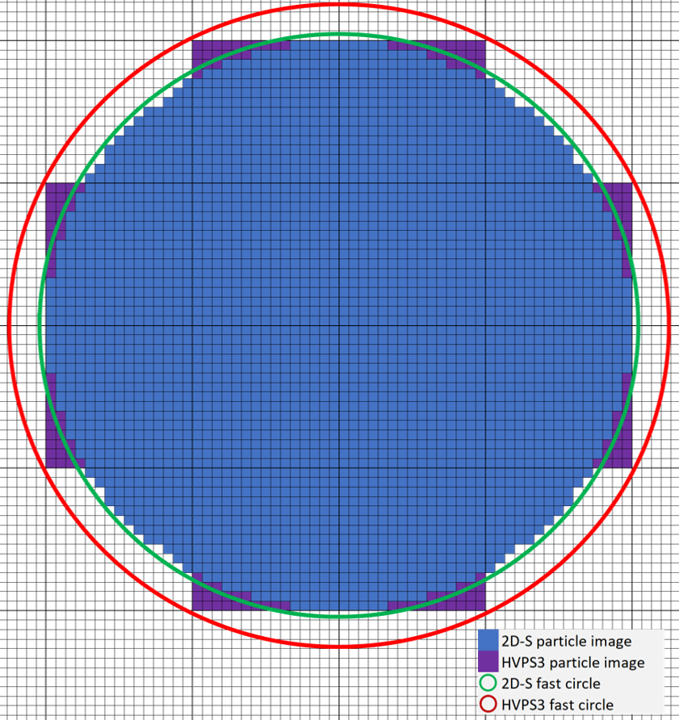
Area Ratio
 | 2D-S | HVPS3
Image Size [µm²] | 282,400 | 270,000
Fast Circle [µm²] | 303,054 | 368,212
Area Ratio | 0.93 | 0.73
Area ratio is the ratio of the particle image area to the fast circle area.
Low resolution probes such as the HVPS3 have lower area ratio for circular hydrometeors.

Slide 14
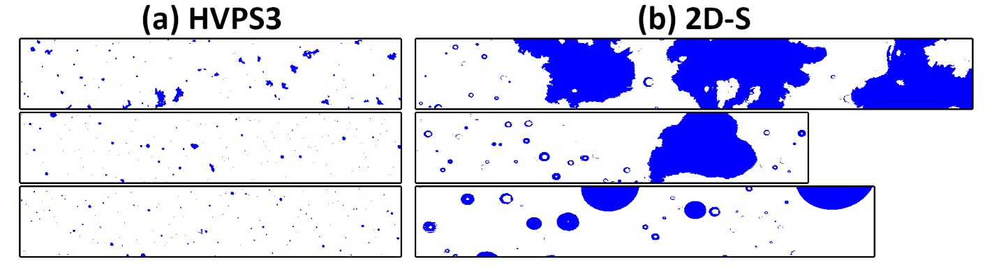
Melting Layer Depth
Top
Middle
Bottom
Top: 0 °C ice-bulb isotherm (frozen hydrometeors, typically aggregates)
Middle: Mixed phase & partially melted hydrometeors
Bottom: All hydrometeors melted – images appear fully round

Slide 15
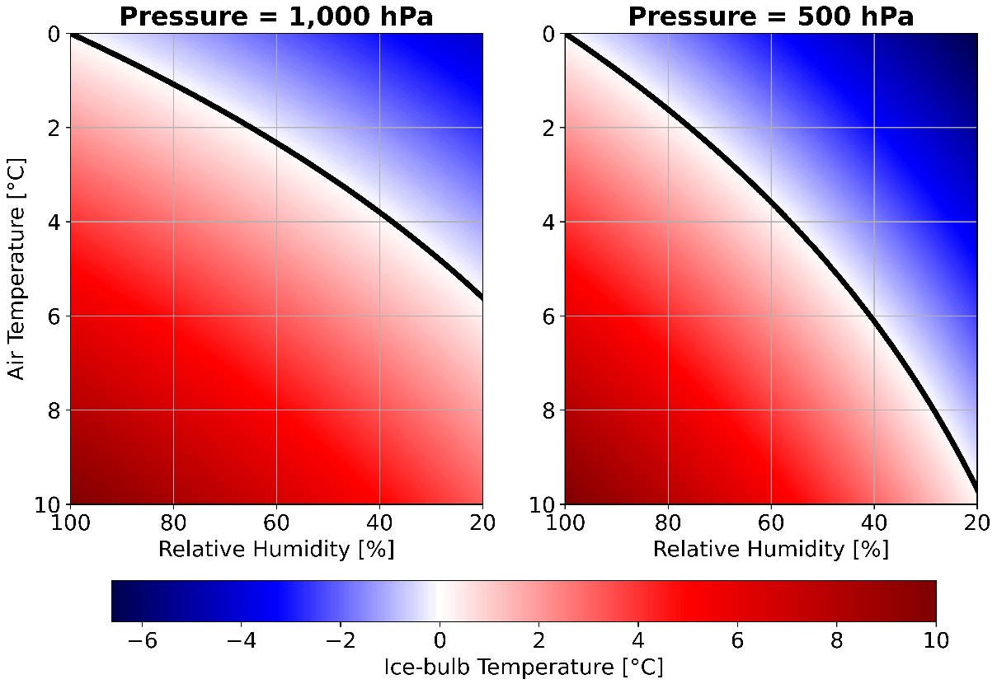
Ice-bulb Temperature Calculation
Ice-bulb temperature (and wet-bulb) calculated with the new bulbtemp ADPAA module that inputs:
  Air temperature
  Dew point temperature
  Pressure
1.1 °C
1.8 °C

Slide 16
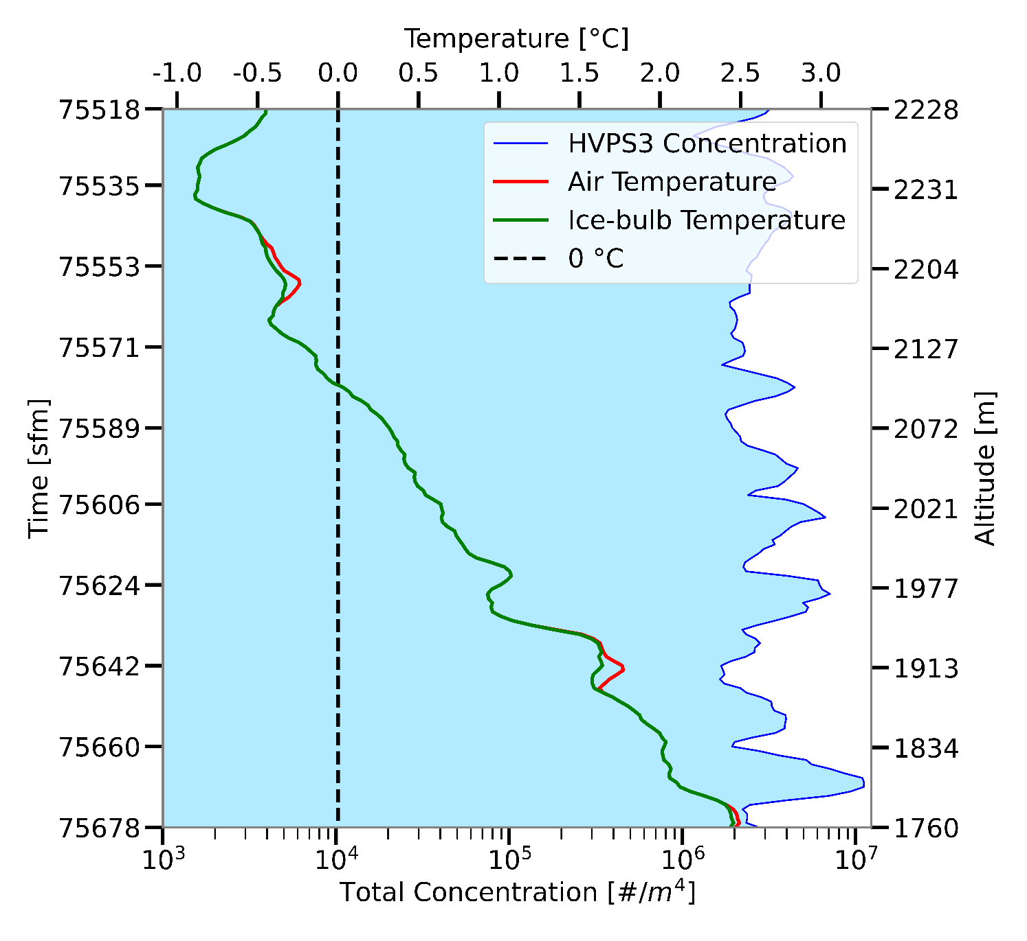
Melting Layer Profile
Melting Layer Criteria
Continuous vertical measurements of hydrometeors melting
Sampled during an ascent or descent
Minimum hydrometeor concentration threshold of 10³ #/m⁴

Slide 17
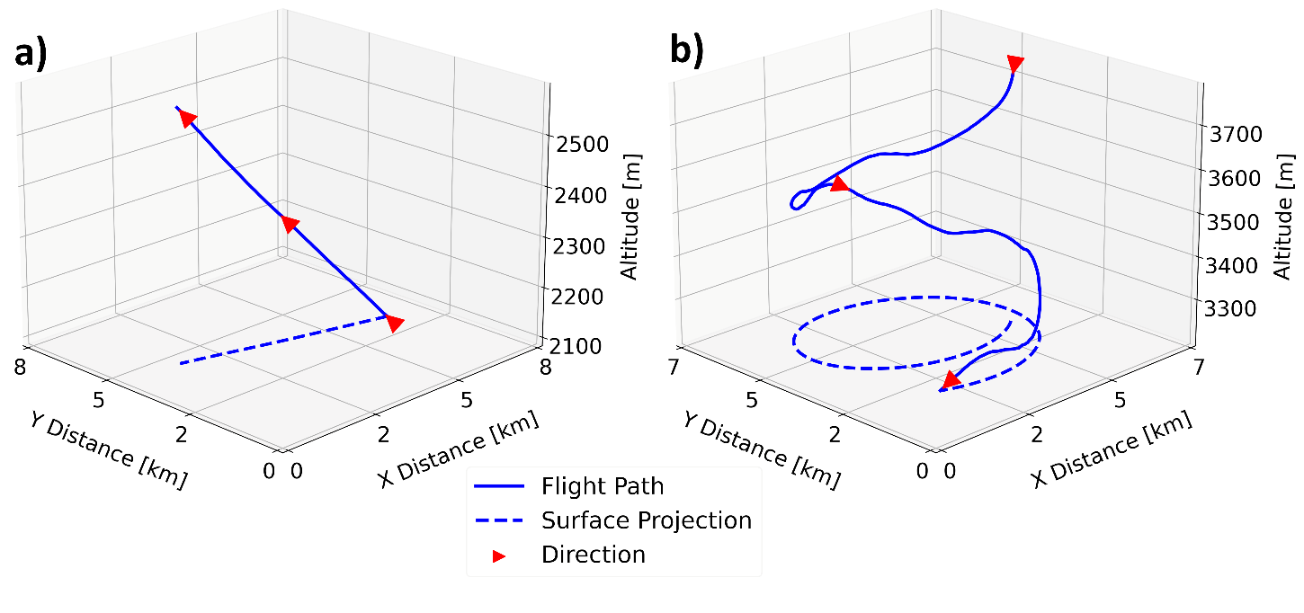
Penetration Type
Ramp
Spiral
Notes:
X-Distance: Longitudinal
Y-Distance: Latitudinal
Some previous studies made a distinction between Eulerian and Lagrangian spirals

Slide 18
Melting Layer Cases
1
4
5
6
9
8

Slide 19
Melting Layer Cases
33 Total Cases
5 Case Types
High Relative Humidity - OLYMPEX_Ram-Des_98RH
Saturated - OLYMPEX_Ram-Des_100RH
Enhanced Aggregation
  IMPACTS_Spi-Des_94RH
  MC3E_Ram-Asc_83RHa
Low Relative Humidity – GCPEX_Spi-Des_84RH
Isothermal Layer – GCPEX_Spi-Asc_100RH

Slide 20
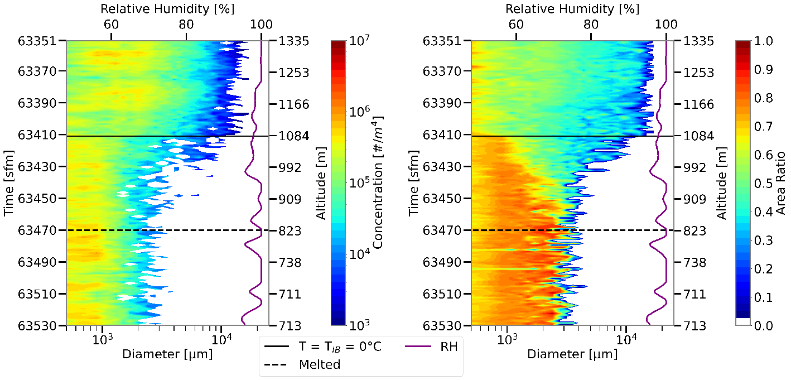
High Relative Humidity
OLYMPEX_Ram_Des_98RHa
Notes:
OLYMPEX_Ram_Des_98RHa

Slide 21
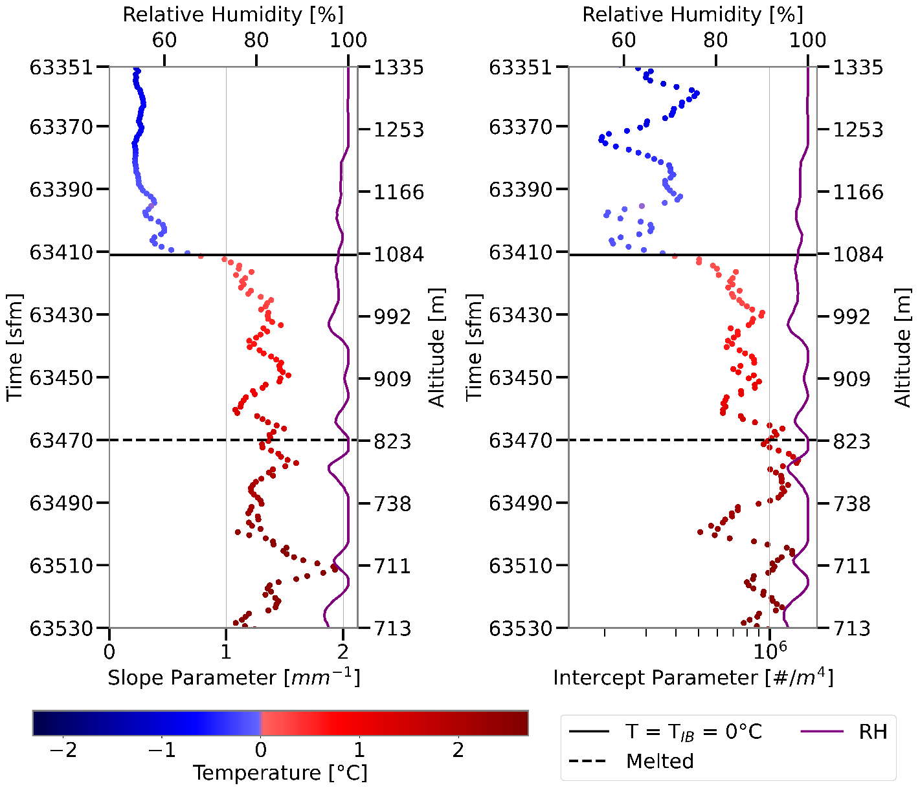
High Relative Humidity
Both exponential fit parameters lowest above melting layer.
Both increase as melting begins and concentration of large particles decreases.
Most significant changes near the melting layer top.
OLYMPEX_Ram_Des_98RHa
Notes:
OLYMPEX_Ram_Des_98RHa

Slide 22
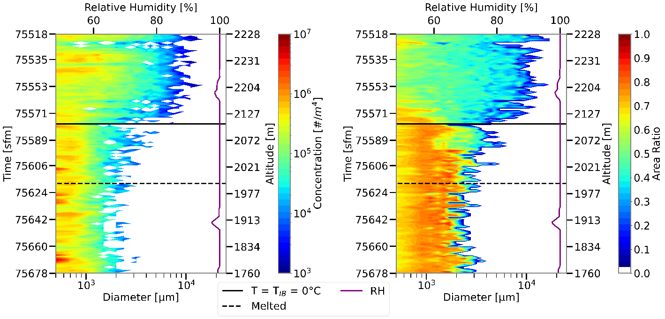
Saturated Case
OLYMPEX_Ram_Des_100RH

Slide 23
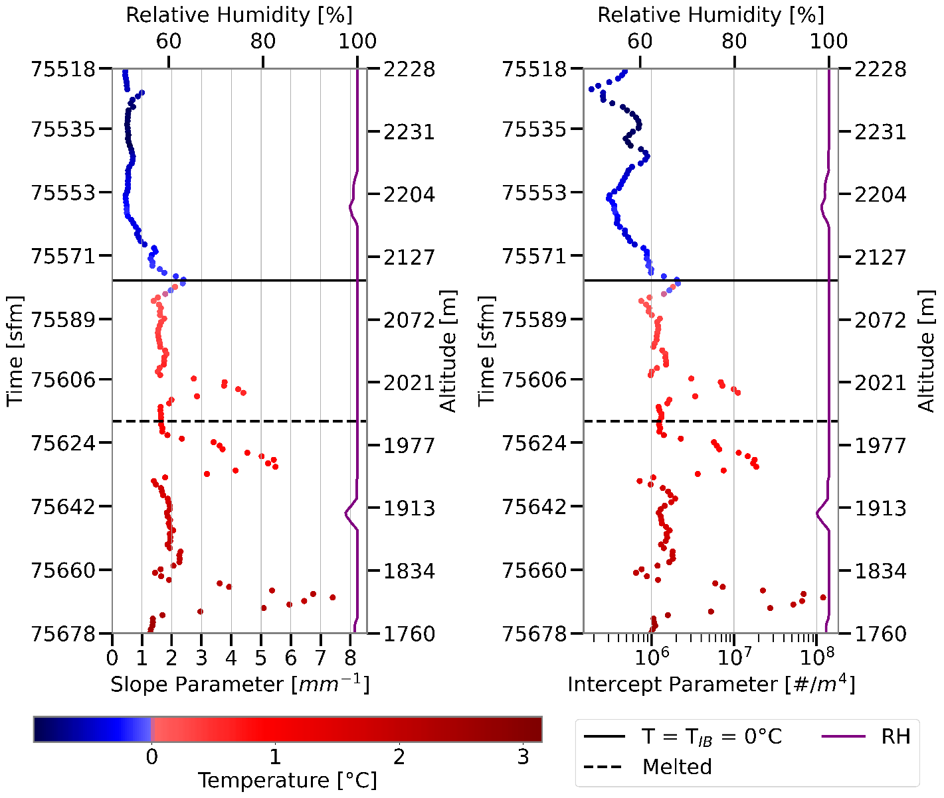
Saturated Case
Both parameters smallest above melting layer.
Both parameters slightly larger below the melting layer than within.
Distinct spikes in parameters associated with increases of small hydrometeor concentration.
OLYMPEX_Ram_Des_100RH

Slide 24
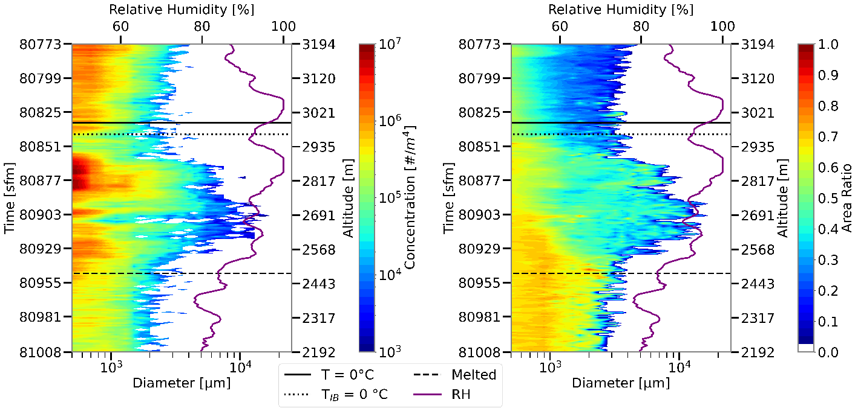
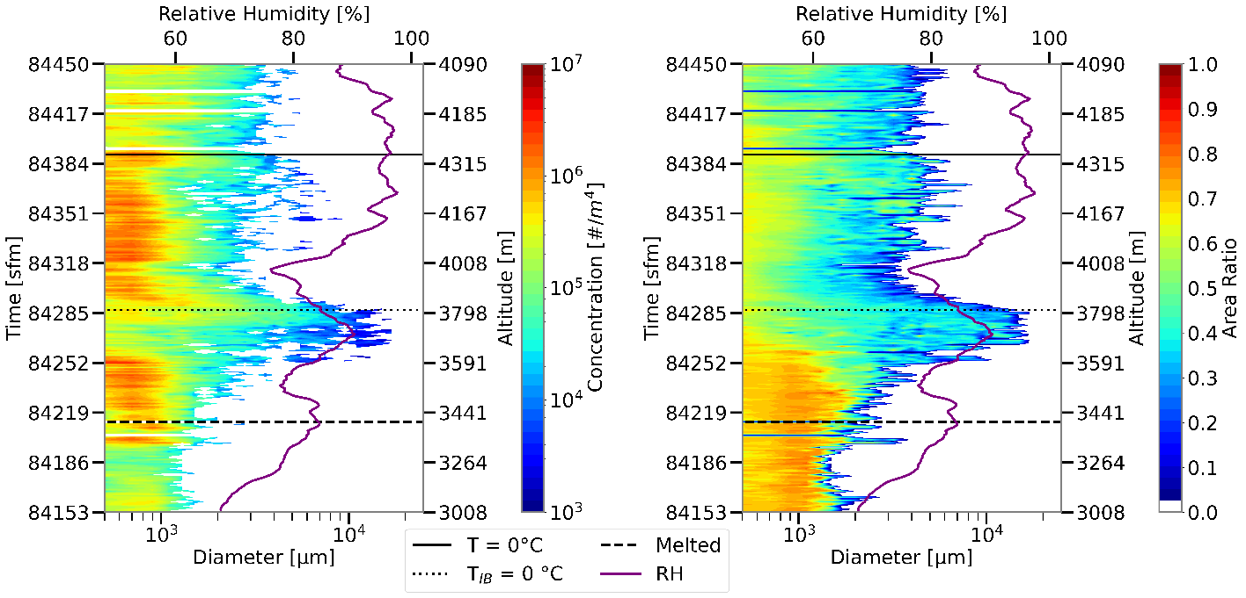
Significant Aggregation Cases
IMPACTS_Spi_Des_94RH
MC3E_Ram-Asc_83RHa

Slide 25
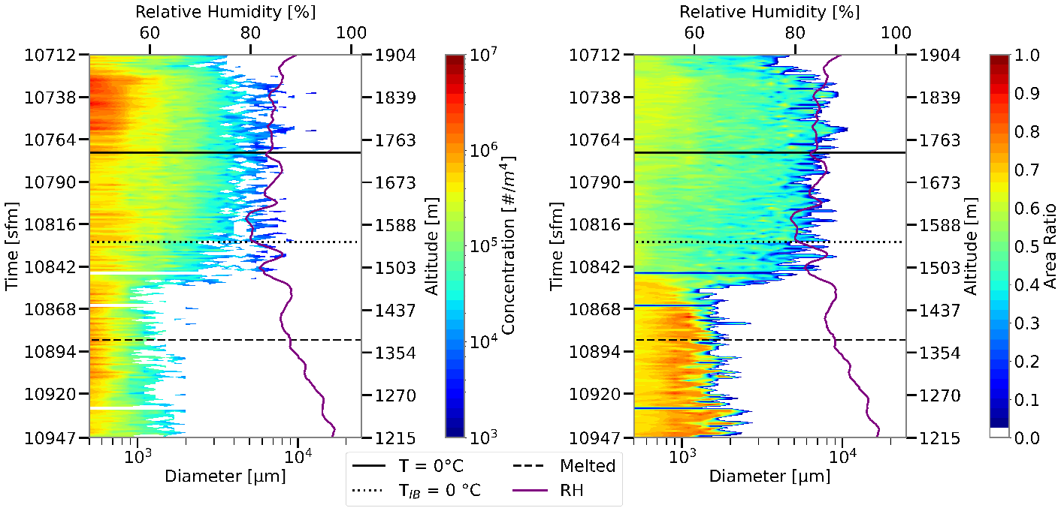
Low Relative Humidity
GCPEX_Spi-Des_84RH
Notes:
GCPEX_Lag_Des_84RH

Slide 26
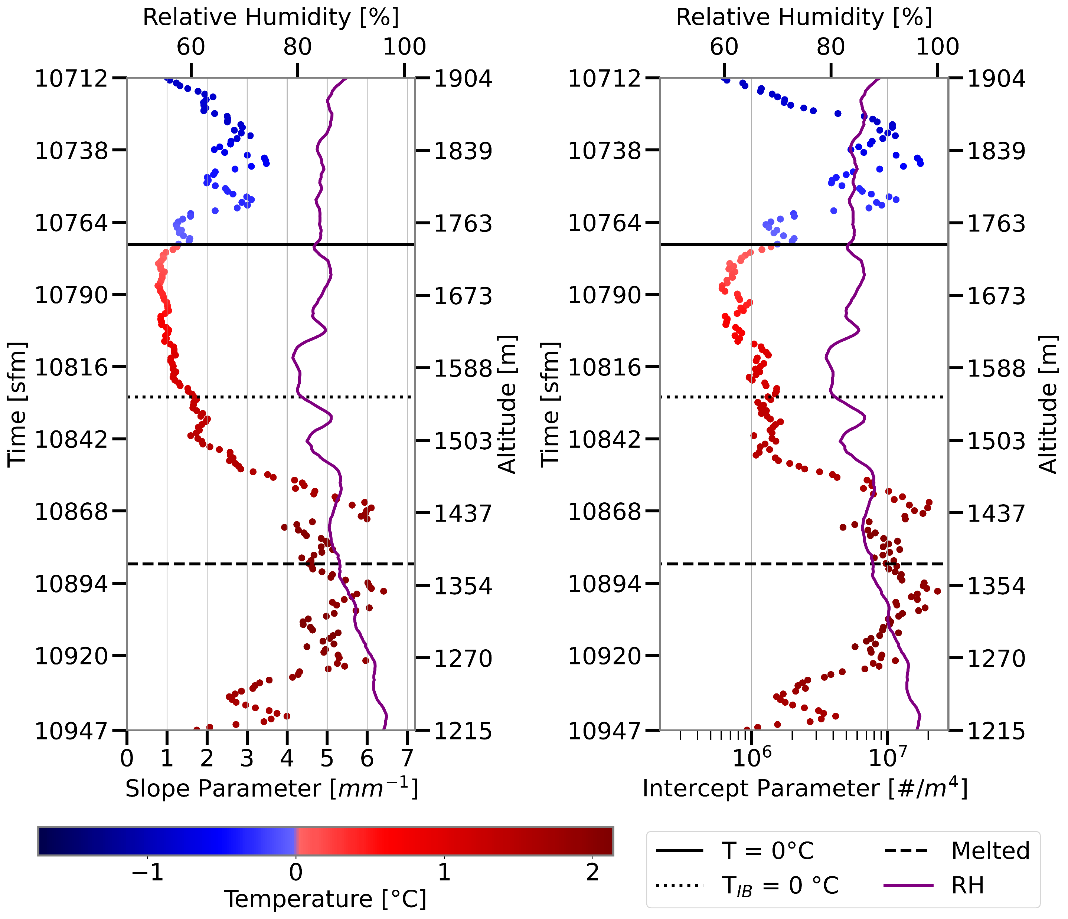
Low Relative Humidity
GCPEX_Spi-Des_84RH
Notes:
GCPEX_Lag_Des_84RH

Slide 27
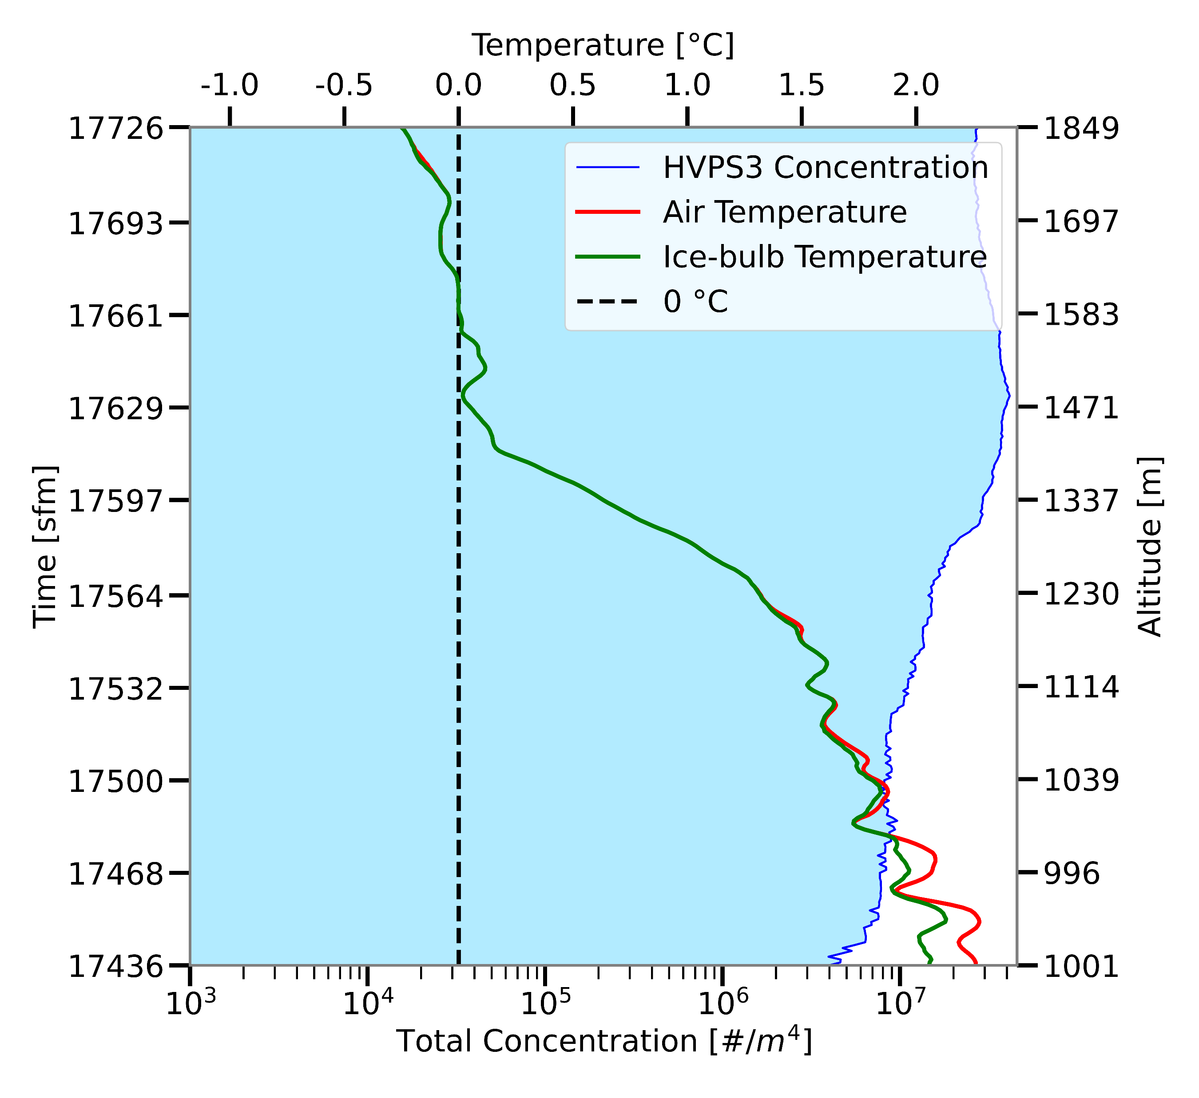
Quasi-isothermal Layer
Notes:
One more case had isothermal layer, but that was solely above the melting layer, so not due to melting.

Slide 28
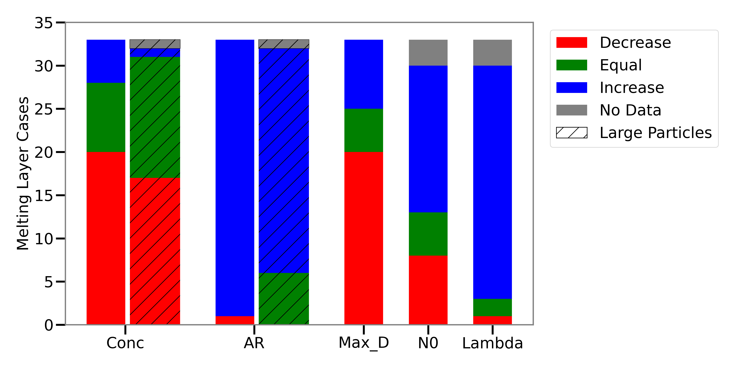
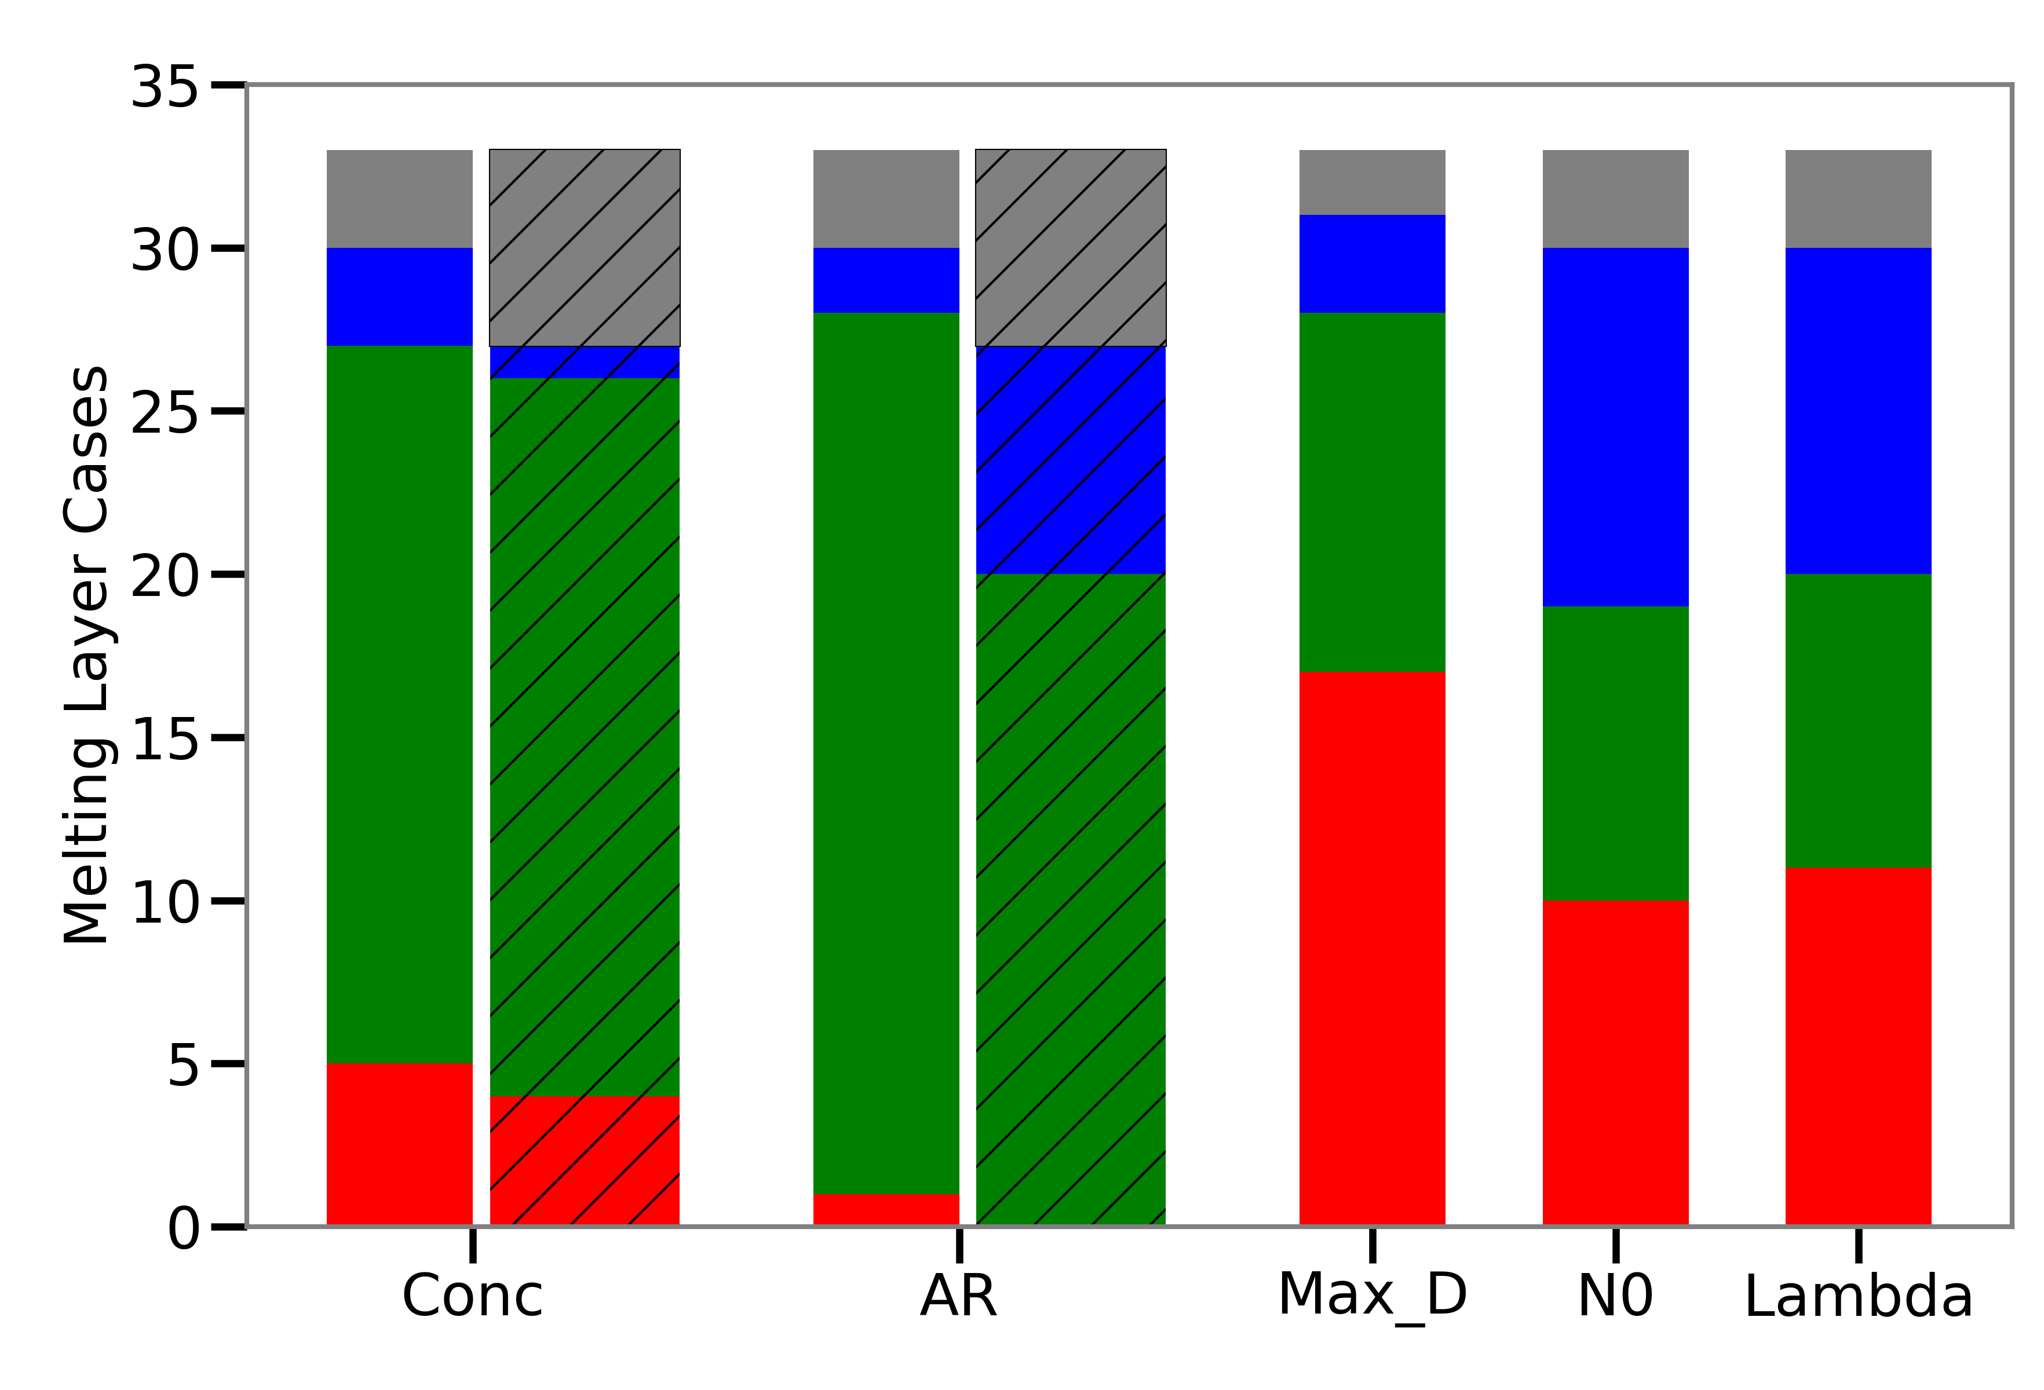
Results
Above to Within
Melting Layer
Total Cases
Concentration decreases
  More frequent with low relative humidity
Area ratio increases
Max diameter decreases
Exponential Fit
  Slope parameter increases
Total Cases
Conc = Concentration
AR = Area Ratio
Max_D = Maximum Diameter
N₀ = Intercept Parameter
λ = Slope Parameter
Within to Below
Melting Layer
N₀
λ
Notes:
Highlight in order left to right

Slide 29
Results
Above to Within
Melting Layer
Total Cases
Concentration decreases
  More frequent with low relative humidity
Area ratio increases
Max diameter decreases
Exponential Fit
  Slope parameter increases
Total Cases
Conc = Concentration
AR = Area Ratio
Max_D = Maximum Diameter
N₀ = Intercept Parameter
λ = Slope Parameter
Within to Below
Melting Layer
N₀
λ
Notes:
Highlight in order left to right

Slide 30
Conclusions
Summary Table
An increase in area ratio over a depth indicates melting is occurring.
Area ratio begins to increase below 0 °C ice-bulb isotherm.
  Confirms Heymsfield et al. (2021).
Concentration of both small and large hydrometeors decreases.
Few cases have enhanced aggregation
Only 2/33 cases have a quasi-isothermal layer
N₀
λ

Slide 31
Future Work
How is the lapse rate impacted?
How do radar reflectivity changes in the melting layer compare to the observed particle spectrum changes?
  How does this relate to the bright band?
What happens to hydrometeors smaller than 500 µm?
  Newer probes with larger sample volume than 2D-S but higher resolution than HVPS3?
Notes:
A lower lapse rate would deepen the melting layer and better match results of previous studies
Why did we not see enhanced aggregation in the melting layer?

Slide 32
Acknowledgements
Committee Members
  Dr. David Delene, UND
  Dr. Michael Poellot, UND
  Dr. Andrew Heysmfield, NCAR
UND Atmospheric Sciences Department
  Faculty Members
  Students
Friends and Colleagues
Family

Slide 33
References
Delene, D. J., 2011: Airborne data processing and analysis software package. Earth Sci Inform, 4, 29–44, https://doi.org/10.1007/s12145-010-0061-4.
Fabry, F., and I. Zawadzki, 1995: Long-Term Radar Observations of the Melting Layer of Precipitation and Their Interpretation. Journal of the Atmospheric Sciences, 52, 838–851, https://doi.org/10.1175/1520-0469(1995)052<0838:LTROOT>2.0.CO;2.
Gorgucci, E., L. Baldini, and V. Chandrasekar, 2006: What Is the Shape of a Raindrop? An Answer from Radar Measurements. Journal of the Atmospheric Sciences, 63, 3033–3044, https://doi.org/10.1175/JAS3781.1.
Heymsfield, A. J., and J. L. Parrish, 1978: A Computational Technique for Increasing the Effective Sampling Volume of the PMS Two-Dimensional Particle Size Spectrometer. Journal of Applied Meteorology and Climatology, 17, 1566–1572, https://doi.org/10.1175/1520-0450(1978)017<1566:ACTFIT>2.0.CO;2.
——, ——, M. R. Poellot, and N. Wood, 2015: Observations of Ice Microphysics through the Melting Layer. Journal of the Atmospheric Sciences, 72, 2902–2928, https://doi.org/10.1175/JAS-D-14-0363.1.
——, ——, A. Theis, and C. Schmitt, 2021: Survival of Snow in the Melting Layer: Relative Humidity Influence. Journal of the Atmospheric Sciences, https://doi.org/10.1175/JAS-D-20-0353.1.
Igel, A. L., and S. C. van den Heever, 2014: The role of latent heating in warm frontogenesis: The Role of Latent Heating in Warm Frontogenesis. Q.J.R. Meteorol. Soc., 140, 139–150, https://doi.org/10.1002/qj.2118.
Iversen, E. C., G. Thompson, and B. E. Nygaard, 2021: Improvements to melting snow behavior in a bulk microphysics scheme. Atmospheric Research, 253, 105471, https://doi.org/10.1016/j.atmosres.2021.105471.
Kain, J. S., S. M. Goss, and M. E. Baldwin, 2000: The Melting Effect as a Factor in Precipitation-Type Forecasting. Weather and Forecasting, 15, 700–714, https://doi.org/10.1175/1520-0434(2000)015<0700:TMEAAF>2.0.CO;2.
Marshall, J. S., and W. M. K. Palmer, 1948: THE DISTRIBUTION OF RAINDROPS WITH SIZE. Journal of the Atmospheric Sciences, 5, 165–166, https://doi.org/10.1175/1520-0469(1948)005<0165:TDORWS>2.0.CO;2.
Mitra, S. K., O. Vohl, M. Ahr, and H. R. Pruppacher, 1990: A Wind Tunnel and Theoretical Study of the Melting Behavior of Atmospheric Ice Particles. IV: Experiment and Theory for Snow Flakes. Journal of the Atmospheric Sciences, 47, 584–591, https://doi.org/10.1175/1520-0469(1990)047<0584:AWTATS>2.0.CO;2.
Stewart, R. E., J. D. Marwitz, J. C. Pace, and R. E. Carbone, 1984: Characteristics through the Melting Layer of Stratiform Clouds. Journal of the Atmospheric Sciences, 41, 3227–3237, https://doi.org/10.1175/1520-0469(1984)041<3227:CTTMLO>2.0.CO;2.
Willis, P. T., and A. J. Heymsfield, 1989: Structure of the Melting Layer in Mesoscale Convective System Stratiform Precipitation. Journal of the Atmospheric Sciences, 46, 2008–2025, https://doi.org/10.1175/1520-0469(1989)046<2008:SOTMLI>2.0.CO;2.
Psychrometric formula - Glossary of Meteorology. https://glossary.ametsoc.org/wiki/Psychrometric_formula (Accessed May 2, 2022).

Slide 34
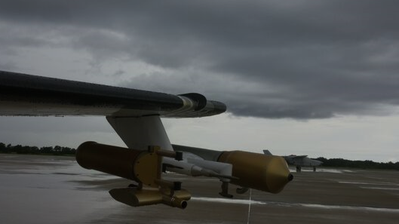
QUESTIONS?

Slide 35
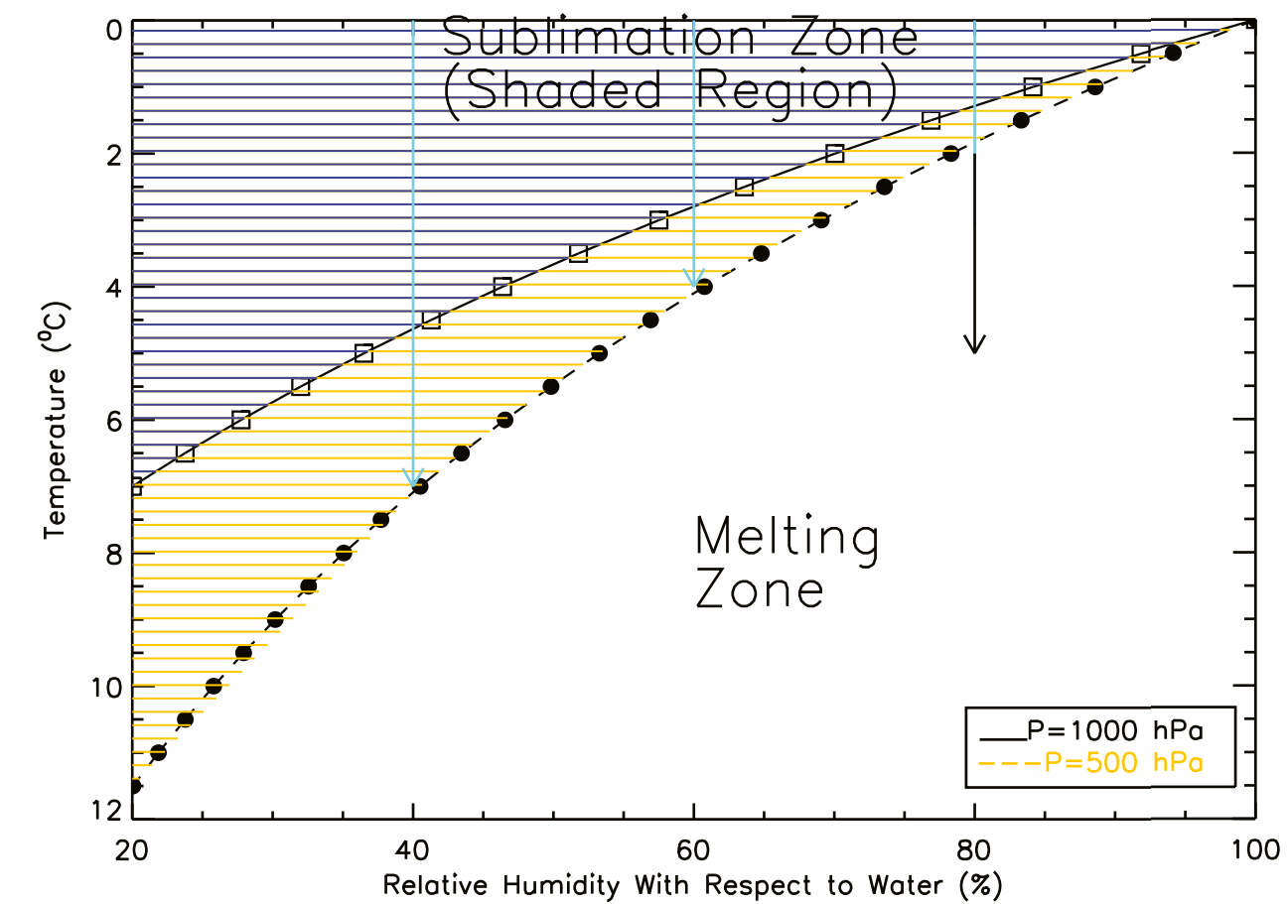
Ice-bulb Comparison
1 °C
1.8 °C

Slide 36
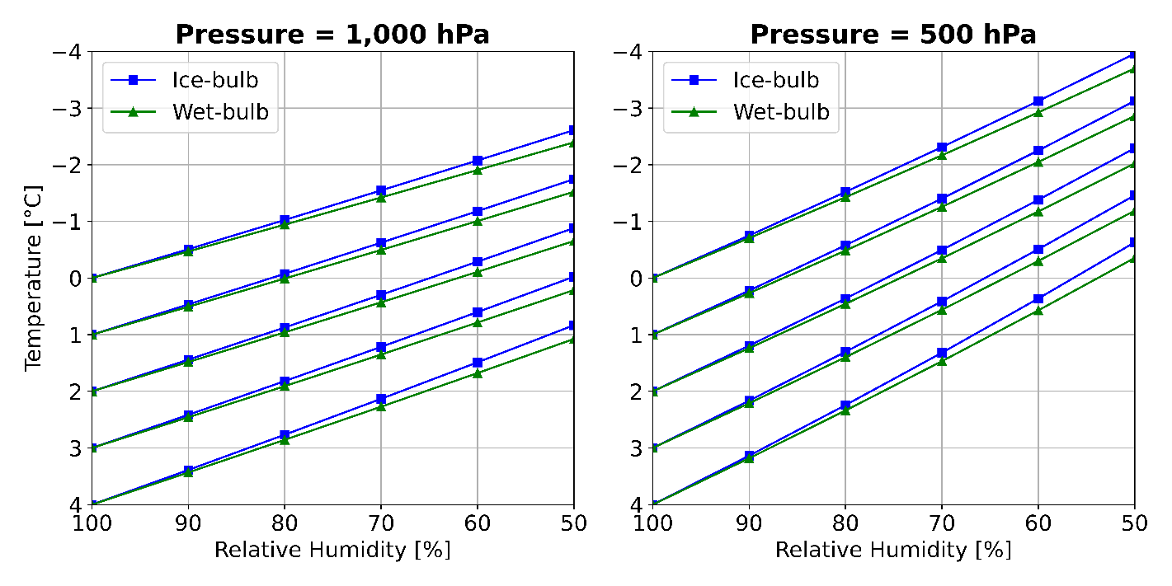
Ice-bulb Temperature

Slide 37
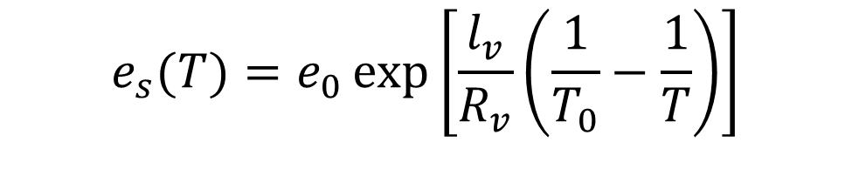
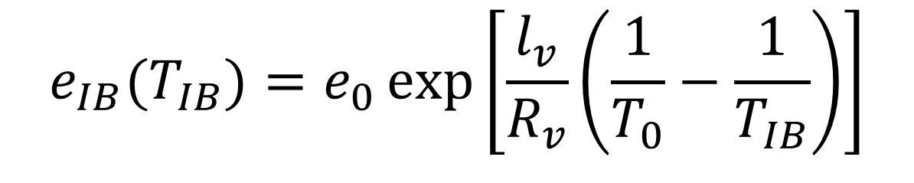
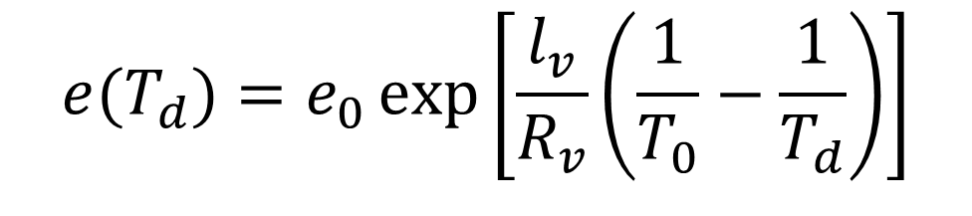
Ice-bulb Derivation
$$e_{s}(T)=e_{0}\exp\left[\frac{l_{v}}{R_{v}}\left(\frac{1}{T_{0}}−\frac{1}{T}\right)\right]$$
$$e(T_{d})=e_{0}\exp\left[\frac{l_{v}}{R_{v}}\left(\frac{1}{T_{0}}−\frac{1}{T_{d}}\right)\right]$$
$$e_{IB}(T_{IB})=e_{0}\exp\left[\frac{l_{v}}{R_{v}}\left(\frac{1}{T_{0}}−\frac{1}{T_{IB}}\right)\right]$$
$$e= e_{IB}\left(T_{IB}\right)−5.82 ×{10}^{−4} \left(1+0.00115 T_{w}\right) p \left(T−T_{w}\right)$$

Slide 38
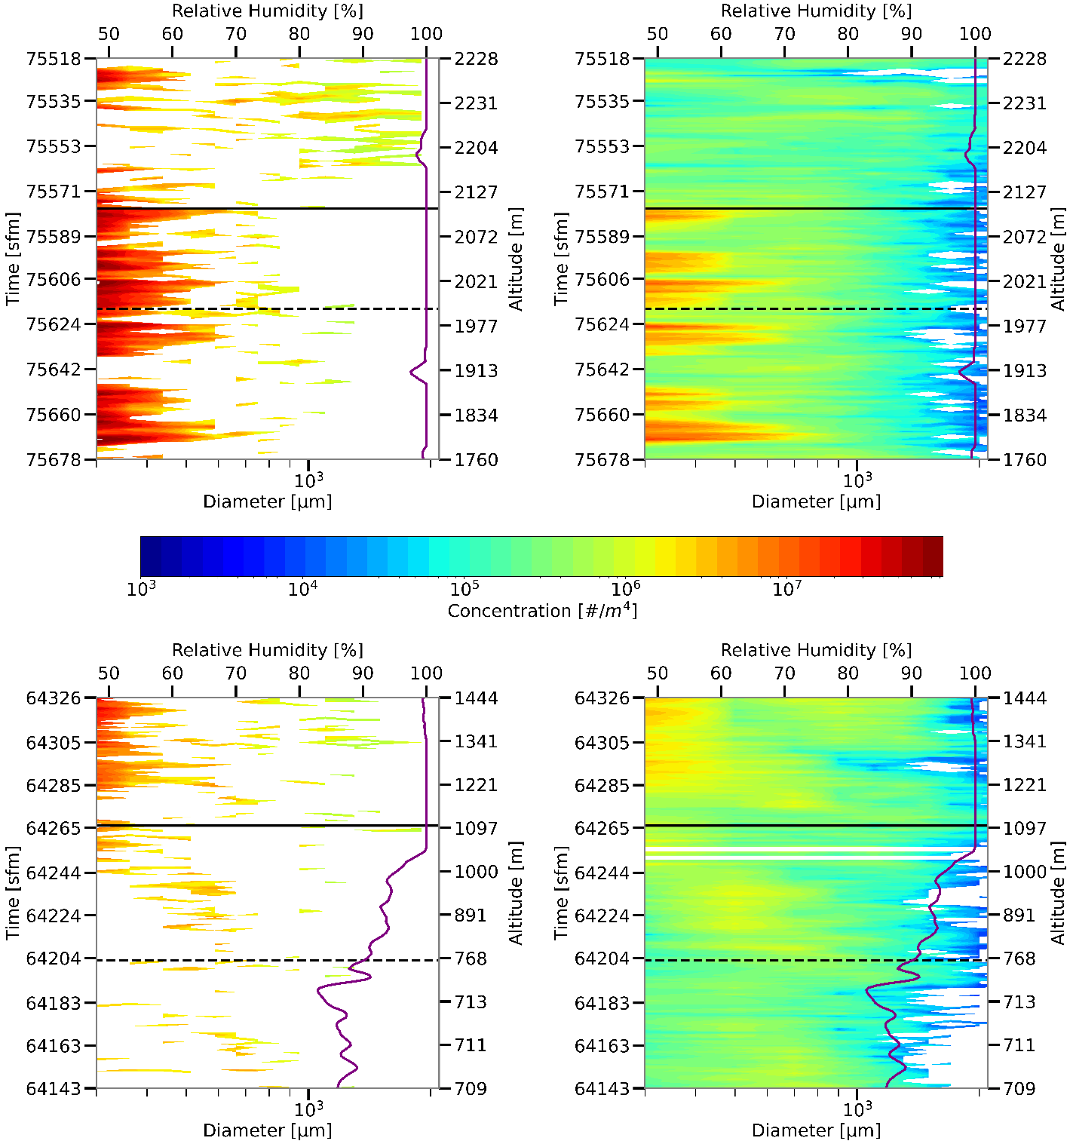
2D-S vs. HVPS3
Zero counts in 2D-S

Slide 39
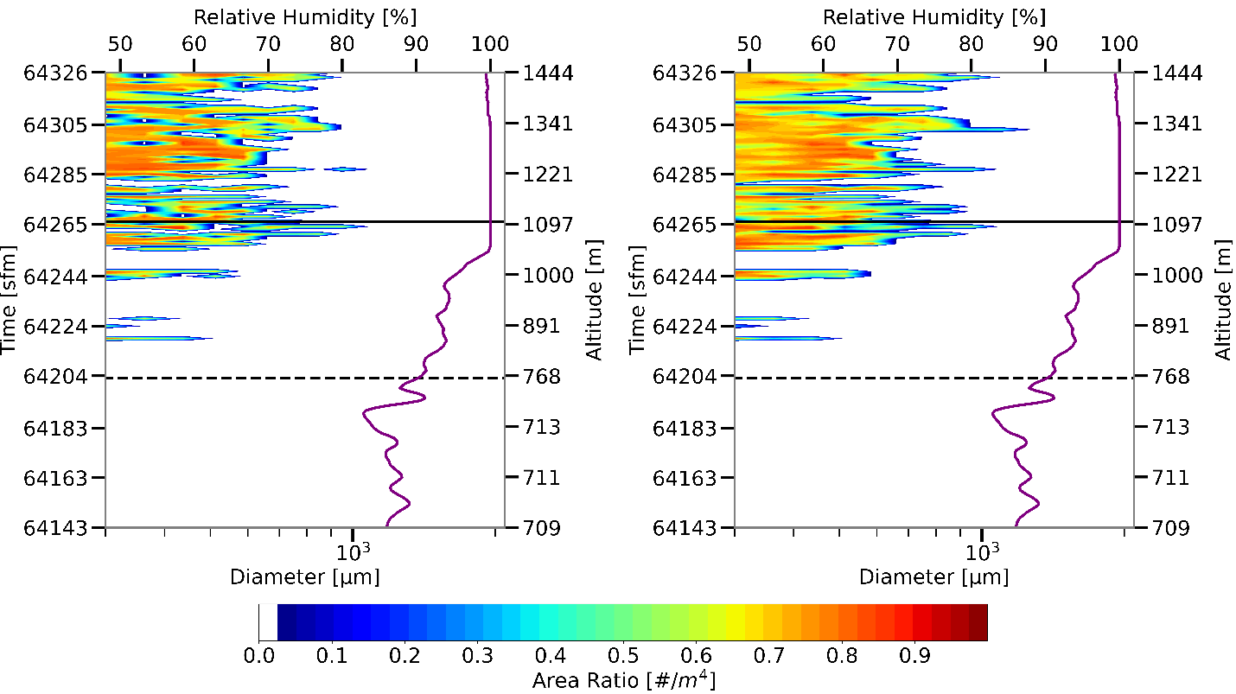

Slide 40
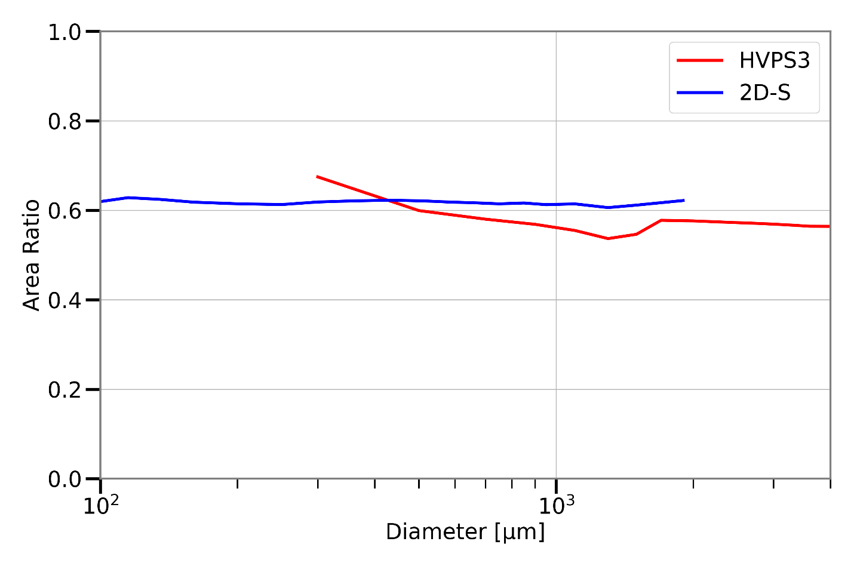
Pixels Necessary for Area Ratio Analysis

Slide 41
Melting Layer Cases
 | Low (≤ 90%) RH | High (> 90%) RH | Saturated | Total
Spiral | 4 | 8 | 6 | 18
Ramp | 5 | 9 | 1 | 15
Total | 9 | 17 | 7 | 33

Slide 42
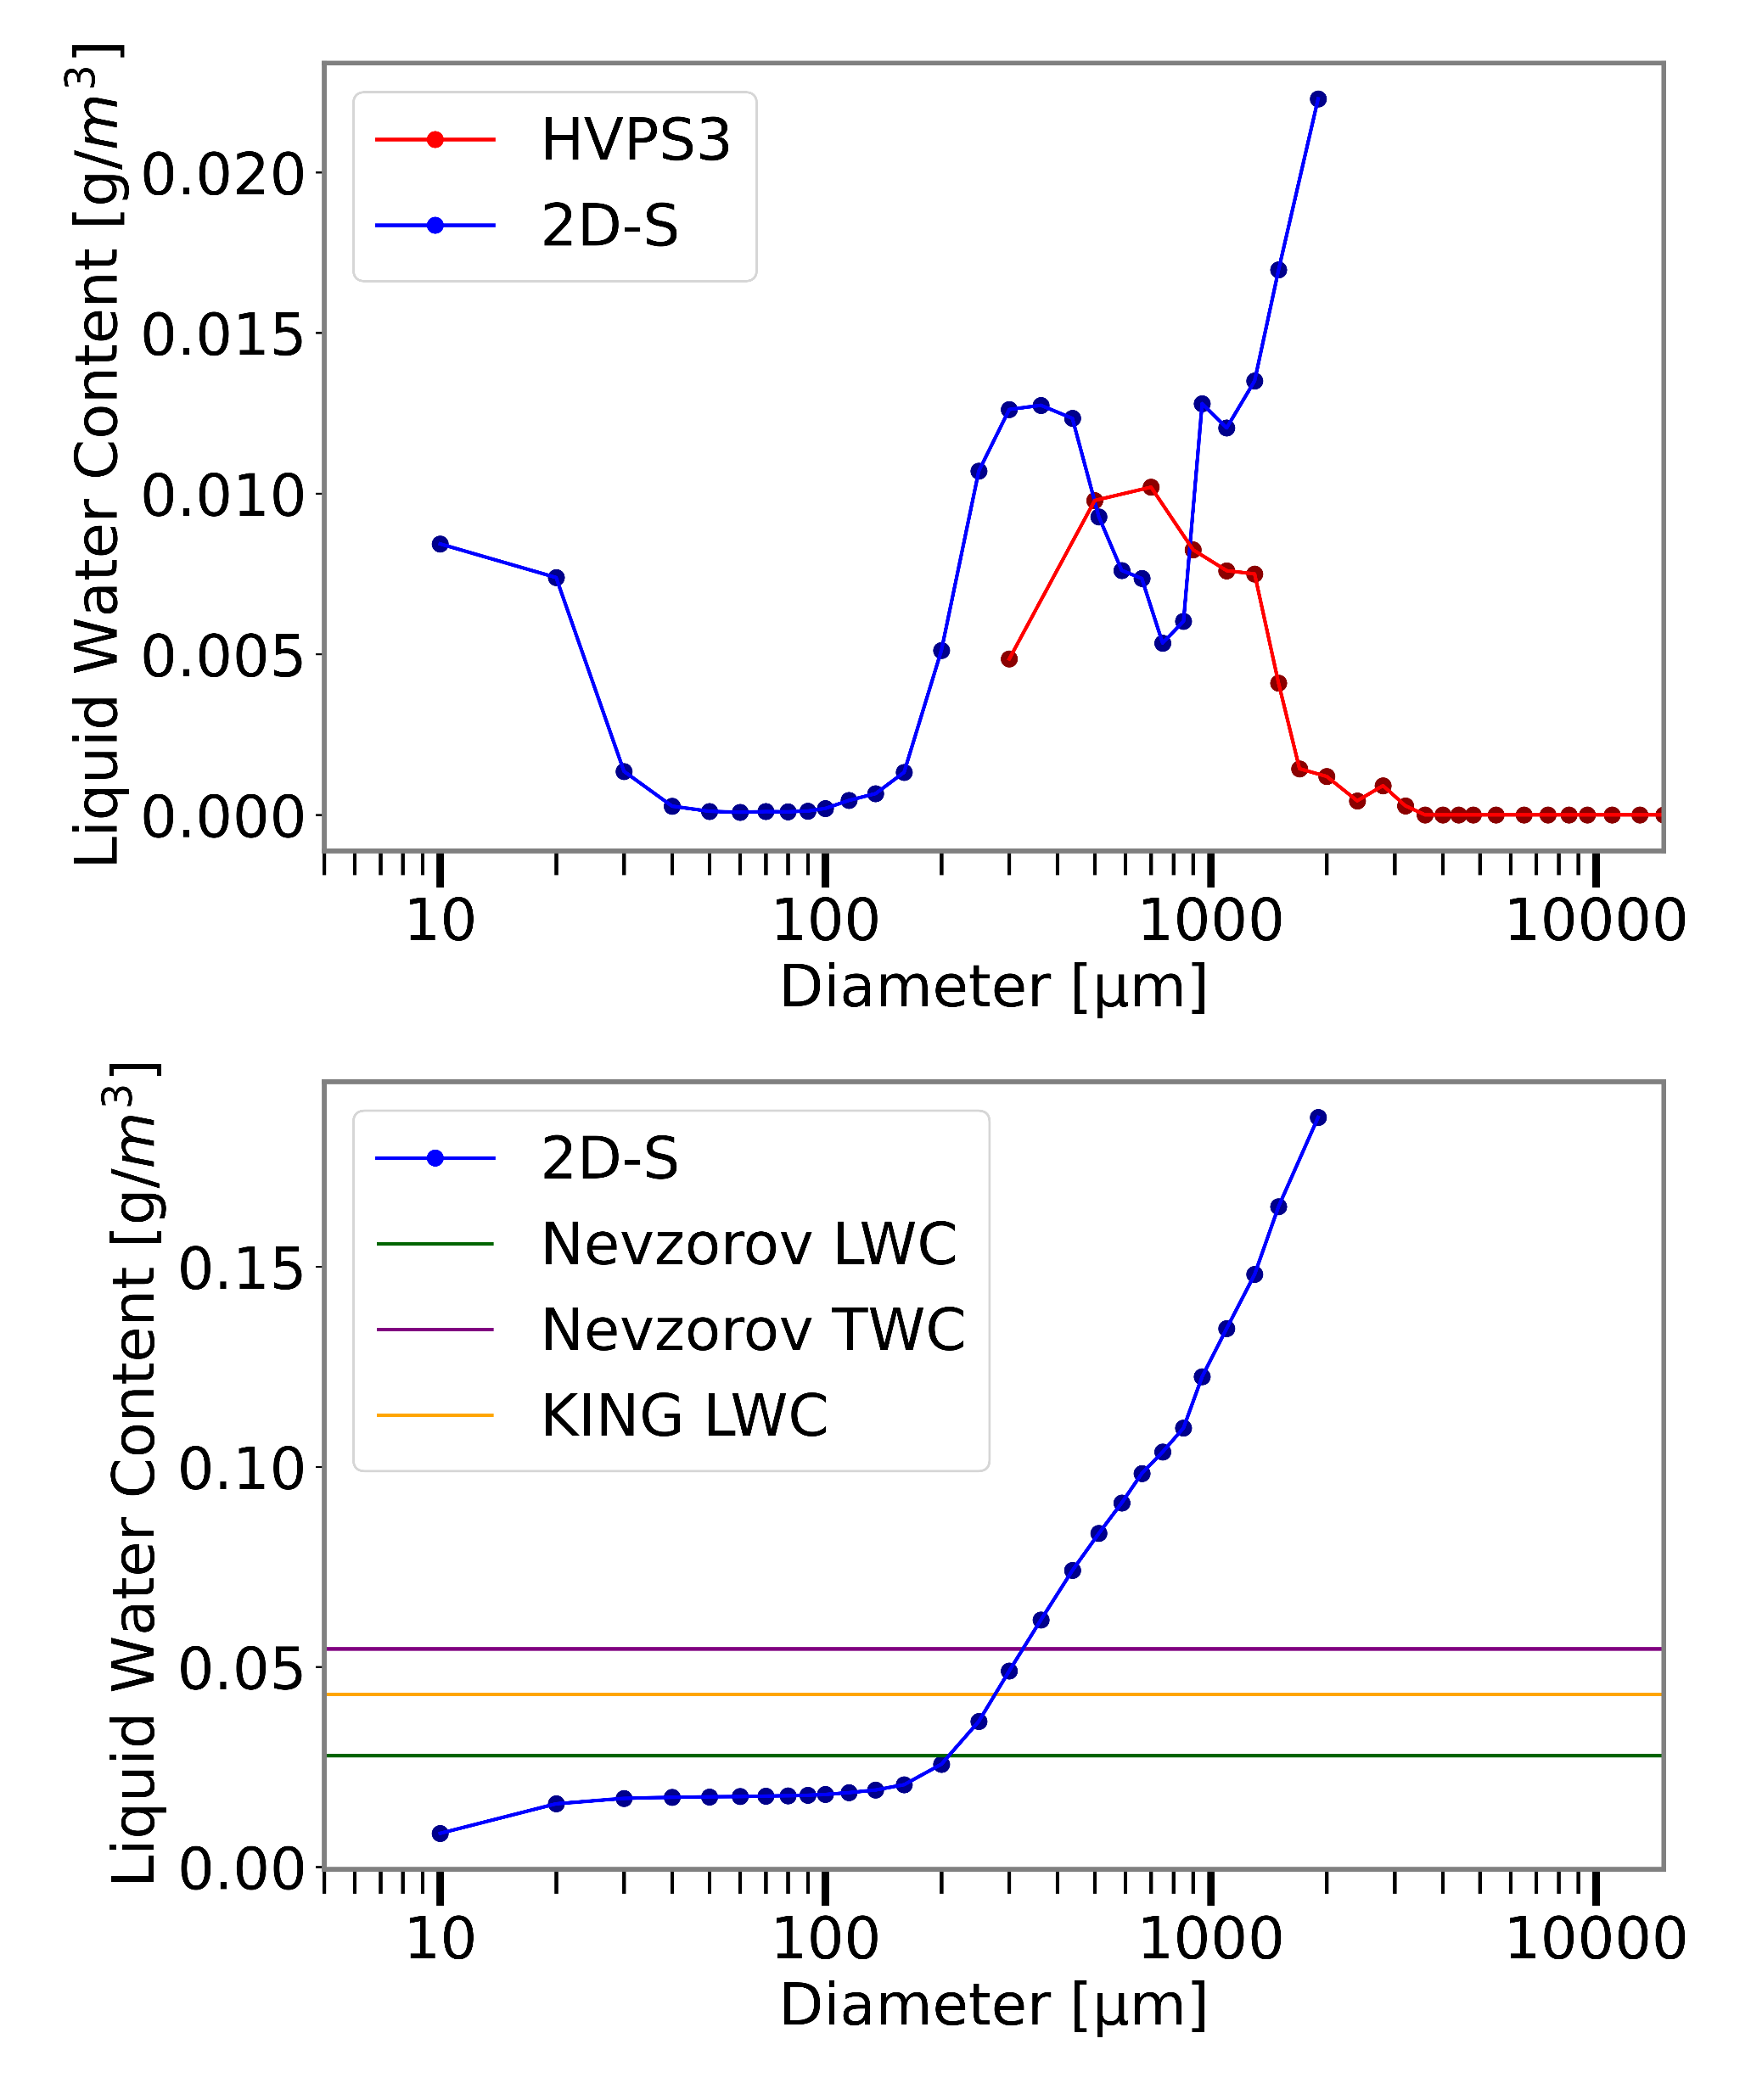
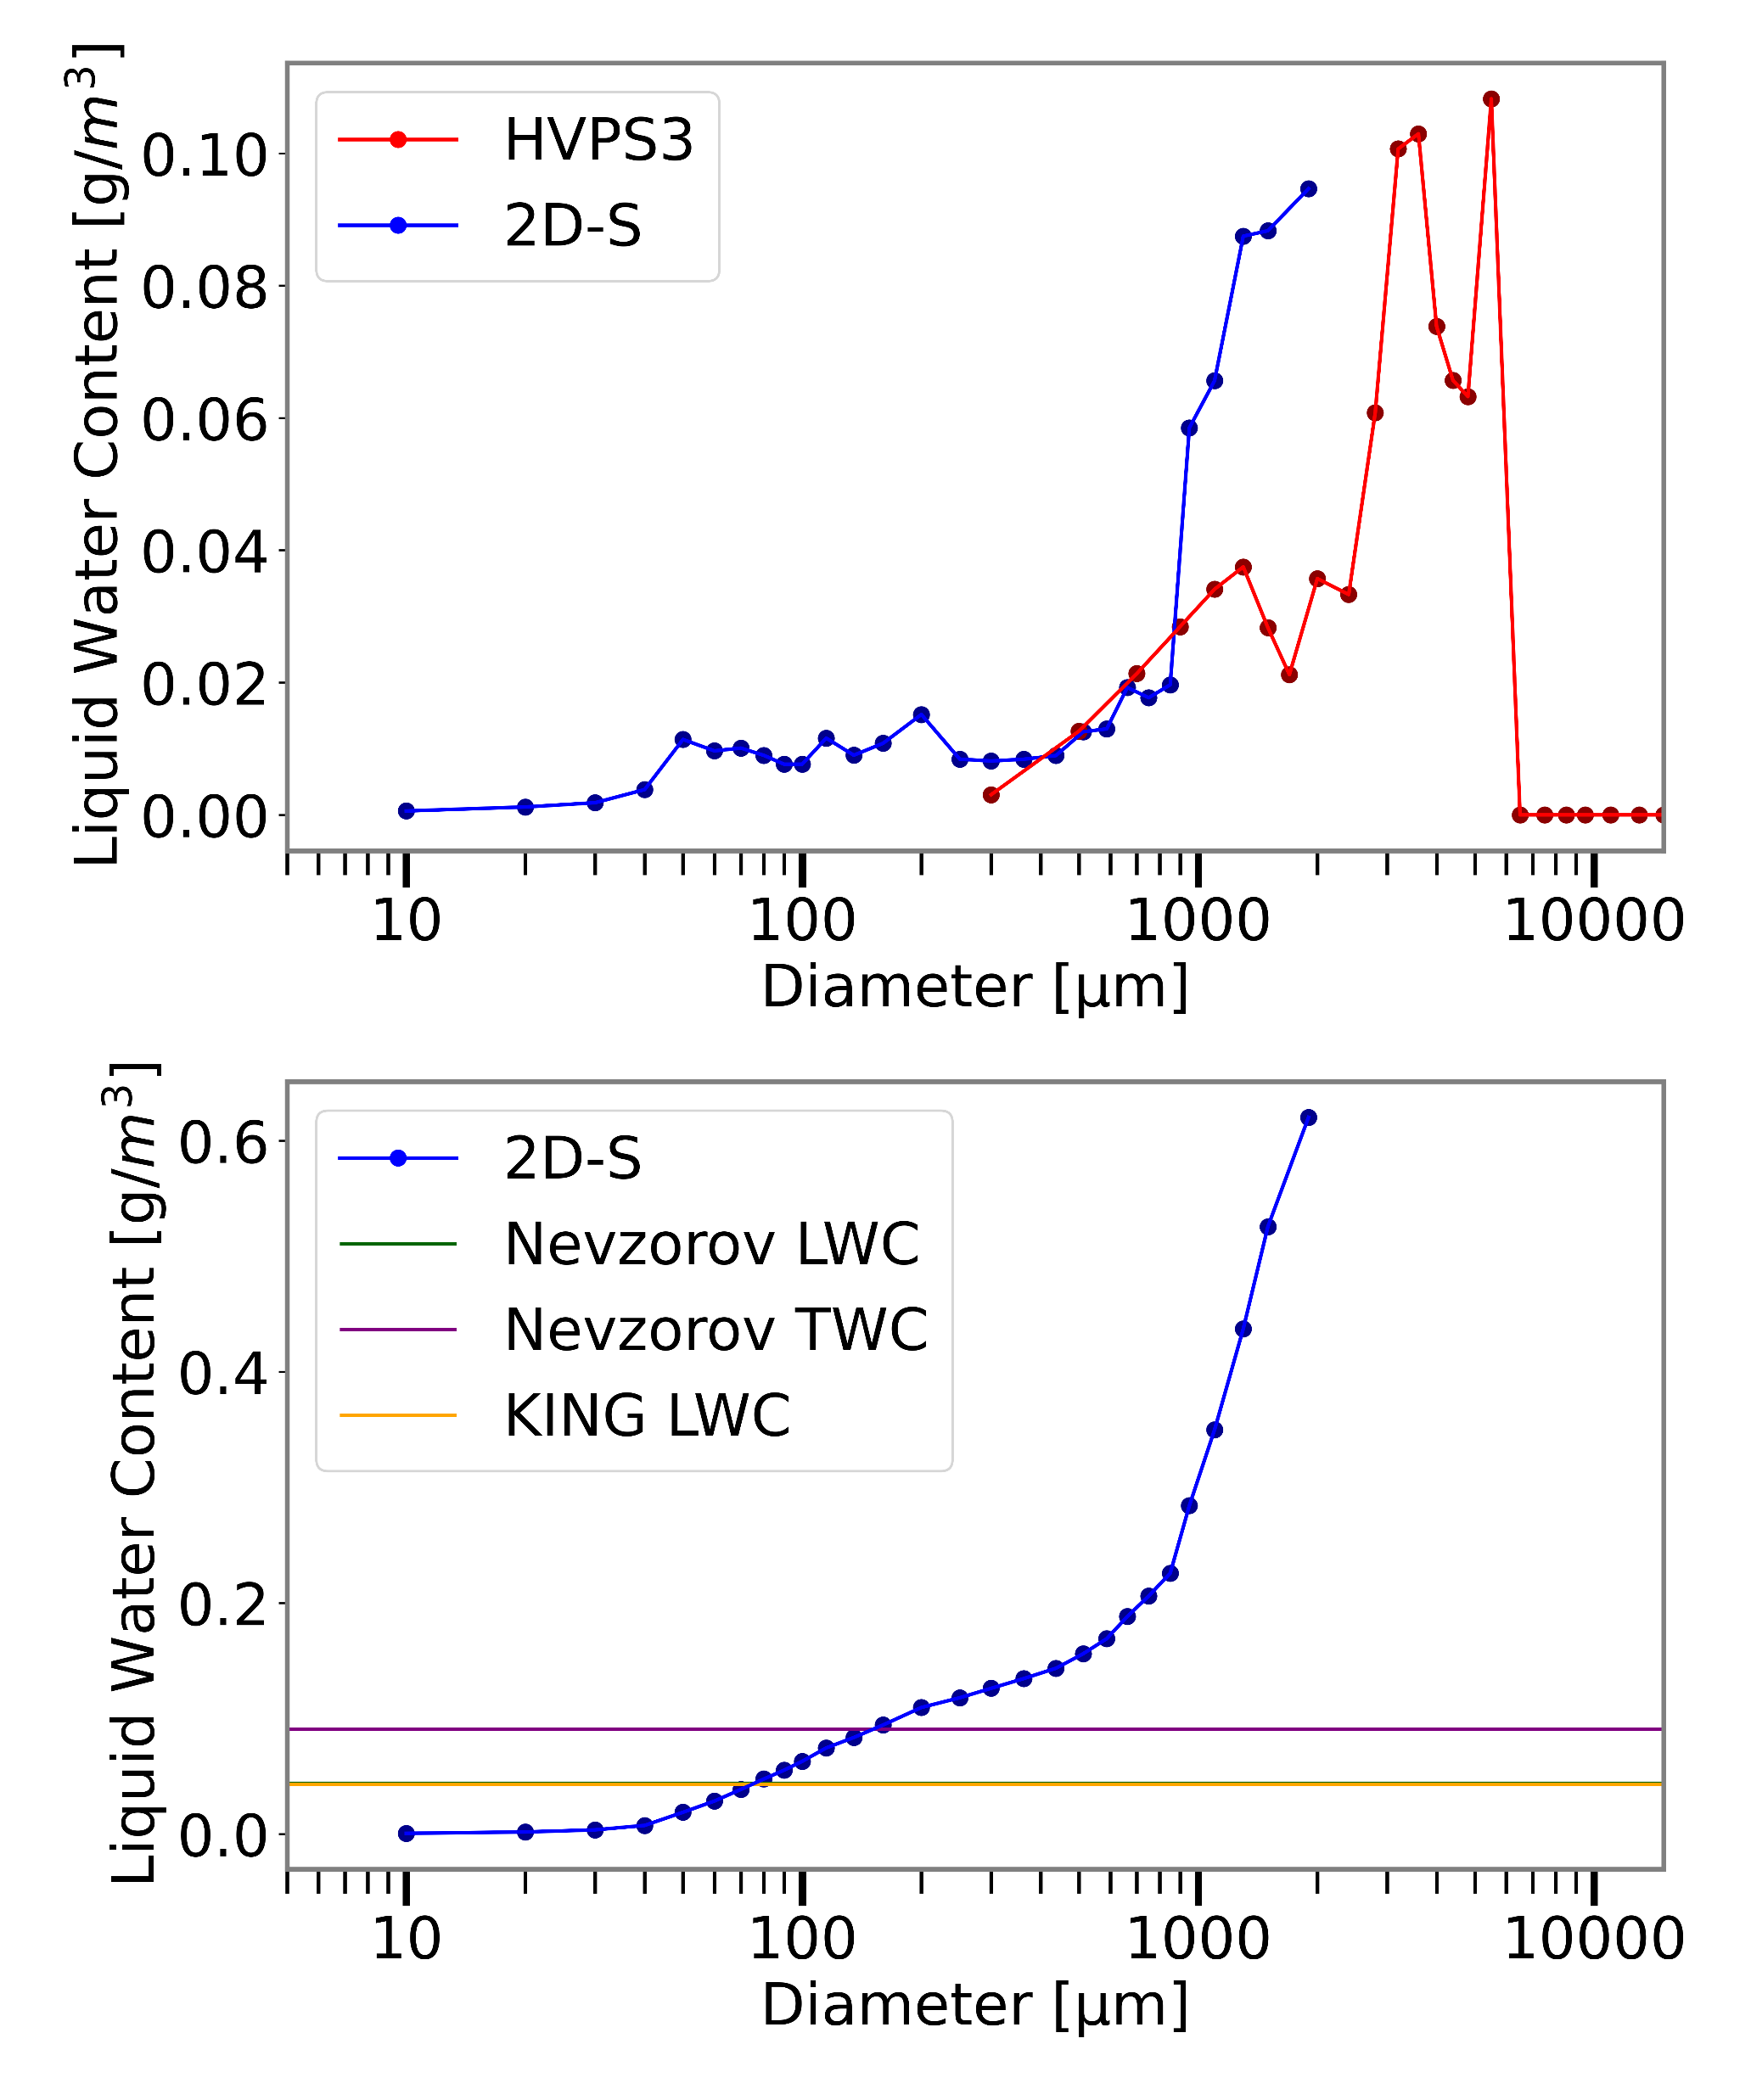
Liquid Water Content: 12 November 2015

Slide 43
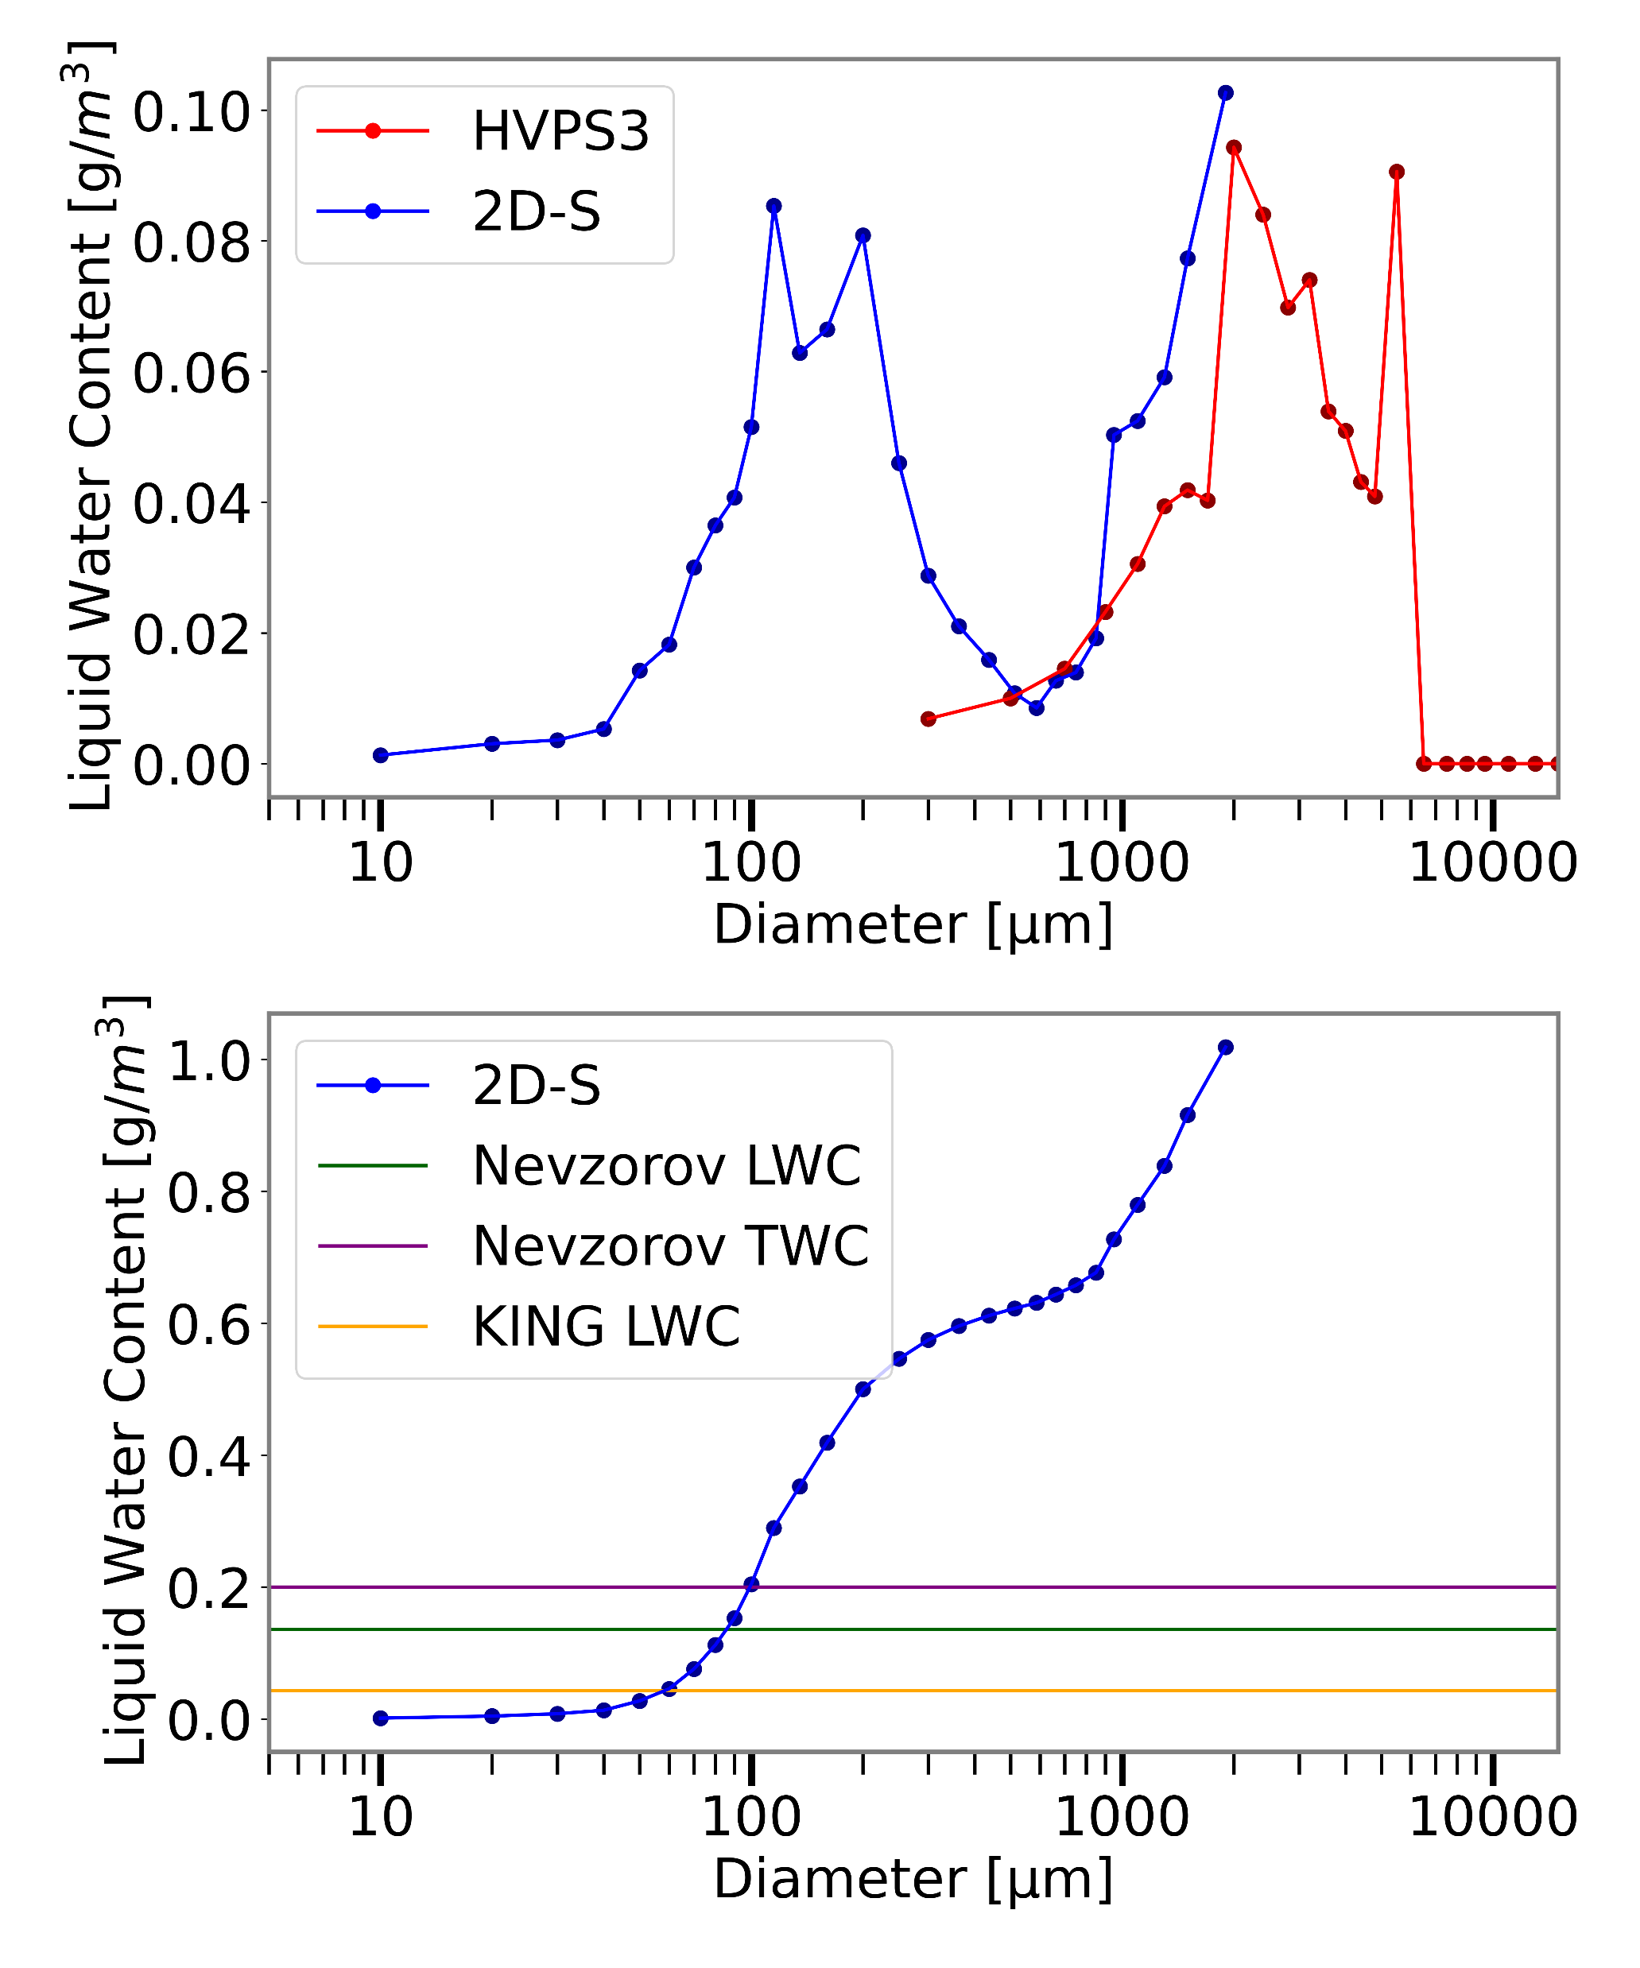
Liquid Water Content: 12 November 2015

Slide 44
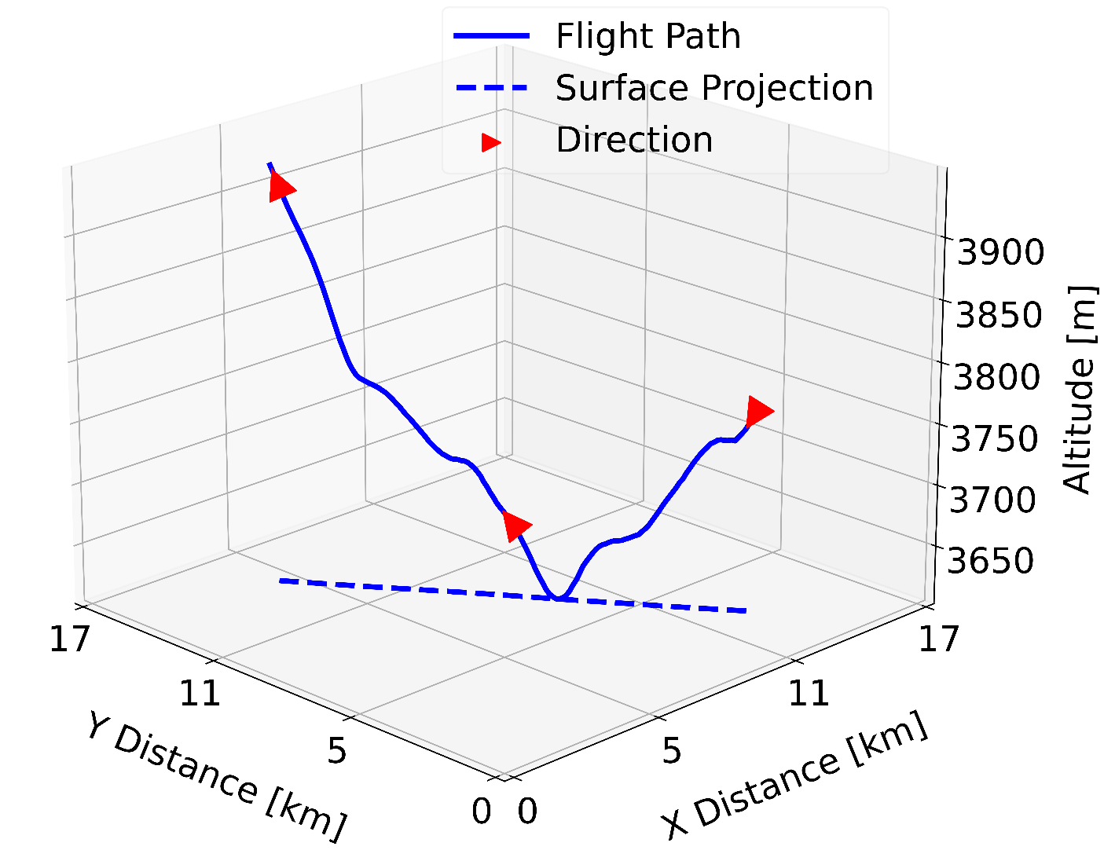
One Melting Layer Sampled Twice During MC3E
Melting layer top around 3,750 m
Depths of 133 m (descent) and 123 m (ascent)
RH of 83% and 79%
0 °C isotherm is 235 m higher during the ascent

Slide 45
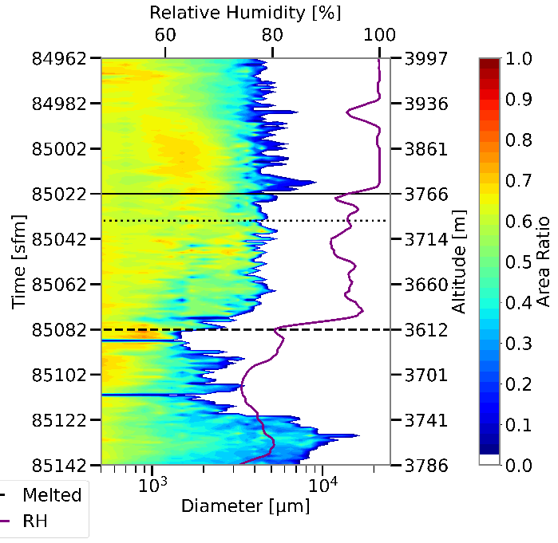
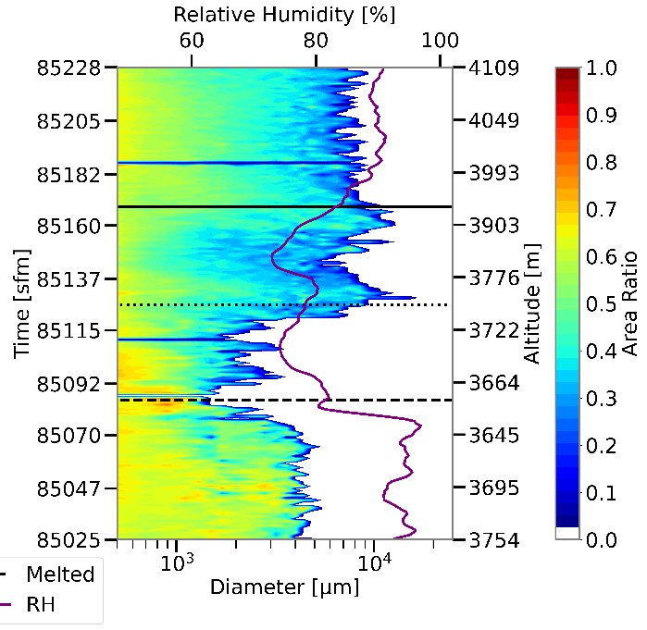
Descent
Ascent

Slide 46
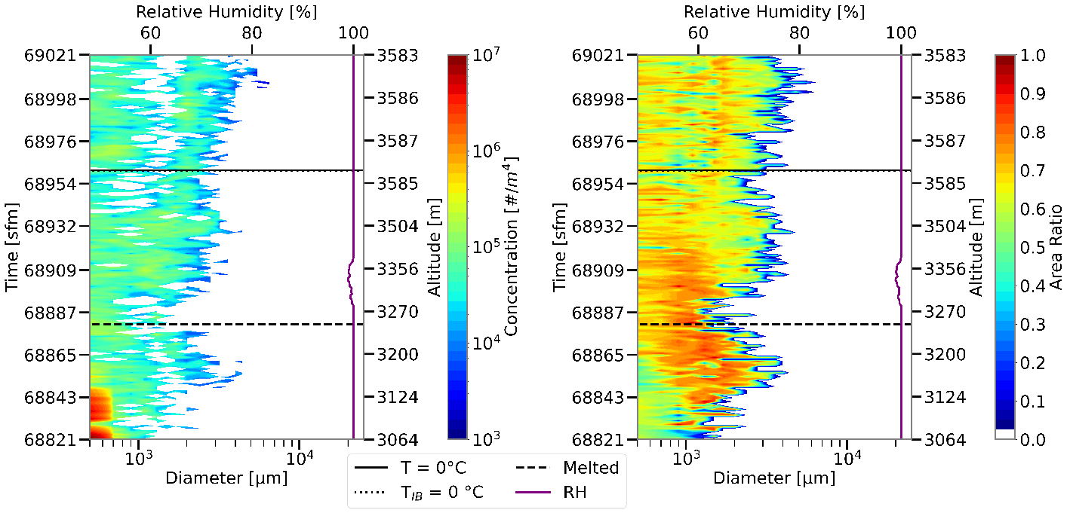
IPHEX_Spi-Asc_100RH

Slide 47
IPHEX_Ram-Asc_92RH

Slide 48
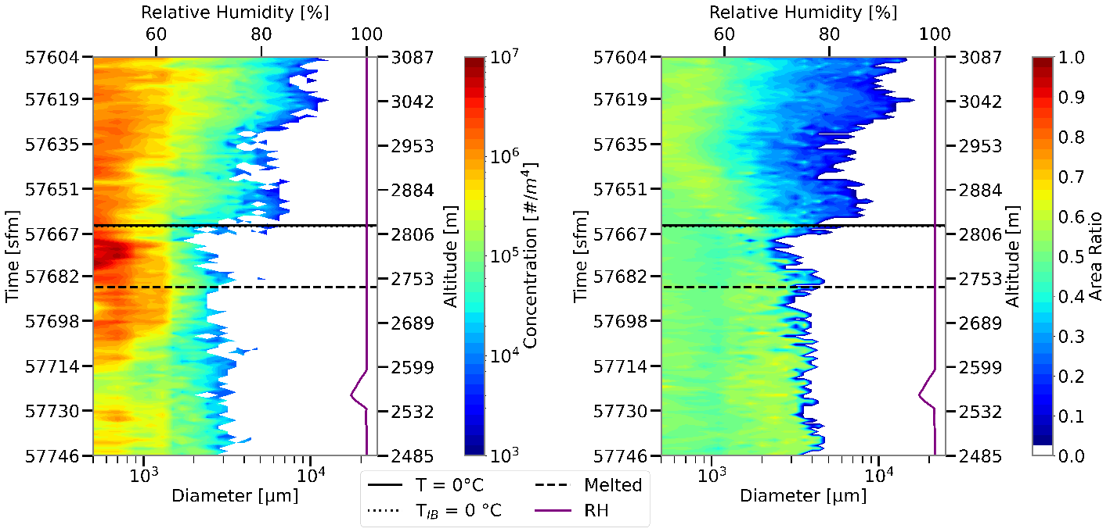
OLYMPEX_Spi-Des_100RHa

Slide 49
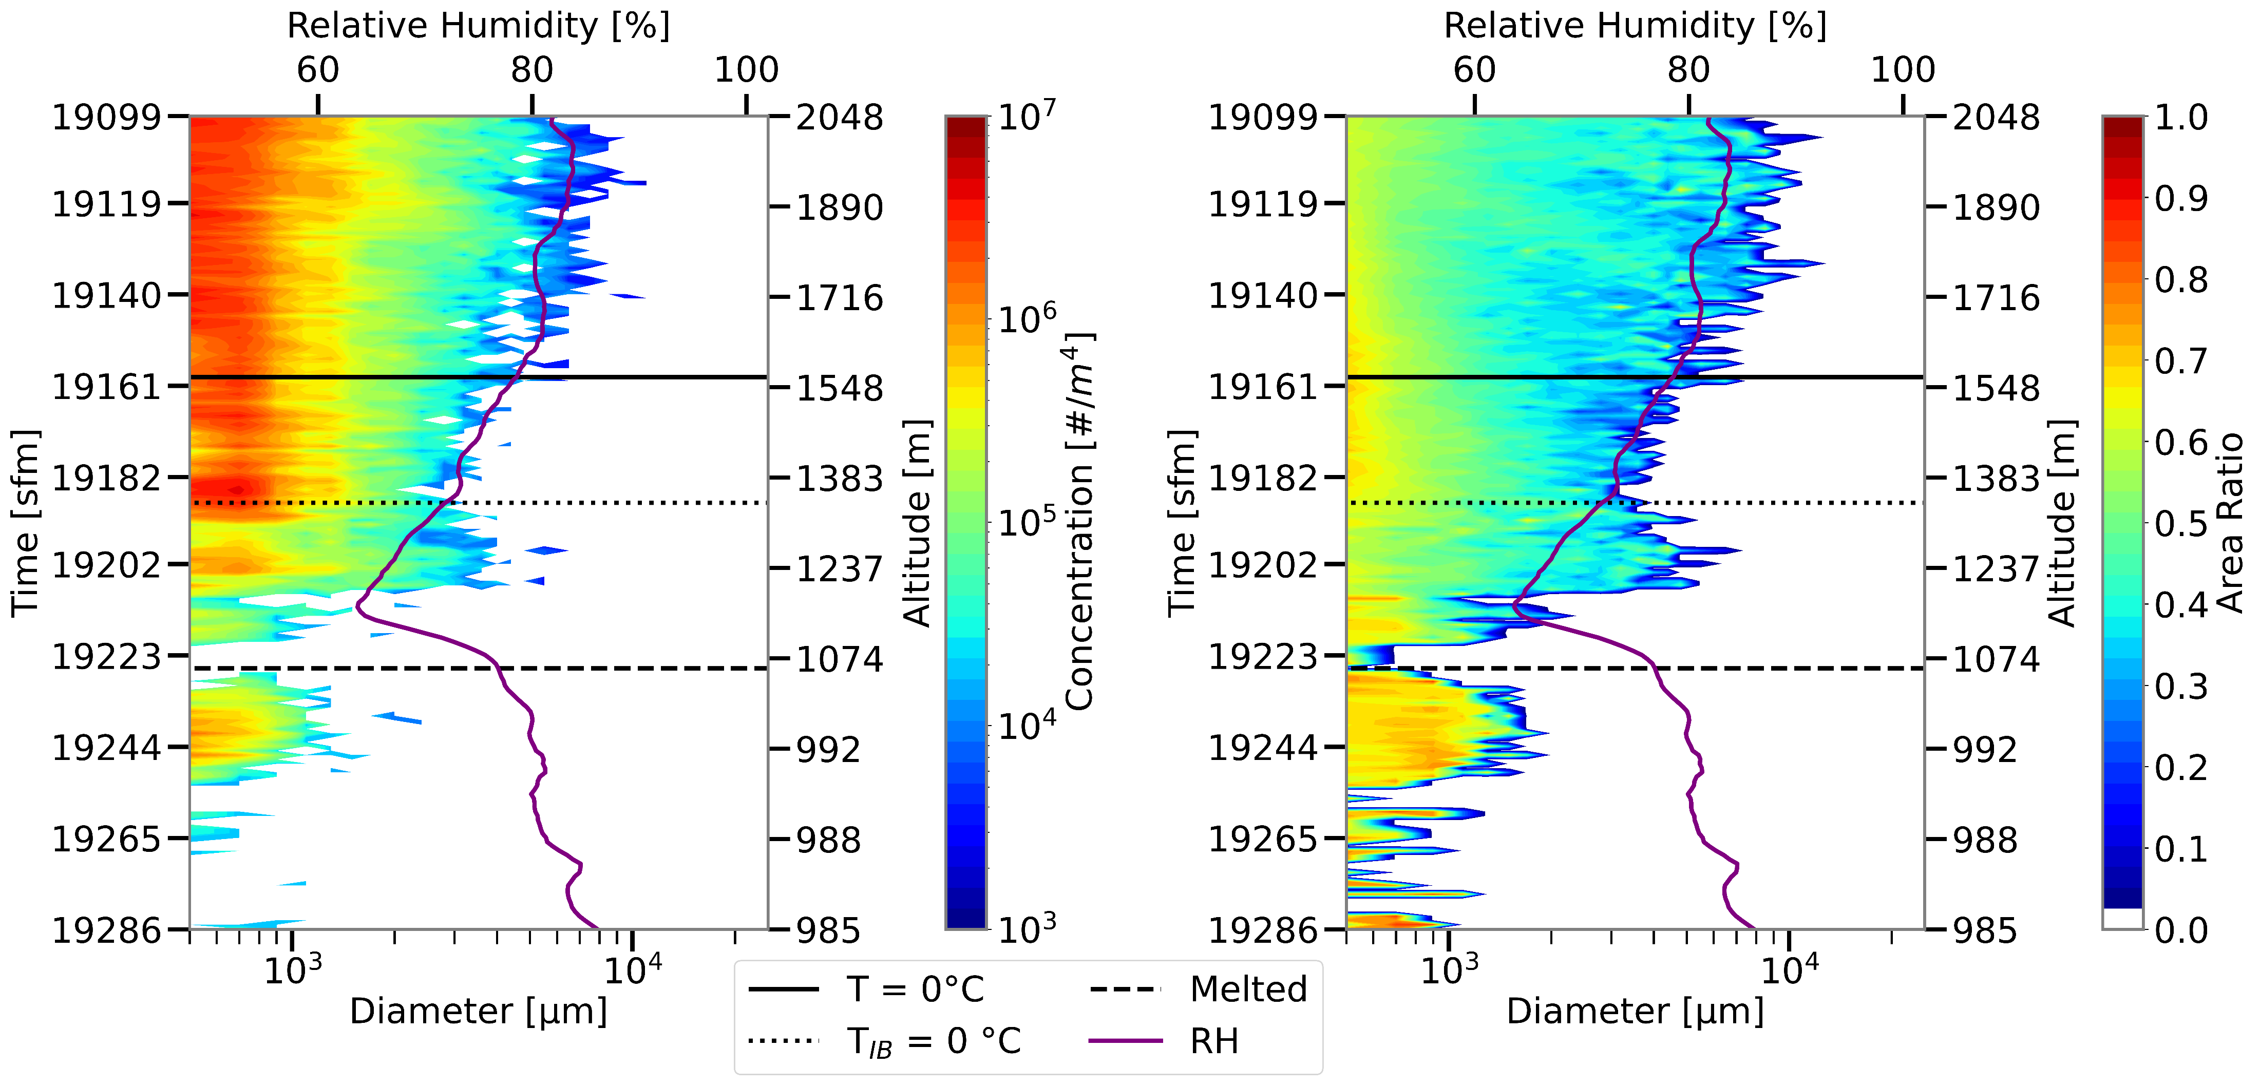
GCPEX_Ram-Des_71RH

Slide 50
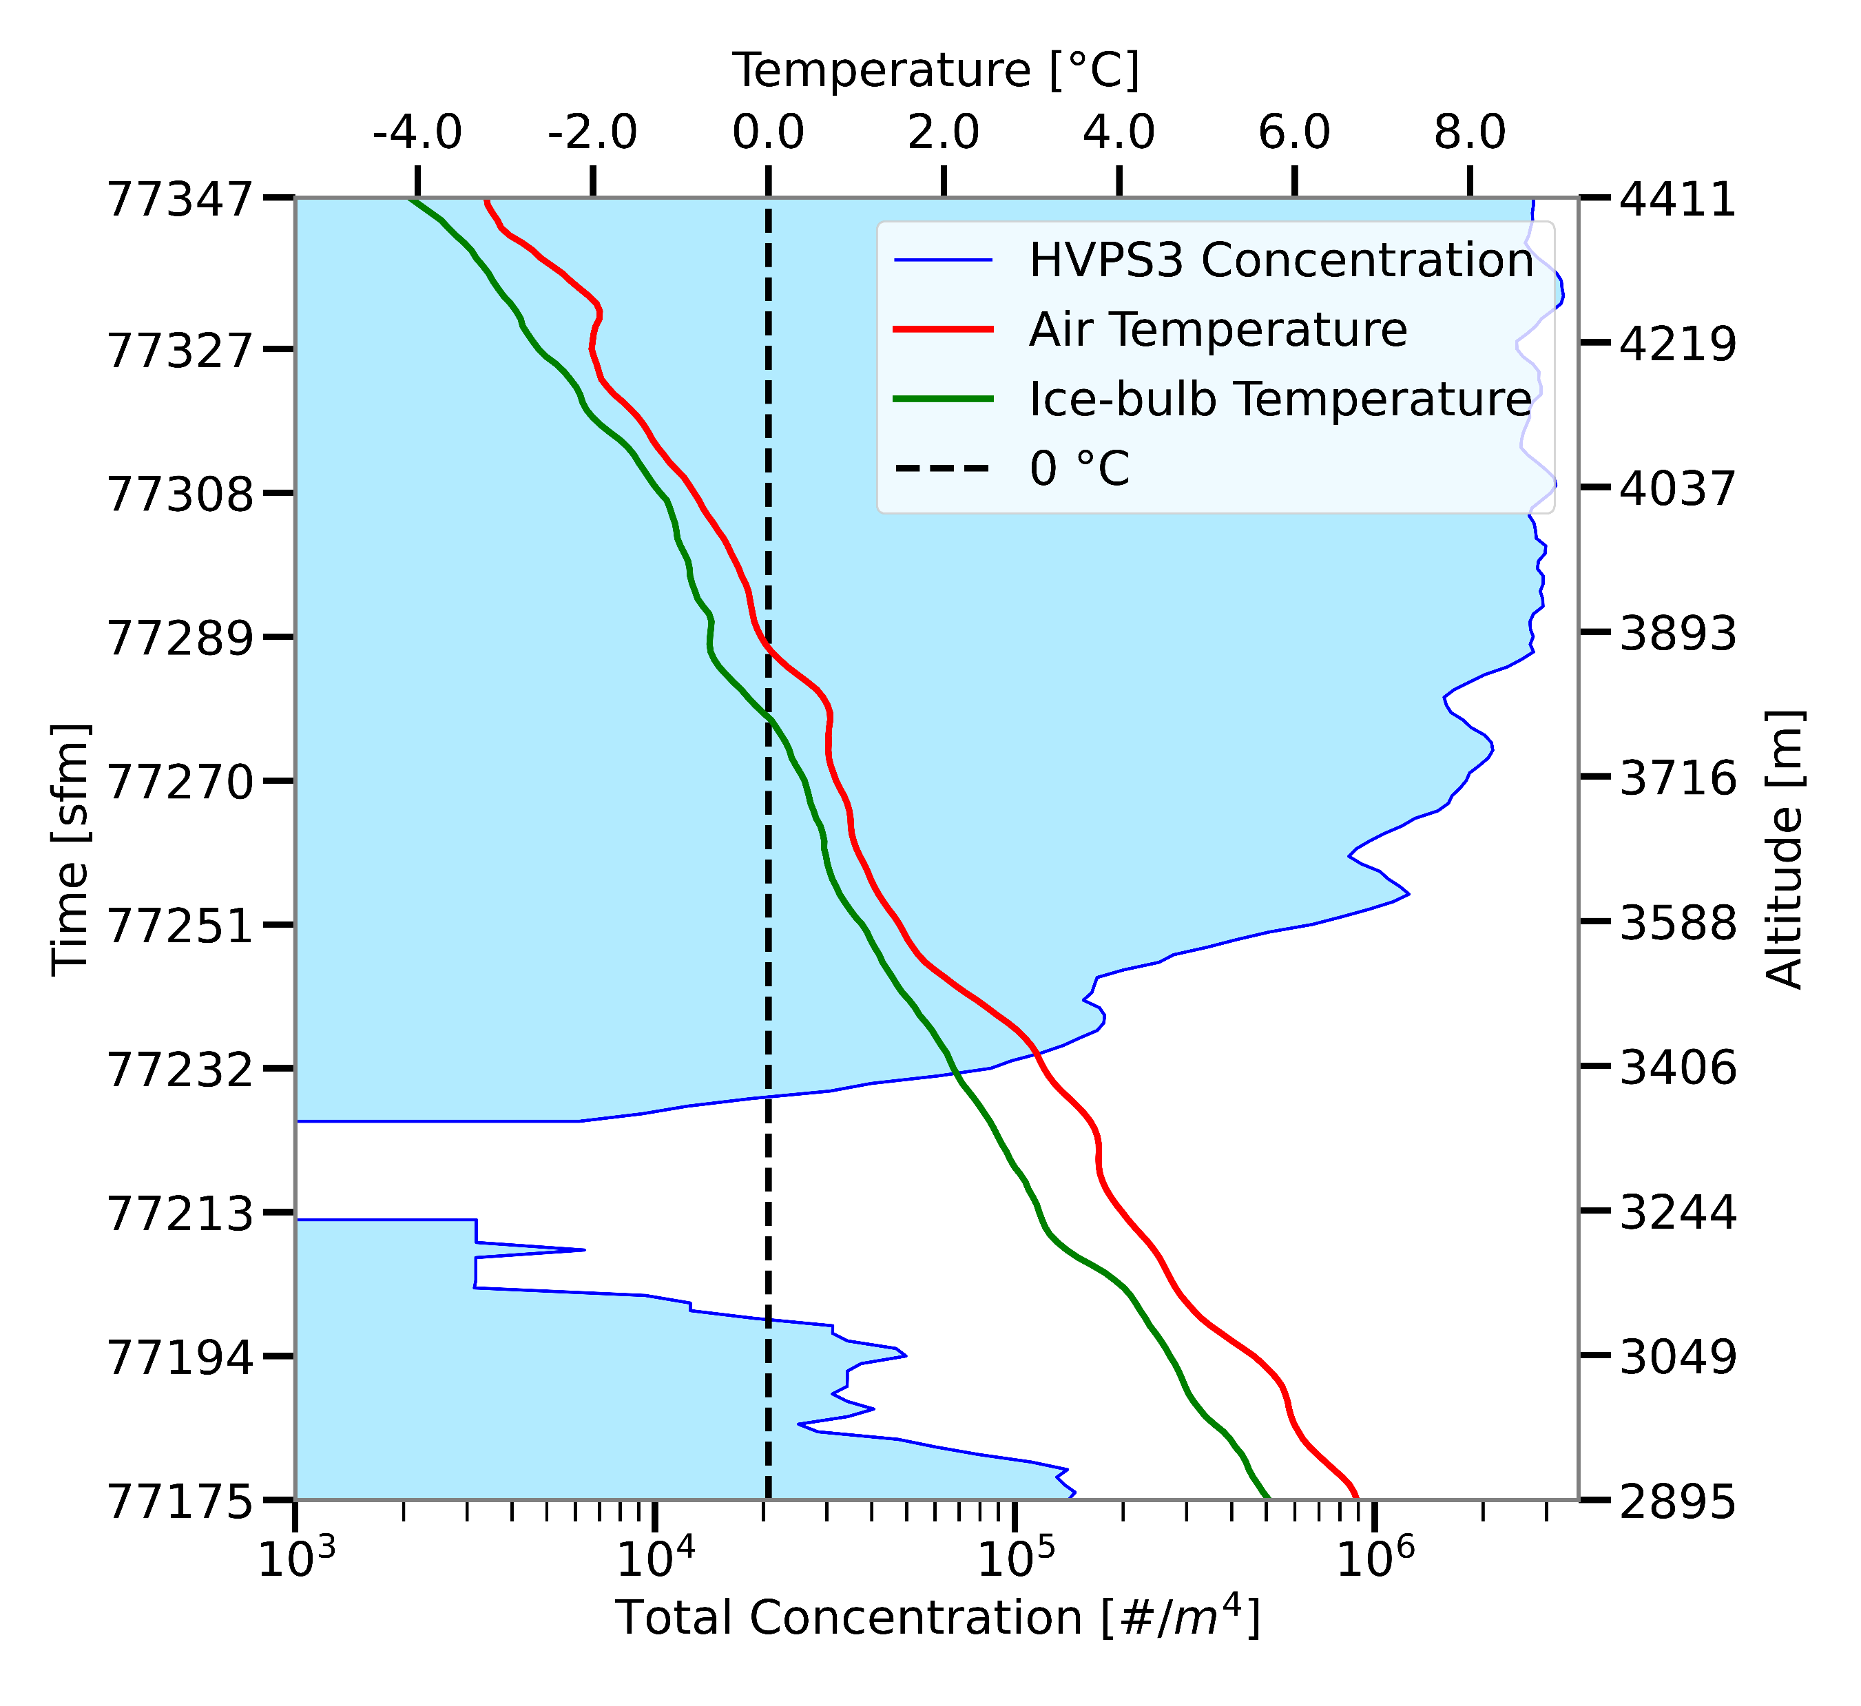
IPHEX_Ram-Asc-92RH
Notes:
Lapse rate decreases at the onset of melting

