Slide 1
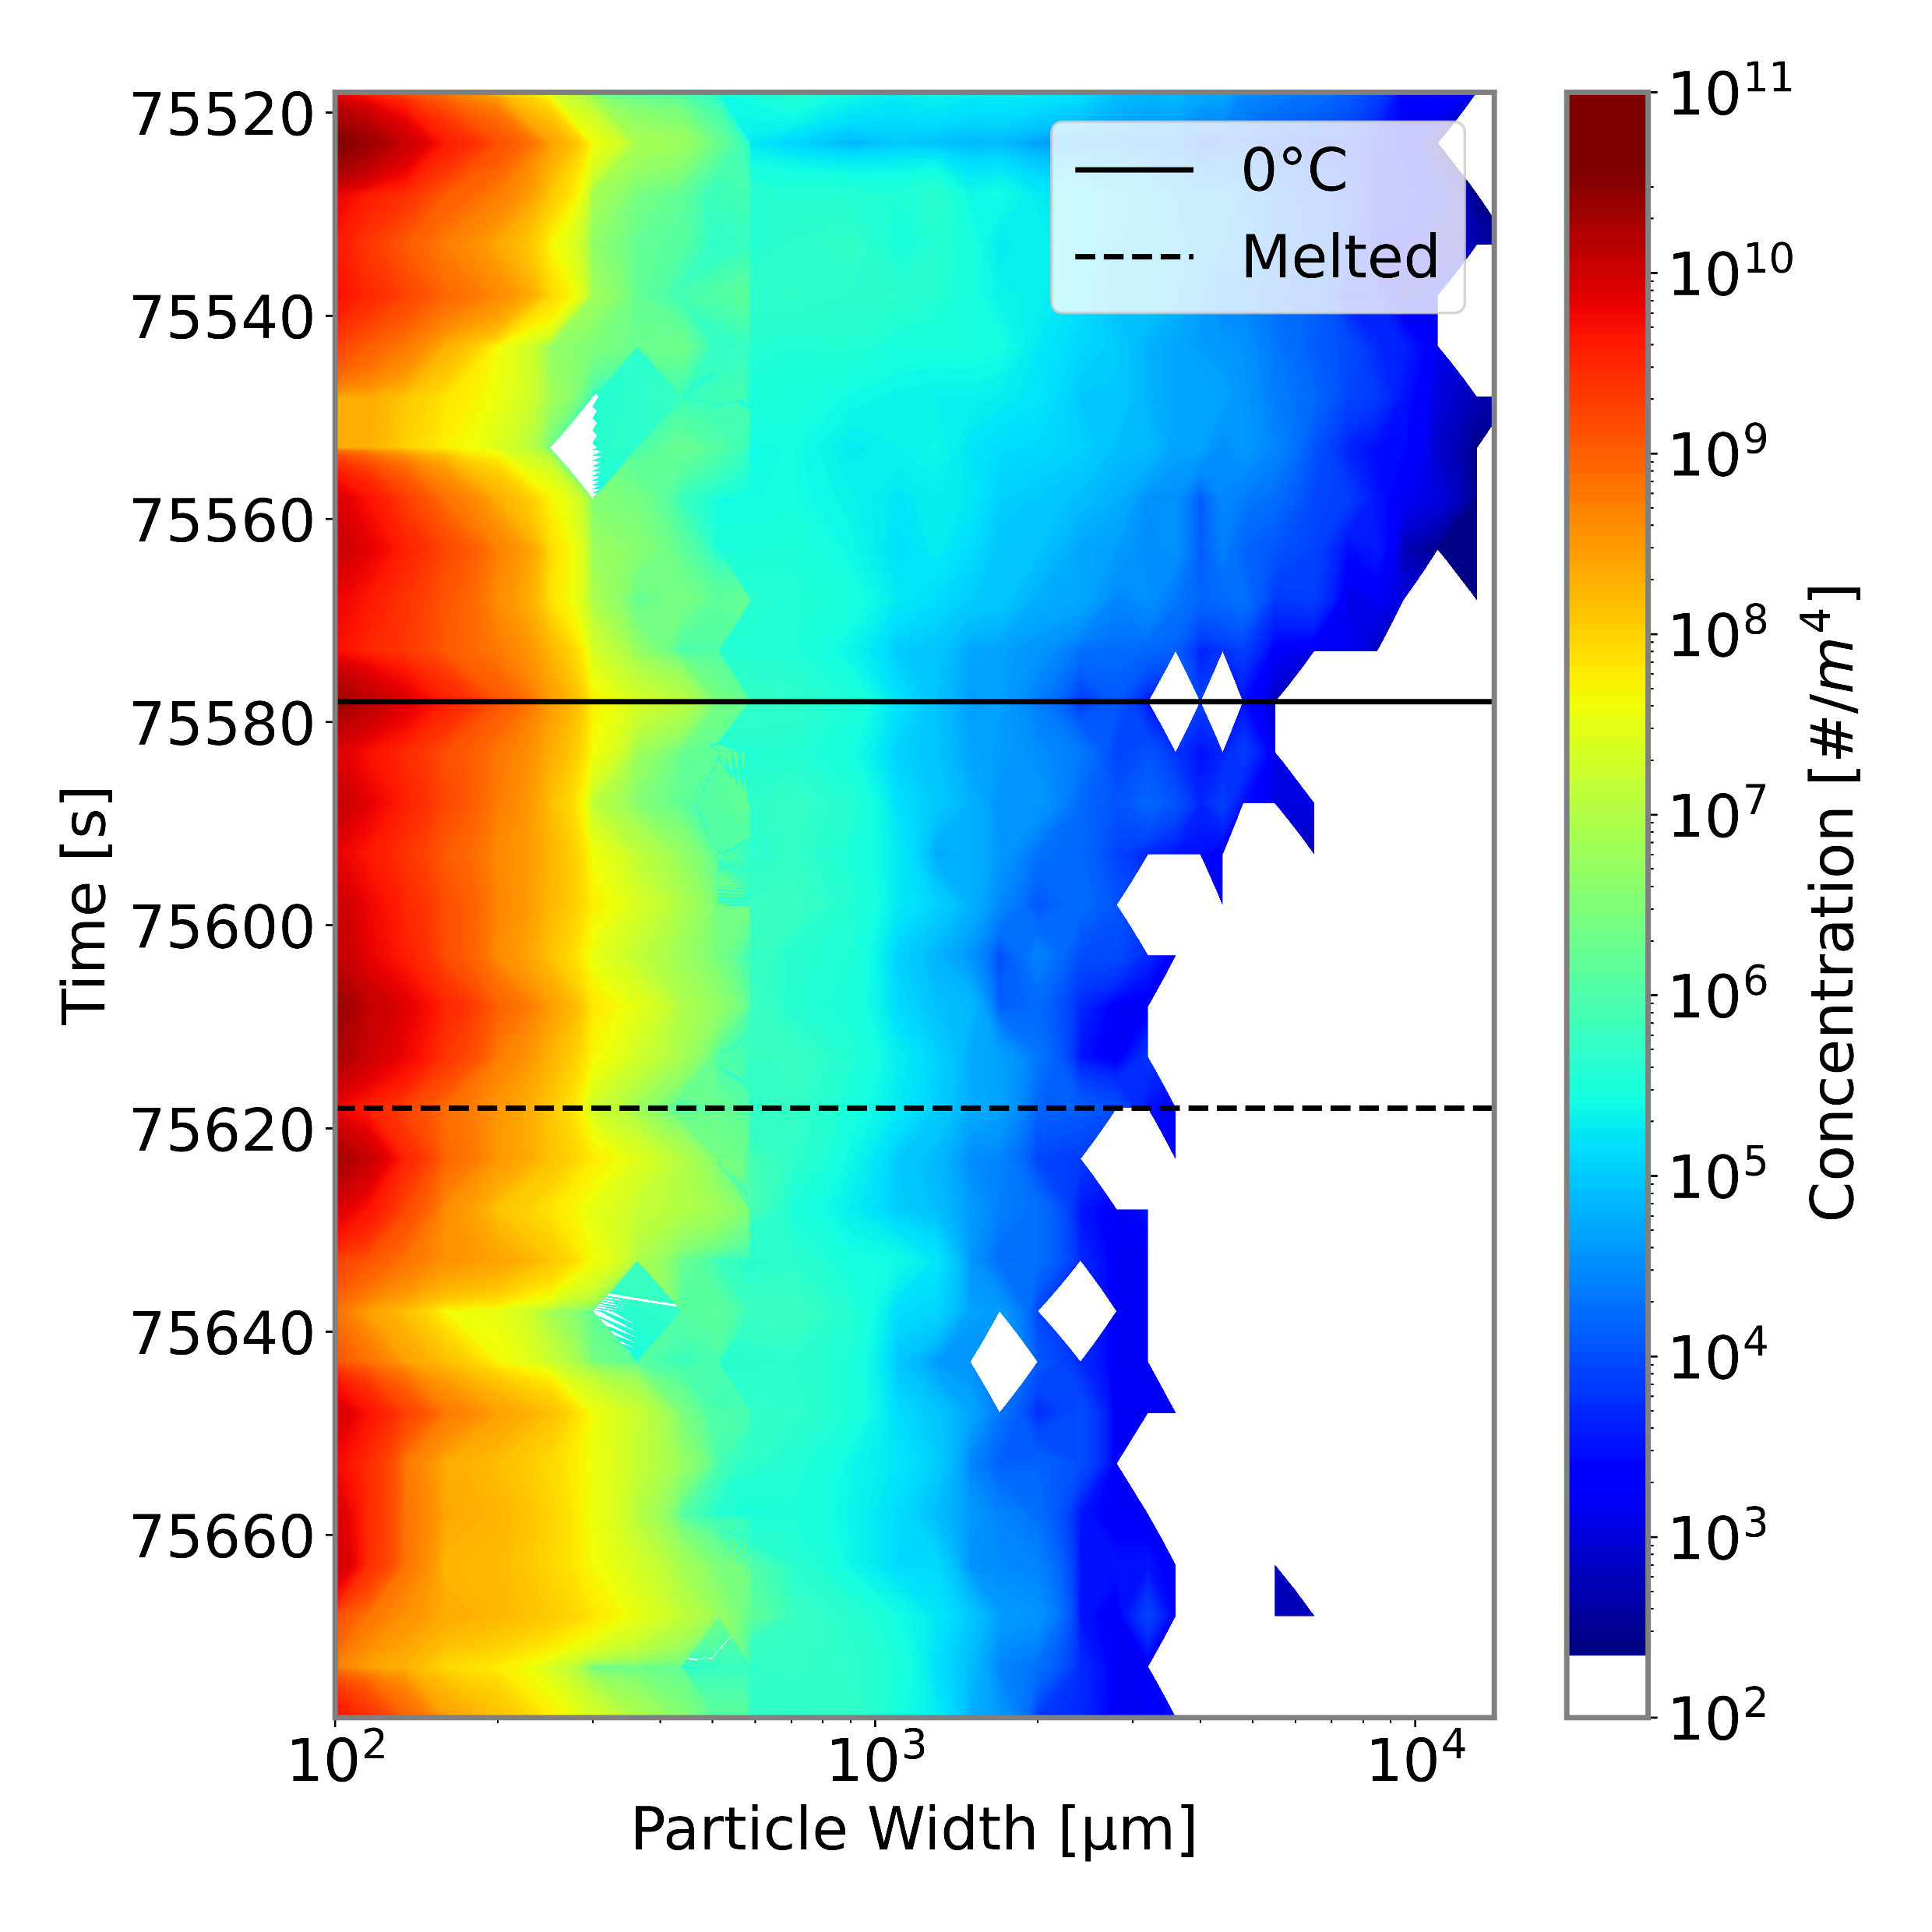
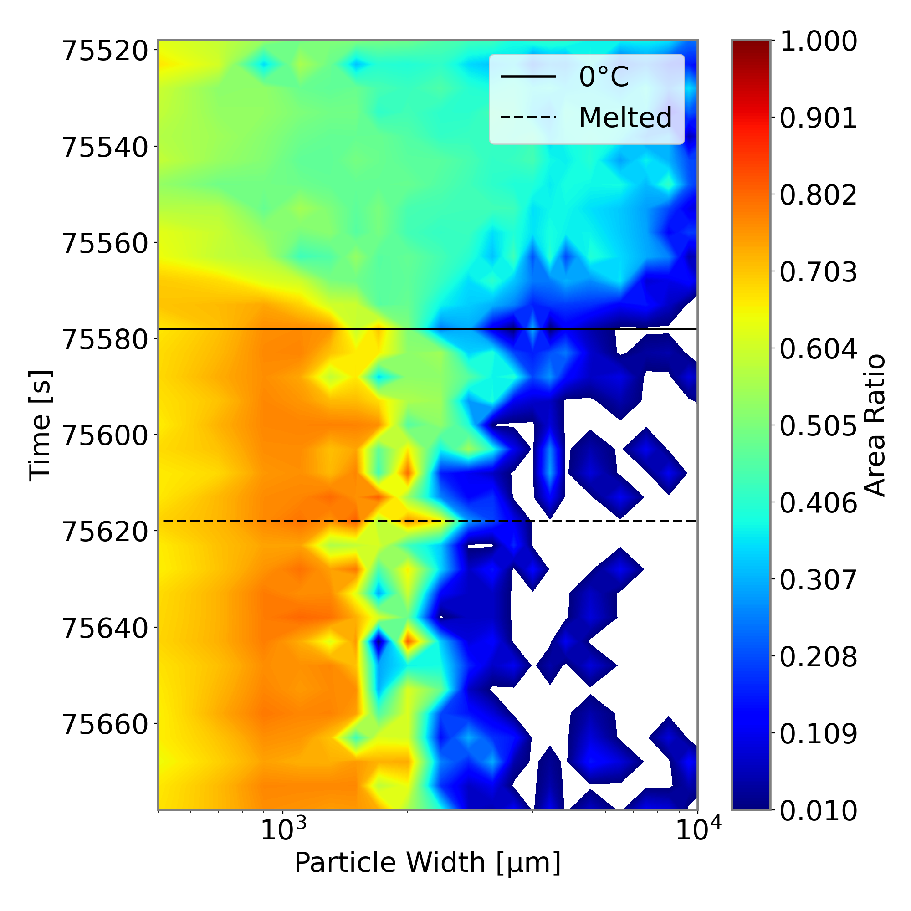
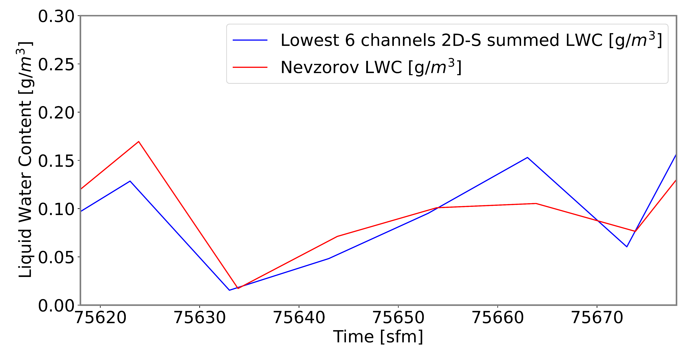
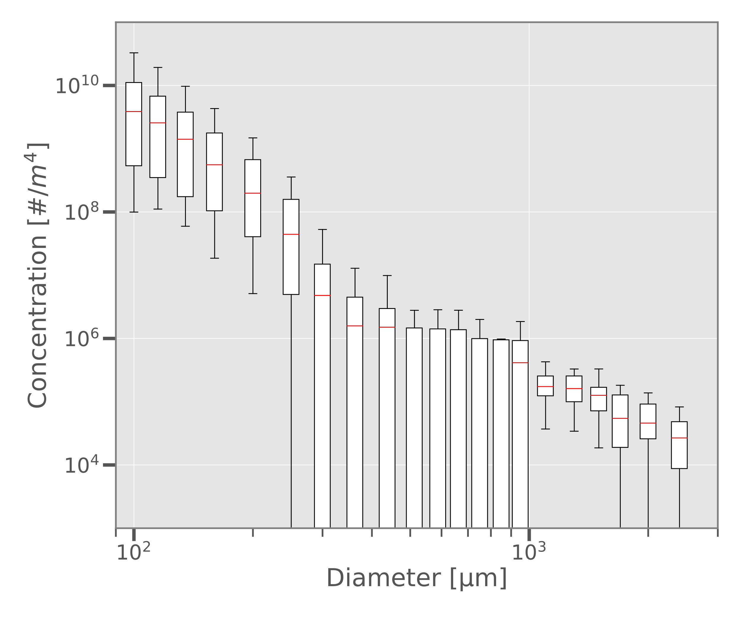
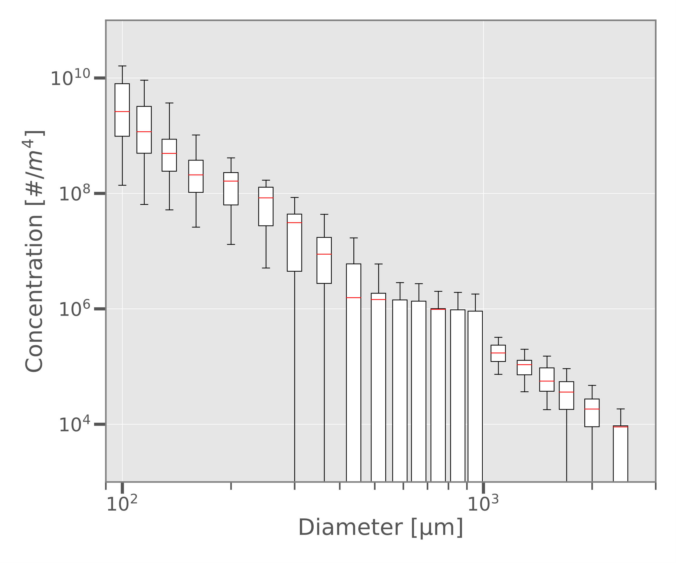
Microphysical Observations in the Melting Layer of Precipitating Clouds
Logan Twohey and David Delene, Department of Atmospheric Sciences, University of North Dakota
MOTIVATION
The goal is to characterize microphysical properties in the melting layer, where snow transitions to rain.
This layer affects storm evolution
Improved understanding of microphysical processes can lead to more accurate model forecasts
DATA
Melting layer observations are available from aircraft profiles during ten NASA campaigns.
Program | Dates | MLs
CAMEX-4 | 08/01 - 09/01 | 3
CRYSTAL-FACE | 07/02 - 08/02 | 4
NAMMA | 08/06 - 09/06 | 3
TC4 | 07/07 - 08/07 | 2
GRIP | 08/10 - 09/10 | 0
LPVEx | 09/10 - 10/10 | 2
MC3E | 04/11 - 06/11 | 7
GCPEx | 01/12 - 02/12 | 11
IPHEx | 05/14 - 06/14 | 4
OLYMPEX | 11/15 - 12/15 | 9
IMPACTS | 01/20 - 02/20 | 6
TOTAL |  | 51
Colored contour plots showing combined 2D-S and HVPS3 particle size distribution (left) and HVPS3 area ratio (right) through the melting layer for 12 NOV 2015 during OLYMPEX.
As snow melts, there is a decrease in maximum diameter
Concentration of small particles remain relatively unchanged during the melting process
The melting process causes irregular-shaped particles to become rounder, leading to an increase in area ratio as liquid water overtakes the crystals
Liquid water content (LWC) for Nevzorov probe compared to 2D-S mass (top) and a time series of the lowest six channels of 2D-S LWC compared to Nevzorov LWC (bottom).
The lowest six channels of the 2D-S measurements (up to 60 µm) are in closest agreement with Nevzorov probe
However, the diameter of the least difference between the two is between the sixth and seventh channel
There are variations in how the lowest six channels of the 2D-S and Nevzorov compare over time
Airborne instruments provide data on hydrometeor size, liquid water content, and temperature
Particle size measurements from the 2D-S are integrated to determine mass through the ML and compared to Nevzorov probe mass measurements
Before Melting
After Melting
CONCLUSION
Melting affects size distribution and hydrometeor shape
Concentration measurements have larger variability before melting than after
Nevzorov LWC measurements most closely match the 2D-S for only the first six channels
Further work is necessary to quantify total mass and uncertainty through the melting layer
Box-and-whisker plots showing 2D-S (< 10³ μm) and HVPS3 (> 10³ μm) combined spectrum concentration on 12 NOV 2015 over the durations: 75519 to 75579 sfm, before melting (left); and 75618 to 75678 sfm, after melting (right).
2D-S particle images showing the transition of hydrometeors for 12 NOV 2015 during OLYMPEX: snow (top), mixed (middle), rain (bottom).
Variability is larger above the melting layer
The 95% confidence interval is wider for larger 2D-S channels (under 10³ μm)

Slide 2
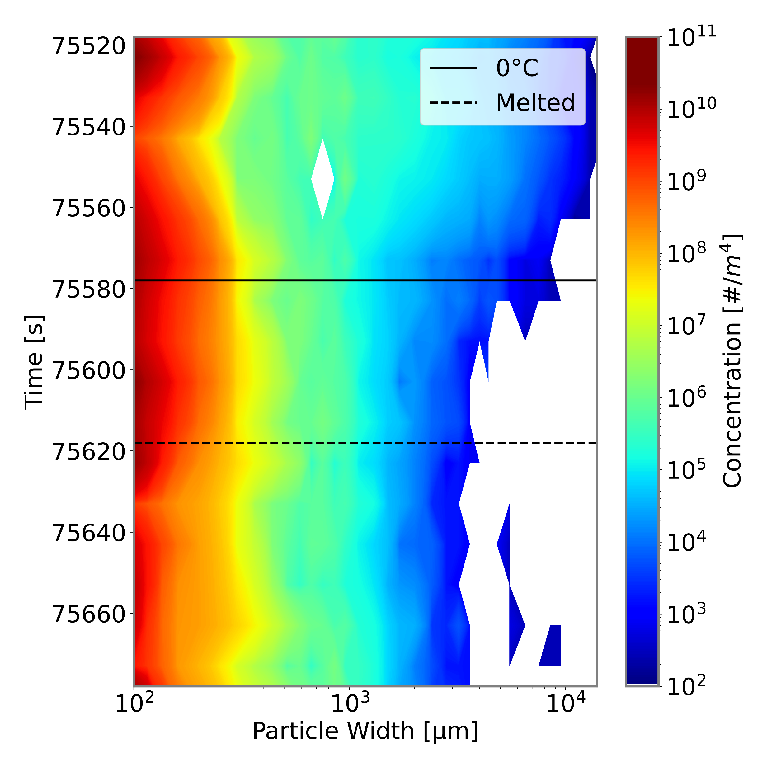
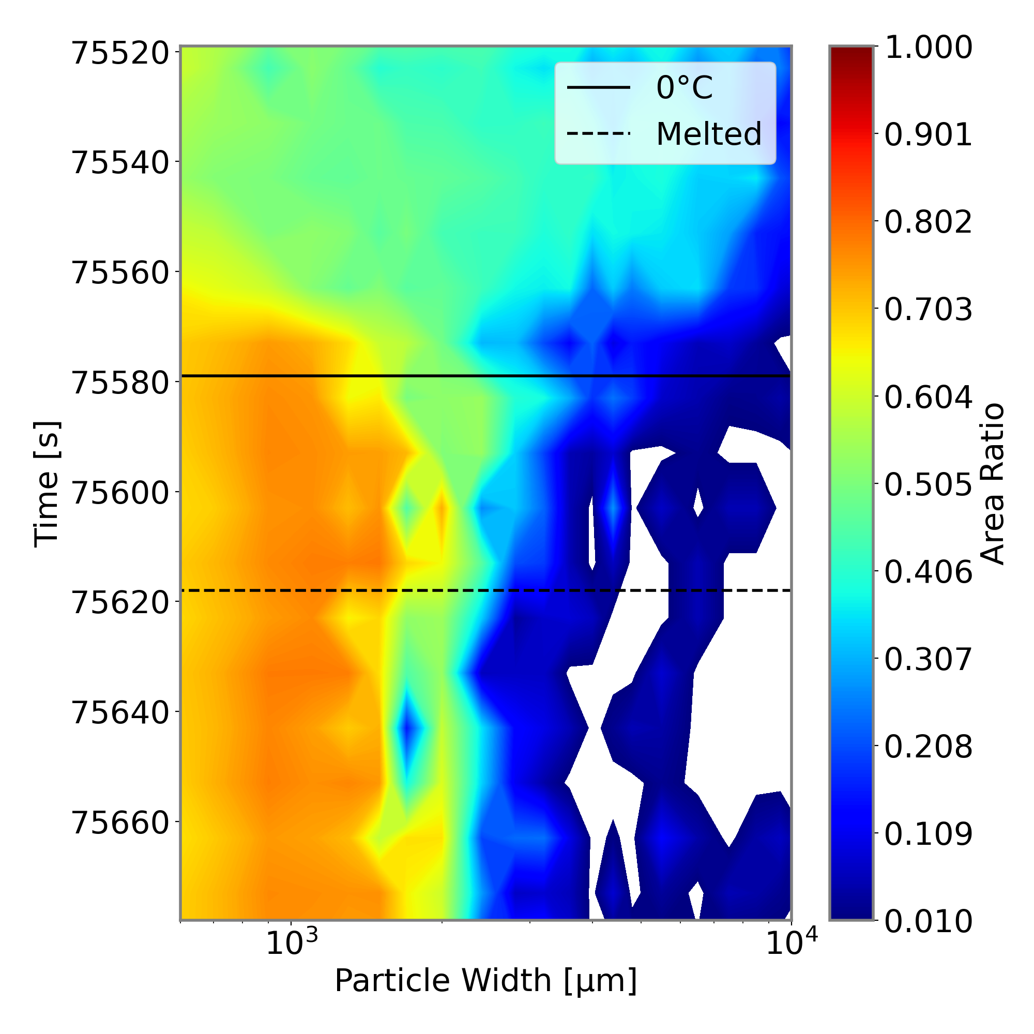
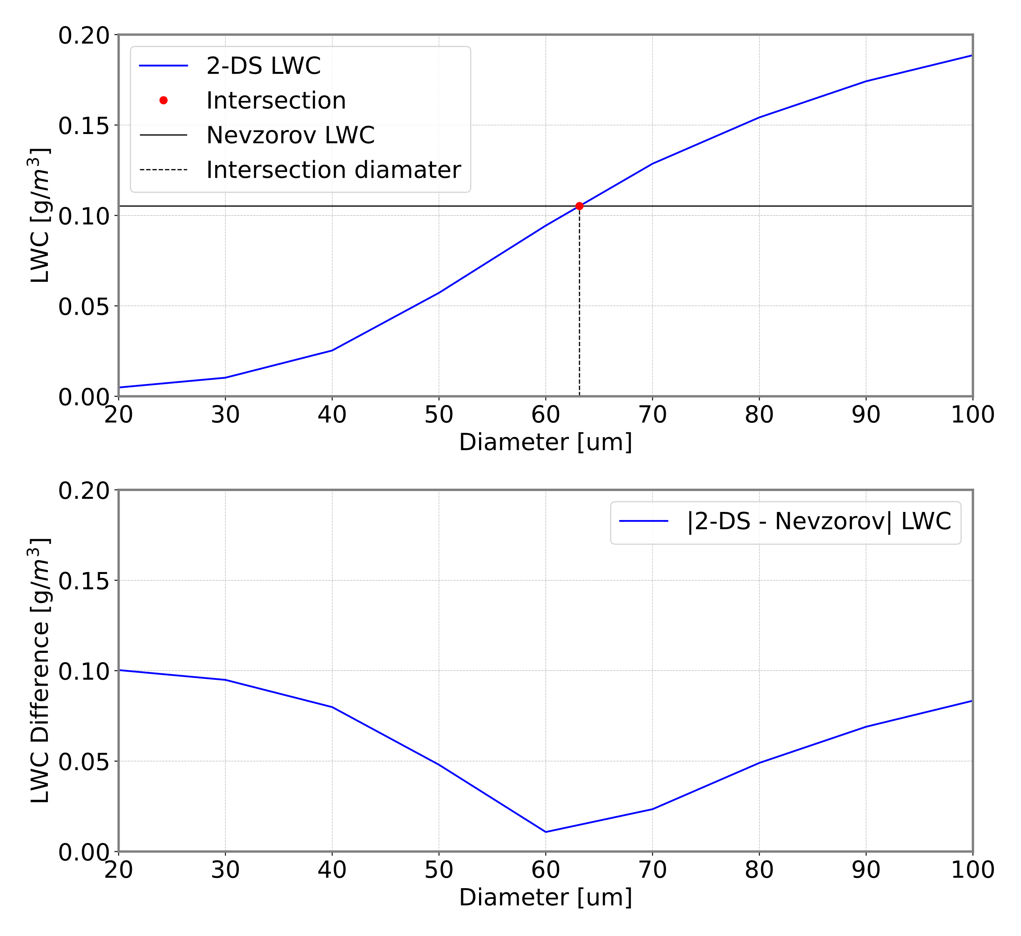
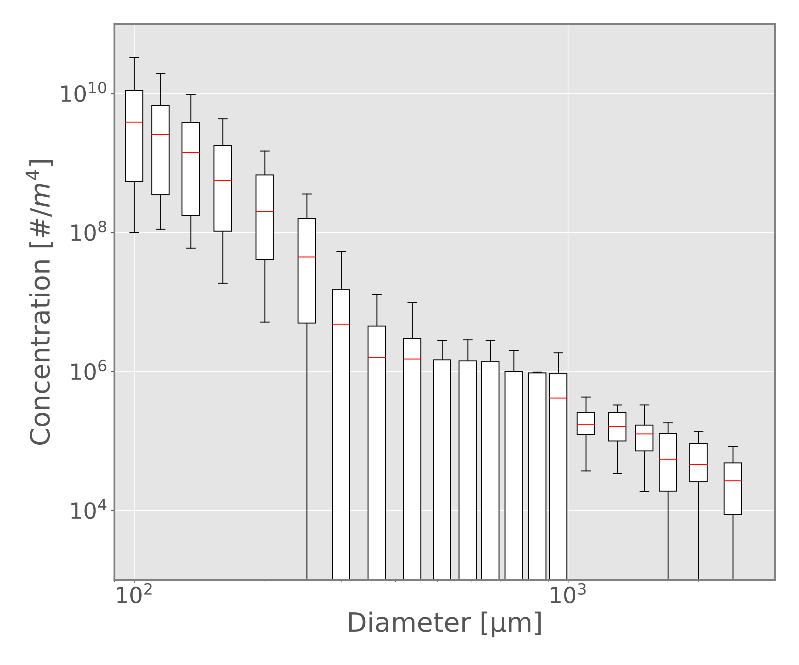
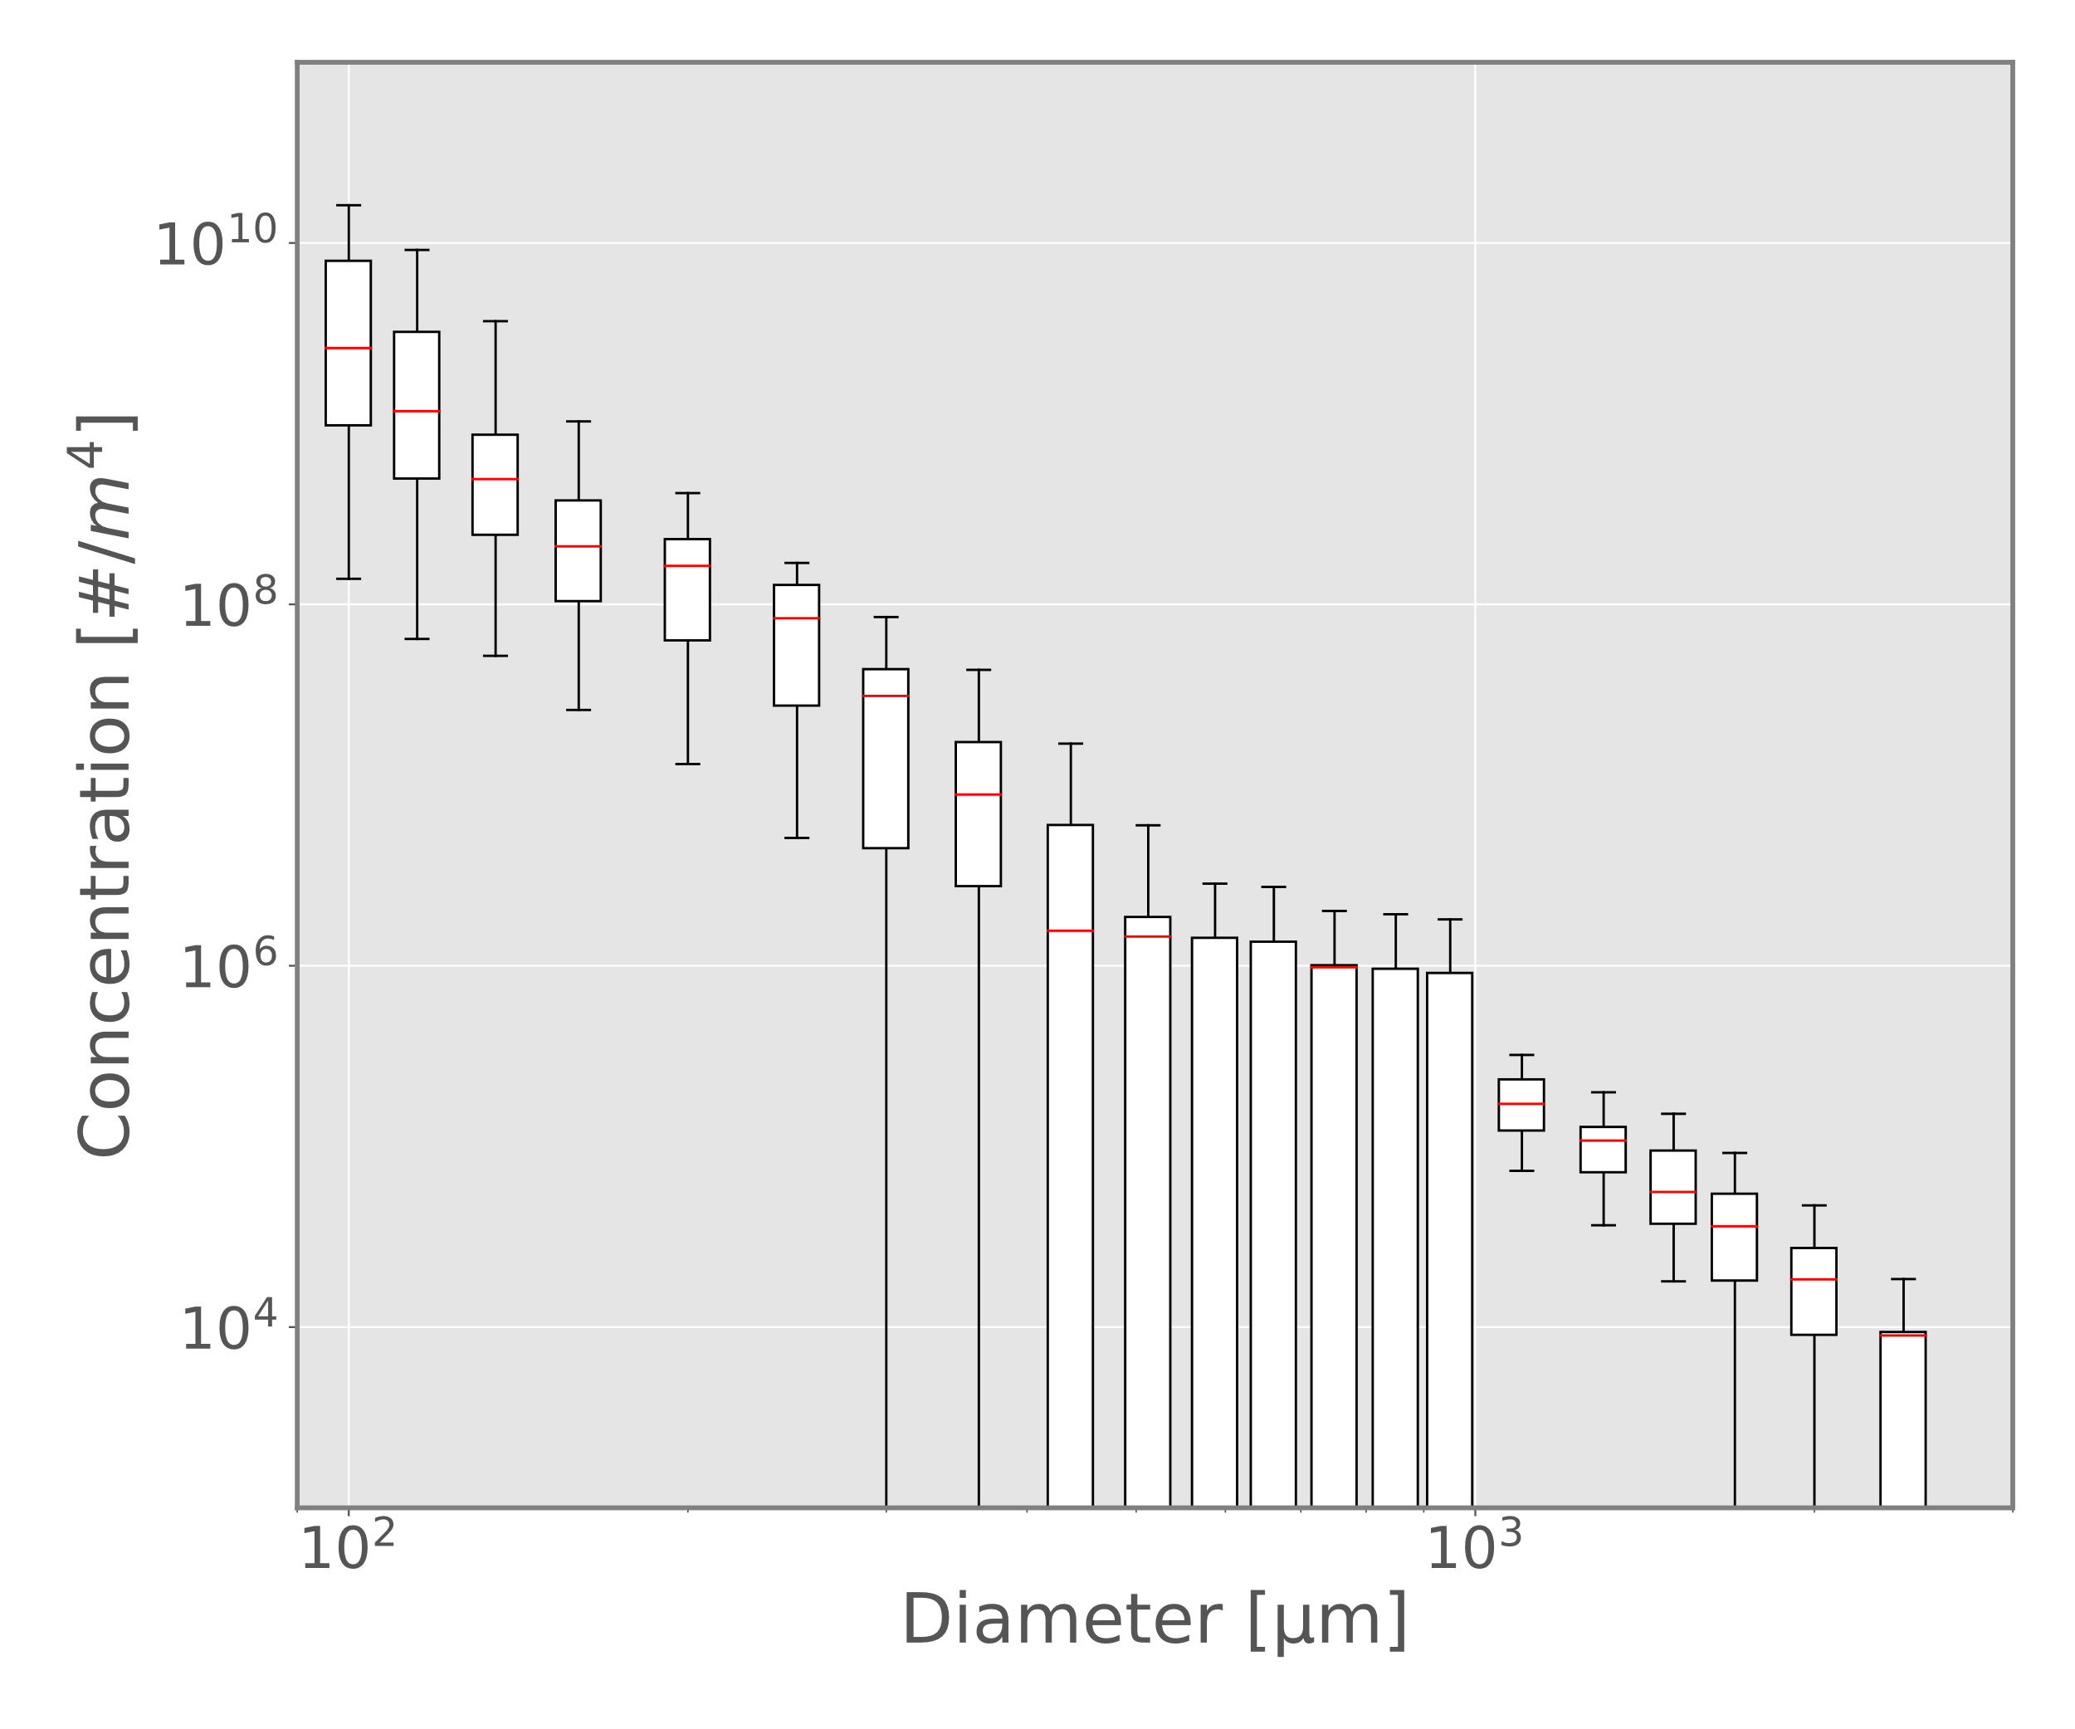
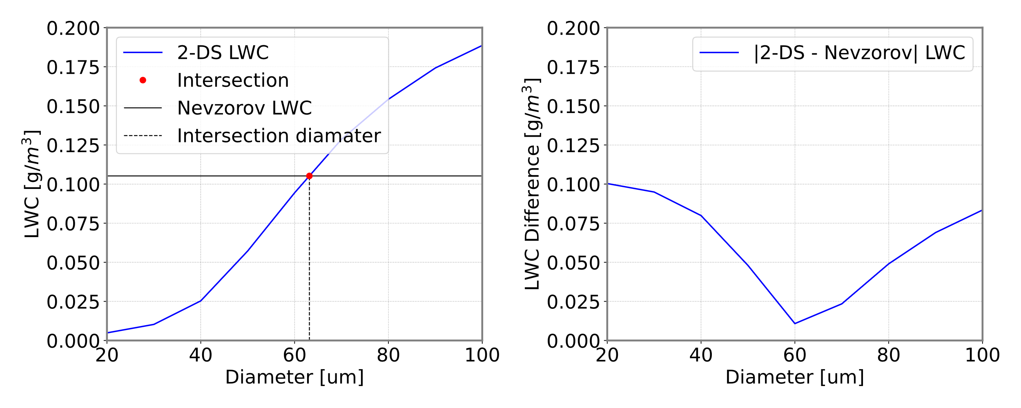
Microphysical Observations in the Melting Layer of Precipitating Clouds
Logan Twohey and David Delene
University of North Dakota, Department of Atmospheric Sciences
MOTIVATION
The goal is to characterize microphysical properties in the melting layer, where snow transitions to rain.
This layer affects storm evolution
Improved understanding of microphysical processes can lead to more accurate model forecasts
DATA
Melting layer observations are available from aircraft profiles during ten NASA campaigns.
Program | Dates | MLs
CAMEX-4 | 08/01 - 09/01 | 3
CRYSTAL-FACE | 07/02 - 08/02 | 4
NAMMA | 08/06 - 09/06 | 3
TC4 | 07/07 - 08/07 | 2
GRIP | 08/10 - 09/10 | 0
LPVEx | 09/10 - 10/10 | 2
MC3E | 04/11 - 06/11 | 7
GCPEx | 01/12 - 02/12 | 11
IPHEx | 05/14 - 06/14 | 4
OLYMPEX | 11/15 - 12/15 | 9
IMPACTS | 01/20 - 02/20 | 6
TOTAL |  | 51
Colored contour plots showing combined 2D-S and HVPS3 particle size distribution (left) and HVPS3 area ratio (right) through the melting layer for 12 NOV 2015 during OLYMPEX.
Before Melting
After Melting
First six channels of 2-DS derived total mass compared to Nevzorov measurements (top) and total mass compared for different 2-DS bin sizes for 12 NOV 2015 during OLYMPEX.
Liquid water content is compared between integration of 2D-S particle concentrations and Nevzorov measurements.
The lowest six channels of the 2D-S measurements are in closest agreement with the Nevzorov for cases studied during OLYMPEX
However, the diameter of the least difference between the two is between the sixth and seventh channel
Airborne instruments provide data on particle size, liquid water content, temperature, and relative humidity
Particle size measurements from the 2D-S are integrated to determine mass through the ML and compared to Nevzorov probe mass measurements
Box-and-whisker plots showing 2D-S (< 1000 μm) and HVPS3 (> 1000 μm) combined spectrum concentration on 12 NOV 2015 over the durations: 75519 to 75579 sfm, before melting (left); and 75618 to 75678 sfm, after melting (right).
DISCUSSION
This study investigates the transition of snow to rain in the melting layer.
Particle concentration and area ratio change during melting
Large variability in concentration measurements highlight uncertainty
Bulk mass of the size distribution are compared to Nevzorov direct measurements
2D-S particle images showing the transition of hydrometeors for 12 NOV 2015 during OLYMPEX: snow (top), mixed (middle), rain (bottom).
Plots comparing 2D-S derived mass and Nevzorov LWC measurements.

Slide 3
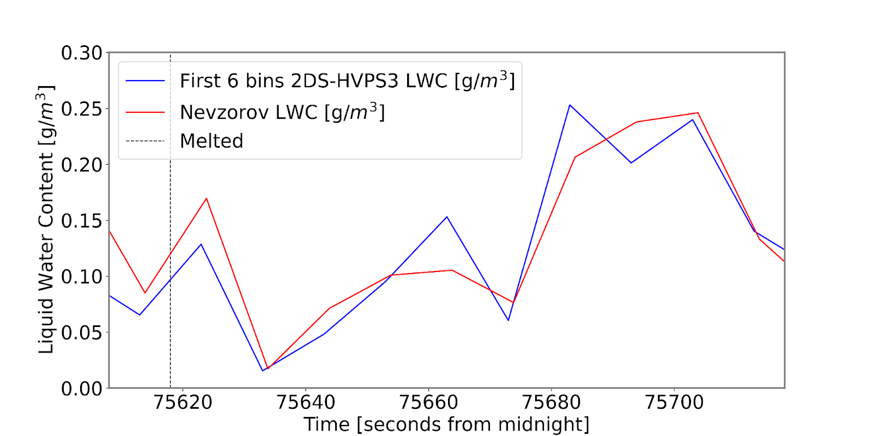
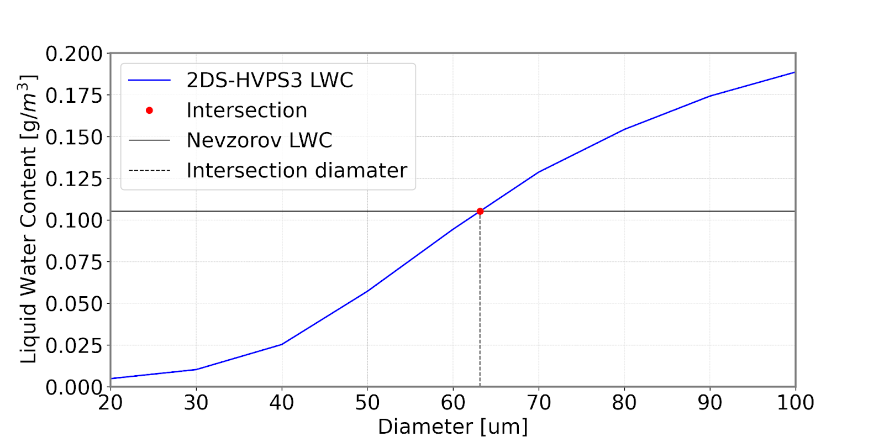
Microphysical Observations in the Melting Layer of Precipitating Clouds
Logan Twohey and David Delene
University of North Dakota, Department of Atmospheric Sciences
MOTIVATION
The goal is to characterize microphysical properties in the melting layer, where snow transitions to rain.
This layer affects storm evolution
Improved understanding of microphysical processes can lead to more accurate model forecasts
DATA
Melting layer observations are available from aircraft profiles during ten NASA campaigns.
Program | Dates | MLs
CAMEX-4 | 08/01 - 09/01 | 3
CRYSTAL-FACE | 07/02 - 08/02 | 4
NAMMA | 08/06 - 09/06 | 3
TC4 | 07/07 - 08/07 | 2
GRIP | 08/10 - 09/10 | 0
LPVEx | 09/10 - 10/10 | 2
MC3E | 04/11 - 06/11 | 7
GCPEx | 01/12 - 02/12 | 11
IPHEx | 05/14 - 06/14 | 4
OLYMPEX | 11/15 - 12/15 | 9
IMPACTS | 01/20 - 02/20 | 6
TOTAL |  | 51
Colored contour plots showing combined 2D-S and HVPS3 particle size distribution (left) and HVPS3 area ratio (right) through the melting layer for 12 NOV 2015 during OLYMPEX.
Particle size distribution and area ratio change through the melting layer.
As particles melt, there is a decrease in maximum diameter
Concentration of small particles remain relatively unchanged during the melting process
The melting process causes irregular-shaped particles to become rounder, leading to an increase in area ratio as liquid water overtakes the crystals
First six channels of 2-DS derived total mass compared to Nevzorov measurements (top) and total mass compared for different 2-DS bin sizes for 12 NOV 2015 during OLYMPEX.
Liquid water content is compared between integration of 2D-S particle concentrations and Nevzorov measurements.
The lowest six channels of the 2D-S measurements are in closest agreement with the Nevzorov for cases studied during OLYMPEX
However, the diameter of the least difference between the two is between the sixth and seventh channel
Airborne instruments provide data on particle size, liquid water content, temperature, and relative humidity
Particle size measurements from the 2D-S are integrated to determine mass through the ML and compared to Nevzorov probe mass measurements
Before Melting
After Melting
CONCLUSION
This study investigates the transition of snow to rain in the melting layer.
Particle concentration and area ratio change during melting
Large variability in concentration measurements highlight uncertainty
Bulk mass of the size distribution are compared to Nevzorov direct measurements
Box-and-whisker plots showing 2D-S (< 1000 μm) and HVPS3 (> 1000 μm) combined spectrum concentration on 12 NOV 2015 over the durations: 75519 to 75579 sfm, before melting (left); and 75618 to 75678 sfm, after melting (right).
There is large variability in instrument measurements for concentration.
Variability is larger above the melting layer
The 95% confidence interval is wider for larger 2D-S channels (under 10³ μm)
Spectrums also show decreased concentration at high diamters
2D-S particle images showing the transition of hydrometeors for 12 NOV 2015 during OLYMPEX: snow (top), mixed (middle), rain (bottom).

Slide 4
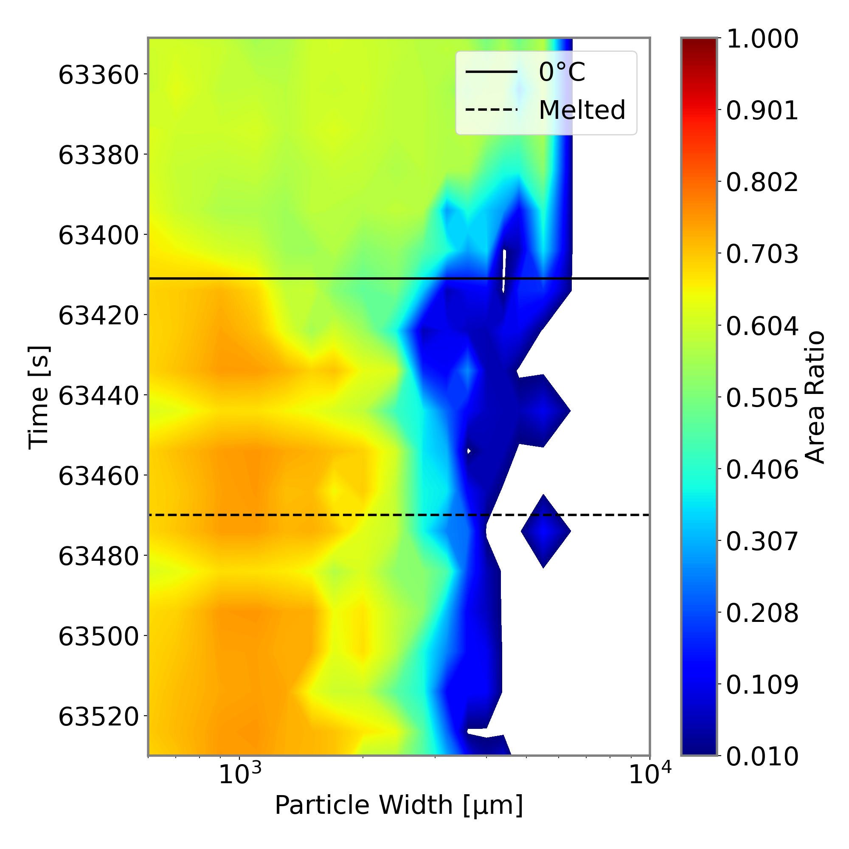
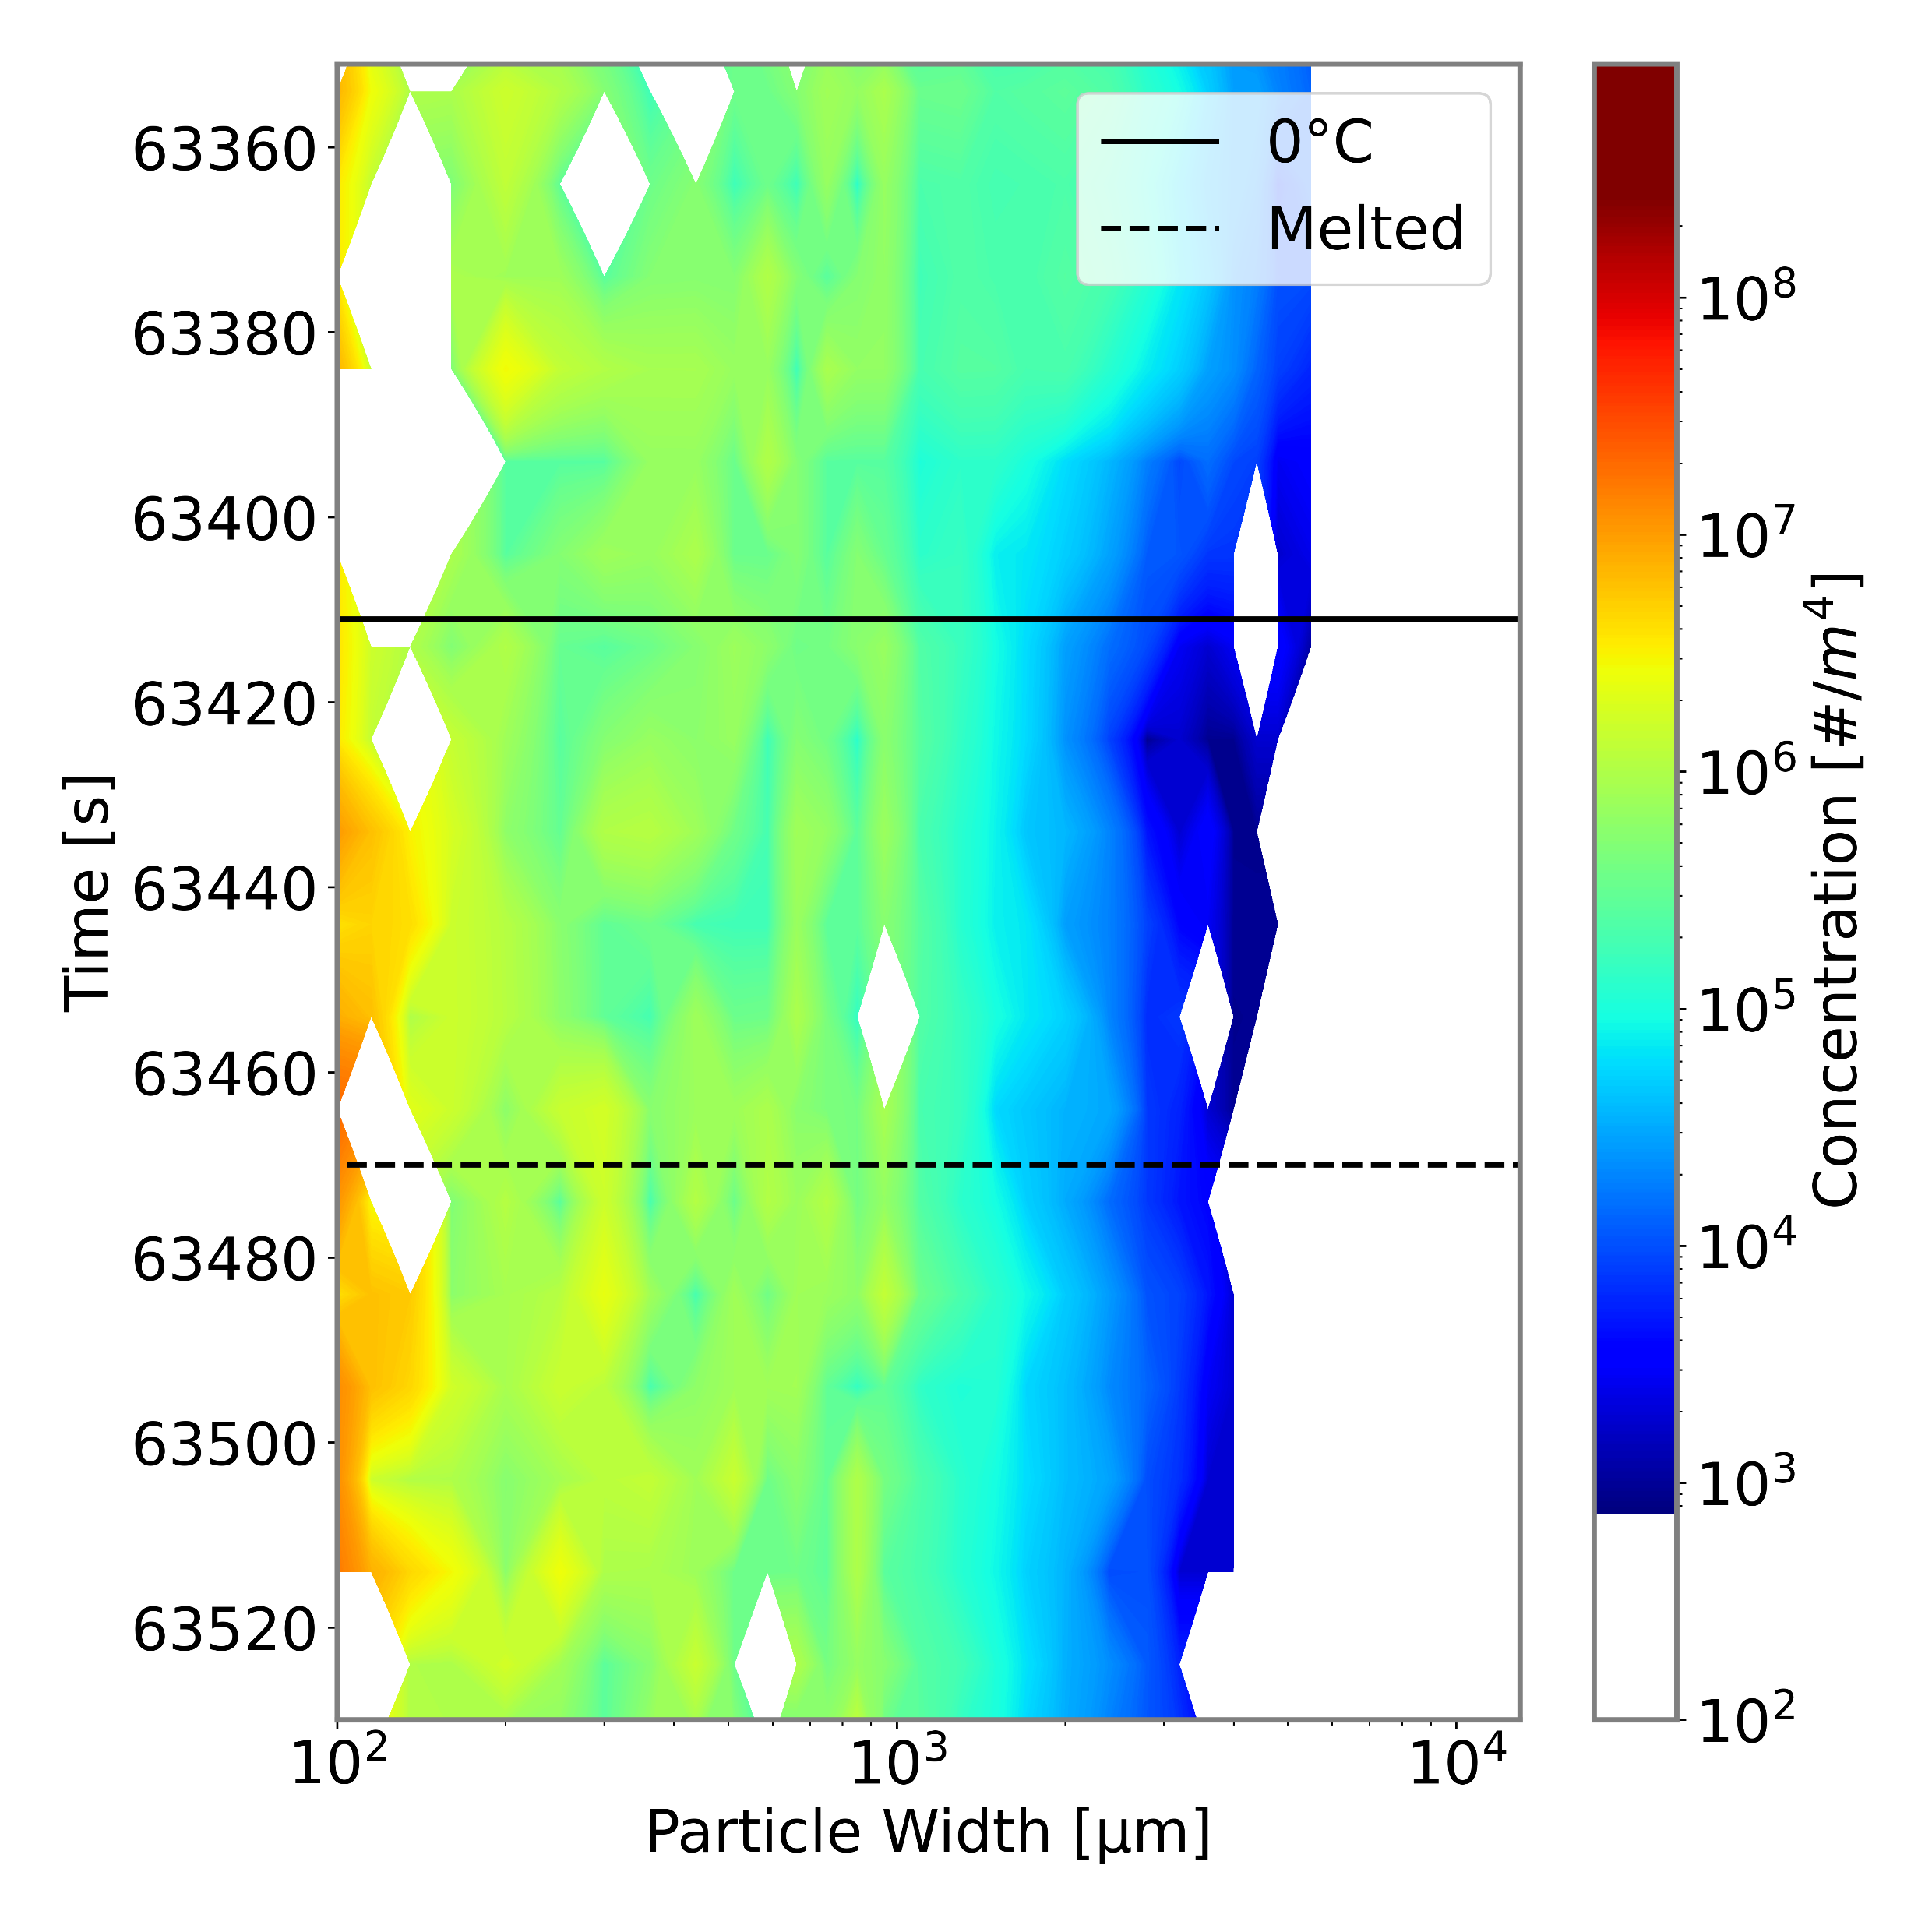
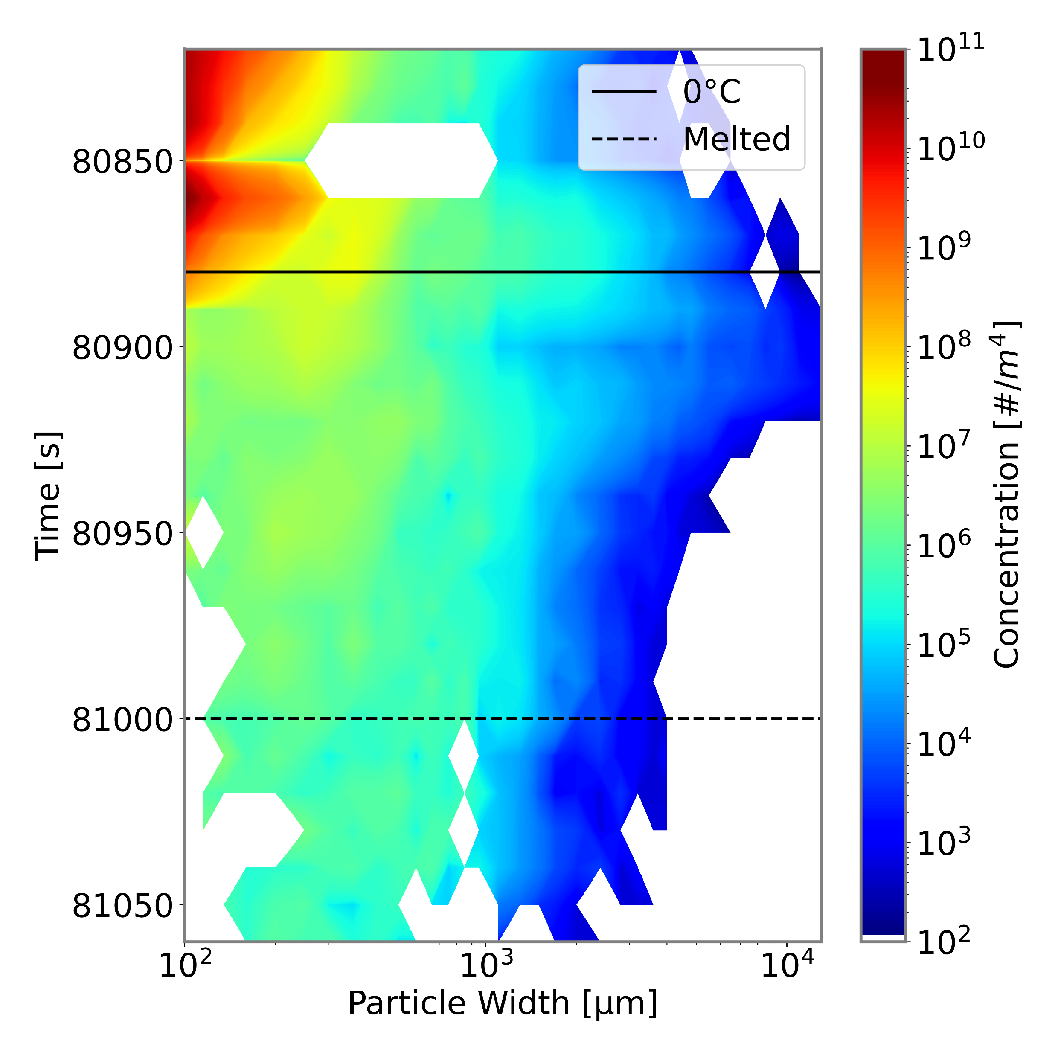
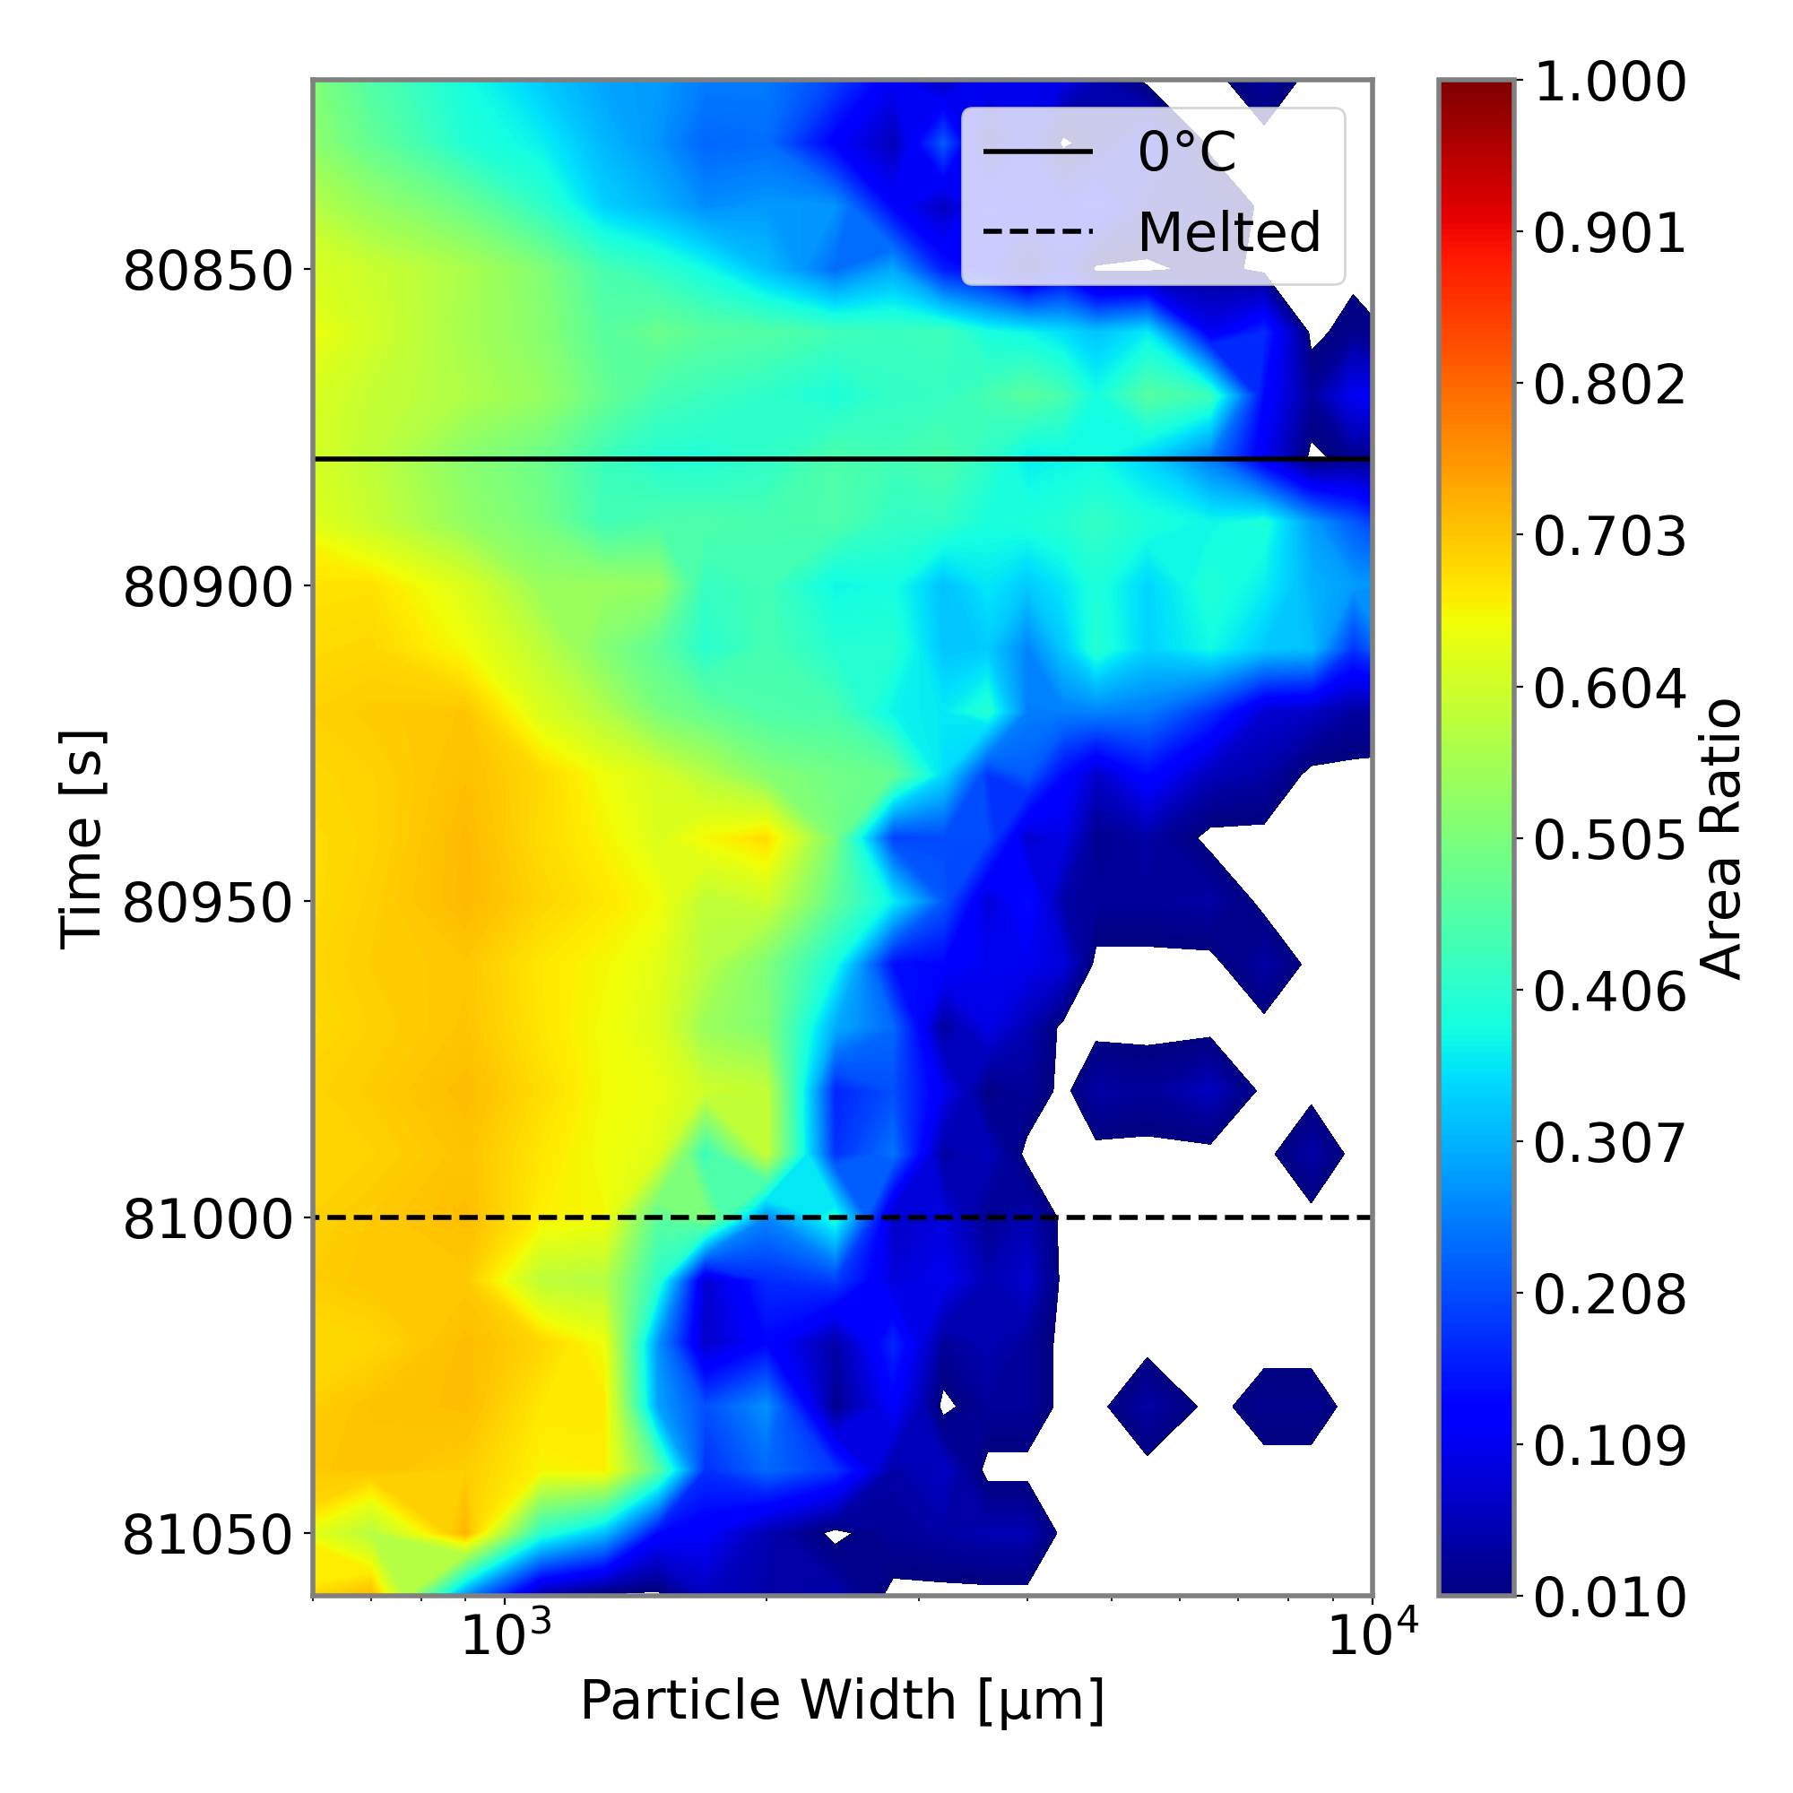
Microphysical Observations in the Melting Layer of Precipitating Clouds
Logan Twohey and David Delene
MOTIVATION
The goal of the study is to characterize microphysical properties in the melting layer, where snow melts to rain.
This layer affects storm evolution
Improved modeling of the melting layer can better our understanding of microphysics and lead to more accurate model forecasts
RESULTS
RESULTS (Cont.)
Combined 2D-S and HVPS3 particle size distribution (left) and HVPS3 area ratio (right) through the melting layer for 12 DEC 2015 during OLYMPEX.
The transition of snow to rain: 2D-S particle images.
First six channels of 2-DS derived total mass compared to Nevzorov measurements (top) and total mass compared for different 2-DS bin sizes for 12 NOV 2015 during OLYMPEX.
METHODS & DATA
Melting layer observations are available from aircraft profiles during ten NASA campaigns.
Liquid water content is compared between integration of 2D-S particle concentrations and Nevzorov measurements.
The lowest six channels of the 2D-S measurements are in closest agreement with the Nevzorov for cases studied during OLYMPEX
However, the diameter of the least difference between the two is between the sixth and seventh channel
Program | Dates | MLs
CAMEX-4 | 08/01 - 09/01 | 3
CRYSTAL-FACE | 07/02 - 08/02 | 4
NAMMA | 08/06 - 09/06 | 3
TC4 | 07/07 - 08/07 | 2
GRIP | 08/10 - 09/10 | 0
LPVEx | 09/10 - 10/10 | 2
MC3E | 04/11 - 06/11 | 7
GCPEx | 01/12 - 02/12 | 11
IPHEx | 05/14 - 06/14 | 4
OLYMPEX | 11/15 - 12/15 | 9
IMPACTS | 01/20 - 02/20 | 6
TOTAL |  | 51
Combined 2D-S and HVPS3 particle size distribution (left) and HVPS3 area ratio (right) through the melting layer for 05 FEB 2020 during IMPACTS (right).
CONCLUSION
This study investigates the transition of snow to rain in the melting layer.
Particle concentration and area ratio change during melting
Large variability in concentration measurements highlight uncertainty
Bulk mass of the size distribution are compared to Nevzorov direct measurements
Particle size distribution and area ratio change through the melting layer.
As particles melt, there is a decrease in maximum diameter
Concentration of small particles remain relatively unchanged during the melting process
The melting process causes irregular-shaped particles to become rounder, leading to a sharp increase in area ratio as liquid water overtakes the crystals
The increase in particle concentrations and maximum diameter around the melting level (0 °C) is likely a result of aggregation due to increased stickiness of particles
Airborne instruments provide data on particle size, liquid water content, temperature, and relative humidity
Particle size measurements from the 2D-S are integrated to determine mass through the ML and compared to Nevzorov probe mass measurements

