Slide 1


INVESTIGATION OF THE EXISTENCE OF VERTICALLY ORIENTED ICE CRYSTALS IN WINTER STORMS
Kendra Sand
M.S. Thesis Defense
University of North Dakota
Grand Forks, North Dakota
November 14, 2024
Committee Members: Dr. David Delene, Prof. Emeritus Michael Poellot, Dr. Jared Marquis

Slide 2
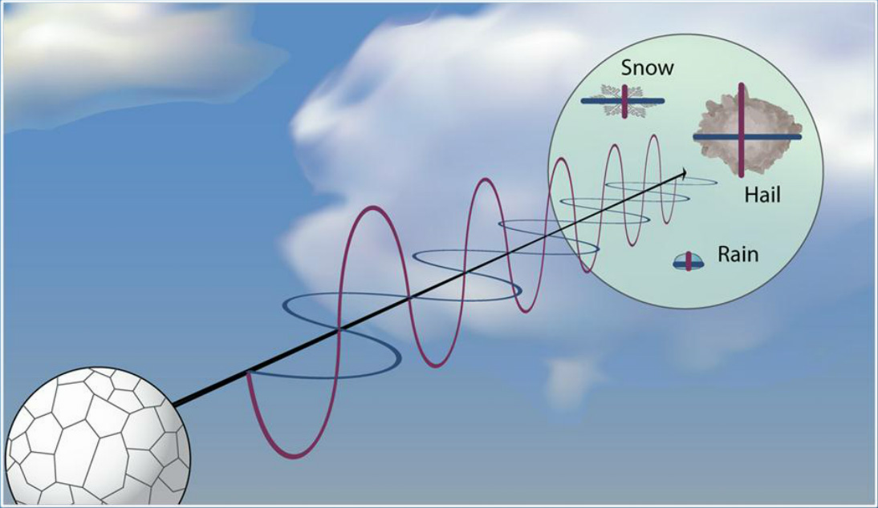

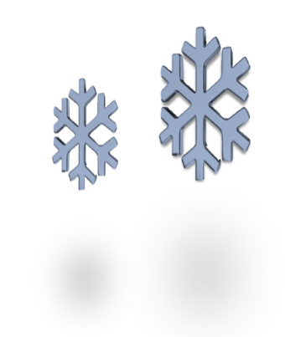
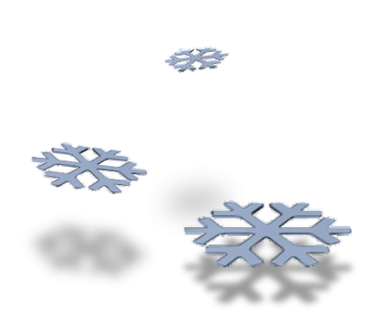
Motivation
A dual-polarized radar product, ZDR, measures the differential equivalent-reflectivity of a sample volume.
Through ZDR and other studies and observations, it has been shown that ice crystals typically orient roughly parallel to the horizontal plane (Thomas et al. 1990; Hogan 2012).
Dual-polarization radar depiction from Weather.gov
Typical Orientation
Vertical Orientation
Z_{H} > Z_{V}
Z_{H} - Z_{V} = Positive ZDR value
Z_{H} < Z_{V}
Z_{H} - Z_{V} = Negative ZDR value
Horizontal Plane

Slide 3
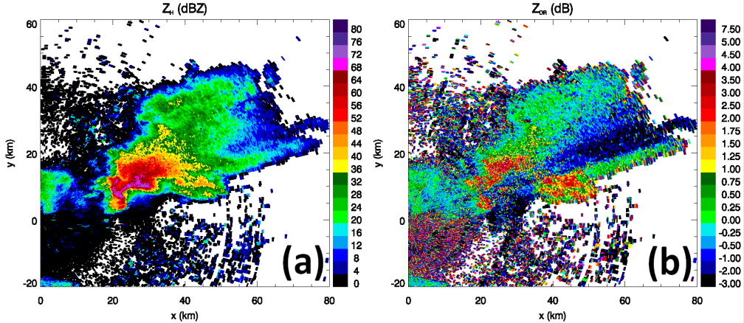
Vertically Oriented Ice Crystals
Laboratory studies have revealed ice crystal alignment with electric field (EF) lines when in the presence of EF charging (Magono and Sekiya 1965; Weinheimer and Few 1987; Foster 2002; Foster 2008 and Hashino et al. 2014).
Vertically oriented ice crystals are most often associated with thunderstorm anvil regions.
Example of Radar Base Reflectivity and Differential Reflectivity published in the Journal of Operational Meteorology (Kumjian 2013).

Slide 4
Non-Thunderstorm, Cold Season Application
Less is known about vertical ice crystal orientation occurrence in winter storms.
A largely overlooked ice crystal property is the spatial arrangement of ice crystal axes and faces, which can exhibit specific orientations due to aerodynamic, electric, and gravitational forces (Weinheimer and Few 1987).
Purpose: relate remotely sensed observations to in situ measurements.
Ice crystal orientation directly relates to:
  Particle scattering properties
  Cloud reflectance
  Particle fall speed (Jiang et al. 2019)
  Precipitation growth (Jiang et al. 2019)
  Ice and total water content measurements
  Climate model implications

Slide 5

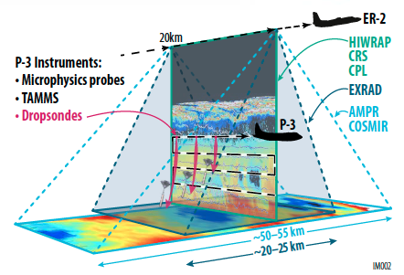

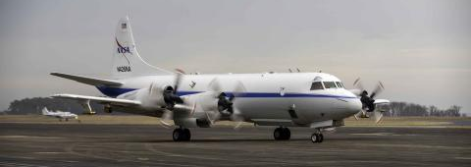
NASA IMPACTS Field Campaign
Investigation of Microphysics and Precipitation for Atlantic Coast-Threatening Snowstorms
Data Collection:
Jan - Feb 2020
Jan - Feb 2022
Jan - Feb 2023
Targeted Nor’easters affecting the Atlantic Coast and Northeastern United States.
Objectives related to a better understanding of precipitation processes in winter storms.
Notes:
5-year NASA Earth Venture campaign beginning in 2020
Targeted Nor’easters affecting the Northeastern United States
Objectives were to better understand precipitation processes in winter storms
First major study of its kind since 1986

Slide 6
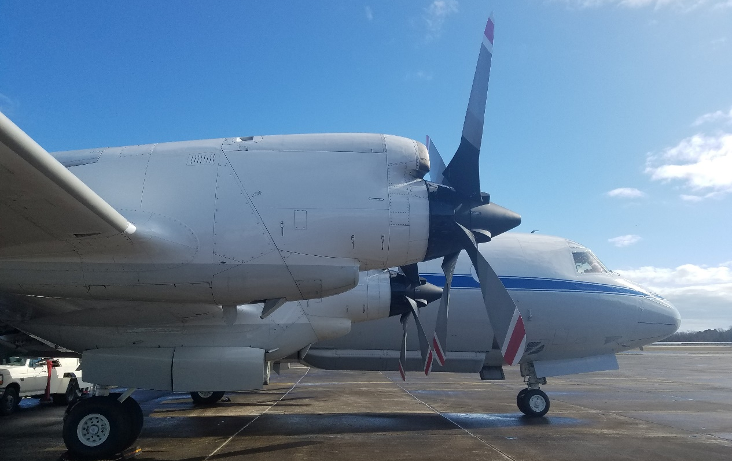
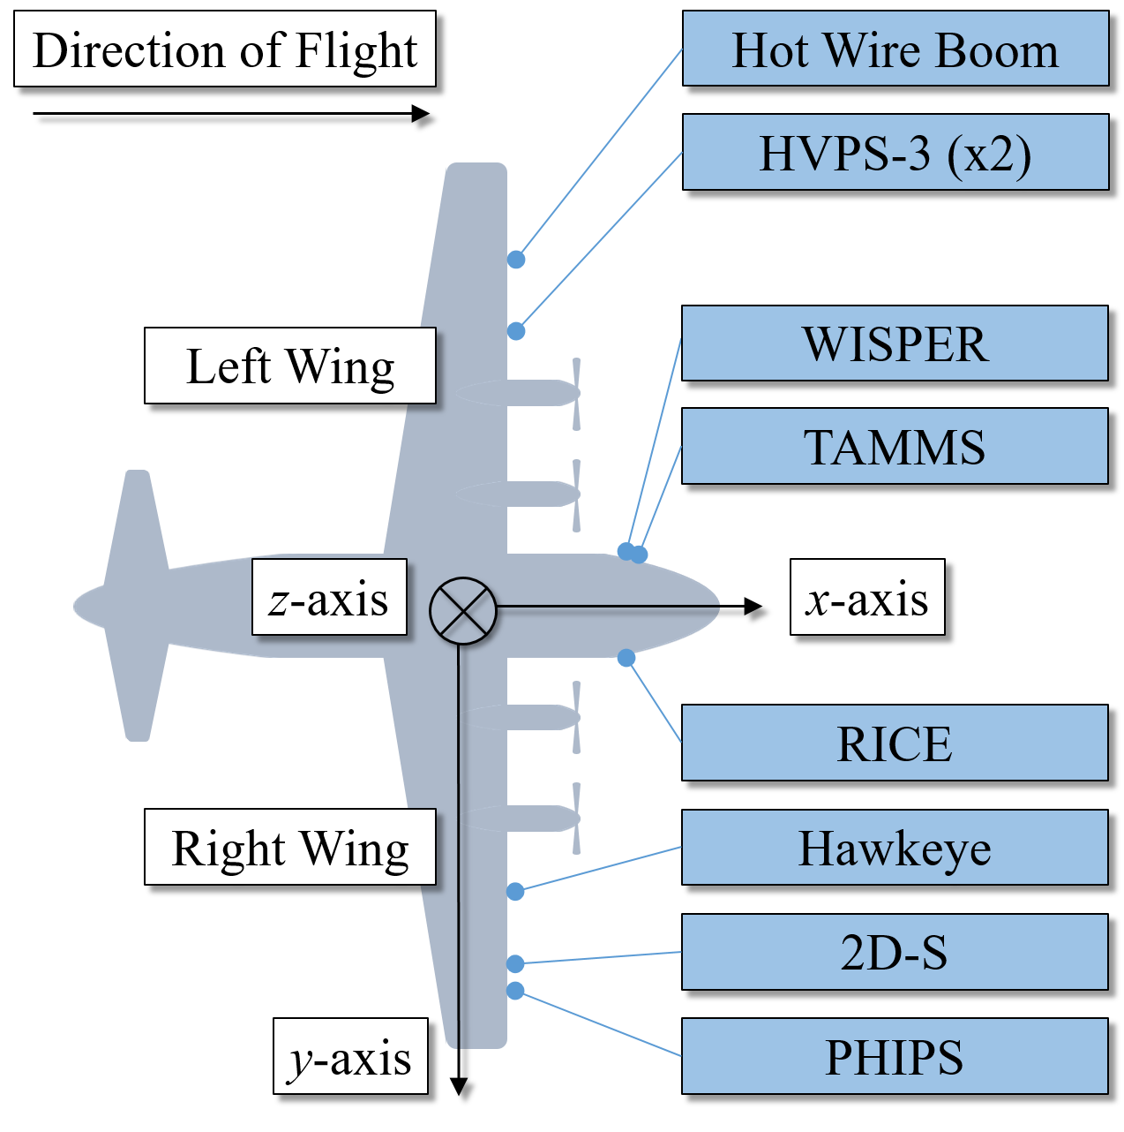
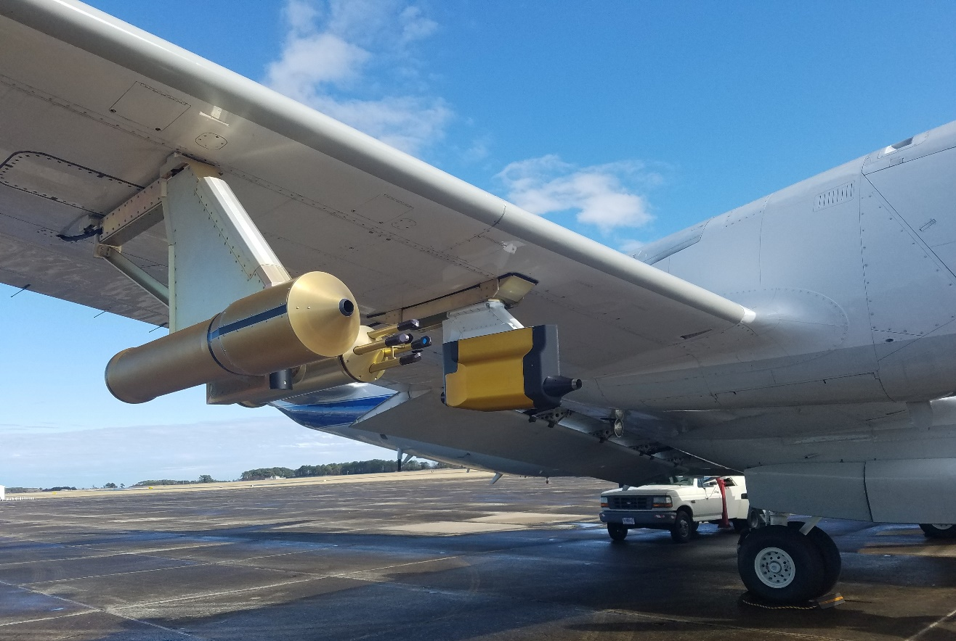
NASA P-3 Research Aircraft
The NASA P-3 is an all-weather aircraft modified extensively for airborne scientific research.
Powered by four turbopropellers.
Wing-mounted instruments were outboard.
2D-S
*Two-Dimensional Stereo (2D-S) Optical Array Probe (OAP)
2D-S* Mounting Location

Slide 7
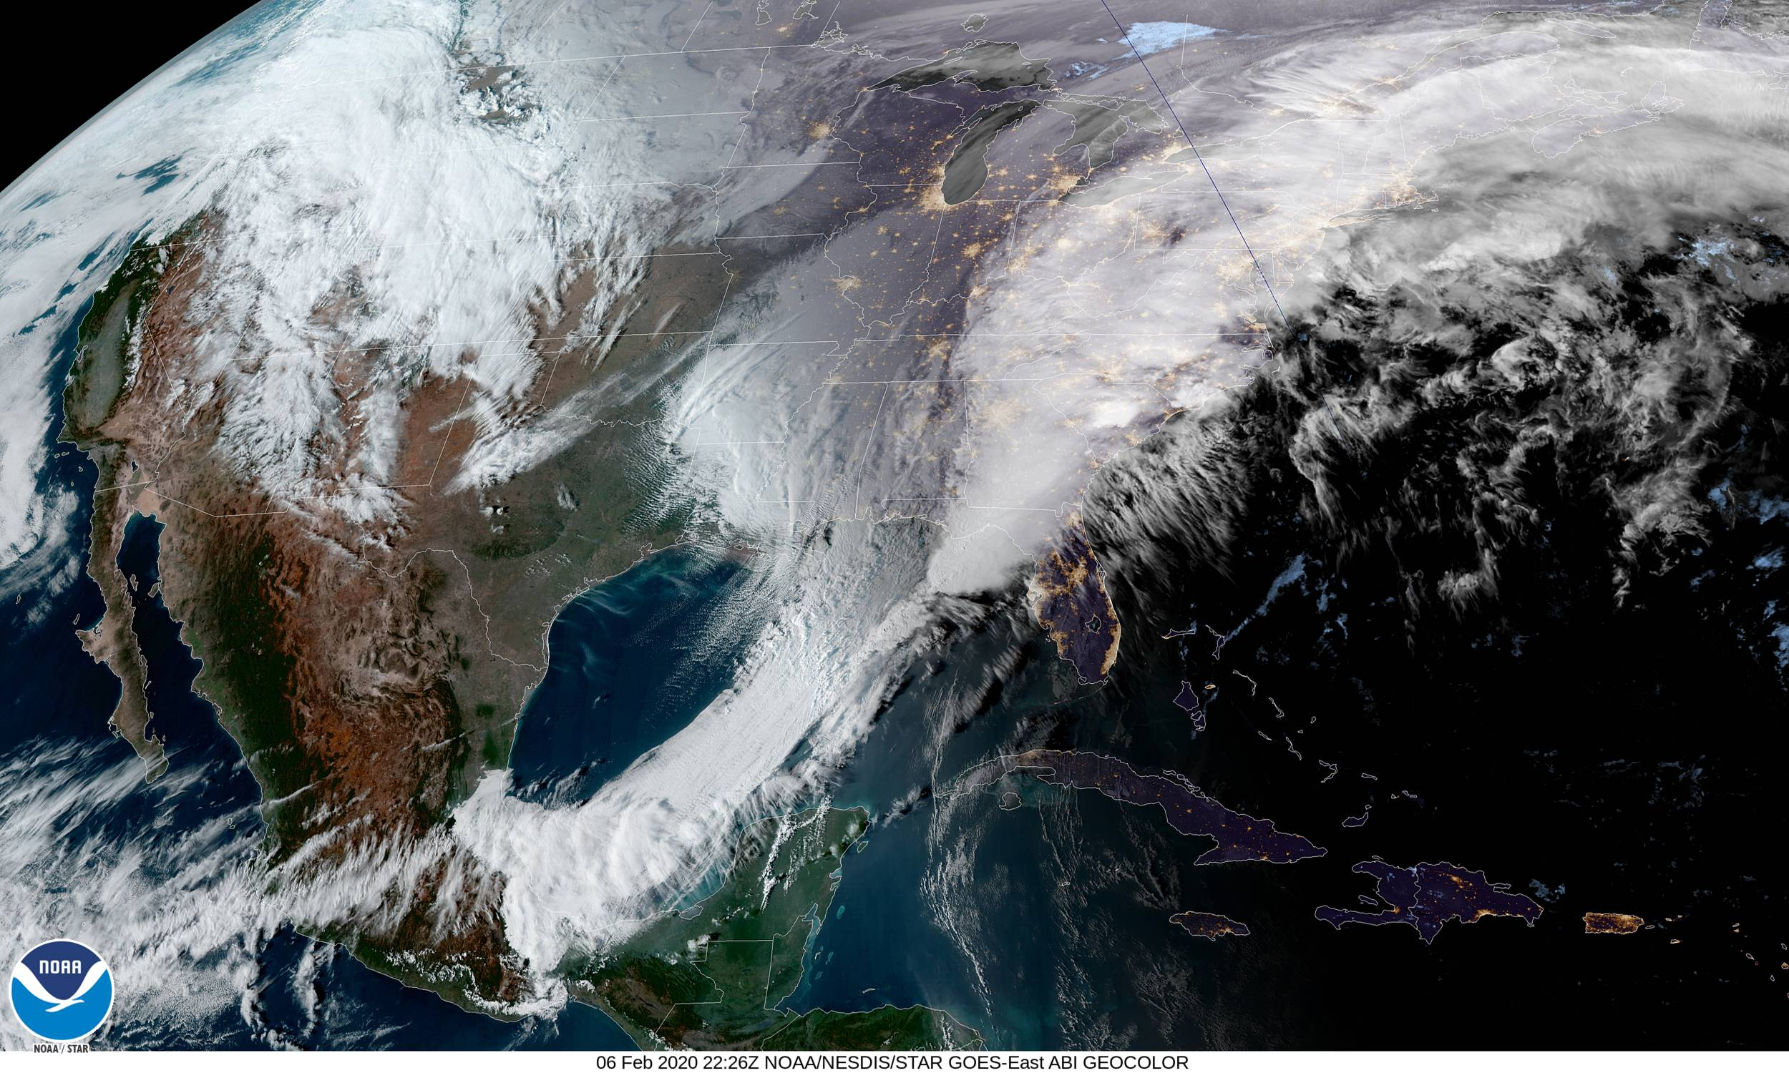
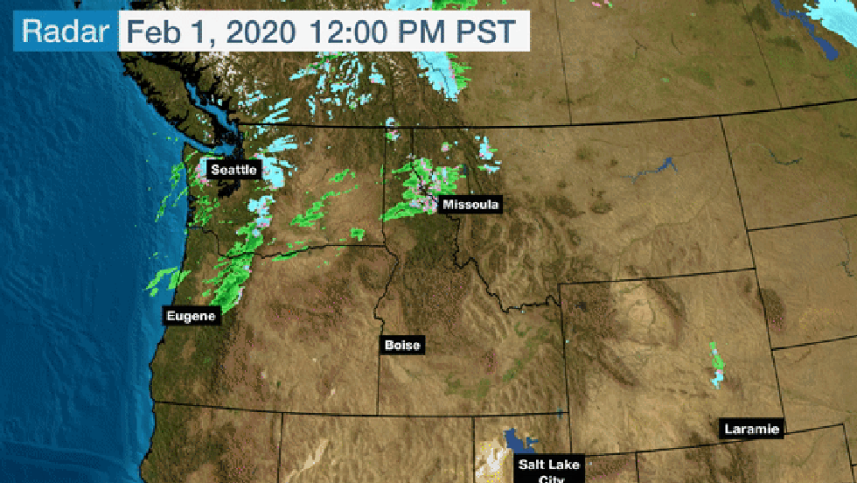
February 7th, 2020 Science Flight
NOAA/NESDIS 06 Feb 2020 Satellite Image from GOES-East in ABI Geocolor
Dubbed “Winter Storm Kade” by The Weather Channel.
Mature synoptic low pressure system.
Well-supported by combined jet region of over 200 knots.
Simultaneously created winter conditions and a line of thunderstorms.
Forecast significant, hazardous weather in New York and surrounding regions.
Concurrently sampled by the NASA P-3 and NASA ER-2.
Produced ten cases of interest.
Storm Recap from Weather.com

Slide 8
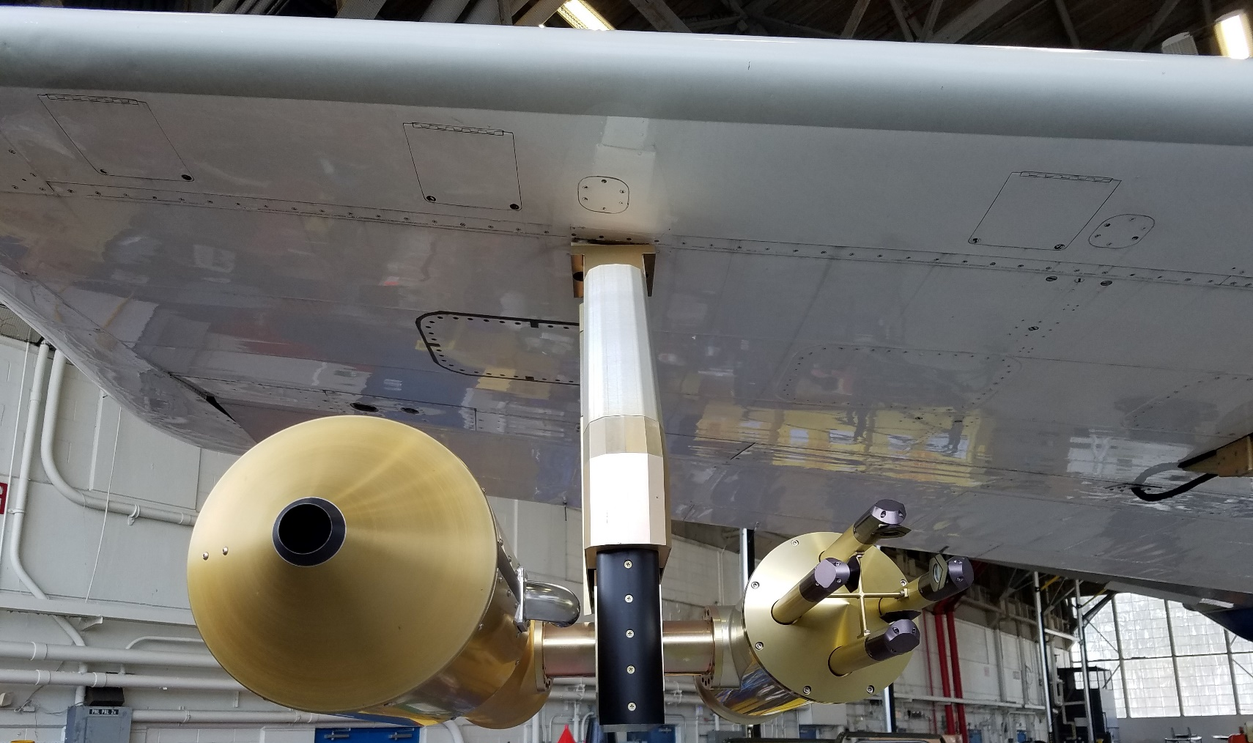
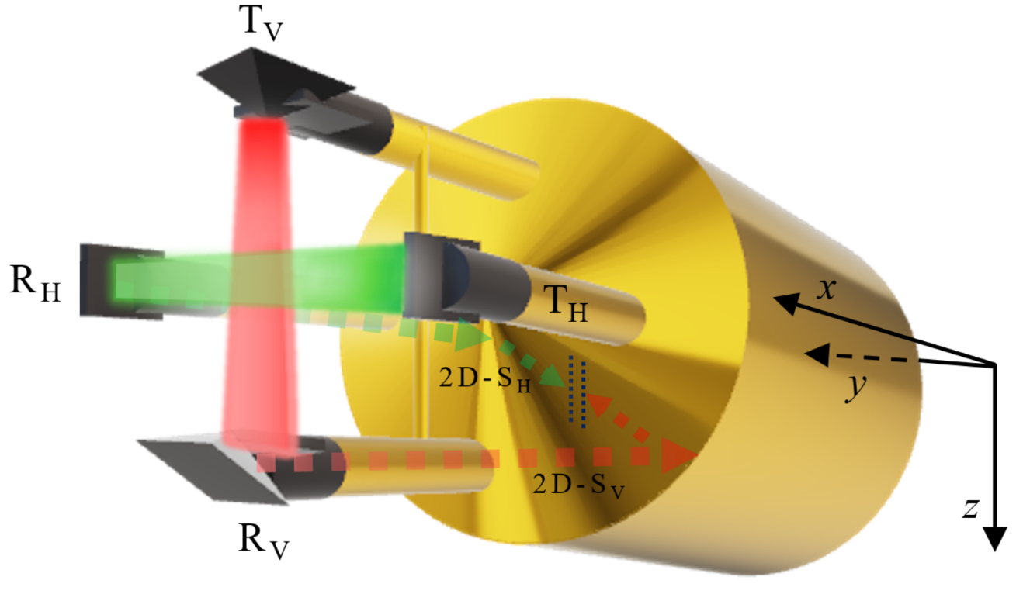
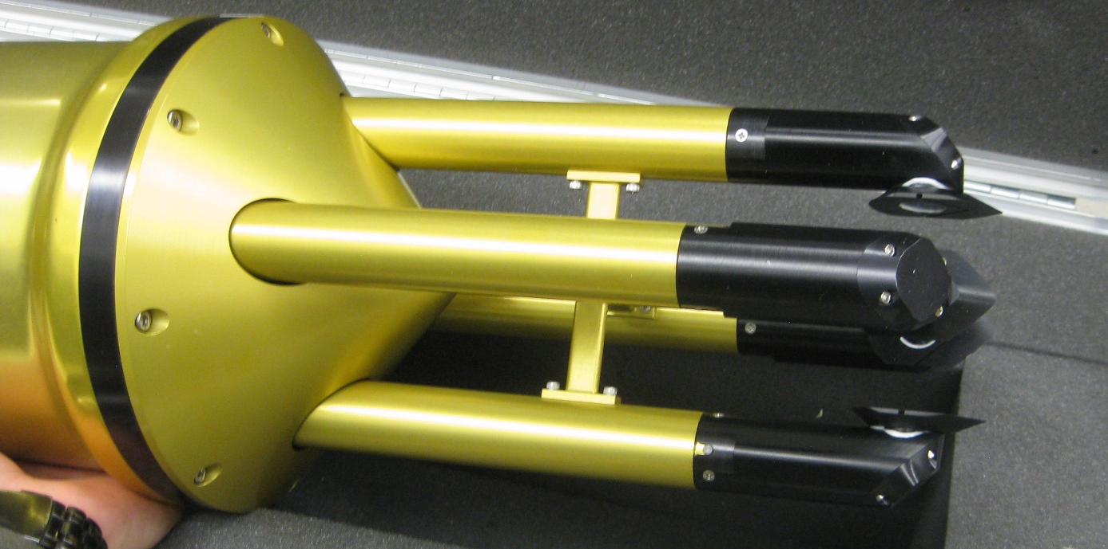
Two-Dimensional Stereo Optical Array Probe (2D-S)
Two perpendicular laser beams.
Illuminates 10 to ~2000 µm diameter particles.
Records shadow image and associated parameters.
Wingtip
Fuselage
2D-S
y
x
ʘ
z
2 mm
8 mm

Slide 9
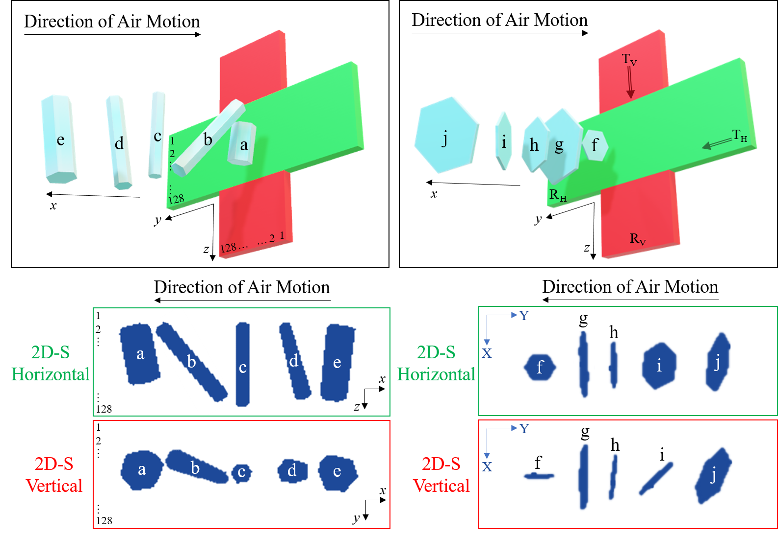

Slide 10
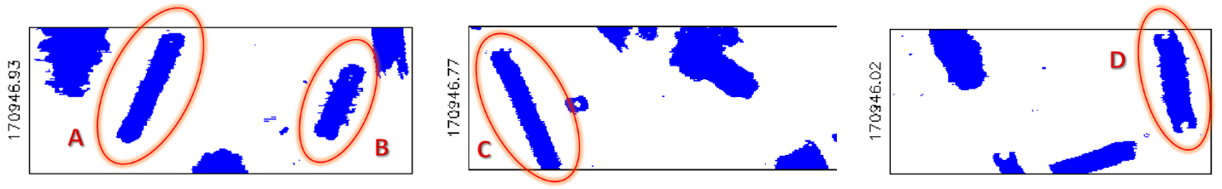
Example 2D-S Data
Horizontal Channel
Vertical Channel

Slide 11


Science Questions
Can ice crystal vertical orientations be observed through in situ measurements?
Can any relationship be drawn between ice crystal vertical orientations and cold season cloud top electric field charging?
Is there any relationship between ice crystal vertical orientations and periods of high particle concentration?

Slide 12
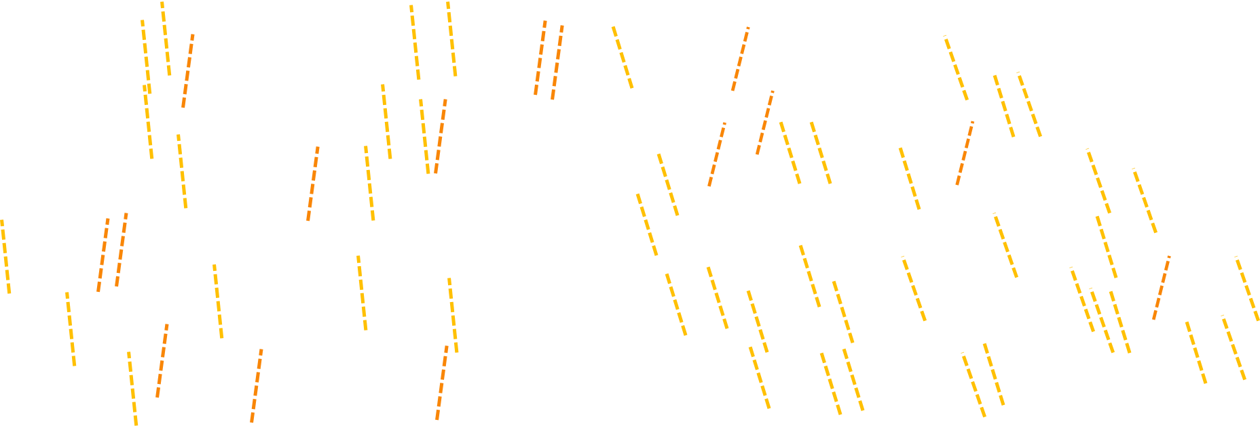
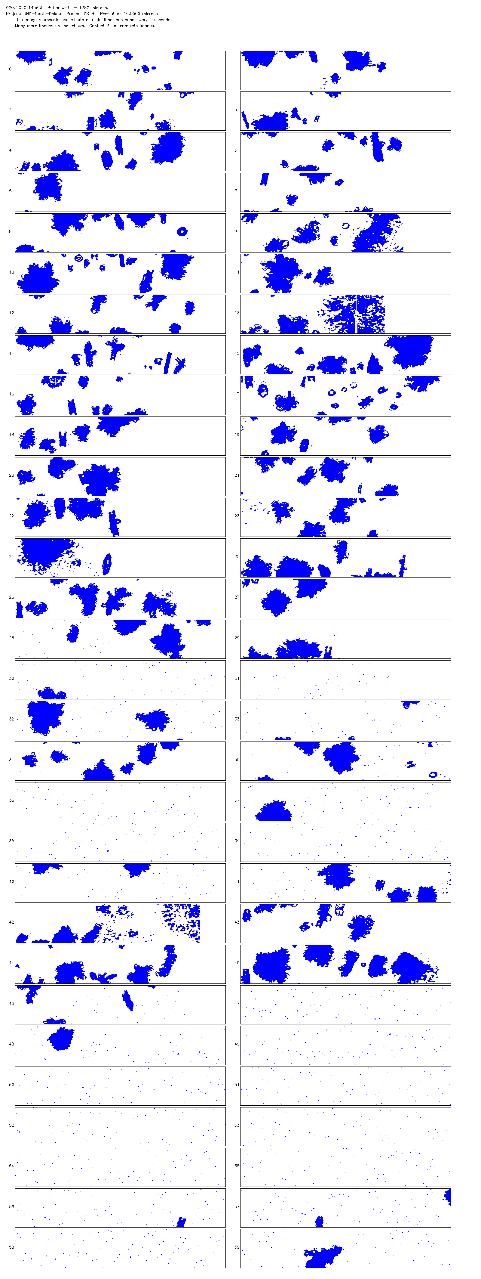
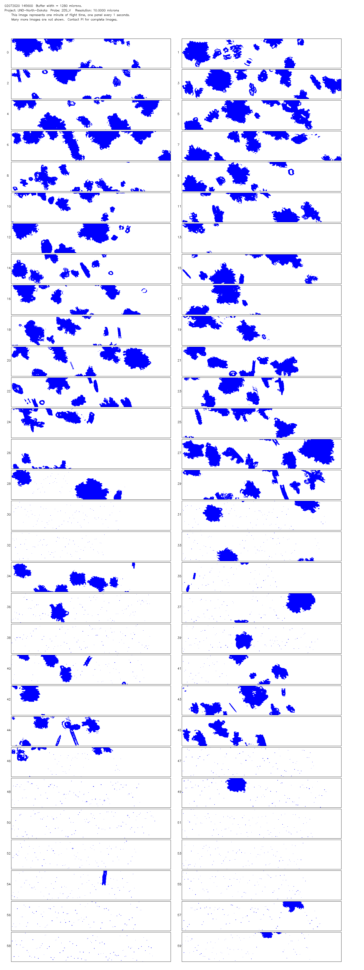
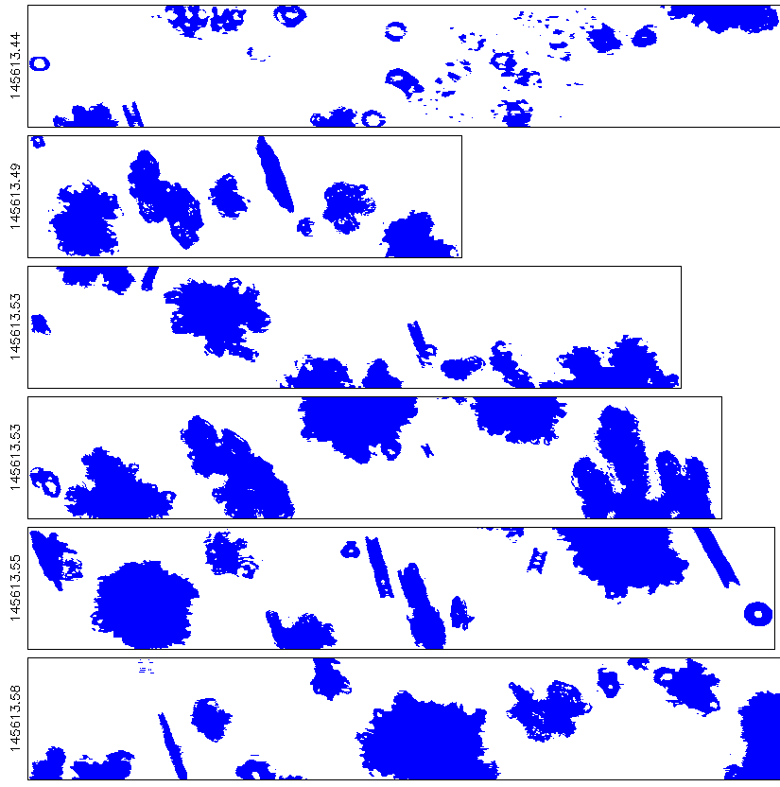
Case Selection Methodology
The 2D-S Image Data appears to show similar angles in the low aspect ratio ice crystals.
Isolate the low aspect ratio ice crystals of interest observed in the 2D-S Image Data.
Statistically analyze orientation angles of low aspect ratio ice crystals.
8 mm

Slide 13
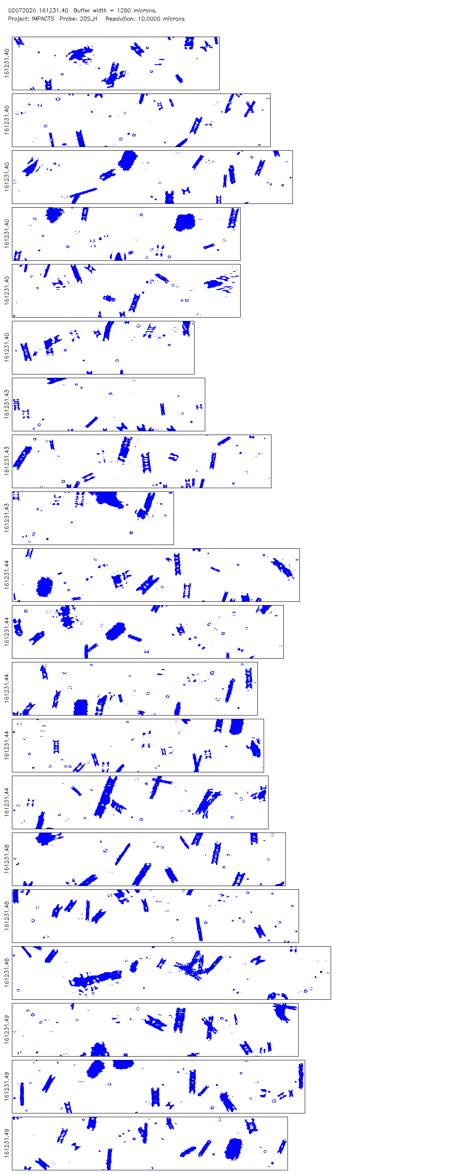
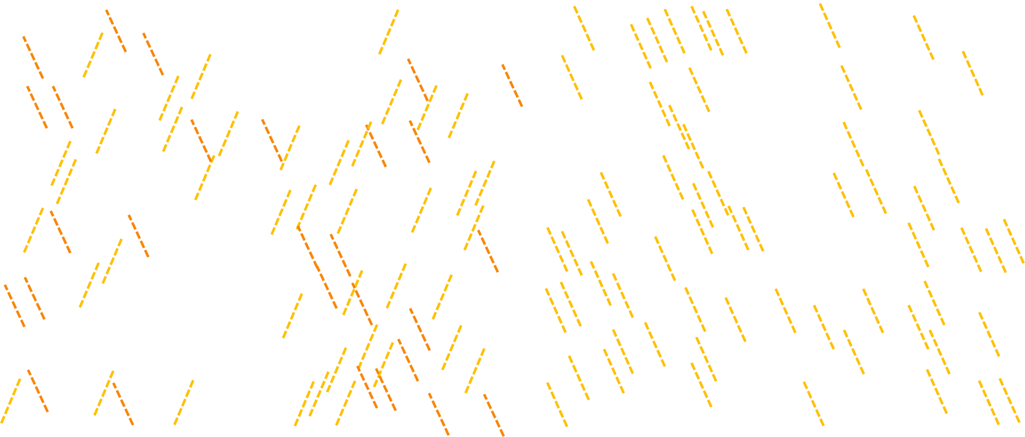
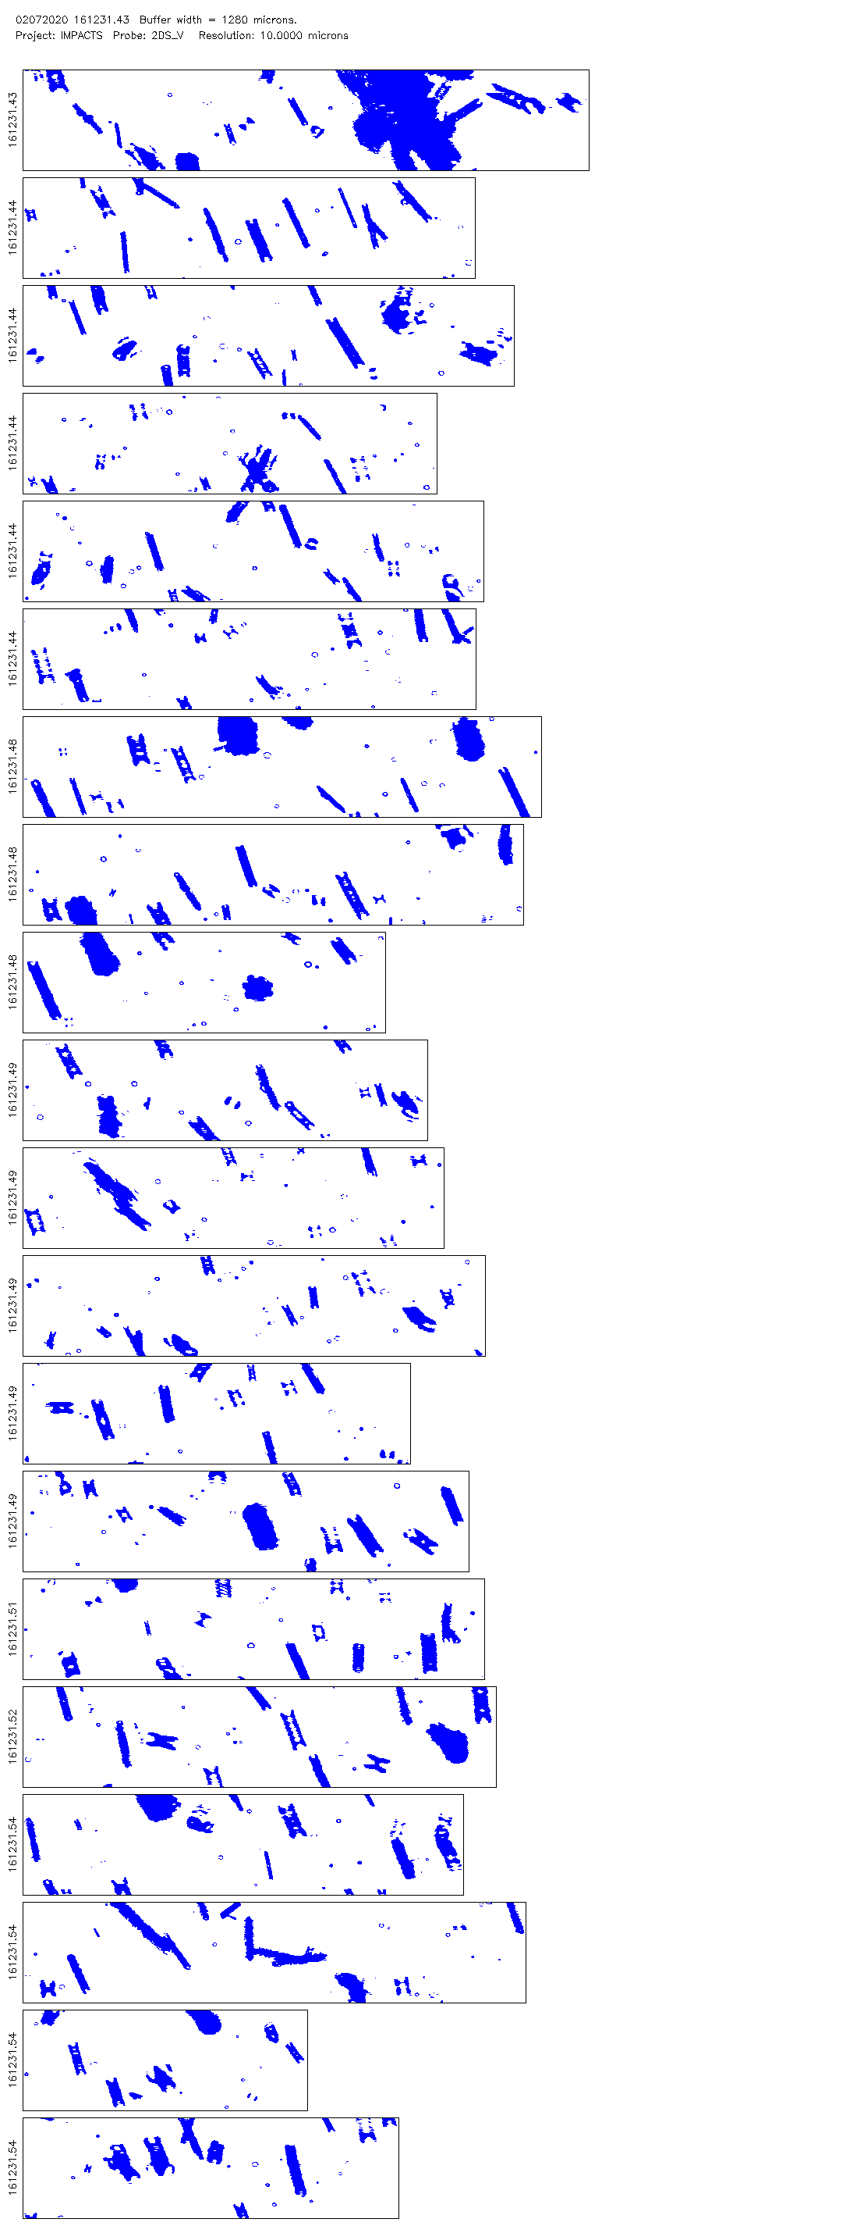
Case Selection Methodology
8 mm

Slide 14
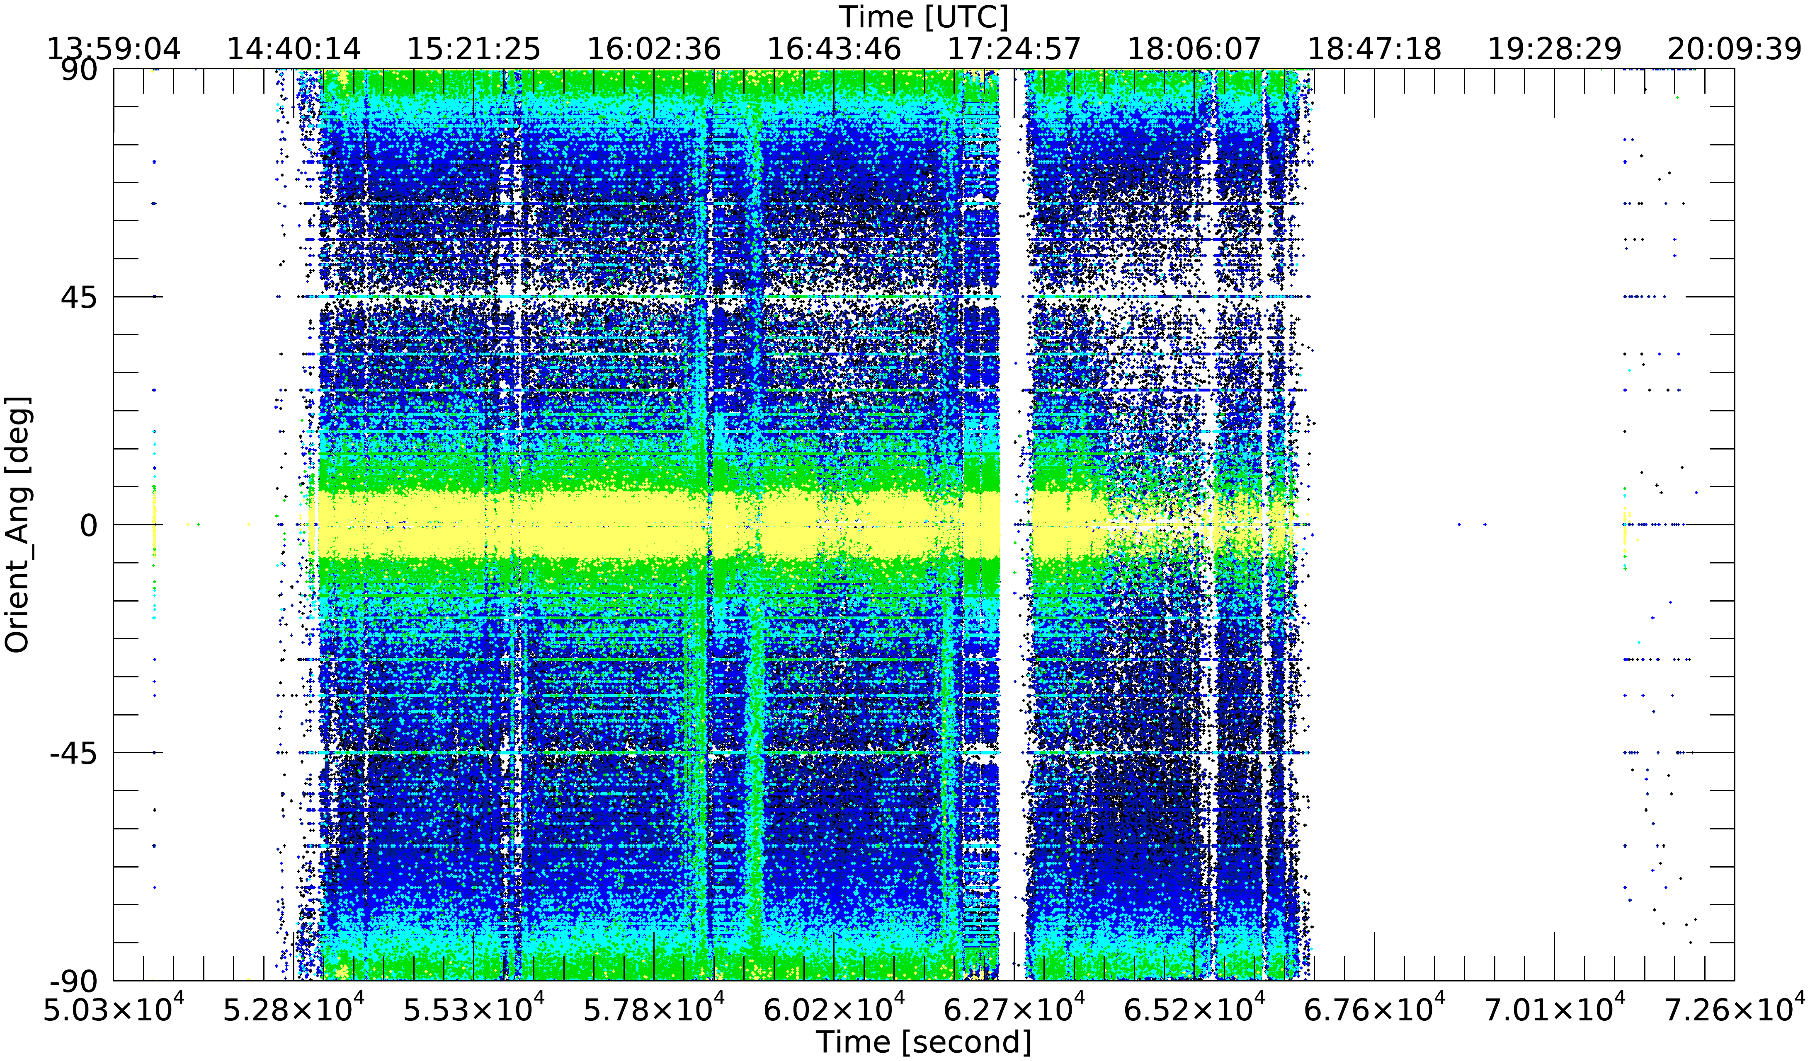
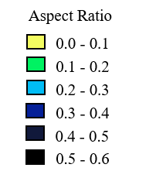
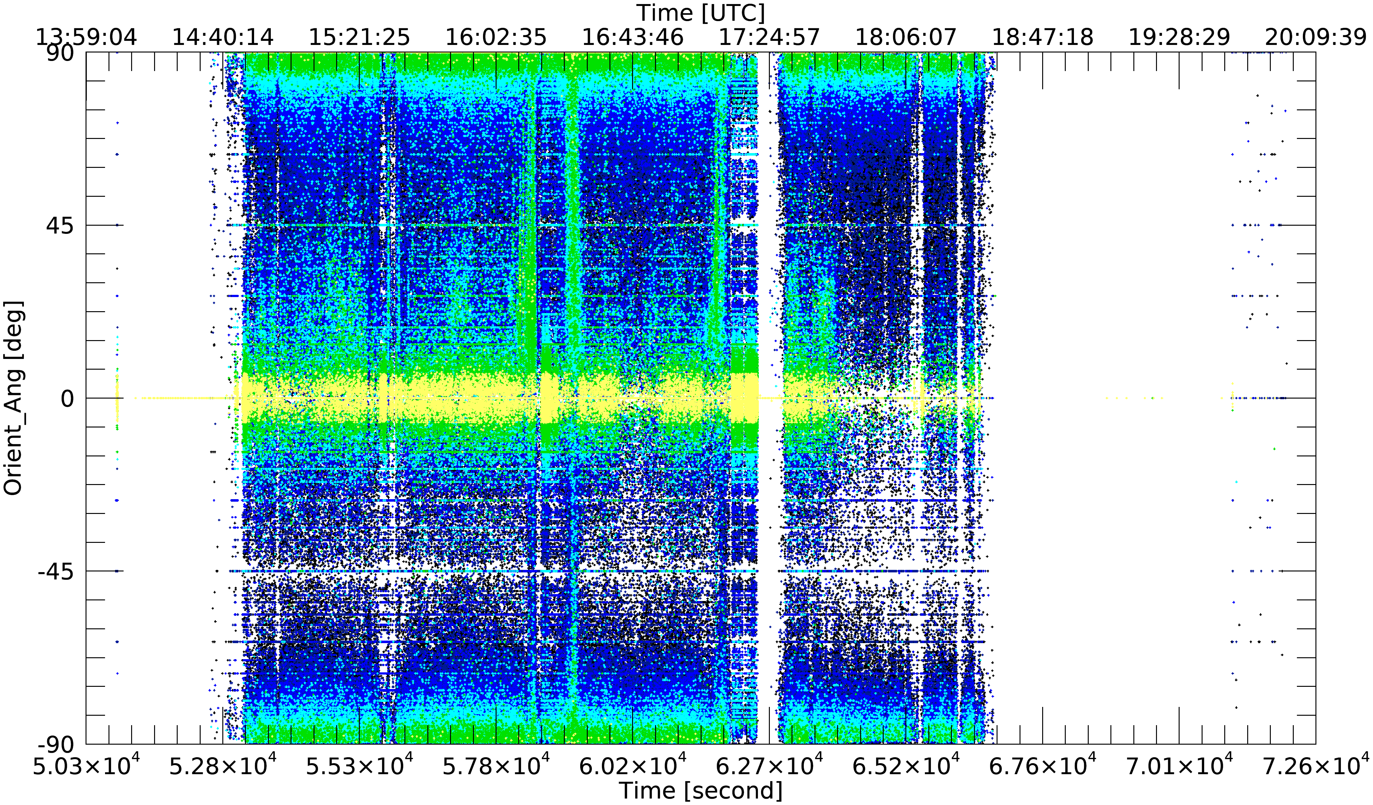
Time Series of 2D-S Orientation Angles
Horizontal Channel
90°
0°
(Before applying subset criteria)
-90°
90°
0°
Vertical Channel
-90°

Slide 15
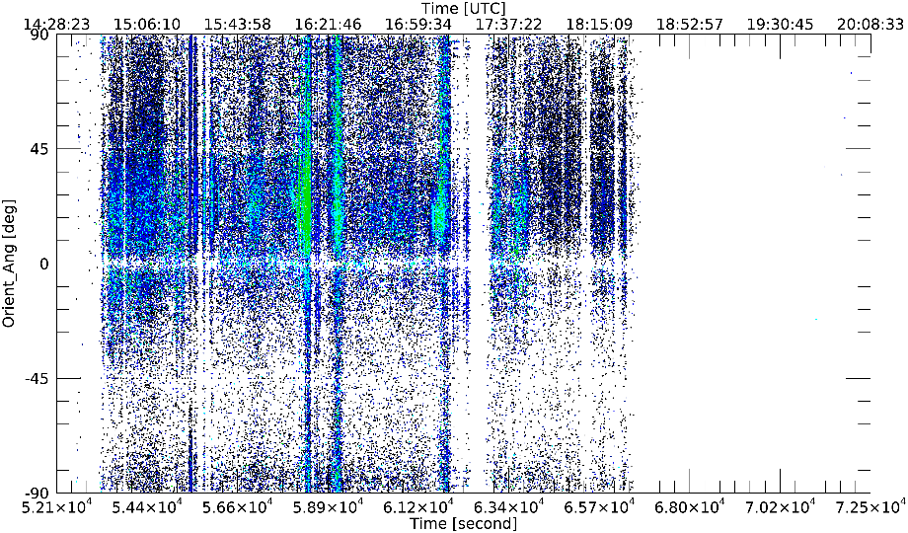
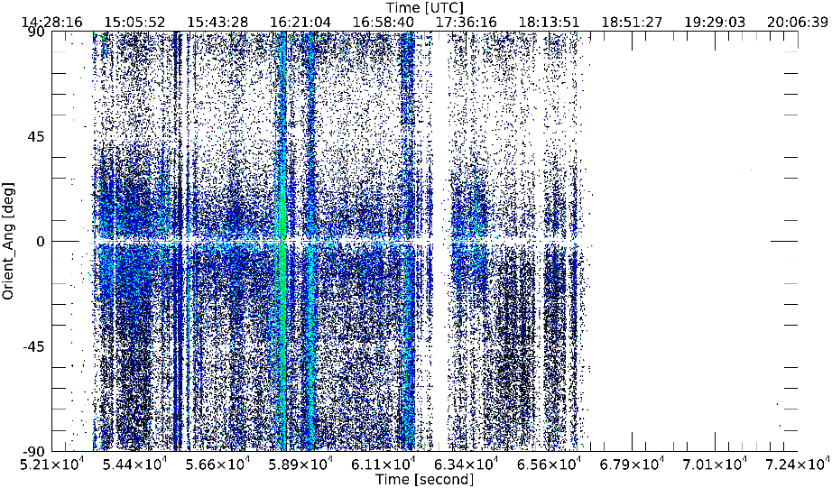
Time Series of 2D-S Orientation Angles
Horizontal Channel
90°
0°
(After applying subset criteria)
-90°
90°
0°
Vertical Channel
-90°

Slide 16
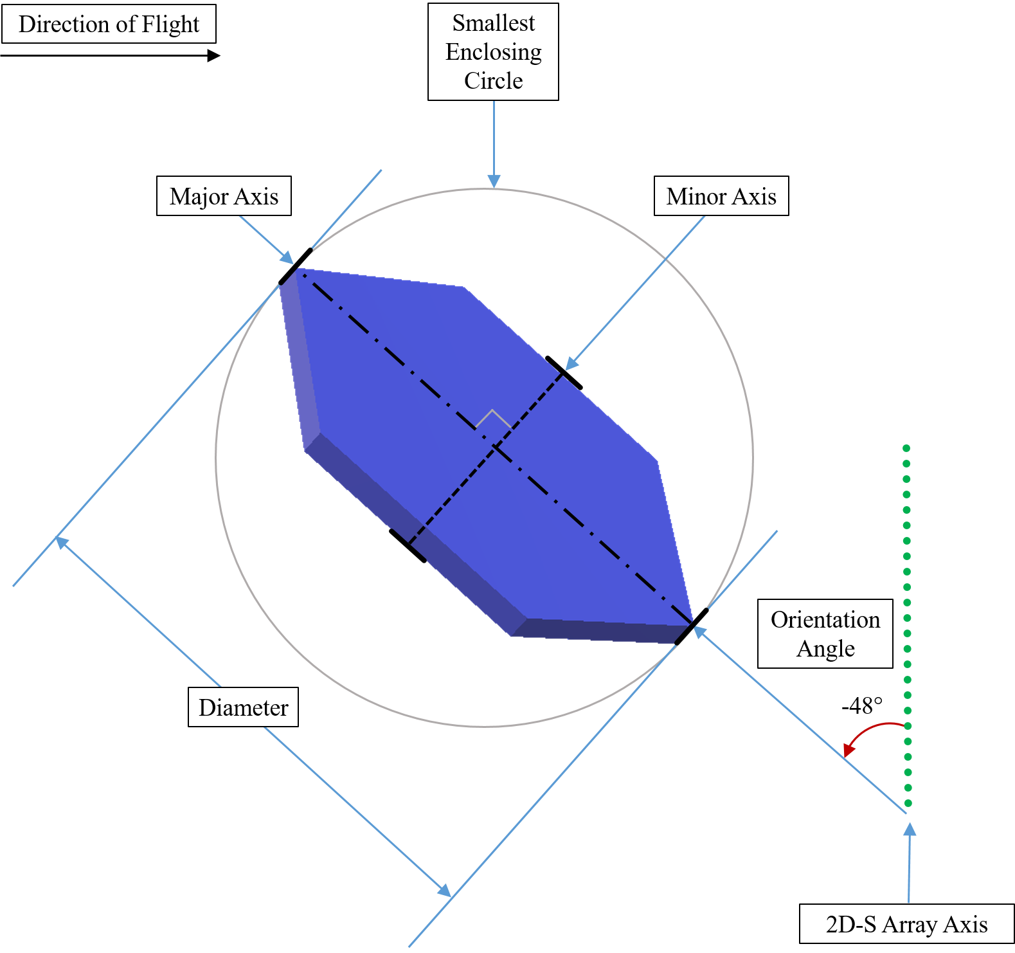


Subset Criteria
All-in particles
Diameters greater than 100 µm
Aspect ratios up to 0.6
Area ratios greater than 0.1
$$Aspect Ratio=\frac{Minor Axis of Particle Image}{Major Axis of Particle Image}$$
$$Area Ratio=\frac{Area of the Particle Image}{Area of the Bounding Circle}$$

Slide 17
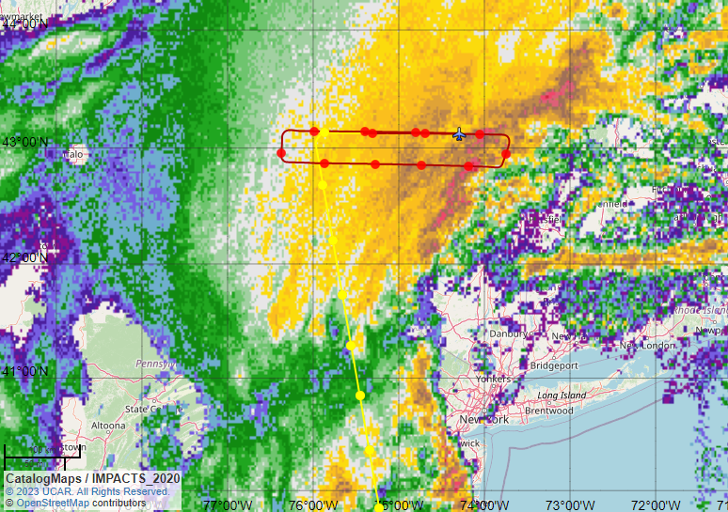
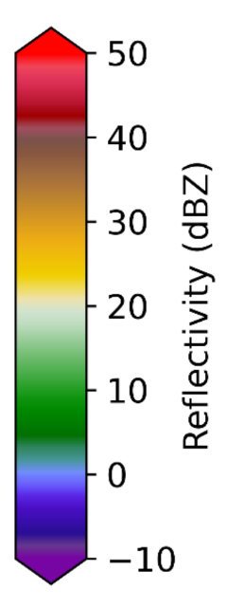
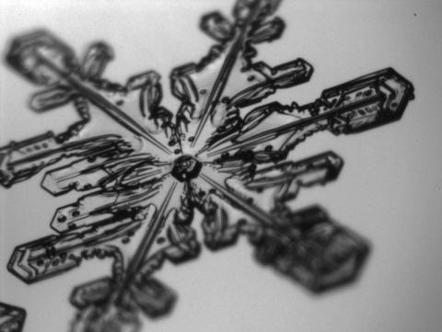
February 7th, 2020 Cases
PHIPS Image. Photo credit: Christian Nairy

Slide 18
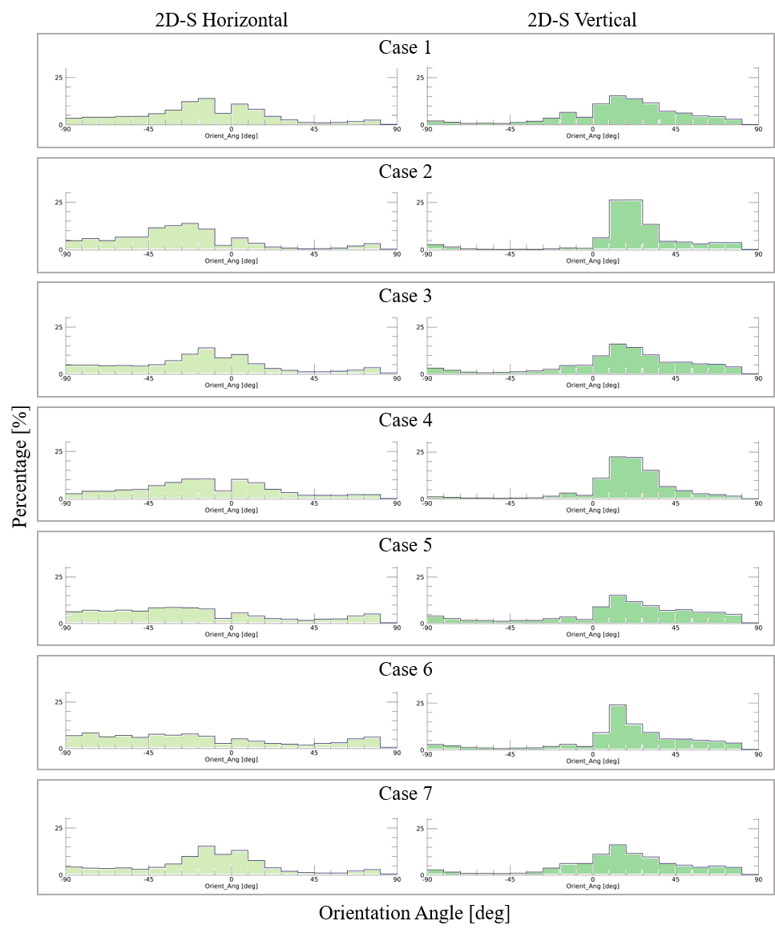
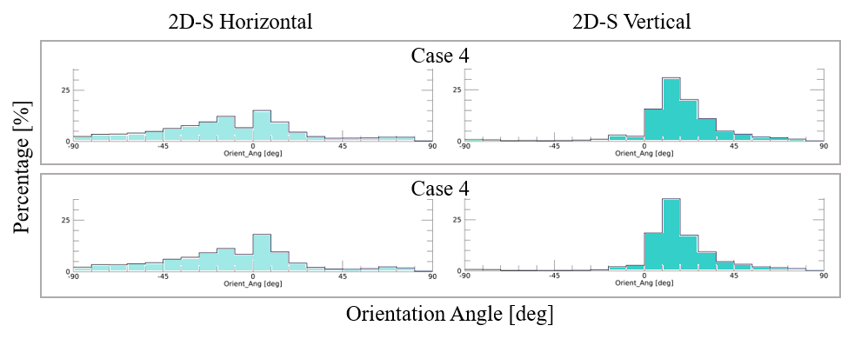
Orientation Angle Histograms
(V) consistently peaks near +21°
(V) peaks tend to be more prominent with columnar ice crystal cases
(H) more randomly distributed
(H) favors a modest peak near 0° (±30°) generally with plate crystal cases
(a)
(b)
Case 4 was further subset with an aspect ratio of
  0.1 to 0.4
  0.2 to 0.3

Slide 19
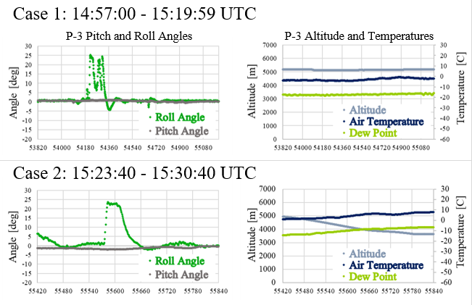
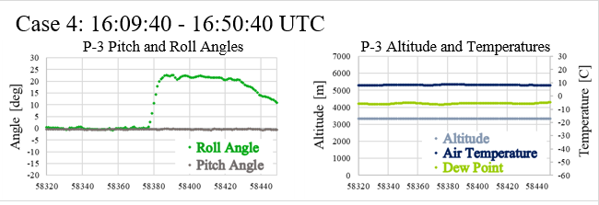
Aircraft Maneuvers within Cases
Objective: validate probe-measured ice crystal orientation
Hypothesis: if truly sensing atmospheric vertically oriented ice crystals, the histogram peak should shift during an aircraft banking turn
A select few cases were examined:
Case | ID | Maneuver
1 | a | Straight & Level
 | b | Banking Right
 | c | Banking Left
2 | a | Descending
 | b | Banking Right & Descending
 | c | Straight & Level
4 | a | Straight & Level
 | b | Banking Right

Slide 20
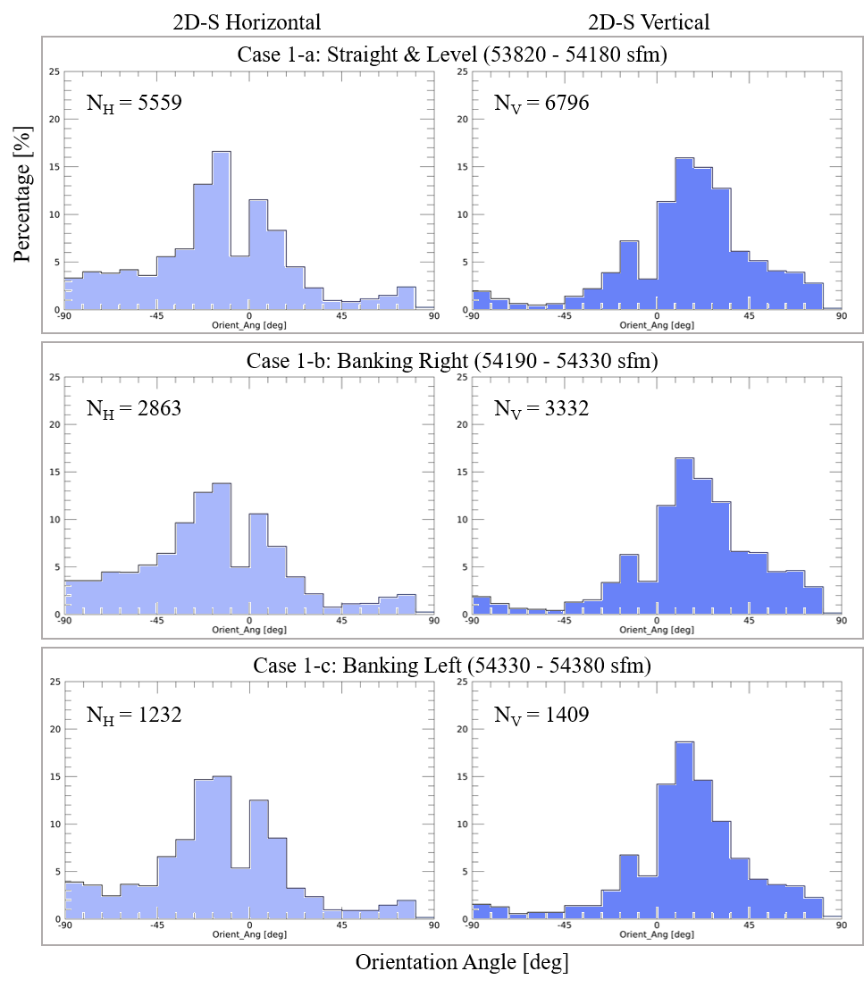
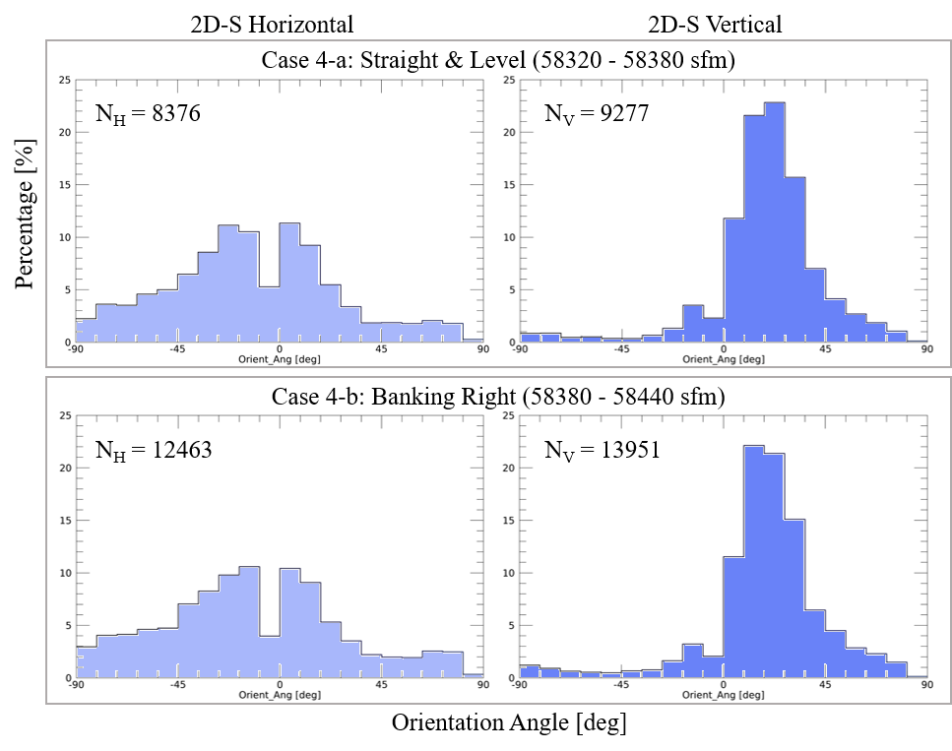
Aircraft Maneuver Comparisons from Cases 1 and 4

Slide 21
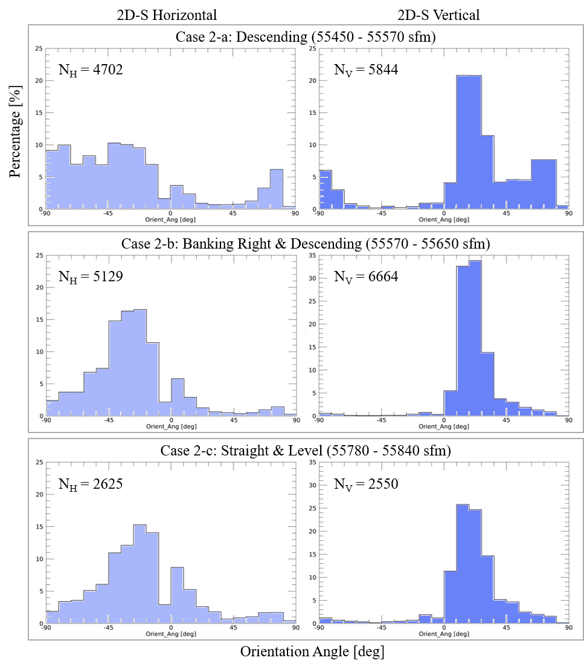
Aircraft Maneuver Comparisons from Case 2
Descending sub-case resulted in a wider distribution of negative orientation angles in the horizontal channel and multiple peaks in the vertical channel
Roll angle near zero
Pitch angle near zero
Nearly constant true air speed

Slide 22
Conclusions
Can ice crystal vertical orientations be observed through in situ measurements?
  Yes… but no
Can any relationship be drawn between ice crystal vertical orientations and cold season cloud top electric field charging?
  Nothing conclusive without additional measurements
Is there any relationship between ice crystal vertical orientations and periods of high particle concentration?
  Nothing conclusive due to misleading periods of high concentration
Key findings: the data collection method is problematic

Slide 23
Future Work
Change of aircraft
Speed runs, aircraft stalls
Direct EF measurement
Laboratory experiments isolating possible causes of vertical orientation
High Volume Precipitation Spectrometer (HVPS-3) dataset
Other cases/science flights
Reconstruction data processing method to include not all-in particles

Slide 24
References
Burrows, D. A., and J. L. Stith. “Alignment of Free Crystals Due to Transient Electric Fields.” Journal of Atmospheric and Oceanic Technology 3, no. 2 (June 1, 1986): 265–72. https://doi.org/10.1175/1520-0426(1986)003<0265:AOFCDT>2.0.CO;2.
Delene, D. J., 2011: Airborne Data Processing and Analysis Software Package, Earth Science Informatics, 4(1), 29-44, http://dx.doi.org/10.1007/s12145-010-0061-4, DOI: 10.1007/s12145-010-0061-4.
Foster, T. C., and J. Hallett. “Enhanced Alignment of Plate Ice Crystals in a Non-Uniform Electric Field.” Atmospheric Research 90, no. 1 (October 1, 2008): 41–53. https://doi.org/10.1016/j.atmosres.2008.02.017.
Foster, T. C., and J. Hallett. “The Alignment of Ice Crystals in Changing Electric Fields.” Atmospheric Research 62, no. 1 (May 1, 2002): 149–69. https://doi.org/10.1016/S0169-8095(02)00008-X.
Hogan, R. J., L. Tian, P. R. A. Brown, C. D. Westbrook, A. J. Heymsfield, and J. D. Eastment, 2012: Radar Scattering from Ice Aggregates Using the Horizontally Aligned Oblate Spheroid Approximation. https://doi.org/10.1175/JAMC-D-11-074.1.
Jiang, Z., J. Verlinde, E. E. Clothiaux, K. Aydin, and C. Schmitt, 2019: Shapes and Fall Orientations of Ice Particle Aggregates. Journal of the Atmospheric Sciences, 76, 1903–1916, https://doi.org/10.1175/JAS-D-18-0251.1.
King, W. D., 1986: Air Flow and Particle Trajectories around Aircraft Fuselages. IV: Orientation of Ice Crystals.
Kubicki, Marek, Anna Odzimek, and Mariusz Neska. “Relationship of Ground-Level Aerosol Concentration and Atmospheric Electric Field at Three Observation Sites in the Arctic, Antarctic and Europe.” Atmospheric Research 178–179 (September 1, 2016): 329–46. https://doi.org/10.1016/j.atmosres.2016.03.029.
Kumjian, M., 2013: Principles and applications of dual-polarization weather radar. Part III: Artifacts. J. Operational Meteor., 1, 265–274, https://doi.org/10.15191/nwajom.2013.0121.
Mach, Douglas M., Monte Bateman and Christopher Schultz.2022. Lightning Instrument Package (LIP) IMPACTS [February 7, 2020 Science Flight, V2]. Dataset available online from the NASA Global Hydrometeorology Resource Center DAAC, Huntsville, Alabama, U.S.A. DOI: http://dx.doi.org/10.5067/IMPACTS/LIP/DATA101

Slide 25
MacGorman, D. R., and W. D. Rust, 1998: The Electrical Nature of Storms. Oxford University Press, Inc., 422 pp.
MacPherson, J. I., and D. Baumgardner. “Airflow about King Air Wingtip-Mounted Cloud Particle Measurement Probes.” Journal of Atmospheric and Oceanic Technology 5, no. 2 (April 1, 1988): 259–73. https://doi.org/10.1175/1520-0426(1988)005<0259:AAKAWM>2.0.CO;2.
Magono, Choji, and Tsutomu Nakamura. “Aerodynamic Studies of Falling Snowflakes.” Journal of the Meteorological Society of Japan. Ser. II 43, no. 3 (1965): 139–47. https://doi.org/10.2151/jmsj1965.43.3_139.
McMurdie, L.A., Heymsfield, G., Yorks, J.E., and Braun, S.A. 2019. Investigation of Microphysics and Precipitation for Atlantic Coast-Threatening Snowstorms (IMPACTS) Collection [Full February 7, 2020 Dataset]. Data available online [http://ghrc.nsstc.nasa.gov/] from the NASA EOSDIS Global Hydrology Resource Center Distributed Active Archive Center, Huntsville, Alabama, U.S.A. doi: http://dx.doi.org/10.5067/IMPACTS/DATA101.
O’Brien, JR. “Sensitivity of Two-Dimensional Stereo (2DS) Probe Derived Parameters to Particle Orientation.” Accessed September 14, 2022. https://www.proquest.com/openview/70b4ce484f793eb78a63c1b474f4962e/1?pq-origsite=gscholar&cbl=18750.
Ryzhkov, Alexander V., and Dusan S. Zrnić. “Depolarization in Ice Crystals and Its Effect on Radar Polarimetric Measurements.” Journal of Atmospheric and Oceanic Technology 24, no. 7 (July 1, 2007): 1256–67. https://doi.org/10.1175/JTECH2034.1.
Schultz, C. J., and Coauthors, 2021: Remote Sensing of Electric Fields Observed Within Winter Precipitation During the 2020 Investigation of Microphysics and Precipitation for Atlantic Coast-Threatening Snowstorms (IMPACTS) Field Campaign. Journal of Geophysical Research: Atmospheres, 126, e2021JD034704, https://doi.org/10.1029/2021JD034704.
Stratton Park Engineering Company, 2011: 2D-S Technical Manual Rev. 3.1. http://www.specinc.com/sites/default/files/software_and_manuals/2D-S_Technical%20Manual_rev3.1_20110228.pdf (Accessed October 21, 2023).
Thomas, L., J. C. Cartwright, and D. P. Wareing, 1990: Lidar observations of the horizontal orientation of ice crystals in cirrus clouds. Tellus B, 42, 211–216, https://doi.org/10.1034/j.1600-0889.1990.00001.x-i1.
Weinheimer, A. J., and A. A. Few, 1987: The electric field alignment of ice particles in thunderstorms. Journal of Geophysical Research: Atmospheres, 92, 14833–14844, https://doi.org/10.1029/JD092iD12p14833.

Slide 26


Acknowledgements
IMPACTS science team, flight crews, and project managers who made it all possible
UND AtSci Faculty: Wanda, Sue, Matt Gilmore, Aaron Kennedy
Instruments research group, in particular: Joseph O’Brien, Nick Gapp, Christian Nairy, Jenn Moore, Greg Sova, and Trece Hopp
Weather career mentors and personal advocates Randy Tompkins, Paul Leidig, and Jason Patla
Colleagues and students at the 17th Operational Weather Squadron and the Joint Typhoon Warning Center for their encouragement and considerable patience
Thanks to everyone in attendance!
God for giving me the opportunity and ability to complete this work
My family and friends for their love and support
Dave, Mike, Jared, and Tony for much guidance and constructive feedback
Aaron Bansemer, NCAR for considerable assistance with 2D-S Data interpretation
Christopher Schultz and Douglas Mach, Marshall Space Flight Center for LIP data

Slide 27
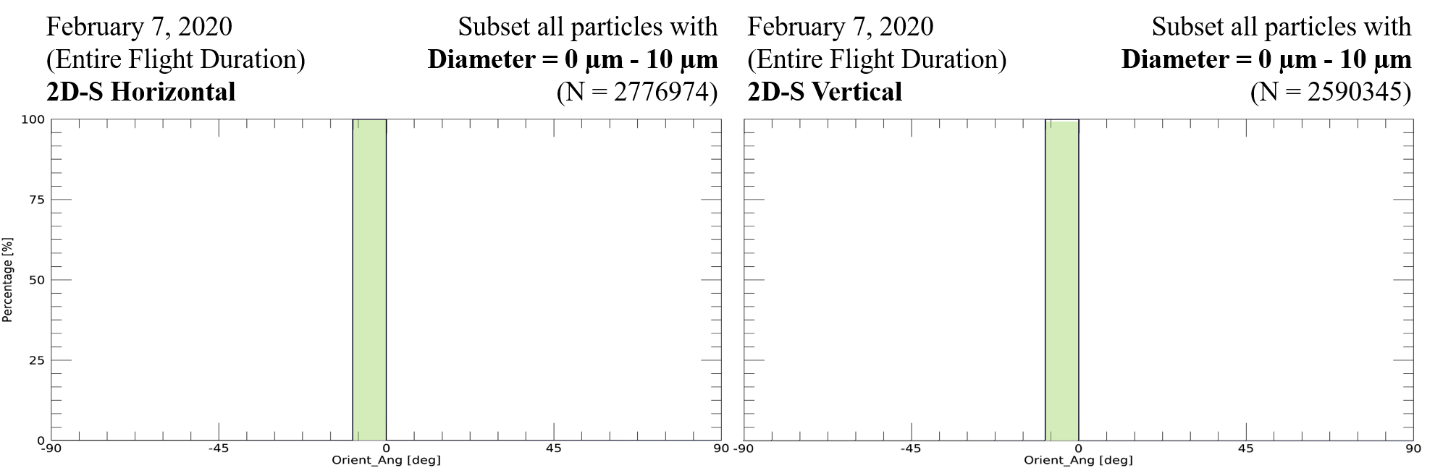
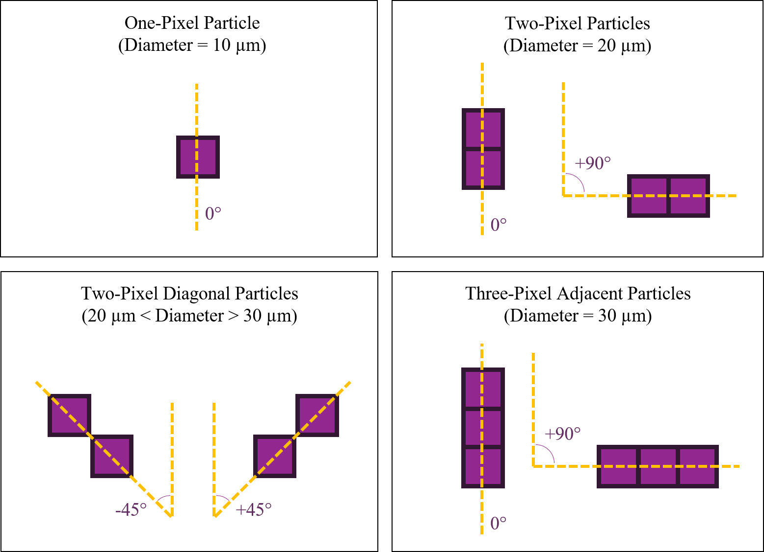
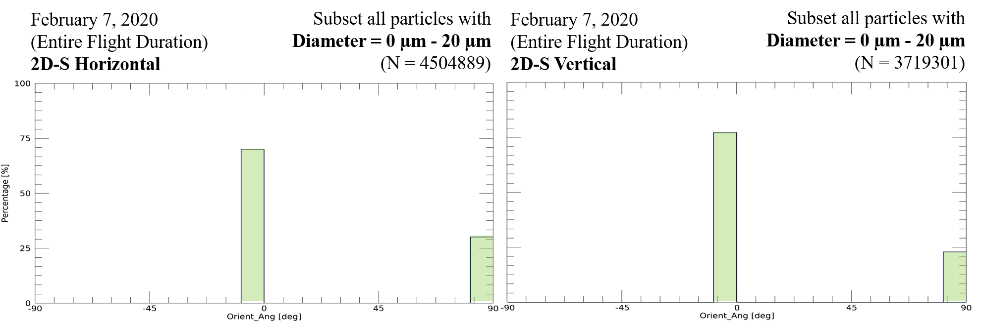
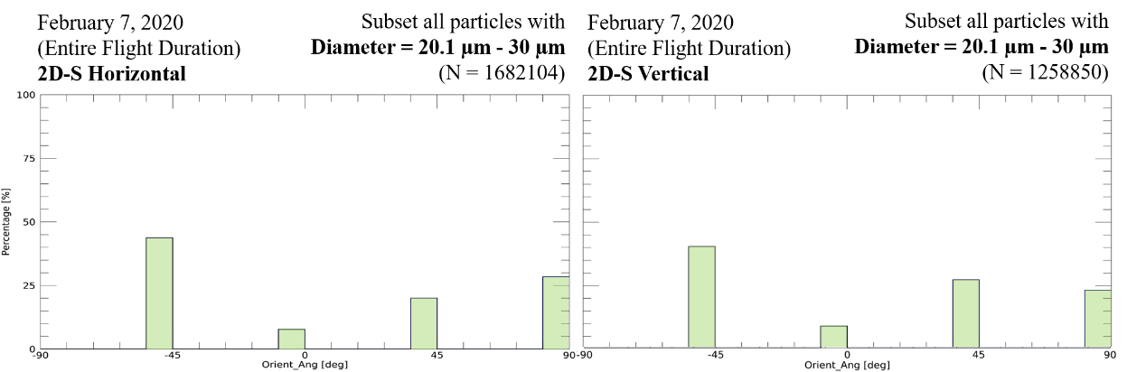
2D-S Orientation Angle Lower Limitations
(a)
(a)
(b)
(b)
(c)
(d)
(c)
(d)

Slide 28
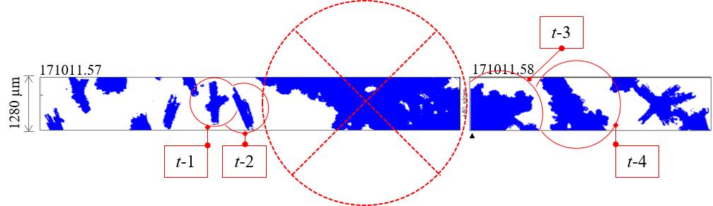
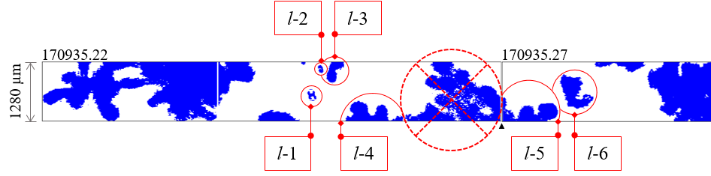
2D-S Buffer Wrapping Issue

Slide 29
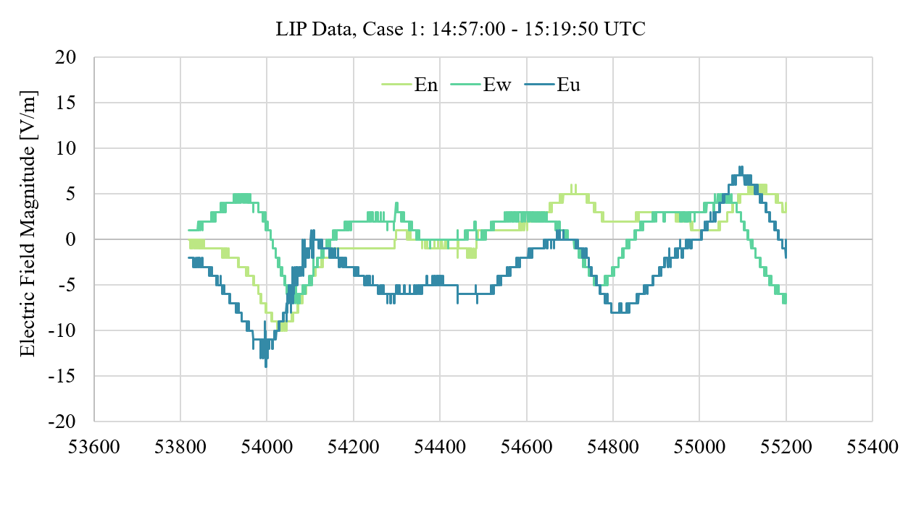
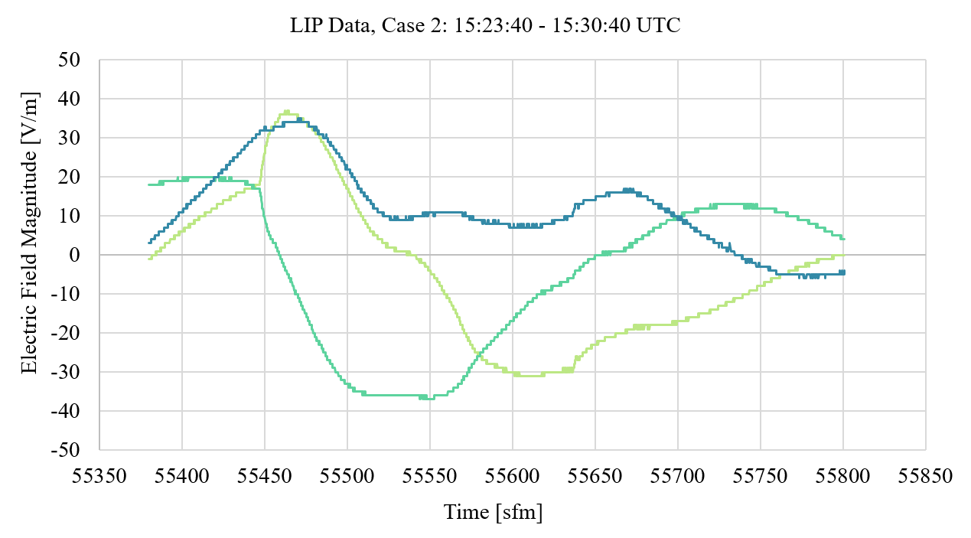
Lightning Instrument Package (LIP) Data

Slide 30
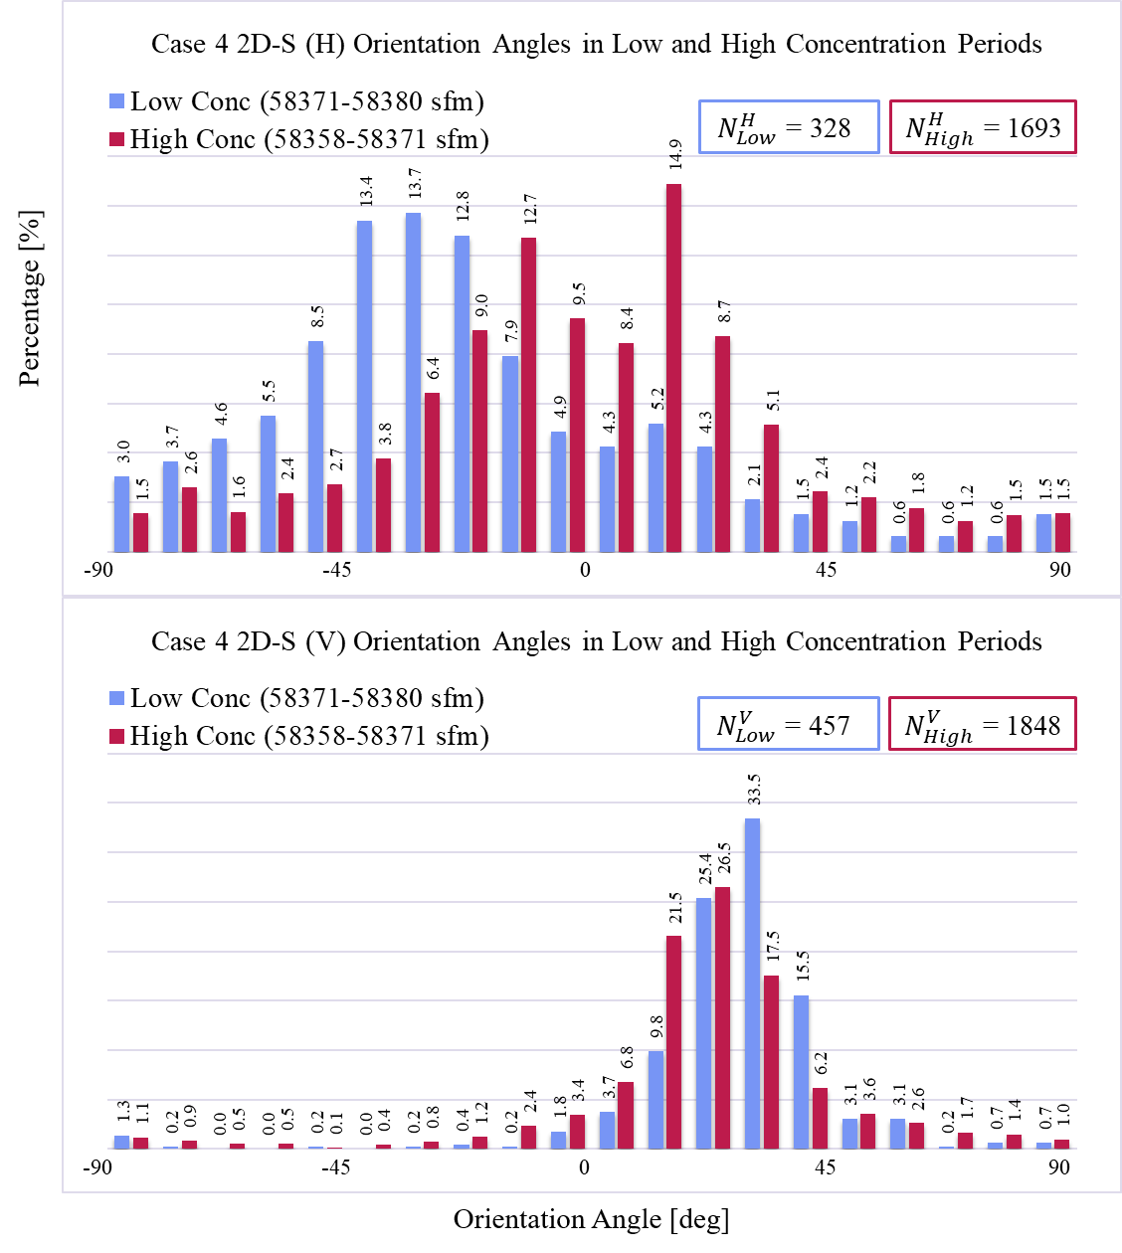
Low vs. High Concentration Periods (Case #4)
(H) orientation percentages at peak angles were similar between high and low concentration periods
However, there was an approximate shift of 30-40° from a peak near -36° in the low concentration period to a bimodal distribution centered around 0° in high concentration periods, with the highest orientation percentages near ±18°.
The vertical channel showed stronger orientation peaks during low concentration periods, with a preferred orientation angle that persisted even when concentration increased.

Slide 31
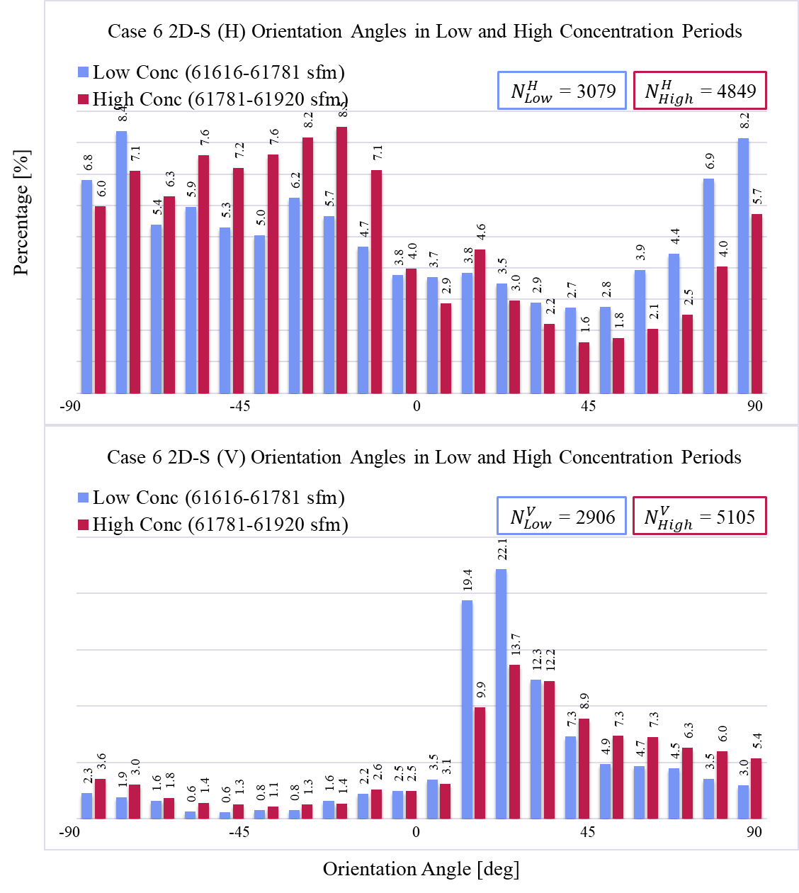
Low vs. High Concentration Periods (Case #6)
Columnar and needle aggregates
(H) more random distribution of orientation angles during periods of low concentration.
(H) in high concentration, increasingly asymmetrical.
(V) unexpectedly, a pronounced orientation peak appeared around +20° during low concentration intervals.
  While the peak orientation remained near this angle during high concentration, the intensity of the peak was markedly reduced, contradicting the initial hypothesis that orientation would remain stable regardless of concentration.

Slide 32
Cases

Slide 33
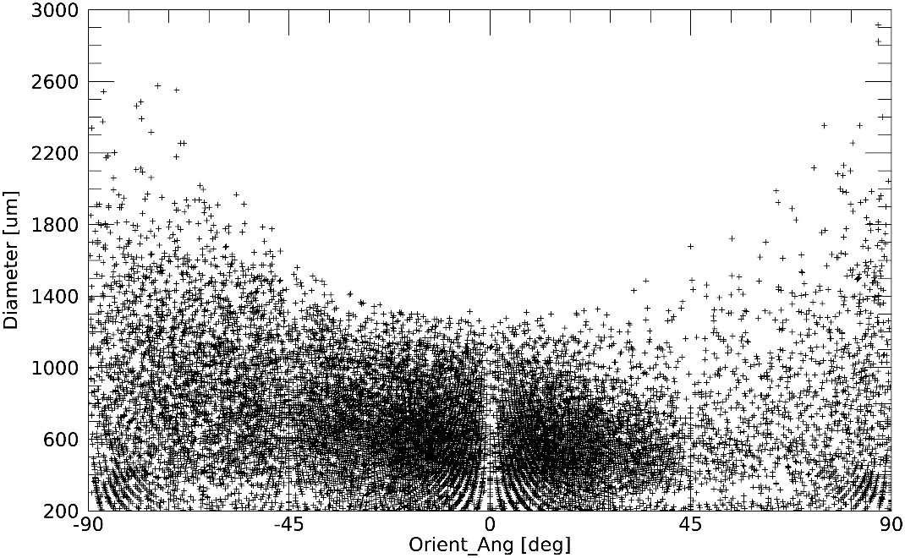



Case 01
Particle Size Distribution
Habit Classification: Plates
Time Segment: 14:57:00 (53820) - 15:19:59 (55199) UTC (sfm)
Particle Size Distribution
by 2D-S Orientation Angle
Particle Size Distribution
Time Series
2D-S Horizontal
N_{H} = 20816
2D-S Vertical
N_{V} = 24493

Slide 34




Case 02
Particle Size Distribution
Habit Classification: Columns
Time Segment: 15:23:40 (55420) - 15:30:40 (55840) UTC (sfm)
Particle Size Distribution
by 2D-S Orientation Angle
Particle Size Distribution
Time Series
2D-S Horizontal
N_{H} = 15007
2D-S Vertical
N_{V} = 18163

Slide 35




Case 03
Particle Size Distribution
Habit Classification: Plates, Plate Aggregates, Plates Fragments
Time Segment: 15:48:00 (56880) - 15:55:50 (57350) UTC (sfm)
Particle Size Distribution
by 2D-S Orientation Angle
Particle Size Distribution
Time Series
2D-S Horizontal
N_{H} = 5980
2D-S Vertical
N_{V} = 7179

Slide 36




Case 04
Particle Size Distribution
Habit Classification: Needles, Columns, Prisms
Time Segment: 16:09:40 (58180) - 16:15:40 (58540) UTC (sfm)
Particle Size Distribution
by 2D-S Orientation Angle
Particle Size Distribution
Time Series
2D-S Horizontal
N_{H} = 31575
2D-S Vertical
N_{V} = 35015

Slide 37




Case 05
Particle Size Distribution
Habit Classification: Column Aggregates
Time Segment: 16:22:00 (58920) - 16:28:20 (59300) UTC (sfm)
Particle Size Distribution
by 2D-S Orientation Angle
Particle Size Distribution
Time Series
2D-S Horizontal
N_{H} = 12988
2D-S Vertical
N_{V} = 13275

Slide 38




Case 06
Particle Size Distribution
Habit Classification: Columns, Needle Aggregates
Time Segment: 17:04:50 (61490) - 17:12:00 (61920) UTC (sfm)
Particle Size Distribution
by 2D-S Orientation Angle
Particle Size Distribution
Time Series
2D-S Horizontal
N_{H} = 9406
2D-S Vertical
N_{V} = 9830

Slide 39




Case 07
Particle Size Distribution
Habit Classification: Plates, Sectored Plates, Plate Aggregates
Time Segment: 17:29:25 (62965) - 17:36:35 (63395) UTC (sfm)
Particle Size Distribution
by 2D-S Orientation Angle
Particle Size Distribution
Time Series
2D-S Horizontal
N_{H} = 3213
2D-S Vertical
N_{V} = 3760

Slide 40




Case 08
Particle Size Distribution
Habit Classification: Plates, Prisms
Time Segment: 17:36:36 (63396) - 17:43:40 (63820) UTC (sfm)
Particle Size Distribution
by 2D-S Orientation Angle
Particle Size Distribution
Time Series
2D-S Horizontal
N_{H} = 2833
2D-S Vertical
N_{V} = 3326

Slide 41




Case 09
Particle Size Distribution
Habit Classification: Plates Aggregates, Columns, Prisms, Plates
Time Segment: 17:46:00 (63960) - 18:07:20 (65240) UTC (sfm)
Particle Size Distribution
by 2D-S Orientation Angle
Particle Size Distribution
Time Series
2D-S Horizontal
N_{H} = 8243
2D-S Vertical
N_{V} = 9678

Slide 42




Case 10
Particle Size Distribution
Habit Classification: Rimed Plate Aggregates. Rimed Columns, Plate Aggregates, Columns, Prisms
Time Segment: 18:11:30 (65490) - 18:21:17 (66077) UTC (sfm)
Particle Size Distribution
by 2D-S Orientation Angle
Particle Size Distribution
Time Series
2D-S Horizontal
N_{H} = 4744
2D-S Vertical
N_{V} = 5646

