Slide 1
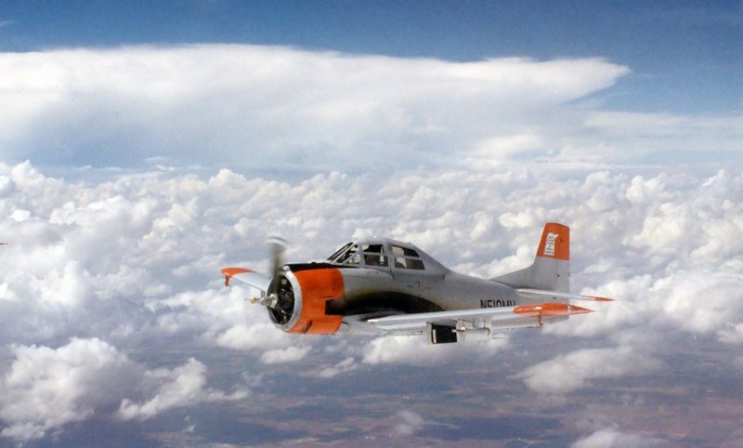
Evaluating Hail Spectrometer Data Quality and Uncertainty for Calculating Radar Reflectivity
November 17th, 2025
James Klinman
Photo provided by Tom Warner
Notes:
Thank you all for coming
Excited to share what I’ve been working on
And the title is

Slide 2
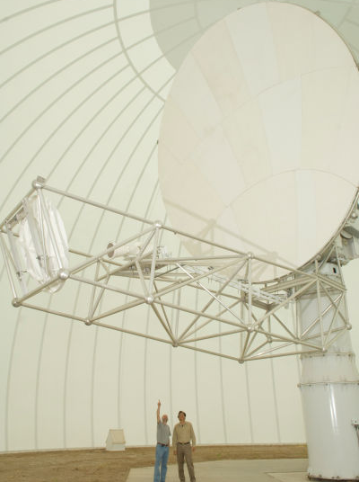
Project Introduction
Particle Size Distributions
Evaluating Data Quality
Reflectivity Comparisons
Annually, hail causes ~1.433 billion USD in damage to crops within the US (Changnon et al., 2009)
Improved understanding will help forecasts and modeling of hail
Photo provided by Tom Warner
Photo by Jim George
2
Notes:
Background on this project…
Long running field campaign 1970 – 2003… we focus on data from later 1995-2003
Aircraft collected in-situ measurements ….. Ground based radar
Time/space synchronous
Dataset is unique
No future plans
All we have to work with
So, hail causes damage
Motivation is to improve physical understanding of hail, which could ultimately improve forecasts and models of hail

Slide 3
Project Introduction
Particle Size Distributions
Evaluating Data Quality
Reflectivity Comparisons
Research Objectives
Research group objective
Compare T-28 aircraft in-situ measurements of hail with CSU-CHILL radar observations.
UND specific objectives
  Assess the data quality of Optical Array Probe (OAP) measurements.
  Assess uncertainty in using T-28 in-situ data for calculating radar signatures such as reflectivity.
3

Slide 4
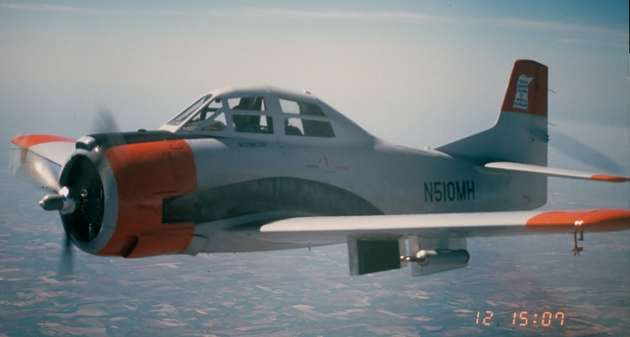
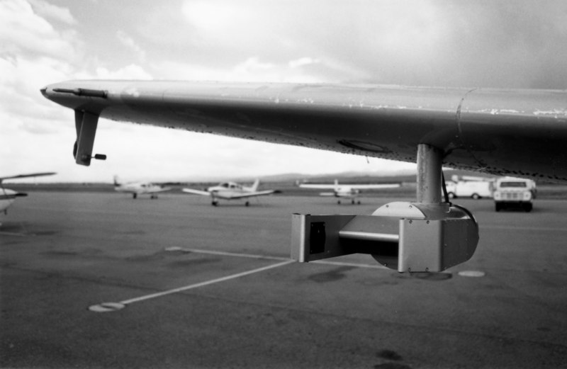
Project Introduction
Particle Size Distributions
Evaluating Data Quality
Reflectivity Comparisons
The T28 Aircraft,
  Could fly through hail up to 7.5 cm
  14 flights are used
  Housed two optical array probes for multiple flights
Hail Spectrometer
Photo provided by Tom Warner
High Volume Particle Spectrometer v1
Photo provided by Tom Warner
4
Notes:
More background on t-28
7.5 cm
We are using 14 flights, 5 campaigns, 4 unique years
Two OAPs
Hail Spec
Hail spec is primary probe, operational for entirety of all 14 flights
However, no de-icing
HVPS would often crash in with high numbers of particles
Key difference,
Hail spec does not de-ice, developed in 1970
HVPS a developed a couple of decades later, can de-ice
Can use HVPS to verify hail spec, but hail spec is required for quantitative analysis.

Slide 5
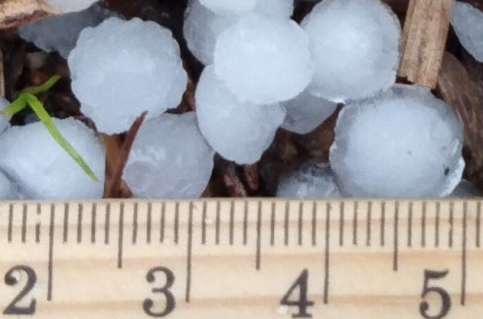
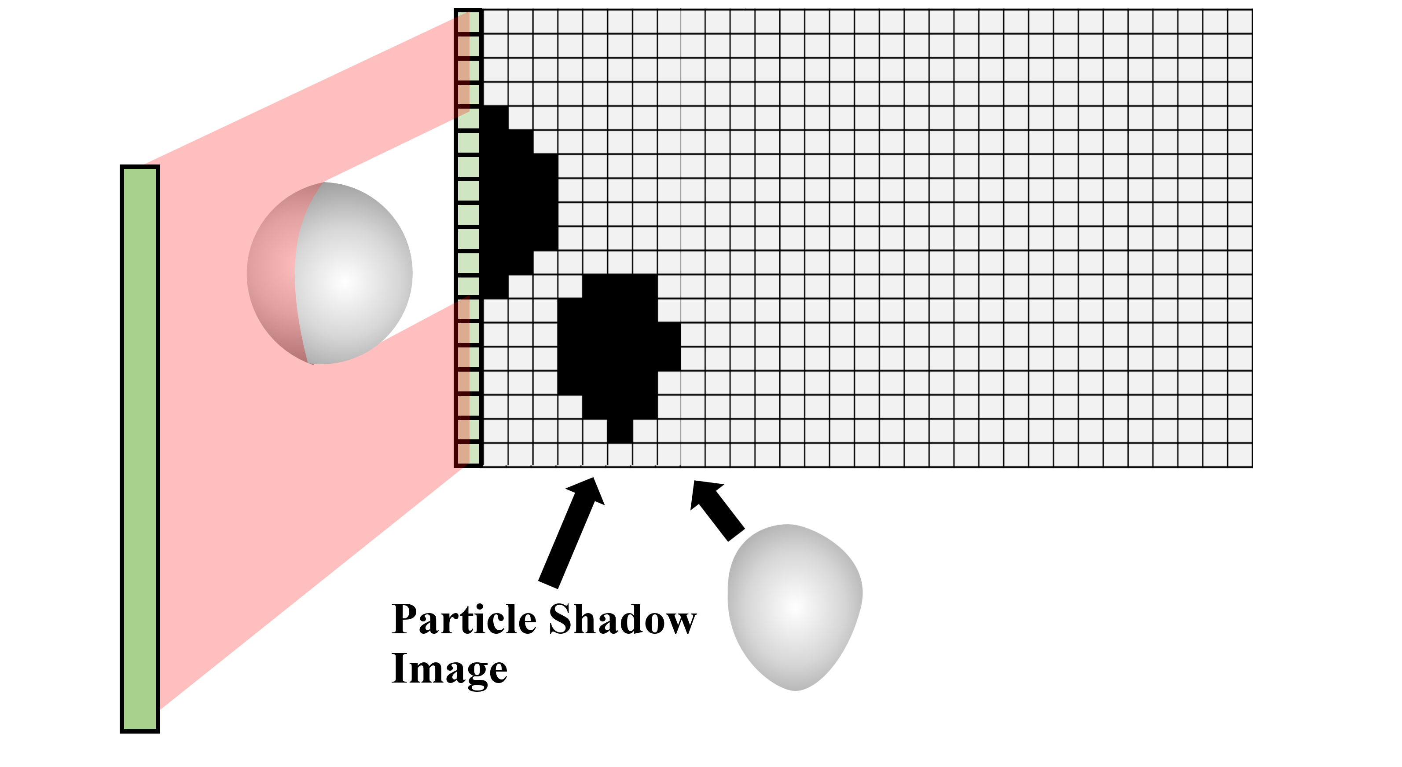
Project Introduction
Particle Size Distributions
Evaluating Data Quality
Reflectivity Comparisons
The Hail Spectrometer recorded data in two ways,
    By sizing particles in real time and saving counts (1D counts)
    By saving image buffers which can be later processed (2D images)
Circle size: 7.3 mm
X-size: 6.3 mm
Flight Direction
Airflow
Example of 1 second of Hail Spectrometer 1D particle counts
Size (mm) | 4.5 | 5.5 | 6.5 | 7.5 | 8.7 | 10.2 | 12.0 | 14.3 | 17.1 | 20.1 | 23.9 | 29.1 | 36.0 | 45.0
Counts | 4 | 10 | 1 | 10 | 33 | 37 | 8 | 4 | 1 | 1 | 1 | 1 | 1 | 0
5
Notes:
Probe operation by shining laser on diode array. Casts shadow.
Remember, 2D shadows of 3D particles
Two ways shadows are handled and recorded
1970-2003, real-time with 1D sizing method (uniquely shadowed diodes)
Once particle passes through, data is processed in sizing algorithm.
Size is recorded as a count (7 pixels or 6.3mm)
Table below, counts accumulated into 1 second (10 cubic meters)
1D COUNTS, DATA ,ETC
Starting in 1995, upgraded to save 2D images in addition to the counts
Images can be processed at a later date
Images stored in a image buffer.
As shown no deadspace recorded
Can make use of 2D processing methods
Such as 5 sizing methods
Xsize basically 1D sizing style
Circle size is if you draw circle
For both the 1D and 2D sizing methods, if a particle touches the edge, it’s assumed to not be fully imaged, and is thus discarded

Slide 6
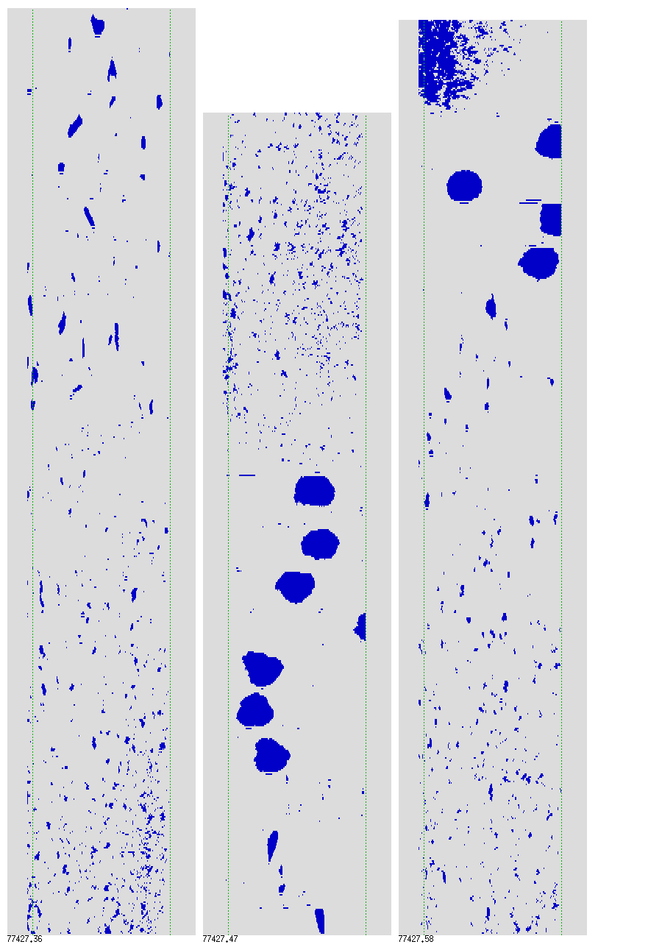
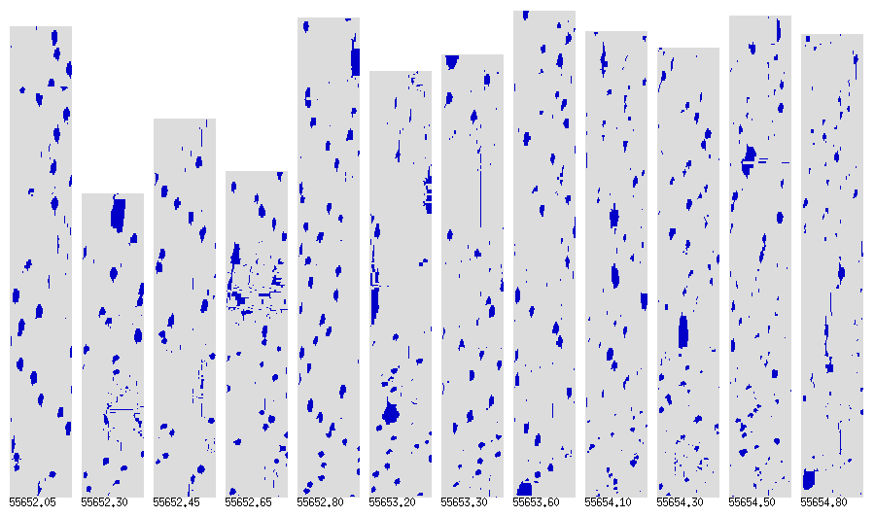
Project Introduction
Particle Size Distributions
Evaluating Data Quality
Reflectivity Comparisons
Shown are two image buffers.
High Volume Particle Spectrometer (HVPS)
Hail Spectrometer
3.7 cm
5.7 cm
Airflow
Airflow
Size (mm) | 4.5 | 5.5 | 6.5 | 7.5 | 8.7 | 10.2 | 12.0 | 14.3 | 17.1 | 20.1 | 23.9 | 29.1 | 36.0 | 45.0
Counts | 4 | 10 | 1 | 10 | 33 | 37 | 8 | 4 | 1 | 1 | 1 | 1 | 1 | 0
6
Notes:
Res of .9 to .2 mm
Blocky
Remember that HVPS frequently crashed, so have to rely on lower resolution images
Processed using SODA, which enables processing across the whole dataset
Blob finding mechanism to identify particles.
Distinctly 2D

Slide 7
Project Introduction
Particle Size Distributions
Evaluating Data Quality
Reflectivity Comparisons
The sample area determines how many particles will be observed
Sensor length
Arm width
$$Sensor length ×Arm width =Sample area$$
7
Notes:
Sample area is important! Determines how many particles are observed
Simple, just l x w
The larger the sample area, the higher the chance a particle passes through and is fully imaged

Slide 8
Project Introduction
Particle Size Distributions
Evaluating Data Quality
Reflectivity Comparisons
The sample area determines how many particles will be observed
HS sample area
                0.1040 m²
        0.0520 m²
      HVPS sample area
      0.0074 m²
$$Sensor length ×Arm width =Sample area$$
One-dimensional (1D) Setup
Hail Spectrometer (HS)
11.5 cm
90 cm
Two-dimensional (2D) Setup
5.7 cm
High Volume Particle Spectrometer (HVPS)
90 cm
HVPS1 Setup
3.8 cm
20 cm
8
Notes:
Two HS sample areas
128 diodes, 11.5 cm
64 diodes
2D buffer size is an electronic limitations. Can only save so much data before they have to dump it and record more data
So…. 2D setup only records half the particles that pass through the Hail Spectrometer sample area
And remember what I said about rejecting anything that touching the edge,
This is disproportionately impacted with the 2D sample area which means large particles are less likely to be fully imaged.
We’re studying hail so we’re interested in large particles.
HVPS
Small
About 7x and 14x
The sample areas are scaled relative to each other.

Slide 9
Project Introduction
Particle Size Distributions
Evaluating Data Quality
Reflectivity Comparisons
Research Objectives
Research group objective
Compare T-28 aircraft in-situ measurements of hail with CSU-CHILL radar observations.
UND specific objectives
  Assess the data quality of Optical Array Probe (OAP) measurements.
  Assess uncertainty in using T-28 in-situ data for calculating radar signatures such as reflectivity.
9
Notes:
So, that’s an introduction to the data
What do we send to our collaborators so that they can calculate reflectivity
PSDs!!!

Slide 10
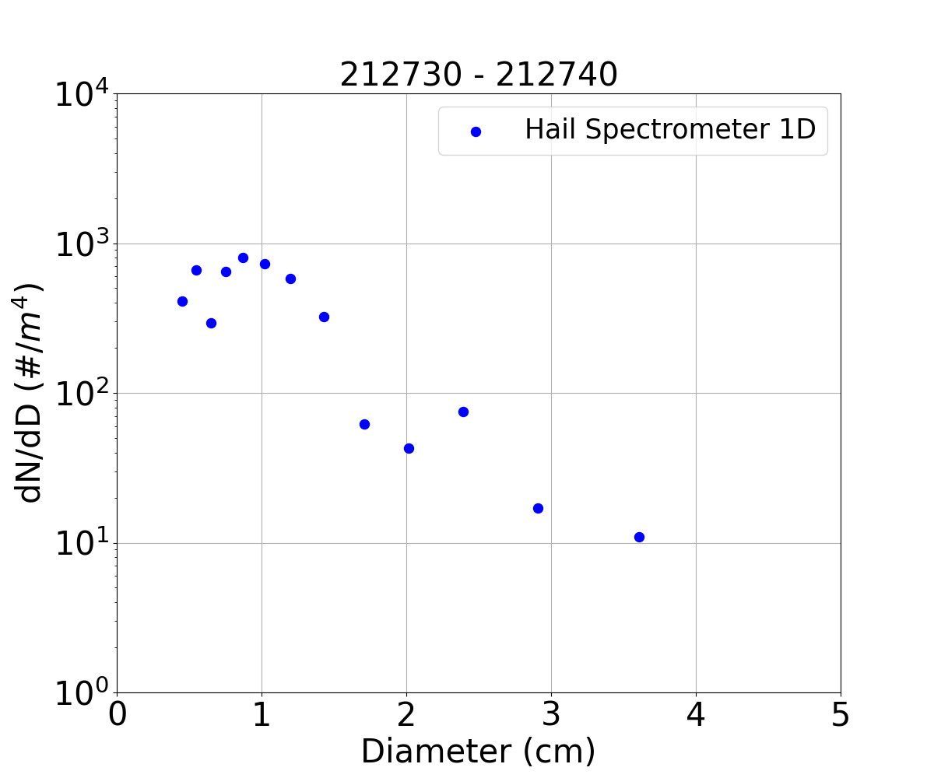


Project Introduction
Particle Size Distributions
Evaluating Data Quality
Reflectivity Comparisons
Particle size distributions (PSDs) are used to calculate reflectivity
  Count distribution
  Sample volume
  Channel width
$$\frac{dN}{dD}=\frac{N(D)}{V∗∆D}$$
PSD:
Sample volume (V)
Particle counts (N(D))
Size (mm) | 4.5 | 5.5 | 6.5 | 7.5 | 8.7 | 10.2 | 12.0 | 14.3 | 17.1 | 20.1 | 23.9 | 29.1 | 36.0 | 45.0
Counts | 4 | 10 | 1 | 10 | 33 | 37 | 8 | 4 | 1 | 1 | 1 | 1 | 1 | 0
Channel width ($∆$D)
Width (mm) | 1.0 | 1.0 | 1.0 | 1.0 | 1.4 | 1.6 | 2.0 | 2.6 | 3.0 | 3.1 | 4.4 | 6.0 | 7.9 | 10.0
10
Notes:
PSD defined as…
ND,
SV 100m/s… 100 m or 1000m
Will account for different sample areas between the 1D and 2D data.
Channel width… notice that the width increases with larger particles
This is to account for the rapidly decreasing number of large particles relative to small particles.
As diameter increases, the concentration decreases, so we increase channel width to gets more counts into the bins and thus less uncertaint
THIS IS WHAT NORMALIZES IT… bc the bin widths are changing
So, here’s a PSD
Small particles have a higher concentration
Note logarithmic yscale
Exponential distribution
1d data is already in counts, so easy to start with
But now what about 2d data

Slide 11
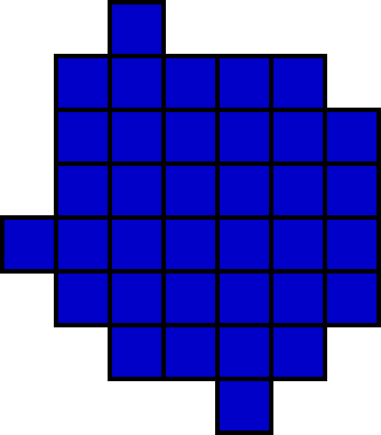
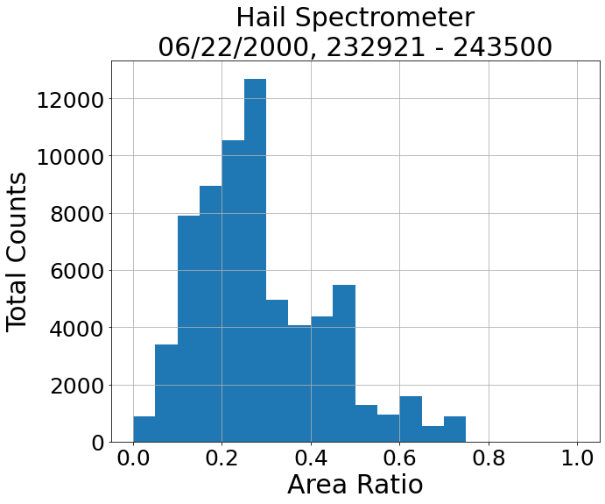
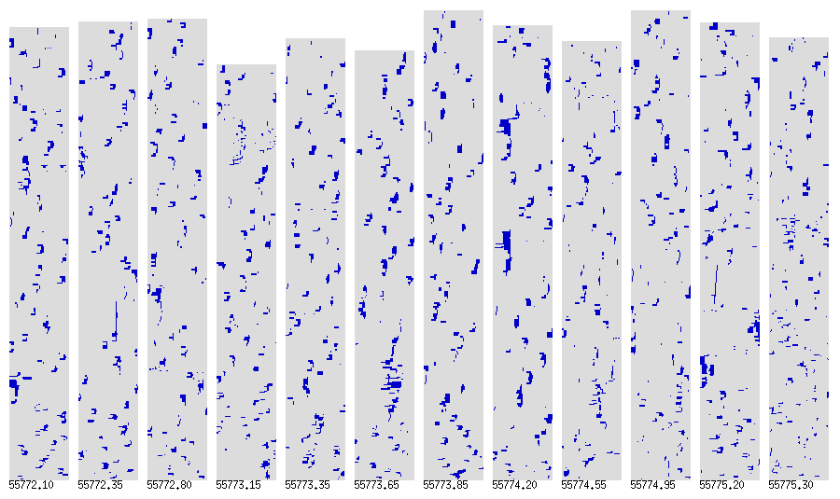
Project Introduction
Particle Size Distributions
Evaluating Data Quality
Reflectivity Comparisons
For the 2D PSDs, we need,
Particle size
Area ratio
  Area of the shadowed diodes to the area of the smallest enclosing circle
  The primary rejection criterion
Area of,
Circle = 43.57 um²
Pixels = 29.16 um²
Area ratio = 0.67
11
Notes:
Particle size, let’s use x-size method since close match. Want to evaluate 1D vs 2D data
Area ratios
Measures how “filled in” or “well-defined” a particle image is.
Higher area ratio = well defined particle
Low area ratio suggests noise, streaks, breakup, artifacts
Primary… Convenient particle attribute to use when processing hundreds of thousands of particles
Will inform us what particles are “good” data and which are noise or unrecoverable
Top buffer
Well defined particles, so high quality images
Bottom buffer
Just 1 minutes later … ?maybe icing, or electronic noise
Bottom line, particles have holes, or are less well defined overall
Can be hard to call particles or know what to do with them
Dataset wide, low to medium quality images are make up most of the dataset
medium to low is primary data, so need to figure out how we can use it (area ratio) to distinguish between real particle or if it’s Thrown out because of icing, electronic noise, or shattered particles off the tips
Good psrticle, keep in mind area ratio of 0.67,
When plotted for while flight, majority lie below 0.3 then a steep difference, with another steel difference at 0.5
Both are interesting to consider
Keep this in mind, but 0.5 would remove most of the dataset and results in PSDs that aren't filled

Slide 12
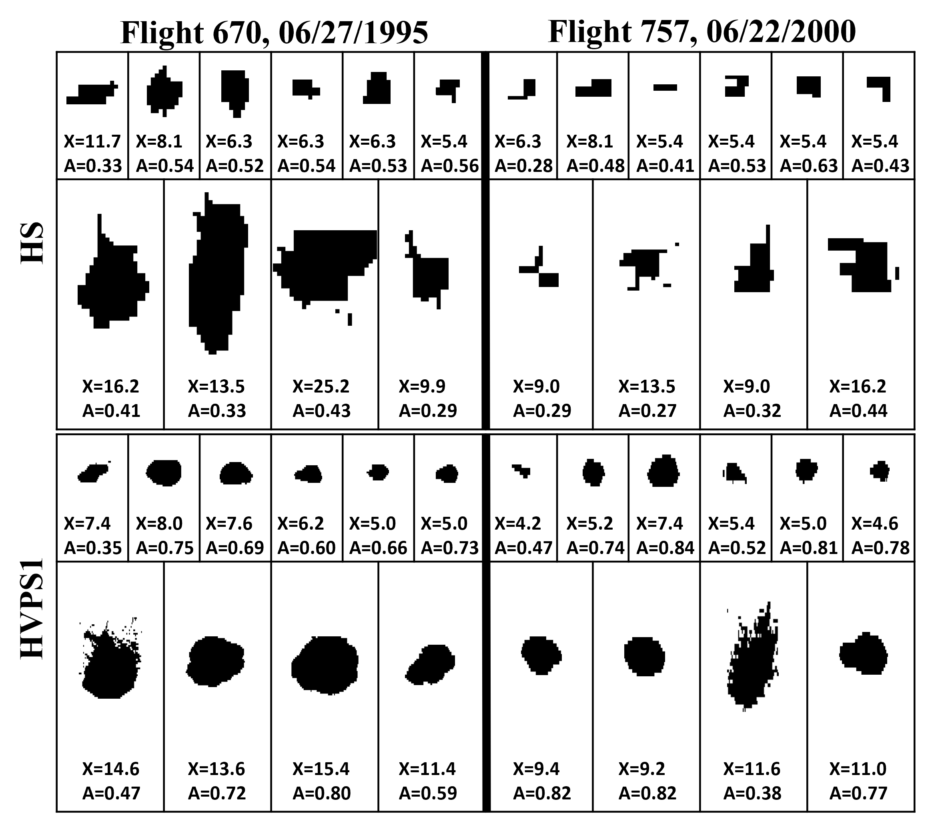
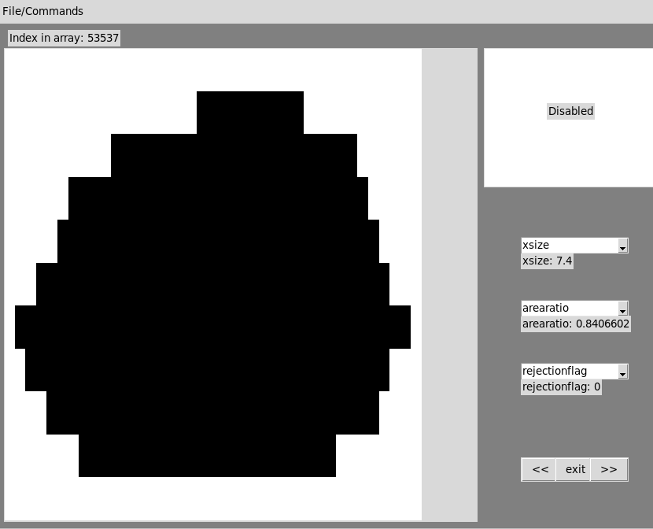
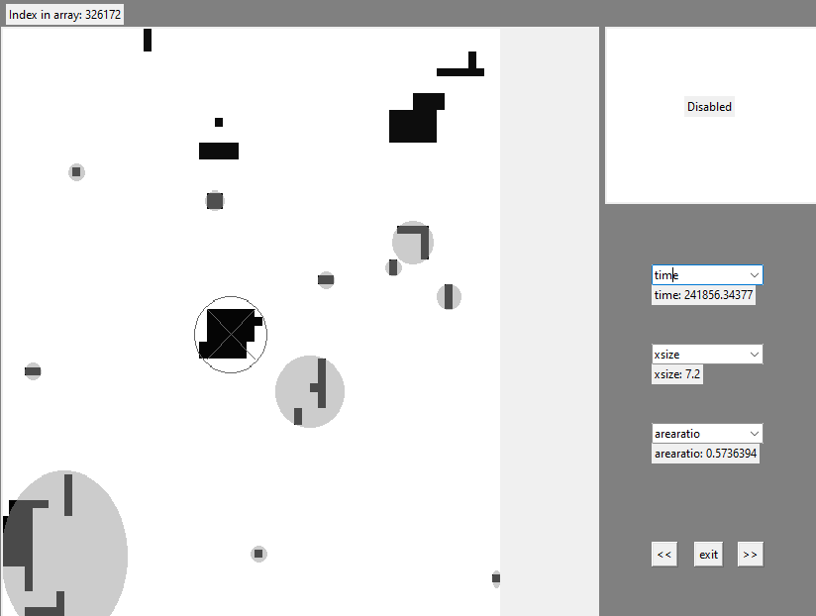
Project Introduction
Particle Size Distributions
Evaluating Data Quality
Reflectivity Comparisons
Qualitative inspection of individual particles is required to,
Provide confidence in area ratio threshold
Assess image quality overall
Hail Spectrometer
HVPS1
Legend:
X = x-size diameter (mm)
A =Area ratio
12
Notes:
To out 0.3 and 0.5 into context
Large quantity of particles analyzed
Shown in image is a small selection
For the hail soec, which is top two rows, across two flights renting from high to low quality images, here are some examples of particles below 0.3
Can see that they have tails, might be fragmented, are slightly stealing… etc
But the rest are above 0.3.
Large particles tend to be below 0.5 due to their somewhat unique shapes,
Small particles tend to just become squares and rectangles
When doing this for a lot of particles
0.5 would keep the best particles, but remove most the data
0.3 retains enough data to work with, but may include questionable particles that have a large sizing uncertainty
Since we're using 0.3, and some of the images are questionable, I want to show you that these images are at least based on real particles

Slide 13
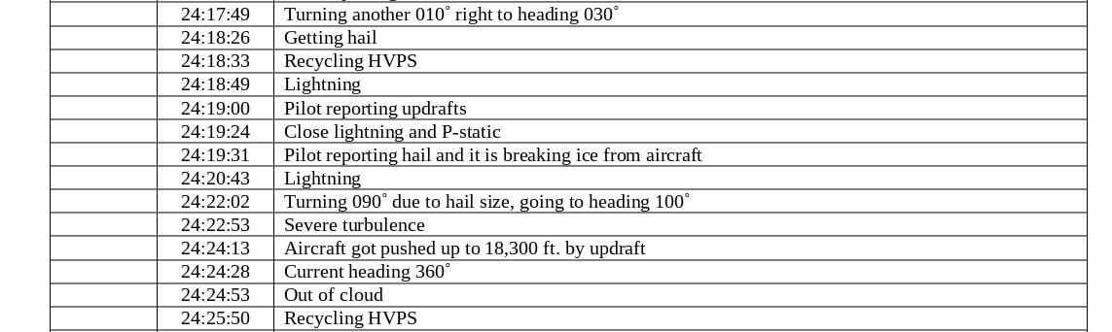
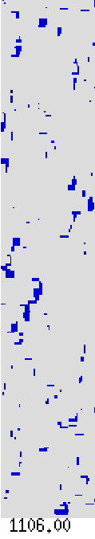
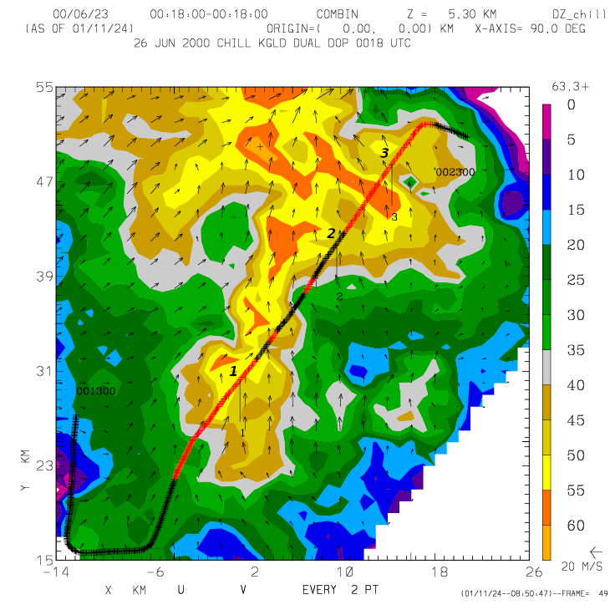
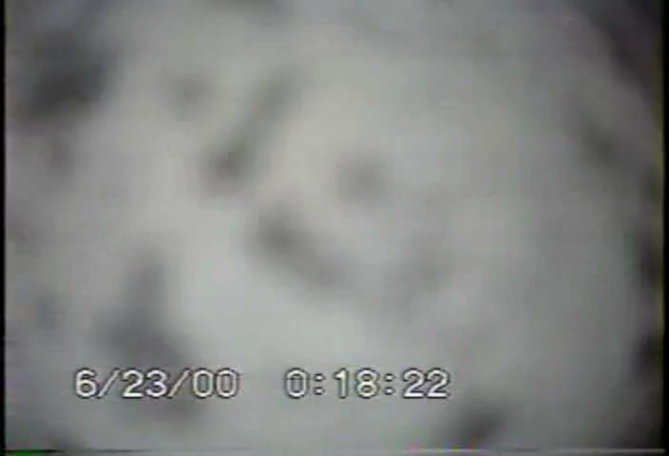
Project Introduction
Particle Size Distributions
Evaluating Data Quality
Reflectivity Comparisons
To validate lower quality images, we look at,
Image Buffers
Reflectivity plots
Video recordings
Pilot report
Data from Flight 757 (June 22, 2000)
24:18:26 UTC
13
Notes:
Medium to low quality images
Pilot, a human being says that there's hail at this time
Reflectivity is around 50, so should be a lot of particles, potentially some big one
Video shows particles sticking, impacting, bouncing off

Slide 14
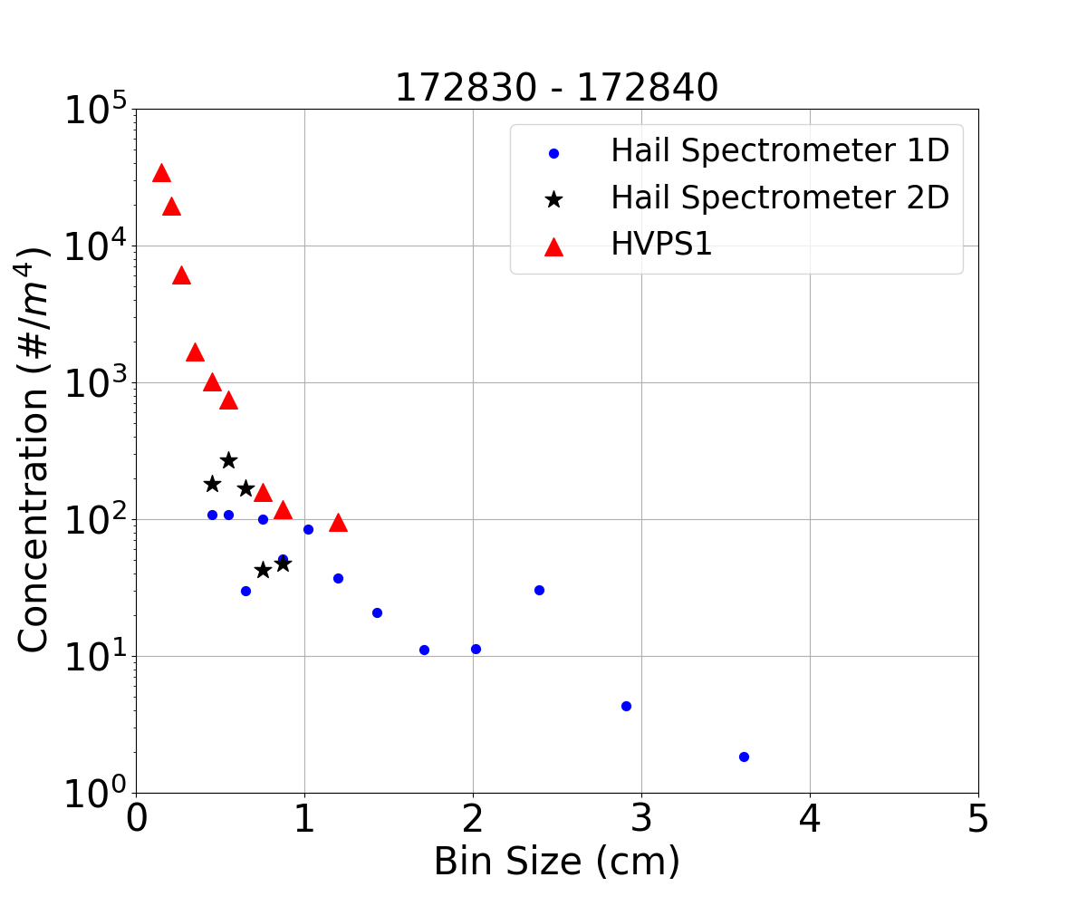
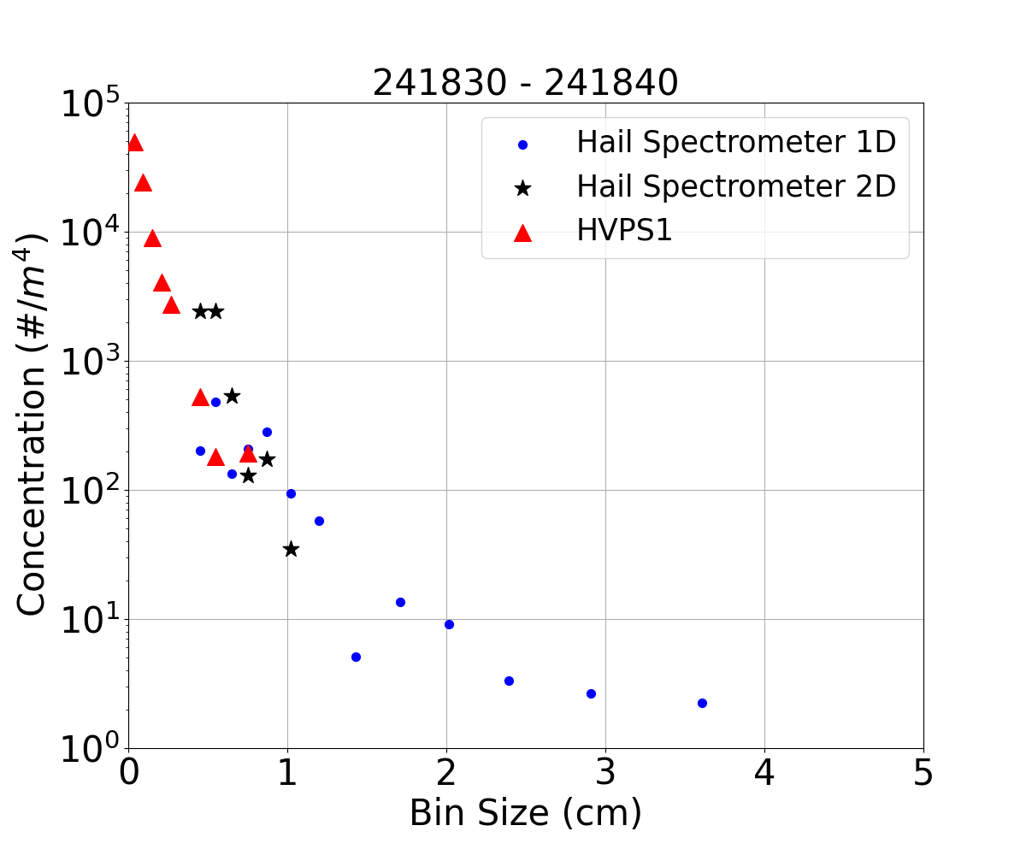
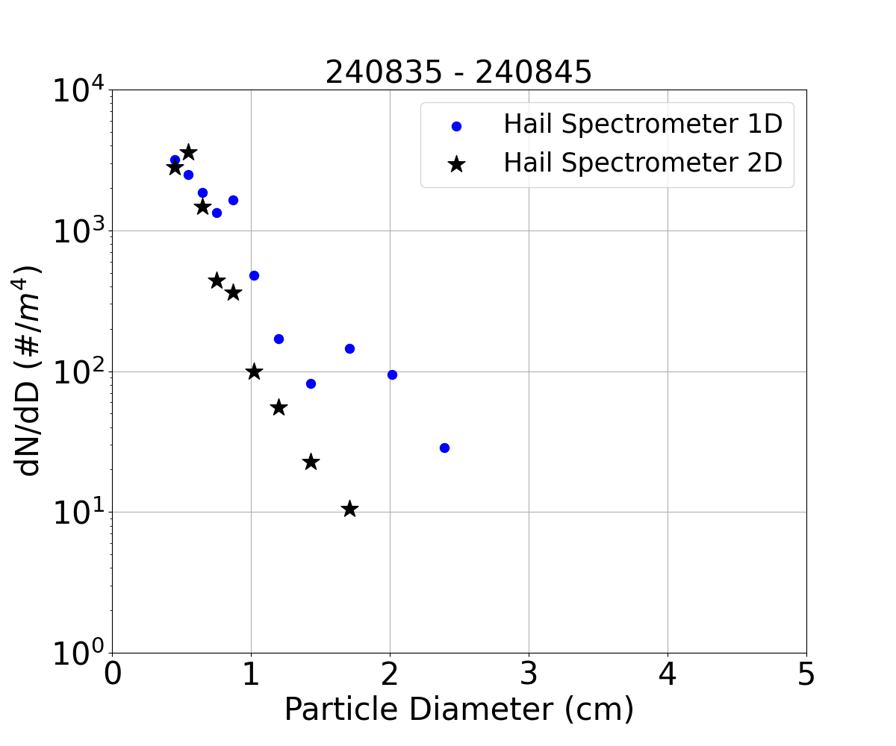
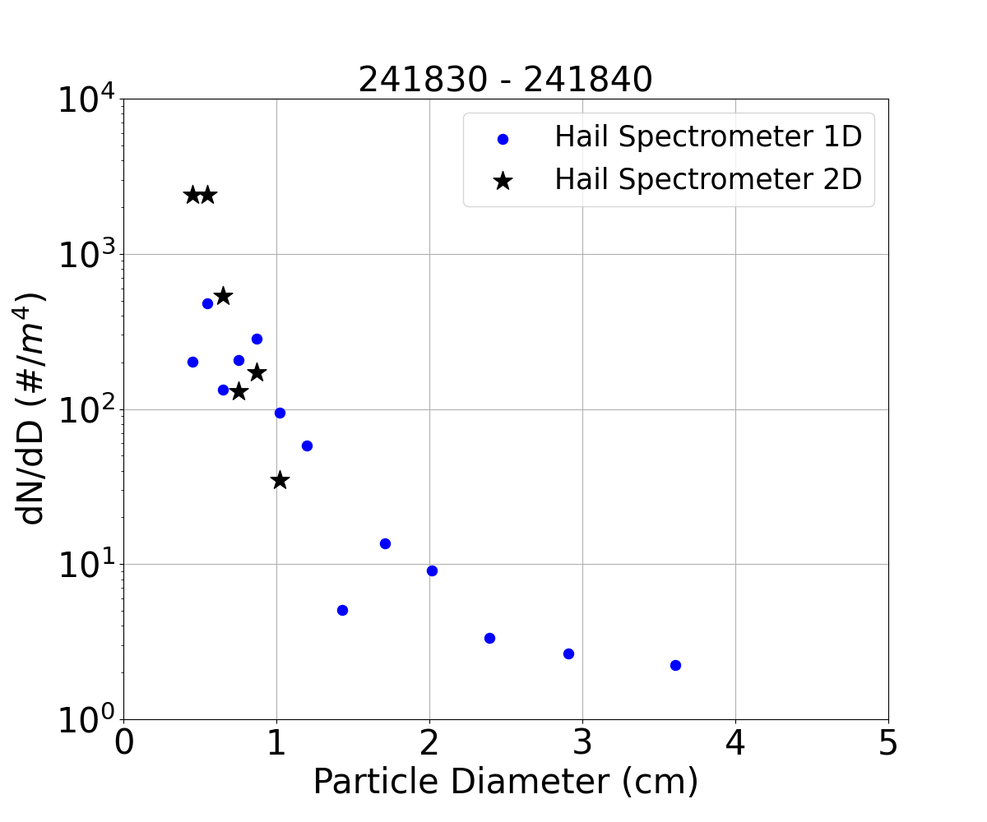
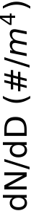
Project Introduction
Particle Size Distributions
Evaluating Data Quality
Reflectivity Comparisons
Hail Spectrometer 1D and 2D x-size concentrations can now be compared
They don’t perfectly match
  Different sample areas
  Different sizing methods
14
Notes:
Now create 2d PSDs
Use xsixe method to match 1d sizing method
Use area ratio of 0.3
2d higher small particles concentration. 1d higher large particle concentration
Similar for another interval
Maybe a result of different sample areas,
Sanity check… add hvps
Distributions overlap. Not perfect but it's within the ballpark
Reassuring because the hcps has higher quality imagery, and it's a completely independent probe from the Hail Spec
What do these plots look like when we add uncertainty

Slide 15



Project Introduction
Particle Size Distributions
Evaluating Data Quality
Reflectivity Comparisons
Two types of uncertainty
Poisson
Sizing method
Poisson uncertainty is used for 1D v 2D evaluation
Both Poisson and sizing method uncertainty are used for reflectivity
$$σ=\sqrt{N(D)}$$
$$10=\sqrt{100}$$
Circle-fit: 6.15 mm
X-size: 5.4 mm
X-extent: 5.4 mm
Y-size: 3.6 mm
Area-size: 4.76 mm
15
Notes:
Produce 5 separate PSDs using each of the 5 sizing methods.
Then take the mean of those 5 psds.
Total possible range gives the uncertainty

Slide 16
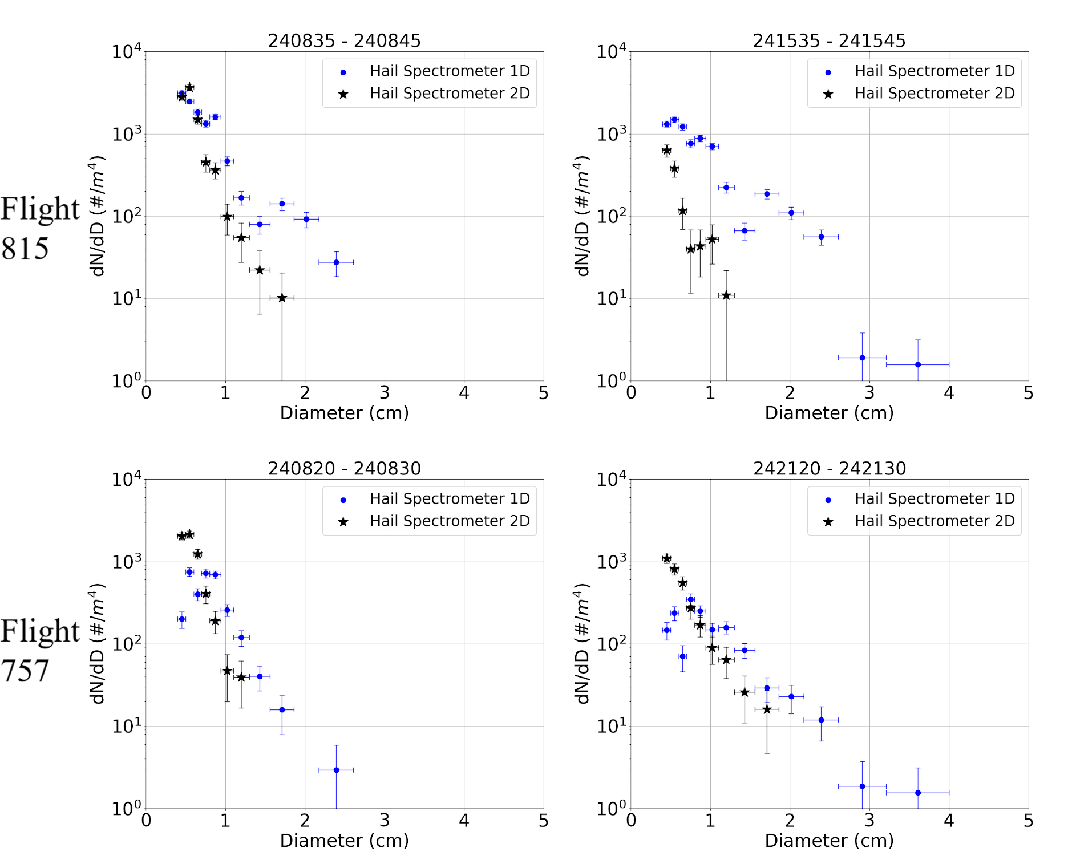
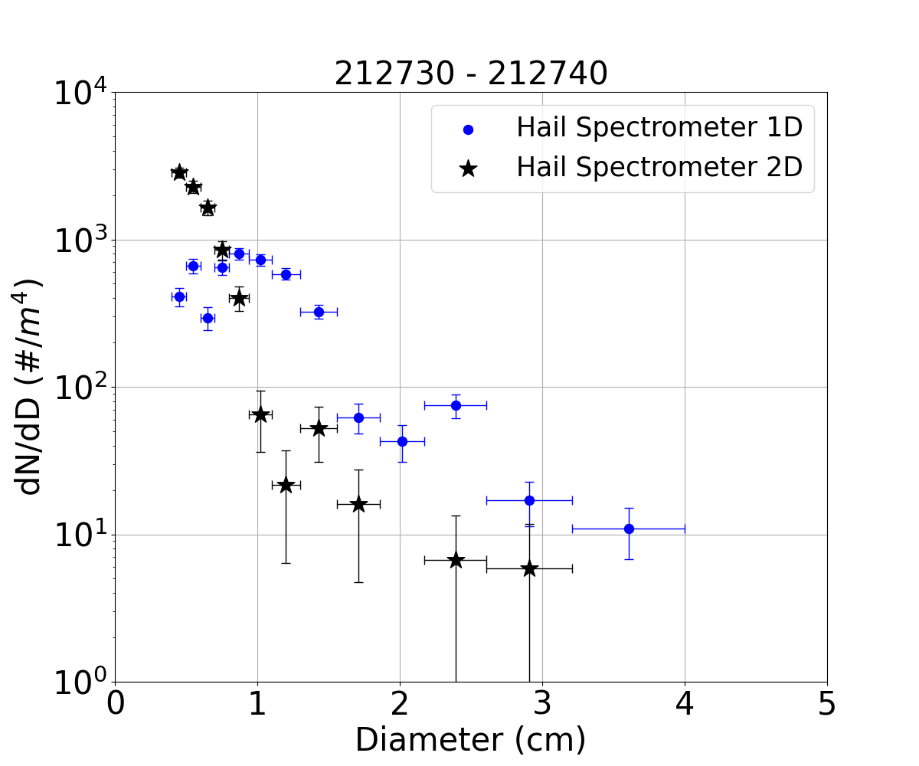
Project Introduction
Particle Size Distributions
Evaluating Data Quality
Reflectivity Comparisons
Wide range of uncertainties, from under 10% up to 100%
Still see regular discrepancies, primarily that the 1D typically records the largest particles
Upper: 1820
Middle: 1642
Lower: 1464
Upper: 27
Middle: 16
Lower: 5
16
Notes:
Uncertainty doesn't overlap despite sometimes being large
So uncertainty can't resolve our 1d 2d distributions not agreeing with each other.
Looking at more plots seem similar issues, and again, I want to draw attention to the largest particle size differences
I've only shown a few plots, so what do these large particle differences look like across the entire dataset for all 14 flights.

Slide 17
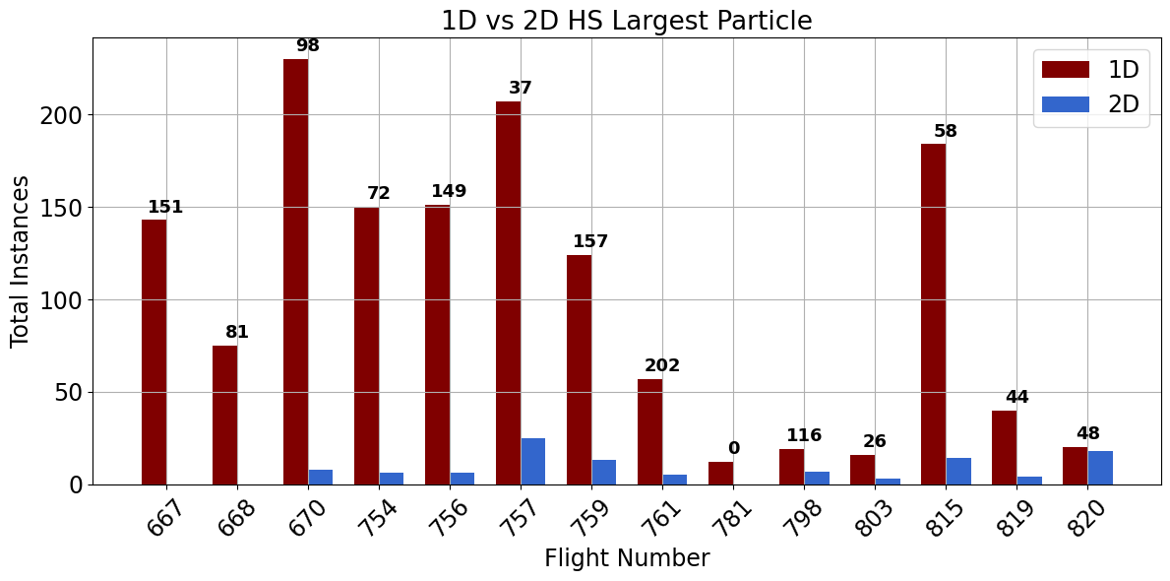
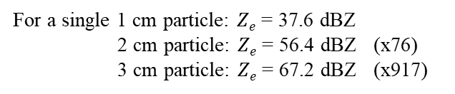

Project Introduction
Particle Size Distributions
Evaluating Data Quality
Reflectivity Comparisons
$$Ze=10∗\log_{10}(\frac{{0.197}^{2} }{{0.93}^{2}}\sum_{i=1}^{14}{D_{i}^{6}∗C_{i}})$$
The 1D data records a larger particle than the 2D data 1428 times.
  The 2D data only records a larger particle 109 times.
  This will have a big impact on reflectivity calculations
For a single 1 cm particle: $Ze$ = 37.6 dBZ
2 cm particle: $Ze$ = 56.4 dBZ (x76)
3 cm particle: $Ze$ = 67.2 dBZ (x917)
17
Notes:
Plot is for every 10s interval, and is not adjusted to only represent high concentration periods
However, the story we see in this plot is as expected
1D data records the largest particle almost always
This is a dataset wide bias
Which should we use. Which should we trust? the 1d or 2d data?
To highlight importance
Simple reflectivity calculation, focus on d to the sixth
Plug particle into concentration equation and you get ….
So, we need to make sure we’re sending the right PSDs to our collaborators

Slide 18
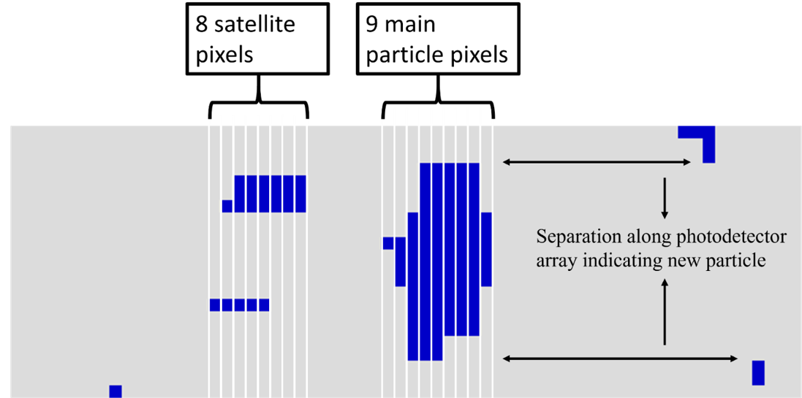
Project Introduction
Particle Size Distributions
Evaluating Data Quality
Reflectivity Comparisons
To learn why there are PSD discrepancies, 10 seconds of image buffers are processed manually.
  When using 1D processing methods, particle groups may contain coincident particles
    9 unique ways to process the data are tested
coincident
Along Airflow
Along Diode Array
18
Notes:
Okay, so, back to the question… should we use the 1d or 2d data
Attempt to recreate the 1d distribution processing the image buffers by hand
Keep in mind, image buffers only store half the area so we can't do a perfect recreation
First, I want to talk about the 1d processing algorithm
Dead space.
Particle group
Coincidence rejection
So we can handles groups in three ways
Also have three varying levels of lenient to strict rejection criteria

Slide 19
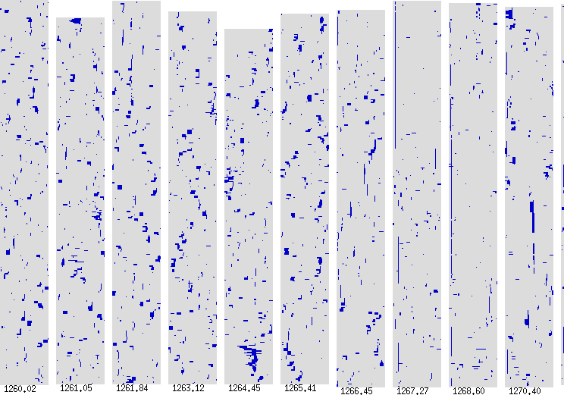
Project Introduction
Particle Size Distributions
Evaluating Data Quality
Reflectivity Comparisons
19
Notes:
Quick look at what 10 seconds of particles looks like
Nothing special to note

Slide 20
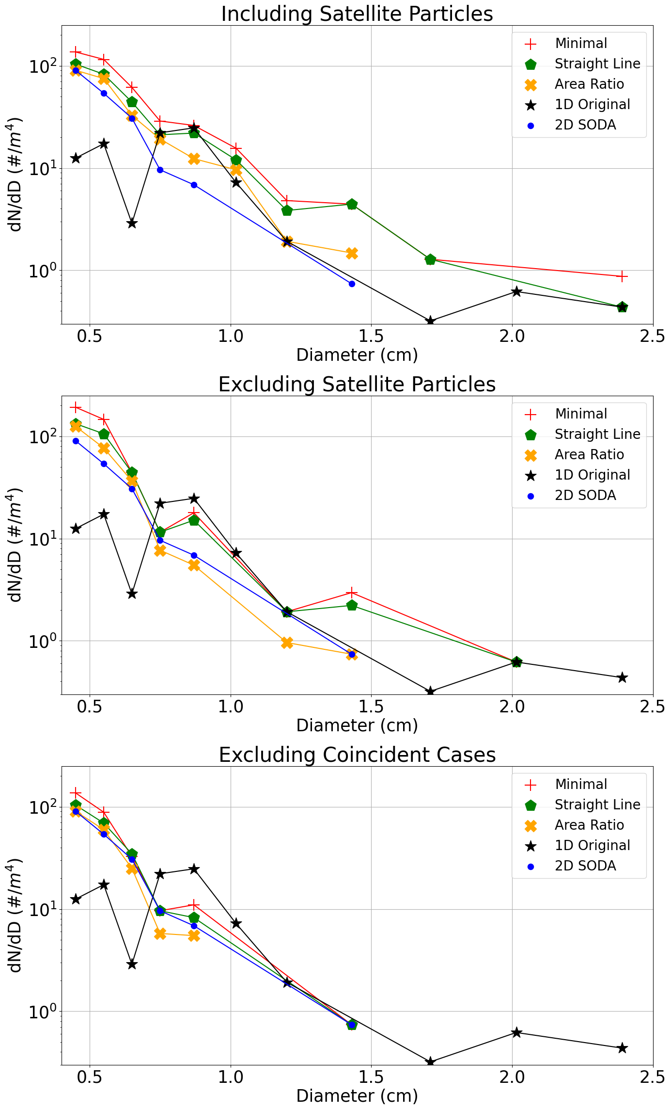
Project Introduction
Particle Size Distributions
Evaluating Data Quality
Reflectivity Comparisons
Including coincident particles matches the largest particle
Excluding coincident particles improves large particle overcounting
Rejecting coincidence is intended to match the 1D sizing but results in the least similar PSD
Rejecting Coincident Groups
Including Coincident Particles
Excluding Coincident Particles
20
Notes:
Satellite
Big match but large concentration
Exclude satellite
Big worse match but better concentration match
Coincident, supposed to be the closest fit to 1d
Worst size match
So this is concerning
Large particles just are not seen in the buffer, when in reality you expect to see at least 25-50% of them
How many you should fully image is a bit complicated, but it's expect you would at least see some but really hardly any are observed
Could spend hours talking about these three plots, but long story short, inspection of the image buffers just does not support the 1d distribution, so we place more confidence in the 2d data

Slide 21
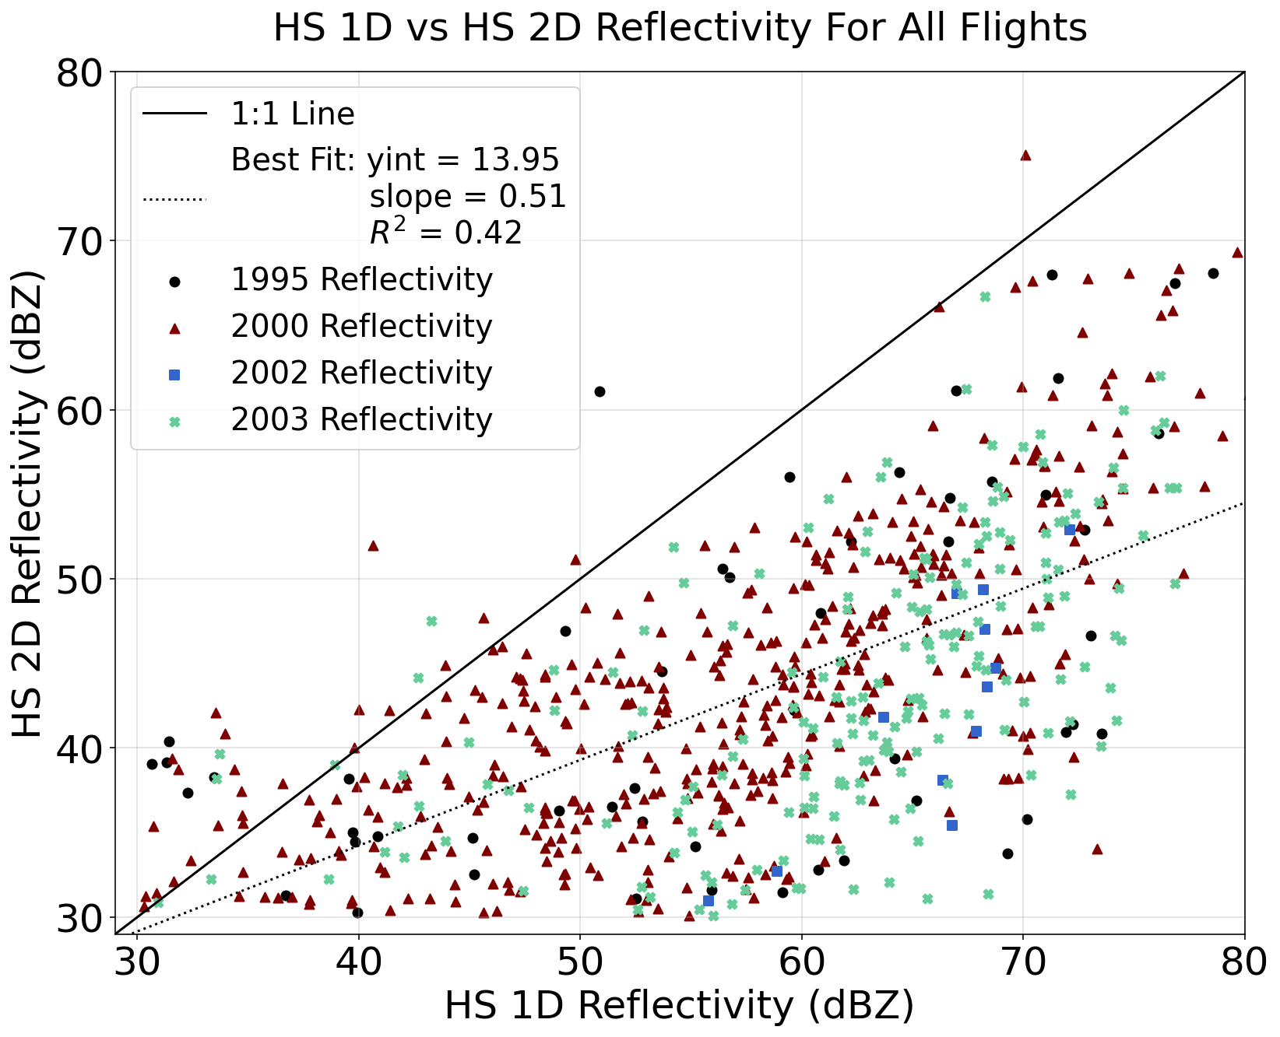

Project Introduction
Particle Size Distributions
Evaluating Data Quality
Reflectivity Comparisons
So, we know that maximum particle sizes are different and how important that difference is.
This results in significant difference in computed reflectivity when all other variables are kept the same
$$Ze=10∗\log_{10}(\frac{0.197 }{0.93}\sum_{i=1}^{14}{D_{i}^{6}∗C_{i}})$$
21
Notes:
What does this mean for the data we send to our collaborators…
Well, simple reflectivity calculation
All 10 second intervals
Reflectivities higher than 30 dBZ
Well, we see what we expect. Because reflectivity is sensitive to particle size…
Below 1:1 line. 5-10 dBZ or higher difference
This means the data we provide our collaborators will have big influence
Their reflectivity calculation is more sophisticated. They use something called a t-matrix, and one thing it can do is include particle composition, so does it have air or water mixed in
Air drops reflectivity, water increases reflectivity.
Depending on the PSDs that we provide, that will impact the particle composition required to match the calculated and observed radar reflectivity.

Slide 22
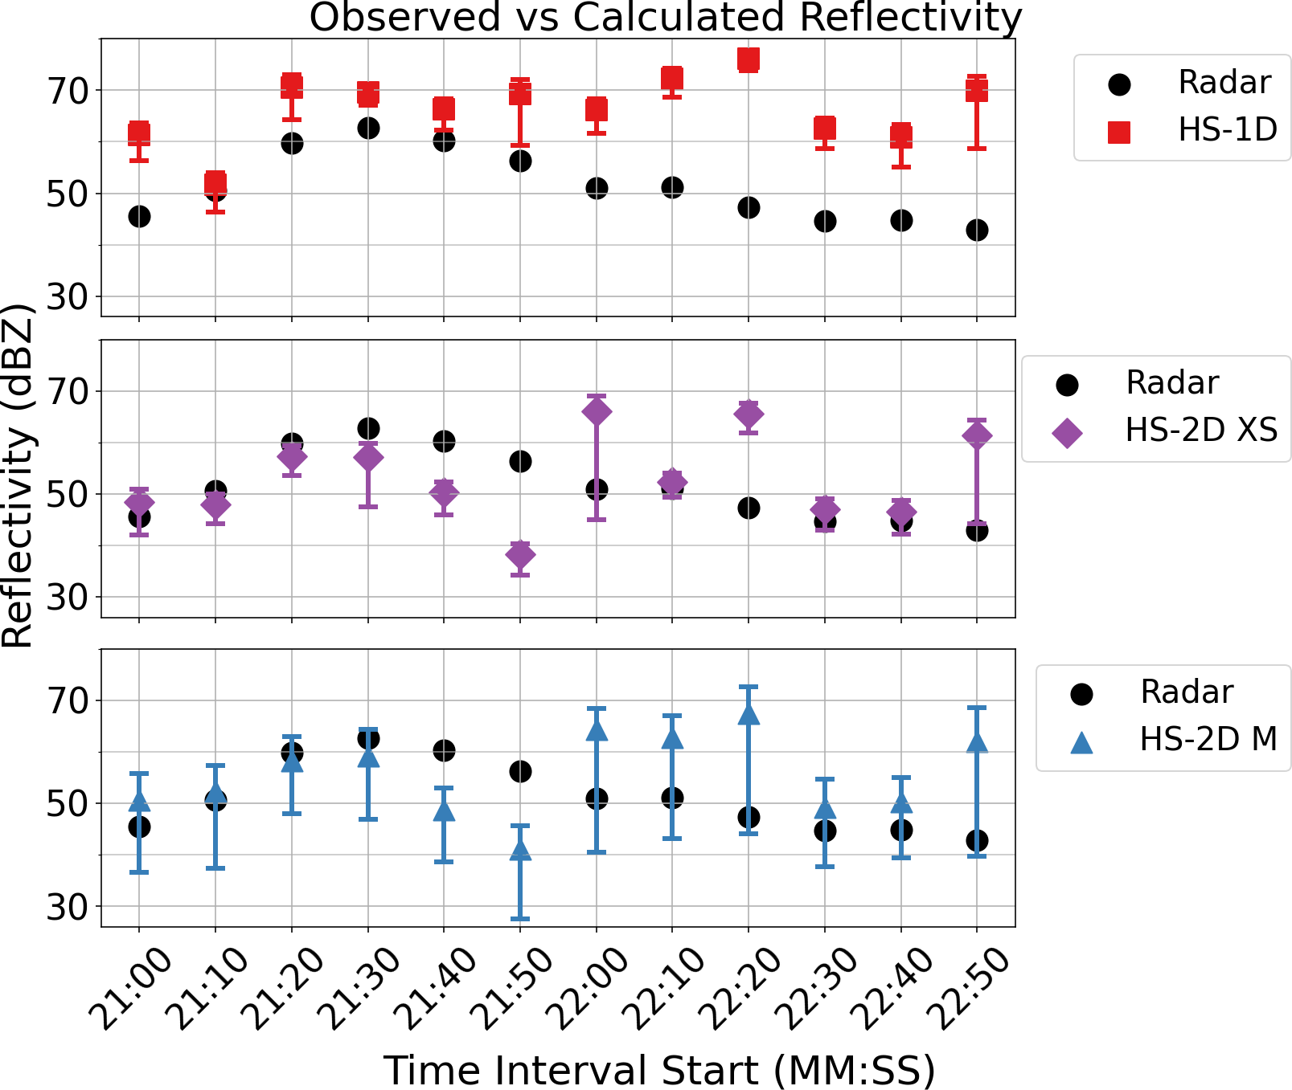
Project Introduction
Particle Size Distributions
Evaluating Data Quality
Reflectivity Comparisons
  1D reflectivity is consistently higher than radar observations.
  2D x-size (XS) reflectivity yields over and underestimates, along with matches to the radar observations.
  2D mean (M) overlaps in 10/12 intervals
22
Notes:
Show how Hail Spec compares to observed radar values
Collaborators shared observed radar observation (radar)
1d dif . 1 overlap. Everything high
Xsize match in 6 cases. Within 3 dBZ.
Mean concentration with uncertainty stretched across all sizing methods, produces overlap in 11/12 intervals
Points towards 2D data matching better
Also reassuring that xsize matches in 6 cases, even with lower quality images and using an area ratio of 0.3
Suggests that the 2D data, once the processing is refined, can match the observed reflectivity in even more cases.
Collaborators are able to adjust the particle compositions and can make the x-size 2D ref match in 11/12 intervals within 3dBZ
Future work could use additional information such as temperature, cloud liquid water content, and updraft speeds to estimate particle composition, which could help constraint the calculated reflectivity.
Bc we match in say, 6 intervals, that’s reassuring that the area ratio worked to separate real particles from noise
The remaining three could be described by adding water to the surface
The other three could be radar uncertainty? Maybe air?

Slide 23
Conclusions
1D and 2D PSDs show different distributions with the 1D data recording a higher concentration of large particles
Based on image analysis and comparison to radar, the 2D data is likely a better representation of the particles
Future work could solve for particle composition using information such as temperature, updraft, and liquid water content.
23

Slide 24
Thank you to all my committee members
Thank you to Wanda and Sue
Thanks to all my friends
Thanks to my family
24
Notes:
D & A for working closely on this project with me for two years
Wanda and Sue for making it possible to organize and arrange everything
Friends for keeping spirits up while working on this
Family, especially my dad who spent many lunch breaks discussing my research with me.

Slide 25
Questions?
Notes:
Limitations/possible improvements
As mentioned, this is still a work in progress, but everything is mostly done.
Priority is to finish addressing comments on thesis and make sure everything is wrapped up by the start of september,
But if theres some time left over, a script exists to do the manual sizing, it just needs to be updated to current methodology and made to run for the 9 different combinations. But then the entire dataset wide results can be used for ref comp plots to check performance of each method against the 1D data. This way we can see how it performs for lower concentration periods to where there should in theory be less overlap
Another idea is to find the average and std dev percent difference for each bin for low, medium, and high concentration. Then apply that correction to the 1D data to “correct” the PSDs and see how that compares with the 2D data with the ref comp plot.

Slide 26
Notes:
Limitations/possible improvements
As mentioned, this is still a work in progress, but everything is mostly done.
Priority is to finish addressing comments on thesis and make sure everything is wrapped up by the start of september,
But if theres some time left over, a script exists to do the manual sizing, it just needs to be updated to current methodology and made to run for the 9 different combinations. But then the entire dataset wide results can be used for ref comp plots to check performance of each method against the 1D data. This way we can see how it performs for lower concentration periods to where there should in theory be less overlap
Another idea is to find the average and std dev percent difference for each bin for low, medium, and high concentration. Then apply that correction to the 1D data to “correct” the PSDs and see how that compares with the 2D data with the ref comp plot.

Slide 27
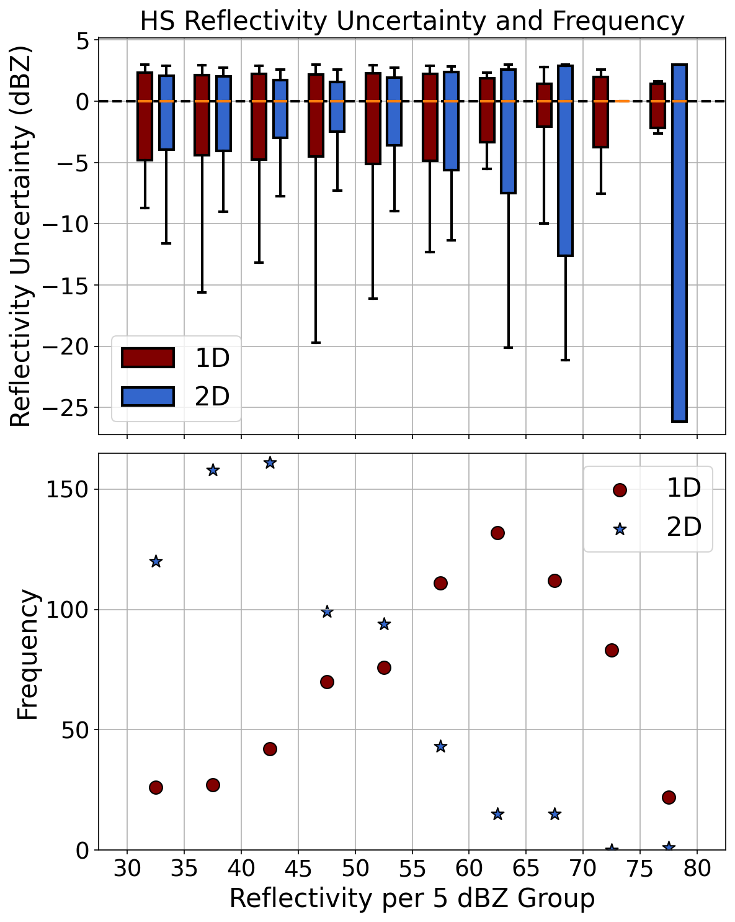
Project Introduction
Particle Size Distributions
Evaluating Data Quality
Reflectivity Comparisons
Because of large PSD uncertainties and reflectivity being logarithmic, the upper and lower uncertainties are unbalanced.
Can see that it’s roughly +3 -5 for about half of the data (frequency).

Slide 28
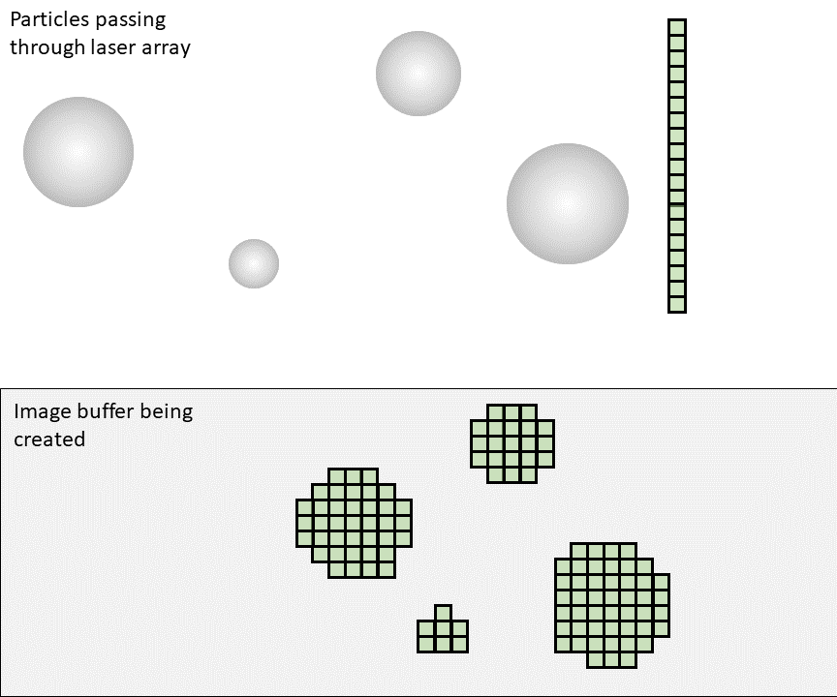
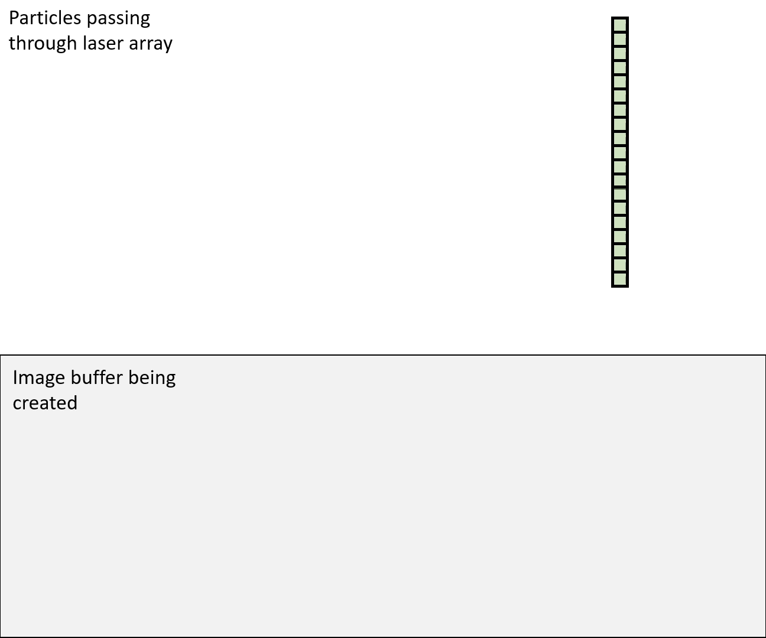
Project Introduction
Particle Size Distributions
Evaluating Data Quality
Reflectivity Comparisons
In this project, an Optical Array Probe can record data two ways,
    Two-dimensional method
    Circle-fit, x-size, x-extent, y-size, area-size.
  One-dimensional method
Shadowgraph Technique
2
4
Shadowed Diodes
1: 8 pixels
2: 5 pixels
3: 3 pixels
4: 7 pixels
1
3

Slide 29
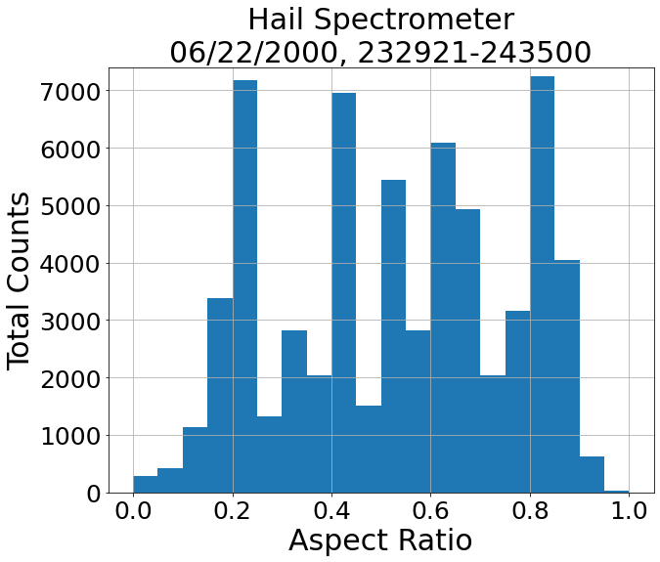
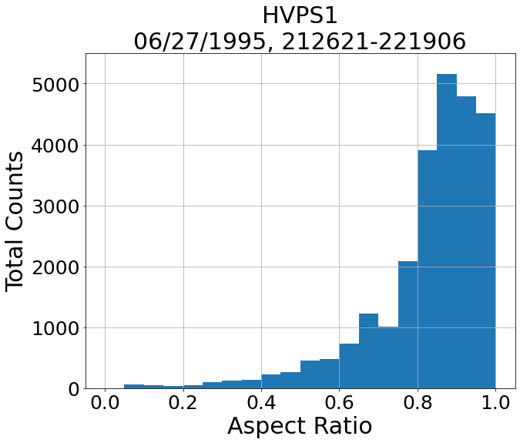
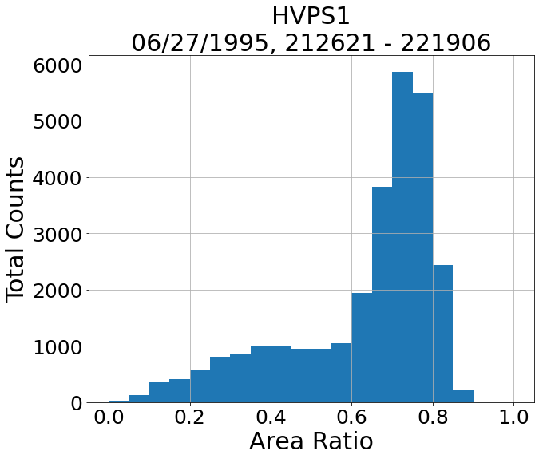
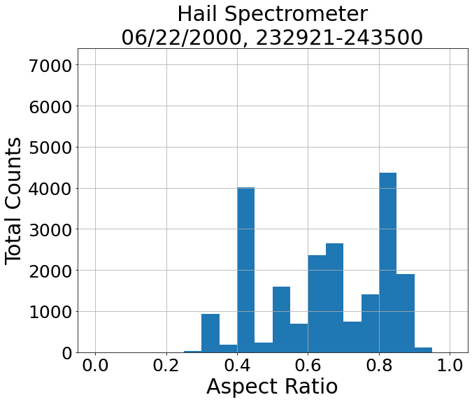
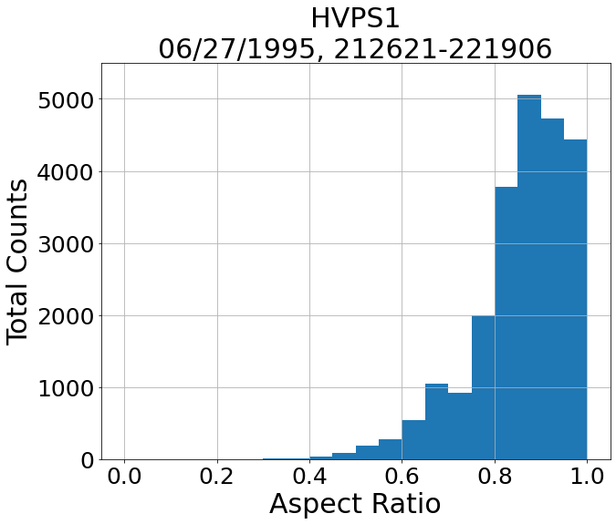
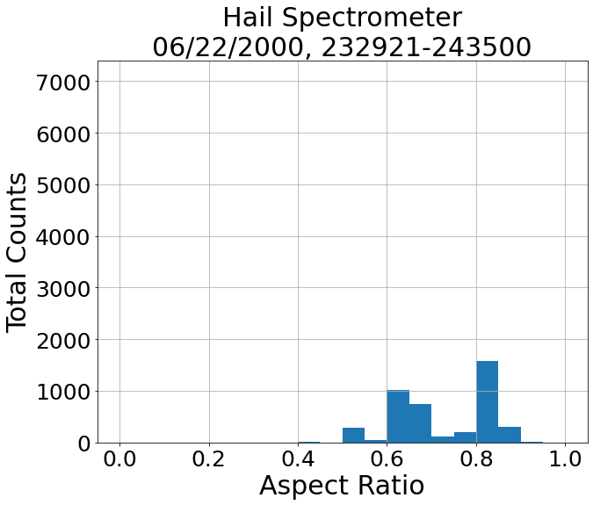
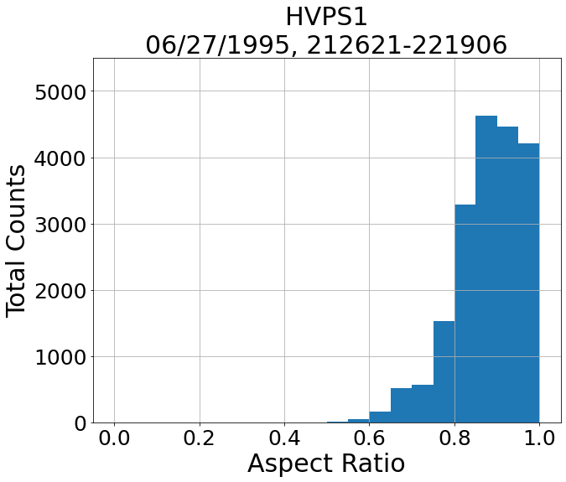


Project Introduction
Particle Size Distributions
Evaluating Data Quality
Reflectivity Comparisons
For the 2D data, we need,
Particle sizes
Area ratio to accept or reject particles
A threshold of 0.3 appears to work for the Hail Spectrometer
All particles
All particles
All particles
All particles
Thirteen pixels with dimensions
0.2 mm x 0.2 mm
r = 0.71 mm
Area Ratio Threshold = 0.3
Area Ratio Threshold = 0.5
Area Ratio Threshold = 0.3
Area Ratio Threshold = 0.5
$$1.58 {mm}^{2}=π{(0.71 mm)}^{2}$$
$$0.52 {mm}^{2}=13(0.2 mm x 0.2 mm)$$
Gives an area
ratio of ~0.33
Notes:
However, we have the 2D data, why not use it to validate the 1D data, especially since we can visually inspect the images and confirm what’s going on.
Well to start, need area ratio. So discuss area ratio stuff
What the area ratio does is inform us of the spericity of a particle. So, if it’s long vs circular, long will have lower area ratio, and if particle seems to have hole in middle, that hole will also reduce the area ratio
But lets explore this in more depth now

Slide 30
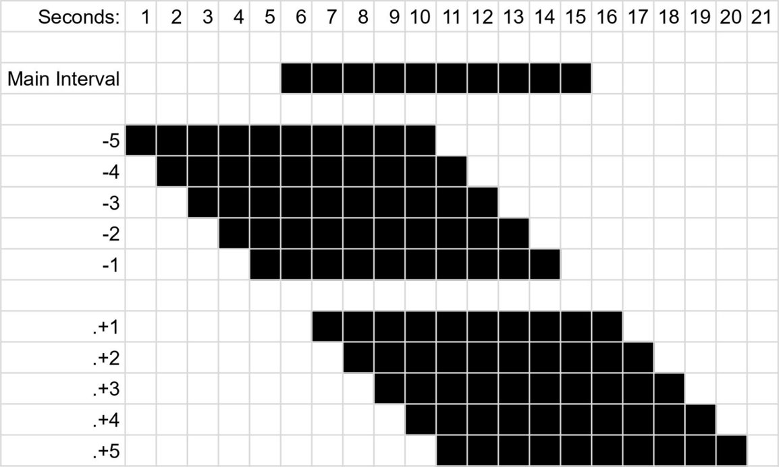
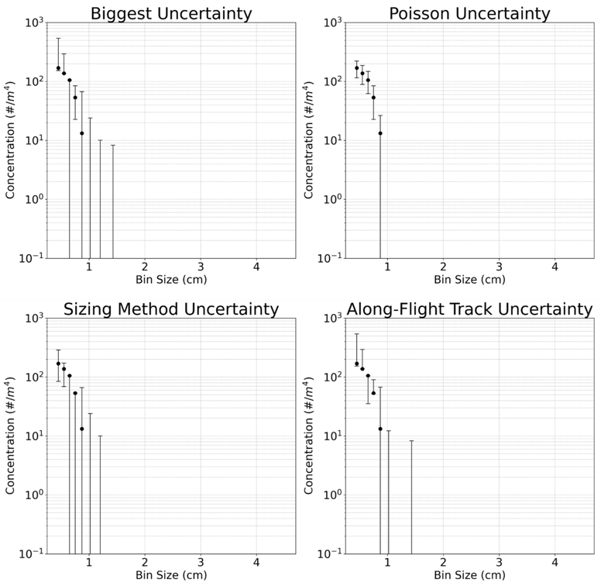


Project Introduction
Particle Size Distributions
Evaluating Data Quality
Reflectivity Comparisons
$$σ=\sqrt{N(D)}$$
Three types of uncertainty
Poisson
Sizing method
Along-flight-track
We select the largest individual range of uncertainty for each bin
Circle-fit: 6.15 mm
X-size: 5.4 mm
X-extent: 5.4 mm
Y-size: 3.6 mm
Area-size: 4.76 mm
$$10=\sqrt{100}$$
Notes:
+0.75 - 1.8

Slide 31

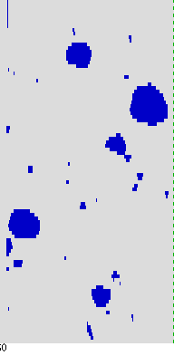
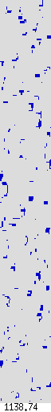
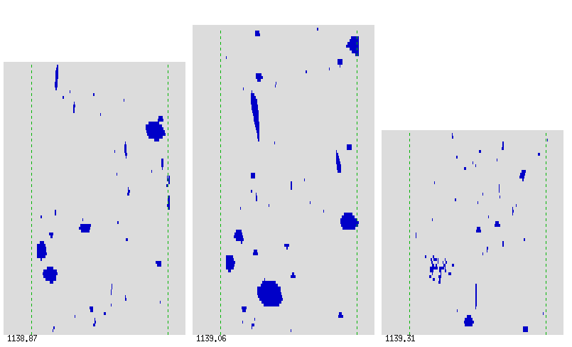
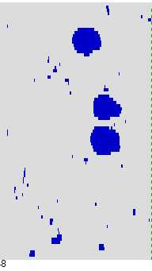
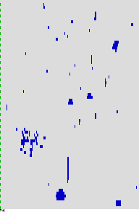
1139.60
1139.06
Project Introduction
Particle Size Distributions
Evaluating Data Quality
Reflectivity Comparisons
1139.48
1139.48
1139.31
1138.87
1139.31
Notes:
However, we have the 2D data, why not use it to validate the 1D data, especially since we can visually inspect the images and confirm what’s going on.
Well to start, need area ratio. So discuss area ratio stuff
What the area ratio does is inform us of the spericity of a particle. So, if it’s long vs circular, long will have lower area ratio, and if particle seems to have hole in middle, that hole will also reduce the area ratio
But lets explore this in more depth now

Slide 32

Project Introduction
Particle Size Distributions
Evaluating Data Quality
Reflectivity Comparisons
Notes:
However, we have the 2D data, why not use it to validate the 1D data, especially since we can visually inspect the images and confirm what’s going on.
Well to start, need area ratio. So discuss area ratio stuff
What the area ratio does is inform us of the spericity of a particle. So, if it’s long vs circular, long will have lower area ratio, and if particle seems to have hole in middle, that hole will also reduce the area ratio
But lets explore this in more depth now

Slide 33



Project Introduction
Particle Size Distributions
Evaluating Data Quality
Reflectivity Comparisons
The 1D first bin was higher 611 times whereas the second bin was higher 800 times
The 2D first concentration bin is higher 701 whereas the second bin is higher 294 times
Notes:
Mention how its not consistent which bin is higher more often across the flights

