Slide 1



Improving Forecasts of Hail
James Klinman
Masters Student
Atmospheric Sciences
Notes:
Your Full Thesis or Dissertation title :

Slide 2




















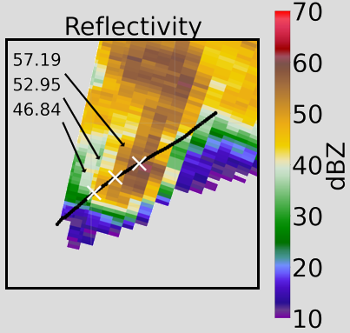
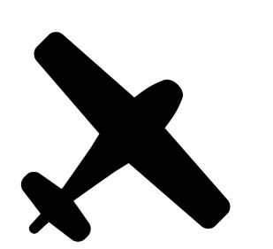
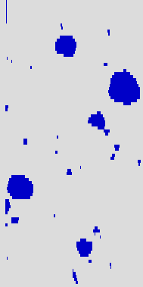

Radar Scan of Cloud
Reflectivity
These are images of hail from inside the clouds!!!
0
3
6
9
Distance in Miles
Higher values suggest presence of larger hail.
¹ Hail images generated using SODA2, A. Bansemer (GitHub, 2020)
² Images: Adobe Stock (IDs: 621801214, 327349864, 535282684, 483692966, 672202026)

