Slide 1



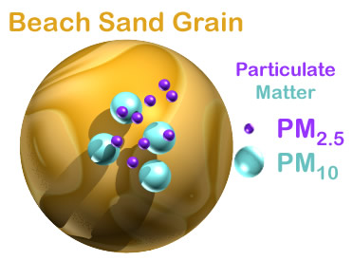
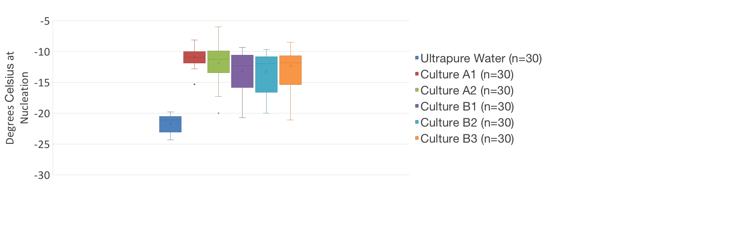
Analysis of Bioaerosols:
DNA and Ice Nucleation Potential
Interdisciplinary
Renewable & Environmental
Collaborative REU
Julie Hibarger, Dr. Rebecca Simmons¹ & Dr. David Delene²
1. University Of North Dakota Department of Biology, 2. University of North Dakota Department of Atmospheric Science
Objectives
Aerosol Collection
Conclusions
To collect biological atmospheric Particulate Matter (PM) that is less than 2.5µm
To culture, isolate, amplify, and sequence DNA from aerosol bacterial samples.
To perform ice nucleation experiments to observe the potential of individual bacterial samples to freeze water at higher temperatures relative to ultrapure water.
Air Inlets
Most bacterial samples were identified as Bacillus as previously reported (Bowers, et al. 2013).
Unfortunately, sampled bacteria was limited to aerobic species that could be cultured on LB agar.
Ice nucleation results were not statistically significant but do imply a higher nucleation temperature for samples containing these bacteria.
  FUTURE WORK:
Illumina sequencing would allow for a more comprehensive view of atmospheric bacteria.
These methods could be employed using aerial sampling of cloud bacteria in active storm conditions
More sophisticated nucleation testing would improve consistency in measurements.
Roof
PM<2.5µm
Pump Vacuum
TEOM 49C
O3 Analyzer
APS
¼” Swagelok steel tube
½” Swagelok steel tube
Vacuum tubing
Copper evacuation pipe
Background
PM sample
Paper filter
Cartridge
Atmospheric PM is comprised of dust, soot, pollen, bacteria, and fungi less 10µm in diameter.
PM that function as ice nuclei are integral to cloud formation, precipitation production, and have potential for applications in agriculture and climate manipulation.
Figure 1: Bioaerosol : Collection of PM less than 2.5 µm
Results
Table 1: Bacteria Identification: BLAST results showing the closest matching species and percent sequence identity
Culture Number | Closest Match | Sequence Identity
Culture A1 | Bacillus aquimaris | 100%
Culture A2 | Erwinia billingiae | 99%
Culture B1 | Bacillus pumilus | 99%
Culture B2 | Bacillus pumilus | 99%
Culture B3 | Bacillus pumilus | 99%
MECHANICS OF ICE NUCLEATION
Solid Particle
Deposition Freezing
Ice Particle
Redrawn from http://bertram.chem.ubc.ca/ice-nucleation/
http://techalive.mtu.edu/envengtext/ch12_health.htm
Acknowledgements
Methods
Dr. Frank Bowman
Dr. Brian Darby
Nickolas S. Goodman, M.S.
Matthew Flom, M.S.
This material is based upon work supported by the National Science Foundation under Grant No. CHE-1757922. Any opinions, findings, and conclusions or recommendations expressed in this material are those of the authors and do not necessarily reflect the views of the National Science Foundation.
Aerosols were collected via roof-mounted inlets on quartz filters at regulated airflow in long (7 day) and short (2 day) exposures.
Samples were cultured on LB agar, isolated, and amplified for a region of the 16S ribosomal subunit. DNA was then sequenced and characterized against the NCBI database via BLAST searches.
Ice nucleation tests were performed on all identified bacteria cultures relative to ultrapure water.
References
Robert M. Bowers, Nicholas Clements, Joanna B. Emerson, Christine Wiedinmyer, Michale P. Hannifan, and Noah Fierer. Seasonal Variability in Bacterial and Fungal Diversity of the Near Surface Atmosphere. Environmental Science and Technology. 2013. 12097-12105.
Figure 2: Temperature at ice nucleation (Cº). Samples with cultured bacteria formed ice nuclei at slightly higher temperatures.

