Slide 1
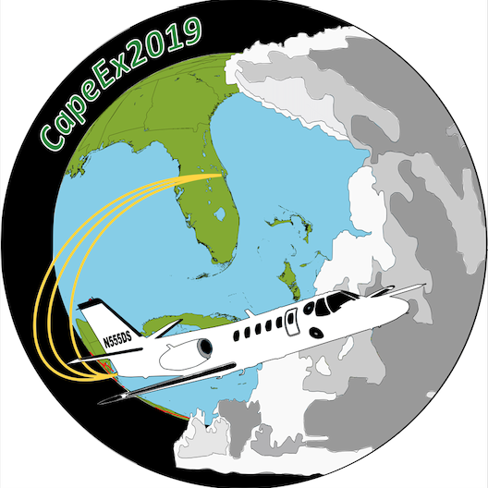
Biological Particles (Bacteria and Fungi) in Thunderstorms
Harrison Rademacher, Dr. David Delene, Dr. Karin Ardon-Dryer, and Dr. Michael San-Francisco

Slide 2
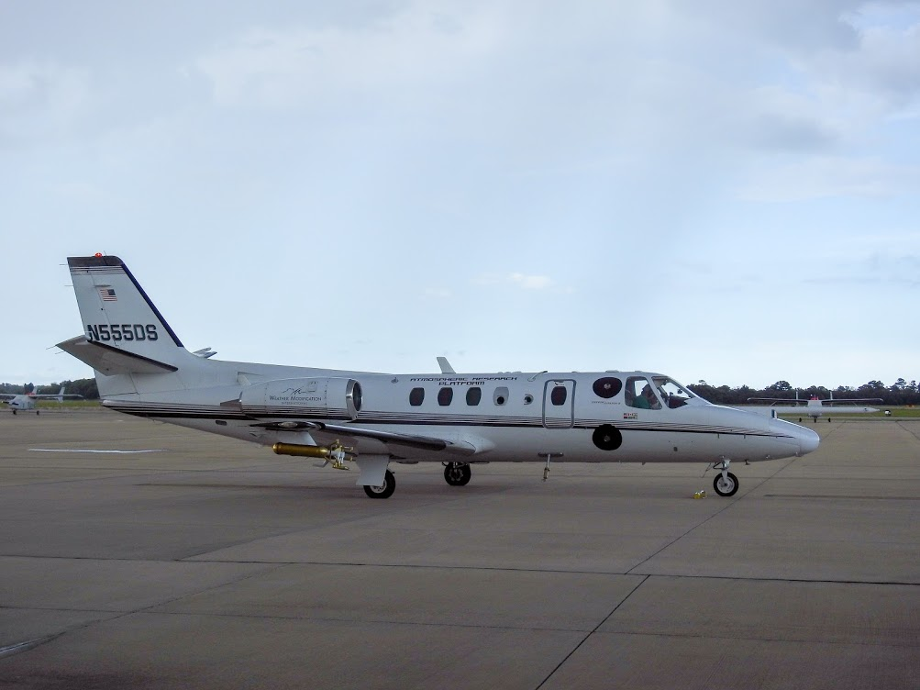
Motivation - Why Study Biogenic Particles?
<0.1% of cells carried into atmosphere survive (DasSarma, 2018)
Diseases and airborne illnesses can be carried into the atmosphere via airborne biogenic particles (Burrows et al., 2009).
Seasonal variations in bacteria and particle concentrations, and local events (e.g. dust storms) lead to bacteria isolates (Harbizadeh, 2019).
Cloud and climate impacts (aid in heterogeneous freezing of cloud droplets).
Most studies focus lower portions of troposphere.
Challenges collecting airborne measurements.

Slide 3
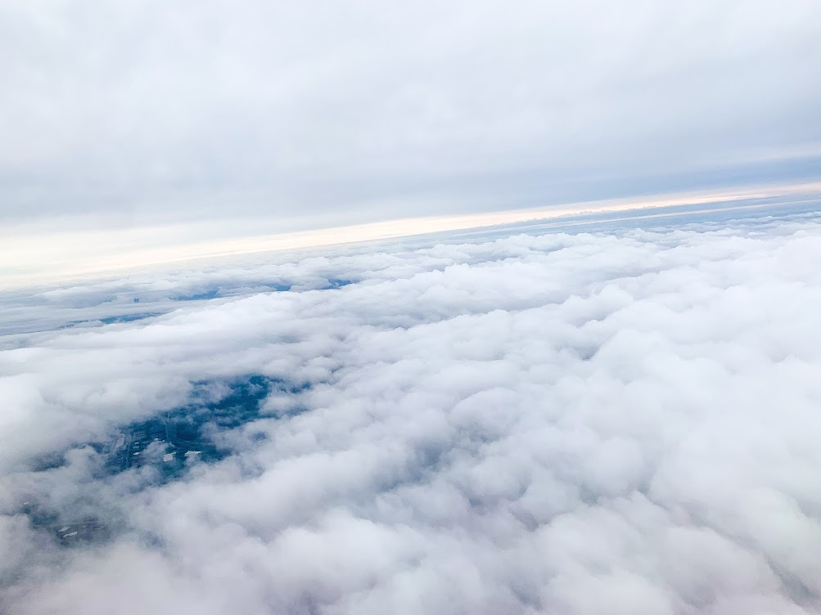
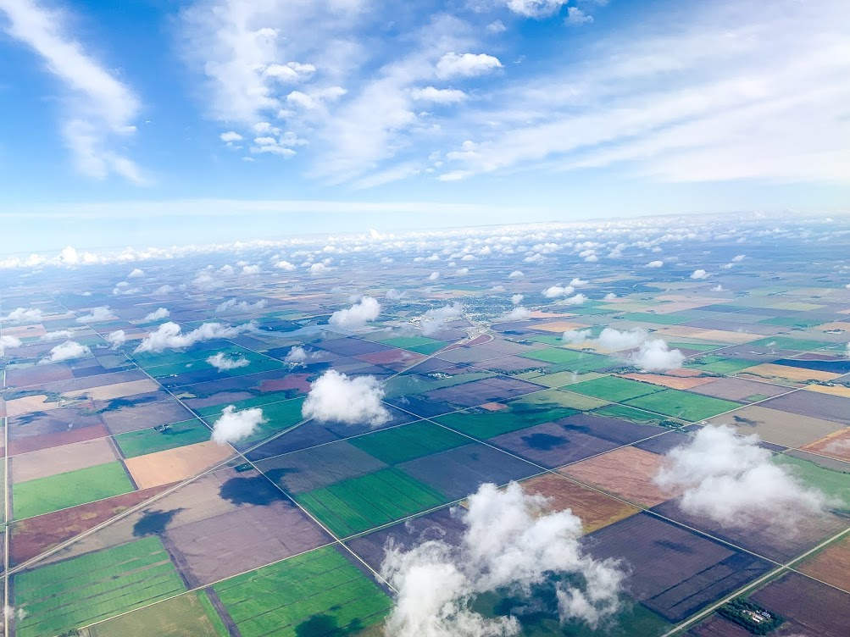
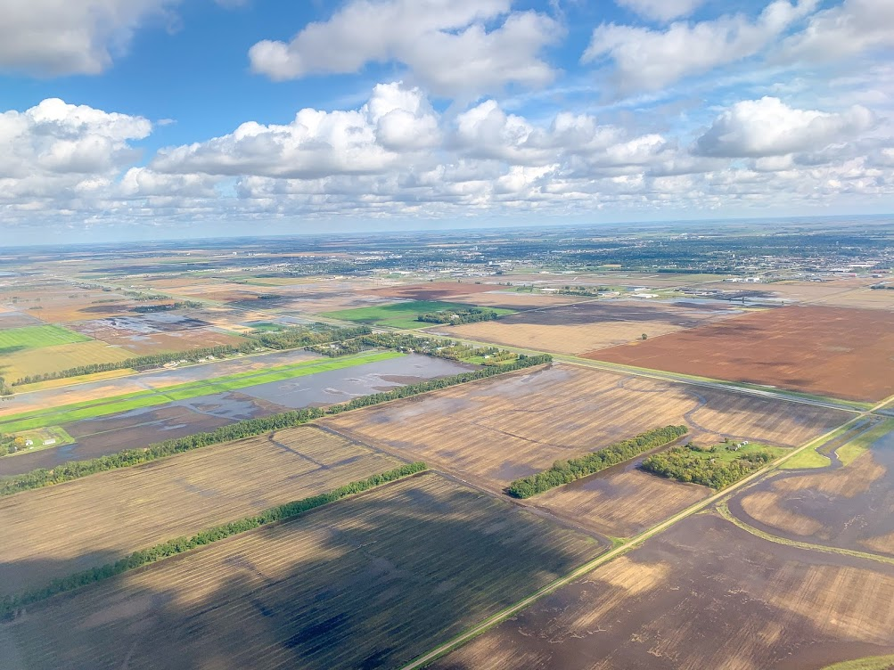
Introduction - Aerosol Particles
Aerosol Particles range from variety of natural and man made materials
Fine particles are Aitkin range, have condensation and coagulation of primary particles and chain aggregates, and accumulation range.
Forms particles into droplets via homogeneous nucleation or condensation growth of nuclei (Whitby, 1977)

Slide 4
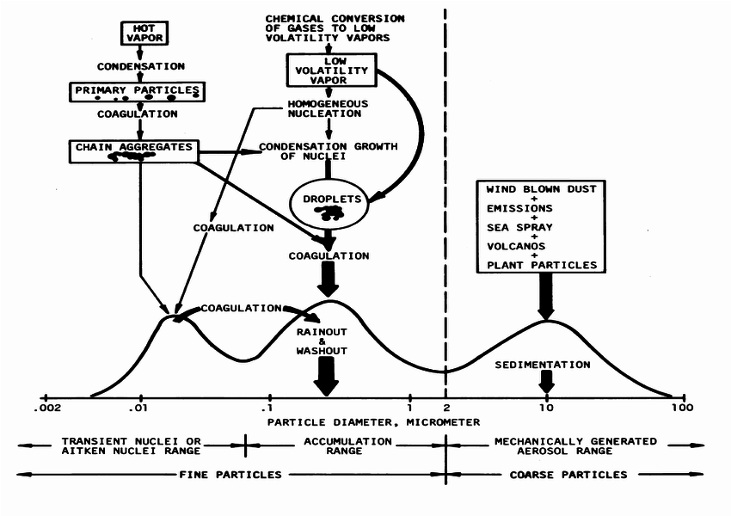
Figure 1: Idealized schematic of the distribution of particle surface area of an atmospheric aerosol (Whitby, 1977).

Slide 5
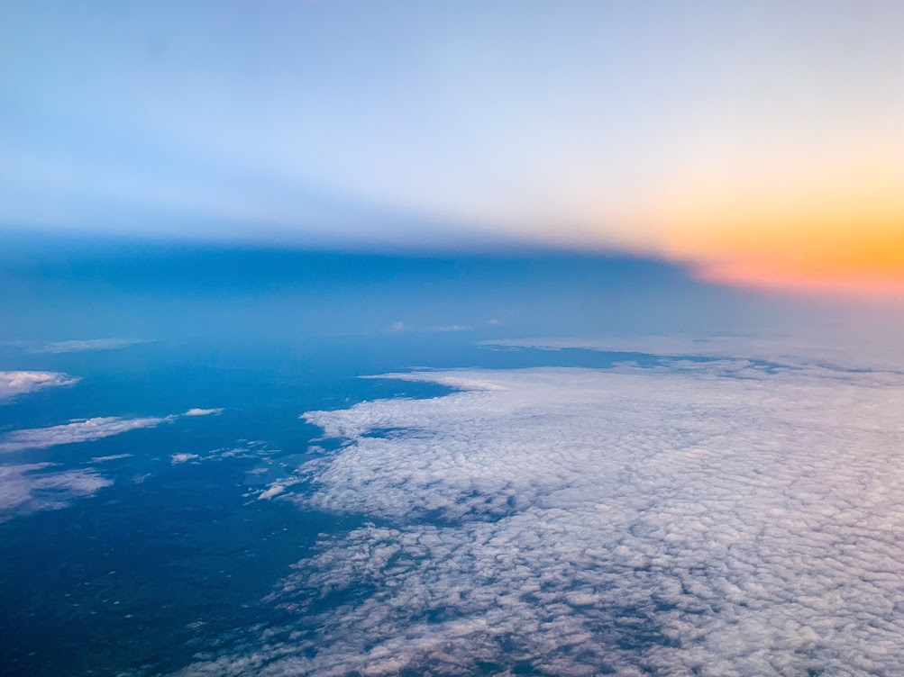
Introduction - Biogenic Particles
Biological particles act (dead or alive) as Ice Nuclei Particles (INP) at temperatures less than -10 °C, sometimes activate up to -4 °C (Matthias-Maser et al., 2000).
Bacteria and fungi - proven to be good INP, found in atmospheric fog, clouds, and rainwater (residency time of several days).
Atmospheric waters can transport bacteria via lifting from surfaces and mix vertically (Hu et al., 2018).

Slide 6
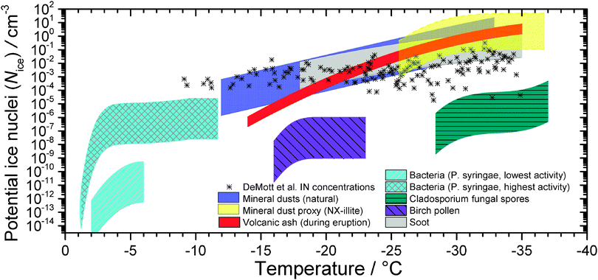
Figure 2: Potential immersion modes of different ice nuclei concentrations as a function of temperature for different atmospheric species (Murray et al., 2012).

Slide 7
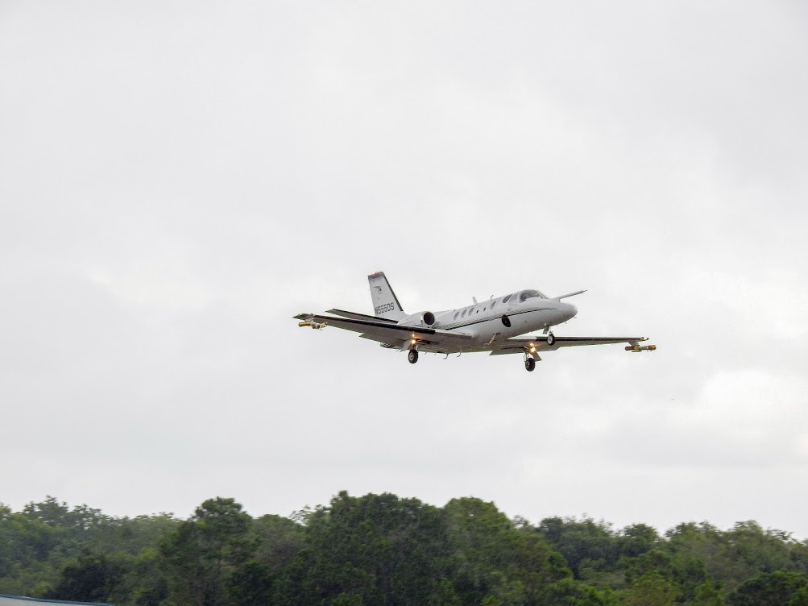
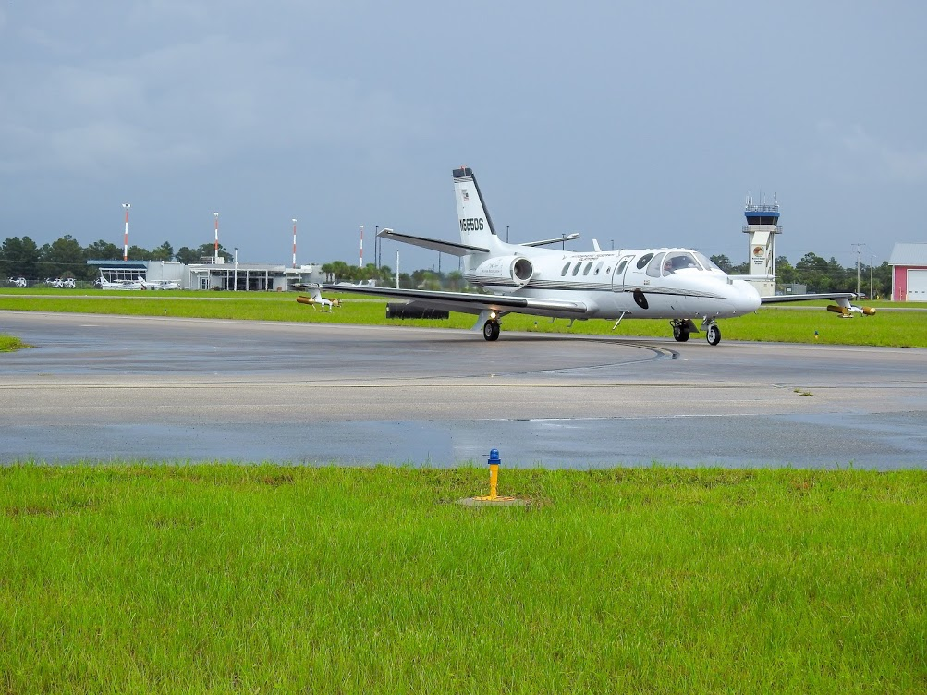
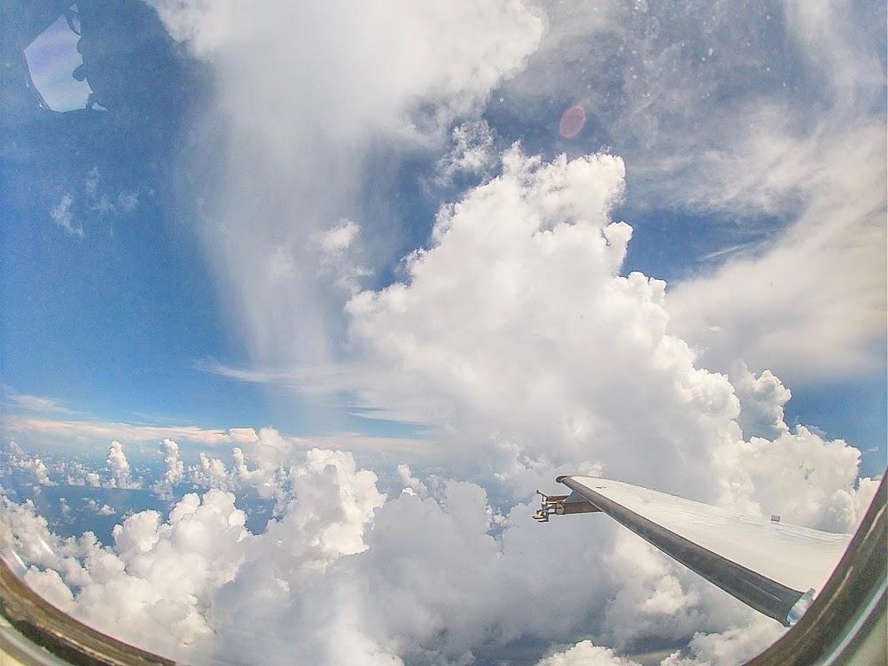
Experiment Objectives
Determine if we can sample biological particles in the anvils of thunderstorms.
Use DNA sequencing to determine the kinds of bacteria and fungi sampled, and identify their origins by relating their types to surface locations.

Slide 8
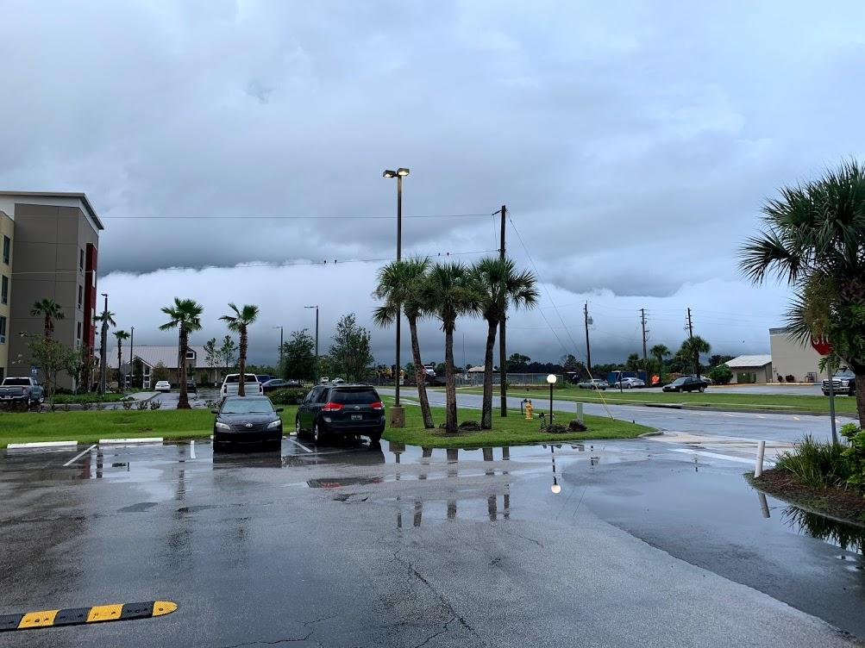
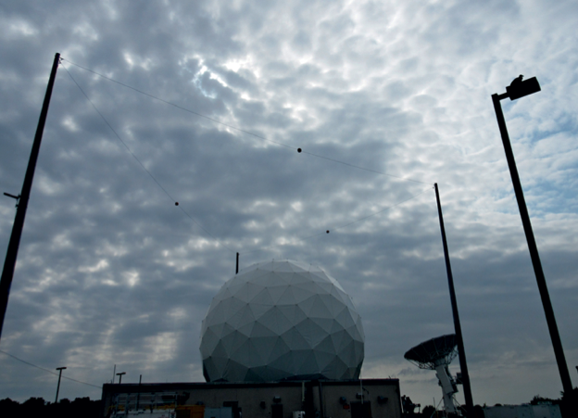
CapeEx19 Field Campaign
Titusville, FL July 22nd - August 3rd, 2019.
Grant from Naval Surface Weather Center to improve understanding of thunderstorms.
Combines aircraft measurements, observations with US Navy’s Mid Course Doppler Radar (MCR) to develop better cloud models.
Biological particles experiment a side project of the main campaign.

Slide 9
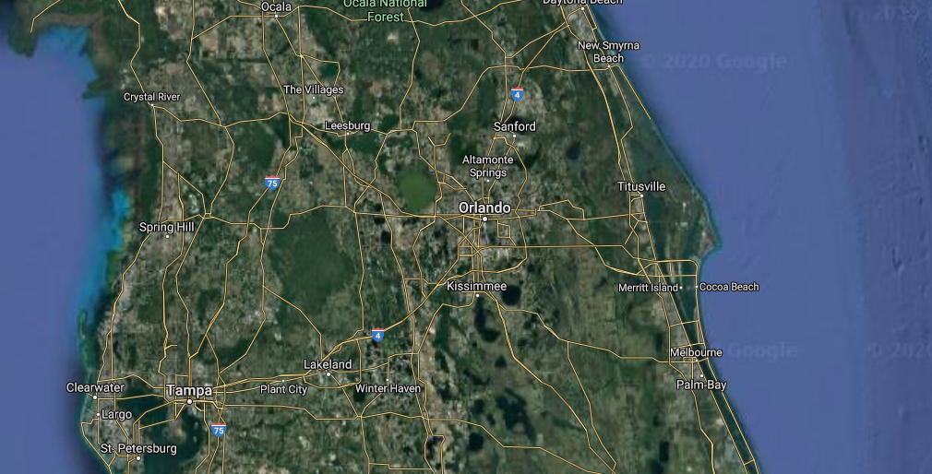
Titusville, FL

Slide 10
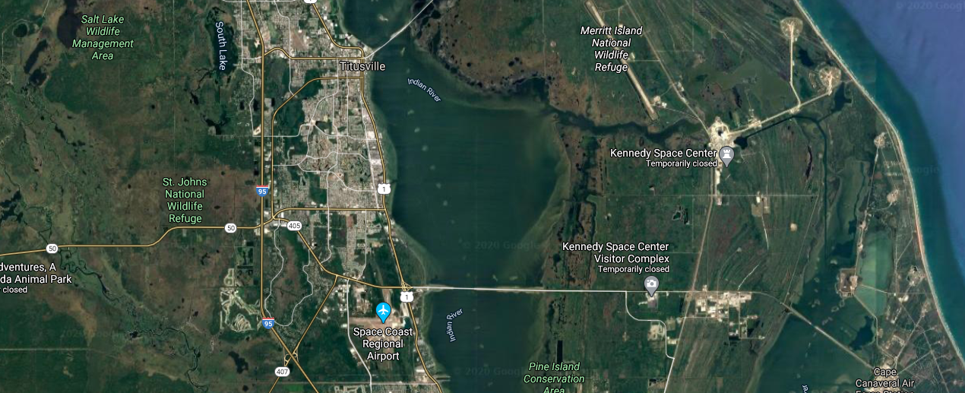
Space Coast Regional Airport (KTIX)
KTIX

Slide 11
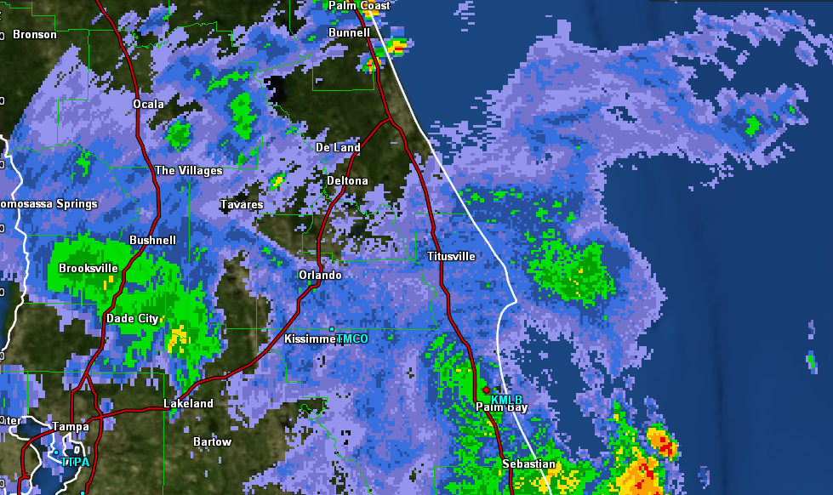
Melbourne Radar (KMLB) - 7/25/19 @18:54:46 UTC
Aircraft
KMLB
Radar Site

Slide 12
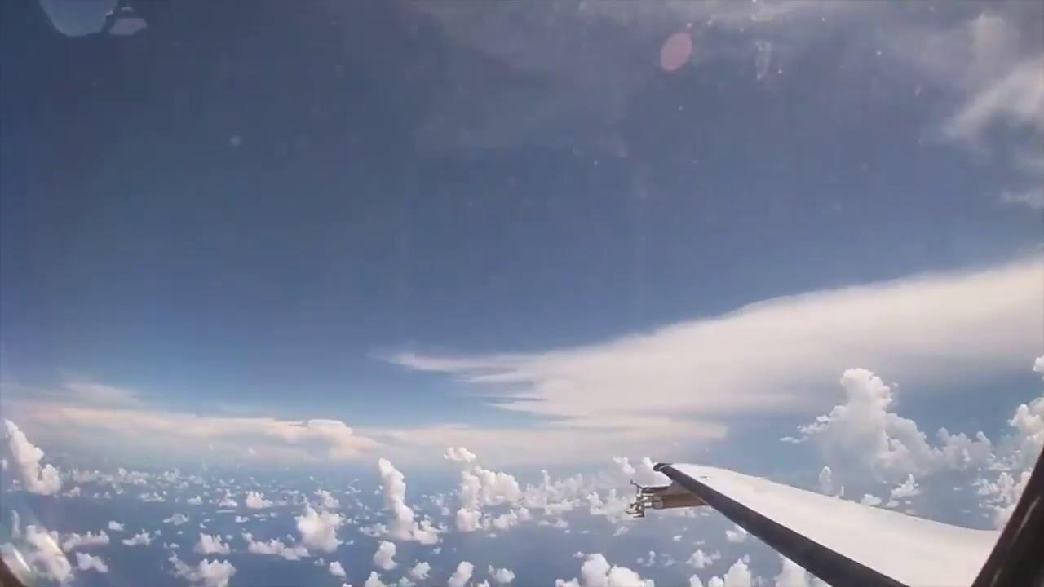
Onboard Citation Research Aircraft

Slide 13
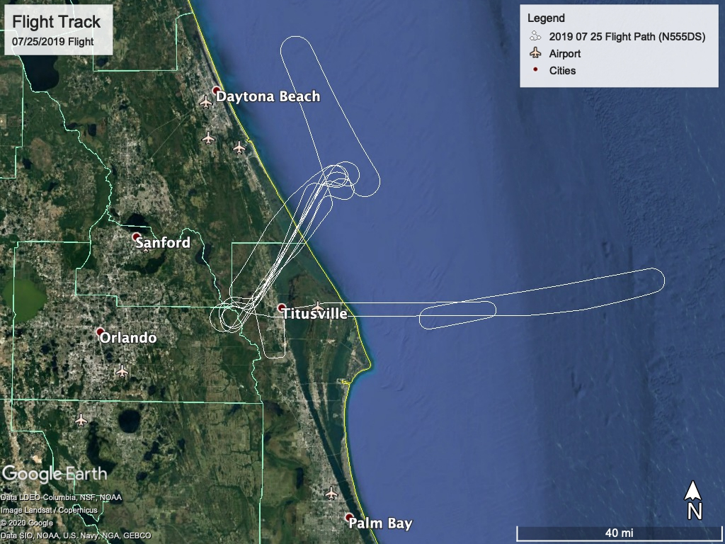
Flight Track Example (7/25/19)
Takeoff: 18:02:52 UTC
Landed: 20:14:40 UTC

Slide 14
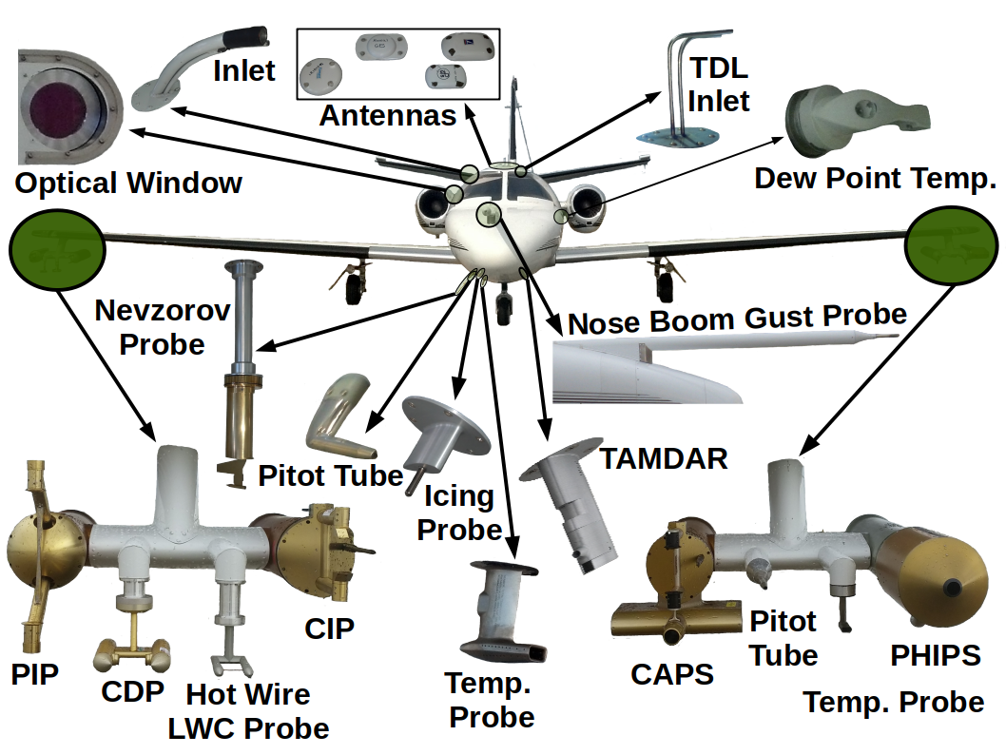
Methods - Aircraft Instrumentation
North Dakota Citation Research Jet participated in CapeEx19 Field Campaign in Titusville, FL summer 2019
Instrument rack held filter holder tied into aircraft’s inlet.
Priority of good airflow, sampling control valves, and prevention of decompression due to pressure changes.
Figure 3: CPC inlet is labeled as “heated inlet”.

Slide 15
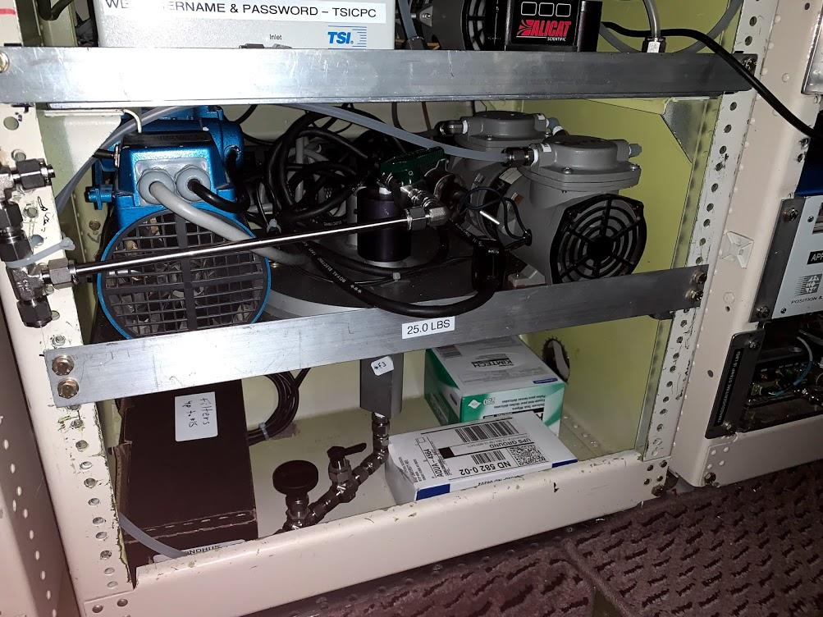
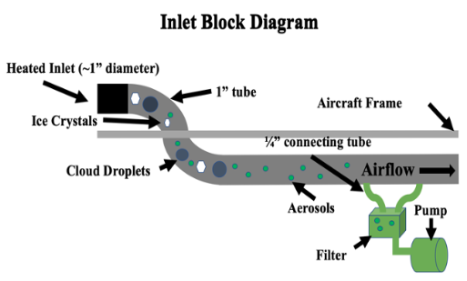
Aircraft Filter System
Inlet
Figure 4: Diagram of filter inlet inside the plane. Real pictures on the right.

Slide 16
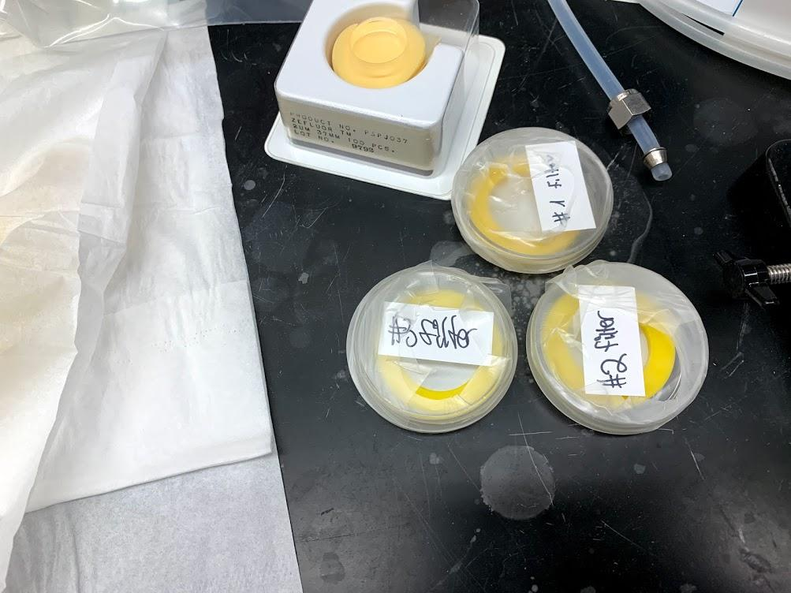
Methods - Pre Experiment Prep
37mm tissuquartz filters 0.45 μm pores were sterilized from contaminants via autoclaving (121 °C for 45 min.).
Placed inside filter holders, sealed in containers.
Before each flight, filter was taken from container and placed inside filter holder (done carefully with clean gloves and 98% ethanol-based alcohol).
Filter valves opened when ready for sampling, closed when done
After landing, filter removed from aircraft, placed into incubation jar

Slide 17
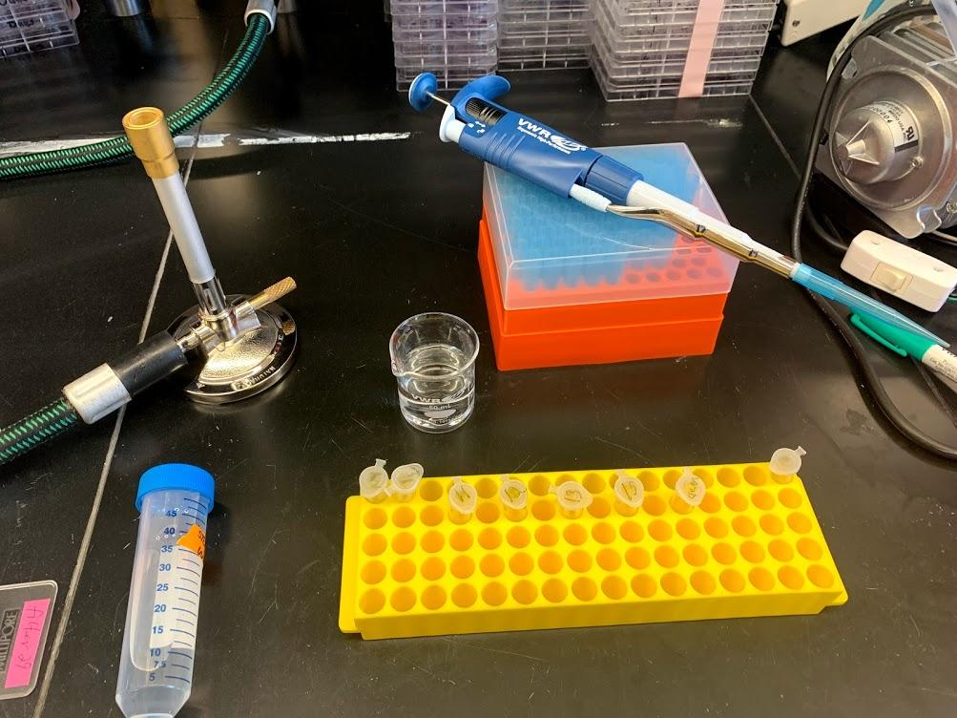
Methods - Post Experiment Prep
Filters cut up carefully, half of it placed into 2 ml RNA/DNA free tubes with 1 ml of double distilled water. Other half preserved.
Bunsen burner used to kill outside contaminants.
Tubes cleaned with ultrasonic bath for 60 min to remove particles from the filter into the water.
Tubes then stored in -80°C freezer until sequencing via ribosomal internal transcribed spacer sequence ITS for fungi, 16S ribosomal RNA-encoding DNA for bacteria

Slide 18
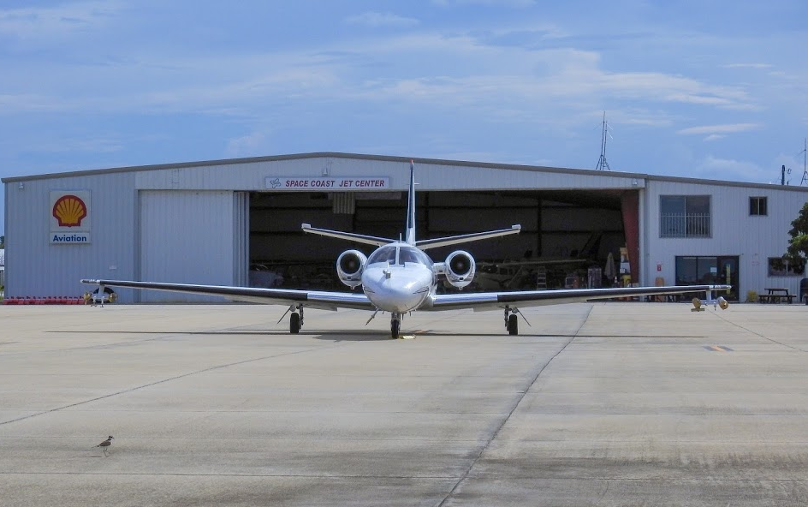
Overview of Results
15 filters used in CapeEx19.
10 filters (4 blanks and 6 in flight) were processed for bacteria and fungi sequencing.
Only 5 filters were completely sequenced.
Sequencing calculates highest top 10 bacteria/fungi types with highest of concentrations (1000’s of bacterias).
Clean Filter (background/control test)
Filter 11 (Blank Flight) (8/2/19)
Filter 12 (Anvil TS40) (8/2/19)
Filter 13 (Anvil TS31) (8/3/19)
Filter 15 (Multi-Cloud TS38) (8/3/19)

Slide 19
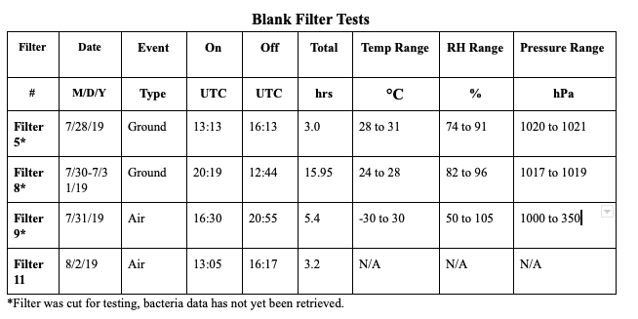
Data Set (Blank Tests)
Blank
Flight Filter

Slide 20
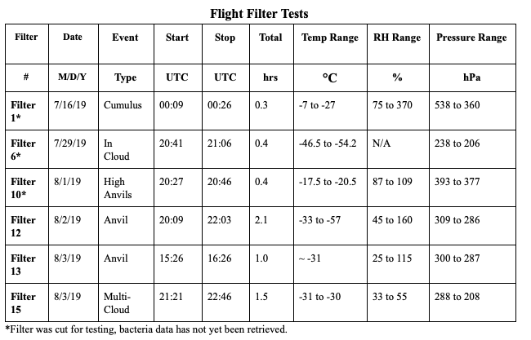
Data Set (Flight Tests)
Anvil TS40
Anvil TS31
Multi-Cloud TS38

Slide 21
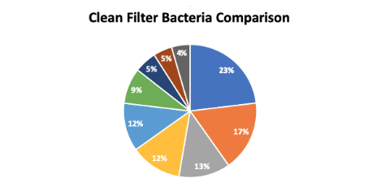
Clean Filter Bacteria Analysis
Aeromonas media (23%) - not widely researched or known (found on Filter 15).
Salinicola halomonas (17%) - first isolated from salt water sample.
Acidobacteria (12%) - found in soils.
Aeromonas (5%) - human related.

Slide 22
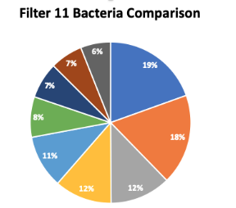
Blank Flight (Filter 11) Bacteria Analysis
Large amounts of sphingomonas yabucchiae (19%), strictly aerobic bacteria, play a role in treatable human infections.
Corynebacterium aurimucosum (18%), rothia mucilaginosa (8%) linked to human diseases.
Ralstonia pickettii (6%) found in moist environments, linked to rare human diseases.

Slide 23
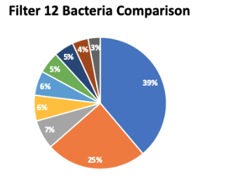
Anvil TS40 (Filter 12) Bacteria Analysis
Lactuca Sativa (39%) is likely sourced to lettuce seeds.
Halospirulina (25%) - salt tolerant, not widely known.
Dietzia (7%) - human and animal pathogen.
Pseudomonas (6%) - good ice nucleating agent, comes from soil and water.
Other salt-tolerant bacteria from the halo spirulina species.
Total sample time: 2.1 hrs.

Slide 24
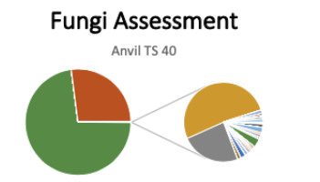
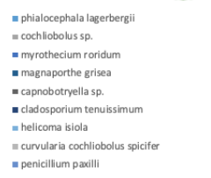
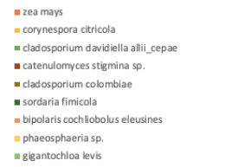
Anvil TS40 Fungi Analysis
Only filter with significant amounts of fungi.
Resupinatus trichotis (72%) - known to grow on underside of decaying wood.
Pichia Kudriavzevii (27%) - found in soil on outside of fruits (McDonald, 2015).
1%
27%
72%

Slide 25
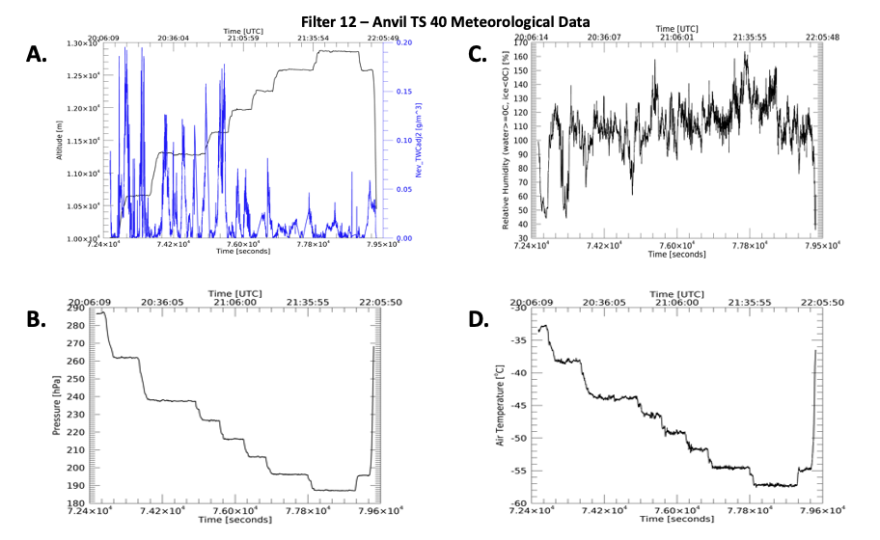
Anvil TS40 Aircraft Data (20:09Z to 22:03Z)

Slide 26
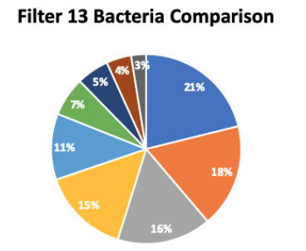
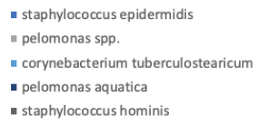
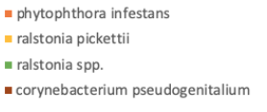
Anvil TS31 (Filter 13) Bacteria Analysis
Phytophthora (18%) - plant pathogenic fungus, causes potato & tomato disease.
Staphylococcus epidermidis (21%) - normal human flora from skin.
Pelomonas (16%) and ralstonia pickettii (15%) are natural water sourced bacteria.
Total sample time: 1.0 hr.

Slide 27
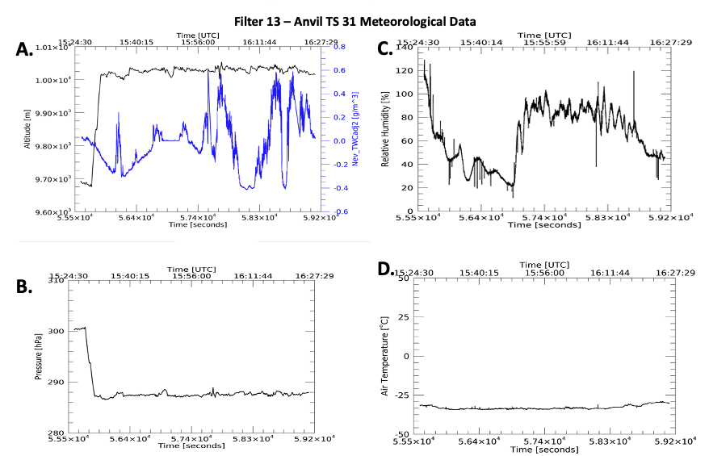
Anvil TS31 Aircraft Data (15:26Z to 16:26Z)

Slide 28
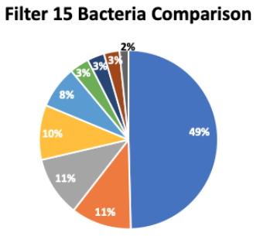
Multi-Cloud TS38 (Filter 15) Bacteria Analysis
Streptococcus salivarius (49%) - oral and respiratory portions of human body (McDonald, 2015).
Acinetobacter junii (11%) - linked to nosocomial infections, streptococcus, pyogenes.
Brevibacterium jeotgali (8%) - related to producing antibiotics.
Aeromonas (genus) (3%) - ubiquitous in fresh and brackish water.
Total sample time: 1.5 hrs.

Slide 29
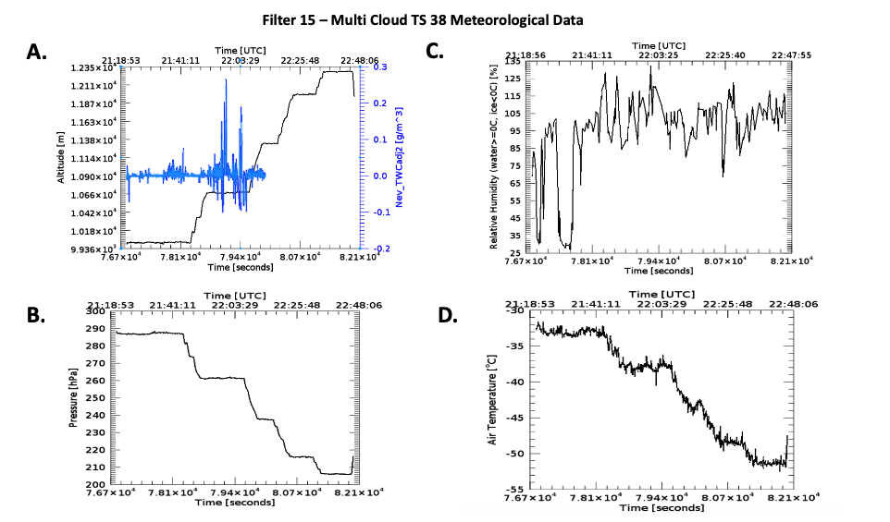
Multi-Cloud TS38 Aircraft Data (15:26Z to 16:26Z)

Slide 30
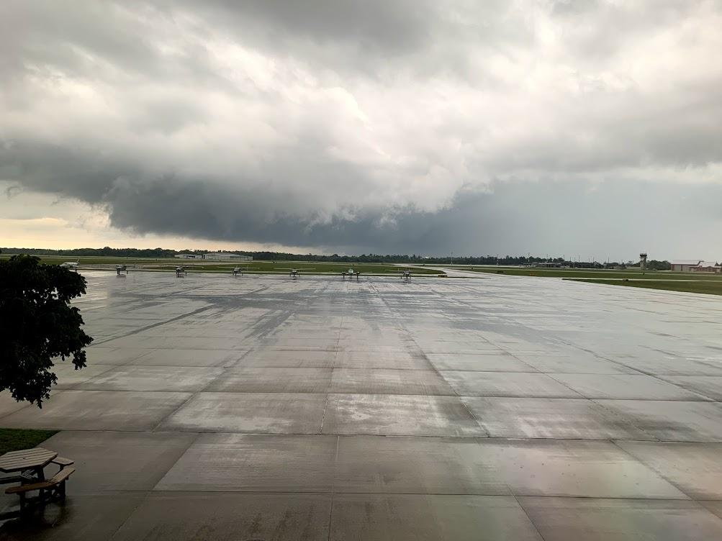
Summary of Results
Anvil TS40 had the most variety of species and was the only filter with fungi.
Many species pertained to natural plants found in the Florida region.
Salt-tolerant bacterias likely came from ocean waters.
Pseudomonas Syringae found, most well known INP bacteria.
Higher amounts of human-related bacteria found on Multi-Cloud TS38, likely due to human contamination.

Slide 31
Conclusions
Challenges collecting data still present with human-related bacteria present.
Best ice nucleating particles come from soils, and waters.
Can play huge role in microphysical processes in atmospheric waters.
Particles can be carried up into atmosphere and dispersed miles away, spreading diseases.
Photosynthetic particles can have similar climate impacts to greenhouse gases.

Slide 32
Future Work
In addition to filters, implement water sampling techniques.
Reduce contamination exposures when working with filters - in lab and on plane.
Sample in different types of clouds (cirrus, stratocumulus, etc.).
Compare with different altitudes between high level and low level samples.

Slide 33
Acknowledgements
The National Institute of General Medical Sciences of the National Institutes of Health (Award T34GM122835) supported Harrison Rademacher. The content present is the author’s responsibility and does not necessarily represent the official views of the NIH.
Special thanks to:
Weather Modification Incorporated and U.S. Navy in cooperation for CapeEx19.
Dr. Karin Ardon-Dryer and Dr. Michael San Francisco of Texas Tech University for help preparing the filters.
Dr. David Delene and his students for help installing filter rack and retrieving data from aircraft instruments.
The UND MARC U-STAR program for funding and research support.
Questions?

Slide 34
References
Burrows, S. M., W. Elbert, M.G. Lawrence, and U. Poschl, 2009: Bacteria in the global atmosphere - Part 1: Review and synthesis of literature data for different ecosystems. Atmos. Chem. Phys., 9, 9263-9280, https://doi.org/10.5194/acp-9-9263-2009.
DasSarma, P., and S. DasSarma, 2018: Survival of microbes in Earth’s stratosphere. Current Opinion in Microbiology, 43, 24-30, https://doi.org/10.1016/j.mib.2017.11.002.
Harbizadeh, A., and Coauthors, 2019: Indoor and outdoor airborne bacteria air quality in day-care centers (DCCs) in greater Ahvaz, Iran. Atmospheric Environment, 216, 116927, https://doi.org/10.1016/j.atmosenv.2019.116927
Hu, W., H. Niu, K. Murata, Z. Wu, M. Hu, T. Kojima, and D. Zhang, 2018: Bacteria in atmospheric waters: Detection, characteristics and implications. Atmospheric Environment, 179, 201-221, https://doi.org/10.1016/j.atmosenv.2018.02.
Matthias-Maser, S., B. Bogs, and R. Jaenicke, 2000: The size distribution of primary biological aerosol particles in cloud water on the mountain Kleiner Feldberg/Taunus (FRG). Atmospheric Research, 54, 1-13, https://doi.org/10.1016/S0169-8095(00)00039-9.026.
McDonald, J, and R. Greg Thorn, 2015: Morphological and Molecular Systematics of Resupinatus (Basidiomycota). Electronic Thesis and Dissertation Repository, 3135, doi: https://ir.lib.uwo.ca/etd/3135
Murray, B.J., D. O’Sullivan, J.D. Atkinson, and M.E. Webb, 2012: Ice nucleation by particles immersed in supercooled cloud droplets. Chem. Soc. Rev., 41, 6519-6554, doi:10.1039/c2cs35200a.
Whitby, K. T, 1977: The physical characteristics of sulfur aerosols. Atmospheric Environment, 12, 135-159, https://doi.org/10.1016/0004-6981(78)90196-8.

