Slide 1
Development of an Open Hardware, Modular, Weather Balloon Package
Evelyn Haase, Reed College, Portland, OR
Advisors Dr. David Delene and Dr. Ron Fevig
Research Experience for Undergraduates, University of North Dakota

Slide 2
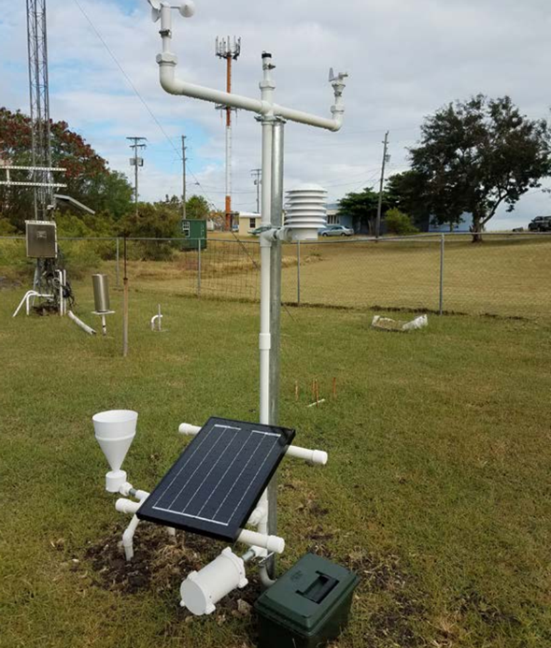
3D Printed Automatic Weather Station (3D-PAWS)
Development Support
  University Corporation for Atmospheric Research (UCAR)
  US National Weather Service International Activities Office (NWS IAO)
  USAID Office of U.S. Foreign Disaster Assistance (OFDA)
Benefits
  Readily available materials
  Beginner-friendly single board computers (Raspberry pi)
  Primarily 3D printed parts
  Open source
    Useful for educational settings
3D-PAWS https://sites.google.com/ucar.edu/3dpaws/instruments.

Slide 3
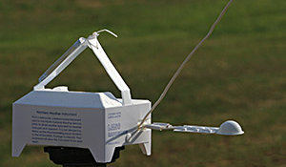
Atmospheric Weather Balloons and Balloon Packages
Latex Weather Balloon
Radiosonde
3D-PAWS
Radio Transmitter for real-time data downlink
Wind speed
Wind direction
Precipitation
Visible/UV/ Infrared light
Temperature
Pressure
Relative Humidity
Parachute
Balloon Package
3D-PAWS https://sites.google.com/ucar.edu/3dpaws/instruments.
US Department of Commerce, N. NWS JetStream - Radiosondes. https://www.weather.gov/jetstream/radiosondes.

Slide 4
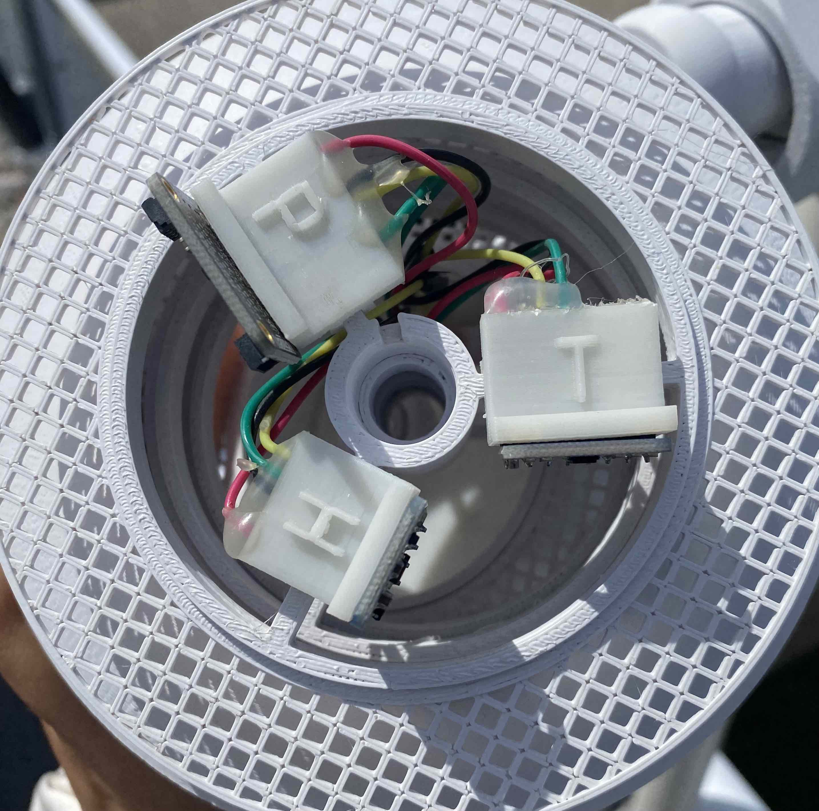
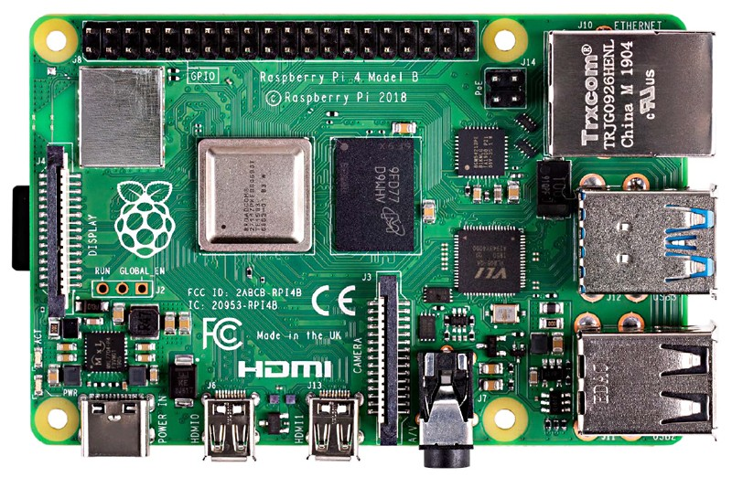
Project Overview
Design 3D printed package housing
Test system battery duration
Connect T, P, RH sensors to Raspberry Pi
Preform weather balloon test to compare to Radiosonde data
Compare and analyze results, make changes where necessary
Print and assemble balloon package
Image credit: What is a Raspberry Pi? | Opensource.com.

Slide 5
Design Considerations
Modular Design
  Many types of balloon packages
    Radiosonde
    Ozonesonde
Open Hardware
  Developing open-source 3D printing files
  Using existing open-source code from 3D-PAWS
Documentation
  Wiki page

Slide 6
Acknowledgments
Advisors Dr. David Delene and Dr. Ron Fevig
Dr. Frank Bowman
IREC REU Program at the University of North Dakota
National Science Foundation REU Grant No. CHE 175922

