Slide 1
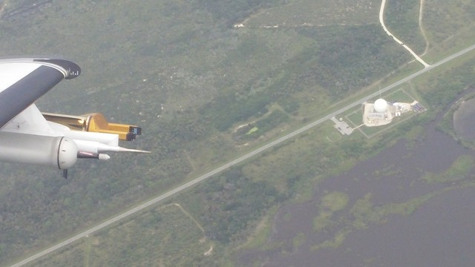
Comparison of Concurrent Radar and Aircraft Measurements of Cirrus Clouds
Committee Members:
Dr. David Delene*, UND
Dr. Matthew Gilmore, UND
Dr. Jerome Schmidt, NRL-MRY
Dr. Paul Harasti, NRL-MRY
* Committee Chair
Nicholas Gapp
M.S. Thesis Defense
University of North Dakota
Grand Forks, North Dakota
2019/06/07

Slide 2
Motivation for Research
Cirrus clouds are important
Everywhere
Tough to model and predict
More understanding is needed to derive vertically integrated cloud water content
Many previous studies and field projects have researched cirrus clouds
Cirrus Regional Study of Tropical Anvils and Cirrus Layers—Florida Area Cirrus Experiment (CRYSTAL-FACE) (Jensen et al. 2004)

Slide 3
3
CRYSTAL-FACE
Summer 2002 field project in southern Florida
Studied cirrus cloud shields from deep convection
Six aircraft including North Dakota Cessna Citation II Research Aircraft
A couple goals:
Study physical processes in and properties of cirrus anvils
Dependence of cirrus properties on strength of convection and state of environment
Found that anvil ice crystals are smaller and more reflective than what was assumed in global climate models of the day
Among many other findings
Notes:
CRYSTAL-FACE: Cirrus Regional Study of Tropical Anvils and Cirrus Layers—Florida Area Cirrus Experiment
- Took place in southern FL in summer 2002
- Studied thunderstorm anvils

Slide 4
4
The CAPE2015 Field Experiment
Near Cape Canaveral, Florida, from 28 July to 11 August, 2015
Studied cirrus cloud anvils from Florida thunderstorms
Different from other studies
Concurrent measurements between in-situ (aircraft) and remote (radar) platforms
Goals:
Derive vertical profiles of cloud water content from radar returns for weapons assessment (Z-WC relationship),
Apply knowledge gained from land-based data to shipborne radars in remote areas of the world, and
Improve scientific understanding of cloud systems in both microphysical and dynamical senses to improve inputs in models.

Slide 5
5
Motivation for This Research
Satisfy Goal 1 of CAPE2015 Field Experiment.
Obtain a radar reflectivity factor (Z)-measured cloud water content (WC) relationship.
I have been involved with this research since data collection.

Slide 6
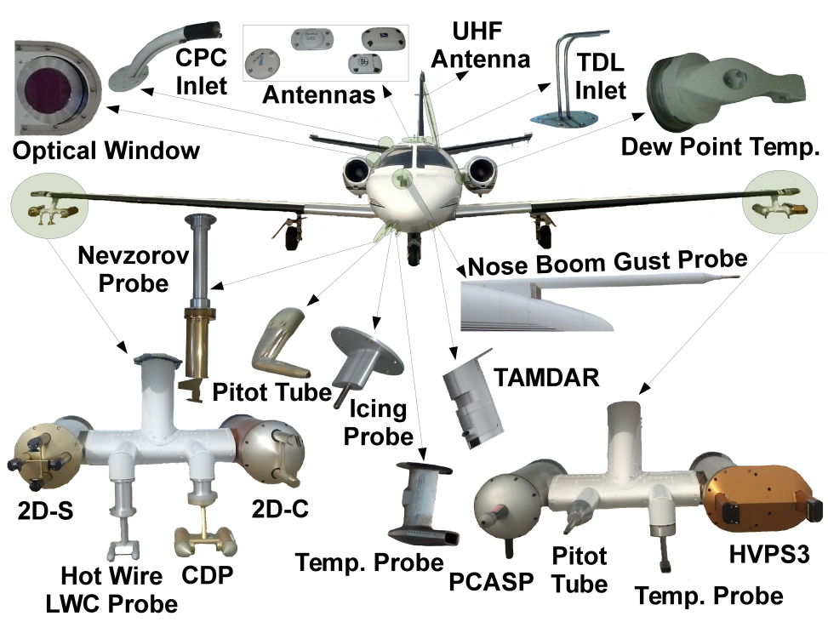
6
Aircraft Instrumentation

Slide 7
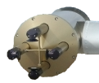
7
Two-Dimensional Stereographic Probe (2D-S)
Optical array probe with two lasers oriented perpendicular (Lawson et al. 2006)
128 10-um photodiodes
10-2000 µm
Cloud particles shadow diodes and image is recorded
Data post-processing reconstructs images and sorts by diameter (29 size bins)
Anti-shatter tips

Slide 8
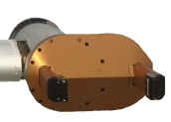
8
High-Volume Precipitation Spectrometer Version 3 (HVPS3)
Optical array probe with one laser oriented horizontally (Lawson et al. 1993)
128 150-um photodiodes
150 µm to 3 cm
Cloud particles shadow diodes and image is recorded
Data post-processing reconstructs images and sorts by diameter (28 size bins)
Anti-shatter tips

Slide 9
9
Nevzorov Water Content Probe
Constant-temperature, hot-wire probe (Korolev et al. 1998)
Measures total (TWC) and liquid water content (LWC) with cone and wire, respectively
0.003-3.0 g/m³
Ice particles <4 mm melt entirely in TWC sensor (Korolev et al. 2013)
Larger particles may bounce out
Flight correct and base-line adjust data

Slide 10
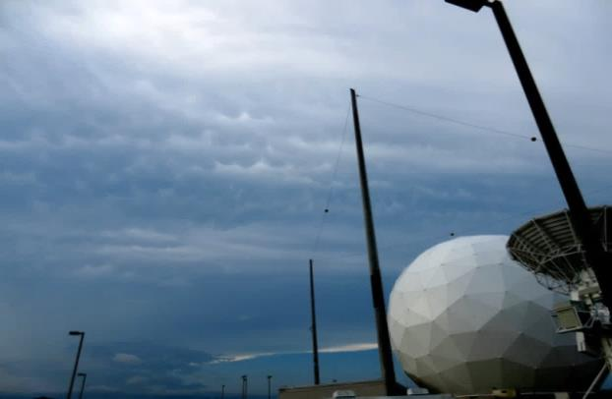
10
Mid-Course Radar (MCR)
Primary features:
C-band dual-polarization Doppler radar
3 MW peak power & 0.2° beamwidth
Real-time satellite & aircraft tracking
Two waveforms:
Narrowband (37 m range resolution with two 75 km range windows
Wideband (0.5 m range resolution with two 400 m range windows
Range windows
MCR
MCR
15.4m Dish
30 July 2015 Wideband Data
- 20
-
- 10
300 m
Reflectivity [dBZ]
-
- 0
200 s
-
Schmidt et al. (2019); images courtesy of Jerome Schmidt

Slide 11
11
MCR
 | MCR | UND WSR-74C | NWS WSR-88D
Antenna Diameter (m) | 15.24 | 3.66 | 8.53
Beamwidth (degrees) | 0.22 | 0.99 | 1.0
Peak Power (MW) | 3.0 | 0.25 | 0.7
Frequency (GHz) | 5.405-5.895 | 5.6 | 2.7-3.0
Pulse Repetition Frequency (Hz) | 160 (both) or 320 | 250-1200 | 318-1304, 318-452
Pulse Length (µs) | 12.5 | 0.6 or 2.0 | 1.57 or 4.5
Transmitter Polarization | Right circular | Linear, horizontal and vertical | Linear, horizontal and vertical
Receiver Polarization | Right and left circular | Linear, horizontal and vertical | Linear, horizontal and vertical
Maximum Range Resolution (m) | 37 | 300 | 250
Minimum Range Resolution (m) | 0.546 | 90 | 250
Sensitivity at 50 km Range (dBZ ) | -36 (narrowband) -18 (wideband) | -8.0 | -17.4
Schmidt et al. (2019); Rinehart (2010)

Slide 12
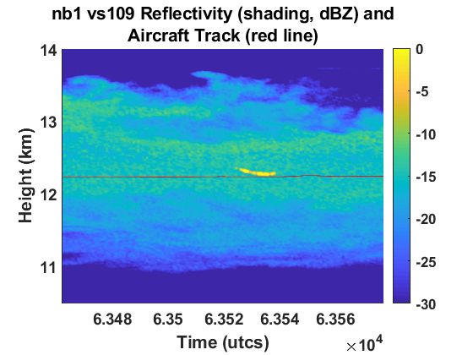
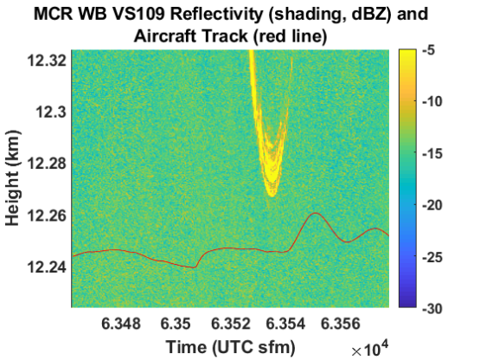
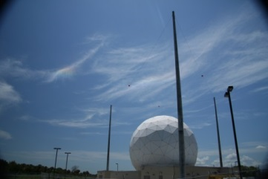
12
Scanning Strategies: Vertical Stare
Narrowband
Wideband
Two co-location options:
MCR operates in vertical stare and waits for aircraft to cross into beam
MCR

Slide 13
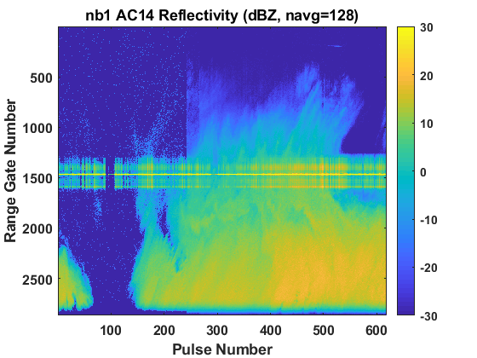
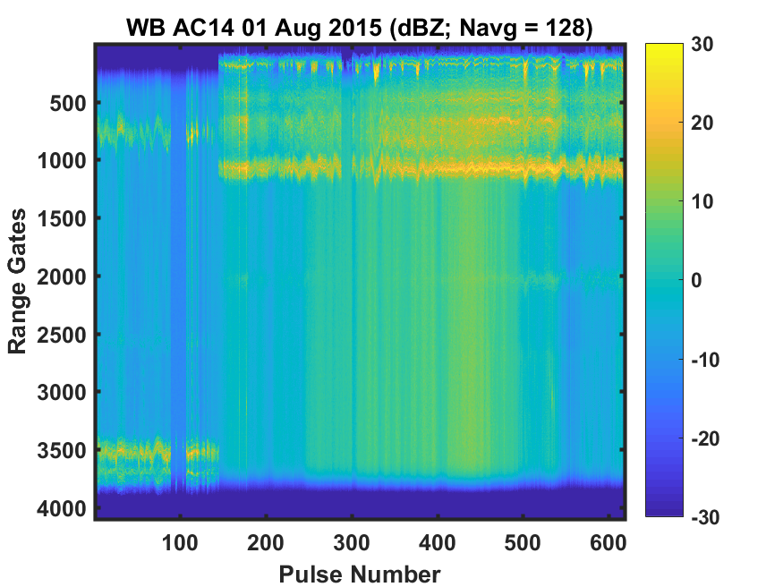
13
Scanning Strategies: Aircraft Tracking
Narrowband
Wideband
Two co-location options:
Track aircraft through the sky by using downlinked GPS information and narrowband beam to lock onto aircraft and follow it with wideband set just ahead of aircraft for concurrent measurements.
Use microphysical measurements to get WC and derive $Z_{e}$, compare $Z_{e}$ to MCR Z to check agreement, and derive Z-WC relationship for vertical profiles.
Will only discuss aircraft tracking results.
MCR

Slide 14
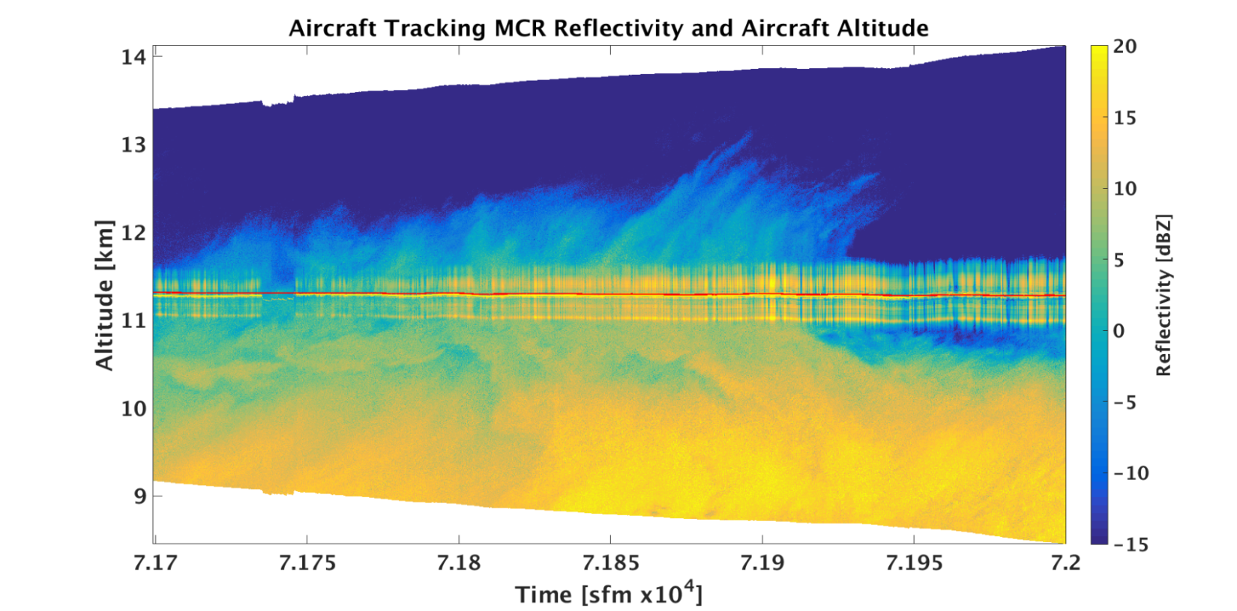
14
MCR
Narrowband (NB) data contaminated from high returns from aircraft
Only wideband (WB) will be used in analysis in this study
Cirrus anvil
Aircraft track
Aircraft contamination

Slide 15
15
Aircraft and Radar Data Comparisons
Derivation of in-situ equivalent radar reflectivity factor ($Z_{e}$)
Merge particle size distributions (PSDs) >100 µm from 2D-S and HVPS3 at 1,000 µm
2D-S particle reconstruction effects are minimized by HVPS3 data
Total particle volume $V_{T}$ per time step from merged PSD bin diameter $D_{i}$ and particle concentration per size bin $N_{i}$
$$V_{T}=\sum_{i}{\frac{π}{6}N_{i}{D_{i}}^{3}}$$
Effective particle density $ρ_{e}$ from Nevzorov particle mass $m_{Nev}$
$$ρ_{e}={m_{Nev}}/{V_{T}}$$
(1)
(2)

Slide 16
16
Aircraft and Radar Data Comparisons
Derivation of in-situ equivalent radar reflectivity factor ($Z_{e}$)
Effective liquid particle size (d) per volume of merged PSD size bin $V_{n}$ and density of water $ρ_{w}$
$$d=\sum_{i}{\sqrt[3]{\frac{6}{π}\frac{V_{i}ρ_{e}}{ρ_{w}}}}$$
Assumes mass of ice equals mass of water
Average d by number of bins that have concentration > 0 #/m³ ($\overline{d}$)
$$Z=10\log{\sum_{i}{N_{i}{{\overline{d}}_{i}}^{6}}}$$
$$Z_{e}=Z−6.5 dBZ$$
Dielectric factor of ice ${\left|K\right|}_{i}^{2}=0.208$ (Smith, 1984)
(3)
(4)
(5)

Slide 17
17
Uncertainty Analysis
Uncertainty in $Z_{e}$ only considers the error in concentration (Poisson Counting Statistics):
$$ε_{rel}=n^{−1/2},$$
where n is the number of counts in a given size bin (Horvath 1990).
Uncertainty in derived radar reflectivity is given by:
$$δz=\frac{∂z}{∂N}δN,$$
where $z=Nd^{6}$ [N is particle concentration and d is liquid-equivalent diameter (Equation 3); z in mm⁶ m⁻³] and $δN$ is absolute uncertainty in particle concentration
Normalize uncertainty per bin and sum (total relative uncertainty):
$$ε_{z}=\sum_{i}{\frac{δz_{i}}{z_{i}}}.$$
(4)
(5)
(6)

Slide 18
18
Uncertainty Analysis
1 second vs. 10 second average
1 second average captures natural variability within atmosphere
10 second average lowers $Z_{e}$ counting uncertainty
Capture systematic differences between data sets

Slide 19
Results

Slide 20
20
Data Analysis
Analysis includes data using following criteria:
Temperatures <= -30 °C (assume all ice particles),
Nevzorov TWC > 0.005 g/m³ (all measurements in-cloud), and
2.5° <= pitch of aircraft <= 4.5° (assume level flight segments).
Date | Start (sfm) | End (sfm) | Min/Max Altitude (m) | Min/Max Temperature (°C) | Points/Percent (# / %)
2015/07/30 | 65,035 | 65,168 | 9,680 / 9,703 | -30.8 / -30.0 | 133 / 100.0
2015/07/31 | 68,466 | 74,812 | 9,526 / 10,019 | -34.2 / -30.1 | 1,760 / 27.7
2015/08/01 | 68,624 | 76,554 | 7,726 / 10,019 | -47.2 / -30.2 | 2,036 / 25.7
2015/08/02 | 71,606 | 73,370 | 9,988 / 10,337 | -36.7 / -32.7 | 467 / 26.5
Notes:
Discuss table:
- 4 flights meet criteria for at least one minute
- Entire time period doesn’t meet criteria, just about 27% of data overall

Slide 21
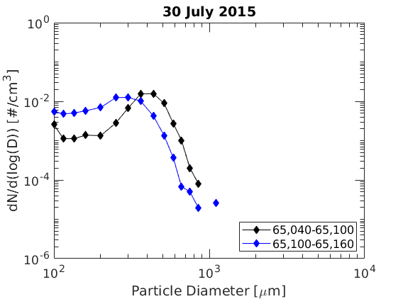
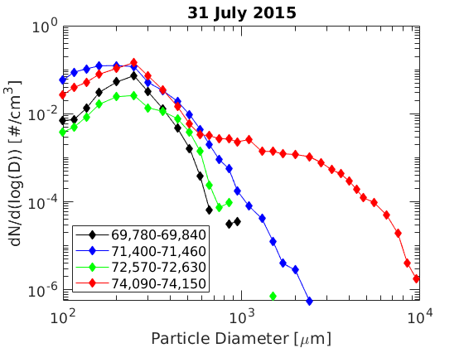
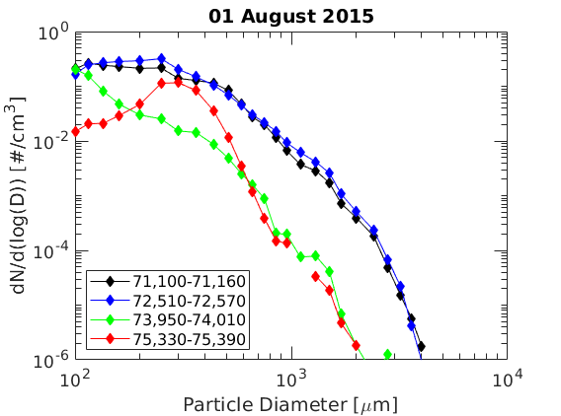
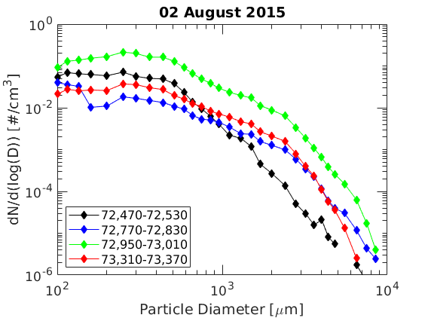
21
Particle size distributions (PSDs)
Each PSD is average of 1 min particle concentration data
7.7-10.3 km, -30 to -47 °C
High concentrations of small particles except on 02 August
Large variability
Standard deviations
Notes:
Standard deviations of bulk parameters within analysis criteria often match or exceed mean values

Slide 22
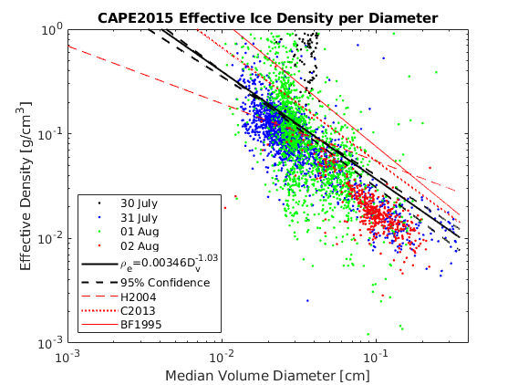
22
CAPE2015 Effective Particle Density
Each dot is calculated using Equation 2.
Red lines are: Heymsfield et al. (2004) (H2004), Cotton et al. (2013) (C2013), and Brown and Francis (1995)
Exponential slope of power law line of best fit mostly agrees with previous studies.
Densities are smaller >300 µm

Slide 23
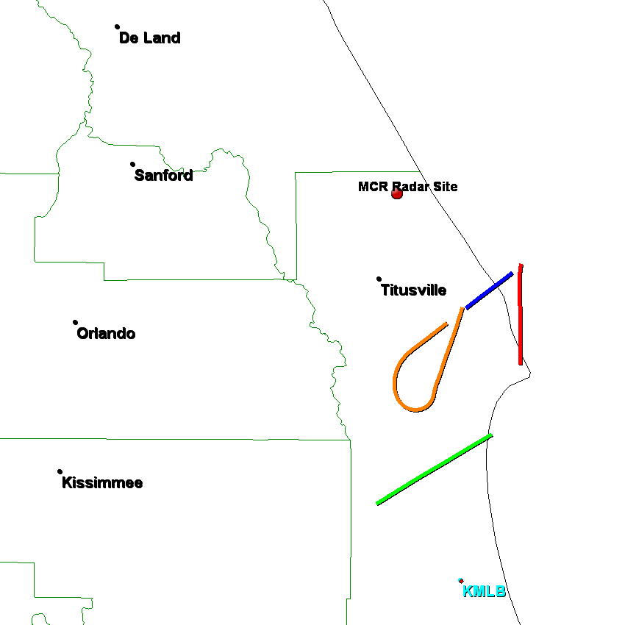
23
01 August 2015 Case Study
34 minutes of data where MCR tracks aircraft
AC13-AC16
Analysis is completed using Data Analysis criteria
AC13
AC14
AC15
AC16
25 km
25 km

Slide 24
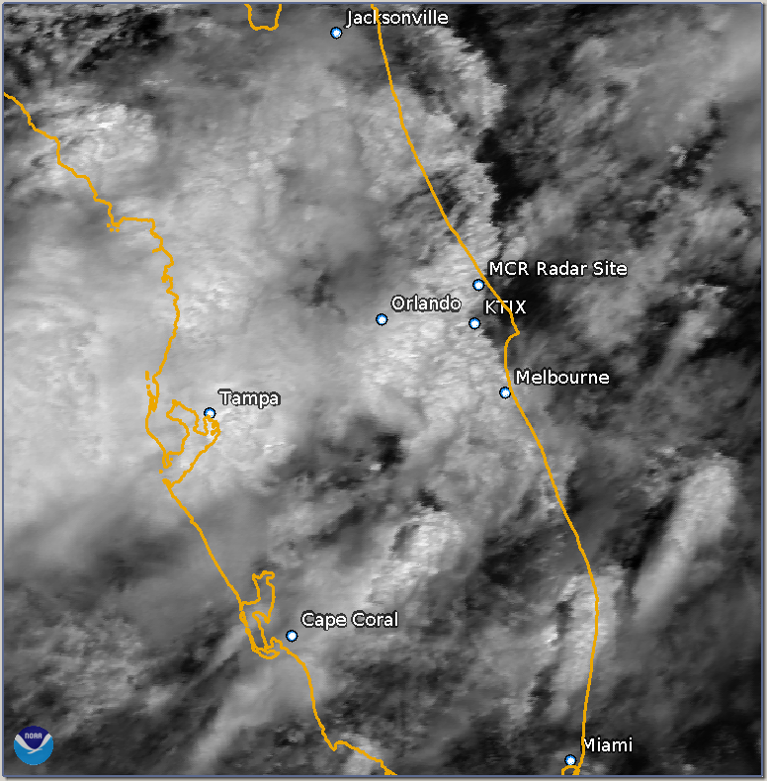
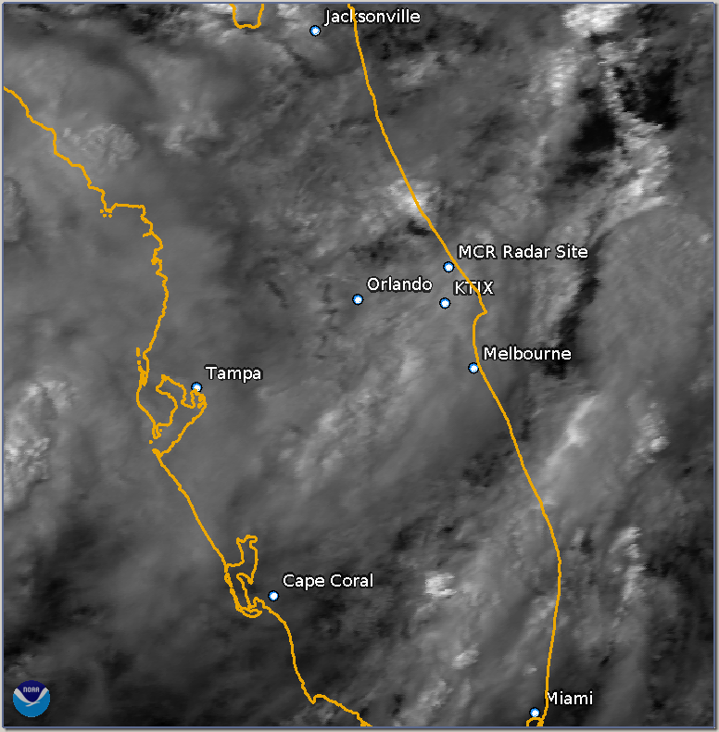
24
01 August 2015 Case Study
18:00 UTC Visible Satellite
21:00 UTC Visible Satellite
50 km
50 km
50 km
50 km

Slide 25
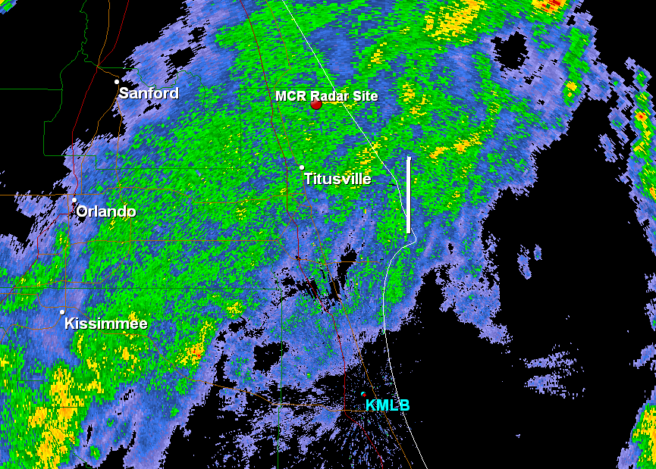
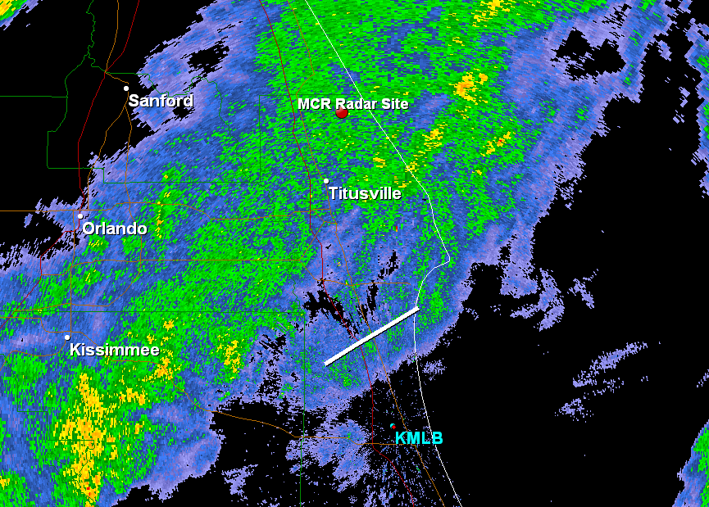
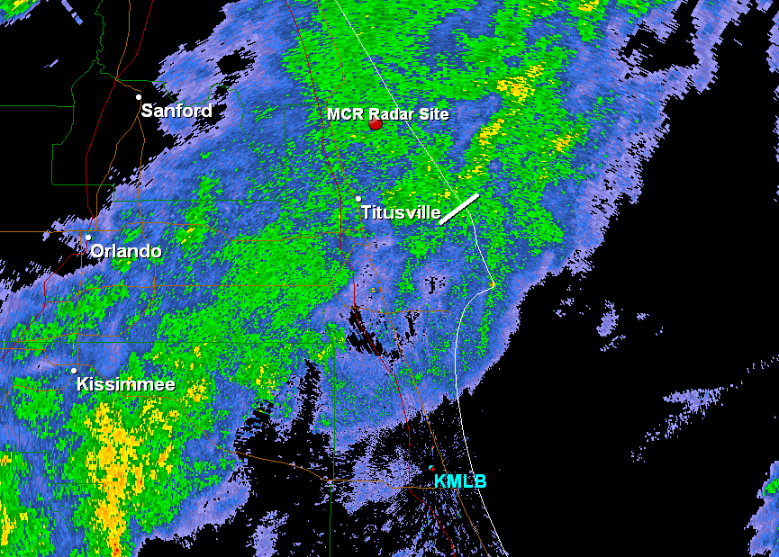
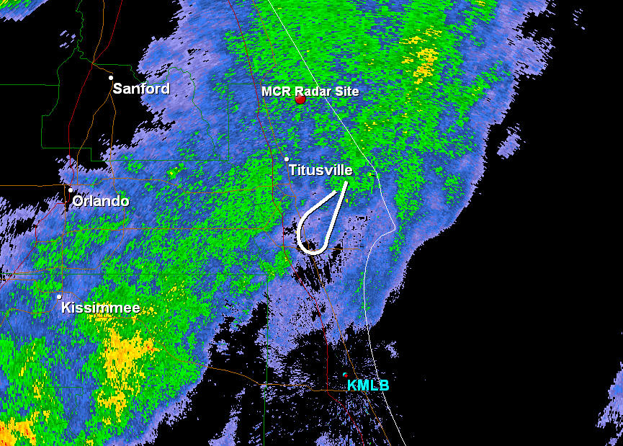
80
AC13
AC14
dBZ
Base reflectivity scan from KMLB nearest each case
Stayed away from areas strong convection
80
70
60
50
AC15
AC16
40
30
20
10
Notes:
(a) 71154.2-71277.7 sfm,( b) 71717.4-71903.3 sfm, (c) 72425.5-72500.0 sfm, and (d) 72530.0-72839.1 sfm.

Slide 26
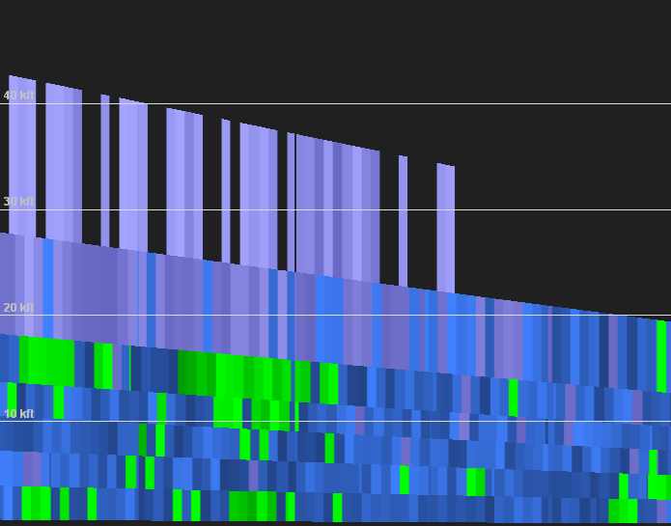
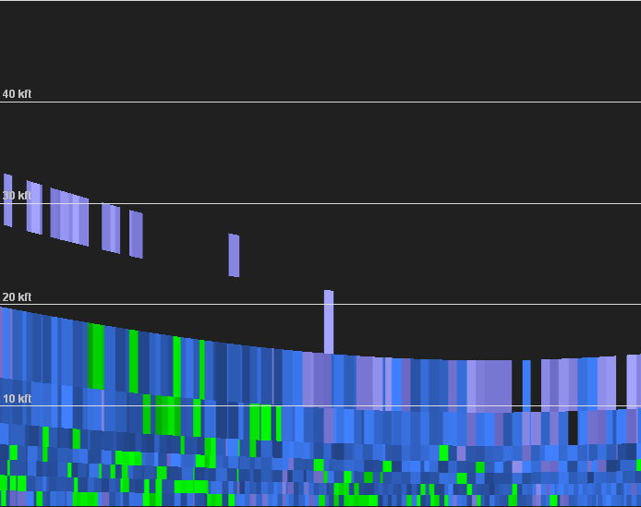
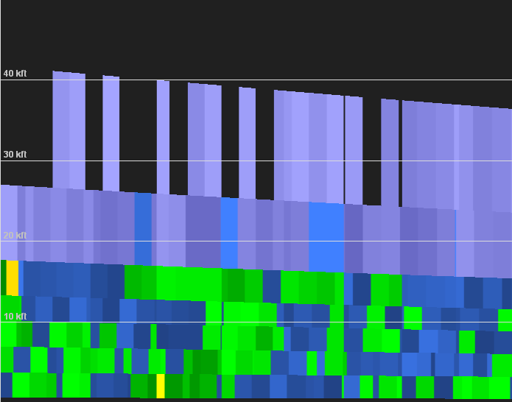
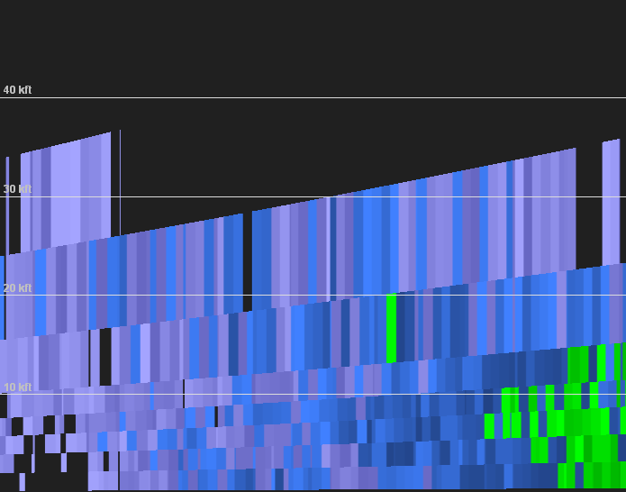
80
kft
40
30
20
10
AC13
AC14
dBZ
Cross-sections of scans from KMLB for each case
Note lack of data at flight levels
80
70
60
50
kft
40
30
20
10
AC15
AC16
40
30
20
10

Slide 27
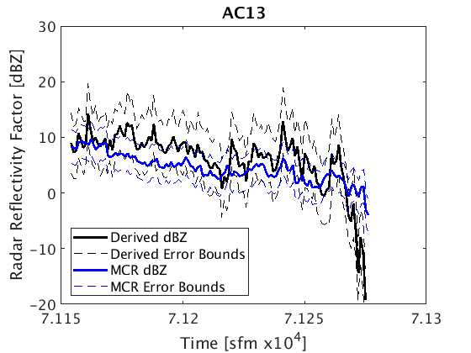
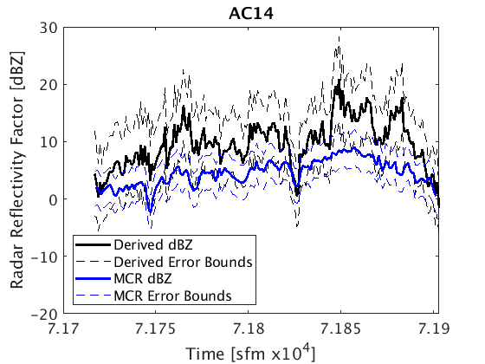
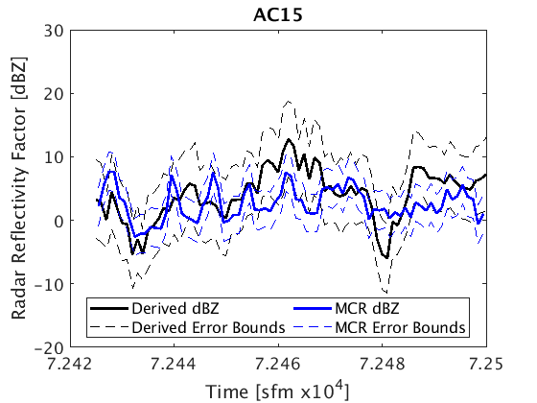
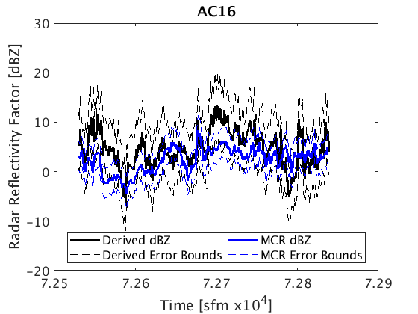
Comparisons between $Z_{e}$ and MCR reflectivity factor
1 s average
Uncertainties up to ±455 % for $Z_{e}$
±3 dBZ bias assumed for MCR
96 %
90 %
97 %
98 %

Slide 28
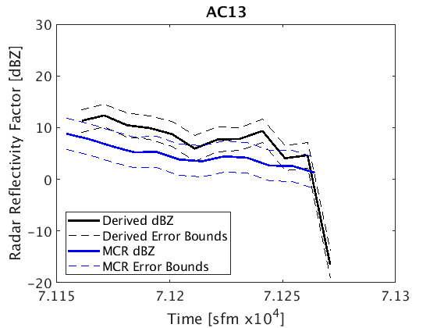
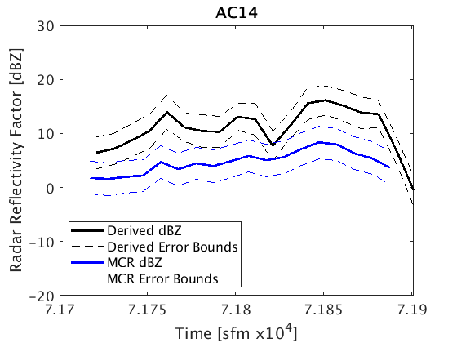
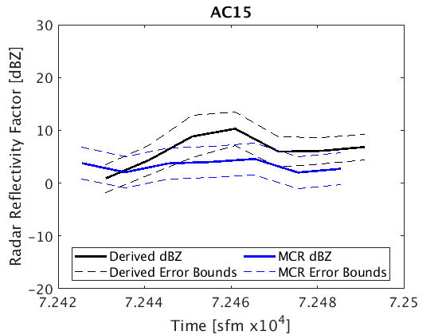
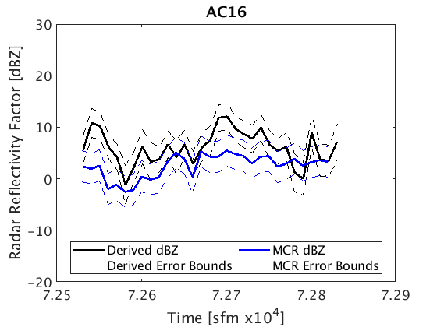
Comparisons between $Z_{e}$ and MCR reflectivity factor
10 s average
Uncertainties up to ±150 % for $Z_{e}$
±3 dBZ bias assumed for MCR
92 %
27 %
86 %
80 %

Slide 29
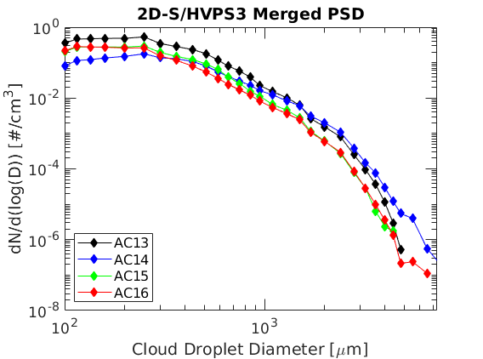
29
01 August 2015 Case Study
Atmospheric conditions for all tracking data are very similar
AC14 case in not good agreement
90 % and 27 %
AC13 case in good agreement
96 % and 86 %

Slide 30
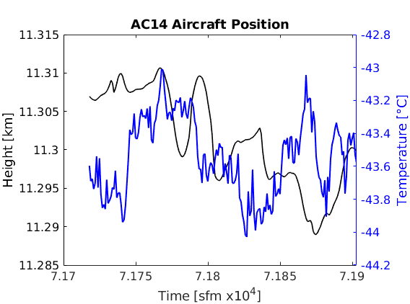
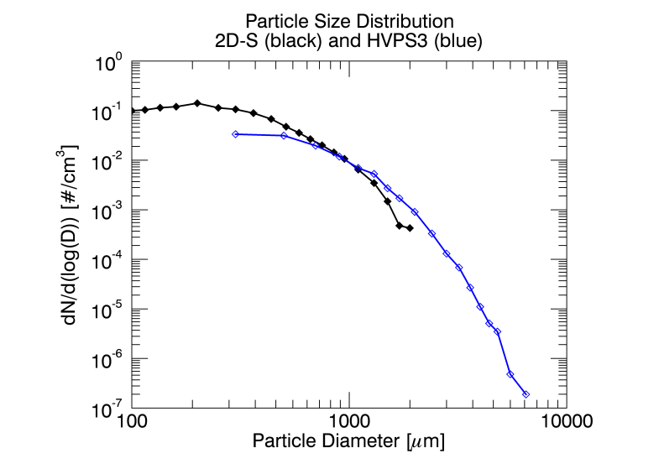
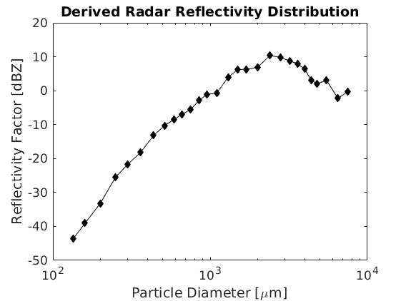
AC14
a)
c)
1
2
3
Not good agreement
~11.3 km and -43.5 °C
Particles greater than 500 µm observed
Peak reflectivity factor at 12 dBZ and 2,500 µm
b)
d)
1
2
3
Notes:
Work down in columns starting with left column and moving to right

Slide 31
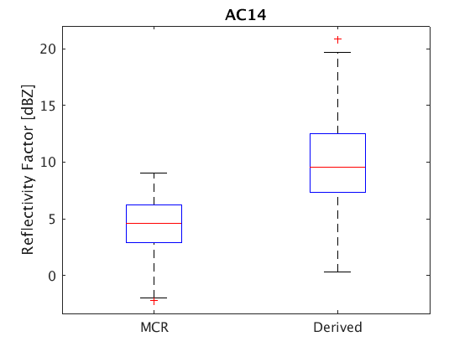
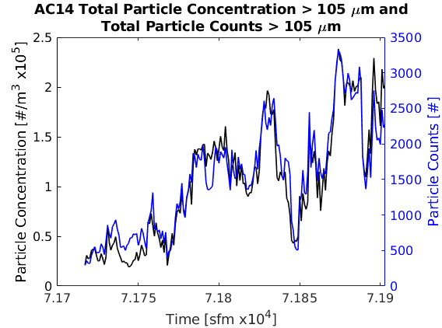
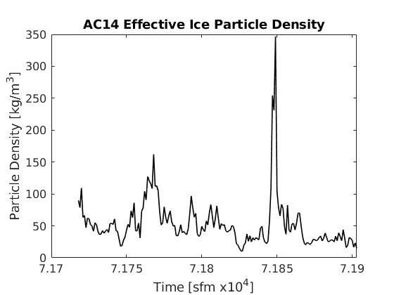
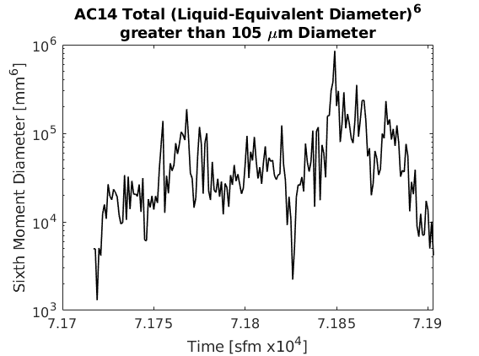
a)
c)
AC14
Not good agreement
53 kg/m³ average effective particle density
Same order of magnitude for particle concentration and LED⁶
75 %
50 %
75 %
25 %
50 %
25 %
b)
d)
Notes:
N and LED^6 hold equal weight in Z_e calculation

Slide 32
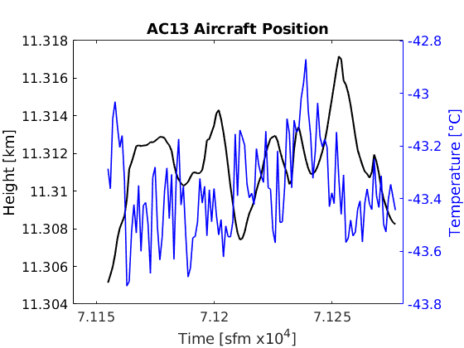
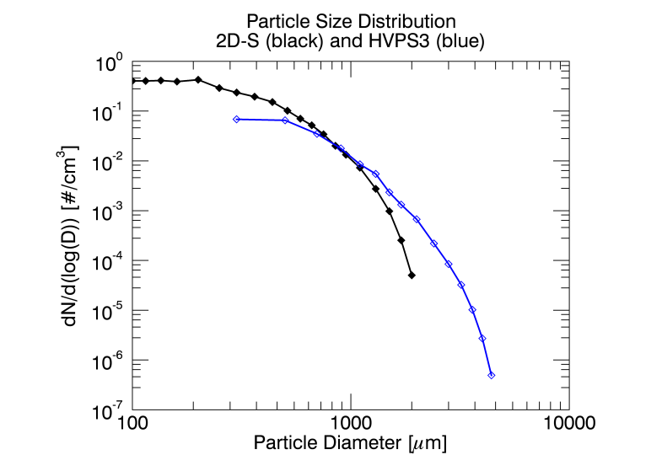
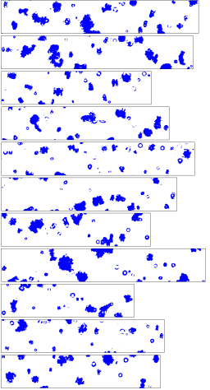
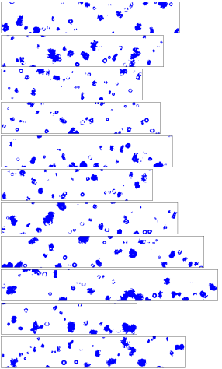
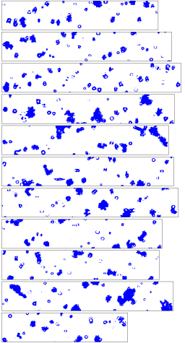
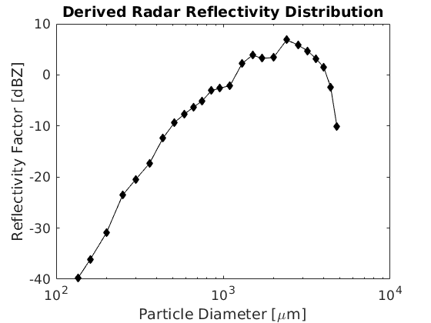
AC13
a)
c)
1
2
3
Good agreement
~11.3 km and -43.4 °C
Particles greater than 500 µm observed
Peak reflectivity factor at 9 dBZ and 2,500 µm
b)
d)
1
2
3
Notes:
- Work down in columns starting with left column and moving to right
- Lower concentration of larger particles than AC14, so large particles stop being important in Z summation sooner than AC14

Slide 33
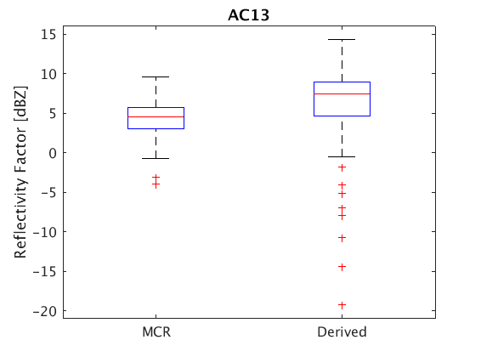
AC13
a)
c)
Good agreement
37 kg/m³ average effective particle density
Same order of magnitude for particle concentration and LED⁶
b)
d)
Notes:
N and LED^6 hold equal weight in Z_e calculation
Effective density is also lower than AC14, so that could also contribute to better agreement with MCR Z

Slide 34
34
CAPE2015 MCR Reflectivity Factor-TWC
Red lines are: Heymsfield et al. (2005) (H2005), Sassen (1987)* (S1987), and Heymsfield (1977)* (H1977)
Asterisks denote the use of reported mass-dimensional relationship
Exponential slope of power law line of best fit mostly agrees with H2005.
CRYSTAL-FACE
Notes:
-3 dBZ to 10 dBZ is covered in plot

Slide 35
Conclusions

Slide 36
36
Conclusions
The MCR successfully tracks aircraft and data can be co-located.
The MCR and aircraft data agree with each other.
Except AC14
Broader HVPS3 PSD and higher effective densities than AC13 may be cause
Average of 95 % and 71 % of time at 1 and 10 s averaging, respectively
$Z_{e}$ 1 s uncertainties up to ±455 %; 10 s uncertainties up to ±150 %
$Z_{e}$ is almost always higher than MCR reflectivity factor.
Effective particle densities agree with published research.
MCR Z-WC relationship agrees particularly well with CRYSTAL-FACE data.

Slide 37
37
Future Work
Need more data for a more complete Z-WC vertical profile
This study covers 300 m and 13 dBZ
Need to find true uncertainties in derived reflectivity factor
Optimizing equations and/or widths of bin sizes
Analyze dual-polarization MCR data

Slide 38
38
Acknowledgements
Funding from Naval Surface Warfare Center
Josh Hoover, NSWC Dahlgren Division
Mark Anderson, NSWC Dahlgren Division
Special thanks
Peter Jones, L3 Interstate Electronics Corp., Anaheim, CA
The flight crew and everyone involved with CAPE2015
Committee
Mom, Dad, and family
Teachers and Professors
Friends

Slide 39
39
References
Brown, P. R. A., and P. N. Francis, 1995: Improved Measurements of the Ice Water Content in Cirrus Using a Total-Water Probe. J. Atmos. Oceanic Technol., 12, 410–414, https://doi.org/10.1175/1520-0426(1995)012<0410:IMOTIW>2.0.CO;2.
Cotton, R. J., and Coauthors, 2013: The effective density of small ice particles obtained from in situ aircraft observations of mid-latitude cirrus: Effective Density of Small Ice Particles. Quarterly Journal of the Royal Meteorological Society, 139, 1923–1934, https://doi.org/10.1002/qj.2058.
Heymsfield, A. J., 1977: Precipitation Development in Stratiform Ice Clouds: A Microphysical and Dynamical Study. J. Atmos. Sci., 34, 367–381, https://doi.org/10.1175/1520-0469(1977)034<0367:PDISIC>2.0.CO;2.
Heymsfield, A. J., A. Bansemer, C. Schmitt, C. Twohy, and M. R. Poellot, 2004: Effective ice particle densities derived from aircraft data. Journal of the Atmospheric Sciences, 61, 982–1003, https://doi.org/10.1175/1520-0469(2004)061<0982:EIPDDF>2.0.CO;2.
Heymsfield, A. J., Z. Wang, and S. Matrosov, 2005: Improved Radar Ice Water Content Retrieval Algorithms Using Coincident Microphysical and Radar Measurements. J. Appl. Meteor., 44, 1391–1412.
Horvath, H., R. L. Gunter, and S. W. Wilkison, 1990: Determination of the Coarse Mode of the Atmospheric Aerosol Using Data from a Forward-Scattering Spectrometer Probe. Aerosol Science and Technology, 12, 964–980, https://doi.org/10.1080/02786829008959407.
Jensen, E., D. Starr, and O. B. Toon, 2004: Mission investigates tropical cirrus clouds. Eos, Transactions American Geophysical Union, 85, 45–50, https://doi.org/10.1029/2004EO050002.
Korolev, A., J. W. Strapp, G. A. Isaac, and E. Emery, 2013b: Improved Airborne Hot-Wire Measurements of Ice Water Content in Clouds. J. Atmos. Oceanic Technol., 30, 2121–2131, https://doi.org/10.1175/JTECH-D-13-00007.1.
Korolev, A. V., J. W. Strapp, G. A. Isaac, and A. N. Nevzorov, 1998: The Nevzorov Airborne Hot-Wire LWC–TWC Probe: Principle of Operation and Performance Characteristics. Journal of Atmospheric and Oceanic Technology, 15, 1495–1510, https://doi.org/10.1175/1520-0426(1998)015<1495:TNAHWL>2.0.CO;2.
Lawson, R. P., R. E. Stewart, J. W. Strapp, and G. A. Isaac, 1993: Aircraft observations of the origin and growth of very large snowflakes. Geophys. Res. Lett., 20, 53–56.
Lawson, R. P., D. O’Connor, P. Zmarzly, K. Weaver, B. Baker, Q. Mo, and H. Jonsson, 2006: The 2D-S (Stereo) Probe: Design and Preliminary Tests of a New Airborne, High-Speed, High-Resolution Particle Imaging Probe. Journal of Atmospheric and Oceanic Technology, 23, 1462–1477, https://doi.org/10.1175/JTECH1927.1.
Schmidt, J. M. and Coauthors, 2019: Radar detection of individual cloud hydrometeors. Bull. Amer. Meteor. Soc, In review.
Sassen, K., 1987: Ice Cloud Content from Radar Reflectivity. J. Climate Appl. Meteor., 26, 1050–1053, https://doi.org/10.1175/1520-0450(1987)026<1050:ICCFRR>2.0.CO;2.
Smith, P., 1984: Equivalent radar reflectivity factors for snow and ice particles. J. Climate Appl. Meteor., 23, 1258–1260.

Slide 40
Extra Slides

Slide 41
41

Slide 42
42

Slide 43
43
Background: Z-IWC Relationship
Heymsfield (1977)
Derived Z-IWC relationship using measured IWC to predict radar reflectivity factor of stratiform ice clouds at various altitudes, temperatures, and synoptic conditions.
After solving for IWC, equation becomes:
$IWC={10}^{0.5051\log{Z}−1.452}.$

Slide 44
44
Background: Z-IWC Relationship
Sassen (1987)
Derived ice-equivalent radar reflectivity factor $Z_{i}=1.18Z_{c}$, where $Z_{c}$ is liquid-equivalent radar reflectivity factor from Smith (1984) for ice mass content from upper portions of deep convection.
Line 2a is Z-IWC relationship from Sassen (1987) and Line 2b is relationship from Heymsfield (1977).

Slide 45
Background: Effective Ice Particle Density
45
Heymsfield et al. (2004)
CRYSTAL-FACE (Jensen 2004)
Used similar instrumentation as in CAPE2015.
Citation Research Aircraft and HVPS mainly
Median mass diameter from a gamma-distributed particle size distribution vs. mean effective particle density.
Relationship is valid for convectively generated anvils.
Error sources include:
Using two-dimensional data to derive effective ice particle densities
Breakup of large particles in the inlet of probes
Under-sampling of large particles by cloud water content instrument
Notes:
CRYSTAL-FACE: Cirrus Regional Study of Tropical Anvils and Cirrus Layers—Florida Area Cirrus Experiment
- Took place in southern FL in summer 2002
- Studied thunderstorm anvils

Slide 46
46
Background: Effective Ice Particle Density
Cotton et al. (2013)
Derived mass-dimensional relationship for use in calculating effective ice particle densities using 2D-S and Nevzorov.
Drift in Nevzorov base-line measurements were corrected.
Concluded small ice particles (diameter <70 µm) have constant effective ice density of 700 kg/m³.

