Slide 1
Aircraft and Radar Observations of Cirrus Clouds during CAPE2015
Nicholas Gapp
University of North Dakota
Grand Forks, North Dakota

Slide 2
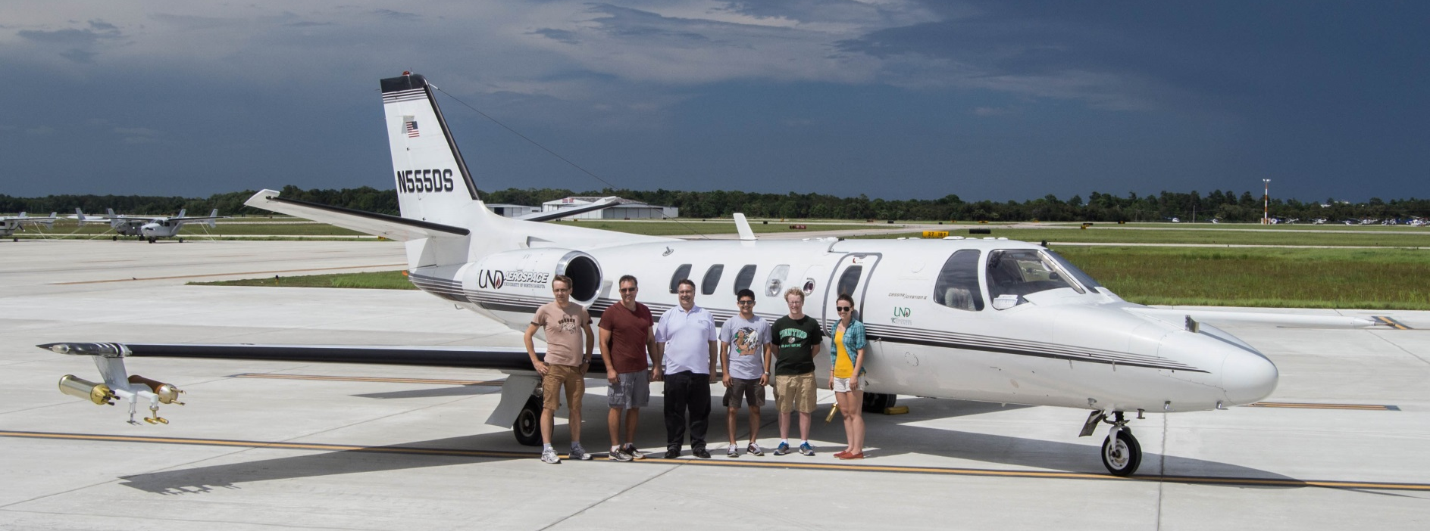
Introduction
CAPE2015
28 July 2015 to 11 August 2015
Near Cape Canaveral, Florida
One objective: measure microphysical properties of cirrus clouds in thunderstorm anvils
Concurrent measurement with aircraft instruments and radar at the surface
Courtesy: Nick Gapp

Slide 3
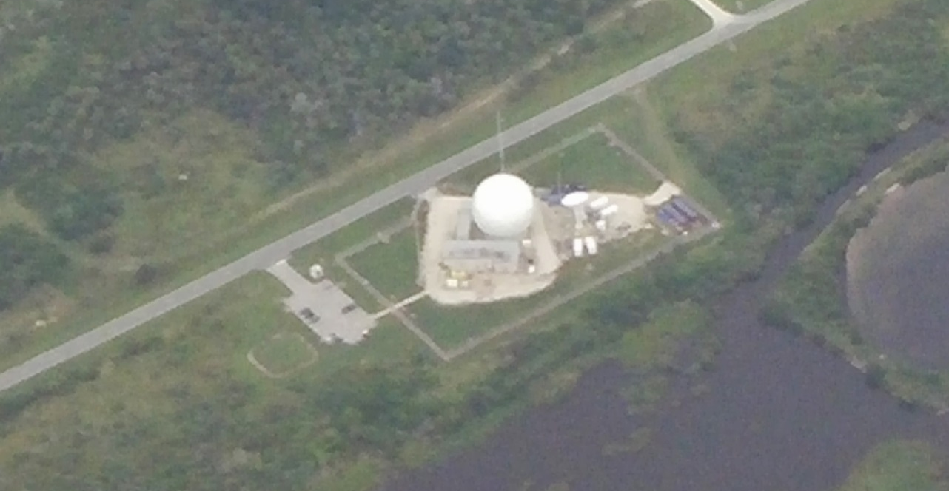
Introduction
Why did I choose this project?
Participated in CAPE2015
Importance of CAPE2015
US Navy wants to compare in-situ measurements with the Mid-Course Radar (MCR)
Continue improvements on MCR
Courtesy: David Delene

Slide 4
Methodology
UND Cessna Citation II Research Aircraft
Flew 21.86 hours in 8 flights

Slide 5
Methodology
UND Cessna Citation II Research Aircraft
Two-Dimensional Stereographic (2D-S) Probe
One laser horizontally oriented and another vertically oriented
Only use horizontal data
Captures images of shadows from cloud particles
Data post-processing uses 29 size bins
10 to 2 000 μm
Use one second-averaged data

Slide 6
Methodology
UND Cessna Citation II Research Aircraft
Nevzorov Probe
Total and liquid water content measurement
Constant-temperature, hot-wire probe
Measures voltage drop from evaporation
Provides a standard for IWC values for comparison
Use total water content (TWC) in place of IWC
Liquid water content negligible
Used one second-averaged data

Slide 7
Methodology
US Navy’s MCR
C-band
Dual-polarization Doppler radar
3 MW operating power
0.22 degree beam width
Pulse volume of 504 m³ at 12 000 m
Box around Citation Research Aircraft would have volume of 1050 m³
Will use data in the future
Courtesy: David Delene

Slide 8
Methodology
Analysis focus is on 30 July flight
First flight where usable data are collected
2 time segments where aircraft is level
+/- 20 m in altitude
First segment can be disregarded
Analyze one pass through thunderstorm anvil
6 minutes of second time segment
Reflectivity, aspect ratio, and mass ratio are calculated
Assume solid, spherical ice particles

Slide 9
Methodology

Slide 10
Methodology

Slide 11
Methodology
Reflectivity
Calculate to compare with MCR
From 2D-S number concentration, derived IWC values, and mean diameter of sampled particles
Dielectric constant for ice of 0.197 (Rinehart, 2010)
Summed over all 29 2D-S size bins
Convert to logarithmic units (dBZ)
$$z= \sum_{i=1}^{n}{N_{i}D_{i}^{6}}{\left|K\right|}^{2}$$
$$Z=10\log_{10}\left(\frac{z}{{{1 mm}^{6}}/{m^{3}}}\right)$$

Slide 12
Methodology
Aspect ratio
Calculate to show validity of spherical particle assumption in calculating reflectivity
Calculated during data post-processing
Shown below
$$Aspect ratio= \frac{horizontal width}{vertical width}$$

Slide 13
Methodology
Mass ratio
Calculate to show validity of solid particle assumption in calculating reflectivity
Ratio of Nevzorov TWC (measured) to 2D-S IWC (derived)
2D-S IWC is calculated by summing over all 29 2D-S size bins
Density of ice = 920 kg/m³
$$Mass ratio= \frac{Nevzorov TWC}{2DS IWC}$$
$$IWC= \sum_{i=1}^{n}{N_{i}V_{i}ρ_{ice}}$$

Slide 14
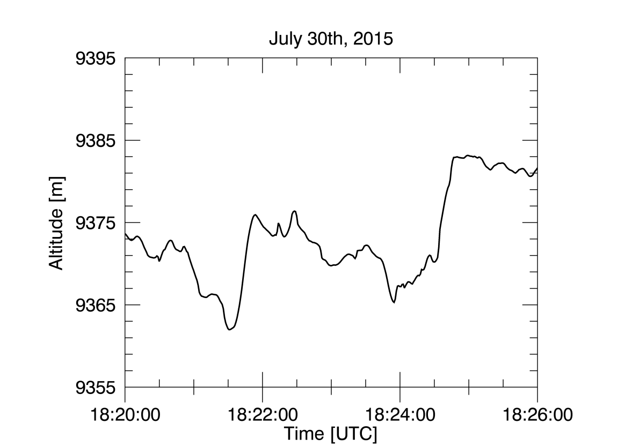
Results
Aircraft altitude
Does not deviate more than 20 m from average altitude
Level

Slide 15
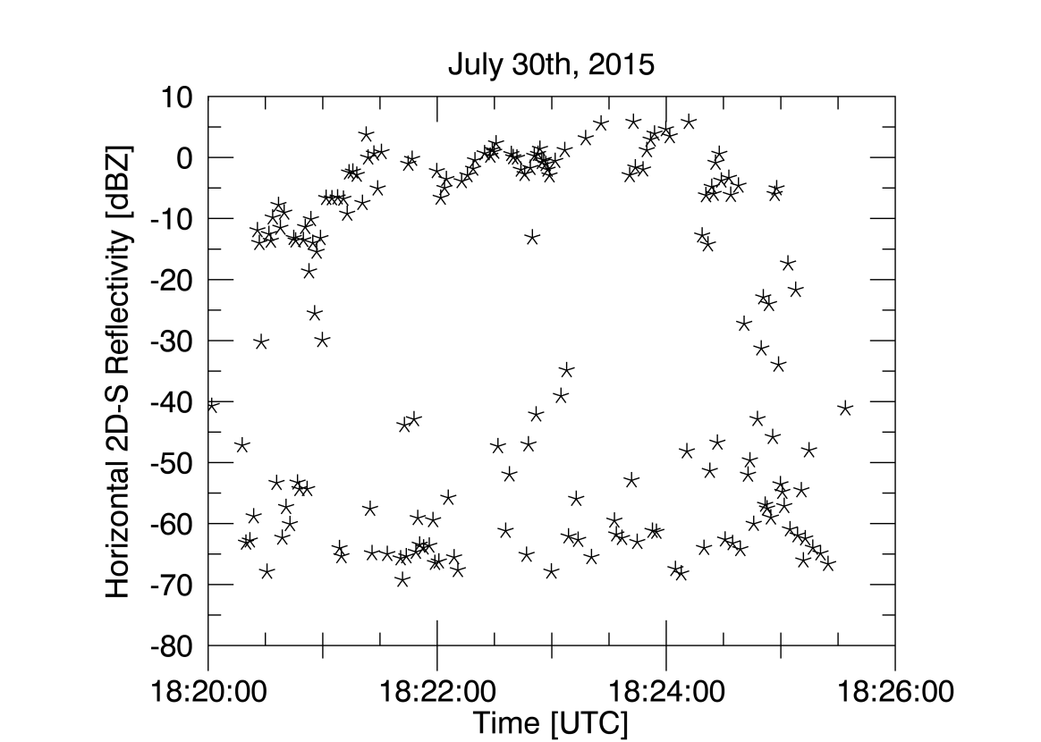
Results
Horizontal 2D-S reflectivity
Large spread
Future work

Slide 16
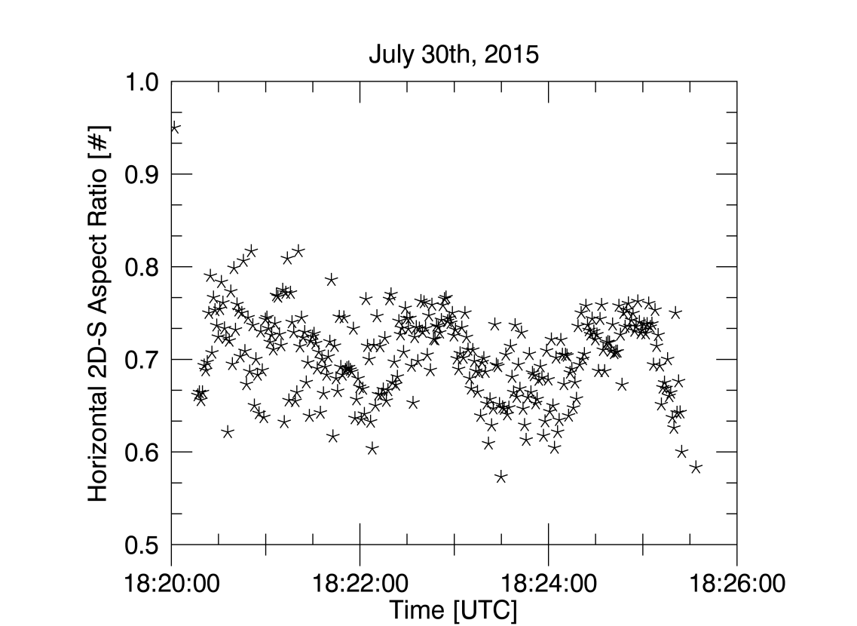
Results
Horizontal 2D-S aspect ratio
Ratio of 1 means horizontal and vertical widths are equal
Spherical
Erroneous data omitted

Slide 17
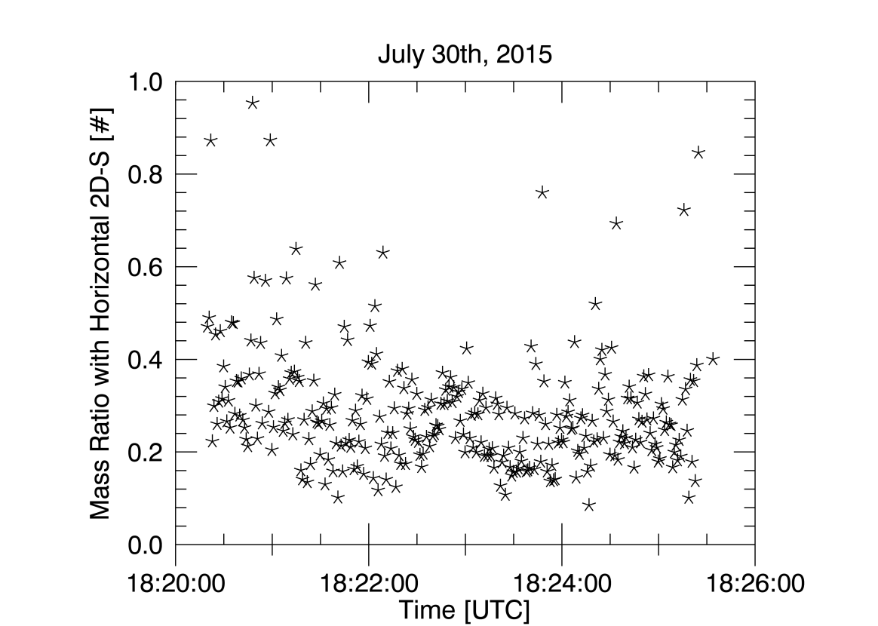
Results
Horizontal 2D-S mass ratio
Ratio of 1 indicates derived 2D-S IWC is equal to measured Nevzorov IWC
Solid
Erroneous data omitted

Slide 18
Conclusions
The assumptions are invalid
Spherical particles would have aspect ratios closer to 1
Aspect ratios are instead 0.6 to 0.8
Sampled particles are not spherical
Causes reflectivity values to be incorrect compared to MCR
Solid particles would have mass ratios closer to 1
Mass ratios are instead 0.1 to 0.4
Derived 2D-S IWC is much larger than Nevzorov IWC
Sampled particles are not solid
Causes reflectivity values to also be incorrect compared to MCR

Slide 19
Future Work
Compare derived 2D-S reflectivity to MCR reflectivity
Use a more appropriate ice density to calculate 2-DS reflectivity
Described in Heymsfield et al. (2004)
Account for non-spherical particles

Slide 20
References
Delene, D. J., 2011: Airborne data processing and analysis software package. Earth Sci. Inform., 4, 29–44, doi:10.1007/s12145-010-0061-4.
Heymsfield, A. J., A. Bansemer, C. Schmitt, C. Twohy, and M. R. Poellot, 2004: Effective ice particle densities derived from aircraft data. J. Atmospheric Sci., 61, 982–1003, doi:10.1175/1520-0469(2004)061<0982:EIPDDF>2.0.CO;2.
Rinehart, R. E., 2010: Radar for Meteorologists. Rinehart Publications, 482 pp.
J. M. Schmidt, and Co-Authors, 2012: Radar observations of individual rain drops in the free atmosphere. PNAS, 109, 9293-9298, doi: 10.1073/pnas.1117776109.

Slide 21
Thank you!
Questions?

Slide 22
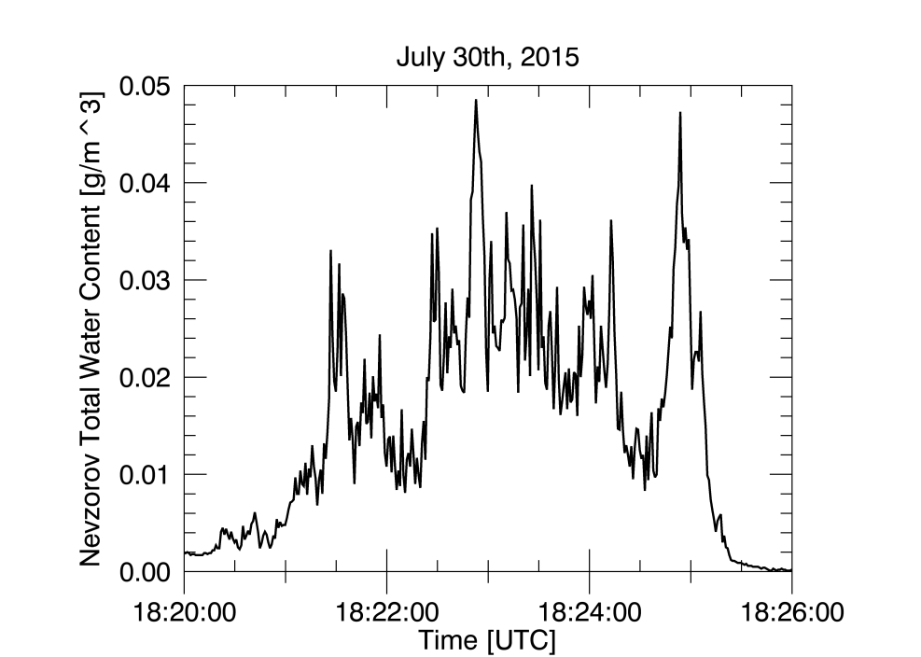
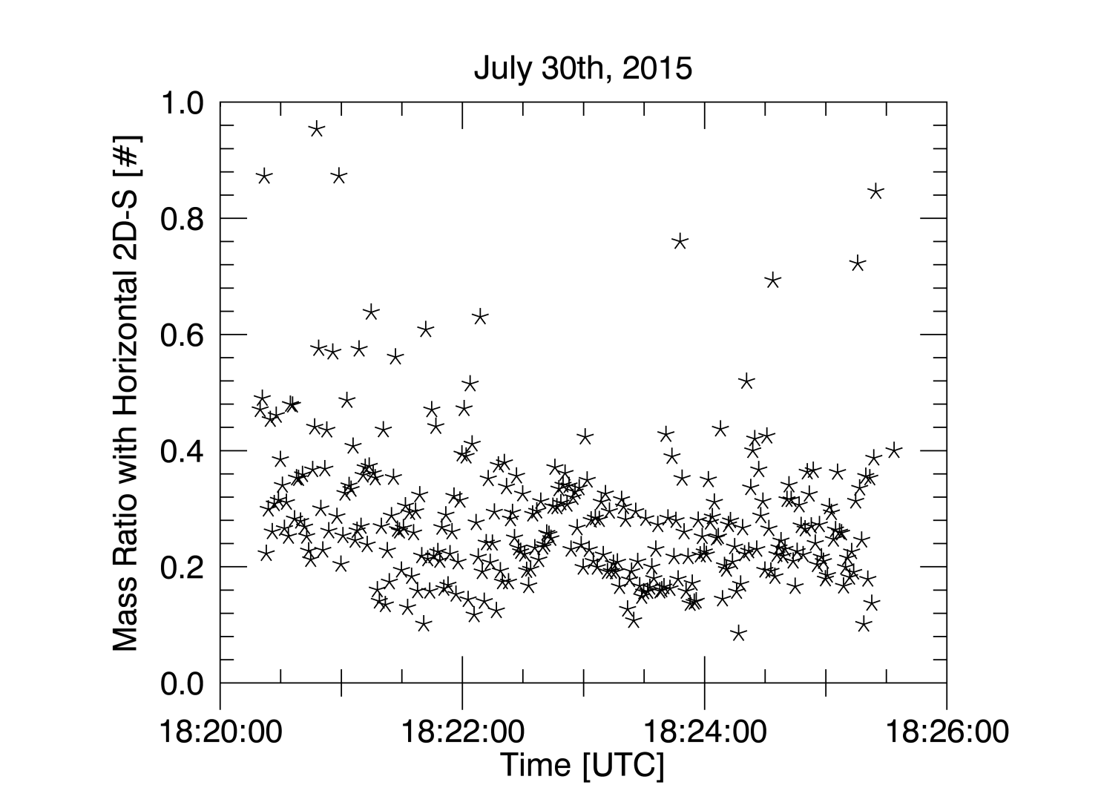
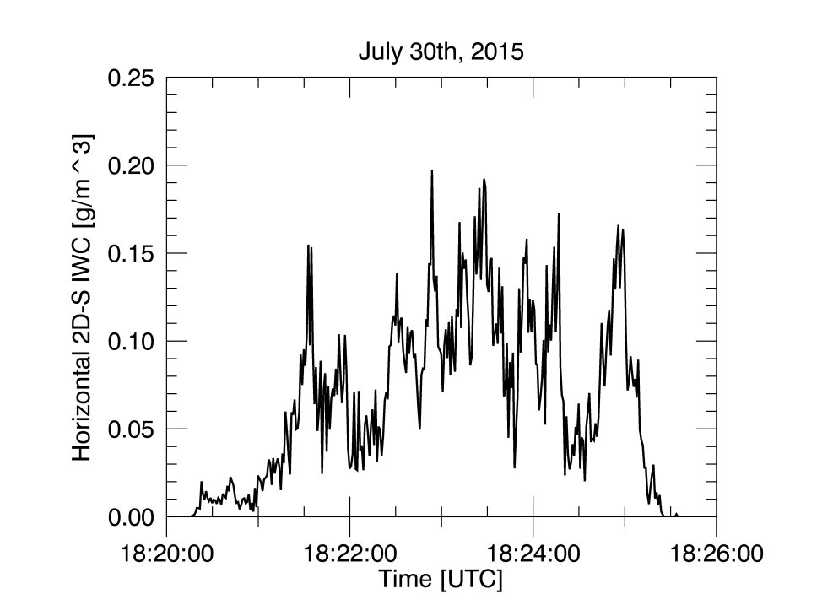
Mass Ratio Calculation
=

