Slide 1
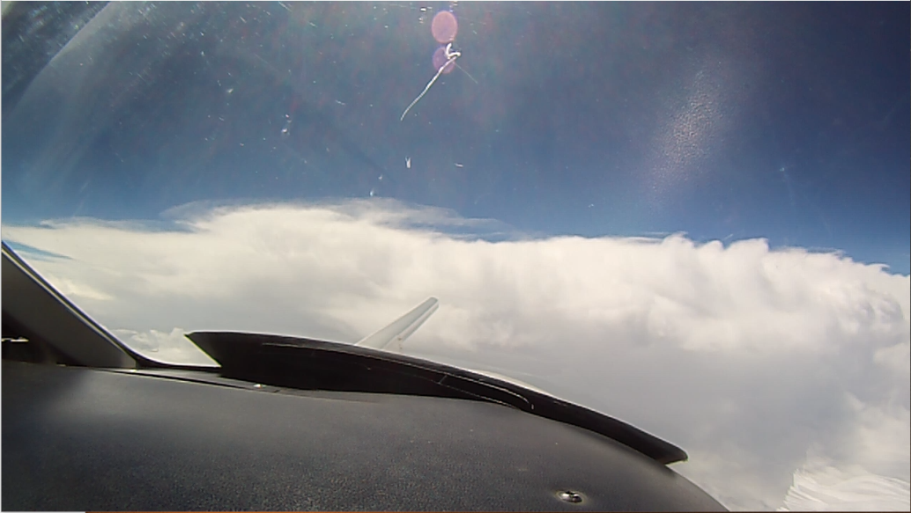
Comparisons of Florida Thunderstorm Cirrus Clouds using Concurrent Radar and Aircraft Measurements
Nicholas Gapp
NREIP Intern, M.S. Student
University of North Dakota
Grand Forks, North Dakota
NREIP Mentor:
Dr. Jerome Schmidt
Additional contributor:
Dr. Paul Harasti

Slide 2
The CAPE2015 Field Experiment
Near Cape Canaveral, Florida, from 28 July to 11 August, 2015
Instrumentation included:
North Dakota’s Cessna Citation II Research Aircraft
U.S. Navy’s Mid-Course Radar (MCR)
Myriad of surface instruments
Concurrent measurements between MCR and aircraft
Cirrus clouds in anvils from Florida thunderstorms
Goals:
Derive vertical profiles of liquid/ice water content from MCR returns for weapons assessment (Z-LWC relationship)
Apply knowledge gained from land-based data to shipborne radars in remote areas of the world
Improved scientific understanding of cloud systems in both microphysical and dynamical senses to improve inputs in models

Slide 3
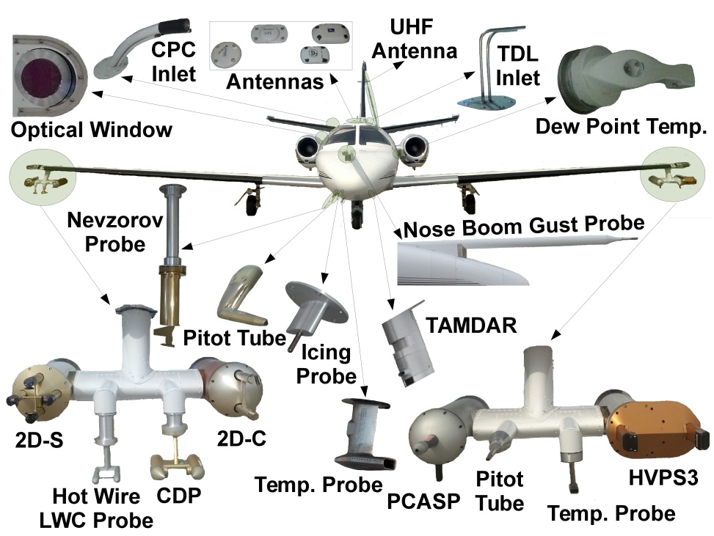
Aircraft Instrumentation

Slide 4
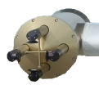
Aircraft Instrumentation
Two-Dimensional Stereographic Probe (2D-S)
Nevzorov Water Content Probe (Nevzorov)
Optical array probe with two lasers oriented perpendicular
128 10-um diode lasers
Cloud particles shadow diodes and image is recorded
Data post-processing reconstructs images and sorts by diameter (29 size bins)
Constant-temperature, hot-wire probe
Measures total and liquid water content with cone and wire, respectively

Slide 5
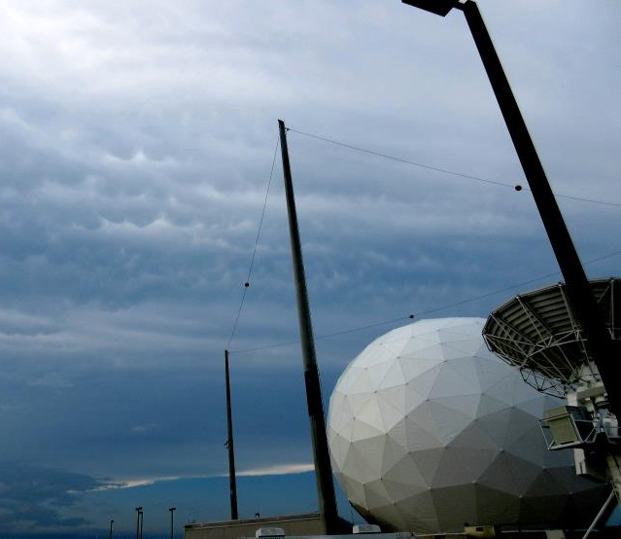
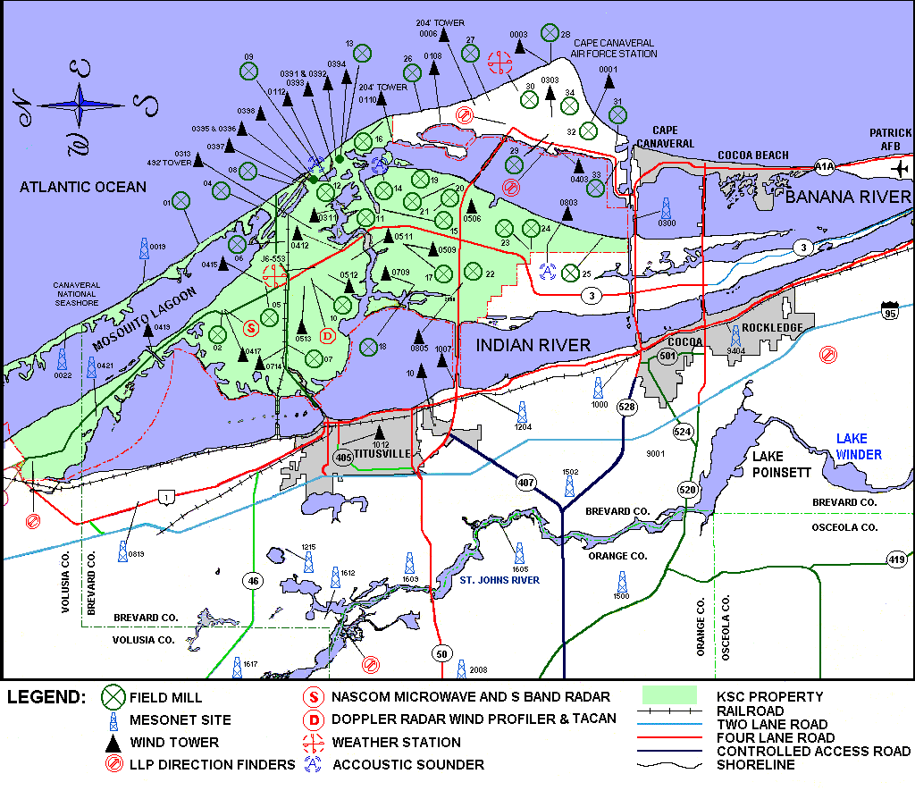
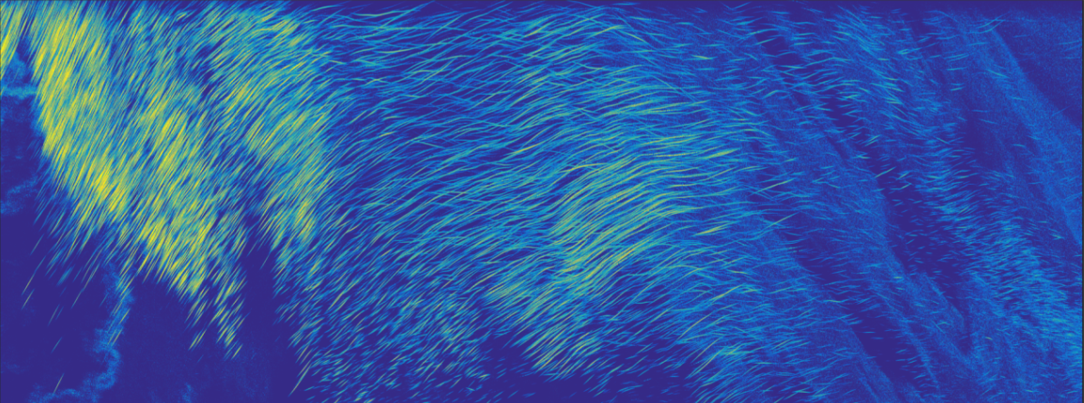
The U.S. Navy MCR Doppler Radar
MCR
X
MCR
NMIS
X
Titusville, FL
MCR
15.4m Dish
Waveform | PRF (Hz) | Frequency (GHz) | Beam Width (degrees) | Range Gates (m) | 6db Range Width (m) | Band Width (MHz) | Pulse Length (μs) | Loop Gain (dB) | Peak Power (MW) | Nyquist Interval (m/s)
Narrowband | 160 | 5.5 | 0.2° | 11.25 | ~ 37 | 7.45 | 12.5 | 271 | 3 | ± 2.1
Wideband | 160 | 5.65 | 0.2° | 0.146 | ~ 0.5 | 500 | 12.5 | 271 | 3 | ± 2.1
Primary Features:
- C-Band dual polarization radar
- 0.2° Beam Width & 3 MW peak power
- Real-time Satellite & Aircraft tracking
- Two primary wave forms:
- Narrowband: 37m range resolution
Two 75km range windows
- Wideband: 0.5m range resolution
Two 400m range windows
The MCR wideband reflectivity provides detailed cloud structure
- 20
-
300 m
- 10
Reflectivity [dBZ]
-
- 0
-
200 s

Slide 6
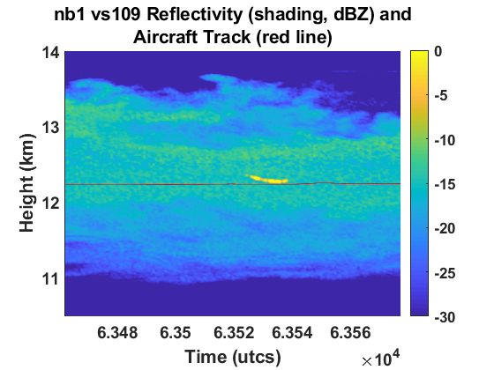
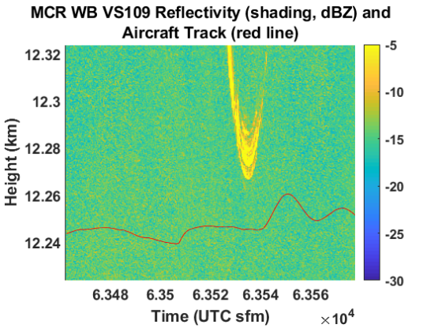
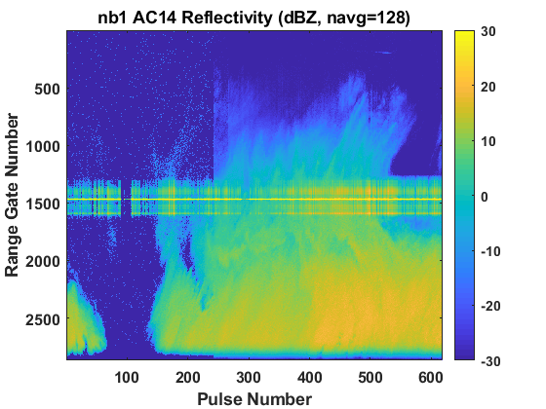
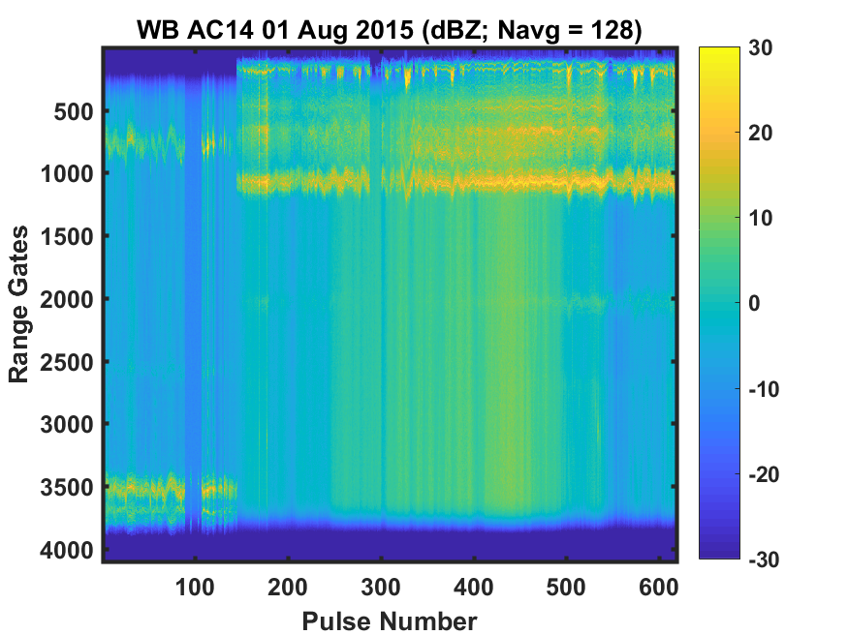
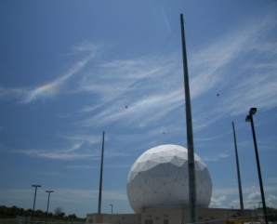
Methodology
Option 2
Option 1
Two co-location options:
MCR operates in vertical stare and wait for aircraft to cross into beam (option 1)
Track the aircraft through the sky (option 2)
Never been done before
Use microphysical measurements to get LWC and derive Z, compare Z to MCR, get Z-LWC relationship, then derive LWC from MCR Z
Only discuss tracking results (option 2)
Notes:
“These are the 2 techniques that we can do, but I’ll just talk about one…”

Slide 7
Methodology
Derivation of in-situ radar reflectivity
Total particle volume $V_{2DS}$ per second from 2D-S bin diameter $D_{n}$ and particle concentration per size bin $N_{n}$
$$V_{2DS}=\sum_{n}{\frac{π}{6}N_{n}{D_{n}}^{3}}$$
Assumes spherical particles
Effective total ice particle density $ρ_{part}$ from Nevzorov particle mass $m_{Nev}$
$$ρ_{part}={m_{Nev}}/{V_{2DS}}$$
Effective liquid particle size (LED) per volume of 2D-S size bin $V_{n}$ and density of water $ρ_{w}$
$$LED=\sqrt[3]{{6V_{n}ρ_{part}}/{πρ_{w}}}$$
Assumes mass of ice equals mass of water
Dielectric factor of ice ${\left|K\right|}_{i}^{2}=0.208$ (Smith, 1984)
Comparison between the MCR and aircraft data sets
Narrowband and wideband to aircraft
(1)
(2)
(3)

Slide 8
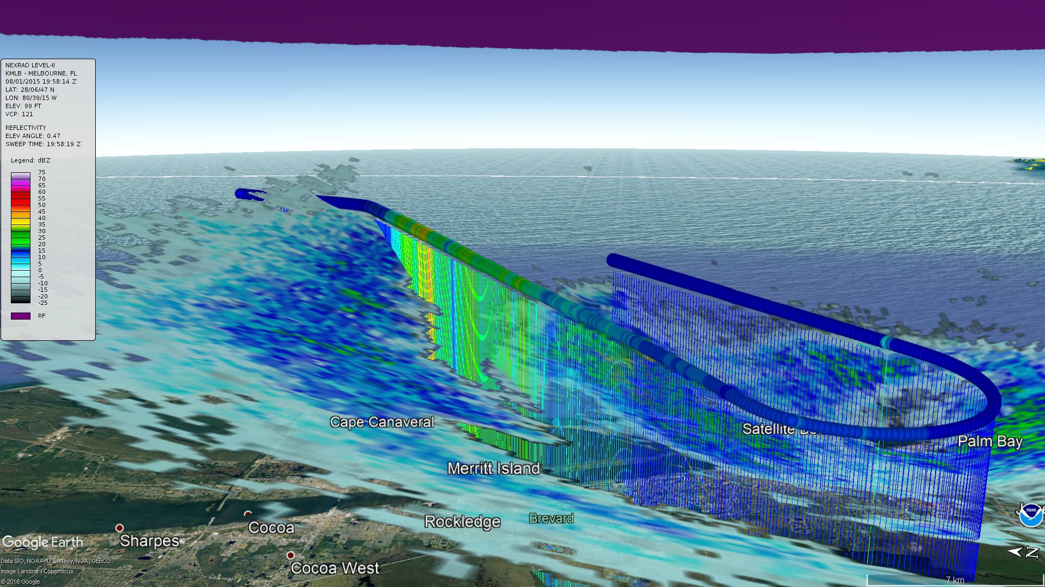
Aircraft Tracking Comparisons
Aircraft track with colors representing total water content
Aircraft motion
Melbourne (KMLB) 19.2º scan

Slide 9
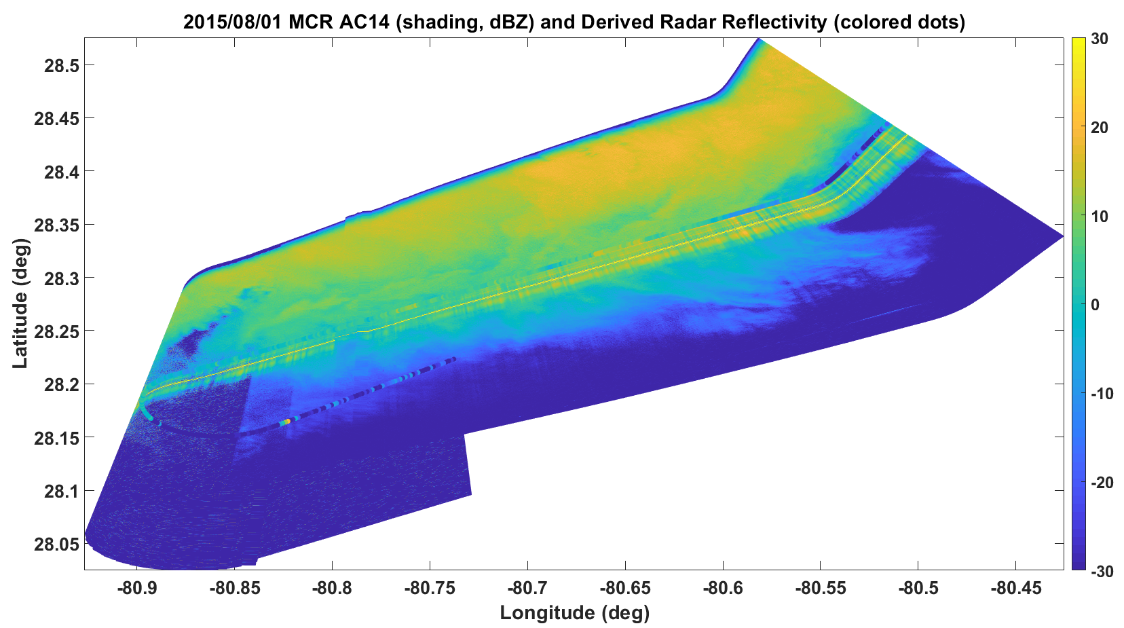
Aircraft Tracking Comparisons
Aircraft track with in-situ derived radar reflectivity values
Aircraft motion
MCR-Derived reflectivity while tracking the research aircraft
Aircraft within narrowband beam
Takeaways:
First successful demonstration that the MCR radar can track research aircraft in real-time
Comparisons of the along-track reflectivity derived from the in-situ cloud microphysics show promising agreement with the radar-derived reflectivity values
Such comparisons will allow Z-LWC relationships to be derived for use in remote U.S. Navy Weapon Performance Evaluations

Slide 10
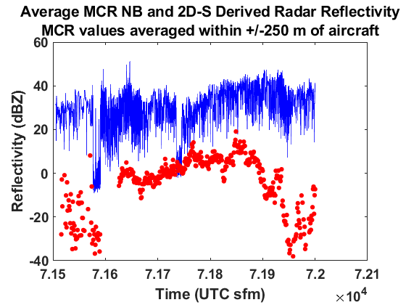
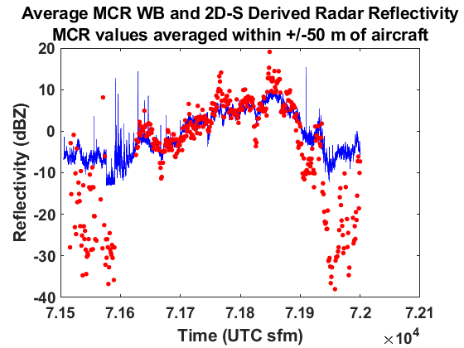
Aircraft Tracking Comparisons
Narrowband
Wideband
Derived Reflectivity
MCR Reflectivity

Slide 11
Conclusions and Future Work
The MCR and aircraft data can be co-located using both MCR scanning strategies
Future work: compare vertical stare data across length scale rather than time scale
Future work: reduce ~900 m separation between MCR and aircraft during tracking scans
The MCR and aircraft data agree with each other
Future work: calculate uncertainties in both data sets
Future work: Z-LWC relationship
The aircraft data is highly variable compared to the MCR data
Future work: determine a reasonable out-of-cloud threshold to apply to aircraft data to reduce measurement variability

Slide 12
Acknowledgements and References
Thesis Committee
Dr. David Delene, University of North Dakota
Dr. Matthew Gilmore, University of North Dakota
Dr. Jerome Schmidt, NRL Monterey
Dr. Paul Harasti, NRL Monterey
Funding from Naval Surface Warfare Center
Josh Hoover, NSWC Dahlgren Division
Mark Anderson, NSWC Dahlgren Division
Special thanks
Peter Jones, L3 Interstate Electronics Corp.
NREIP
NRL
References
Smith, P. L., 1984: Equivalent radar reflectivity factors for snow and ice particles. J. Climate Appl. Meteor., 23, 1258-1260, doi: 10.1175/1520-0450(1984)023%3C1258:ERRFFS%3E2.0.CO;2.

Slide 13
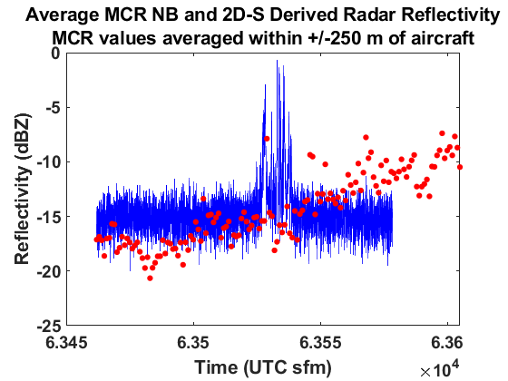
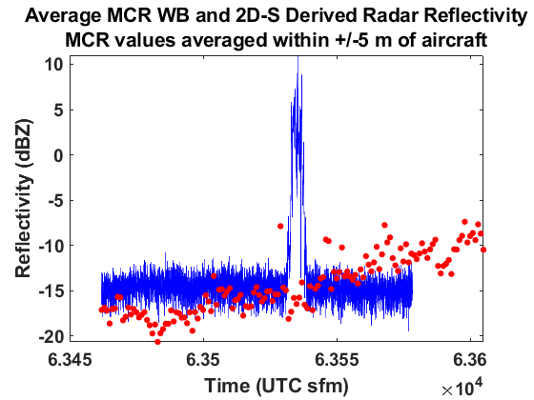
Vertical Stare Comparisons
Narrowband
Wideband
Derived Reflectivity
MCR Reflectivity
Notes:
Use upper left and slide 10 rather than all 4. “These are the 2 techniques that we can do, but I’ll just talk about one…” Put slide 9

Slide 14
Aircraft Tracking Comparisons
Aircraft successfully tracked by MCR
Aircraft
Clear air
Cloud Layer

Slide 15
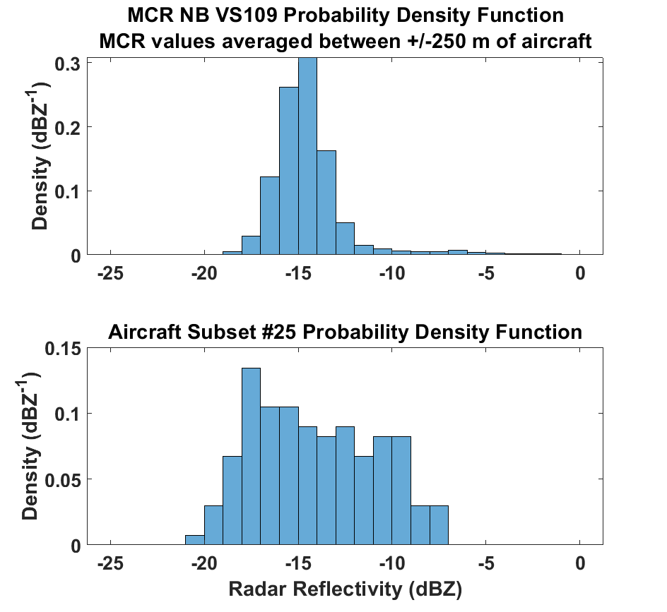
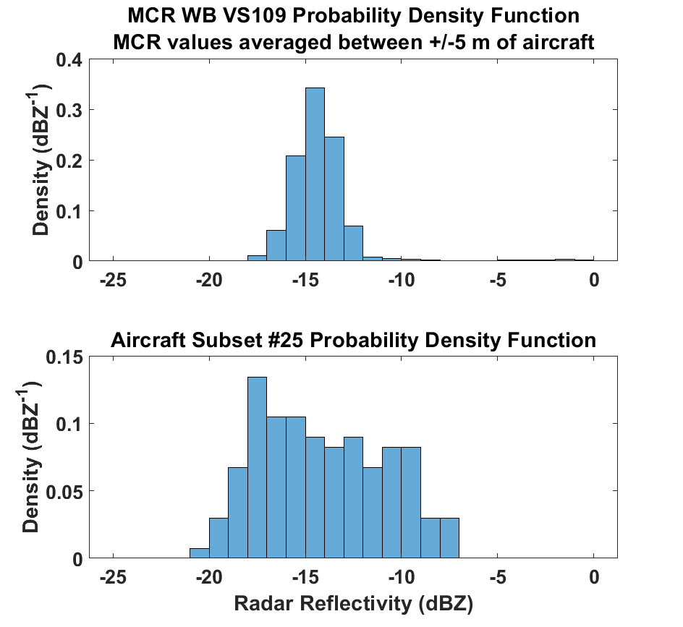
Vertical Stare Comparisons
Narrowband
Wideband

Slide 16
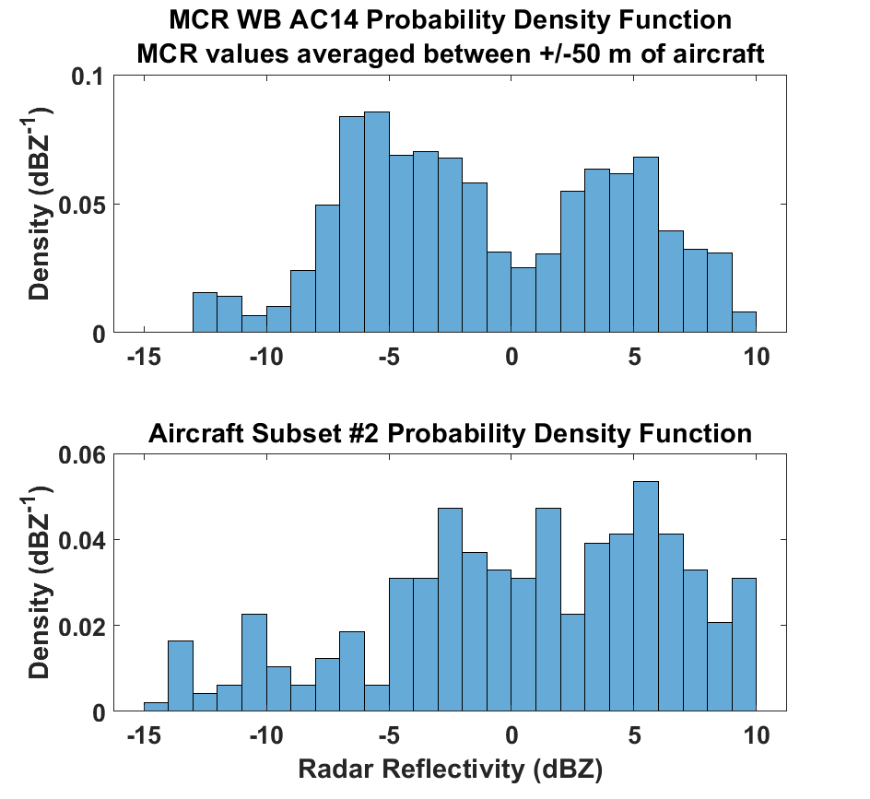
Aircraft Tracking Comparisons
Wideband

Slide 17
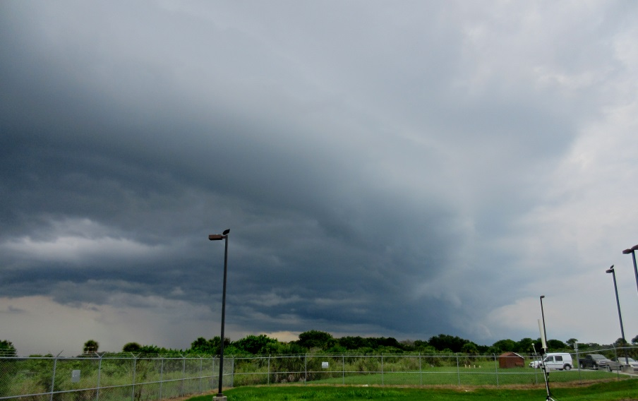
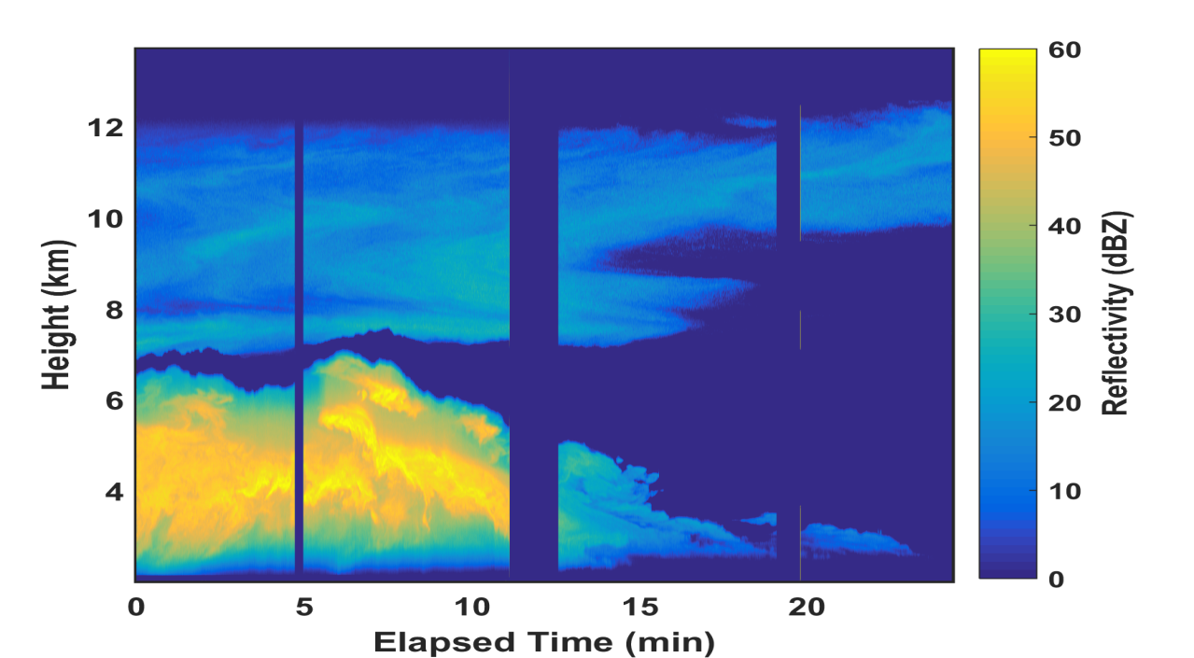
The U.S. Navy’s MCR Radar
MCR Radar:
- C-Band dual polarization
- 0.2° Beam Width & 3MW peak power
- Real-time Satellite & Aircraft tracking
- Two primary wave forms:
- Narrowband: 37m along-range resolution
Two 75km range windows
- Wideband: 0.5m range resolution
Two 400m range windows
The MCR Narrowband data provides
a mesoscale overview of the cloud fields
12 -
- 50
10 -
- 40
8 -
- 30
Height [km]
Reflectivity [dBZ]
Δr = 37m
6 -
- 20
4 -
- 10
2 -
- 0
25 20 15 10 5 0
Photo Courtesy of Jason Nachamkin
- 20
1900 -
The MCR wideband data provides
detailed cloud structure
In-bound linear patterns
or “streaks” reveal individual
raindrop structure
(Δr = 0.5m)
- 15
1850 -
1800 -
- 10
Height [m]
Reflectivity [dBZ]
1750 -
- 5
1700 -
Developing
Rain Shaft
- 0
1650 -
Elapsed Time [Sec]
150 100 50
- -5

Slide 18
Aircraft Tracking Comparisons
Convective turrets
Time: 71600 UTC sfm (19:53:20 UTC)
Altitude: 11.3 km
Temperature: -43.5 ºC

