Slide 1
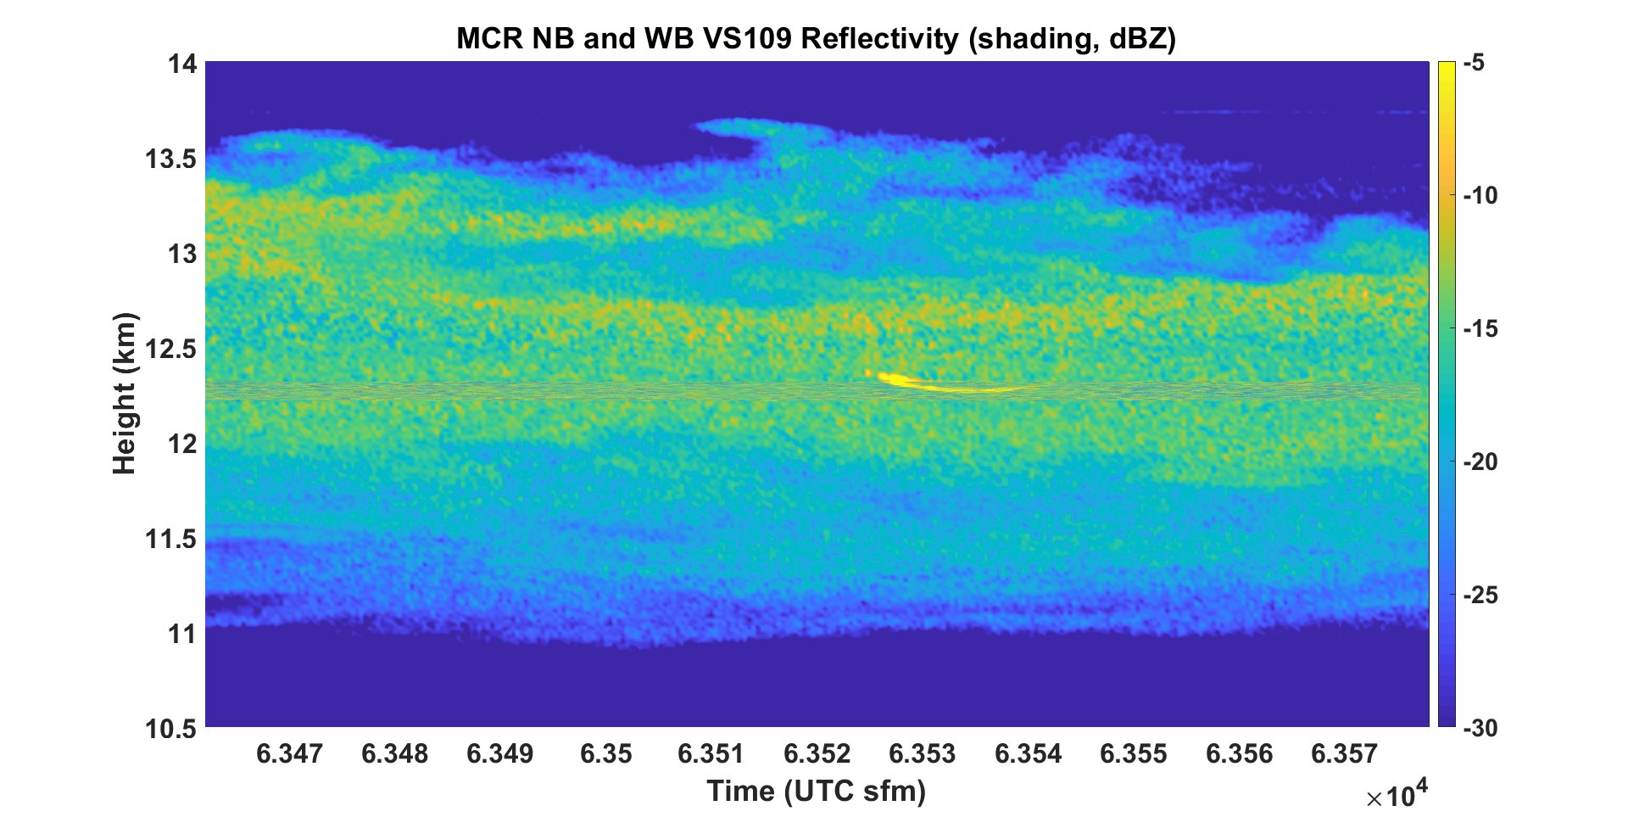
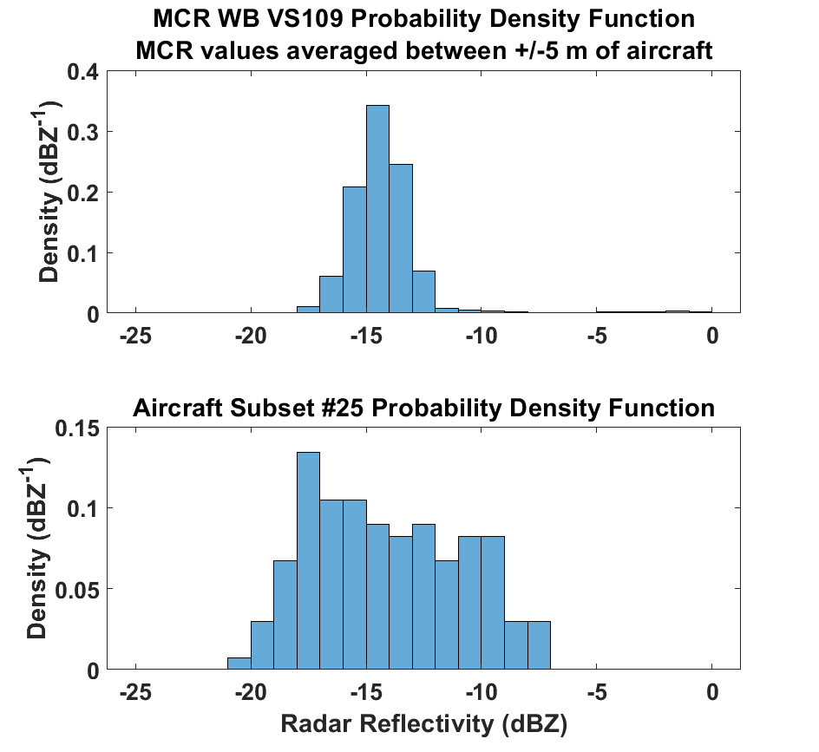
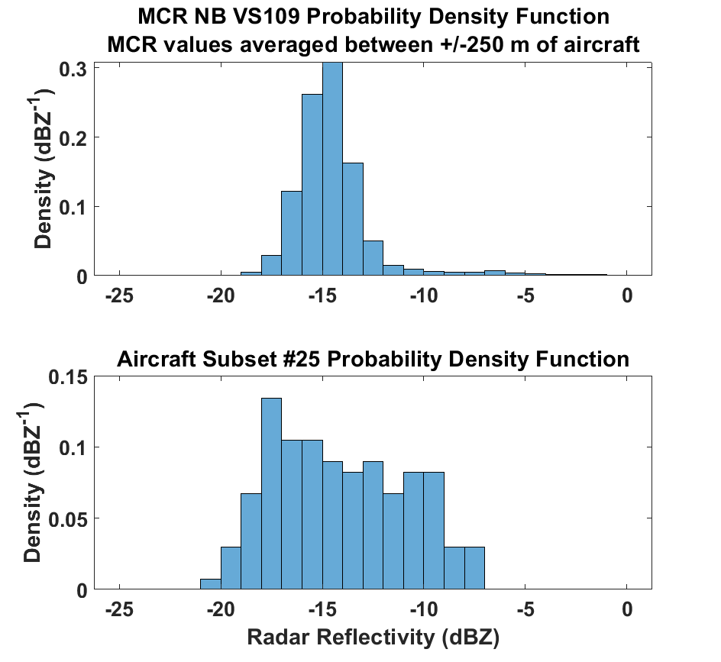
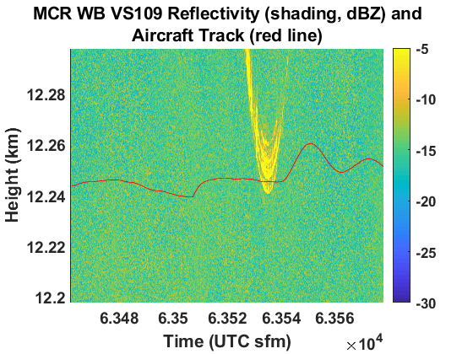
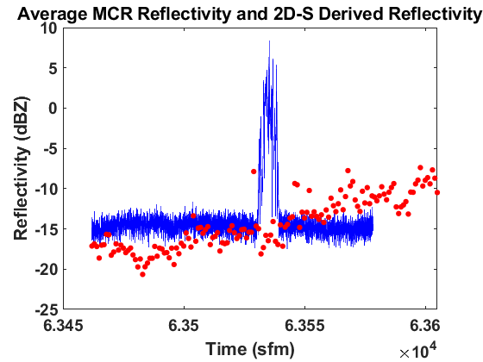
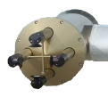
Concurrent Radar and Aircraft Reflectivity Comparisons of Florida Thunderstorm Cirrus Clouds
Nicholas J. Gapp (nicholas.james.gapp@und.edu)¹, Paul R. Harasti², David J. Delene¹, Jerome Schmidt², and Joshua Hoover³
¹ University of North Dakota, Grand Forks, North Dakota, United States of America
² Naval Research Laboratory, Marine Meteorology Division, Monterey, California, United States of America
³ Naval Surface Warfare Center Dahlgren Division, Dahlgren, Virginia, United States of America
Introduction
Radar Measurements
Statistical Radar Reflectivity Analysis
The North Dakota Citation Research Aircraft conducted measurements of cirrus cloud particles produced by Florida thunderstorms in 2015 (CAPE2015 field project). Cloud sampling instruments included the Two-Dimensional Stereographic particle imaging probe (2D-S) and the Nevzorov Water Content Probe (Nevzorov). Concurrent with the aircraft measurements, remote sensing observations were made by the United States Navy’s Mid-Course Radar (MCR). The CAPE2015 field project observed pure ice particles between an altitude of 29,000 ft and 40,000 ft during eight research flights. Comparison between derived radar reflectivity from in-situ probe data and observed MCR data using both the narrowband (NB) and wideband (WB) beams is explored.
The probability density function of the wideband reflectivity values (top) compared to the probability density function of the derived aircraft radar reflectivity values (bottom) from 17:37:42-17:40:05 UTC. Good agreement exists between the MCR and derived aircraft radar reflectivity, but there is more variability in derived radar reflectivity data.
Methodology
Ice water content and radar reflectivity are derived assuming spherical ice particles from measurements taken by the 2D-S and Nevzorov. The MCR is a C-band, dual-polarization Doppler radar that alternates transmissions between two wave forms with range resolutions of either 37 m or 0.546 m (Schmidt et al. 2012). The aircraft position is downlinked in real-time to the MCR which enables the aircraft to be located and followed by the beams of the MCR, thus ensuring concurrent measurements. A dielectric factor of ice of ${\left|K\right|}_{i}^{2}=0.208$ is used to derive equivalent radar reflectivity (Smith 1984). Total particle density is calculated by
$$ρ_{part}={m_{Nev}}/{V_{2DS}},$$
where $m_{Nev}$ is the mass from the Nevzorov and $V_{2DS}$ is the total particle volume defined by
$$V_{2DS}=\sum_{n}{\frac{π}{6}{D_{n}}^{3},}$$
where n is the number of 2D-S size bins and D is the diameter of the 2D-S size bin. The mass of ice and volume of water, assuming mass of ice is equal to mass of water, are calculated per 2D-S size bin and used to calculate liquid-equivalent diameter (LED) of the melted particles per 2D-S size bin by
$$LED=\sum_{n}{\sqrt[3]{{6V_{n}ρ_{i}}/{πρ_{w}}}},$$
where $V_{n}$ is the volume of the 2D-S size bin and $ρ_{i}$ and $ρ_{w}$ are the densities of ice and water, respectively. Radar reflectivity and equivalent radar reflectivity factor per 2D-S size bin are then calculated.
A vertical stare from the MCR (above) showing the height-corrected overlay of narrowband and wideband reflectivity values (shading, values in dBZ) from 63462-63605 sfm. The maximum in the MCR reflectivity between 63525-63545 sfm is the aircraft as it passes over the MCR. The red box highlights the reflectivity values from the wideband beam, and the wideband reflectivity data is shown at left. The red line across the wideband reflectivity data is the height-corrected track of the aircraft.
The probability density function of the narrowband reflectivity values (top) compared to the probability density function of the derived aircraft radar reflectivity values (bottom) from 17:37:42-17:40:05 UTC.. Good agreement exists between the MCR and derived aircraft radar reflectivity, but there is more variability in derived radar reflectivity data.
(1)
(2)
Conclusions and Future Work
Radar Analysis
The MCR and aircraft data agree with each other.
Aircraft data is highly variable. Determine a reasonable out-of-cloud threshold to apply to the aircraft data to reduce measurement variability.
Incorporate area ratio of cloud particles into reflectivity calculation.
Obtain a precise radar reflectivity/liquid water content relationship for the radar.
(3)
MCR Wideband Reflectivity and Derived 2D-S Radar Reflectivity
8 August 2015 17:37:42-17:40:05 UTC
A comparison between the derived aircraft radar reflectivity and the measured MCR reflectivity is shown from 63462-63605 sfm. The MCR reflectivity is averaged over a 10 m column surrounding the mean altitude of the aircraft. The spike in MCR reflectivity (about 63545 sfm) is due to contamination of the signal by the aircraft. The spatial separation between the aircraft and the MCR increases with increasing distance from either side of the spike in MCR reflectivity.
Aircraft Measurements
Derived Reflectivity
References and Acknowledgements
MCR Reflectivity
Delene, D. J., 2011: Airborne data processing and analysis software package. Earth Sci. Inform., 4, 29–44, doi:10.1007/s12145-010-0061-4
Schmidt, J. M., and Coauthors, 2012: Radar observations of individual rain drops in the free atmosphere. PNAS, 109, 9293-9298, doi: 10.1073/pnas.1117776109.
Smith, P. L., 1984: Equivalent radar reflectivity factors for snow and ice particles. J. Climate Appl. Meteor., 23, 1258-1260, doi: 10.1175/1520-0450(1984)023%3C1258:ERRFFS%3E2.0.CO;2.
This research is supported by the Naval Surface Warfare Center grant to analyze the CAPE2015 field project data.
The cloud physics instruments onboard the Citation Research Aircraft are shown to the right. The Two-Dimensional Stereographic probe (2D-S, top right) provides two-dimensional images of particles (above) using 128 10-um diode lasers with one laser oriented horizontally and one oriented vertically. The Nevzorov Probe (bottom right) measures total and liquid water using hot wire sensors and provides total particle mass after processing using routines from the Airborne Data Processing and Analysis software package (Delene 2011).

