Slide 1

Statistical Analysis of the Polarimetric Cloud Analysis and Seeding Test (POLCAST) Field Projects
Jamie Ekness

Slide 2
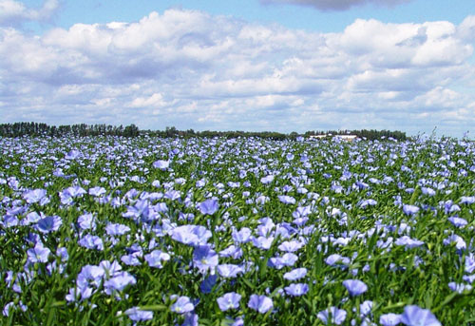

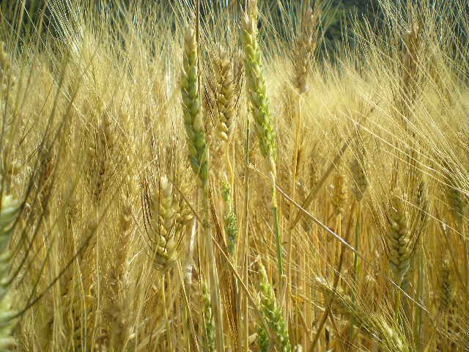
Importance of North Dakota Agriculture
  Agriculture is the number one industry of the state, bringing in more than $4.1 billion annually. (North Dakota Department of Agriculture, 2010)
  North Dakota farmers are responsible for >50 % of many crops produced in the United States. (North Dakota Department of Agriculture, 2010)
Notes:
45 million acres of land in the state with 90 % (40 million acres) used for farming and ranching.

Slide 3
Important North Dakota Crops
Crops | % of U.S. Production
Flax | 96%
Canola | 90%
Durum wheat | 68%
Pinto beans | 65%
Dry edible peas | 64%
Navy beans | 46%
Spring wheat | 45%
All sunflowers | 44%
Confectionary sunflowers | 42%
*North Dakota Studies 2011
Notes:
There is a good portion (> 50 %) of crops produced in North Dakota - therefore to keep up the production enough rain is needed to have healthy and abundant yields.

Slide 4
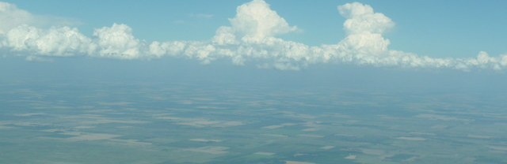
Economic Impact of Drought or Hail
  Results in loss of income/jobs for North Dakota residents.
  Increases consumer cost when crop loss occurs.
  The 2002 drought resulted in $223 million in crop damages. (NCSL 2008)
  The 2006 drought resulted in $425 million in crop damages. (NCSL 2008)
Notes:
Adequate precipitation is necessary for sufficient crop yields

Slide 5
Objectives
Conduct a statistical analysis of the POLCAST randomized seeding field projects in North Dakota.
  Evaluate important environmental factors measured during POLCAST to ensure seed and non-seed cases are from the same population.
  Determine the ratio of radar derived rain rate and rain amount from seeded cases to non-seeded cases.
  Calculate the number of cases required to obtain a statistically significant result (p<0.05).

Slide 6
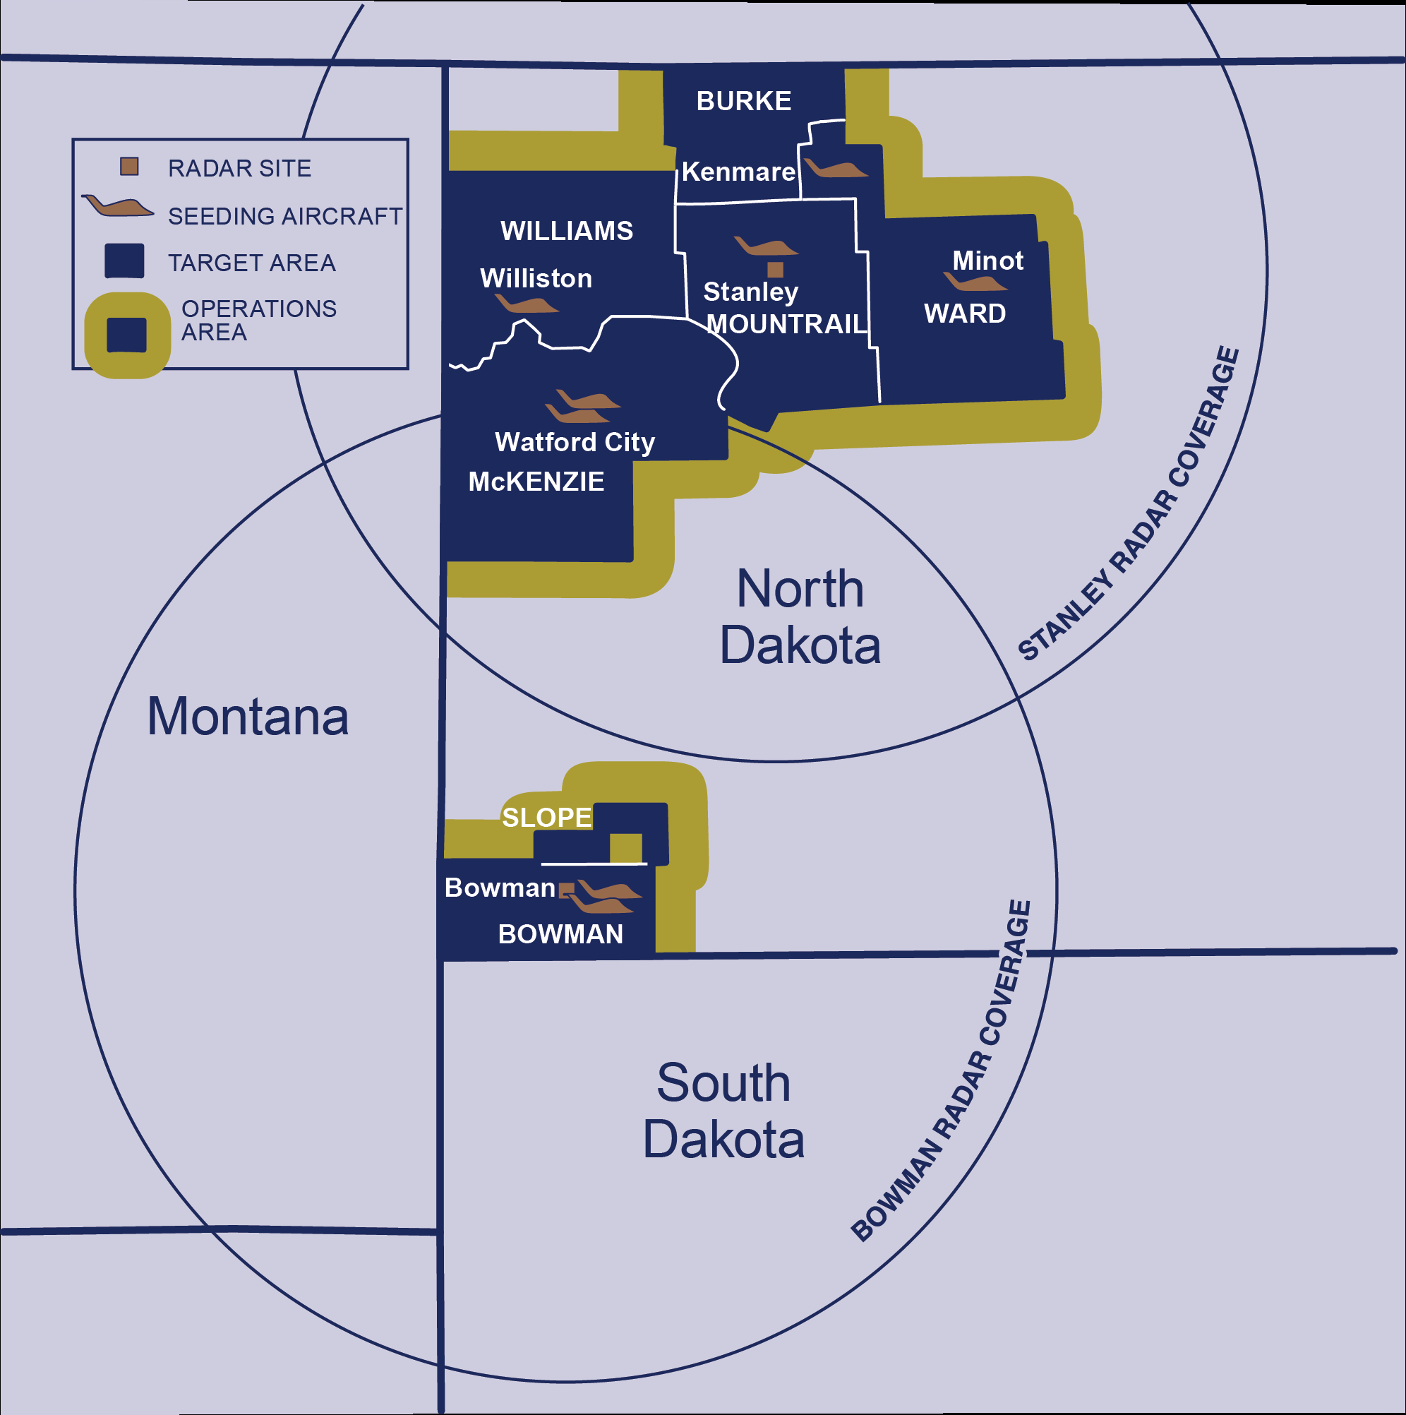
Current Seeding in North Dakota
  Silver Iodide (AgI) seeding has been used since 1950’s.
  Operational seeding is conducted in 6 counties in western North Dakota.
  Hygroscopic seeding has not been tested in North Dakota.
Notes:
The are includes 7.4 million acres (16 % of the state
Seeding with AgI is used in North Dakota mainly for hail suppression, but also may help increase precipitation efficiency and rain rate.
What would hygroscopic seeding be used for?

Slide 7

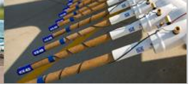
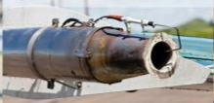
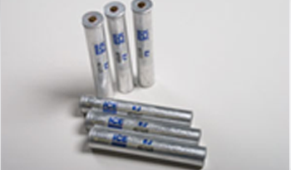
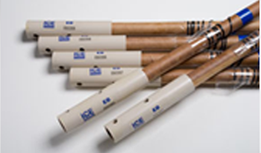
Types of Operational Cloud Seeding
Ejectable
Burn-in-Place
AgI Generator
AgI
AgI
* 2016 North Dakota Cloud Modification Final Report
Notes:
Why is study CaCl2 studied – is AgI hygroscopic?
• 2 WMI-Lohse ram-air pressurized liquid-fueled AgI generators, with a 7-gallon usable capacity, calibrated to a flow rate of 4.0 gallons per hour at 130 kts airspeed. • 2 Wing-mounted flare racks, each capable of carrying 12 burn-in-place flares. • 2 Belly-mounted ejectable flare racks, 204 flare capacity total.

Slide 8
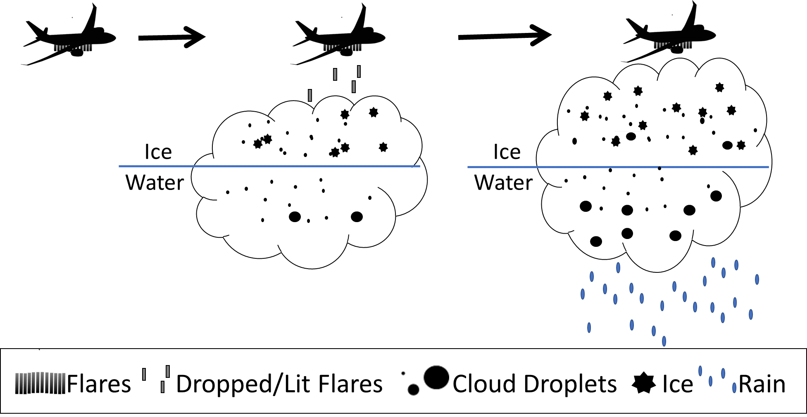
AgI Seeding with Ejectable Flares
9
Notes:
Aggregation – precipitation formation with ice - helps create precipitation size particles sooner than would occur resulting in smaller less damaging hail or rain to be produced.

Slide 9

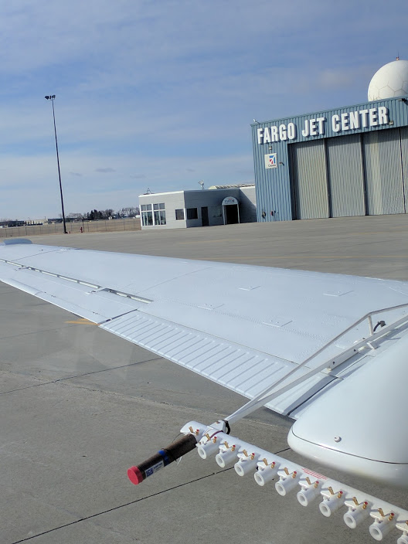
CaCl₂ Hygroscopic Burn-In-Place
The sizes of the aerosols, on the order of 5 μm diameter, are the proper size to start the rain process.
Conceptual model:
  The addition of hygroscopic particles will enhance the collision and coalescence in clouds with a base above freezing and produce precipitation earlier than naturally occurring.
  Hygroscopic seeding will cause clouds that would not naturally rain to rain or clouds that would rain to rain more. (Silverman and Sukarnjanaset 2000)
Applications:
  Rain enhancement by increasing the collision and coalescence process within clouds.
*http://iceflares.com/

Slide 10
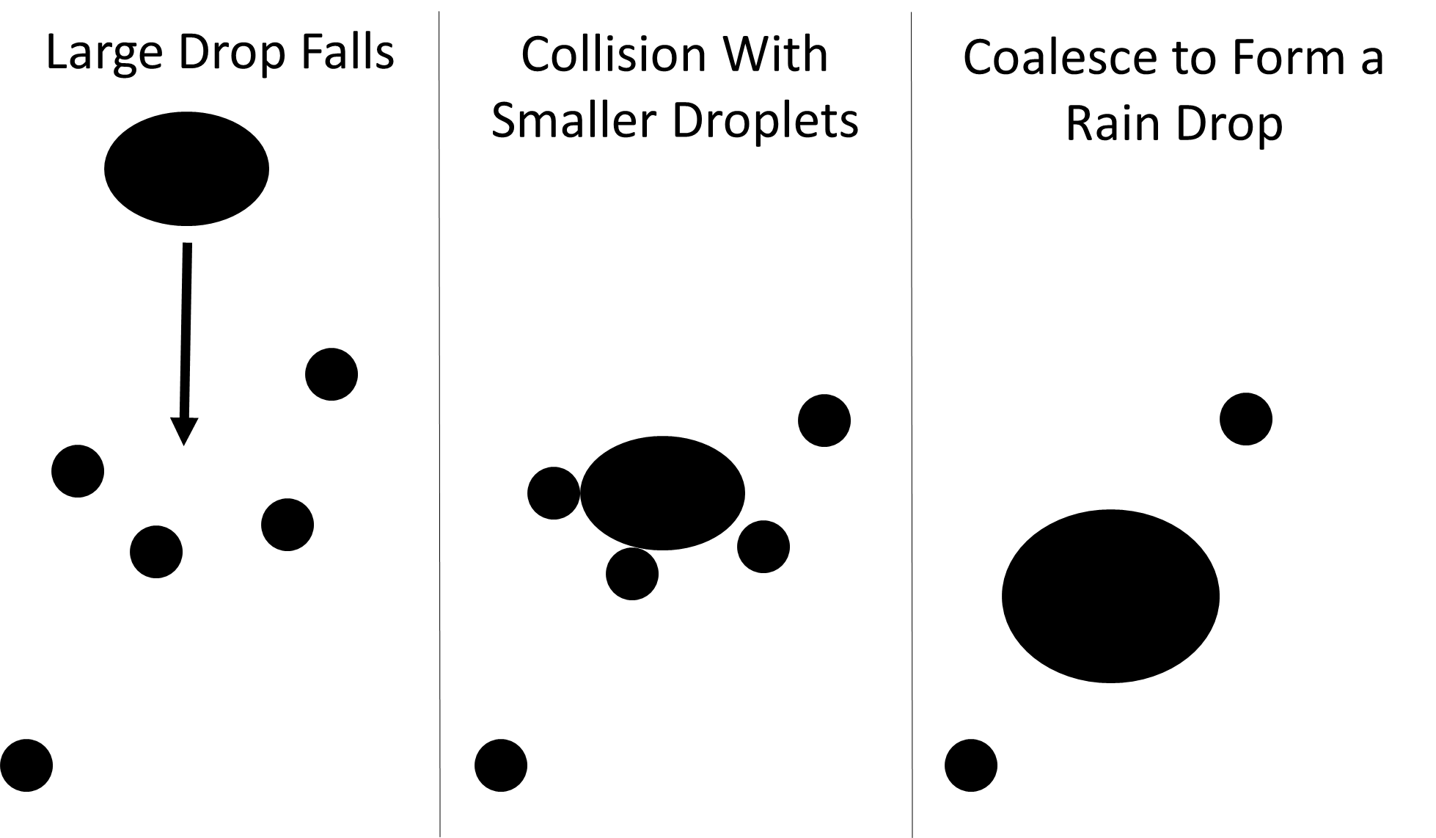
Rain Drop Formation:
Collision and Coalescence

Slide 11






Hygroscopic Seeding with Burn-In-Place Flares
Flares Updraft Lit Flares Cloud Droplets

Slide 12
Hygroscopic Seeding Projects Around the World
South Africa(1991/92 - 1997)
    Study began after measuring changes in cloud microphysics downwind of a Kraft Paper Mill. (Mather et al. 1997)
Mexico(1997-1998)
    Study based on findings of South Africa.
    Seeded clouds found to last longer than non-seeded. (Silverman 2003)
Thailand (1995-1998)
    Best effects were seen in clouds seeded before natural precipitation formation takes place – from model runs.
    Experimental parameters were chosen to: Maximize the seeding signal and minimize the natural variability.
    The effectiveness of the seeding could be evaluated with a relatively small sample size.
    Provided statistically significant evidence of hygroscopic seeding.
  (Silverman and Sukarnjanaset 2000)
Notes:
Thailand experiment:
“ Thailand paper = “It was found that seeding near cloud base with calcium chloride particles produced larger seed–no-seed ratios than did near–cloud-top seeding and that the seed -no-seed ratios incr
Studied model runs to see the best chemical composition would be most efficient: calcium chloride, ammonium nitrate, sodium chloride, and urea – with calcium chloride producing the largest effects, and model shows Seeding before the natural precipitation process takes over before a natural echo is produced shows the best effects of hygro seeding.
ease with increasing concentration or dosage; logistical considerations will place an upper limit on what is possible, however”
maximize the seeding signal
minimize the natural variability so that the effectiveness of the seeding could be evaluated with a relatively small sample size
Thailand Project Requirements
Cloud top height of 3350 m
Liquid water content > 0.5 g m^-3
Updraft max of at least 2.5m/s
Length of cloud 2-6 km

Slide 13
POLarimetric Cloud Analysis and Seeding Test
The first POLCAST project in 2006 had the main objective to determine if a radar signature could be seen in clouds seeded with hygroscopic flares.
Projects in 2008, 2010, and 2012 included random seeding/sampling cloud targets.
Random seed/sample convective cloud targets within 100 km of the UND radar.
Cloud base measurements were taken by instruments on the aircraft in seed and non-seed cases.
14

Slide 14
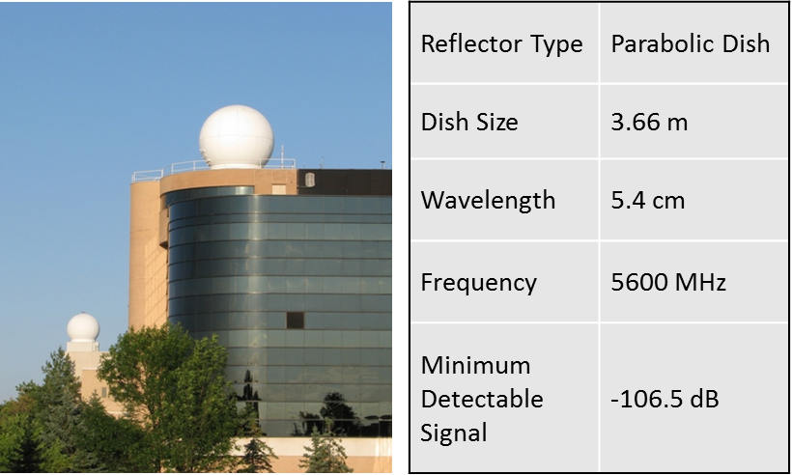
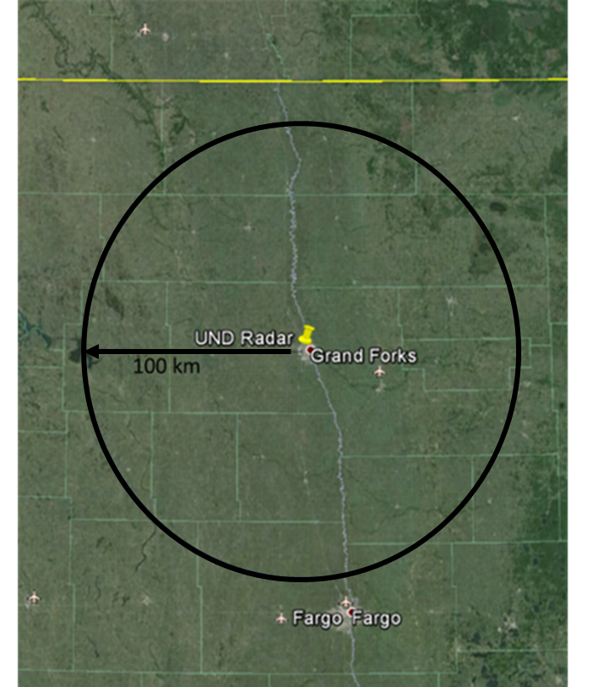
NorthPol C-Band Radar:

Slide 15
POLCAST NorthPol Specifications
Surveillance Type | Scan Type | Parameters
Routine | Full-Volume Mode | 16 tilts with max elevation of ~22º to a max range of 150 km. Spatial resolution: 250 m Temporal Resolution 10 min
Special: Case has been called | Sector-Scan Mode (1-3 min) centered on the case | High vertical resolution and lowest elevation tilts (elevation ~5º) ensure adequate sampling at low levels and provide high temporal resolution to capture the temporal evolution of the storms
http://www.weathermodification.org/publications/index.php/JWM/article/viewFile/147/194

Slide 16
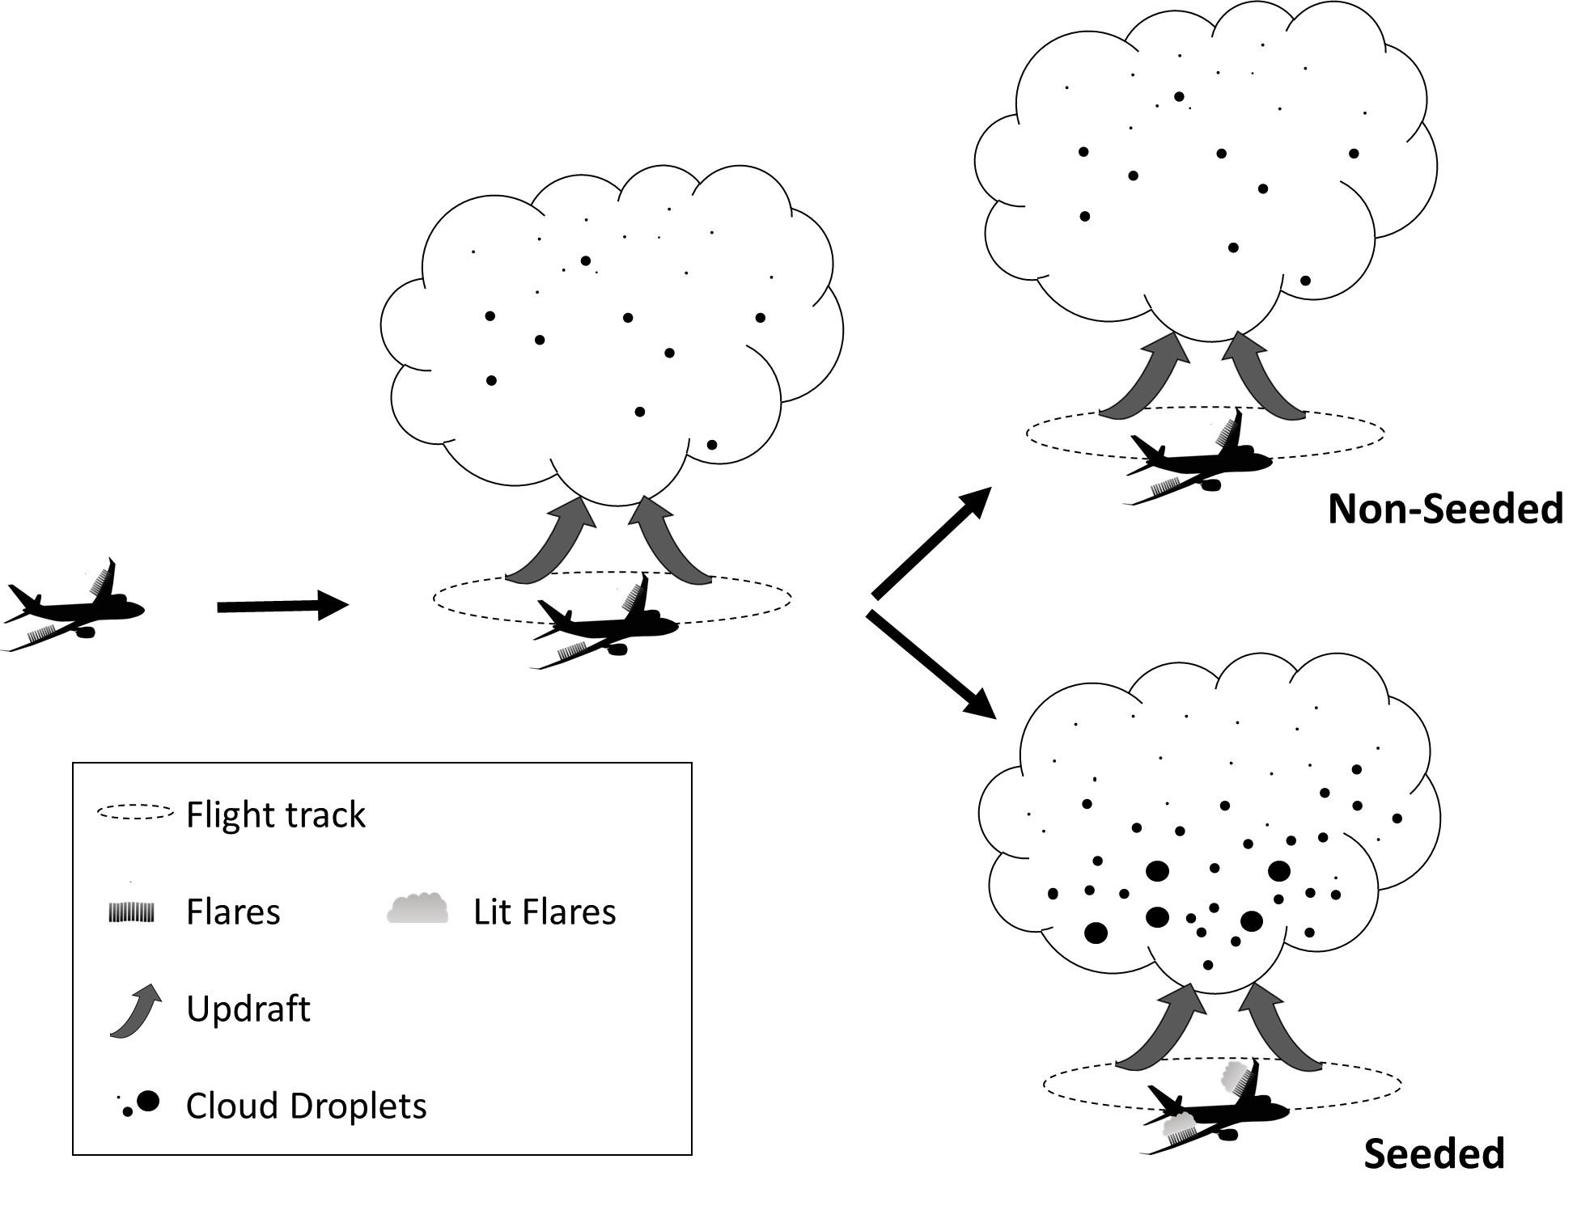
Case
Target
Search
Requirements for a Case:
Updraft of 500 ft/min
Rain free base
Cloud base temperature between 4-20 ºC
Evidence of growth in the early stage of development

Slide 17
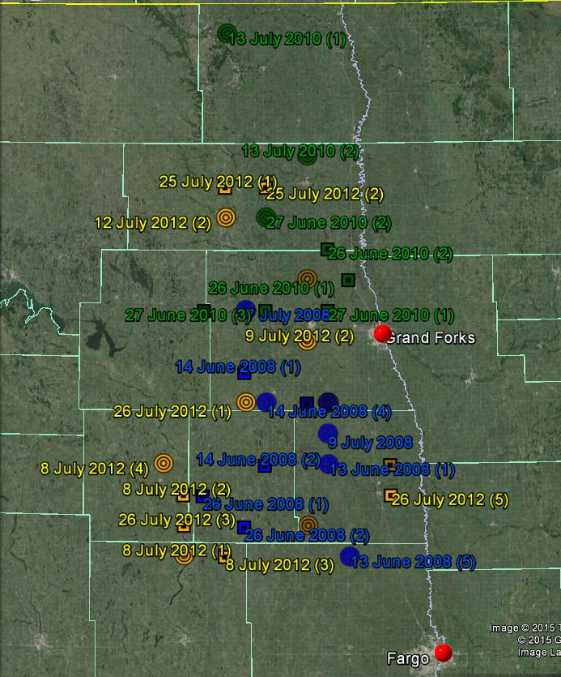
North Dakota convective cloud targets.
2008
Seed
Non-Seed
2010
Seed
Non-Seed
2012
Seed
Non-Seed
Notes:
Requirement to be called a Case: An updraft of 500 ft/min rain free base cloud base temperature between 4 and 20 C evidence of growth in the early stage in development

Slide 18
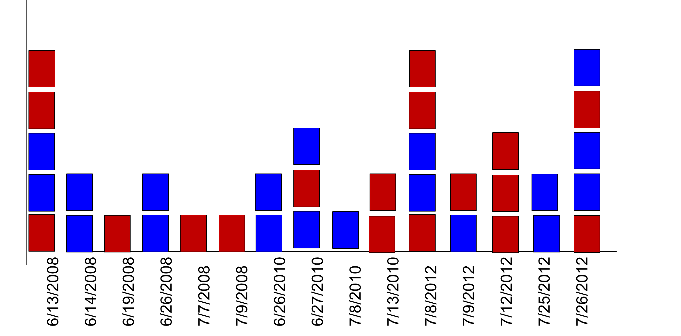
POLCAST Cases
Seeded Case
Non-Seeded Case
Case 5
Case 4
Case 3
Case 2
Case 1
Number of Cases
Date
2008
12 Cases
6 Seed and 6 Non-Seed
2010
8 Cases
3 Seed and 5 Non-Seed
2012
17 Cases
9 Seed and 8 Non-Seed

Slide 19
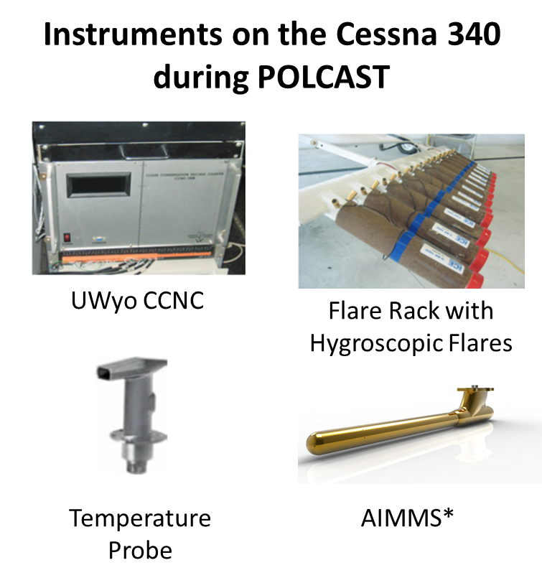
Instruments Used During POLCAST
University of Wyoming Cloud Condensation Nuclei Counter (UWyo CCNC)
Rosemount Aircraft Temperature Sensor
Flare Rack with ICE
Hygroscopic Flares
Aventech Aircraft Integrated Meteorological Measurement System (AIMMS)*
*The AIMMS was only used during the last 5 flights of 2012
(Goodrich 2002), (Delene et al. 2011), (Aventech 2017)
Notes:
Pressure Transducer not shown. - measures static and dynamic pressure – static is fluid at rest and dynamic is fluid in motion
CCNC Uncertainty : Able to measure the concentration of aerosols that activate at supersaturation between 0.3 and 1.6%.
TAT Uncertainty: Able to measure total temperature. Combination of all of the sources of uncertainty = 1.0466 degree C
Flare racks : holds 24 flares
AIMMS Uncertainty: Able to measure 3-dimensional winds. Horizontal North and East Components:0.50 m/s (1.0 knot) @ 150 knot TAS
Vertical: 0.75 m/s (1.5 knot) @ 150 knot TAS
Temperature, Accuracy: 0.30 C, Resolution: 0.01 C, Relative Humidity:Accuracy: 2.0%RH, Resolution: 0.1%RH, Broadcast / Log Update Rate: 1 - 10 Hz,Log Capacity: 45000 Records (12.5 hours @ 1 Hz)

Slide 20
Environmental Factors: 2008, 2010, and 2012

Slide 21
Environmental Factors: 2008, 2010, and 2012
Measurement | Average Value: Seed Days | St Dev. Seed Days | Average Value: Non-Seed Days | St Dev. Non-Seed Days | Percent Accuracy
Cloud Base Temperature | 11.6 ºC | ± 0.82 ºC | 12 ºC | ± 0.70 ºC | 7.8 %
Cloud Base Pressure Altitude | 1673 m | ± 95 m | 1556 m | ± 80 m | 7.3 %
Cloud Base CCNC | 1271 #/cm³ | ± 340 #/cm³ | 1381 #/cm³ | ± 260 #/cm³ | 8.3 %
Notes:
Percent Accuracy
Temp7.8 %
Alt 7.3 %
CCNC 8.3 %
CCN in the accumulation mode are most efficient in starting collision and coalescence process – in natural clouds – little larger for seeding – to add the larger particles in accumulation or coarse mode that are not natural
Cloud base – where condensation exceeds evaporation

Slide 22
Mann-Whitney Statistical Test
  To show a comparison of cloud base environmental measurements between seeded and non-seeded cases.
    Cloud base temperature
    Cloud base altitude
    Cloud base CCN concentration
Notes:
Talk about the tests and what data was used in each of them. Discuss how I chose what cases to keep and what ones did not match the requirements (from 44 cases to 37 for environmental factors to 33 for radar analysis). Why and how the tests were done and why were they chosen. The Mann-whitney test was chosen because of it being a non-parametric test - the distribution of the data is not Gaussian and will not influence the results. The Mann-whitney test compares means of measurements that come from the same population and to test whether they are equal or not.

Slide 23
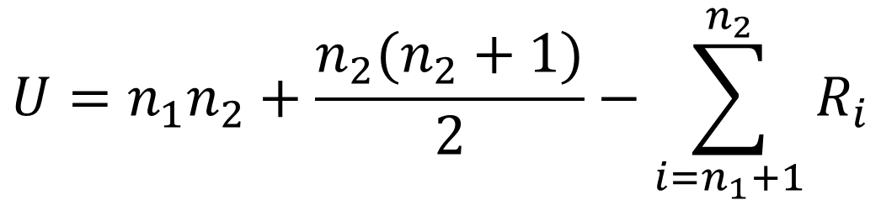
Mann-Whitney Statistical Test
$$U=n_{1}n_{2}+\frac{n_{2}(n_{2}+1)}{2}−\sum_{i=n_{1}+1}^{n_{2}}{R_{i}}$$
U=Mann-Whitney U test
n₁ = Sample size one (seed)
n₂= Sample size two (non-seed)
R_{i} = Rank of the sample size
Null hypothesis = distributions of both the seed and non-seed cases are identical.

Slide 24
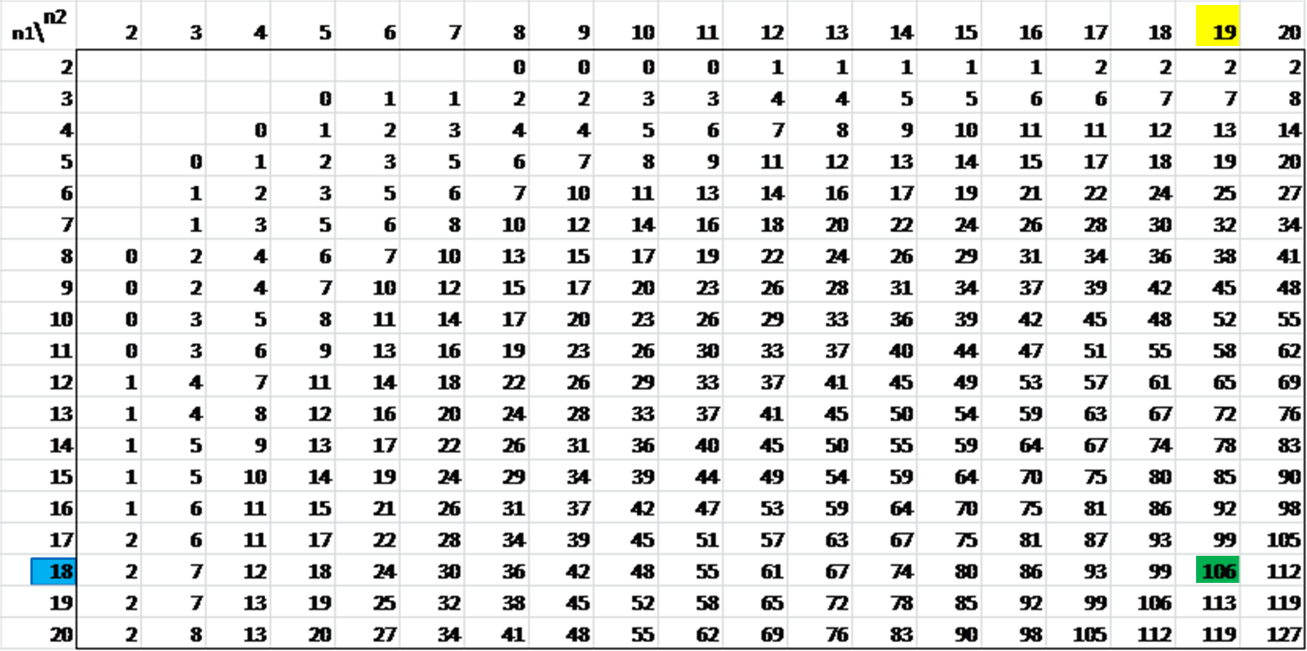
Mann-Whitney Statistical Test
Alpha = 0.05 (two-tailed)
Notes:
Calculated at 95 % confidence

Slide 25
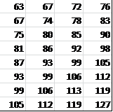
Mann-Whitney Statistical Test
Alpha = 0.05 (two-tailed)
Property | Test Statistic (U) | Accept hypothesis?
Mean Cloud Base CCN Concentration | 154.5 | ✔
Mean Cloud Base Temperature | 153.5 | ✔
Mean Cloud Base Altitude | 158.5 | ✔
If U > 106 do not reject the null hypothesis that properties are randomly distributed.

Slide 26
Mann-Whitney Statistical Test
Cloud Base Cloud Condensation Nuclei Concentration
 | Non-Seed Cases | Seed Cases
Number of Cases | 19 | 18
Mean Rank | 19.87 | 18.08
Sum of Ranks | 377.50 | 325.50
Mann-Whitney Test Statistic | 154.5
Significance | 0.621
Cloud Base Temperature
 | Non-Seed Cases | Seed Cases
Number of Cases | 19 | 18
Mean Rank | 18.08 | 19.97
Sum of Ranks | 343.50 | 359.50
Mann-Whitney Test Statistic | 153.5
Significance | 0.599
Cloud Base Cloud Pressure Altitude
 | Non-Seed Cases | Seed Cases
Number of Cases | 19 | 18
Mean Rank | 19.66 | 18.31
Sum of Ranks | 373.5 | 329.5
Mann-Whitney Test Statistic | 158.5
Significance | .707
Cloud base environmental factors are evenly distributed between seed and non-seed cases.
Notes:
Confirmed that the environmental factors are randomly distributed by using the Mann-Whitney Test. Calculating using the equations from the mann-whitney test from prior slides
With the p values – it can be assumed there is little difference between the seed and non-seed cases – the null hypothesis that the samples are from the same population can be accepted.

Slide 27
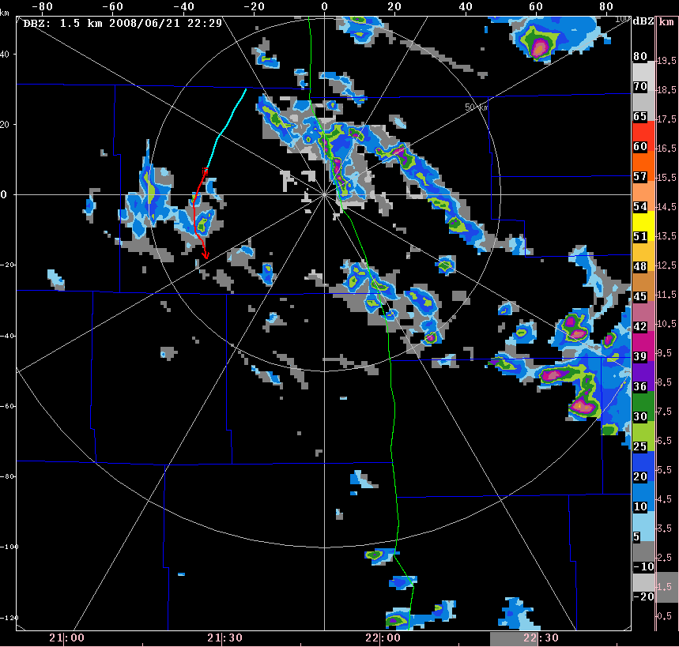
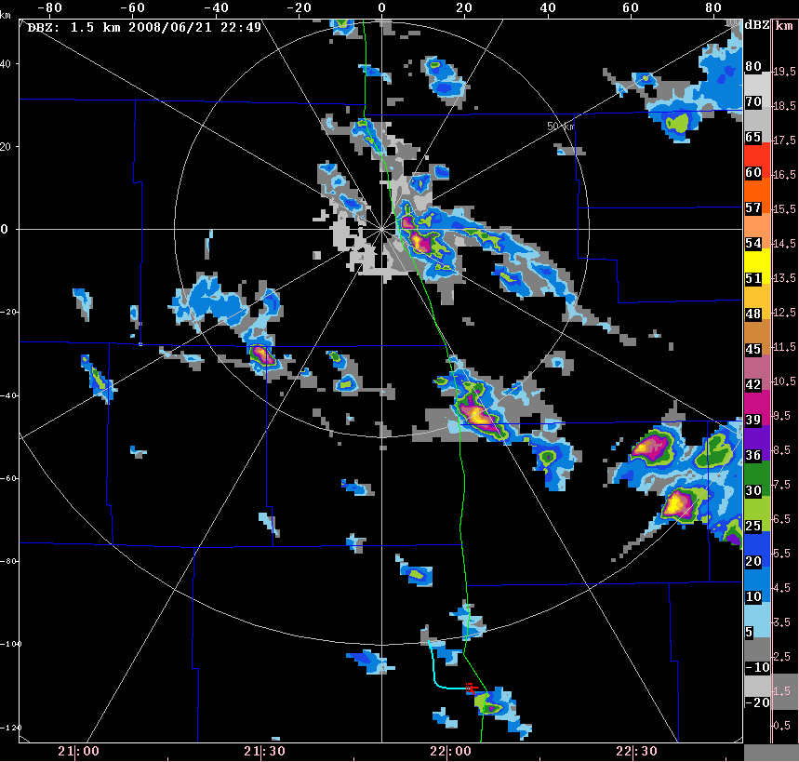
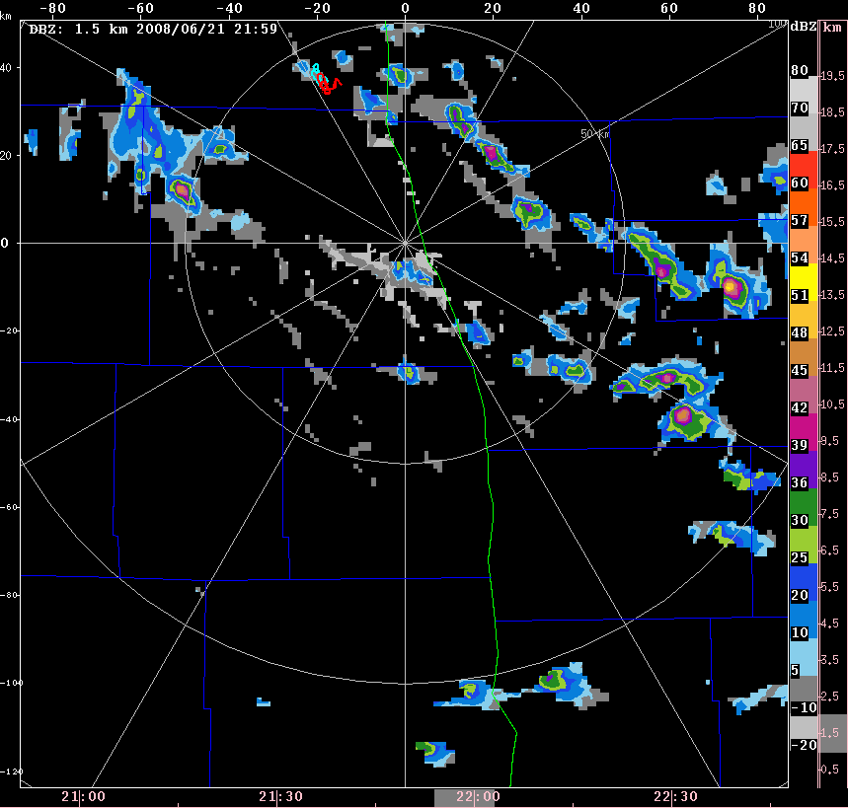
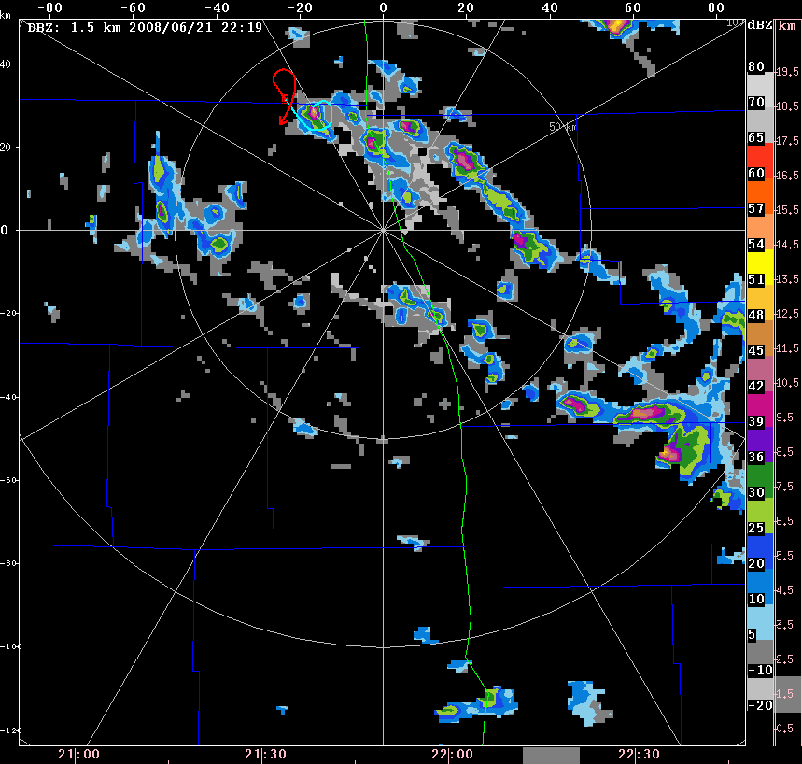
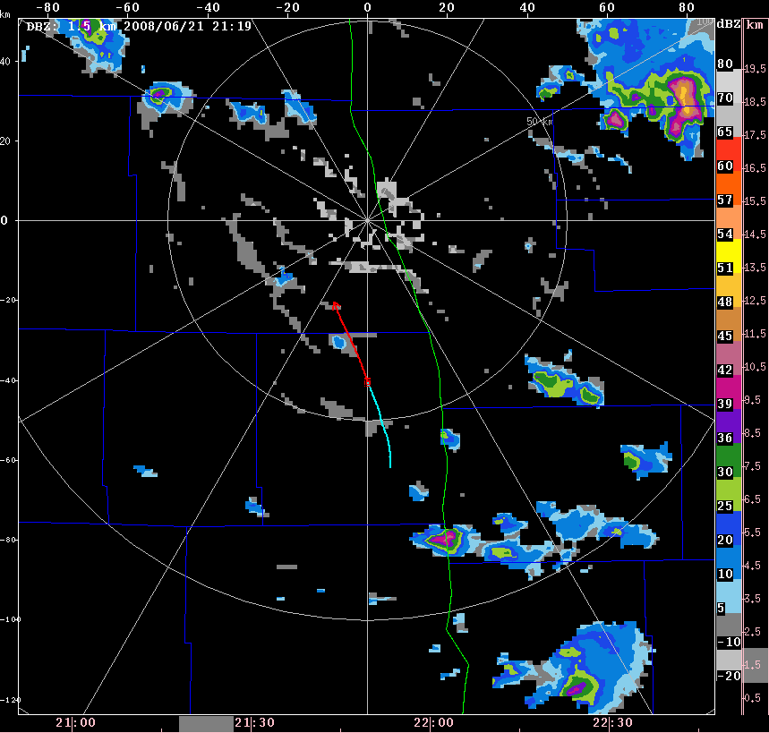
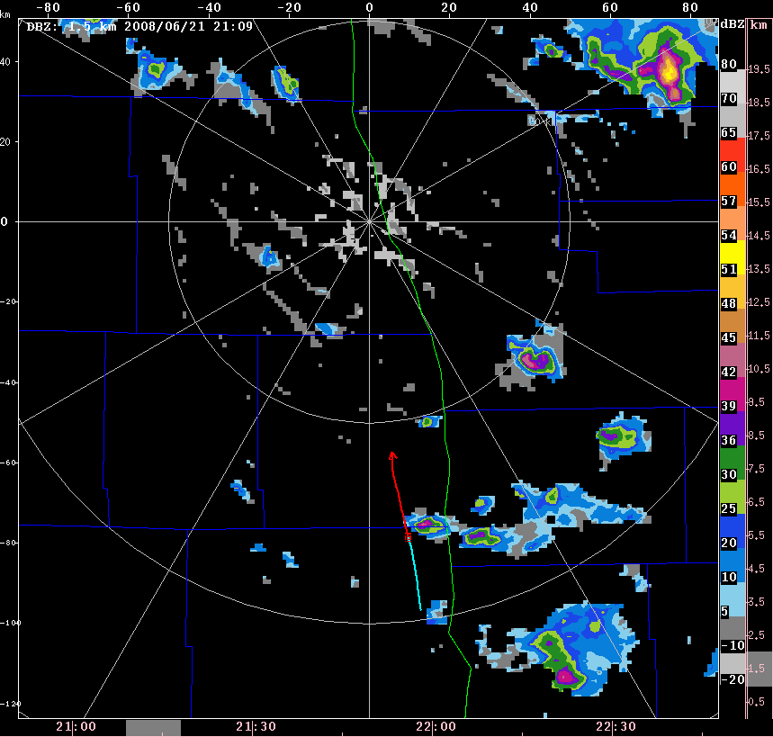
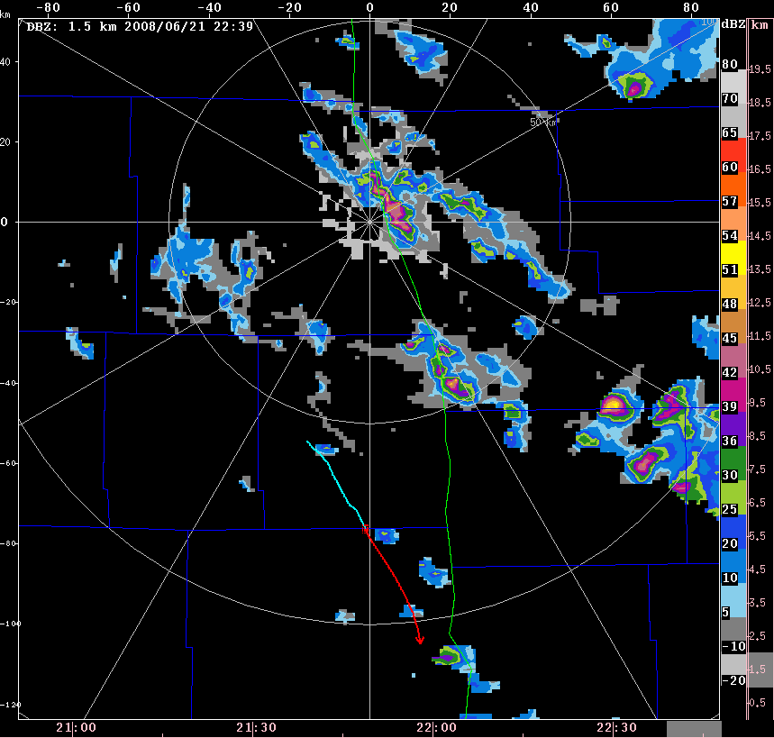
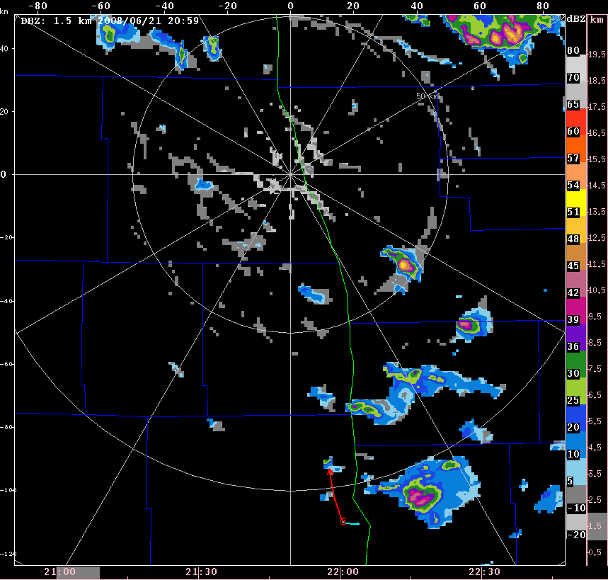
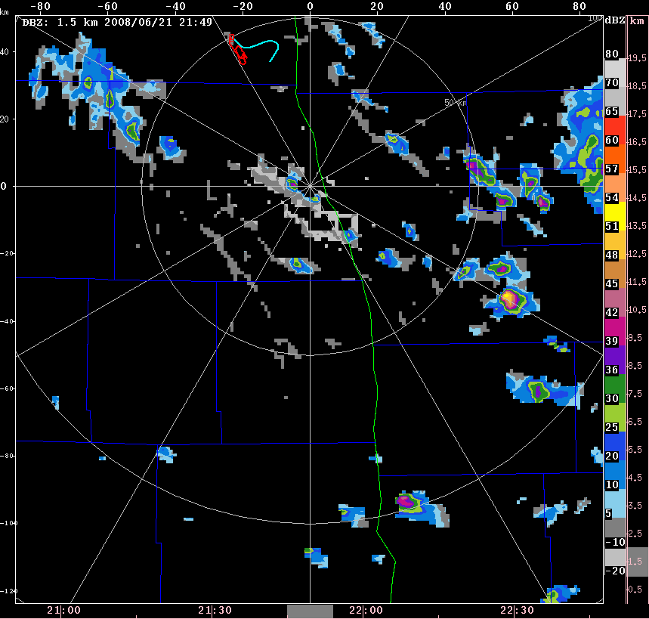
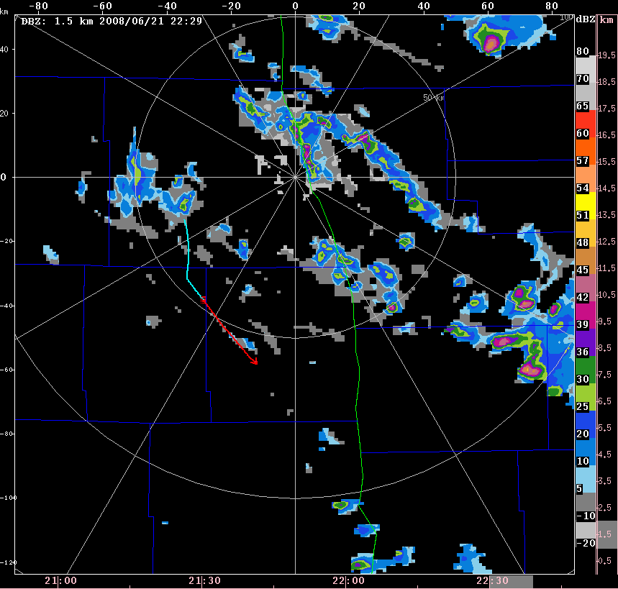
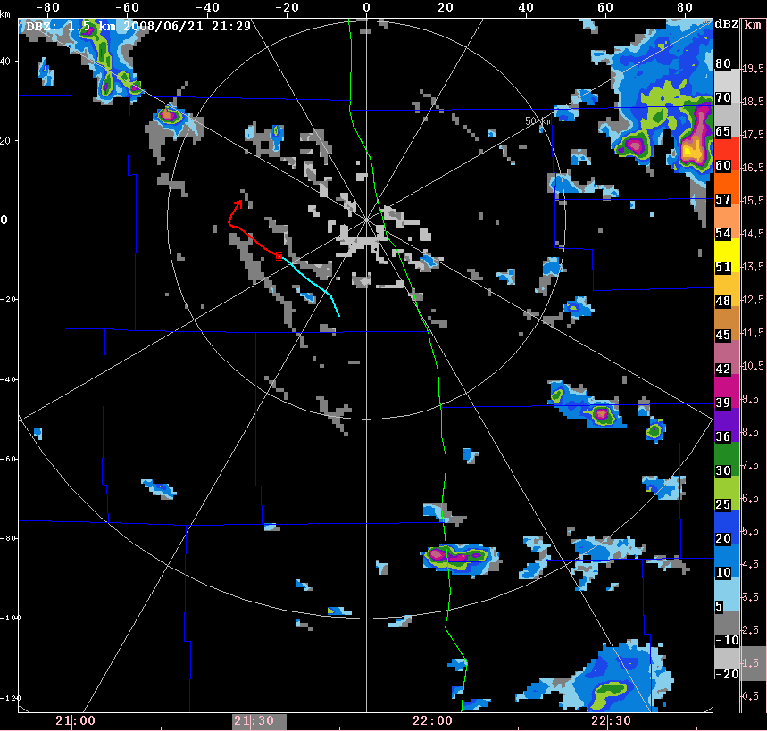
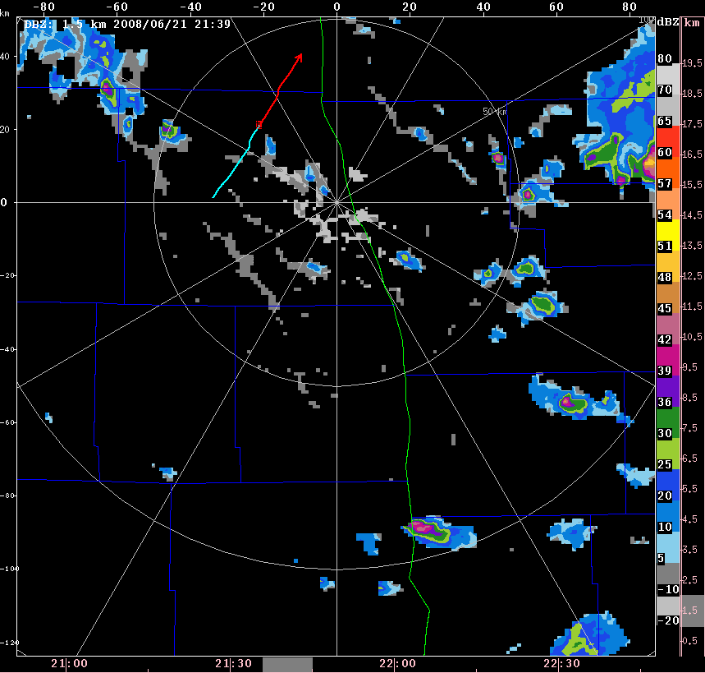
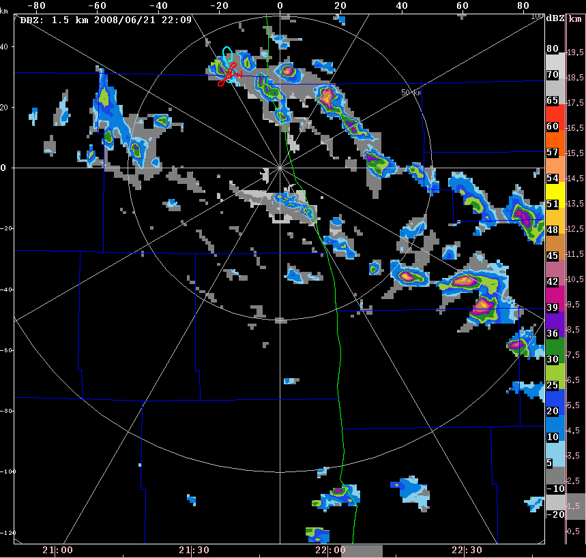
Thunderstorm Identification Tracking And Nowcasting
  Used to track clouds (cases) seeded or sampled by aircraft during POLCAST.
Flight Track on June 21, 2008
Notes:
Talk about the tests and what data was used in each of them. Discuss how I chose what cases to keep and what ones did not match the requirements (from 44 cases to 37 for environmental factors to 33 for radar analysis). Why and how the tests were done and why were they chosen.

Slide 28
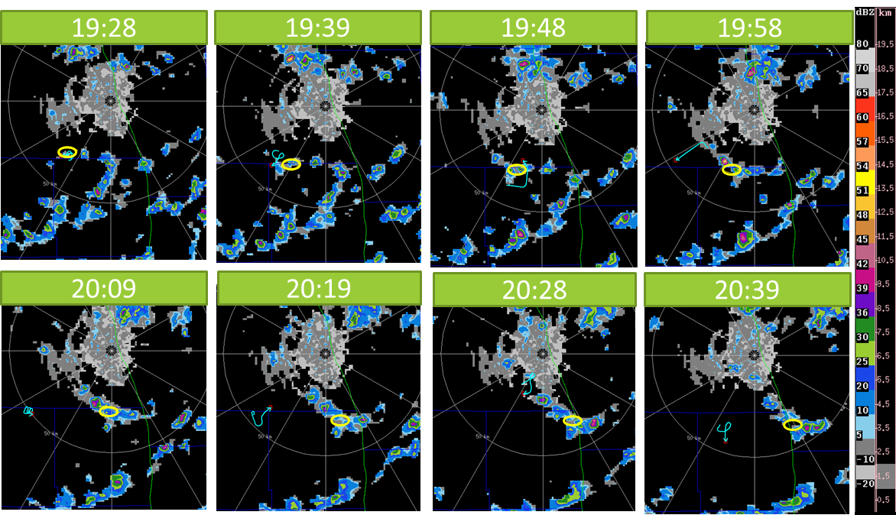
June 13, 2008 POLCAST Non-Seed Case

Slide 29
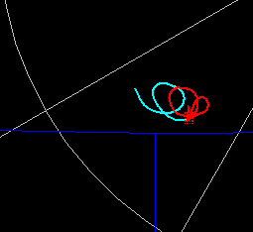
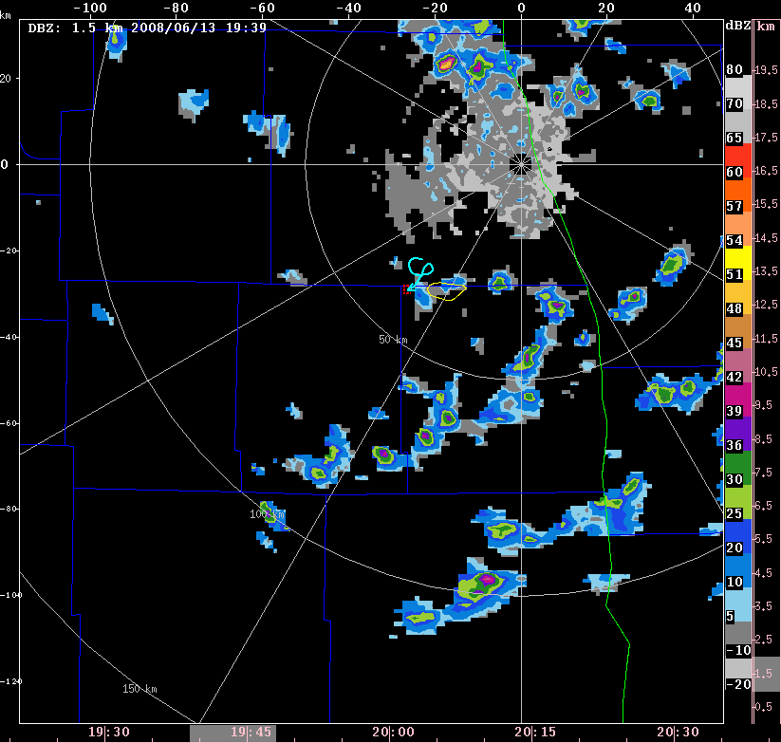
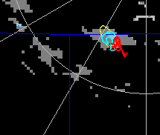
POLCAST2 Case Examples
2008/07/09
Non-Seed Case
Cell: No Echo: No
2008/07/09
Seed Case
Cell: Yes Echo: Yes
Notes:
Some clouds would not appear to be seen on radar due to the precipitation size particles not being large enough to create a return

Slide 30
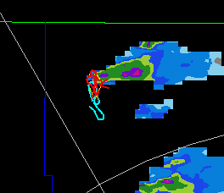
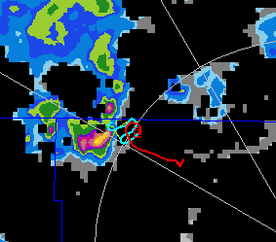
POLCAST3 Case Examples
2010/06/27
Non-Seed Case
Cell: Yes Echo: Yes
2010/07/13
Seed Case
Cell: Yes Echo: Yes

Slide 31
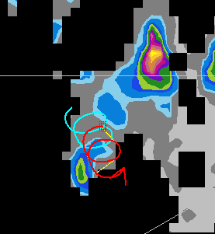
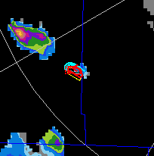
POLCAST4 Case Examples
2012/07/26
Non-Seed Case
Cell: Yes Echo: Yes
2012/07/08
Seed Case
Cell: Yes Echo: Yes

Slide 32
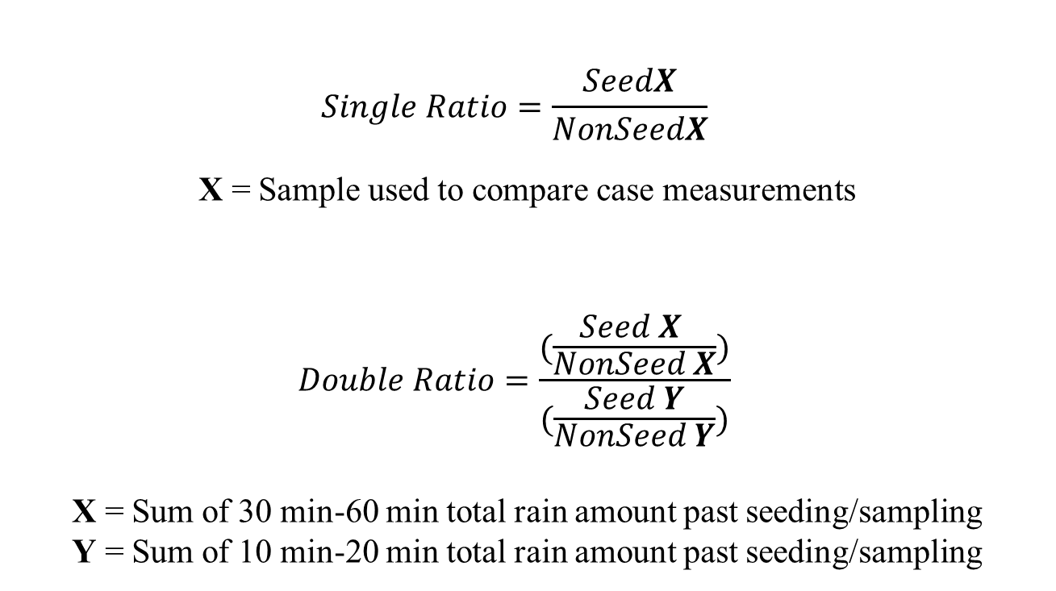
Single Ratio and Double Ratio
  Used to show a percent increase of seeded vs. non-seeded cases of chosen variables.
$$Single Ratio=\frac{SeedX}{NonSeedX}$$
X = Sample used to compare case measurements
$$Double Ratio=\frac{(\frac{Seed X }{NonSeed X})}{(\frac{Seed Y}{NonSeed Y})}$$
X = Sum of 30 min-60 min total rain amount past seeding/sampling
Y = Sum of 10 min-20 min total rain amount past seeding/sampling
Notes:
Why was the Single ratio test done?
What is the benefit of the double ratio test

Slide 33
Single Ratio Results : Reflectivity
Reflectivity (dBZ)
 | SR = Seed Avg/ Non-Seed Avg
10 minutes | 1.369
20 minutes | 1.266
30 minutes | 1.302
40 minutes | 1.444
50 minutes | 1.000
60 minutes | 1.245

Slide 34
Radar Derived Rain Rate

Slide 35
Radar Derived Rain Amount
POLCAST2, 3, 4
 | Seed (Average) | Seed (Total) | Non-Seed (Average) | Non-Seed (Total) | SR = Seed Tot/ Non-Seed Tot | SR = Seed Avg/ Non-Seed Avg
Rain Amount | 0.3 mm | 4.7 mm | 0.2 mm | 2.8 mm | 1.7 mm | 1.5 mm
Notes:
All of the single ratios are greater than 1 showing an increase in the seeded cases for rain amount at each time period

Slide 36
Lifetime of Clouds
Percent of cases lasting 20 - 60 minutes past seeding or sampling
 | Lasted 20 minutes | lasted 30 minutes | lasted 40 minutes | lasted 50 minutes | lasted 60+ minutes
Seed Cases | 100 % | 88 % | 82 % | 76 % | 41 %
Non-seed Cases | 88 % | 62 % | 56 % | 31 % | 25 %

Slide 37
Effectiveness of Hygroscopic Seeding in North Dakota
33 Cases
Double Ratio Rain Amount | P-Value | Single Ratio Average Rain Amount | Seeded Cloud Lifetime 60+ Minutes
1.85 | 0.31 | 1.5 | 41 %

Slide 38
Bootstrapping Method:
Statistical method of resampling with replacement to take values from an original data set and create data sets of varied numbers from the original data.
Values from the original data set could be included once, multiple times, or not at all in the created data sets.

Slide 39
Bootstrapping Method
POLCAST2,3,4
POLCAST4
Bootstrap on the original data set of 33 radar cases.
Iterate through the original data set to create 100, 1,000, and 10,000 data sets of 66, 132, and 264 cases.
Bootstrap on the original data set of 15 radar cases.
Iterate through the original data set to create 100, 1,000, and 10,000 data sets of 30, 60, and 120 cases.
Notes:
What equations/program was used to create the data sets? How does the bootstrapping work to create data - what did I calculate:
Double Ratios for (30-60)/(10-20), Single ratio (max, average), stdev, mean, total
From original – lost 1 seed and 3 non-seed cases due to not producing enough of an echo to be tracked longer than 1 scan after seeding.

Slide 40
Bootstrapped POLCAST Data Set
10,000 Iterations
 | 66 Cases | 132 Cases | 264 Cases
Mean Double Ratio | 1.97 | 1.91 | 1.88
Standard Deviation | 0.81 | 0.54 | 0.36
Z-Score | 1.20 | 1.70 | 2.44
P-Value (Right Tailed) | 0.115 | 0.045 | 0.007

Slide 41
Bootstrapped 2012 POLCAST Data Set
10,000 iterations
 | 30 Cases | 60 Cases | 120 Cases
Mean Double Ratio | 15.07 | 15.26 | 13.89
Standard Deviation | 6.50 | 3.98 | 2.51
Z-Score | 2.16 | 3.59 | 5.14
P-Value (Right Tailed) | 0.0152 | 0.0002 | < 0.00001

Slide 42
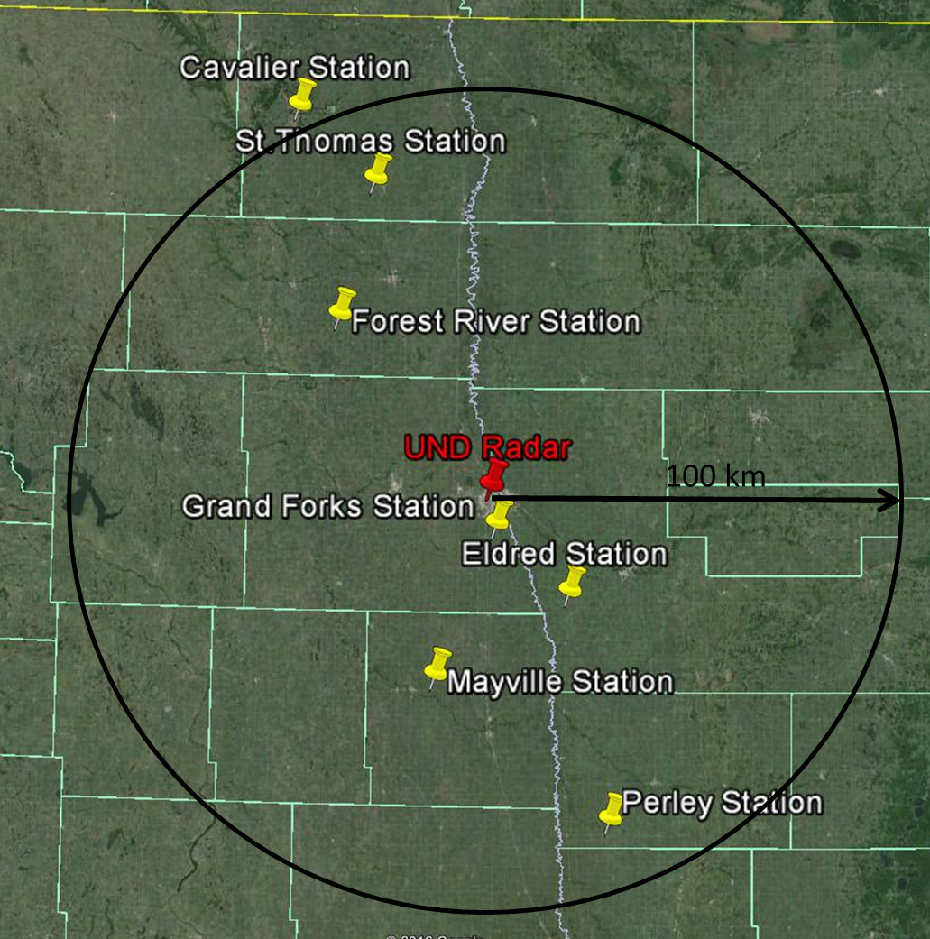
North Dakota Atmospheric Weather Network (NDAWN) Stations
Minnesota:
Eldred, Perley
North Dakota:
Cavalier, Forest River, Grand Forks, Mayville, St. Thomas
43
Notes:
42

Slide 43
Annual Percentage of Rainfall
Station and Years of Data | June and July
Cavalier, ND (1993-2015) | 39 %
Mayville, ND (1995-2015) | 36 %
Grand Forks, ND (1990-2015) | 39 %
St. Thomas, ND (1994-2015) | 39 %
Forest River, ND (1991-2015) | 39 %
Perley, MN (1995-2015) | 38 %
Eldred, MN (1995-2015) | 38 %
Notes:
Rain measurements are from april – October with the percents of june and july shown in the table.

Slide 44
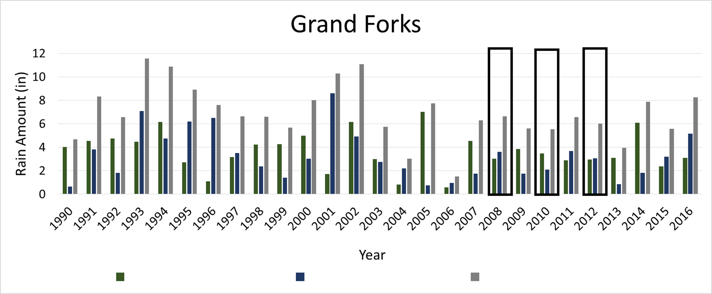
NDAWN: Total Rain Amount in June and July
June
July
Annual
Rain amount from the Grand Forks NDAWN station to show that the years chosen as seeded were not unusual for the area.
Notes:
Rain amount from the NDAWN stations was used to show that the years chosen as seeded were not unusual for the area.

Slide 45
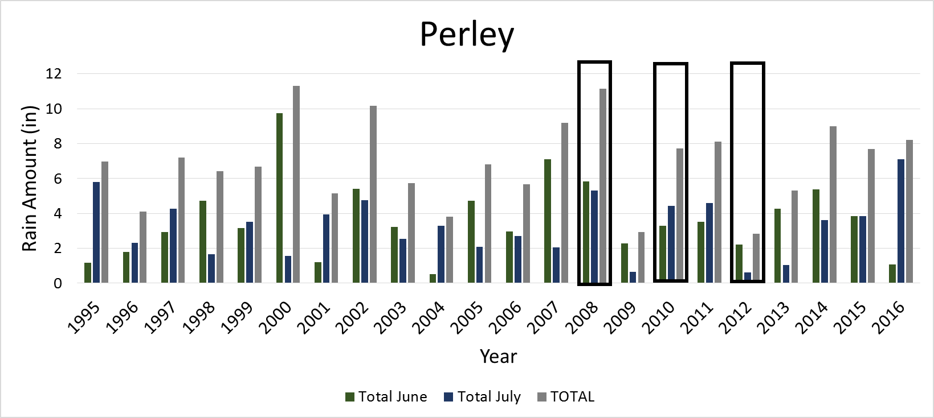
NDAWN: Total Rain Amount in June and July
June
July
Annual
Rain amount from the Perley NDAWN station to show that the years chosen as seeded were not unusual for the area.

Slide 46
Conclusions
Environmental factors are distributed in seed and non-seed cases.
Seeded clouds produced more precipitation than non-seeded clouds.
    Single ratio = 1.7 and Double Ratio = 1.85.
Statistical significance was calculated for >132 cases.
Seeded clouds had longer lifetimes than non-seeded clouds.
    41 % of seeded clouds lasting 60+ minutes compared to 25 % of non-seeded clouds.
There was an increase of rain rate in seeded clouds compared to non-seeded clouds (from TITAN).
Rainfall in eastern North Dakota was typical during June and July of 2008, 2010, and 2012 when POLCAST took place.
47

Slide 47
Broader Impacts and Future Work
  Use the Poission Counting Statistic to determine the p-value uncertainty for the number of cases provided.
  Use data, such as environmental factors, from POLCAST to input into a model for simulations of cloud seeding cases.
  Analyze TITAN cells instead of an area of influence.
48

Slide 48
References
Aventech, 2017: AIMMS-20. http://aventech.com/products/aimms20.html.
Beazell, K. A., 2016: Grown Locally, Praised Globally in North Dakota. http://www.farmflavor.com/north-dakota/north-dakota-agribusiness/grown-locally-praised-globally-north-dakota/ (Accessed March 20, 2017).
Delene, D., C. Grainger, P. Kucera, D. Langerud, M. Ham, R. Mitchell, and K. Kruse, 2011: The Second Polarimetric Cloud Analysis and Seeding Test. J. Weather Modif., 43, 14–28.
Mather, G. K., D. E. Terblanche, F. E. Steffens, and L. Fletcher, 1997: Results of the South African Cloud-Seeding Experiments Using Hygroscopic Flares. J. Appl. Meteorol., 36, 1433–1447, doi:10.1175/1520-0450(1997)036<1433:ROTSAC>2.0.CO;2.
National Conference of State Legislatures, 2008: North Dakota: Assessing the Costs of Climate Change. http://www.ncsl.org/print/environ/ClimateChangeND.pdf.
North Dakota Department of Agriculture, 2010: Major Crops and Livestock of North dakota. https://www.nd.gov/ndda/files/resource/agbrochure2010.pdf (Accessed December 1, 2016).
North Dakota Studies, 2011: North Dakota Leads the Nation. http://www.ndstudies.org/resources/maps/ag/ndleads.html.
Schoonjans, F., Test for one proportion calculator. MedCalc,. https://www.medcalc.org/calc/test_one_proportion.php (Accessed July 13, 2017).
Silverman, B. A., 2003: A Critical Assessment of Hygroscopic Seeding of Convective Clouds for Rainfall Enhancement. Bull. Am. Meteorol. Soc., 84, 1219–1230, doi:10.1175/BAMS-84-9-1219.
——, and W. Sukarnjanaset, 2000: Results of the Thailand Warm-Cloud Hygroscopic Particle Seeding Experiment. J. Appl. Meteorol., 39, 1160–1175, doi:10.1175/1520-0450(2000)039<1160:ROTTWC>2.0.CO;2.

Slide 49
Acknowledgements
Atmospheric Science Department
Committee:
  Dr. Dave Delene
  Leon Osborne
  Dr. Gerry Dunnigan
Friends and Family

Slide 50
Silver Iodide (AgI) Flares used in the NDCMP
 | AgI Ejectable and Burn-in-Place Flares
Advantages | Wide temperature range spectrum for nucleation 63 % of nucleation within the first minute 90 % of nucleation in less than 2 minutes
*http://iceflares.com/
Notes:
Heterogeneous Nucleation – process by which water droplets form on nuclei from the vapor phase

Slide 51


Statistics on 2008, 2010, and 2012 POLCAST Bootstrapped Data Sets
100 iterations
Cases | 66 | 132 | 264 | 528
Mean Double Ratio | 1.9243 | 1.9576 | 1.8927 | 1.8420
Standard Deviation | 0.7798 | 0.4838 | 0.3368 | 0.2677
Z-Score | 1.1853 | 1.9793 | 2.6509 | 3.1452
Test for 1 proportion | .4506 | .2688 | .1449 | .0259
1,000 iterations
Cases | 66 | 132 | 264 | 528
Mean Double Ratio | 1.9894 | 1.9003 | 1.8710 | 1.8654
Standard Deviation | 0.788 | 0.4938 | 0.3513 | 1.8654
Z-Score | 1.256 | 1.8233 | 2.4796 | 3.4901
Test for 1 Proportion | .4194 | .2985 | .1549 | .0229
10,000 iterations
Cases | 66 | 132 | 264 | 528
Mean Double Ratio | 1.9679 | 1.9103 | 1.8814 | 1.8677
Standard Deviation | 0.8070 | 0.5362 | 0.3609 | 0.2536
Z-Score | 1.1993 | 1.6975 | 2.4421 | 3.4214
Test for 1 Proportion | .2147 | .1466 | .0751 | .0023
Equations for the test for 1 proportion

Slide 52
Environmental Factors: 2008, 2010, and 2012
Average = 13 C
Average = 1330 #/cm^3
Average = 1630 m

Slide 53
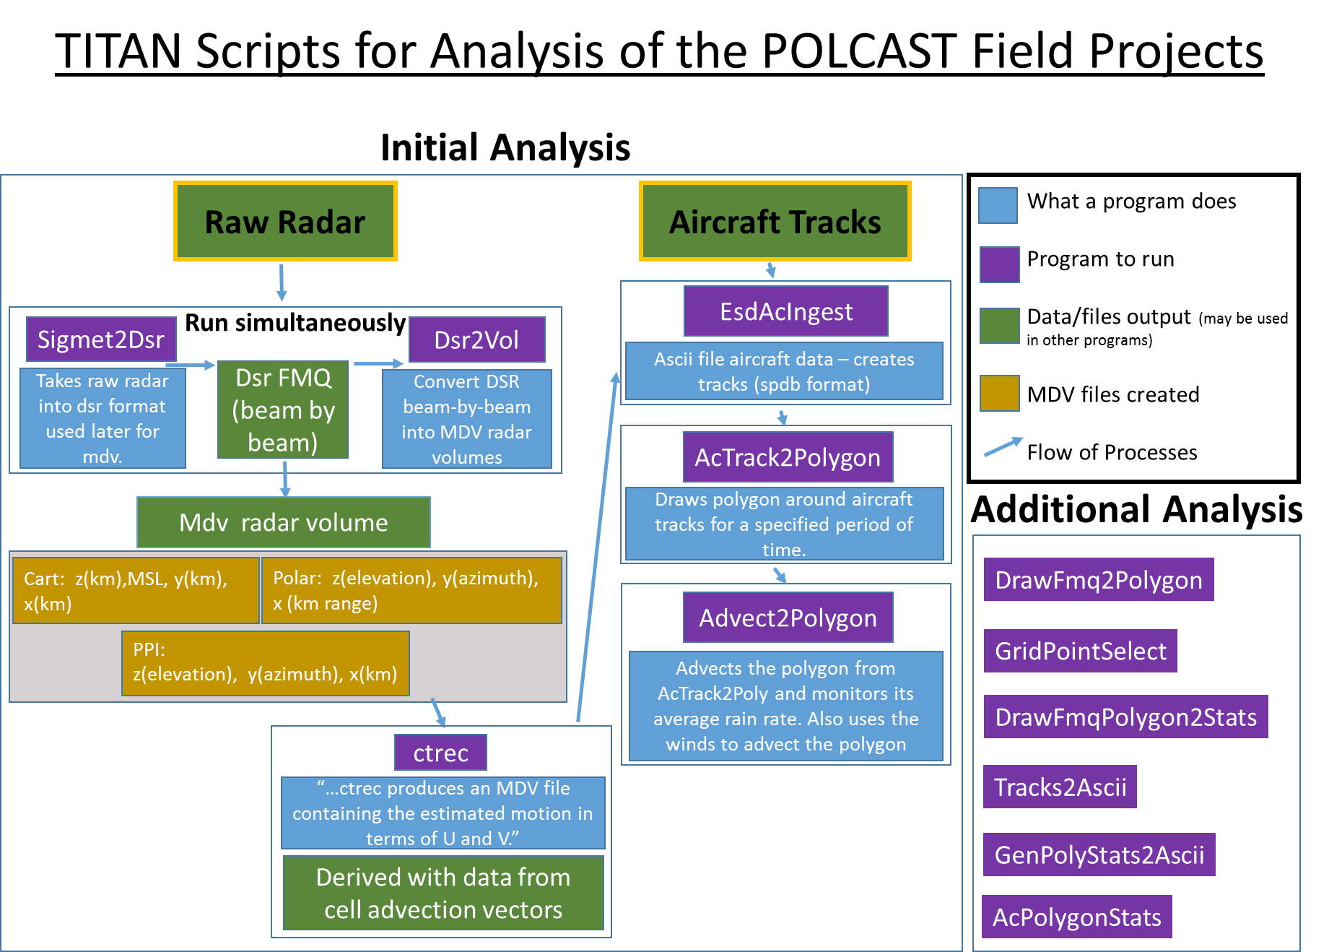

Slide 54
Importance of Cloud Base Temperature

Slide 55
Analysis of POLCAST with TITAN:
Calculate rain rate using Reflectivity
Z-R Relationship Equation used for Summer Deep Convection
Z = 300 * R^1.4
Z = reflectivity (mm⁶/m³)
R = Rain rate in mm/hr
44
Notes:
In the extreme case, there is a possibility that hygroscopic particle seeding merely shifts the existing rain volume into a narrow spectrum of fewer but much larger drops, which yields a large radar return with no actual
rain increase.

Slide 56
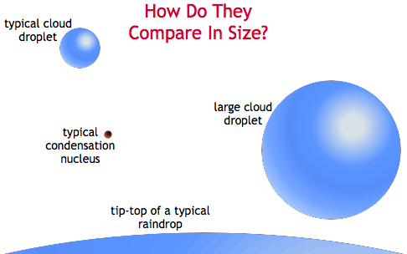
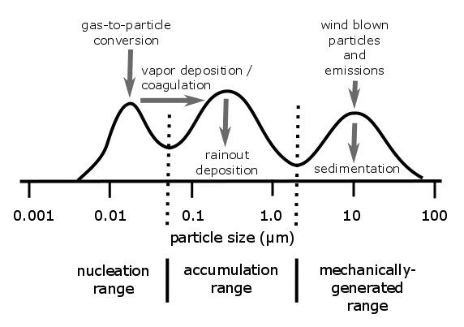
Importance of CCN Diameter For Raindrop Formation
Notes:
The three different modes of aerosols: nucleation, accumulation, mechanically generated(coarse)

Slide 57
Importance of CCN Diameter For Raindrop Formation
North Dakota clouds contain mainly nucleation size particles.

Slide 58
Importance of CCN Diameter For Raindrop Formation
Introduce more accumulation size particles to increase efficiency of precipitation formation.

Slide 59
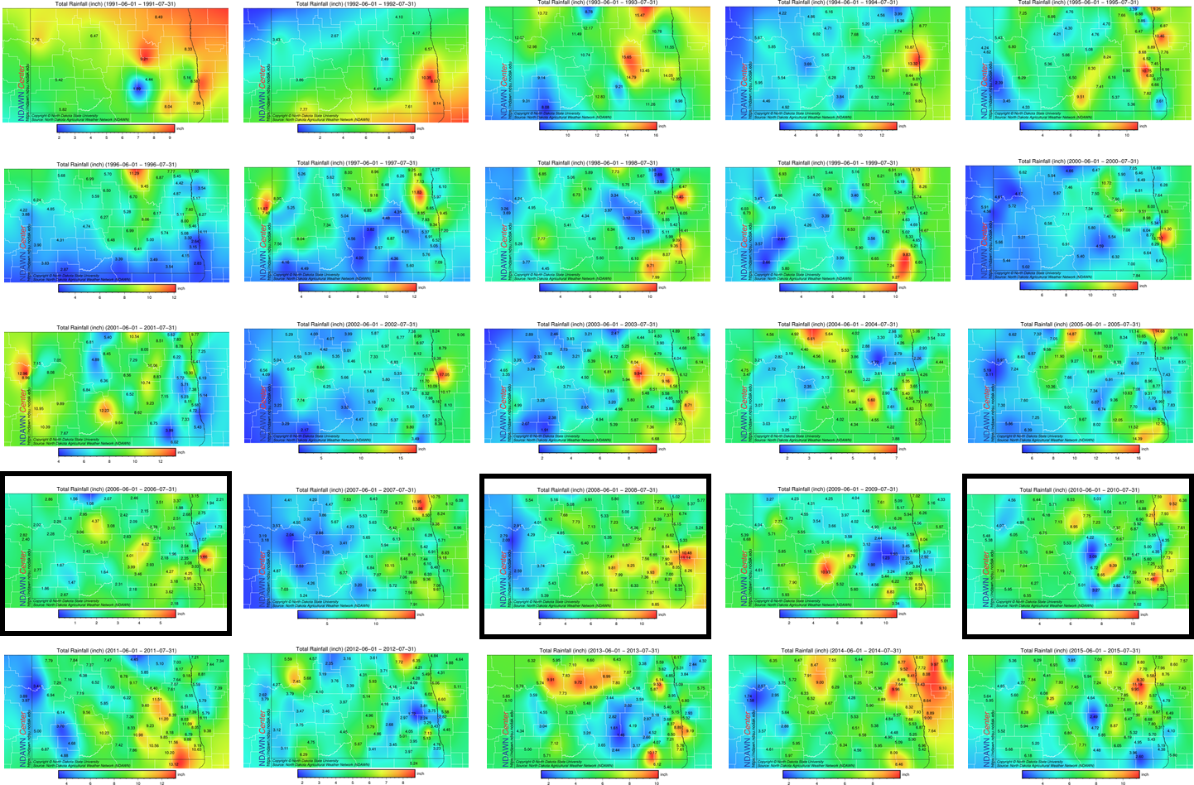
North Dakota Total Rainfall :
1991 - 2015
2008
2010
2012

Slide 60
2008, 2010, and 2012 POLCAST Rain Rate
2008 Seed
2008 Non-Seed
2010 Seed
2010 Non-Seed
2012 Seed
2012 Non-Seed
Rain Rate (mm/hr)
Time Past Seed/Sample (minutes)

Slide 61
June July Annual

Slide 62
June July Annual

Slide 63
June July Annual

Slide 64
June July Annual

Slide 65
June July Annual

Slide 66
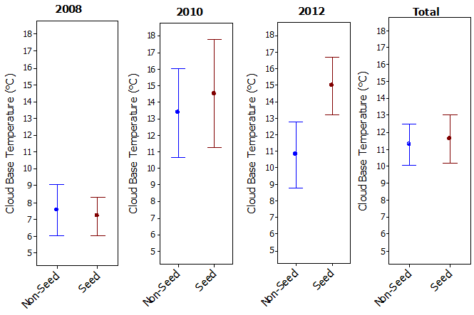
Cloud Base Temperature

Slide 67

Cloud Base CCN

Slide 68

Cloud Base Altitude

