Slide 1

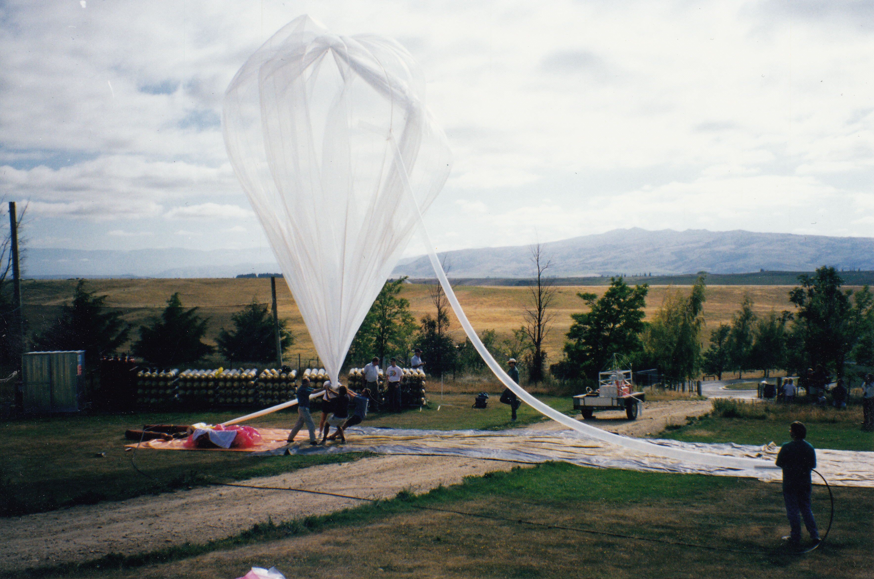
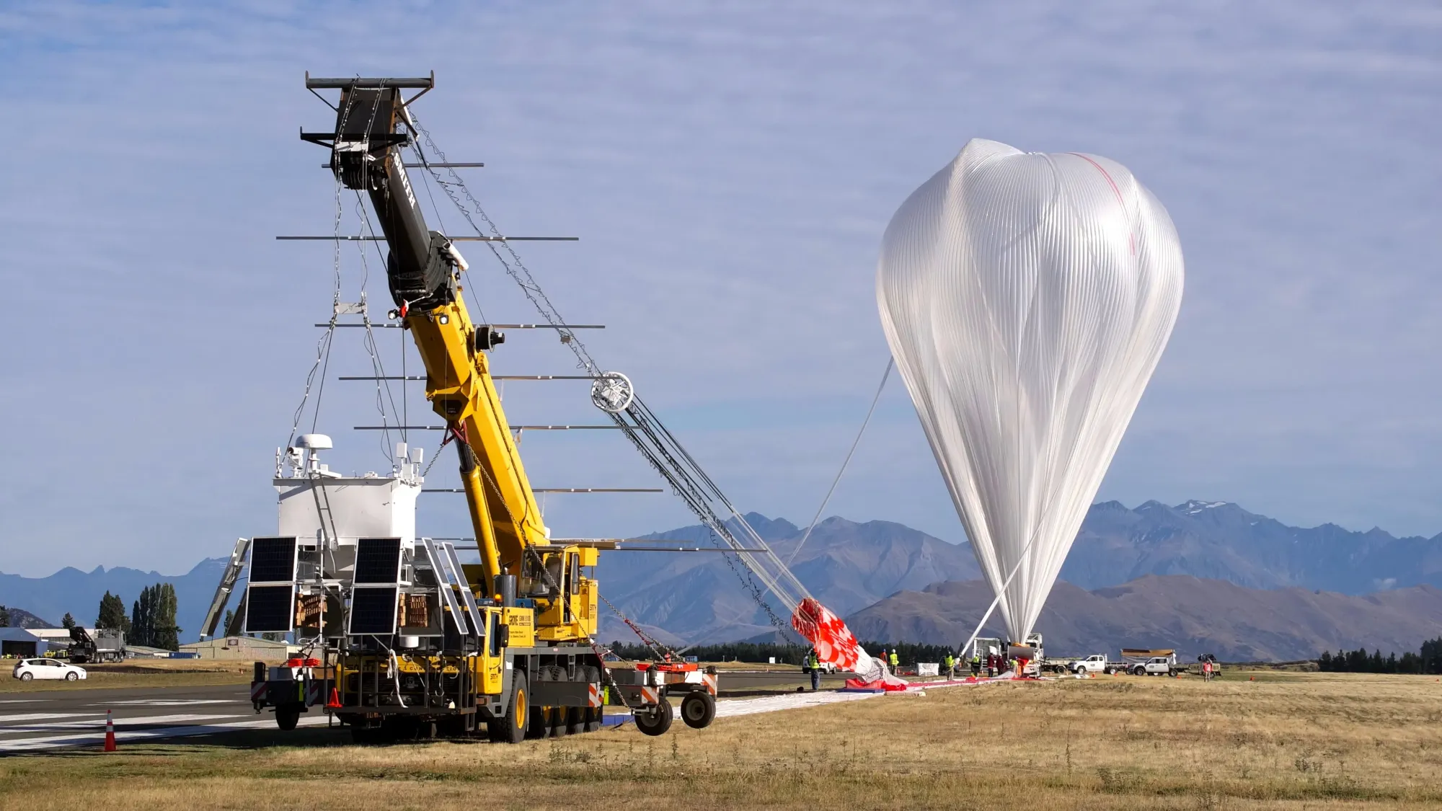
University-Led Stratospheric Operations and Observations: Past and Future
Zero-pressure balloon filling in Lauder, New Zealand, 1998
Super-pressure balloon launch in Wanaka, New Zealand, 2015
David J. Delene, Ronald Fevig, and Paul Snyder
Notes:
https://phys.org/news/2021-03-atmospheric-turbulence-cloud-droplet-formation.html
Atmospheric turbulence may promote cloud droplet formation
by Morgan Rehnberg, American Geophysical Union

Slide 2
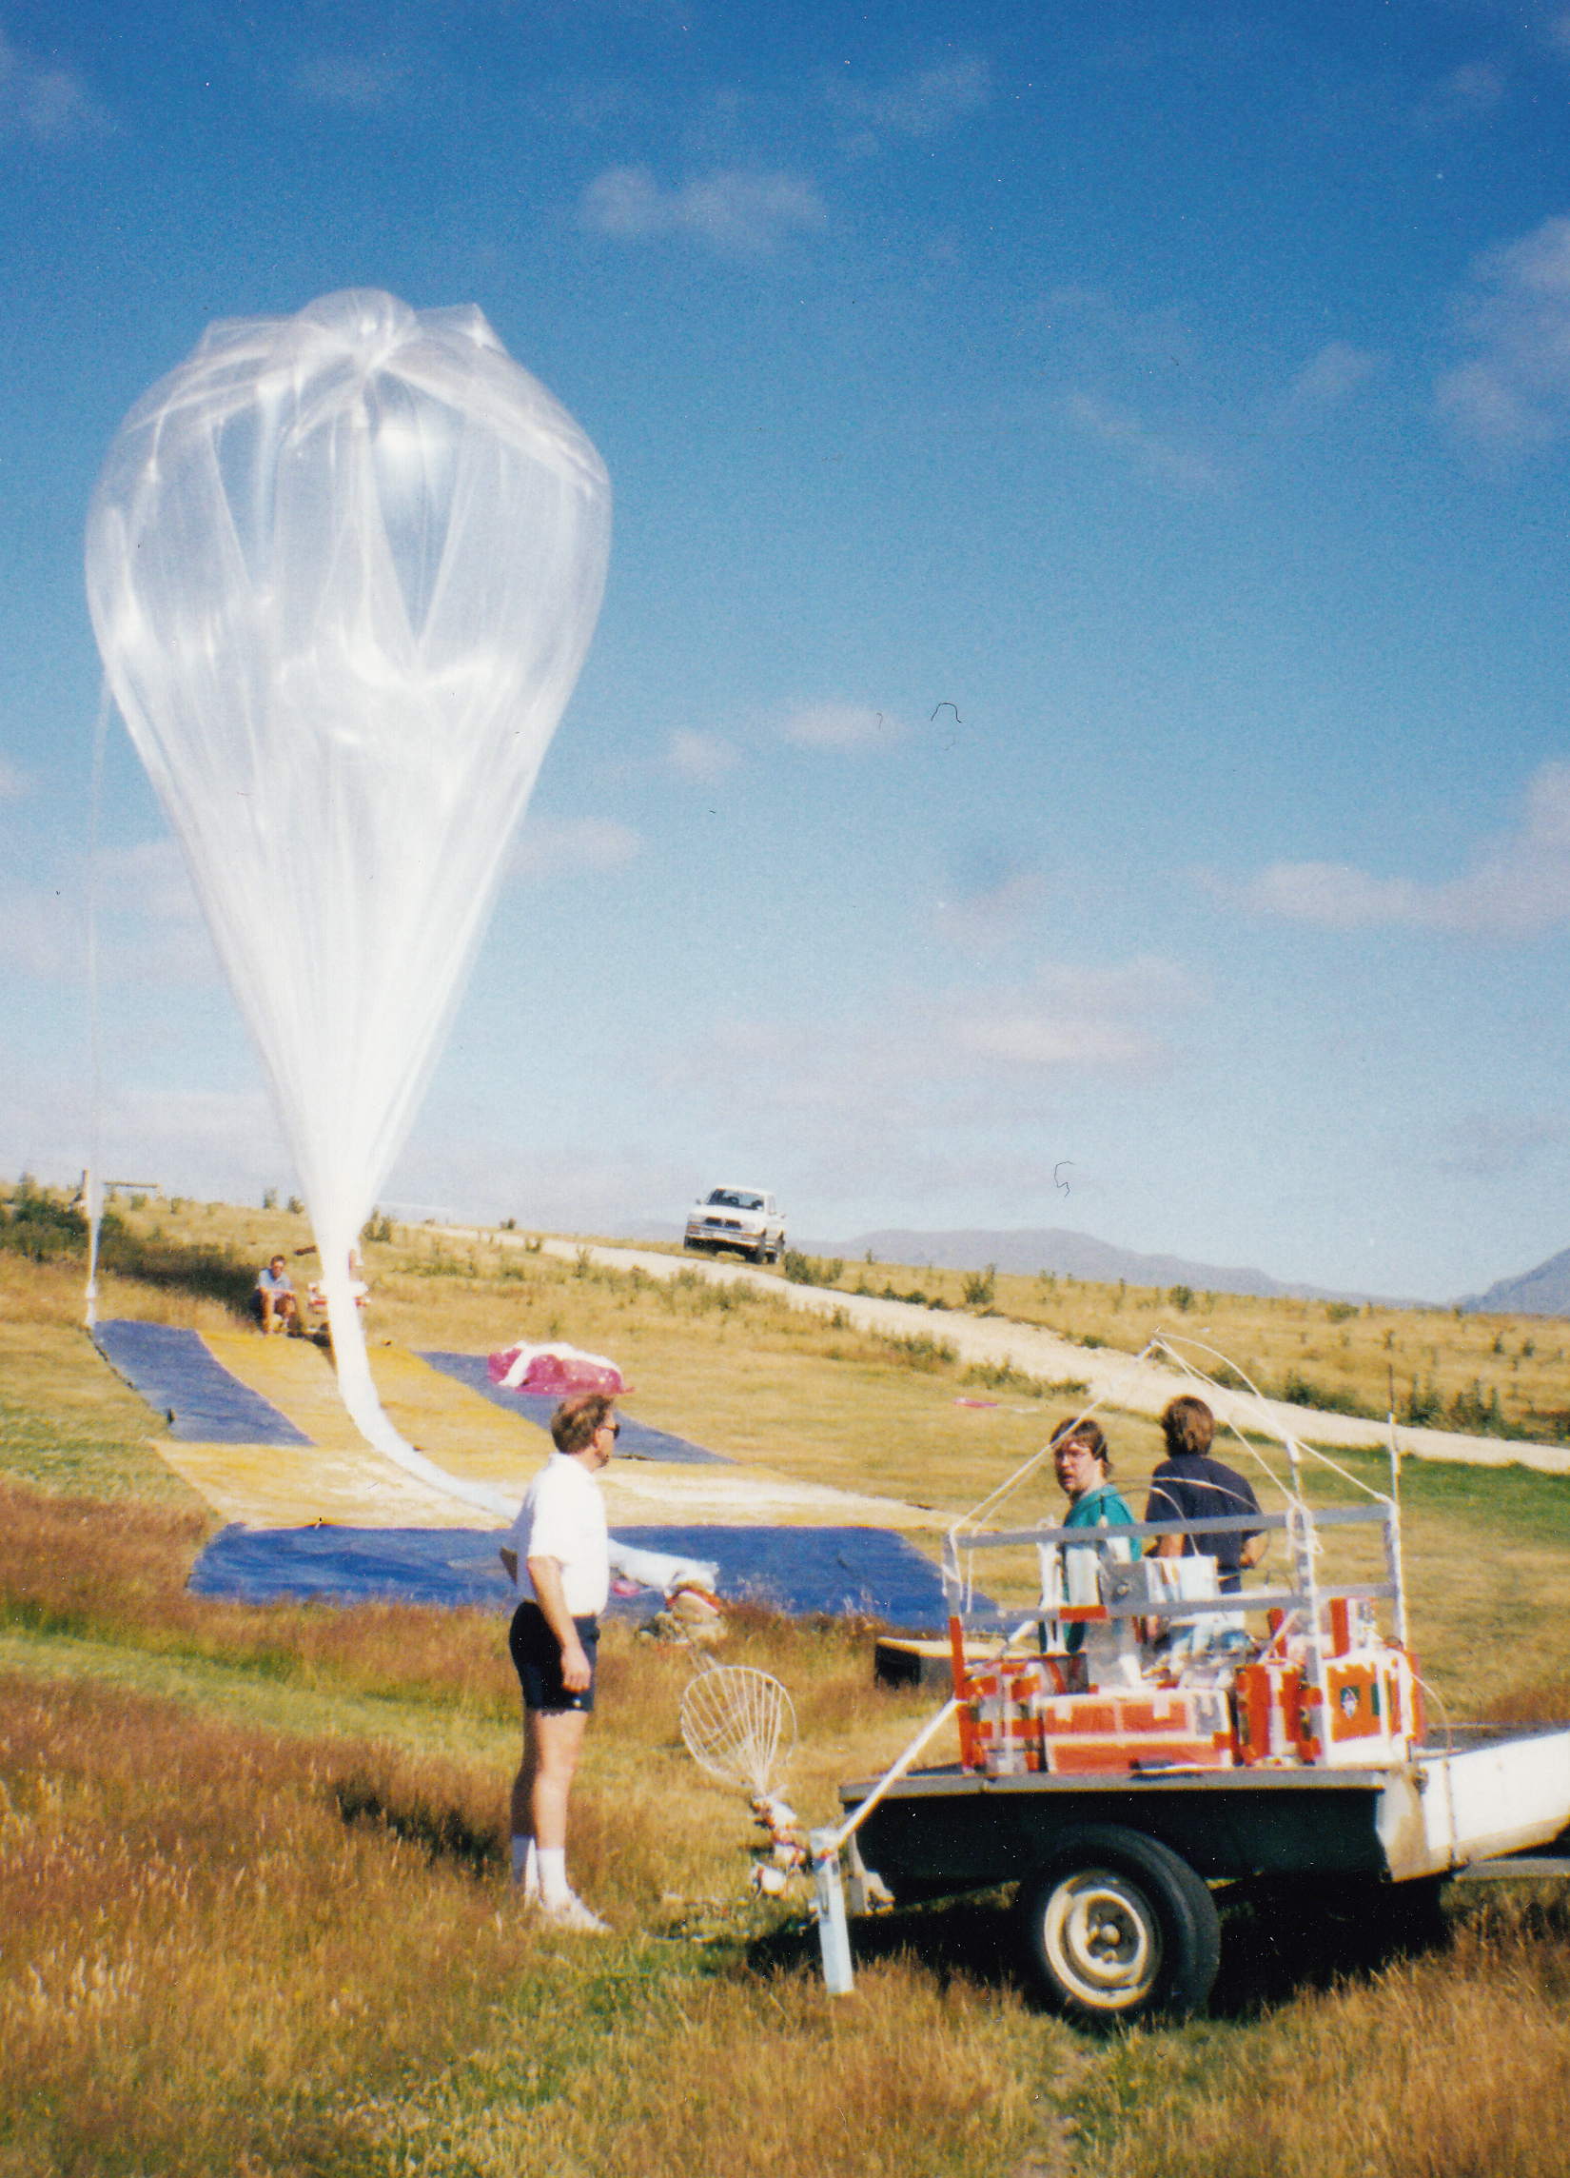
Universities: An Enduring Role in the Stratosphere
Academic institutions have served as both training grounds for operators and proving grounds for novel instrumentation.
  Proving Ground: Novel payloads matured on academic platforms before wider deployment.
  Training Ground: Students become the next generation of stratospheric operators, engineers, and scientists.
  Science Engine: Campaigns deliver observations of stratospheric composition and dynamics not otherwise possible.

Slide 3
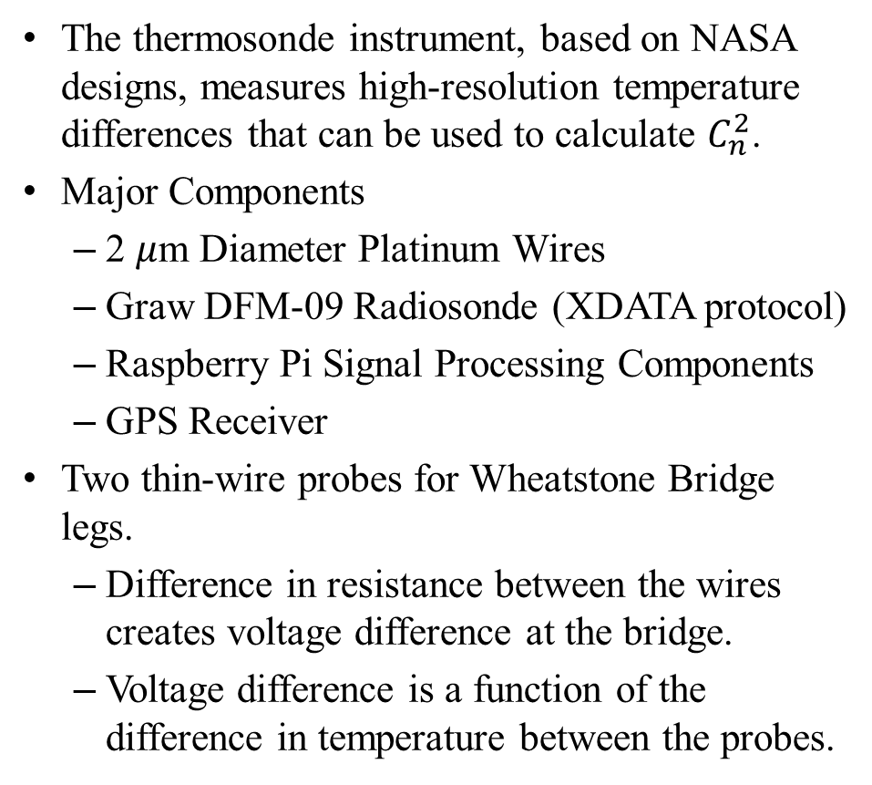
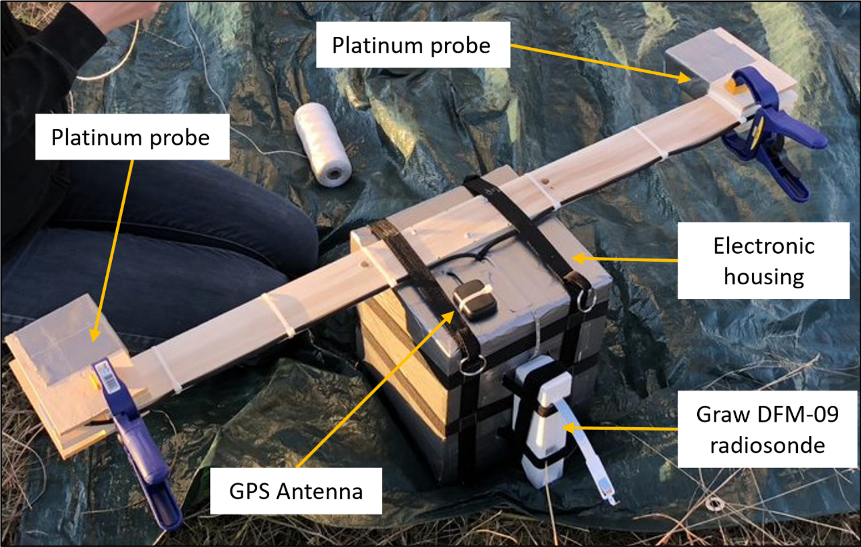
Proving Ground: Thermosonde Instrument Design

Slide 4
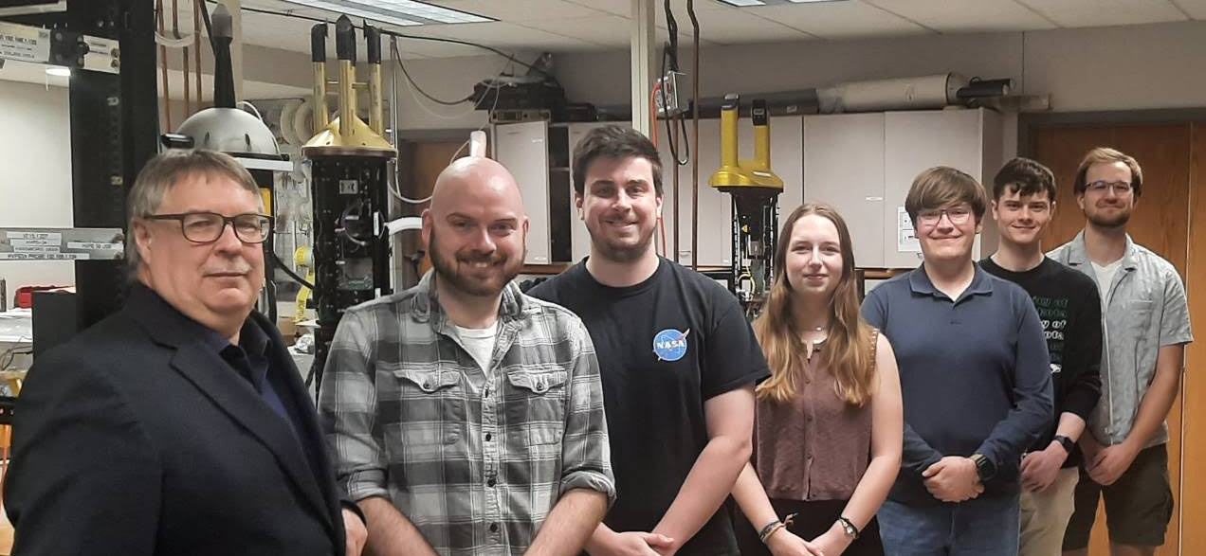
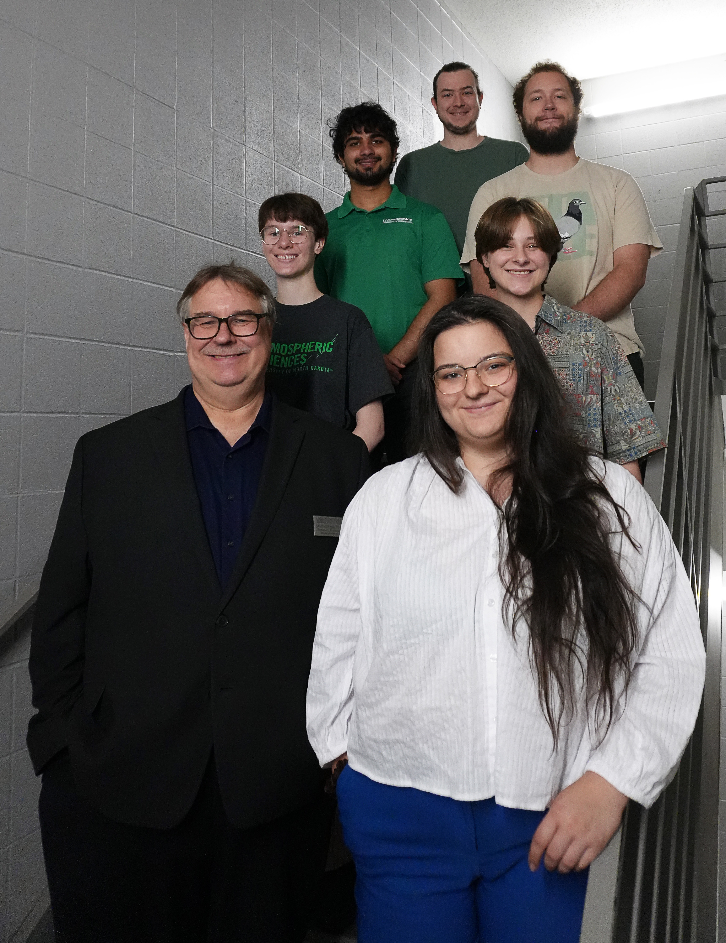
Training Ground: Experimental Learning
People in top imaged from left to right: David Delene, Shawn Wagner (Research Scientist), Christian Nairy (Ph.D.), Jenna Post (Undergrad), Jacob Halmos (Undergrad), Bryce Rickbeil (Undergrad), and Conrad Slad (Undergrad). People in left image from bottom/left to top/right: David Delene, Liz Cardoza (undergrad), Summer Coleman (Grad), Ashley Vos (Undergrad), Paramvir Singh (Undergrad), Benjamin Guida (Undergrad), and Tree (Kevin) Norby (Graduate).

Slide 5
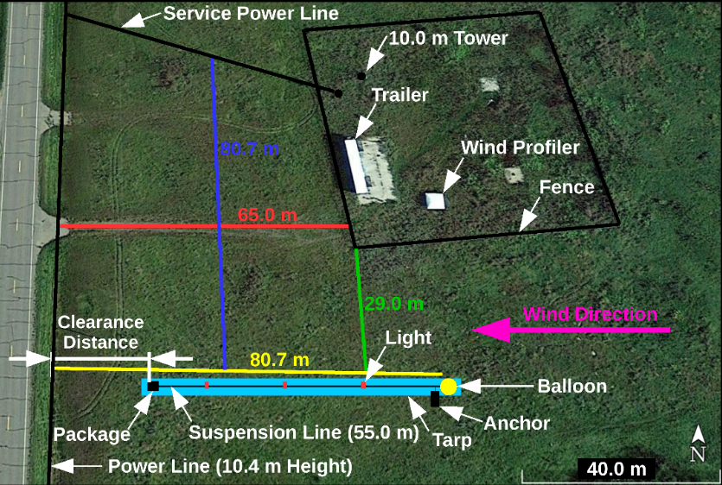
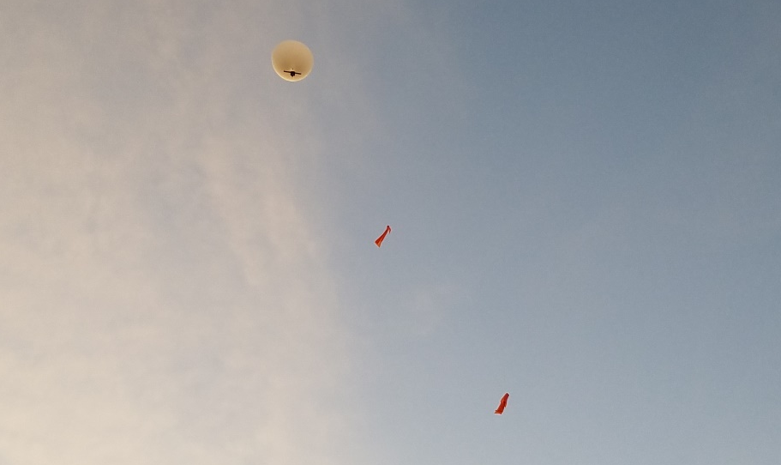
Science Engine: Balloon Flight Operations
Thermosonde package suspended 55 m beneath a balloon.
  Long tether used to reduce the effect of thermal balloon wakes on the measurements.
High altitude balloon carries instrument through the atmosphere and descends after balloon burst.
Initial flights testing conducted at the University of North Dakota Glacial Ridge Atmospheric Observatory.

Slide 6
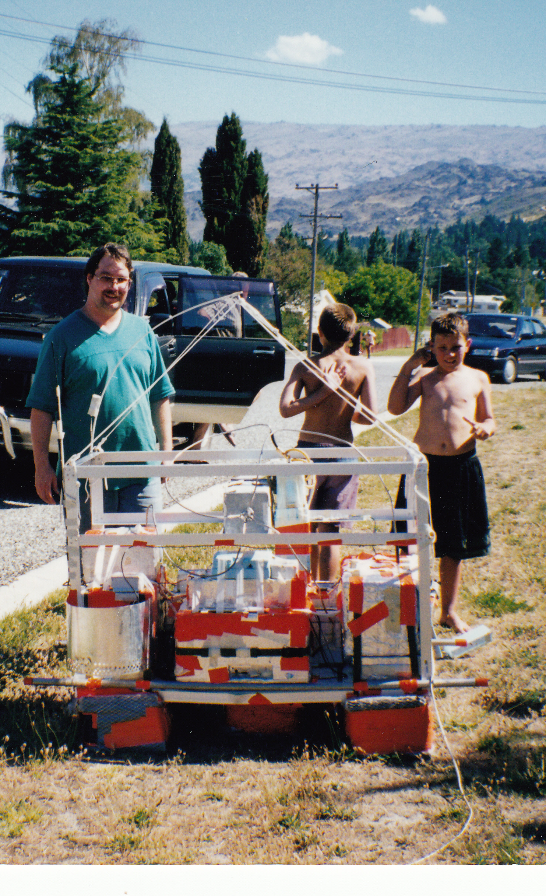
A Legacy Spanning a Century
Early Era:
  Balloon-borne cosmic-ray experiments probe high-energy physics.
  Universities pioneer high-altitude scientific ballooning.
Sounding-rocket Era:
  Student-built instruments fly on early rocket platforms.
Modern Era:
  Campaigns quantify stratosphere–troposphere exchange.
My Own PhD Research
  Balloon-borne, in-situ aerosol measurements.

Slide 7
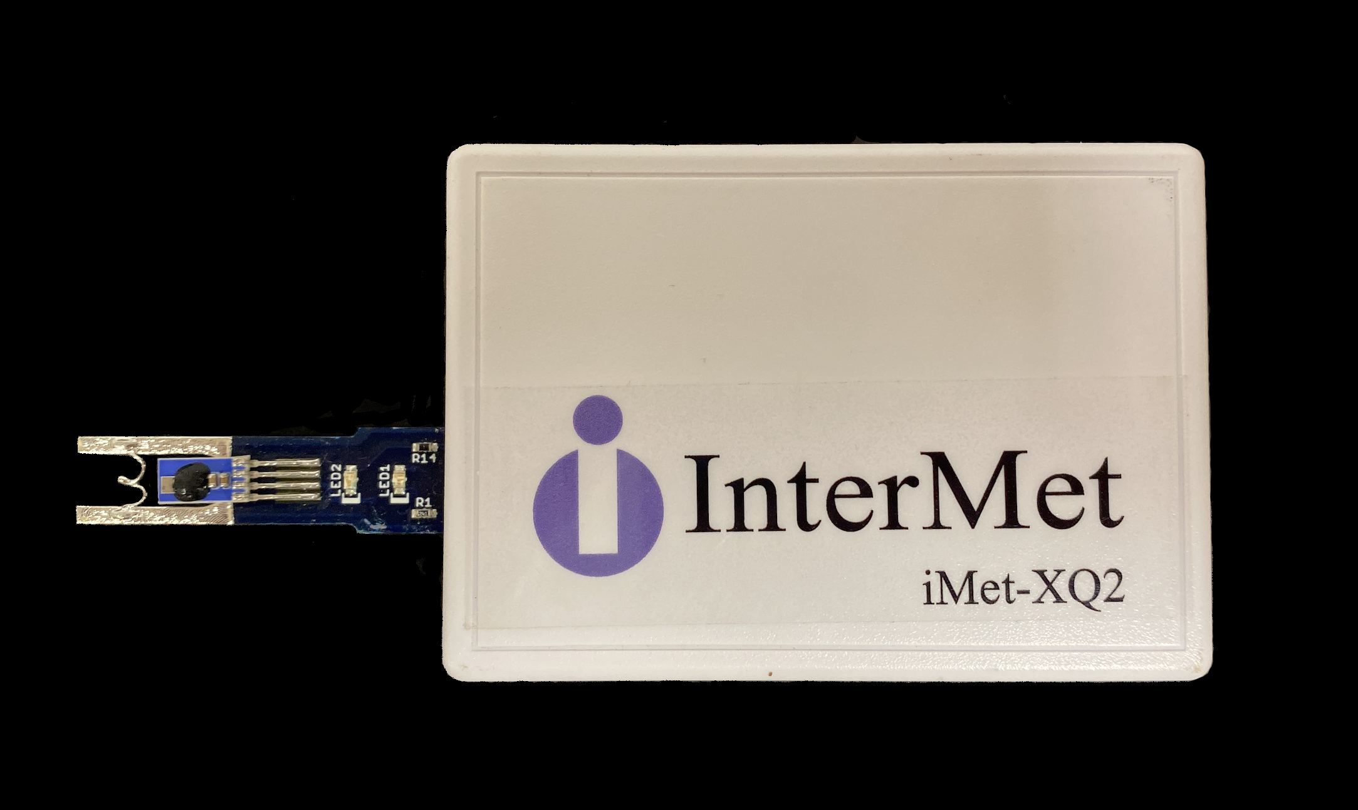
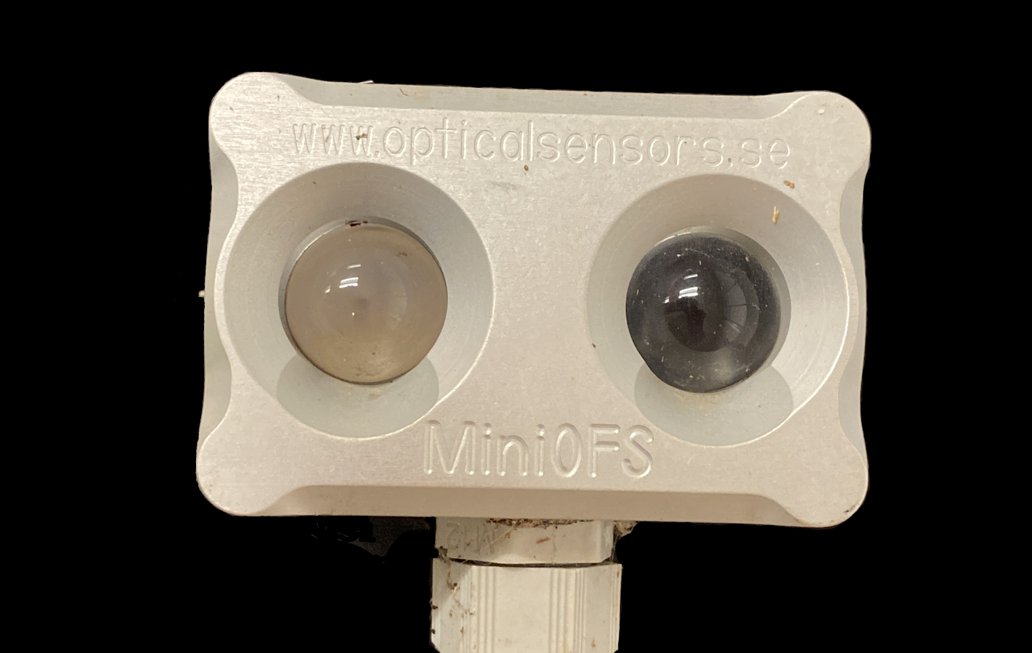
Why Now: Four Trends Are Converging
Platform maturity and cheaper access are meeting smarter payloads and data pipelines.
  Persistent Platforms: HAPS, stratospheric UAS, super-pressure balloons aloft for days to months.
  Miniaturized Payloads: Capable sensing within a student team's reach.
  Machine-learning-enabled processing: Large flight datasets become usable science faster.
  Low-cost Launch Infrastructure: Frequent, iterative academic missions.

Slide 8
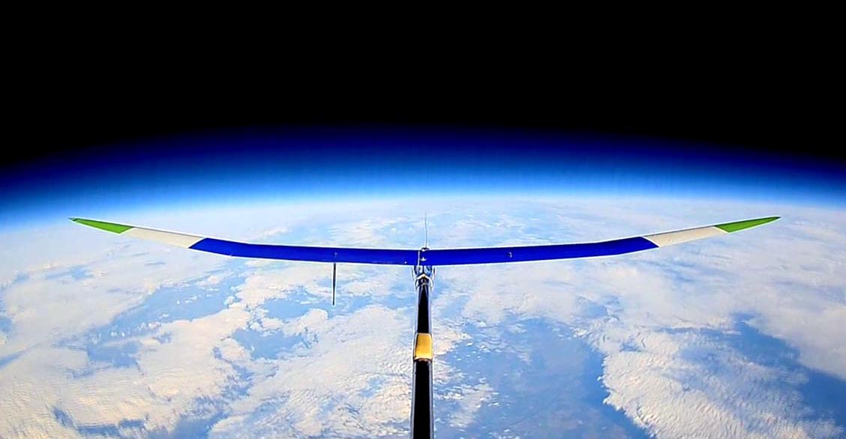
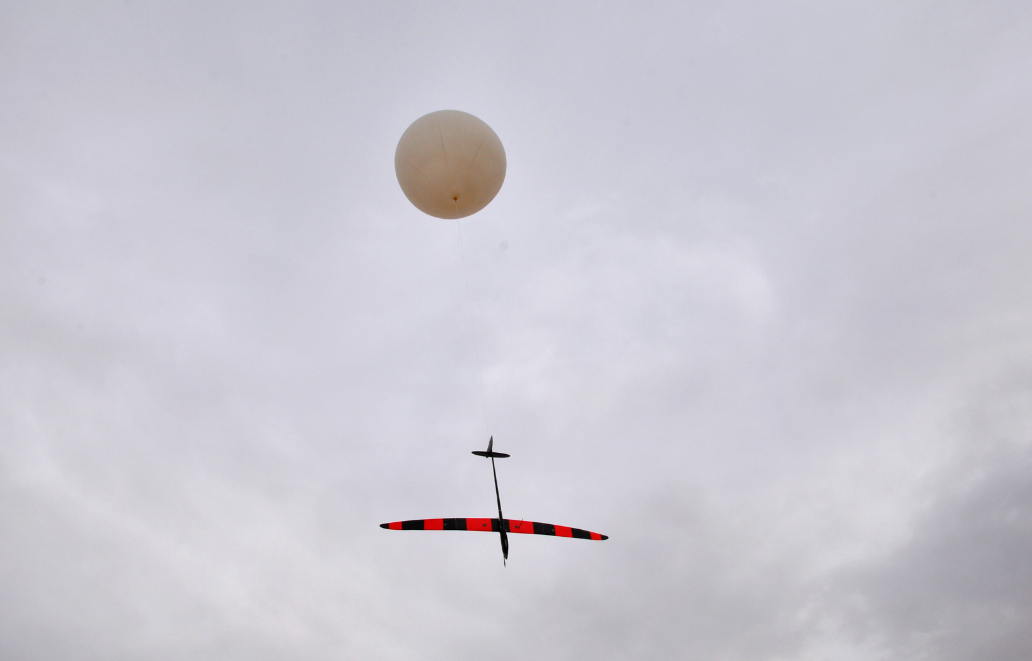
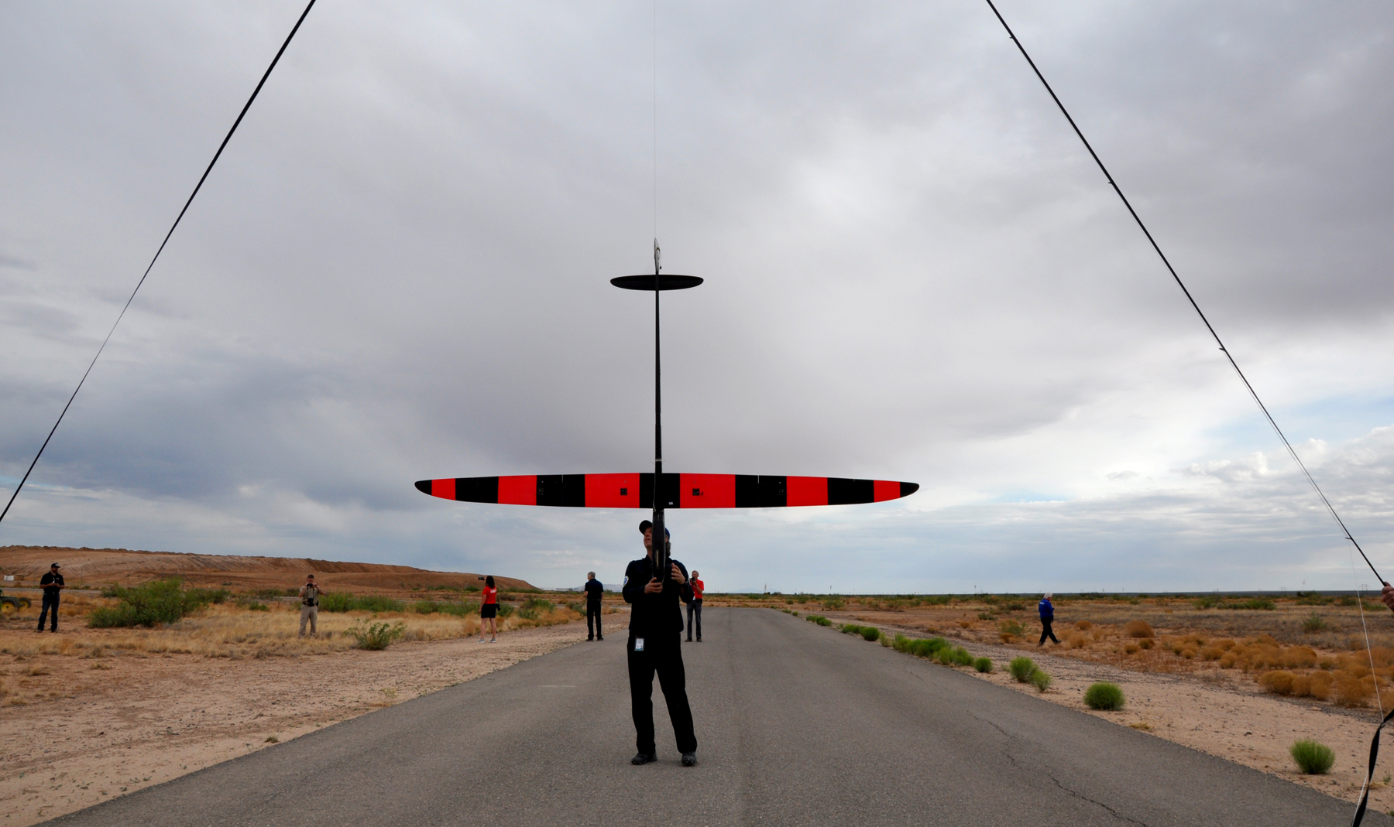
New Capabilities: The Convergence Unlocks
Persistent Telecommunications Relays:
  High-altitude communication nodes over wide areas.
Wide-area Surveillance:
  Sustained station-keeping over large regions.
Novel Scientific Observation:
  Composition and dynamics prior platforms could not sustain.
Each application requires an educated workforce to operate, which is what universities supply.

Slide 9
A Timely Science Driver: Rising Launch Cadence
Growing rocket launch cadence deposits material directly in the stratosphere.
  Each launch injects combustion products and particles
  A composition change we should be measuring.
  In-situ balloon and UAS platforms are well suited to capture this signal.
Data Source: https://planet4589.org/space/stats/launches.html

Slide 10
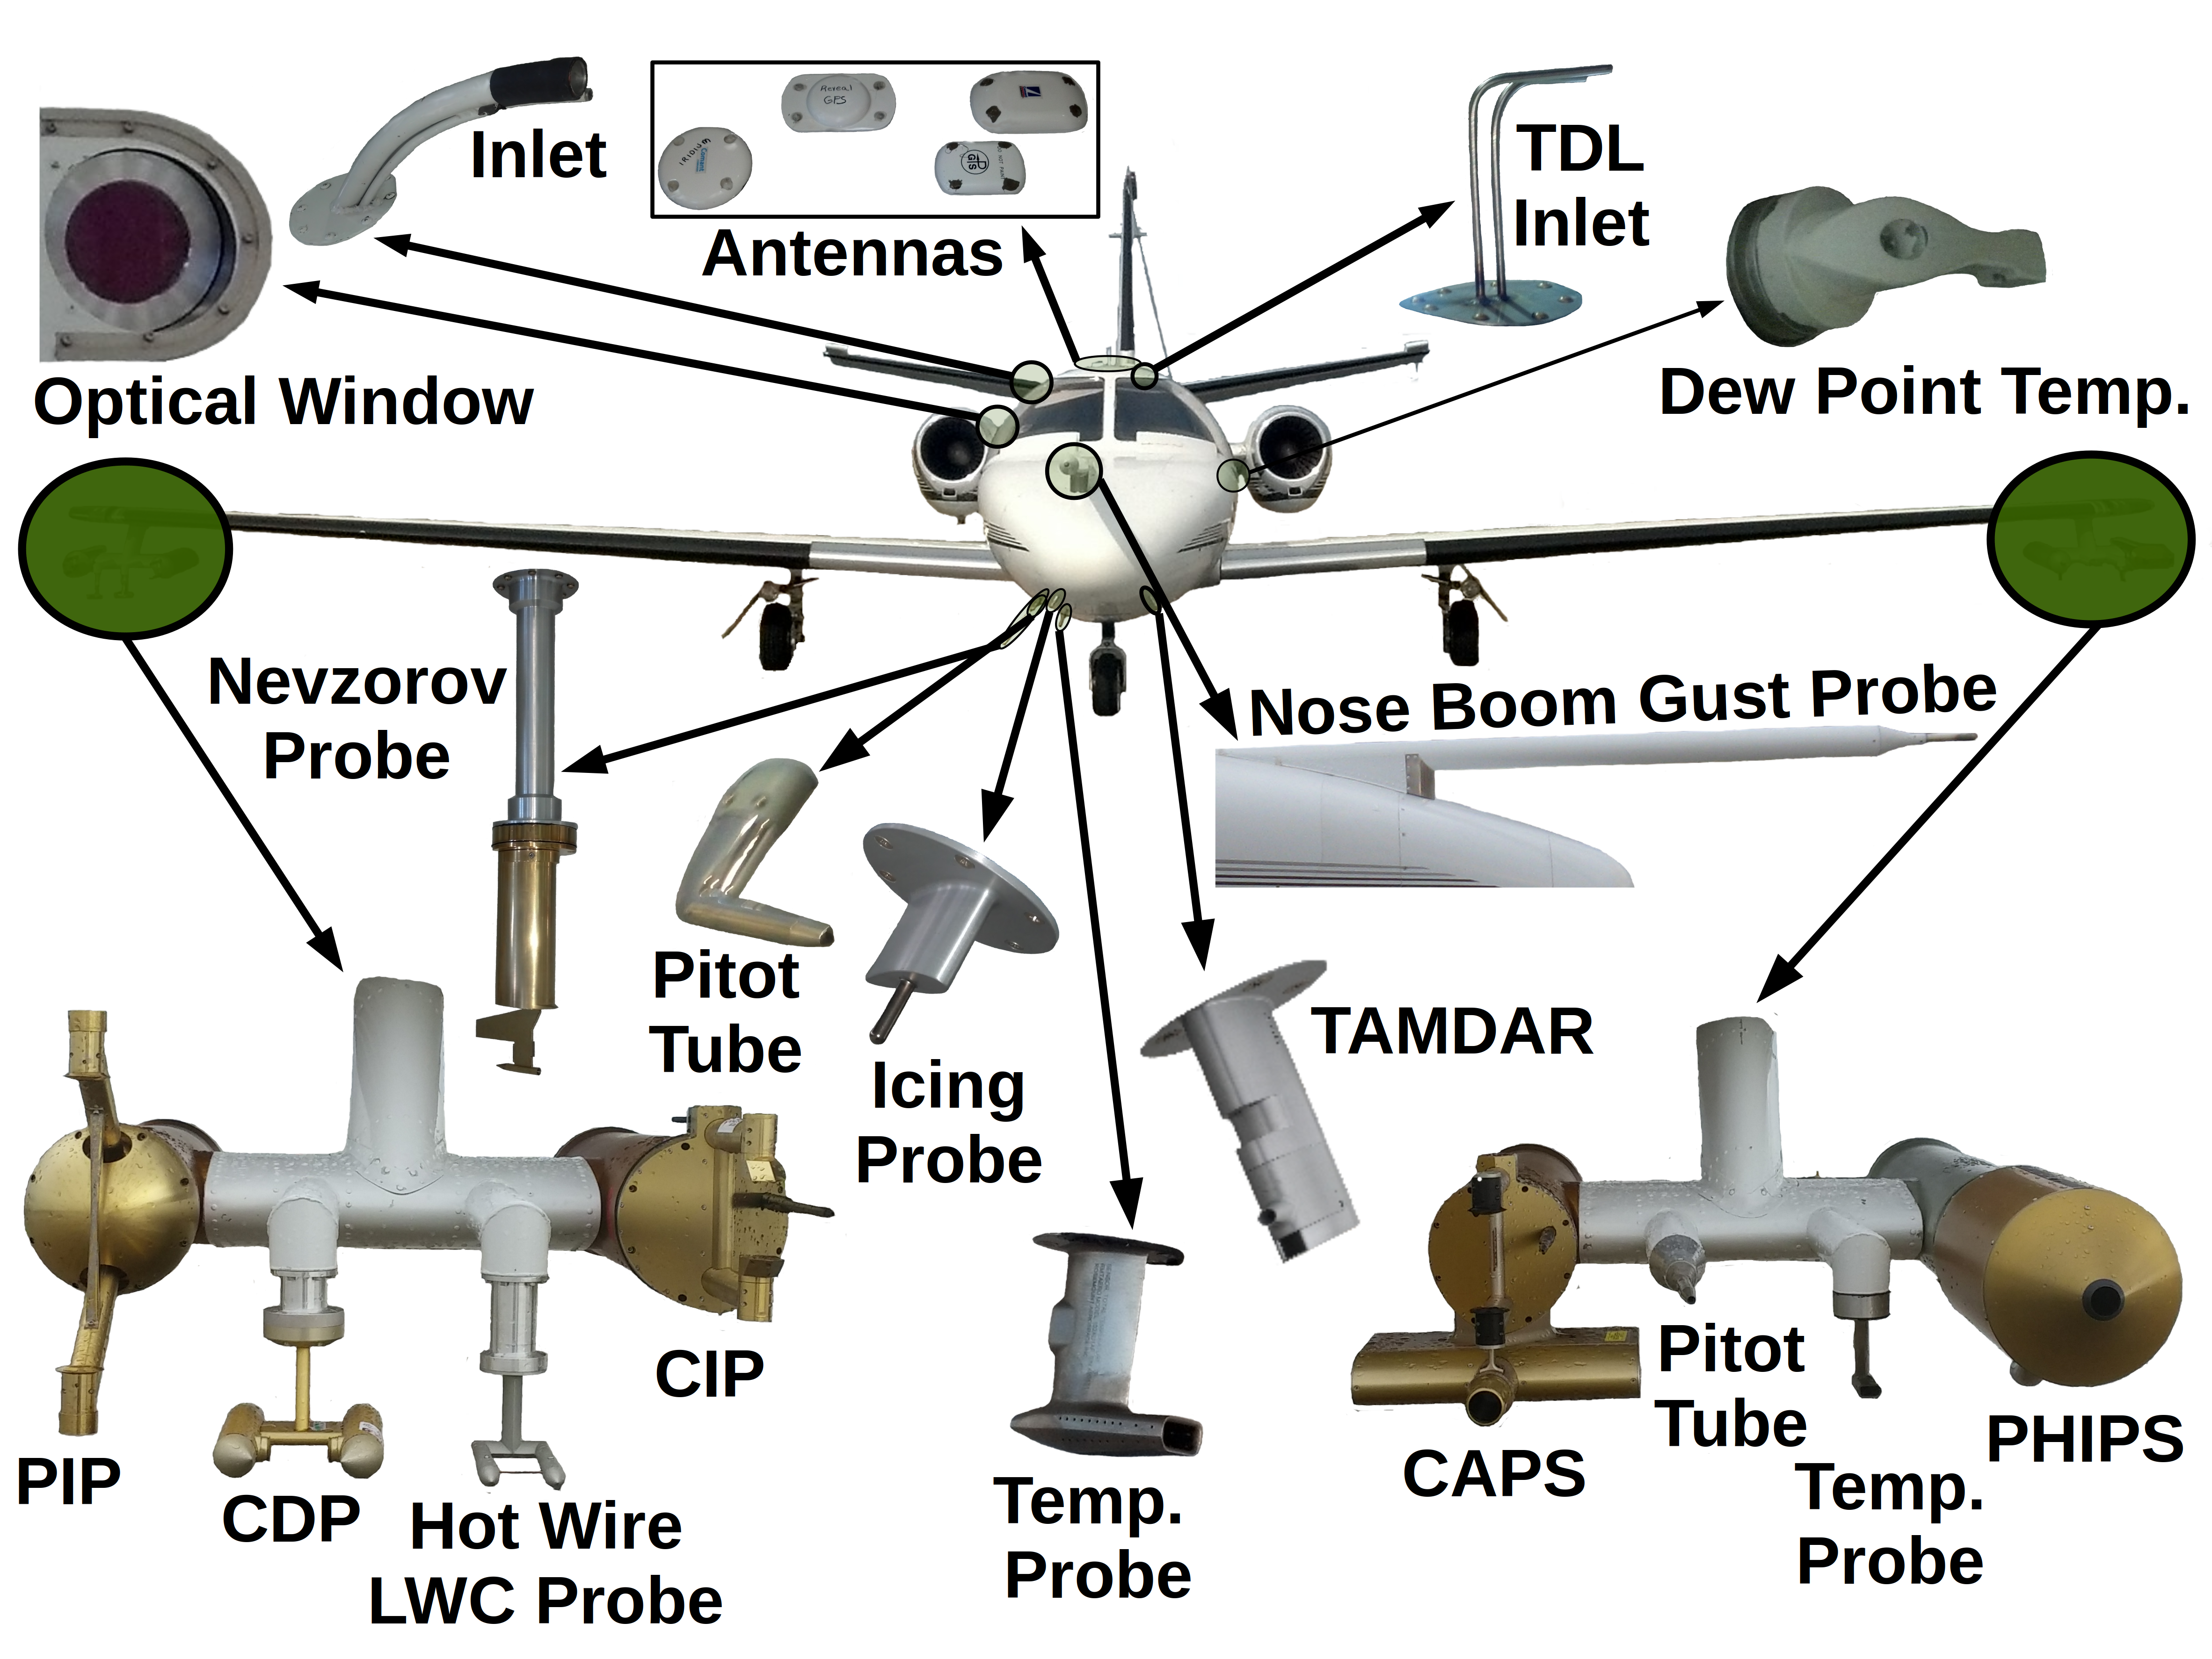
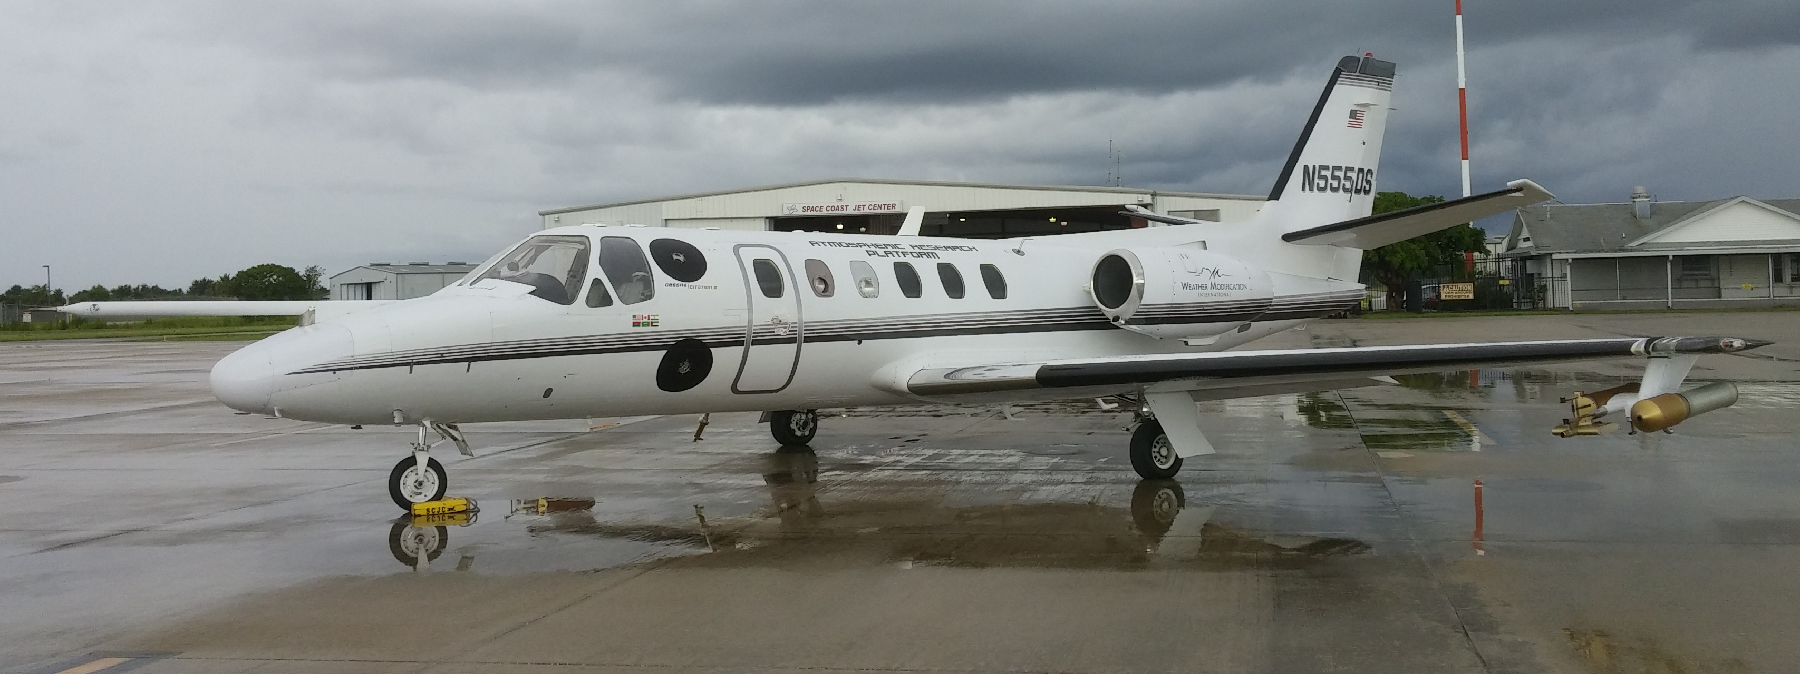
Lessons Learned at the University of North Dakota
Instrument Readiness Drives the Schedule
  Preparation time is typically underestimated.
Students are the Mission
  Campaigns double as workforce training.
Data Pipelines before Flight, not After
  Build workflows ahead of time.
Partnerships de-risk Operations
  University–industry–government ties fill gaps no single lab covers alone.

Slide 11
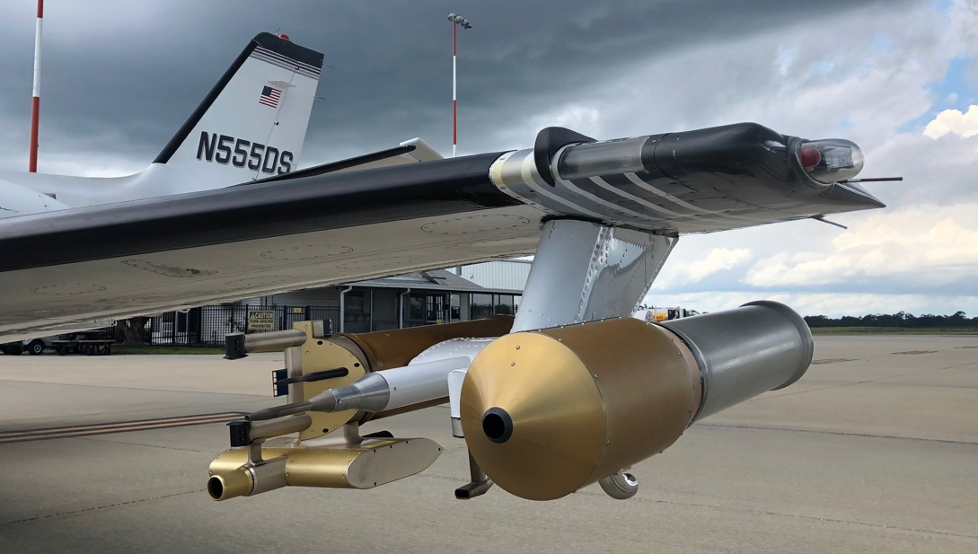
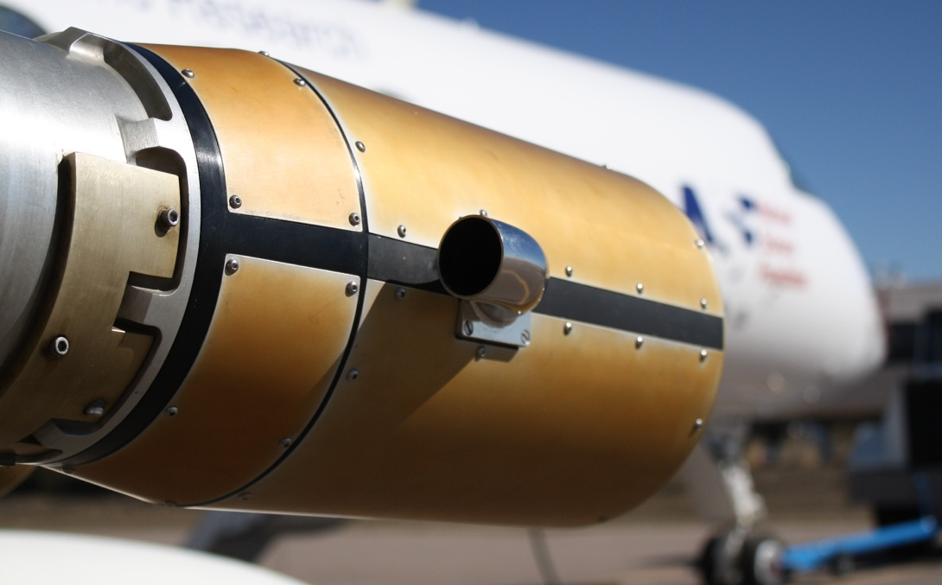
Gaps that Constrain University Participation
Launch and Recovery Access
  Limited affordable, schedulable infrastructure.
Sustained Funding
  Short grant cycles fit poorly with multi-year platform and workforce development.
Regulatory Pathways
  Airspace and operational approvals for persistent UAS/HAPS.
Shared Instrumentation
  Few community payload and calibration resources.

Slide 12

A Framework for Academic Engagement
Build Shared Infrastructure:
  Community launch, recovery, and calibration resources.
Fund the Full Life-cycle:
  Multi-year support aligned to platforms and the students who operate them.
Formalize Partnerships:
  Standing university–industry–government structures.
Notes:
Three moves turn the current inflection point into sustained capability.

Slide 13
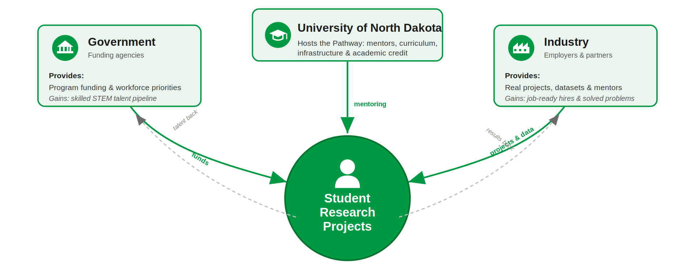
Improving University–Government–Industry Ties
Universities: Curricula built around real operations.
Government: Sustained, multi-year funding.
Industry: Pull-through of student talent into the workforce.

Slide 14
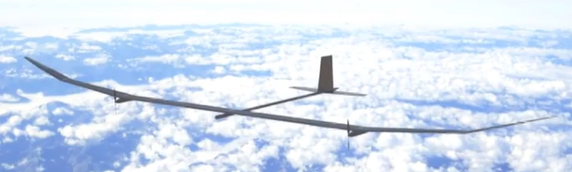
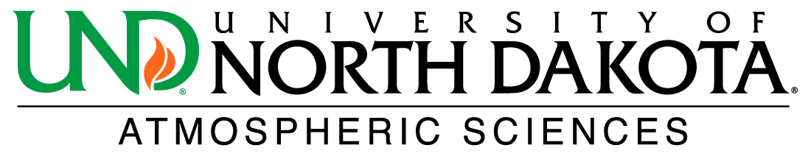
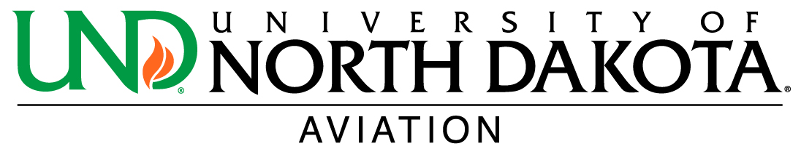

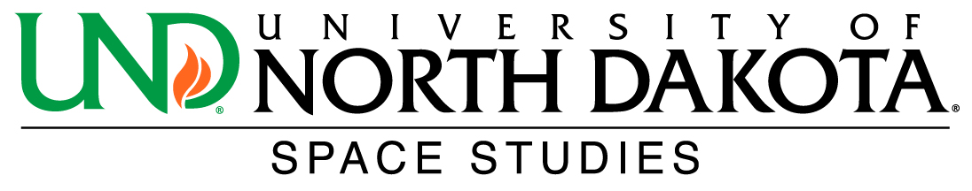
Conclusions: The Next Decade Is Academia's to Shape
Universities have always trained the operators and proven the instruments, which is the legacy.
Convergence of persistent platforms, miniaturized payloads, Machine Learning, and low-cost launch lets Universities do far more.
Realizing current opportunities requires aligning funding, infrastructure, and partnerships.

