Slide 1
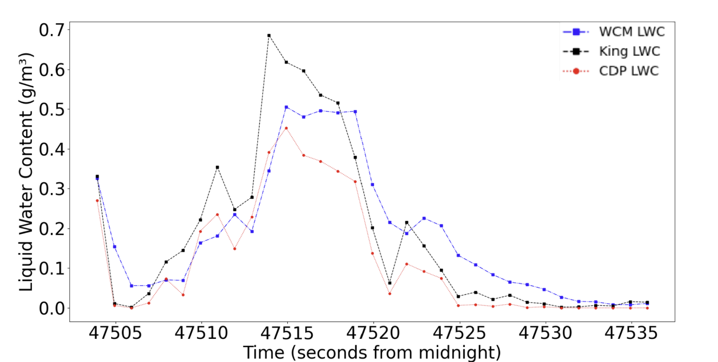
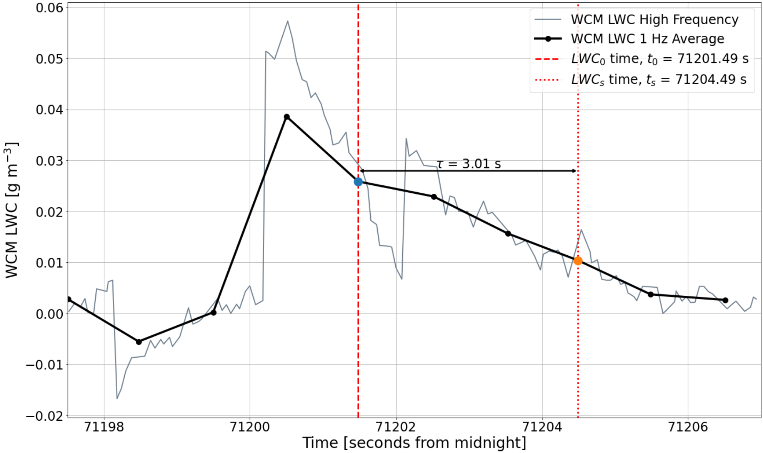
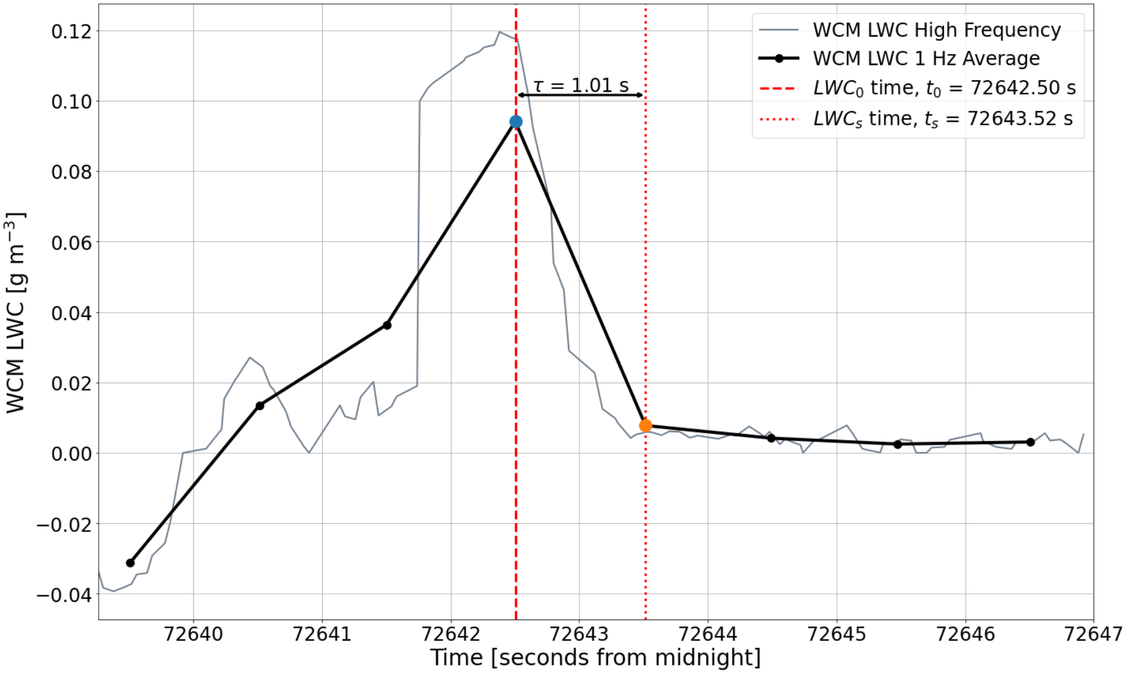
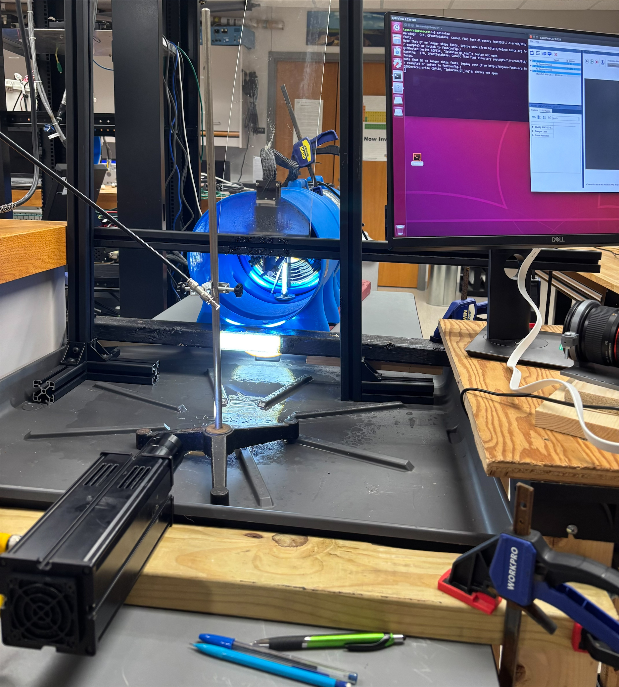
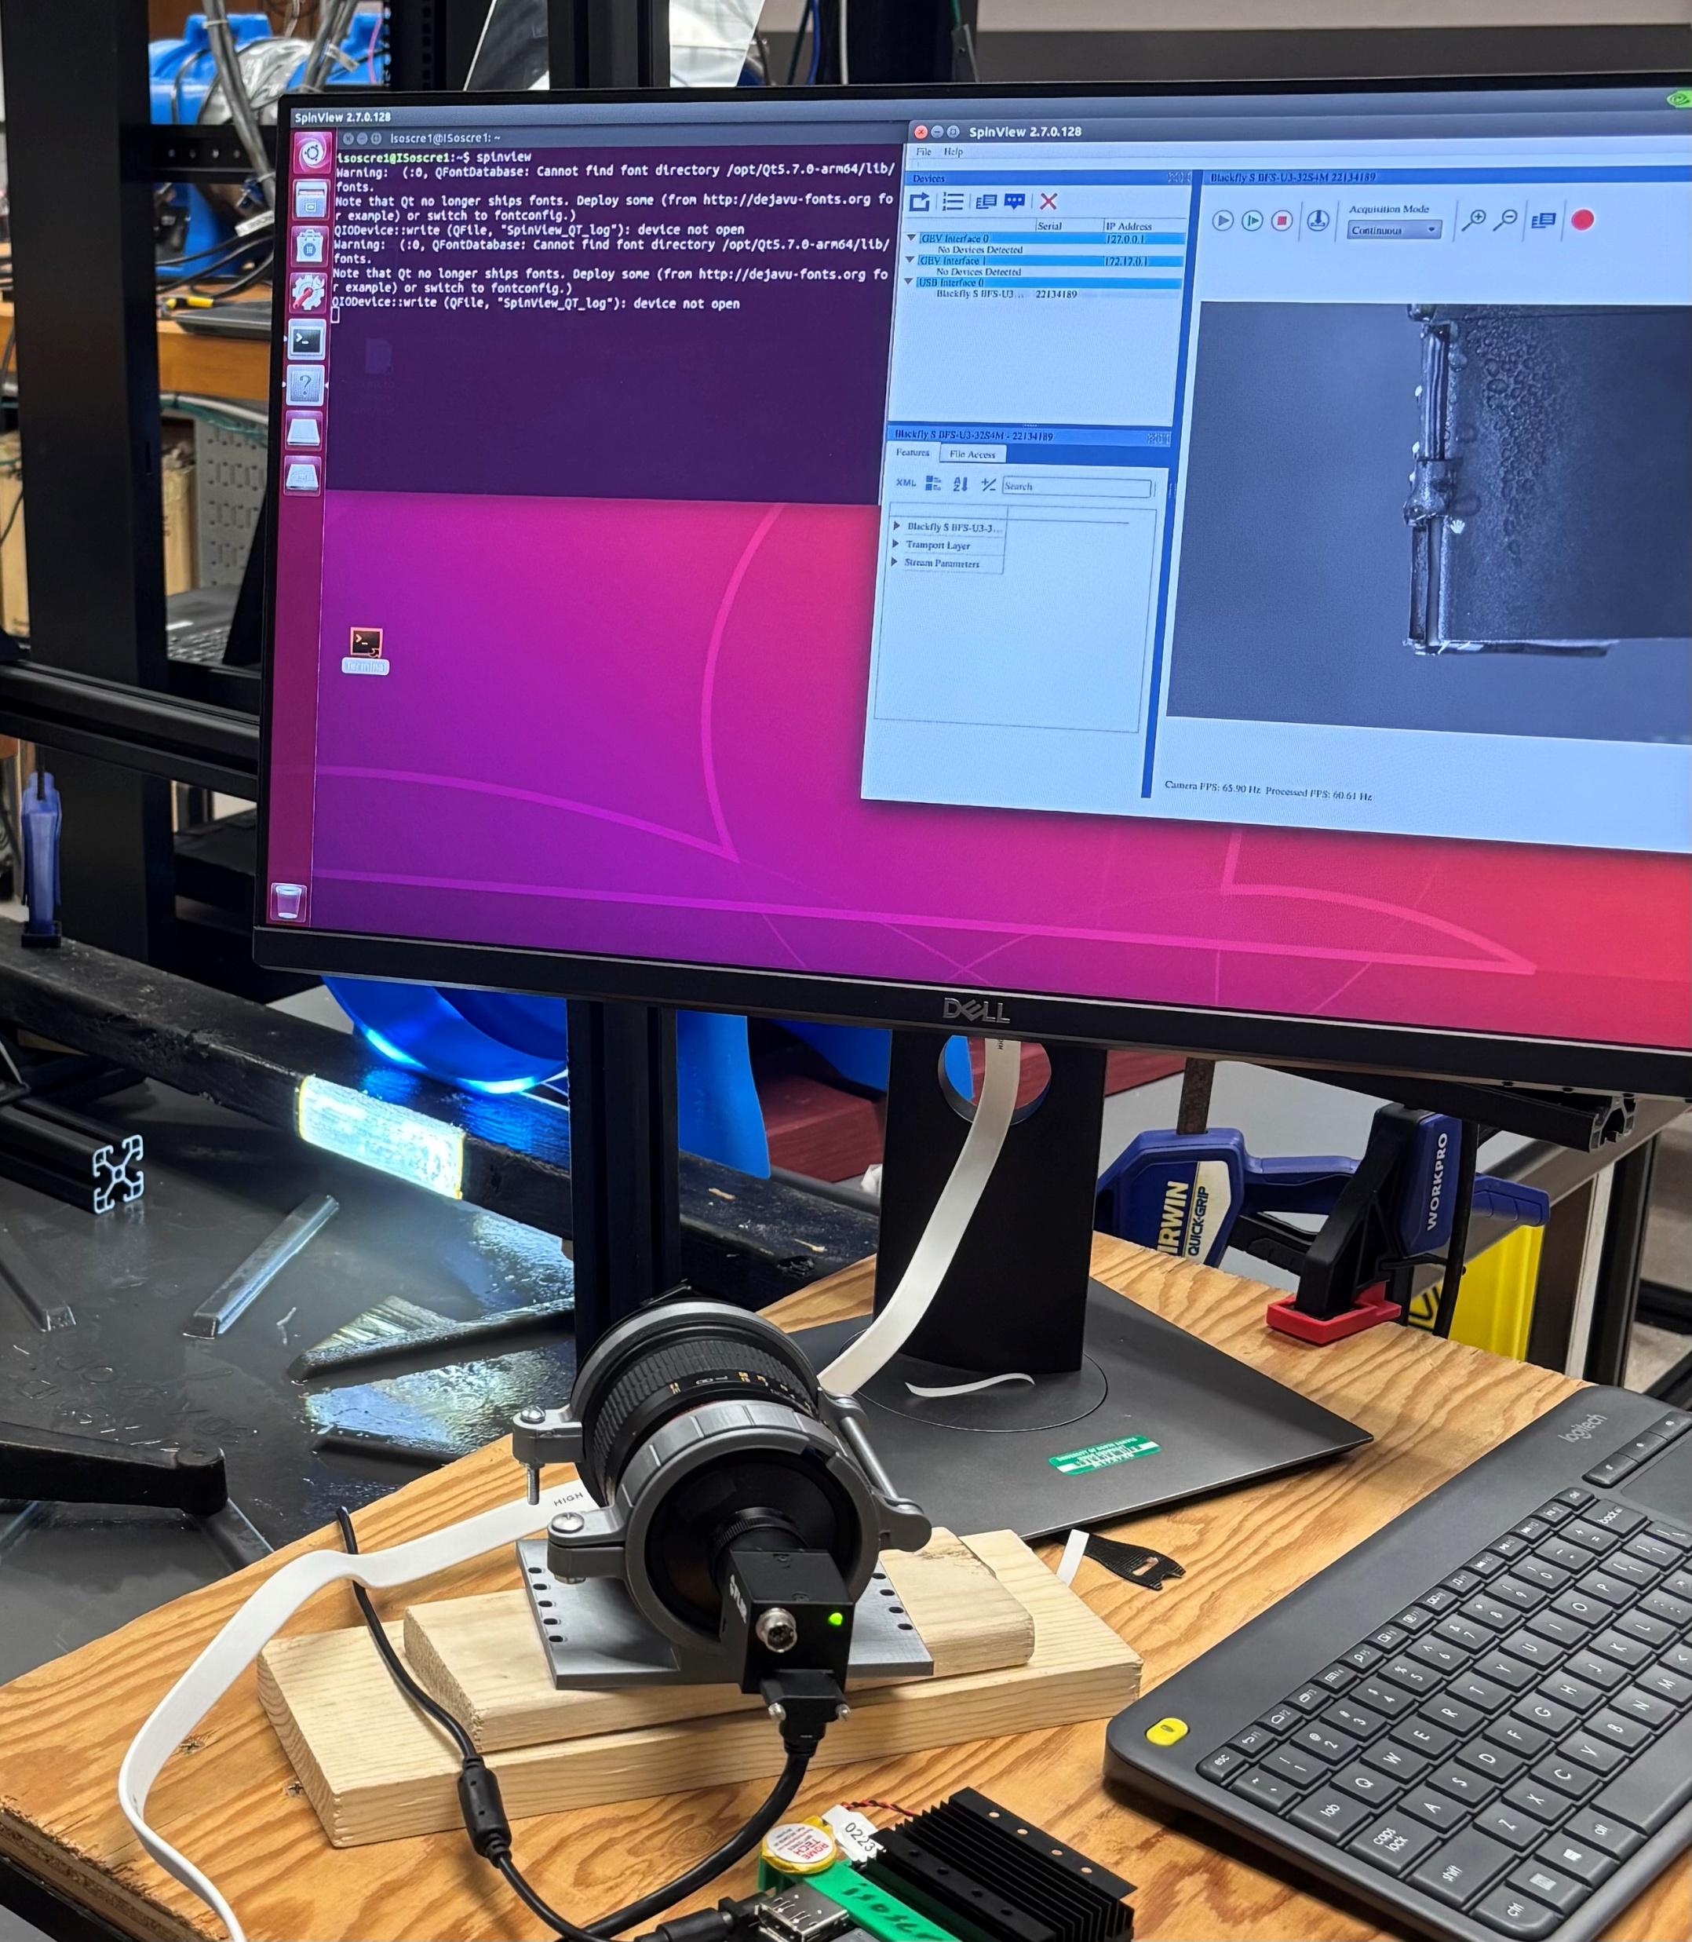
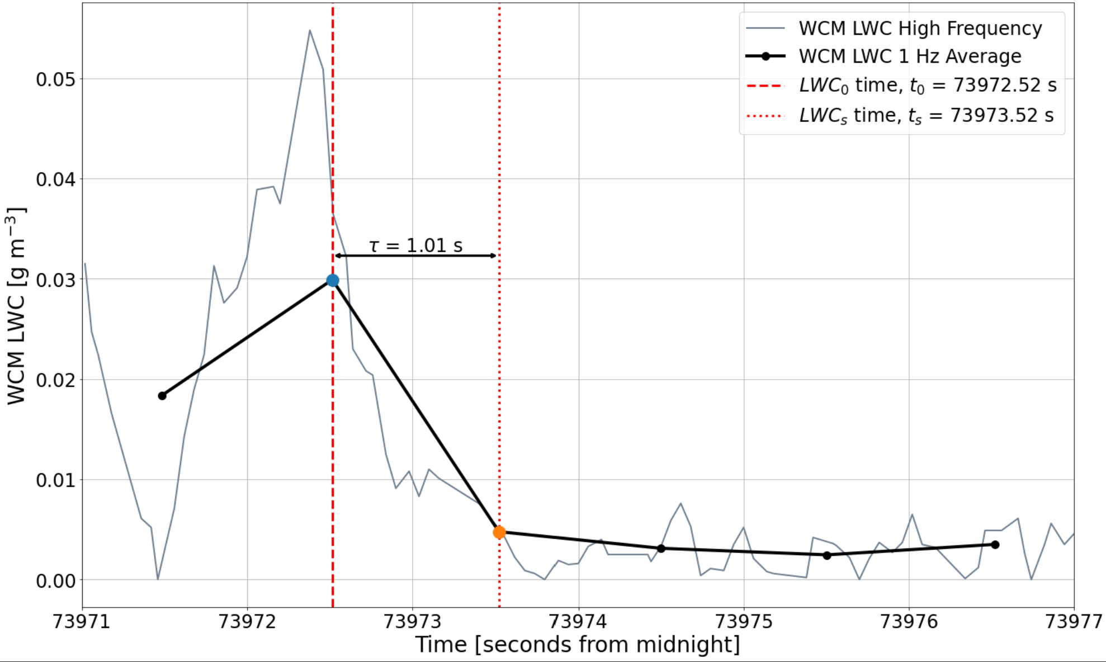
Evaluation of the Water Content Meter (WCM) Hot Wire Probe for In-Situ Water Content Measurements
Summer M. Coleman, David J. Delene, Andrea Neumann-Skow, Bryce Rickbeil and Shawn Wagner
University of North Dakota, Grand Forks, ND
Motivation
Cloud Exit Cases
Key Results
WCM Model 2000 LWC out-of-cloud measurements from all three 10 July 2025 flight legs are shown below in three representative cloud exit cases
Cloud Imaging Probe (CIP) data determines the out-of-cloud-time
The time constant (ͳ) represents the amount of time elapsed between the LWC measurement at cloud exit (LWC₀) and the LWC measurement closest to 37% of the out of cloud value (LWC_{s}). The time constant is calculated using 1 Hz averaged data (black) and compared to the high frequency signal (gray)
The PID controller constant adjustments on the WCM Model 2000 produce a decreased time constant with respect to LWC measurements after cloud exit compared to the 16 December 2022 IMPACTS case
All 3 flight legs from the 10 July 2025 flight produced similar time constants with overlapping standard deviations
To evaluate the time constant in WCM LWC measurements across multiple PID setting adjustments it is crucial to know when liquid droplets are no longer contacting the probe head as precisely as possible
Future Laboratory Work
Ongoing laboratory experimentation seeks to pinpoint when droplets no longer contact the WCM heated sensing elements using the FLIR Blackfly S Camera - a high resolution (2048 x 1536) adjustable frame rate camera
The FLIR Blackfly S can be used to visually identify droplet contact and evaporation on the WCM probe head
In the current laboratory set-up, the FLIR Blackfly S is time synced with the WCM data acquisition system to determine when droplet contact with the probe head ceases down to the millisecond
Liquid droplets are supplied to the WCM using a MistingDirect misting system which uses a .006” nozzle to generate droplets which are pulled over the WCM probe head using two fans
The photographs below show the laboratory set up
Flight Leg 1
A 16 December 2022 stratocumulus cloud layer penetration exemplifies the Liquid Water Content (LWC) measurement decay exhibited by the Water Content Meter (WCM) across the Investigation of Microphysics and Precipitation for Atlantic Coast-Threatening Snowstorms (IMPACTS)
The out-of-cloud WCM LWC time constant for the 16 December 2022 case is 3.4s; the cloud exit is identified using the Cloud Droplet Probe (CDP)
The WCM Model 2000 and 3000 power their heated sensing elements with a proportional, integral, derivative (PID) controller
To reduce the out-of-cloud LWC measurement time constant, the WCM PID controller constants were changed during flight for a WCM Model 2000 during a 10 July 2025 flight onboard the Cessna Citation II Aircraft
PID Controller Function
A PID controller attempts to maintain a constant setpoint temperature for both WCM heated sensing elements
The function of a PID controller can be altered by changing one of three constant values
  The Proportional Value supplies power to the heated sensing elements proportional to the difference between the setpoint temperature and the element temperature
  The Integral Value integrates past errors between setpoint temperature and the element temperature
  The Derivative Value keeps the element temperature from exceeding the setpoint temperature by dampening power output
The table below summarizes the PID constants used during the 10 July 2025 flight
Flight Leg 2
Flight Leg | PID Setting | Average Time Constant (s)
1 | Proportional = 2000 Integral = 20 Derivative = 2000 | 2.2 ± 1.0
2 | Proportional = 2300 Integral = 20 Derivative = 100 | 2.0 ± 1.0
3 | Proportional = 2700 Integral = 20 Derivative = 100 | 1.9 ± 1.0
Acknowledgements and Contact
Flight Leg 3
Jen Moore – 16 December 2022 Preliminary Observations from the NASA IMPACTS Airborne Campaign
Kurt Hibert - Supervising the 10 July 2025 flight onboard the Cessa Citation II and assisting in WCM LWC data collection
Contact: summer.m.coleman@und.edu

