Slide 1
Thesis Draft Figures
Author Kendra Sand,
M.S. Atmospheric Sciences Graduate Student
Dr. David Delene,
Committee Chair
University of North Dakota
2023

Slide 2
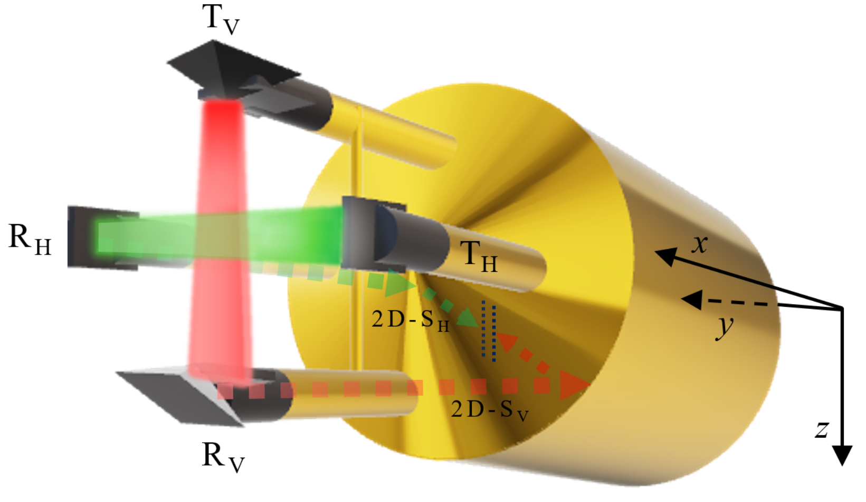
Figure 1

Slide 3
Figure 1
This diagram shows a simplified Two-Dimensional Stereo Optical Array Probe (2D-S) with the vertical channel (2D-S_{V}) laser path in red and the horizontal channel (2D-S_{H}) in green as it originates at the transmitting (T) arms and is sent through the receiving arms (R). The dashed lines show the path each channel takes inside the 2D-S as it is bent 90 degrees twice and is detected by an array of 128 photodiodes, represented by the dotted lines (blue) for each channel. The aircraft-relative reference frame is given, where the x-axis points forward along the direction of flight (aircraft nose), the y-axis points to the right (starboard) wingtip, and the z-axis points down.

Slide 4
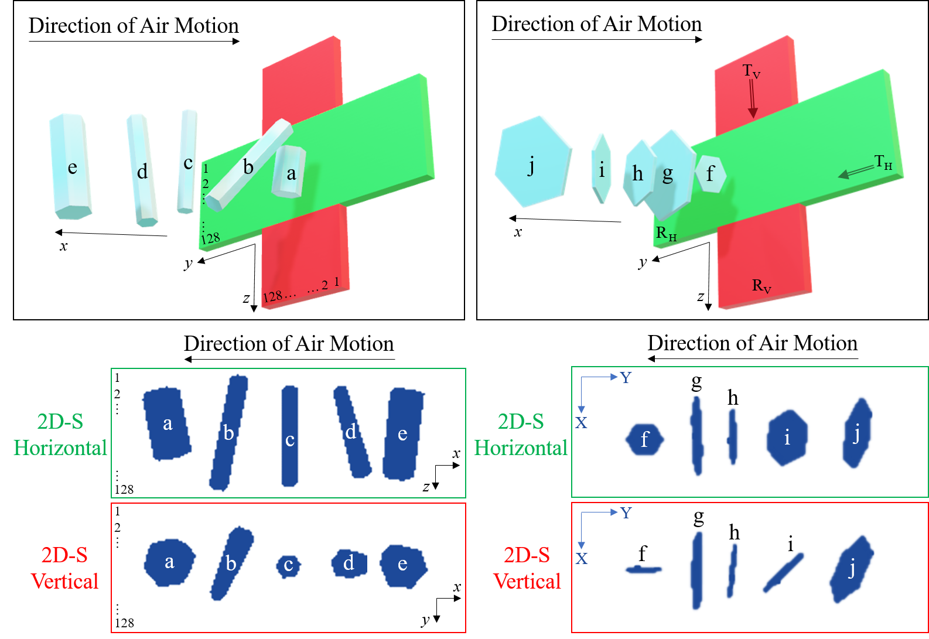
Figure 2

Slide 5
Figure 2
This diagram illustrates how a variety of vertically oriented columnar and planar ice crystals would appear in the two-dimensional shadow image data of the Two-Dimensional Stereo Optical Array Probe (2D-S) if captured by both the horizontal (green) and vertical (red) channels. The ice crystal and laser beam depictions are not to scale. Each 3-D model of an ice crystal in this figure was given a 90 degree rotation to provide an accurate representation of orthogonal shadow image sampling. Note that the images appear on the 2D-S image strip in succession from left to right as the ice crystals pass through the sampling volume sequentially, which appears to be a mirrored image due to the viewing angle of the figure. The x, y, z labels in the diagram indicate the aircraft-relative coordinate system, whereas the X and Y labeled in blue on the image strip are relative to the 2D-S array axis. The array of 2D-S photodiodes are labeled as 1 to 128 in both the diagram and the image strips in the columnar example. The relative position of the transmitting (T) and receiving (R) arms of the 2D-S are labeled in the planar example for both the horizontal (H) and vertical (V) laser beams.

Slide 6
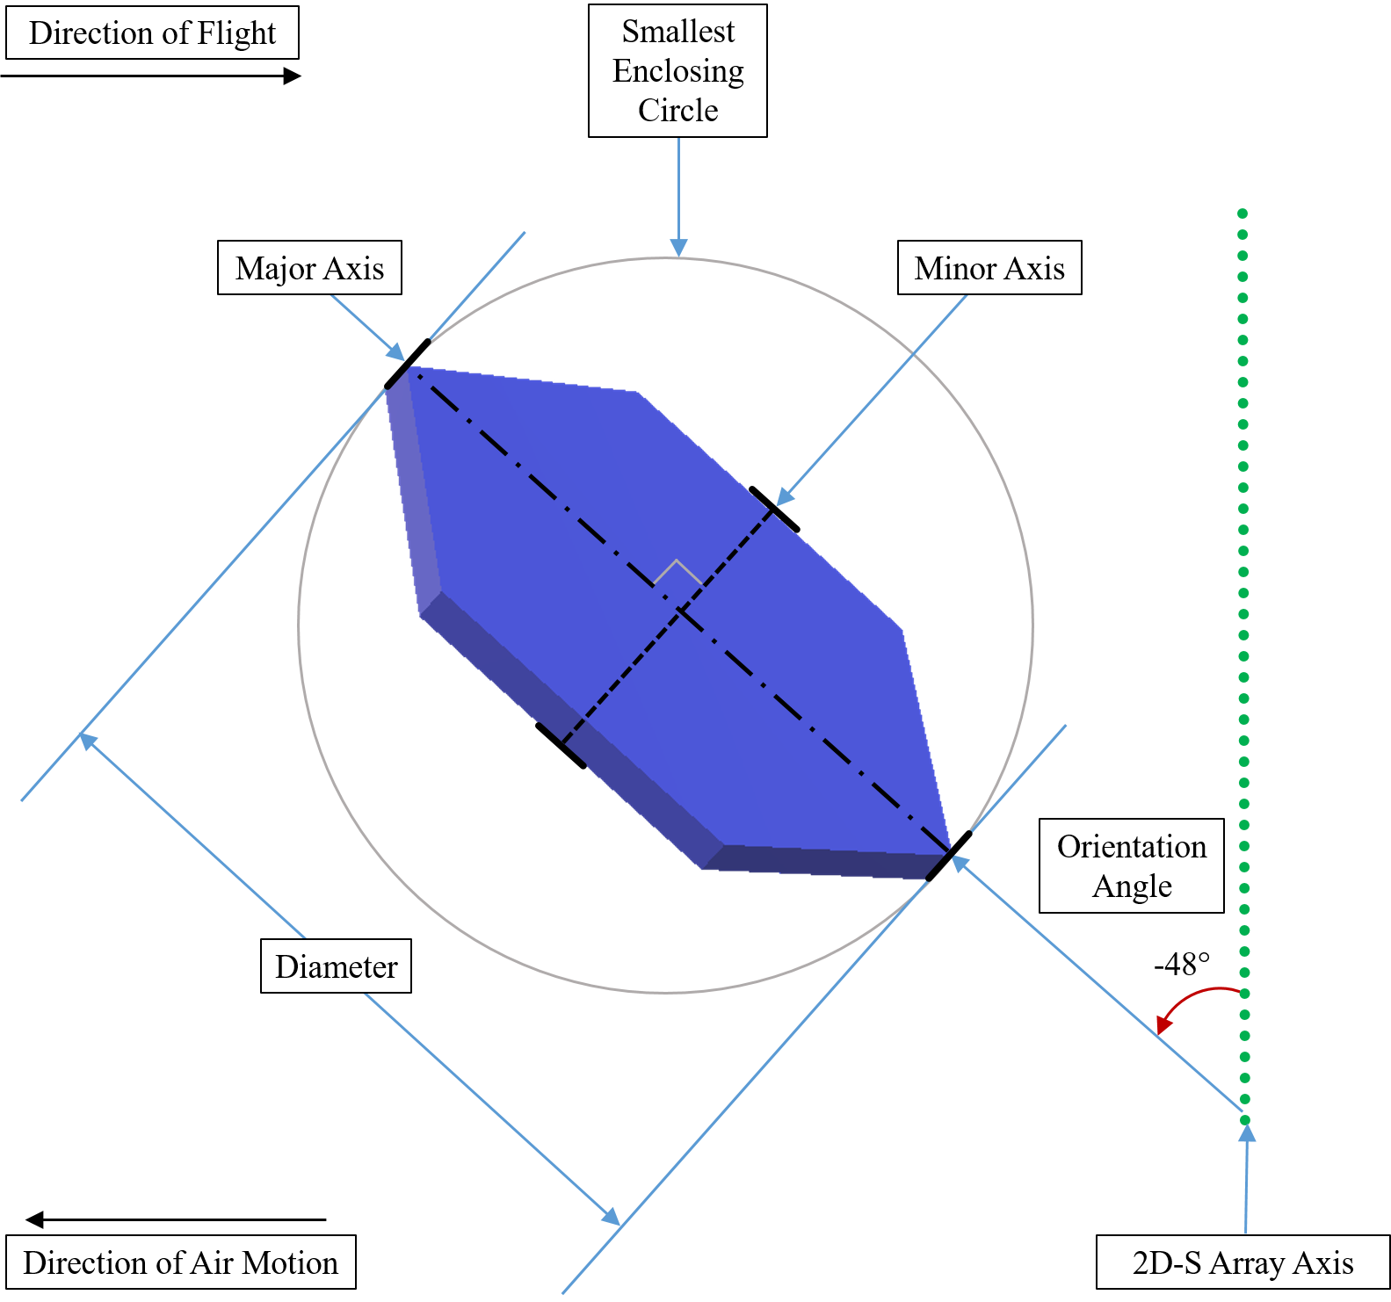
Figure 3

Slide 7
Figure 3
Diagram showing how an in situ idealized hexagonal plate crystal encountering the sampling volume of the Two-Dimensional Stereo Optical Array Probe (2D-S) is recorded in the image data and parameterized by the System for Optical Array Probe (OAP) Data Analysis (SODA-2) processing software using the Fast Circle Method, which generates a smallest enclosing circle for each particle. The measured particle diameter is equal to the diameter of the smallest enclosing circle. The major axis of the particle is identified based on the maximum dimension and is equal to the particle diameter, and the minor axis is orthogonal to the major axis. The Orientation Angle parameter is the angle between the major axis and the 2D-S array axis, with clockwise rotations (towards the direction of flight) being positive angles and counterclockwise rotations being negative angles.

Slide 8
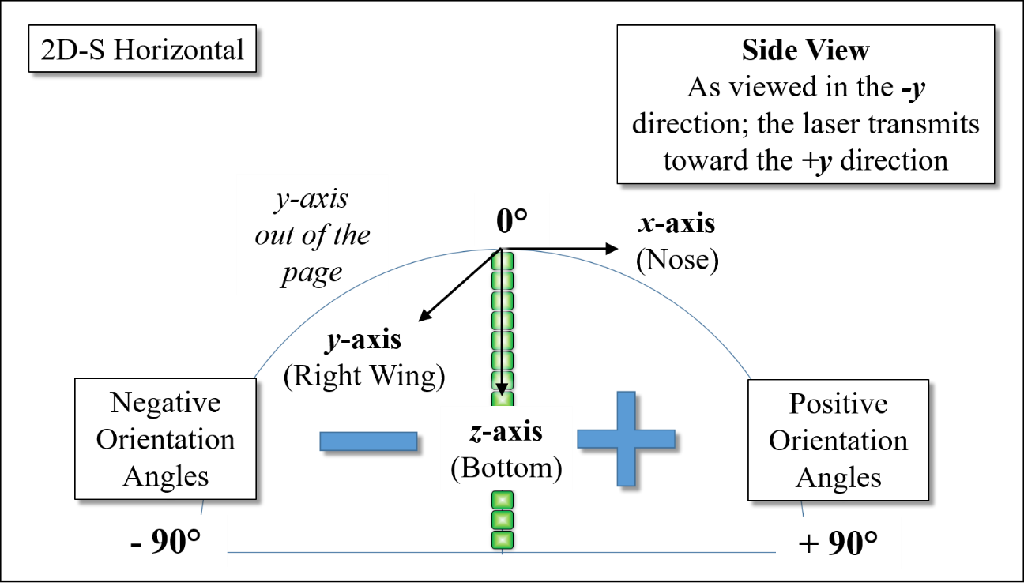
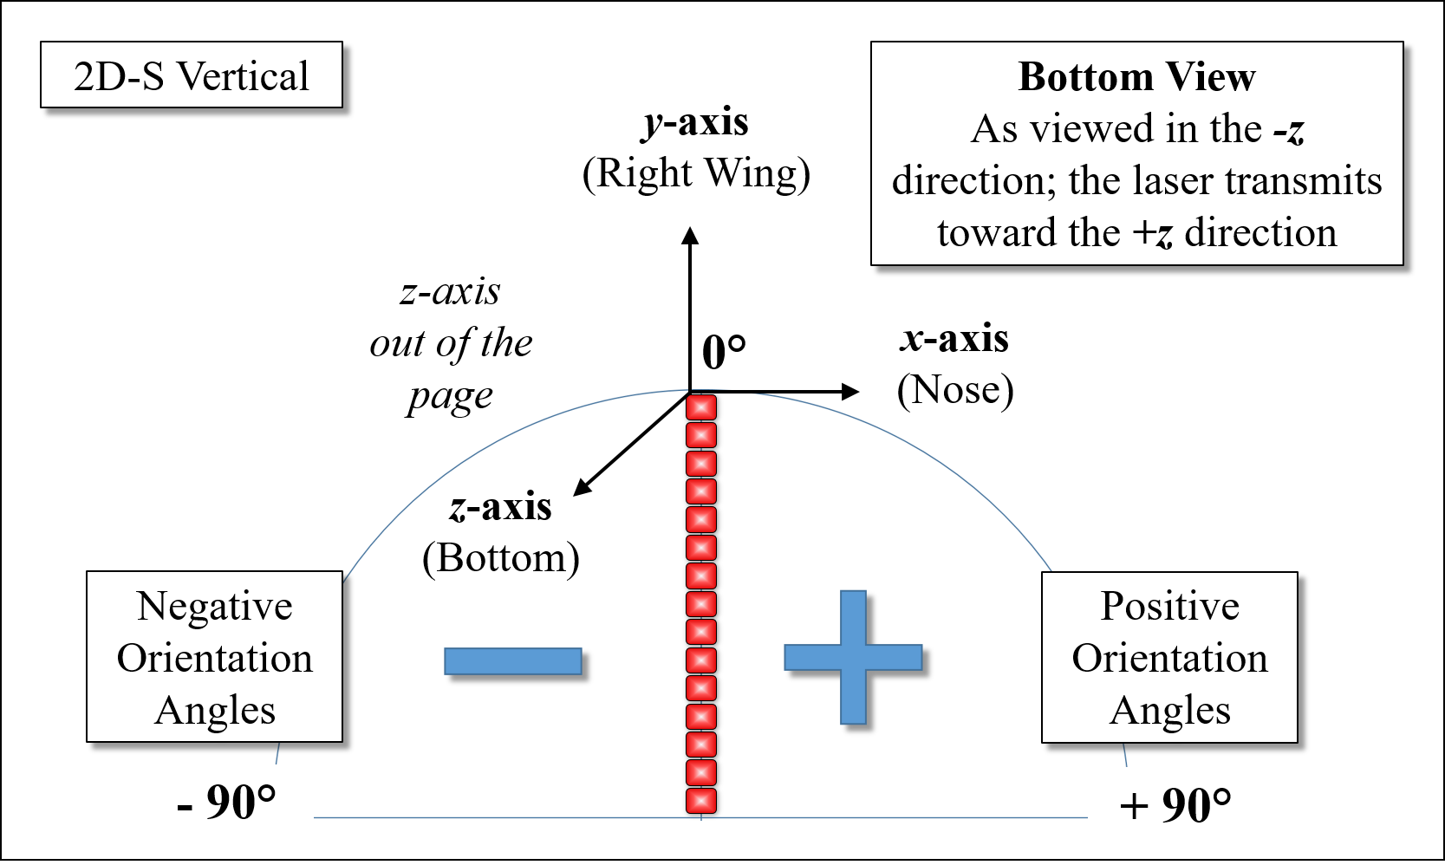
Figure 4
(a)
(b)

Slide 9
Figure 4
This figure shows how particles sampled by the Two-Dimensional Stereo Optical Array Probe (2D-S) and parameterized by System for OAP Data Analysis (SODA-2) define the Orientation Angle parameter of each non-circular particle based on the angle between the major axis of the particle and the array of diodes that receives the laser beam across the sampling volume. A sampled particle that has a major axis parallel with the diode array will result in an Orientation Angle of zero degrees. A clockwise rotation away from the diode array axis is measured as a positive Orientation Angle, and a counterclockwise rotation away from the diode array is a negative Orientation Angle. The range of possible values includes -90 to +90 degree angles. The Orientation Angle is measured by both orthogonally-positioned channels of the 2D-S, with a depiction of the horizontal channel shown in (a) and the vertical channel shown in (b).

Slide 10
Figure 5
Table 1
2D-S Chan. | ID | Time | Diam. | Area Ratio | Aspect Ratio | Angle | All In | X | Buffer Time | Y | IPT
 |  | (sec) | (μm) |  |  | (degrees) |  | (μm) | (sec) | (μm) | (sec)
H | A | 61786.926 | 1097 | 0.22 | 0.24 | -28.0 | 1 | 1000 | 61786.926 | 610 | 0.000671
H | B | 61786.926 | 731 | 0.36 | 0.49 | -33.7 | 1 | 670 | 61786.926 | 460 | 0.003619
V | C | 61786.770 | 1214 | 0.19 | 0.25 | 29.3 | 0 | 1090 | 61786.770 | 640 | 0.001291
V | D | 61786.020 | 927 | 0.29 | 0.33 | 6.9 | 0 | 920 | 61786.020 | 390 | 0.003834

Slide 11
Figure 5
Example shows randomly selected Two-Dimensional Stereo Optical Array Probe (2D-S) image data that corresponds with the attribute data shown in Table 1.

Slide 12
Table 1
Example shows Two-Dimensional Stereo Optical Array Probe (2D-S) attribute data as recorded in the particle-by-particle file corresponding to image data (Figure 5). Two examples are shown from the 2D-S horizontal (H) channel and two from the 2D-S vertical (V) channel. The three linear measurements given for each imaged particle include the particle diameter based on the fast circle method of processing, and an X and Y measurement, with X representing the dimension parallel to the array axis and Y representing the dimension parallel to the direction of flight. The “all in” flag is a 1 if the particle image is fully contained within the image strip and not in contact with array ends, and the flag is a 0 if the particle is only partially contained within the image strip. The inter-arrival time of each particle is shown in the last column as inter-particle time (IPT).

Slide 13
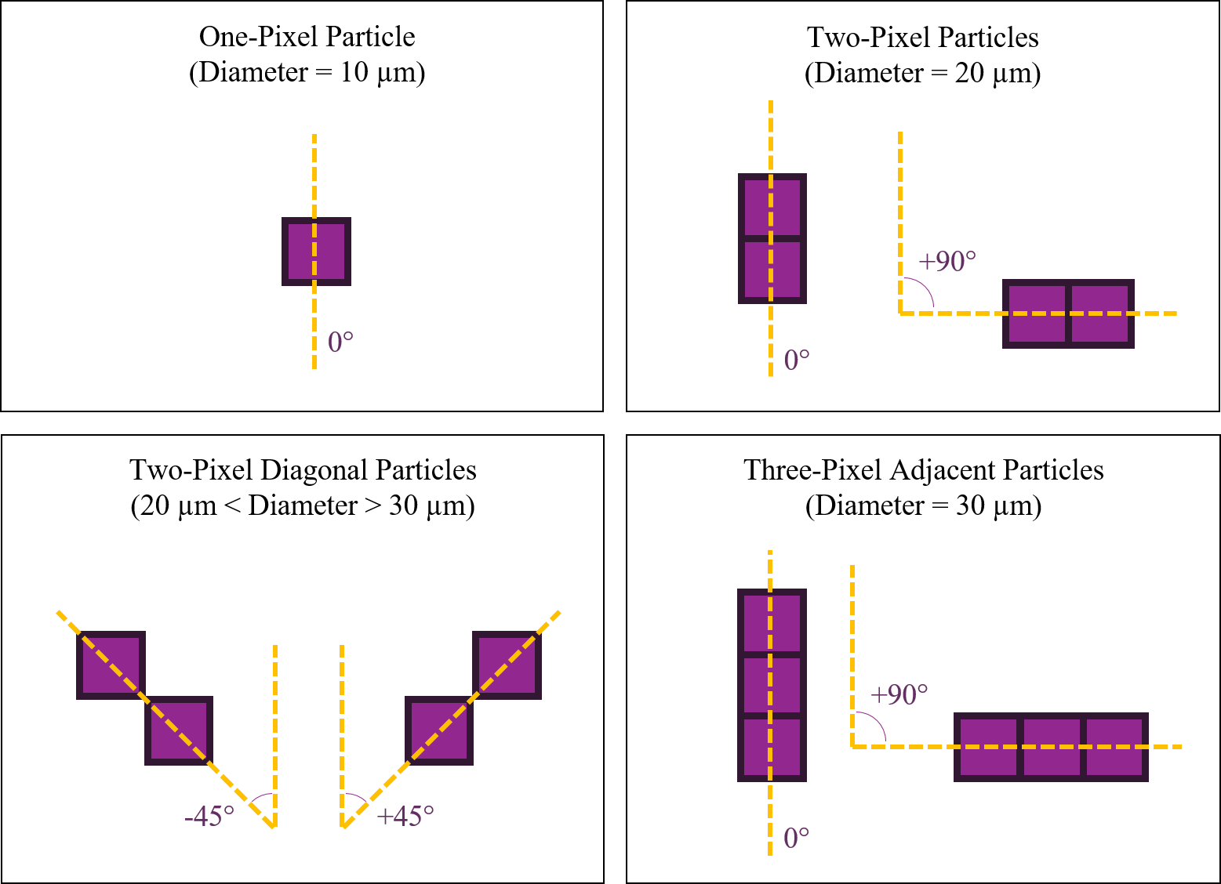
Figure 6
(a)
(b)
(c)
(d)

Slide 14
Figure 6
Diagrams showing the possible shaded pixel configurations of single (a), dual (b) and (c), and up to three (d) pixel particles, as would be depicted in Two-Dimensional Stereo Optical Array Probe (2D-S) image data and the default orientation angles for each possible pixel configuration.

Slide 15
Figure 7

Slide 16
Figure 7
Plot showing the orientation angle histogram for particles with diameters of 10 µm sampled during the February 7, 2020 flight for the Two-Dimensional Stereo Optical Array Probe (2D-S) horizontal (left) and vertical (right) channels.

Slide 17
Figure 8

Slide 18
Figure 8
Plot showing the orientation angle histogram for particles up to 20 µm diameter sampled during the February 7, 2020 flight for the Two-Dimensional Stereo (2D-S) Optical Array Probe (OAP) horizontal (left) and vertical (right) channels.

Slide 19
Figure 9

Slide 20
Figure 9
Plot showing the orientation angle histogram for particles greater than 20 µm but less than or equal to 30 µm in diameter sampled during the February 7, 2020 flight for the Two-Dimensional Stereo Optical Array Probe (2D-S) horizontal (left) and vertical (right) channels.

Slide 21
Figure 10

Slide 22
Figure 10
Plot showing buffer of Two-Dimensional Stereo Optical Array Probe (2D-S) images from the February 7, 2020 flight at 17:09:35 UTC for the vertical channel. The subsequent buffer is positioned to the right of the preceding buffer to demonstrate a case where an ice crystal was sampled near the end of a data buffer and continued in the next buffer. The black triangle along the bottom of the strip denotes the transition point between buffers, and the timestamp (HHMMSS.ss format and UTC time) is labeled along the top of each image strip.

Slide 23
Figure 11

Slide 24
Figure 11
Plot showing buffer of Two-Dimensional Stereo Optical Array Probe (2D-S) images from the February 7, 2020 flight at 17:10:11 UTC for the vertical channel. The subsequent buffer is positioned to the right of the preceding buffer to demonstrate a case where an ice crystal was sampled near the end of a data buffer and continued in the next buffer. The black triangle along the bottom of the strip denotes the transition point between buffers, and the timestamp (HHMMSS.ss format and UTC time) is labeled along the top of each image strip.

Slide 25
Table 2
Ex. | Time | ID | Time | Diam. | Area Ratio | Aspect Ratio | Angle | All In | X | Buffer Time | Y | IPT
 | [UTC] |  | [sfm] | [μm] |  |  | [deg] |  | [μm] | [sec] | [μm] | [sec]
l | 17:09:35 | l-1 | 61775.2230 | 276 | 0.38 | 0.64 | 19.8 | 1 | 260 | 61775.2230 | 200 | 0.000112
 |  | l-2 | 61775.2230 | 185 | 0.53 | 0.58 | 18.4 | 1 | 180 | 61775.2230 | 130 | 0.000512
 |  | l-3 | 61775.2230 | 532 | 0.46 | 0.59 | -32.5 | 0 | 470 | 61775.2230 | 380 | 0.004521
 |  | l-4 | 61775.2230 | 1261 | 0.41 | 0.38 | -87.3 | 0 | 430 | 61775.2230 | 1260 | 0.000841
 |  | l-5 | 61775.2700 | 1260 | 0.36 | 0.41 | 87.7 | 0 | 510 | 61775.2700 | 1210 | 0.000026
 |  | l-6 | 61775.2700 | 871 | 0.48 | 0.70 | 38.9 | 1 | 740 | 61775.2700 | 730 | 0.000412
 |  |  | 61775.2700 | 1110 | 0.22 | 0.20 | 89.5 | 0 | 220 | 61775.2700 | 1110 | 0.006587
t | 17:10:11 |  | 61811.5670 | 161 | 0.68 | 0.58 | -82.4 | 0 | 80 | 61811.5670 | 160 | 0.000681
 |  |  | 61811.5670 | 869 | 0.30 | 0.42 | -9.7 | 1 | 860 | 61811.5670 | 440 | 0.000257
 |  |  | 61811.5670 | 579 | 0.43 | 0.57 | 39.3 | 0 | 470 | 61811.5670 | 400 | 0.000325
 |  |  | 61811.5670 | 95 | 0.57 | 0.82 | 69.4 | 1 | 60 | 61811.5670 | 90 | 0.002299
 |  | t-1 | 61811.5670 | 1093 | 0.28 | 0.56 | 9.4 | 1 | 1080 | 61811.5670 | 580 | 0.000997
 |  | t-2 | 61811.5670 | 1151 | 0.21 | 0.27 | 25.4 | 0 | 1040 | 61811.5670 | 540 | 0.003118
 |  | t-3 | 61811.5820 | 1945 | 0.57 | 0.77 | 58.5 | 0 | 1150 | 61811.5820 | 1660 | 0.000428
 |  | t-4 | 61811.5820 | 2030 | 0.48 | 0.59 | 52.8 | 0 | 1280 | 61811.5820 | 1680 | 0.00116
 |  |  | 61811.5820 | 2703 | 0.36 | 0.48 | 62.1 | 0 | 1280 | 61811.5820 | 2440 | 0.000949
 |  |  | 61811.5820 | 24 | 0.66 | 0.62 | -45.0 | 1 | 20 | 61811.5820 | 20 | 0.000619

Slide 26
Table 2
Two-Dimensional Stereo Optical Array Probe (2D-S) particle-by-particle attribute data for February 7, 2020 Investigation of Microphysics and Precipitation for Atlantic Coast-Threatening Snowstorms (IMPACTS) flight, vertical channel, which corresponds to the images shown in Figure 10 and Figure 11. The time is given in a [HH:MM:SS] UTC format and a seconds-from-midnight (SSSSS.ss sfm) format. The three linear measurements given for each imaged particle include the particle diameter based on the fast circle method of processing, and an X and Y measurement, with X representing the dimension parallel to the array axis and Y representing the dimension parallel to the direction of flight. The “all in” flag is a 1 if the particle image is fully contained within the image strip and not in contact with array ends, and the flag is a 0 if the particle is only partially contained within the image strip. The inter-arrival time of each particle is shown in the last column as inter-particle time (IPT). More examples of buffer-spanning particles and associated particle attributes are detailed in Appendix B.

Slide 27
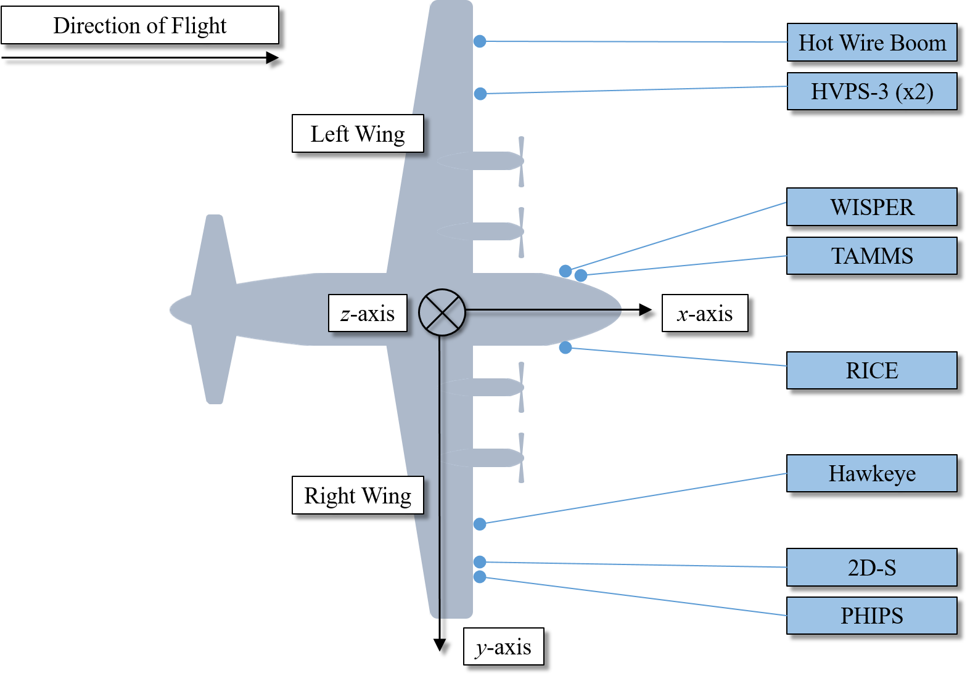
Figure 12

Slide 28
Figure 12
This depiction shows a top-view of the NASA P-3 Orion research aircraft and its local frame of reference coordinate system, where the x-axis points out the nose of the aircraft along the direction of flight, the y-axis is aligned with the right wing (starboard side) of the aircraft, and the z-axis points down towards the ground when in level flight. The instrument labels shown in blue mark the mounting locations of each probe assembly when configured for the Investigation of Microphysics and Precipitation for Atlantic Coast-Threatening Snowstorms (IMPACTS) campaign.

Slide 29
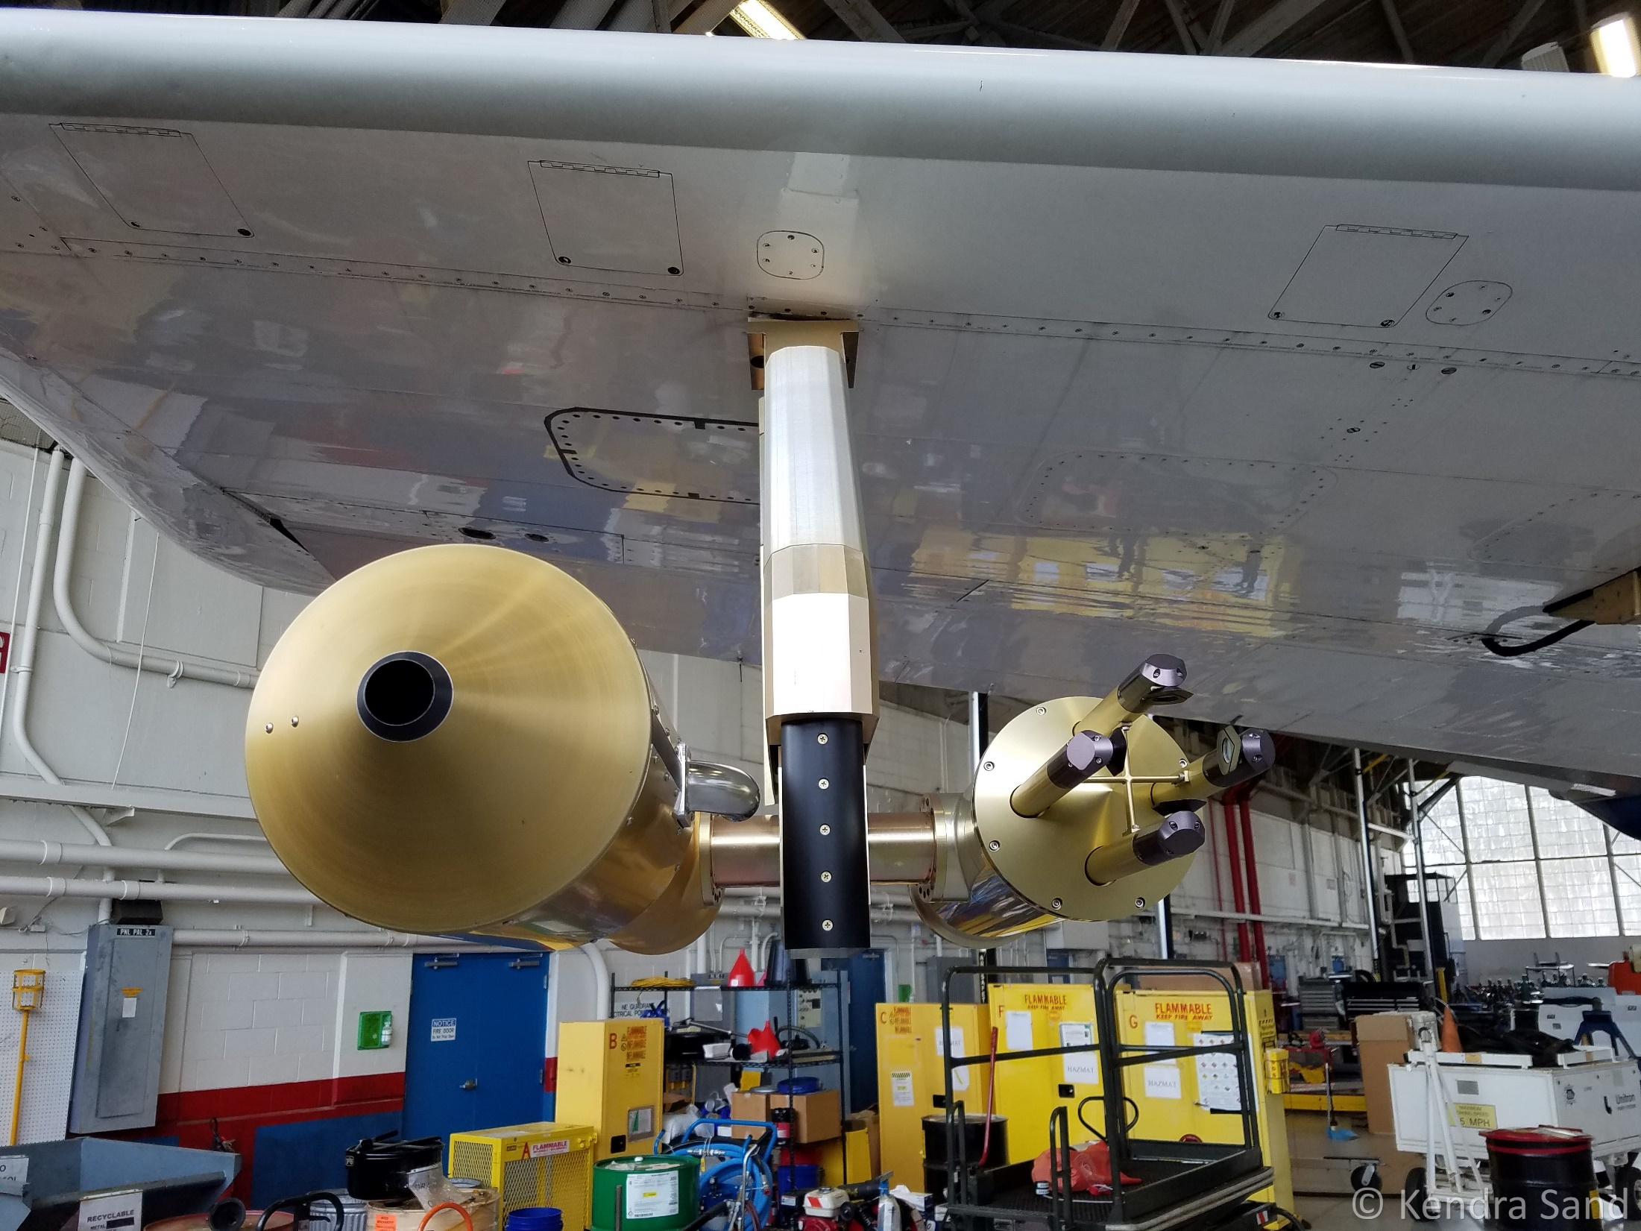
Figure 13

Slide 30
Figure 13
This photo depicts the mounting location of the Particle Habit Imaging and Polar Scattering (PHIPS) Probe and Two-Dimensional Stereo Optical Array Probe (2D-S) on the outer pylon of the starboard wing of the NASA P-3 aircraft during the Investigation of Microphysics and Precipitation for Atlantic Coast-Threatening Snowstorms (IMPACTS) 2020 field campaign.

Slide 31
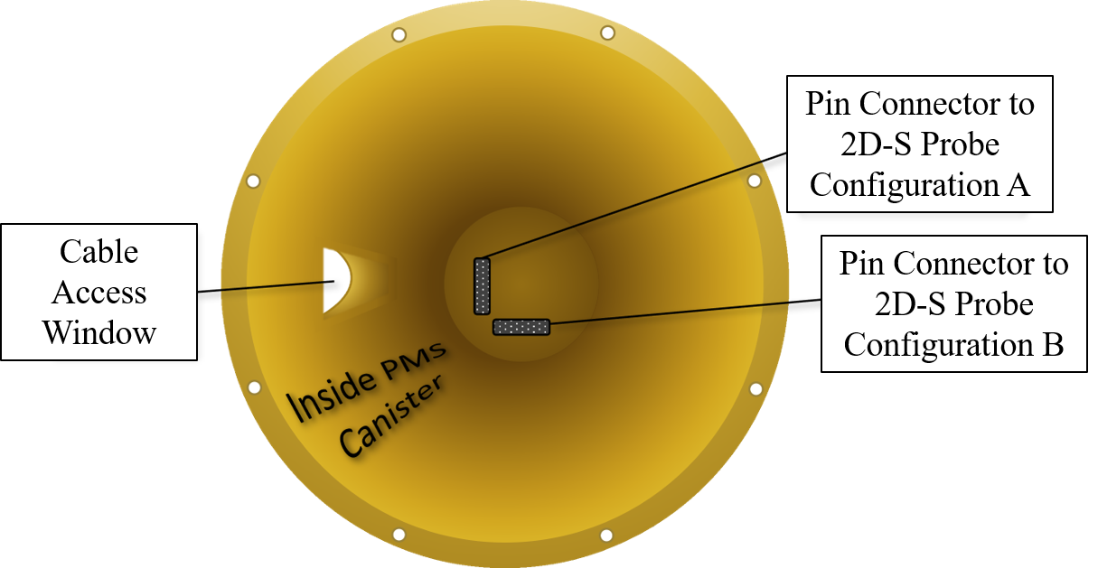
Figure 30

Slide 32
Figure 30
This figure shows that the interior of a Particle Measuring Systems (PMS) canister includes two possible configurations for connecting the pin connecter on the Two-Dimensional Stereo Optical Array Probe (2D-S) to the pin connector on the PMS canister. Configuration A is a connection to the vertical pin connecter, while Configuration B is a connection to the horizontal pin connector. While this provides for flexibility in how the 2D-S probe is installed, it can result in ambiguity as to the orientation of the horizontal and vertical sampling arms. The correct configuration is Configuration A, because it will result in the 2D-S Horizontal Transmitter and Horizontal Receiver arms being parallel with the ground.

Slide 33
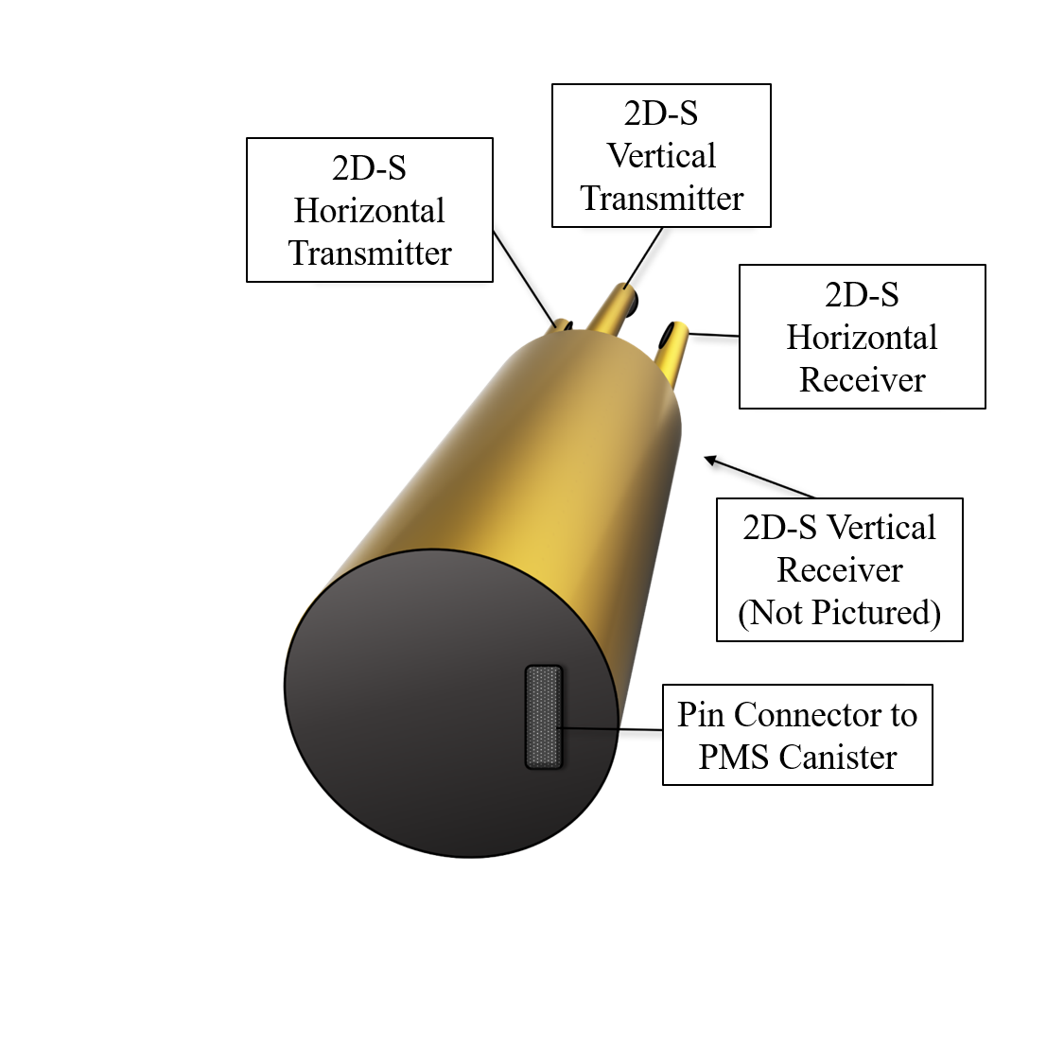
Figure 31

Slide 34
Figure 31
This figure depicts a simplified view of the back of a Two-Dimensional Stereo Optical Array Probe (2D-S), where a pin connector is located. The pin connector provides the necessary connection to the Particle Measuring Systems (PMS) canister probe housing during installation. The PMS canister is then connected to the aircraft wiring, and this is the means by which the 2D-S probe receives power and transmits data during flight. There is only one pin connector on the back of the 2D-S probe, but there are two ways it can be oriented in order to connect with the PMS canister pin connector.

