Slide 1
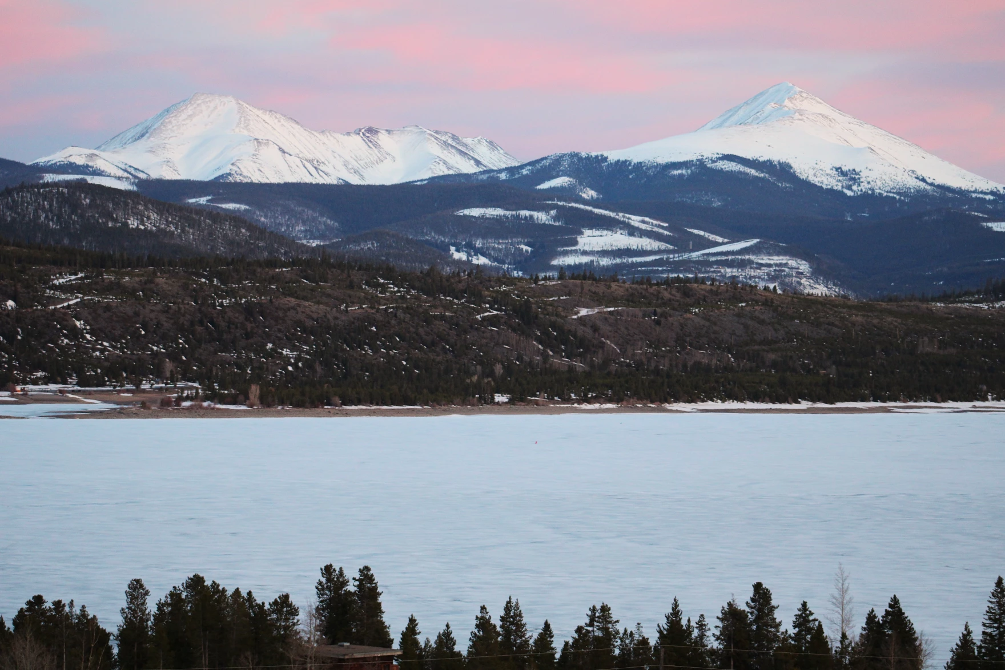
Wintertime Cloud Seeding
Puja Roy
April 28, 2026
Dept. of Atmospheric Sciences, University of North Dakota
ATSC 252
Applied Weather Modification
Snowy mountains loom over Colorado’s Lake Dillon reservoir

Slide 2
Learning Objectives
Need for Wintertime Orographic Cloud Seeding
Conceptual Basis of Wintertime Orographic Cloud Seeding - Fundamental Hypothesis
Ground-Based Generators
Seeding with an Aircraft
Relative advantages and disadvantages of both methods
Recent Field Campaigns – SPERP, SNOWIE

Slide 3
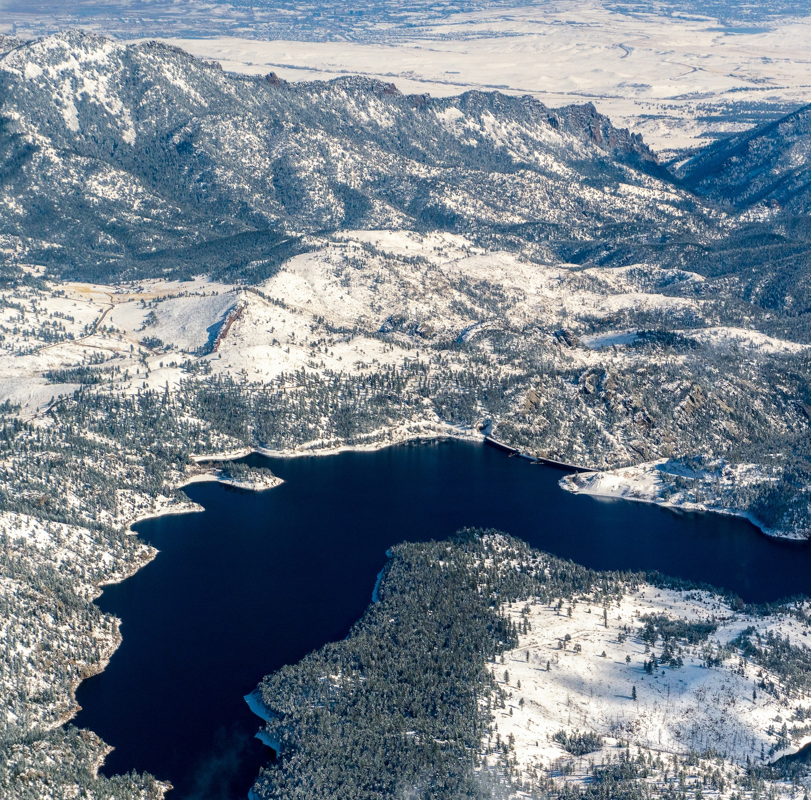
Need for Wintertime Cloud Seeding
U.S. population more than doubled from 1950 to 2010 - shifted from rural to urban (U.S. Census Bureau, 2010), with greatest population increase in Southern and Western states, leading to strained public water supply systems
Water scarcity is expected to worsen due to continued population growth and climate change impacts on mountain snowpack
Winter mountain snowpack acts as a natural water reservoir, supplying spring and summer water through snowmelt
Enhancing snowfall through wintertime orographic cloud seeding can increase snowpack and improve water availability in arid regions
Cloud seeding offers a potential tool for supplementing water resources alongside conservation efforts
Western U.S. snowpack is worth trillions of $$$$$!!
Gross Reservoir, southwest of Boulder, Colorado (Oct, 2019)
Notes:
U.S. population more than doubled from 1950 to 2010 - shifted from rural to urban (U.S. Census Bureau, 2010)with greatest population increase in Southern and Western states, leading to strained public water supply systems
Water scarcity is expected to worsen due to continued population growth and climate change impacts on mountain snowpack.
Winter mountain snowpack acts as a natural water reservoir, supplying spring and summer water through snowmelt.
Enhancing snowfall through wintertime orographic cloud seeding can increase snowpack and improve water availability in arid regions.
Cloud seeding offers a potential tool for supplementing water resources alongside conservation efforts
Despite uncertainties in measuring exact effectiveness, operational winter cloud seeding continues across many western U.S. states due to strong water resource needs.
Gross Reservoir, southwest of Boulder, Colorado, in October 2019. The reservoir, which supplies Denver Water customers on the Front Range, depends heavily on snowmelt. Photo by Mitch Tobin/The Water Desk. Aerial support provided by LightHawk.

Slide 4
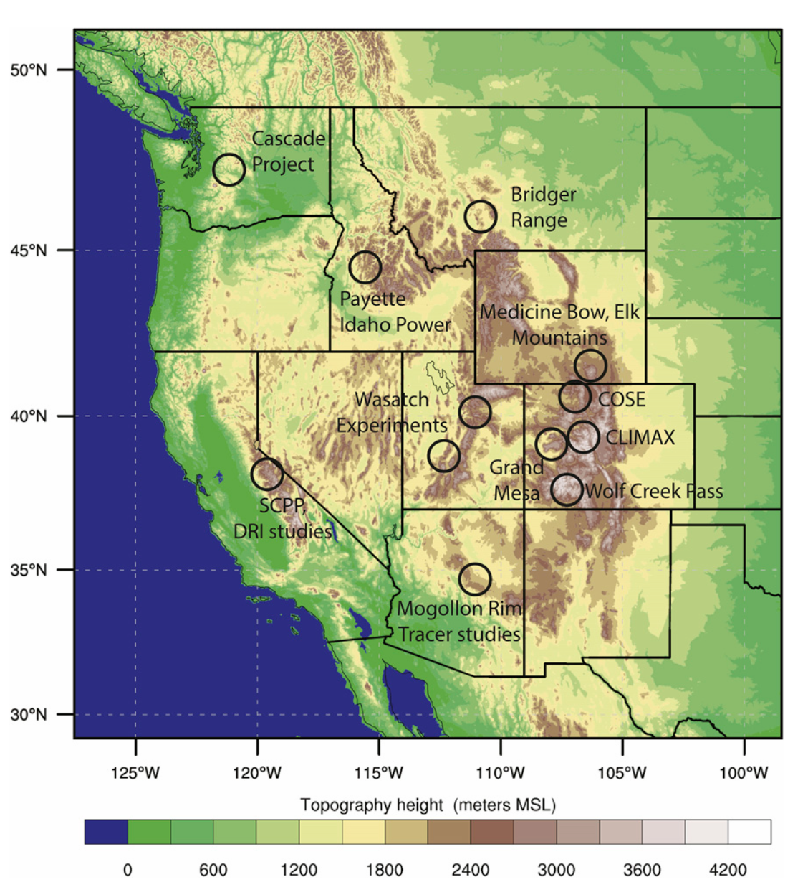
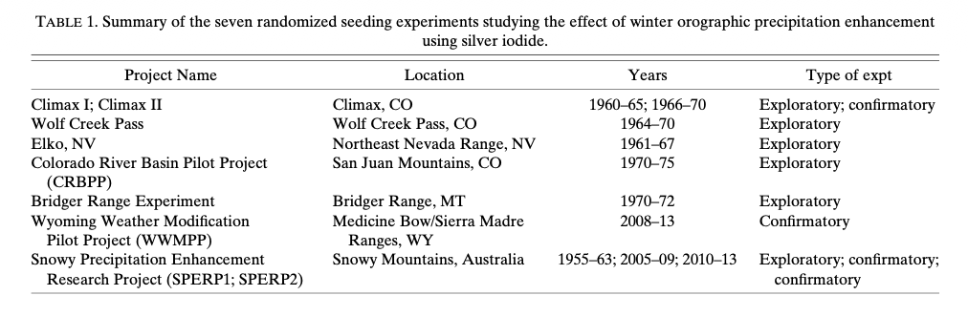
Major Orographic Cloud Seeding Projects
in Western US
Rauber et al., 2019
Notes:
Locations of major research projects in the western United States that were designed to evaluate the feasibility of orographic enhancement of snowpack through cloud seeding over the period 1960–2019.

Slide 5
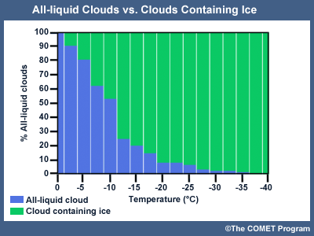
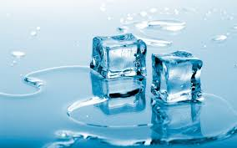
Physical Mechanisms
Does water always freeze right at the “freezing point” of 32°F (0°C)?
No!!

Slide 6
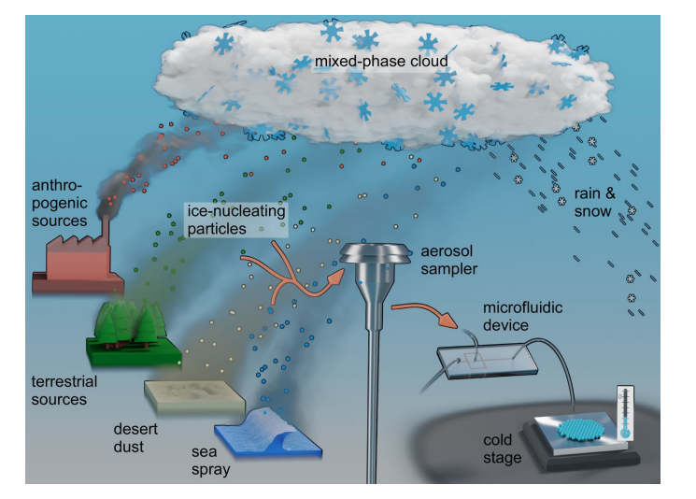
Physical Mechanisms
Between 0°C and -37°C, supercooled water needs foreign Ice-Nucleating Particles (INPs) to freeze.
Tarn et al., 2018
Notes:
Water doesn't always freeze right at what is traditionally known as the “freezing point” of 32°F (0°C) because it needs an ice nucleus around which to freeze. Dust or other particulates are good ice nucleating particles and are readily available in streams, puddles and in bodies of water on the ground, thus freezing water when the temperature is close to 0°C.
Dust or other ice nucleating particles are sometimes available in the air where clouds form, but not always. Sometimes they just don’t become effective at forming ice until temperatures get much colder. If ice nucleating particles (INPs), such as dust, are not available in the air or are not active at the temperature of the cloud, the water droplets in the cloud remain liquid even at temperatures colder than 0° C, and are known as supercooled liquid water (SLW). The blue bars below show the percentage of clouds that are all liquid by temperature below 0°C. As the temperature gets colder, more INPs become active and form ice, which depletes the liquid.
In clouds containing supercooled liquid water, ice nuclei are activated and grow best when the temperature is between -5° to -15° C.
Cloud seeding can help snow form within clouds that contain supercooled liquid water (SLW). Clouds that contain SLW are inefficient at producing natural snow, but can produce snow when INP are introduced. The INPs will quickly form ice crystals, and the ice will begin to grow at the expense of the SLW droplets, drawing moisture from the droplets and depositing it on the ice.
Various INPs become “active” at specific temperatures. Silver iodide, commonly used for seeding operations, can activate at temperatures as warm as -4° C. While it has been observed to activate as warm as -4°C, laboratory studies (Boe and DeMott, 1999) have shown that it more effectively activates ice crystals at temperatures of -5°C and colder. Therefore, most cloud-seeding programs use a temperature criterion of -5°C or colder to indicate the cloud is suitable for cloud seeding.
By introducing INPs that activate at relatively warm temperatures, like silver iodide, into the cloud at temperature ranges where supercooled liquid water dominates, cloud seeding efforts can create more ice crystals that can grow and fall to the ground as snow once they become large enough. The INPs can be placed in the cloud via aircraft or a ground generator.

Slide 7
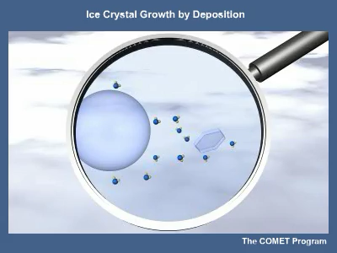
Physical Mechanisms
Various INPs become “active” at specific temperatures. Silver iodide (AgI) can activate at temperatures as warm as -4° C.
Most cloud-seeding programs use a temperature criterion of -5°C or colder to indicate the cloud is suitable for cloud seeding.
INPs can be placed in the cloud via aircraft or a ground generator.
Ice crystals growing at the expense of supercooled liquid droplets within a cloud
Notes:
In clouds containing supercooled liquid water, ice nuclei are activated and grow best when the temperature is between -5° to -15° C.
Cloud seeding can help snow form within clouds that contain supercooled liquid water (SLW). Clouds that contain SLW are inefficient at producing natural snow, but can produce snow when INP are introduced. The INPs will quickly form ice crystals and the ice will begin to grow at the expense of the SLW droplets, drawing moisture from the droplets and depositing it on the ice.
Various INPs become “active” at specific temperatures. Silver iodide, commonly used for seeding operations, can activate at temperatures as warm as -4° C. While it has been observed to activate as warm as -4°C, laboratory studies (Boe and DeMott, 1999) have shown that it more effectively activates ice crystals at temperatures of -5°C and colder. Therefore, most cloud-seeding programs use a temperature criterion of -5°C or colder to indicate the cloud is suitable for cloud seeding.
By introducing INPs that activate at relatively warm temperatures, like silver iodide, into the cloud at temperature ranges where supercooled liquid water dominates, cloud seeding efforts can create more ice crystals that can grow and fall to the ground as snow once they become large enough. The INPs can be placed in the cloud via aircraft or a ground generator.

Slide 8
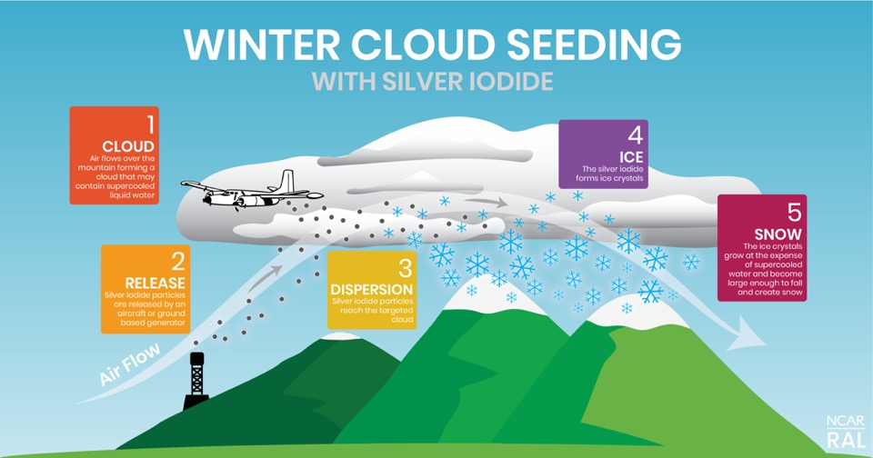
Conceptual Diagram
Notes:
a cloud’s natural precipitation efficiency can be enhanced by converting supercooled water to ice upstream and over a mountain range
in such a manner that newly created ice particles can grow and fall to the ground as additional snow on a specified target area
fundamental hypothesis underlying cloud seeding as a method to enhance precipitation from wintertime orographic cloud systems is that
*An orographic cloud forms when air flows over a mountain. Silver iodide particles are released and after the particles reach the cloud, they form ice crystals if the ambient temperature is colder than -5°C. The ice grows from the supercooled liquid water in the cloud. When the ice crystals become large enough, they fall as snow.
Wintertime mountain cloud systems have been seeded to increase snowpack and water supplies since the discovery (1) that ice crystals could be generated by injecting silver iodide (AgI) into a cloud of supercooled liquid
(2). During this process, termed glaciogenic seeding, AgI aerosols are introduced into a supercooled liquid cloud to nucleate ice crystals, which then achieve sizes and fall velocities sufficient to fall to the surface.

Slide 9
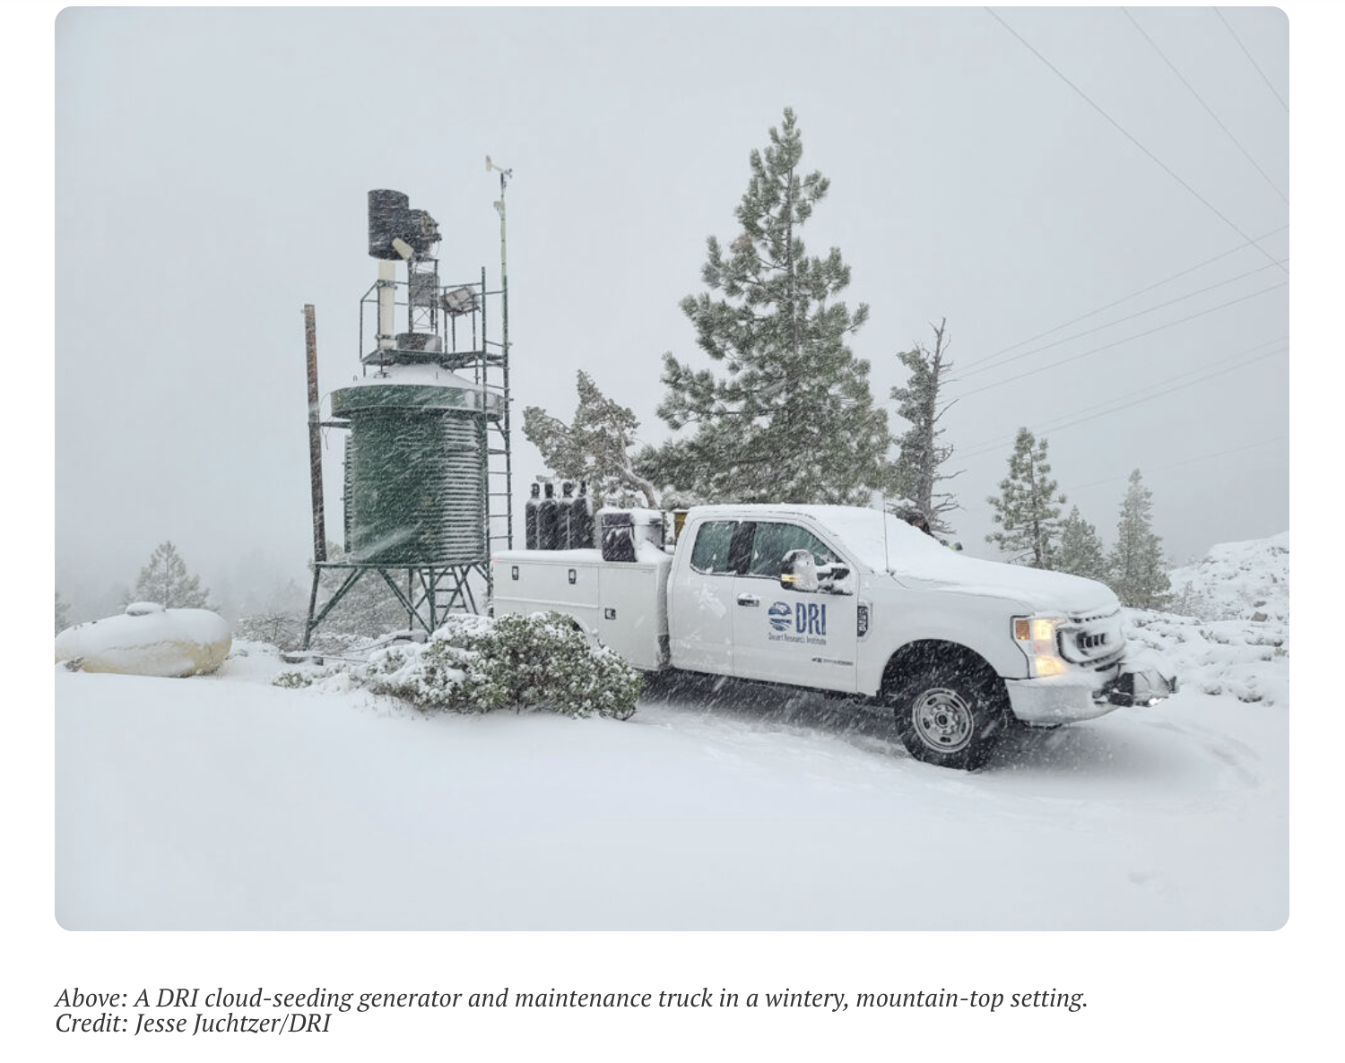
Cloud Seeders
https://www.youtube.com/watch?v=veOlftZp-44 (Courtesy: Desert Research Institute or DRI)

Slide 10
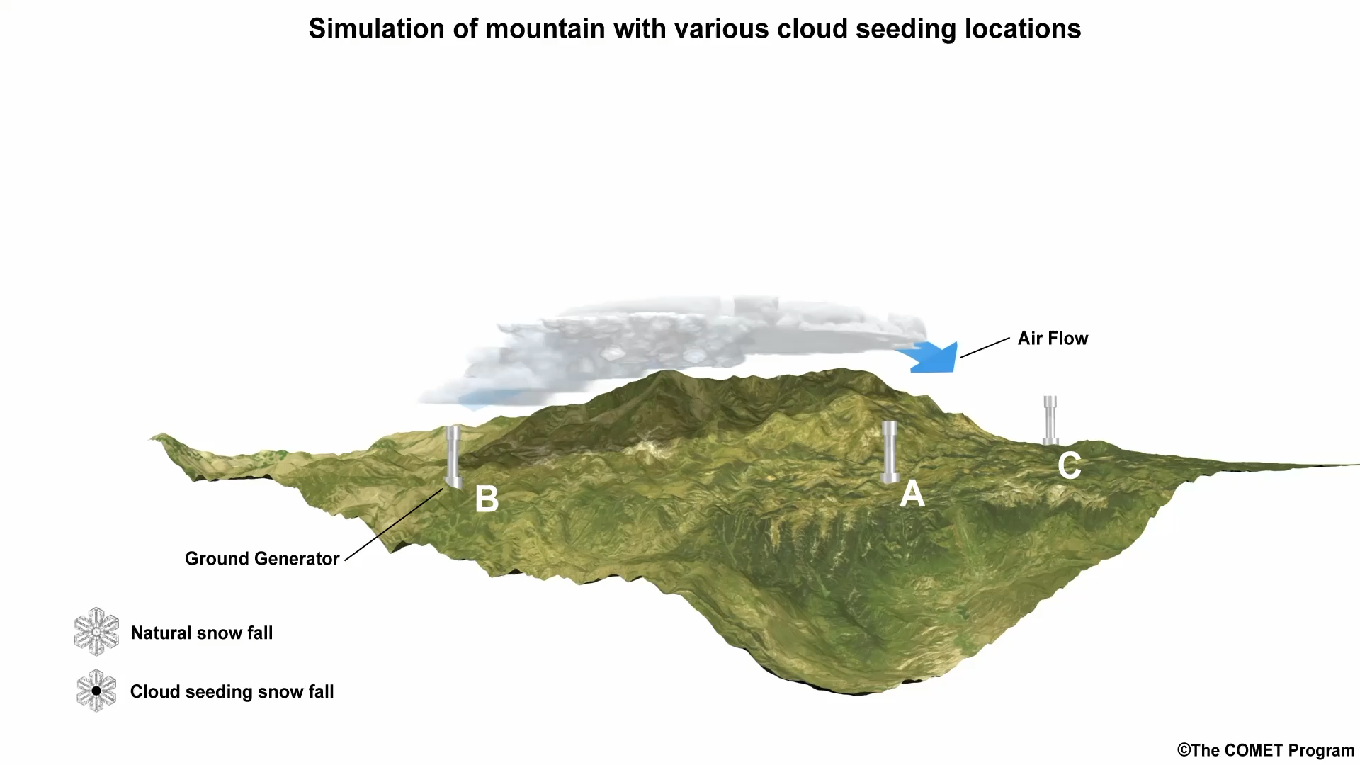
Ground-based Generator locations
Alignment of the ground generators so the wind transports the seeding particles into the cloud is important.
What happens when the winds are weaker?
Notes:
Alignment of the ground generators so the wind transports the seeding particles into the cloud is important.
Because of the variable wind direction, some of the particles reach the cloud but others do not. This illustrates the importance of carrying out climatological studies to identify the predominant wind direction at the potential ground generator location. With this information the generator can be placed in a location so that the majority of the time the winds will carry the particles from the generator into the area where the cloud will be. If the ground generators are placed in alignment with the wind, upwind of the mountain, and the wind blows towards the mountain, the particles will be picked up and carried into the cloud. In that case, the ice nucleating particles will be able to reach the cloud.

Slide 11
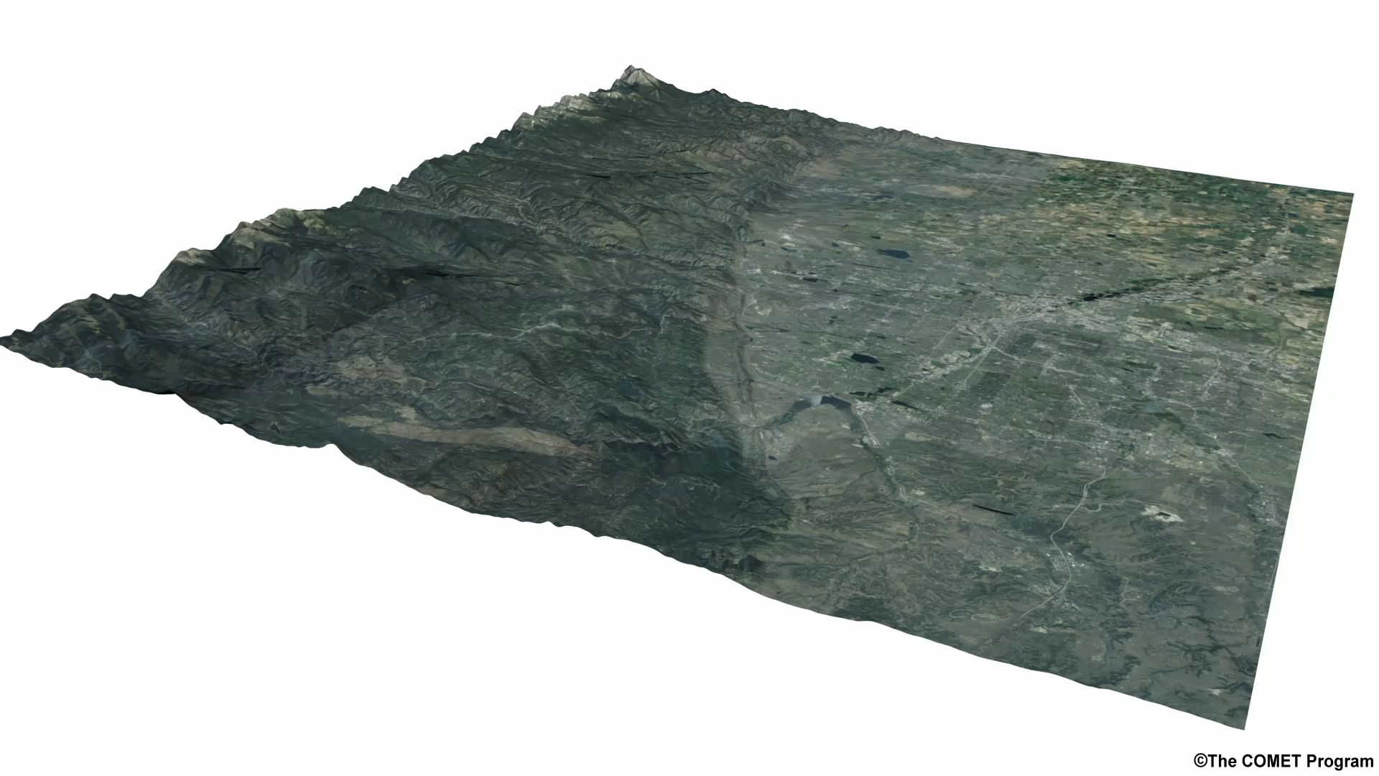
Weak Winds
The particles may not reach the cloud, more likely to flow around the mountain (known as flow blocking)
Notes:
The likelihood of flow blocking depends on three variables: the height of the mountain barrier, the stability of the atmosphere, and the wind speed. With weak winds, flow will be more likely to be blocked unless the mountain is also short or the atmosphere is unstable (read: conducive to vertical cloud development).
With stronger wind speeds, the airflow has a better chance of overcoming any atmospheric stability or mountain heights to get over the mountain barrier, thereby dispersing silver iodide particles over the mountain, which is where they need to go to reach the cloud.

Slide 12
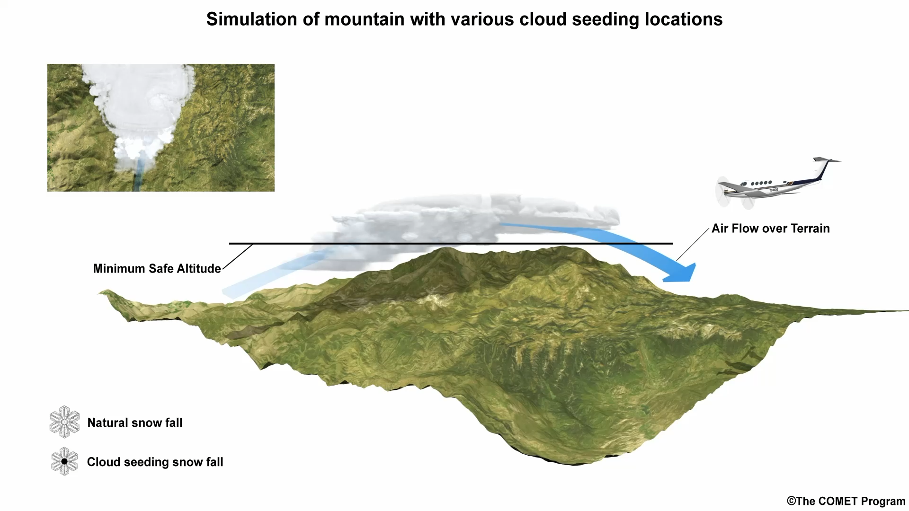
Seeding with an Aircraft
Which of the following positions of the aircraft track will produce snow over the mountains?
a) Flying high above the clouds
b) Flying near the top of the clouds
c) Flying under the clouds
Notes:
The airplane needs to be flying just above or partially inside the clouds to release the particles. In this way, the aircraft can place the particles more precisely. However, due to the possibility of ice formation on the wings of the aircraft, it can be dangerous to fly the plane in those in-cloud conditions. In those circumstances, an aircraft can release “ejectable” particles below the aircraft that drop down into the cloud. It is best to carefully weigh the pros and cons of using ground generators or airplanes for particle dispersal for safety and seeding effectiveness.
Because of their ability to fly in a variety of directions and precision in placing the seeding particles directly into the cloud, aircraft can also release particles in more variable wind regimes than ground generators.

Slide 13
Advantages/Disadvantages
Based on the previous information on ground generators and aircraft seeding methods,
what are the advantages and disadvantages of cloud seeding via each method?
a) Aircraft can disperse particles directly into the cloud
Advantage
b) Aircraft are costly to operate and fly for limited periods of time
Disadvantage
c) SLW in clouds can coat aircraft wings and cause loss of lift
Disadvantage
d) Ground generators can run continuously for many hours or days
Advantage
e) Ground generators need to be located where they will align with the predominant airflow
Disadvantage
Notes:
It is necessary to carefully weigh the pros and cons of each method of particle dispersal. Ground generators work well for long duration storms when they are aligned with the dominant airflow and the atmospheric stability and winds allow the particles to reach the clouds. They can continuously release particles. A variable airflow will diminish the effectiveness of ground generators that are sited at fixed locations. Releasing seeding material from an aircraft can improve the placement of the particles, ensuring they disperse into the cloud, and an aircraft can align with any direction of the airflow.
Aircraft cannot fly continuously for more than a few hours at a time (~4 hours, but depends on aircraft type) and there is the danger of SLW in the cloud causing icing on the aircraft that could cause an aircraft to lose lift. There isn’t one approach that will fit all conditions. The project directors will need to assess each storm and decide on the seeding approach that could produce the best results for the given situation.

Slide 14
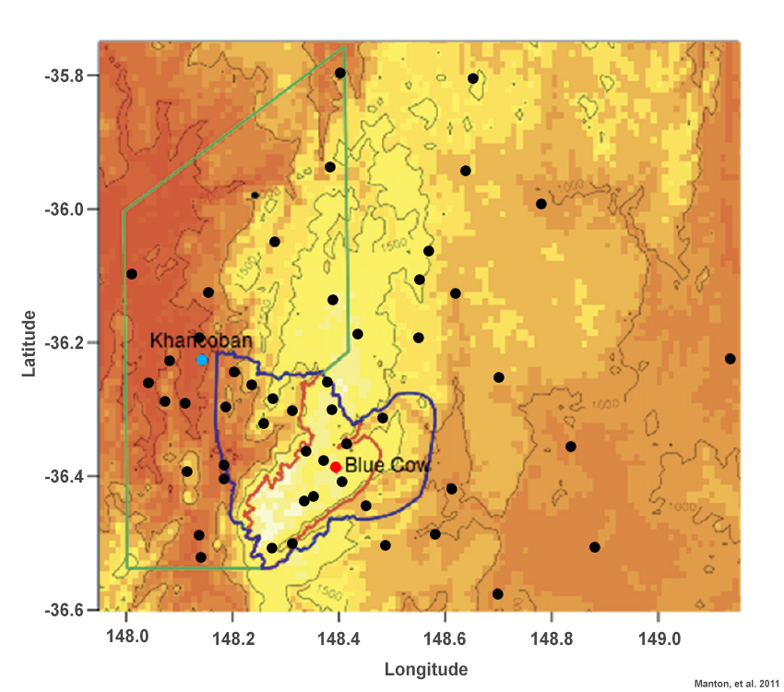
Cloud Seeding Efficacy
How much snow is cloud seeding likely to generate?
Snowy Mountains of southeastern Australia
Observational studies such as Snowy Precipitation Enhancement Research Project (SPERP) statistically examined seeding effects using a network of 13 ground generators and 44 precipitation measuring gauges at various locations along Snowy Mountains in Australia (Manton et. al. 2011a,b)
53 instances of seeding periods compared with 31 similar unseeded cases
Total fractional increase in precipitation above natural precipitation level in the overall target area was found to be 14% with 3% risk (chances of observed precipitation differences due to inadequate sampling, much larger natural variability, etc)
Primary target area
Overall target area
Control area
Black dots – Precipitation gauges
contours at 500, 1000, and 1500 m
Notes:
Water resource managers began to realize that seeding wintertime orographic storms had the potential to increase water supplies as early as the 1950s. Observational studies of orographic cloud seeding from the 1970s and 1980s made some progress in understanding effective cloud seeding conditions, but could not clearly attribute the amount of snowfall enhancement to seeding efforts. Flying the sampling aircraft to collect measurements and validate silver iodide dispersion or observe physical cloud processes has often been difficult due to concerns surrounding icing and flying close to topography. Similarly, siting of ground-based measurement stations that could validate cloud seeding efficacy has proven a challenge in terms of the number required for statistical significance and in terms of placement with respect to a target area. A 2003 National Research Council report stated that “there is still no convincing scientific proof of the efficacy of international weather modification efforts.” Three more modern studies, carried out in 2011 over the Snowy Mountains in Australia and in 2014 over Wyoming’s Medicine Bow Mountains, alongside newer cloud seeding modeling efforts, are demonstrating correlations between cloud seeding and precipitation amount enhancements. These are described in more detail in the tabs above.
Two Manton et. al. 2011 observational studies statistically examined seeding effects using a network of 13 ground generators and 44 precipitation measuring gauges at various locations along the Snowy Mountains in Australia. 53 instances of seeding periods in which environmental conditions were optimal and the generators ran for nearly the full time window were compared with 31 similar unseeded instances. The total fractional increase in precipitation above the natural precipitation level in the overall target area was found to be 14% at a significance level of 3% - in other words, precipitation in the target area increased by 14% above what would occur naturally, with only a 3% risk that the observed precipitation differences did not actually occur and the results were due to inadequate sampling, much larger natural variability, or other issues.
Location of precipitation gauges (black dots) used for SPERP analysis; the red line shows the primary target area, blue shows the overall target area, and green shows the control area; Khancoban is denoted by a blue diamond and Blue Cow is shown by a red diamond; the distance between Khancoban and Blue Cow is 29 km; background colors show topography, with contours at 500, 1000, and 1500 m.
- in other words, precipitation in the target area increased by 14% above what would occur naturally, with only a 3% risk that the observed precipitation differences did not actually occur and the results were due to inadequate sampling, much larger natural variability, or other issues.

Slide 15
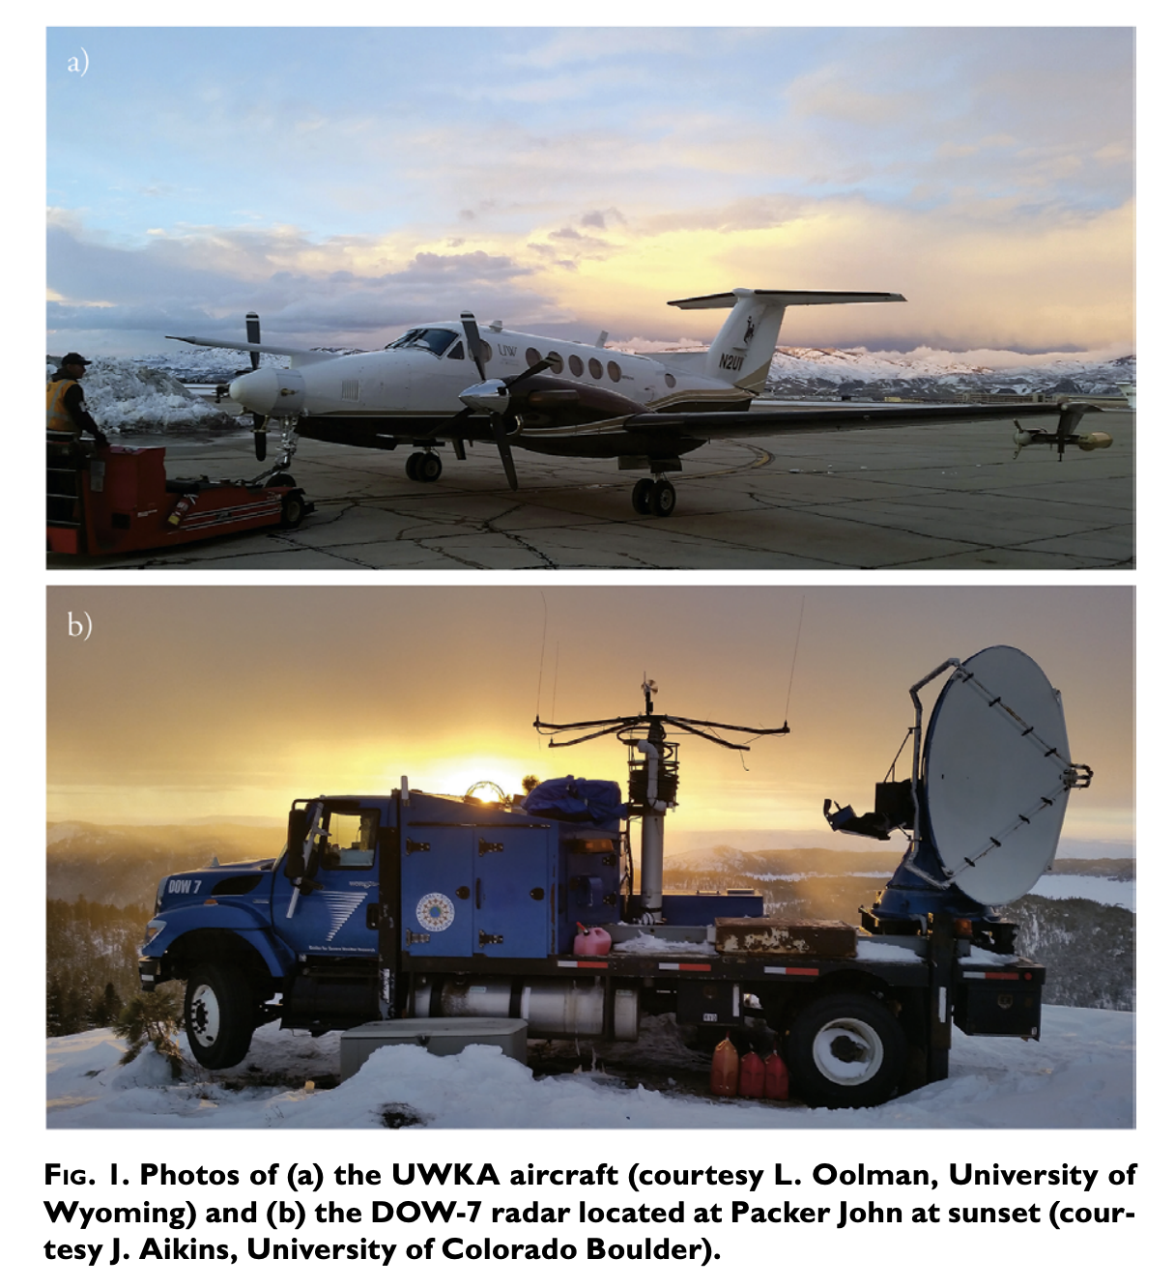
SNOWIE
SNOWIE (Seeded and Natural Orographic Wintertime Clouds: The Idaho Experiment)
to understand natural dynamical and microphysical processes by which precipitation forms and evolves within orographic winter storms
to determine the physical processes by which cloud seeding with silver iodide (AgI), either from ground generators or aircraft, impacts the amount and spatial distribution of snow falling across a river basin
The study reported increases in liquid equivalent snowfall of 0.05 mm to 0.28 mm and snowfall rates of 0.04 mm/hr to 1.2 mm/hr as a result of cloud seeding in three cases.
Notes:
The study reported increases in liquid equivalent snowfall of 0.05 mm to 0.28 mm and snowfall rates of 0.04 mm/hr to 1.2 mm/hr as a result of cloud seeding in three cases. These results were obtained by clearly identifying the resulting radar echoes from aircraft seeding in cases with negligible natural precipitation. The echoes were tracked to quantify the associated ground-level precipitation gauge increases.

Slide 16
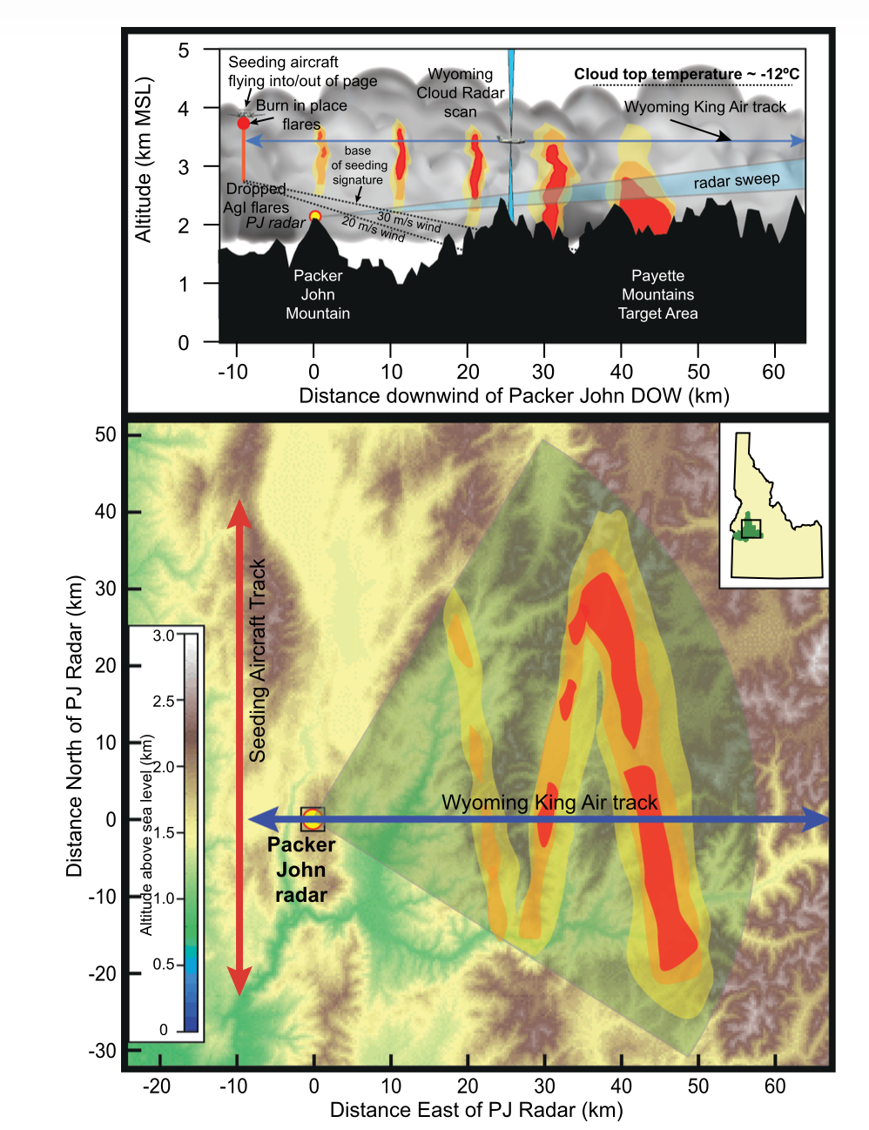
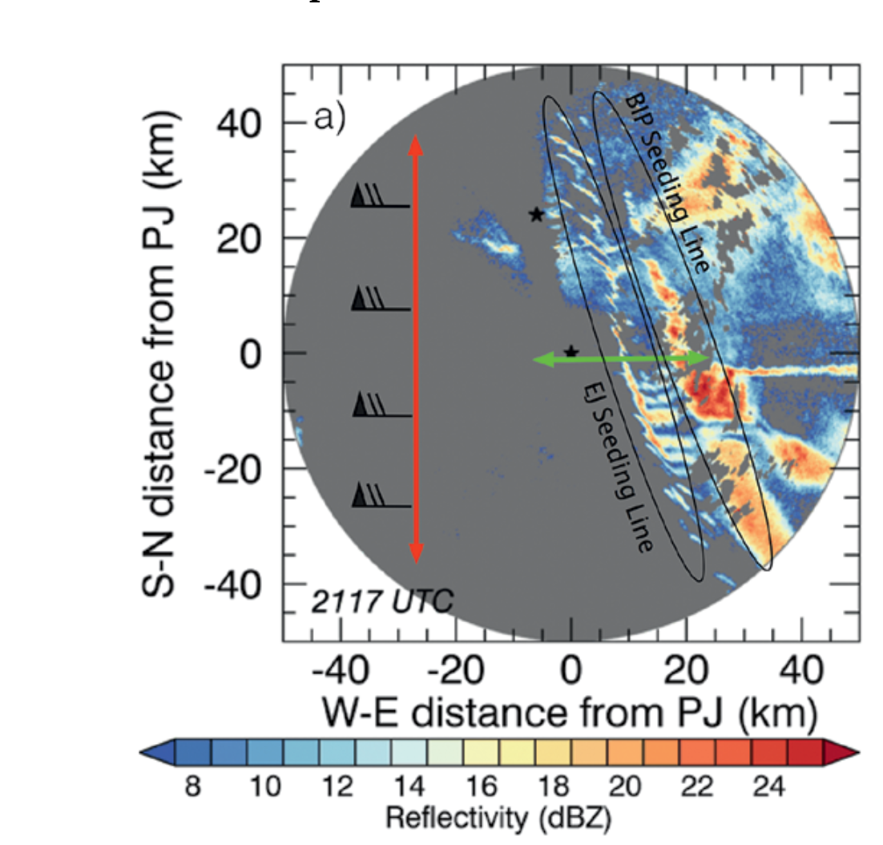
SNOWIE
Notes:
A conceptual illustration of the anticipated seeding signature and the
experimental setup as part of SNOWIE. The yellow–orange–red colors in-
dicate locations and relative magnitude of radar reflectivity echoes. Yellow
dots show locations of ground-based radars, the red line represents a typical
flight track for the seeding aircraft under westerly winds (left to right across
the figure), and the blue line is the corresponding flight track for the UWKA.
(top) A vertical cross section along the flight track of the UWKA and (bottom)
a plan view. Seeding material is released either as BIP or EJ flares. Vertical
depth of echoes as a function of downwind distance depends, in part, on wind
speed. The bases of the radar echo descend as particles grow and fall and are
illustrated by the dashed lines in the top panel for two different wind speeds.
Here, for illustration purposes, we assume constant wind speed with height.
[Figure from French et al. (2018).]

Slide 17
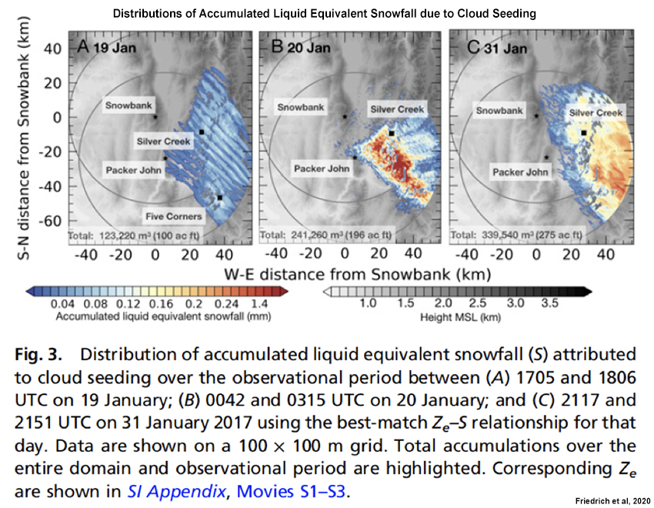
SNOWIE
SNOWIE (Seeded and Natural Orographic Wintertime Clouds: The Idaho Experiment)
The study reported increases in liquid equivalent snowfall of 0.05 mm to 0.28 mm and snowfall rates of 0.04 mm/hr to 1.2 mm/hr as a result of cloud seeding in three cases
https://movie-usa.glencoesoftware.com/video/10.1073/pnas.1917204117/video-1
Notes:
The study reported increases in liquid equivalent snowfall of 0.05 mm to 0.28 mm and snowfall rates of 0.04 mm/hr to 1.2 mm/hr as a result of cloud seeding in three cases. These results were obtained by clearly identifying the resulting radar echoes from aircraft seeding in cases with negligible natural precipitation. The echoes were tracked to quantify the associated ground-level precipitation gauge increases.
At first, there was nothing. "The radar can only see [water] particles that are big enough, and these clouds had tiny droplets not detectable by radar," Friedrich says. "Suddenly, we saw lines appear. It was really astonishing." The zig-zagged lines matched the flight path of the first plane. Within these lines, the cloud's water particles were getting bigger as they hit the silver iodide and froze. After a couple of hours, the snowflakes had grown from a few microns in diameter to 8 millimeters in diameter—heavy enough to fall to the ground, Friedrich and her colleagues report today in the Proceedings of the National Academy of Sciences. "We were super, super excited. Nobody had seen that before," she says.

Slide 18
How much snow is likely to be generated?
Challenging to quantify amount of precipitation over a specific target area attributed to seeding efforts
Past observational studies have used statistical experiments (similar to how pharmaceutical companies trial new medicines). Given there is so much natural variability in weather and sample of clouds that could be seeded for some of the trials was too low to gain statistical significance, a lot of these studies have not proven how much snow was produced by cloud seeding. For those studies that have been able to claim significant or less ambiguous results, such as finding a 14% increase from the statistical experiment in Australia, those results do not apply everywhere.
Each individual cloud-seeding program needs to do their own evaluation in order to estimate what the impacts in that region are.
Modeling Studies:
New computer models like WRF simulations of WWMPP cases in Rasmussen et al., 2018 are showing promise in being able to simulate how much additional snow from cloud seeding may be falling, and where it is falling. Those models could eventually be coupled with hydrological models to project streamflow impacts of cloud seeding.
Notes:
Tessendorf et al., 2019

Slide 19
Learning Objectives
Need for Wintertime Orographic Cloud Seeding
Conceptual Basis of Wintertime Orographic Cloud Seeding - Fundamental Hypothesis
Ground-Based Generators
Seeding with an Aircraft
Relative advantages and disadvantages of both methods
Recent Field Campaigns

Slide 20
Further Reading Suggestions
How Cloud Seeding Works – UCAR COMET Program
Yau, M. K., & Rogers, R. R. (1996). A short course in cloud physics. Elsevier.
Friedrich, K., Ikeda, K., Tessendorf, S. A., French, J. R., Rauber, R. M., Geerts, B., ... & Dawson, N. (2020). Quantifying snowfall from orographic cloud seeding. Proceedings of the National Academy of Sciences, 117(10), 5190-5195.
Manton, M. J., Warren, L., Kenyon, S. L., Peace, A. D., Bilish, S. P., & Kemsley, K. (2011). A confirmatory snowfall enhancement project in the Snowy Mountains of Australia. Part I: Project design and response variables. Journal of applied meteorology and climatology, 50(7), 1432-1447.
Manton, M. J., & Warren, L. (2011). A confirmatory snowfall enhancement project in the Snowy Mountains of Australia. Part II: Primary and associated analyses. Journal of applied meteorology and climatology, 50(7), 1448-1458.
Manton, M. J., Peace, A. D., Kemsley, K., Kenyon, S., Speirs, J. C., Warren, L., & Denholm, J. (2017). Further analysis of a snowfall enhancement project in the Snowy Mountains of Australia. Atmospheric Research, 193, 192-203.
Rasmussen, R. M., Tessendorf, S. A., Xue, L., Weeks, C., Ikeda, K., Landolt, S., ... & Lawrence, B. (2018). Evaluation of the Wyoming Weather Modification Pilot Project (WWMPP) using two approaches: Traditional statistics and ensemble modeling. Journal of Applied Meteorology and Climatology, 57(11), 2639-2660.
Rauber, R. M., Geerts, B., Xue, L., French, J., Friedrich, K., Rasmussen, R. M., ... & Parkinson, S. (2019). Wintertime orographic cloud seeding—a review. Journal of Applied Meteorology and Climatology, 58(10), 2117-2140.
Xue, L., Hashimoto, A., Murakami, M., Rasmussen, R., Tessendorf, S. A., Breed, D., ... & Blestrud, D. (2013). Implementation of a silver iodide cloud-seeding parameterization in WRF. Part I: Model description and idealized 2D sensitivity tests. Journal of applied meteorology and climatology, 52(6), 1433-1457.
Xue, L., Tessendorf, S. A., Nelson, E., Rasmussen, R., Breed, D., Parkinson, S., ... & Blestrud, D. (2013). Implementation of a silver iodide cloud-seeding parameterization in WRF. Part II: 3D simulations of actual seeding events and sensitivity tests. Journal of Applied Meteorology and Climatology, 52(6), 1458-1476.

