Slide 1
Opportunity Recognition
Base Seeding

Slide 2
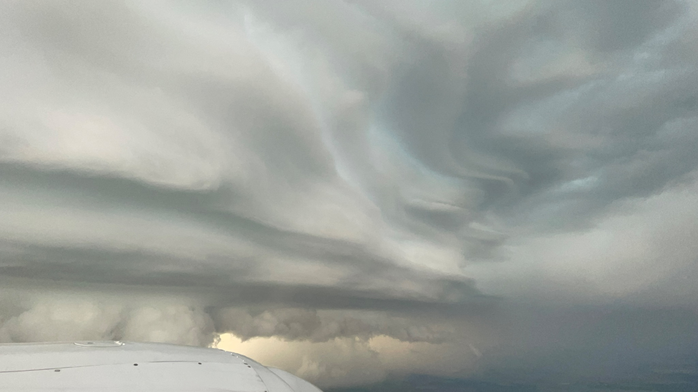
Base Seeding ND
Notes:
Interesting cloud formation, Multiple levels of indicated inflow with all of the ridges. Well defined bases but also Scud

Slide 3
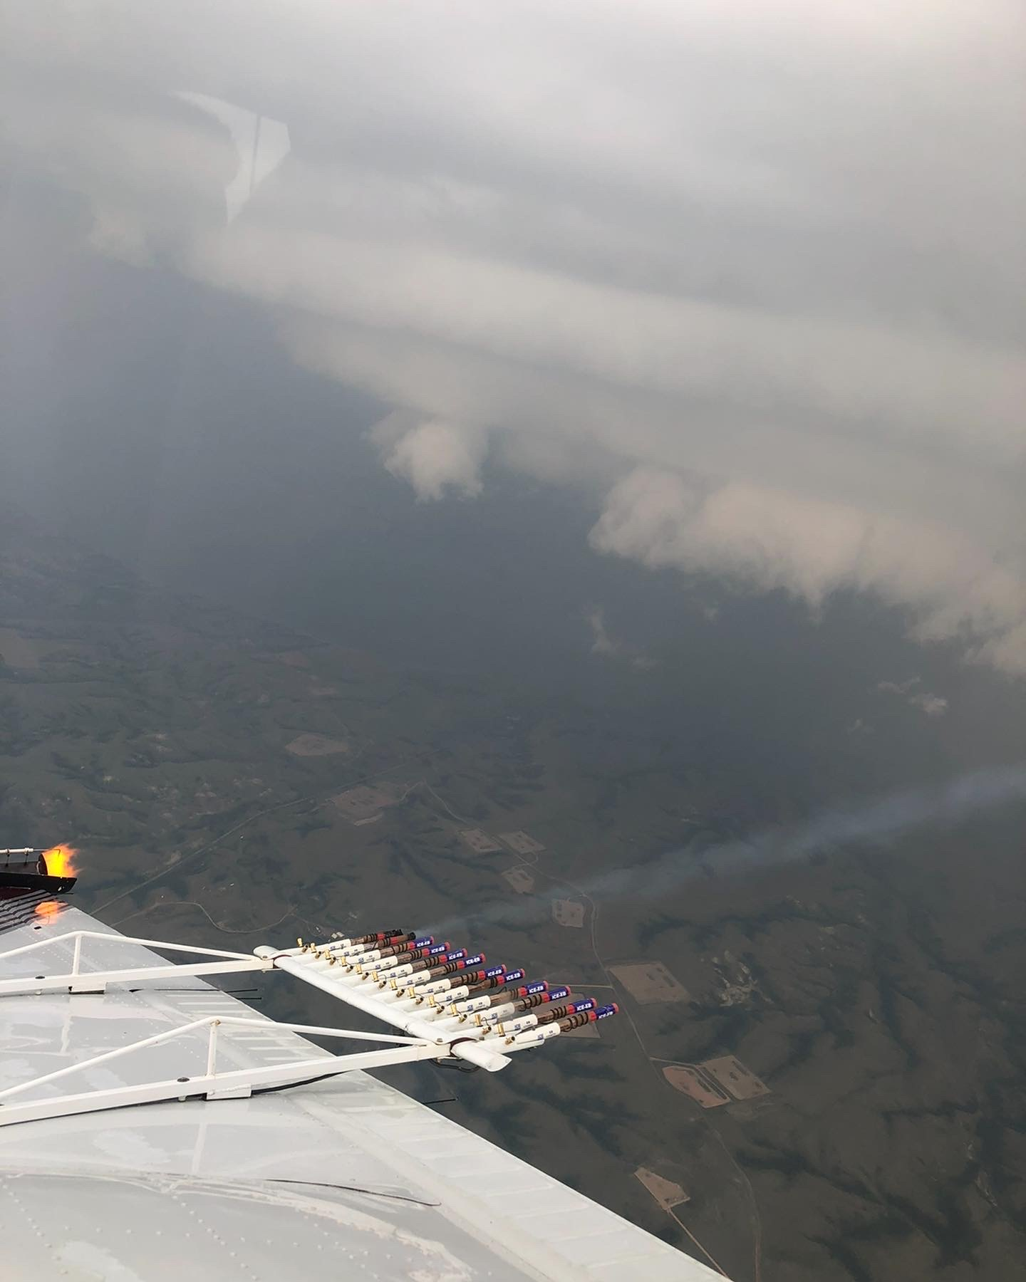
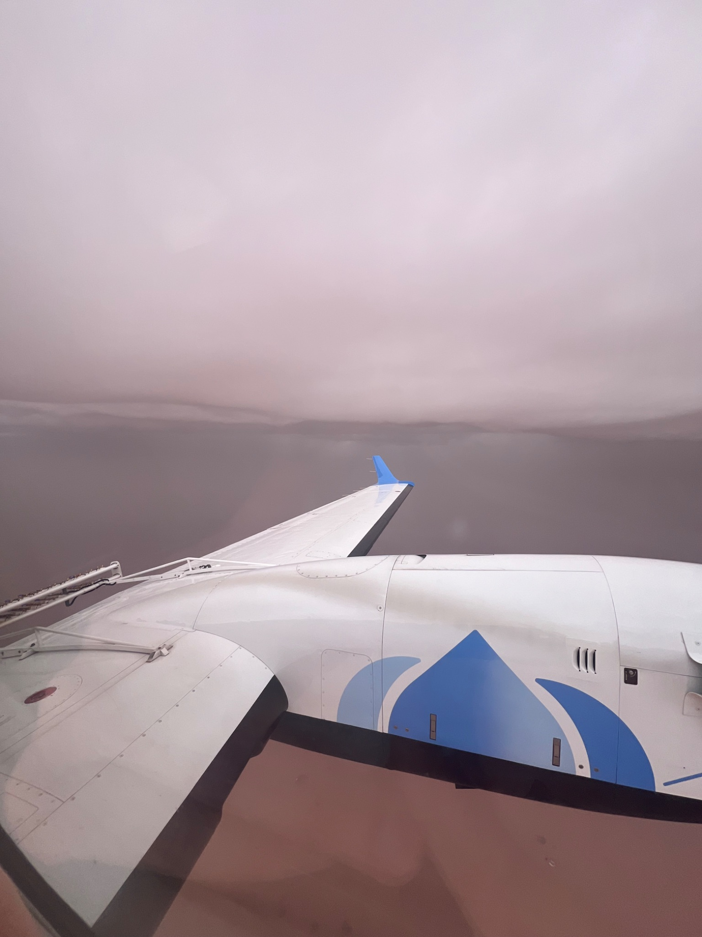
Notes:
First picture shows wedding cake looking bases, also BIP and Burner running at the same time. Again flat, dark with scud. Second picture shows Saudi base seeding in the king air dark bases but lots of dust.

Slide 4
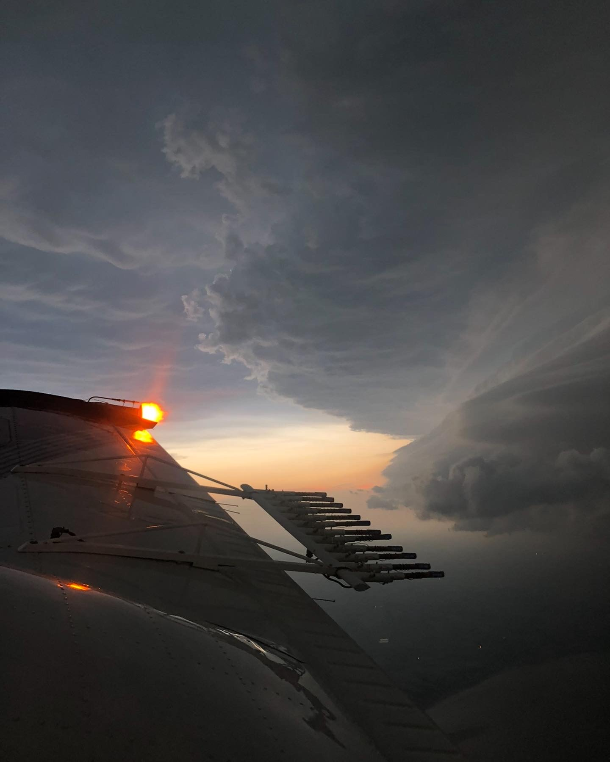
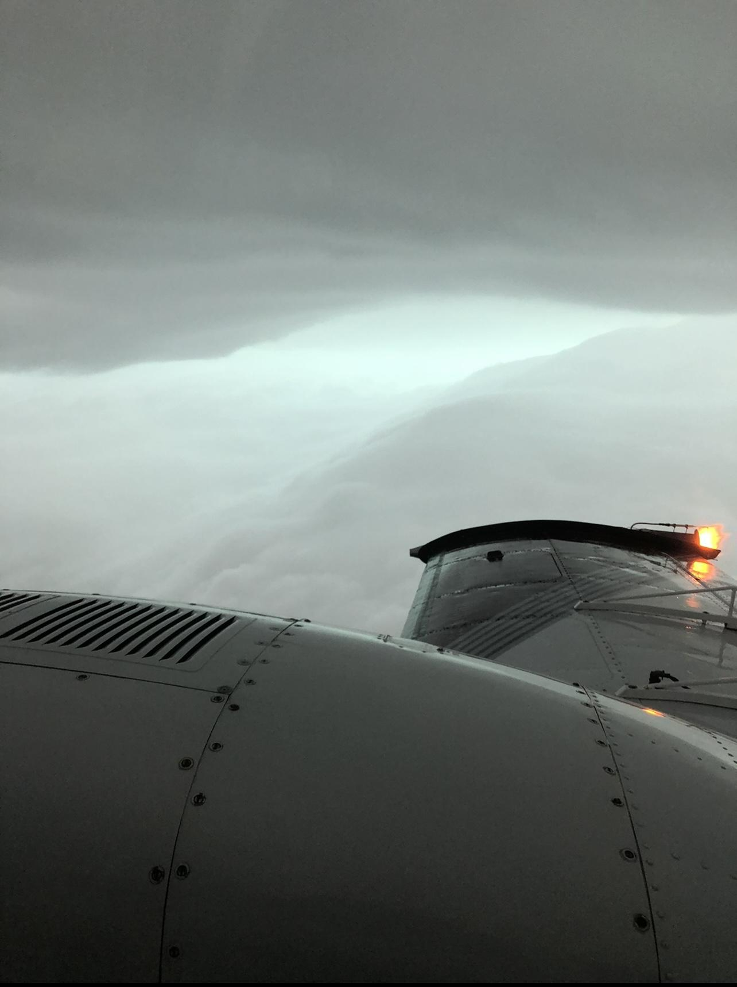
Notes:
Classic inflow wedges

Slide 5
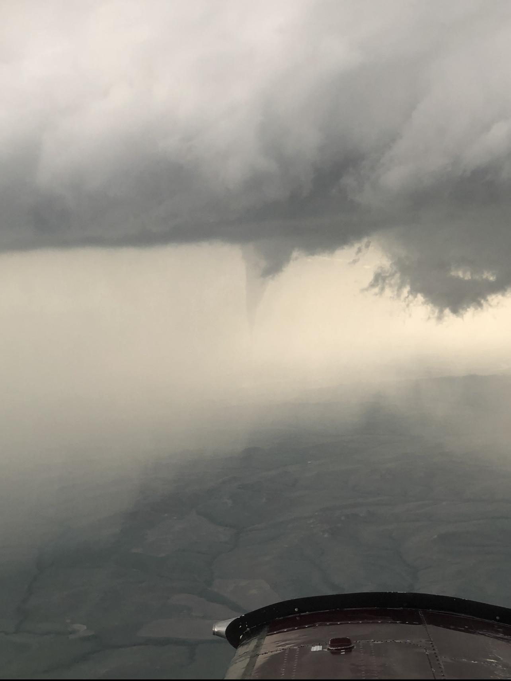
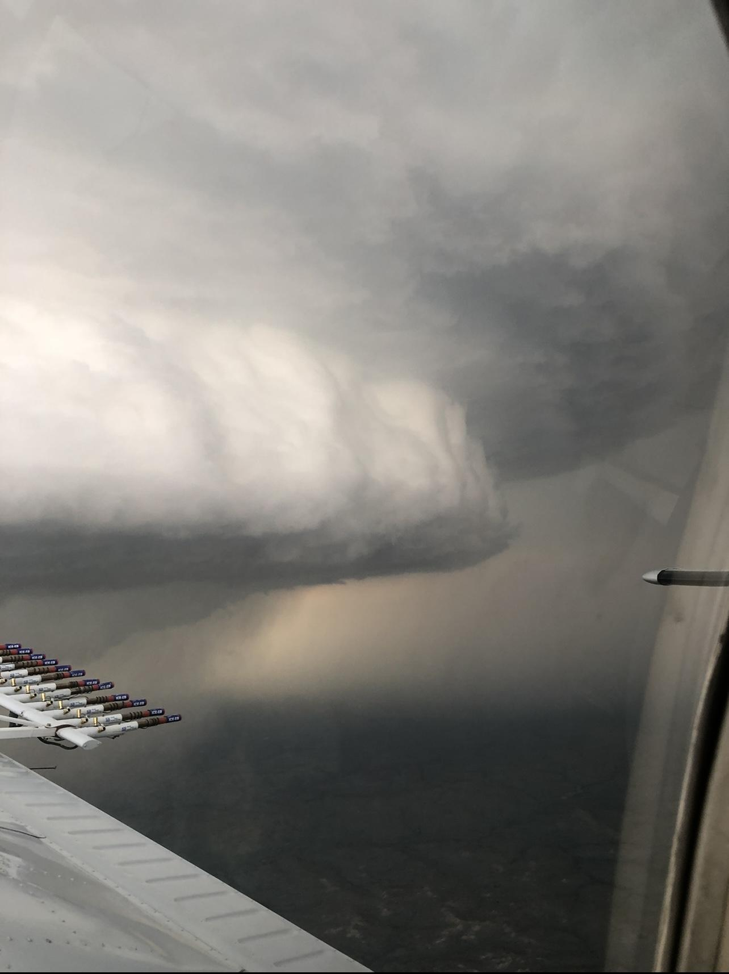
Notes:
Tornado and wall cloud

Slide 6
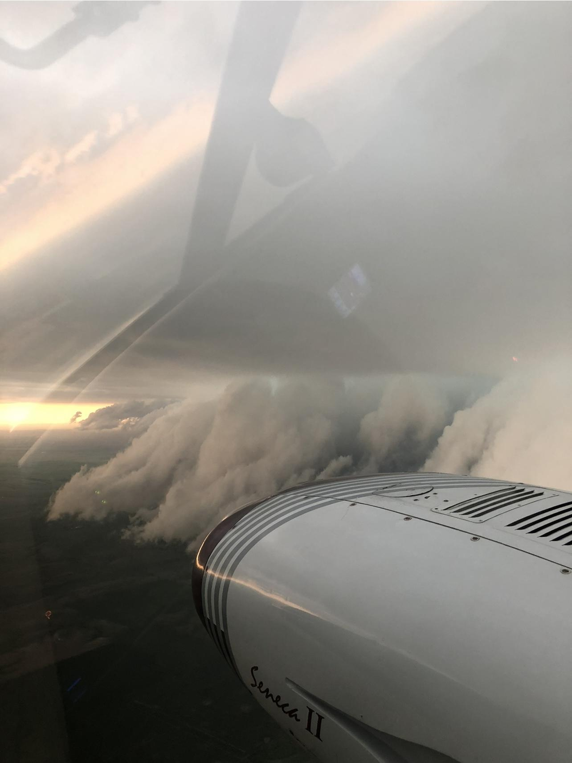
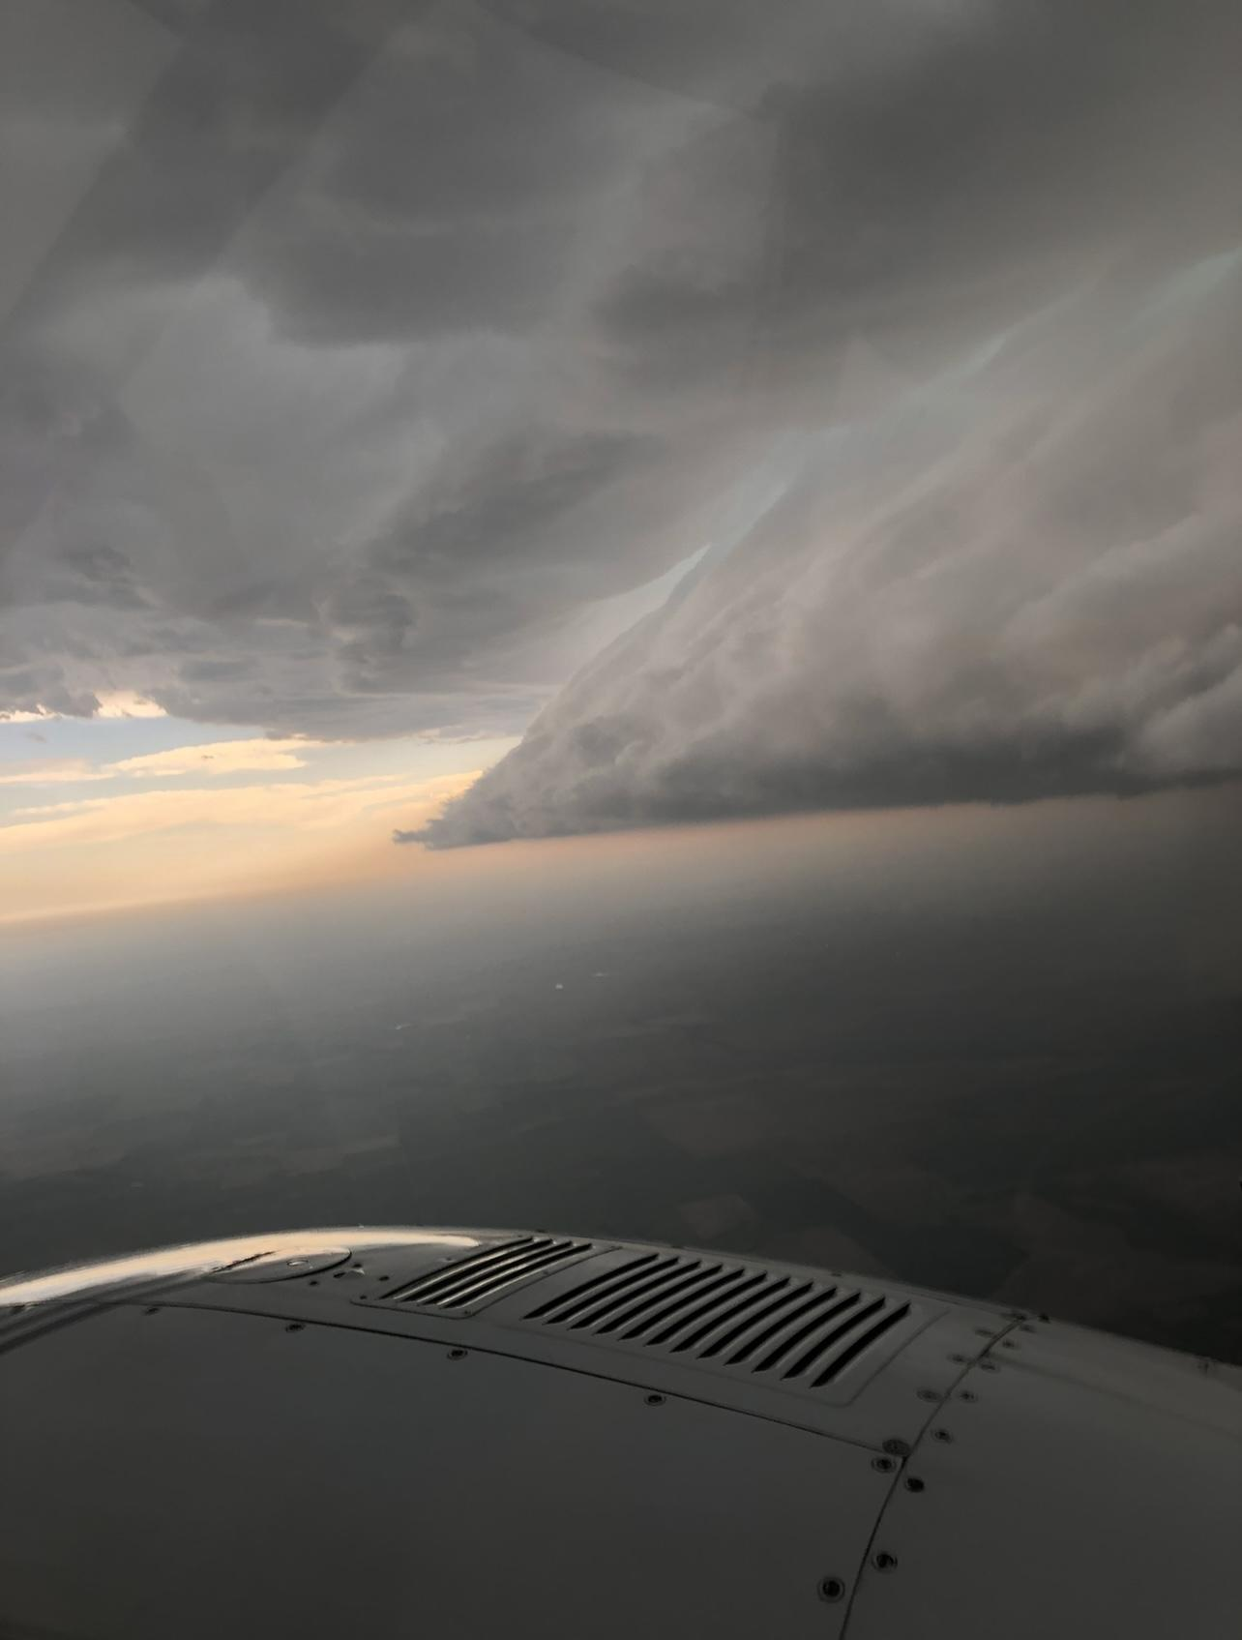
Notes:
Great inflow wedge on the right, Scud below the base on the left

Slide 7
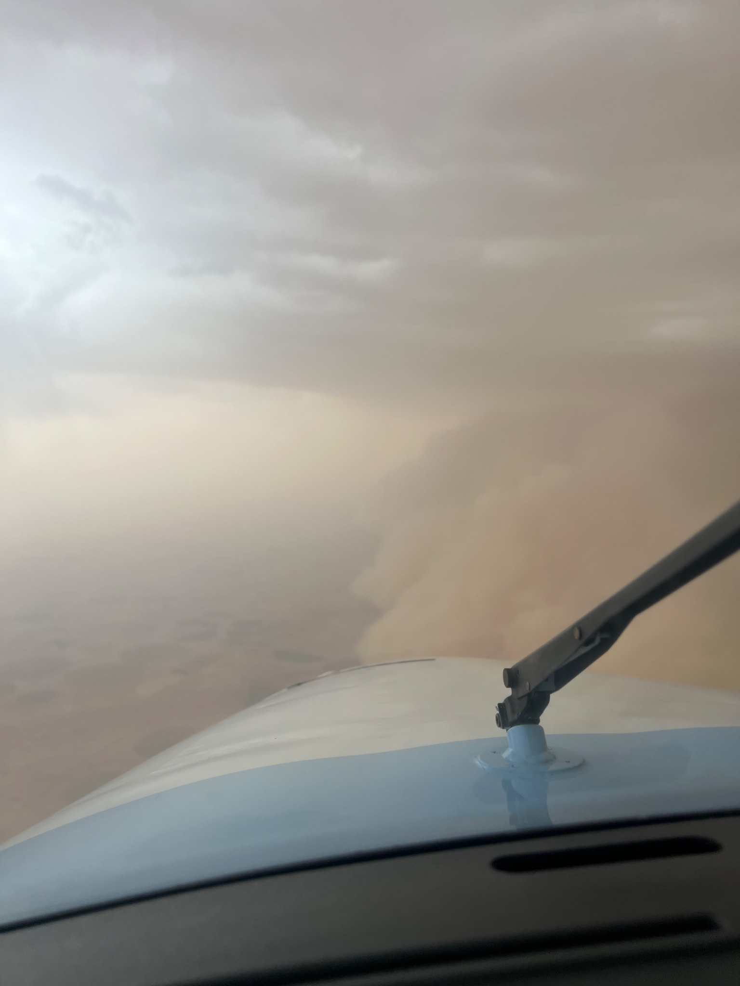
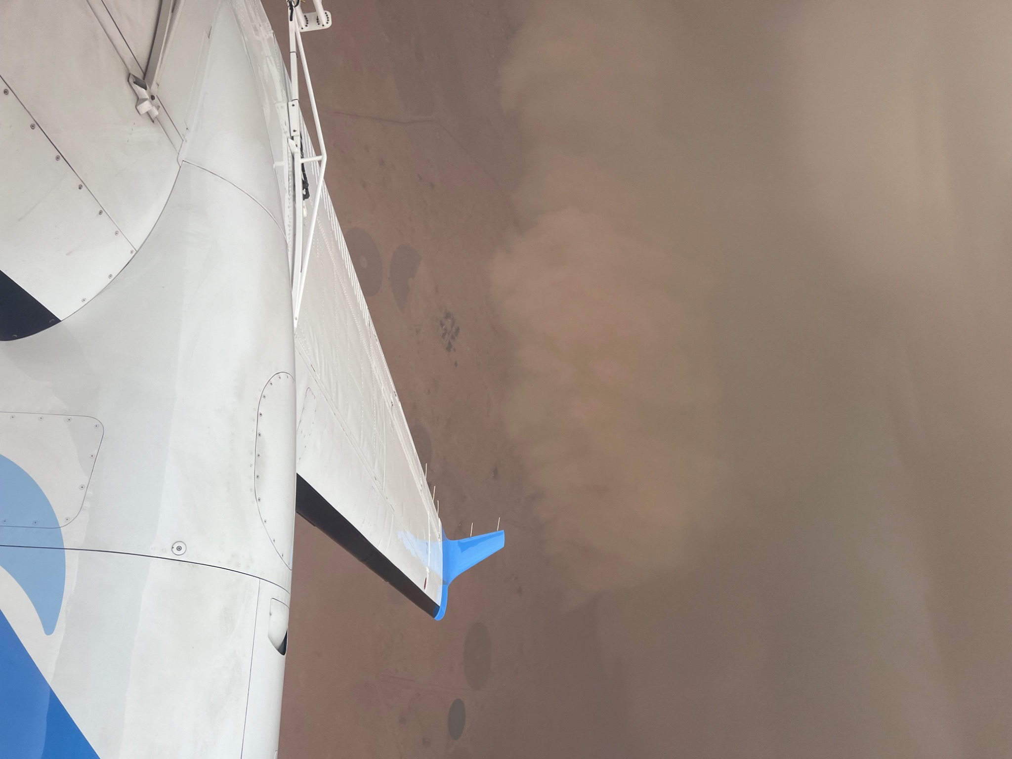
Notes:
Haboob in saudi. Storm is lifting sand and sucking it up into the atmosphere

Slide 8
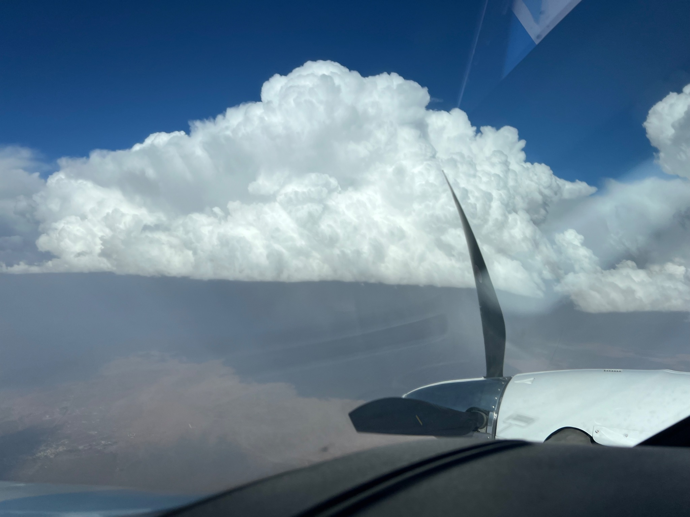
Notes:
Best defined base I have ever seen

Slide 9
Top Seeding

Slide 10
Notes:
Large line of cells developing along the Escarpment in SW Saudi, It is caused by orographic lifting over the mountains.

Slide 11
Notes:
Flying at the -10 C level, this is what we are looking for for clouds. Sharp, defined “crispy” clouds.

Slide 12
Notes:
Mamatus and seedable targets on the left, shows the randomness of the cells on the right.

Slide 13
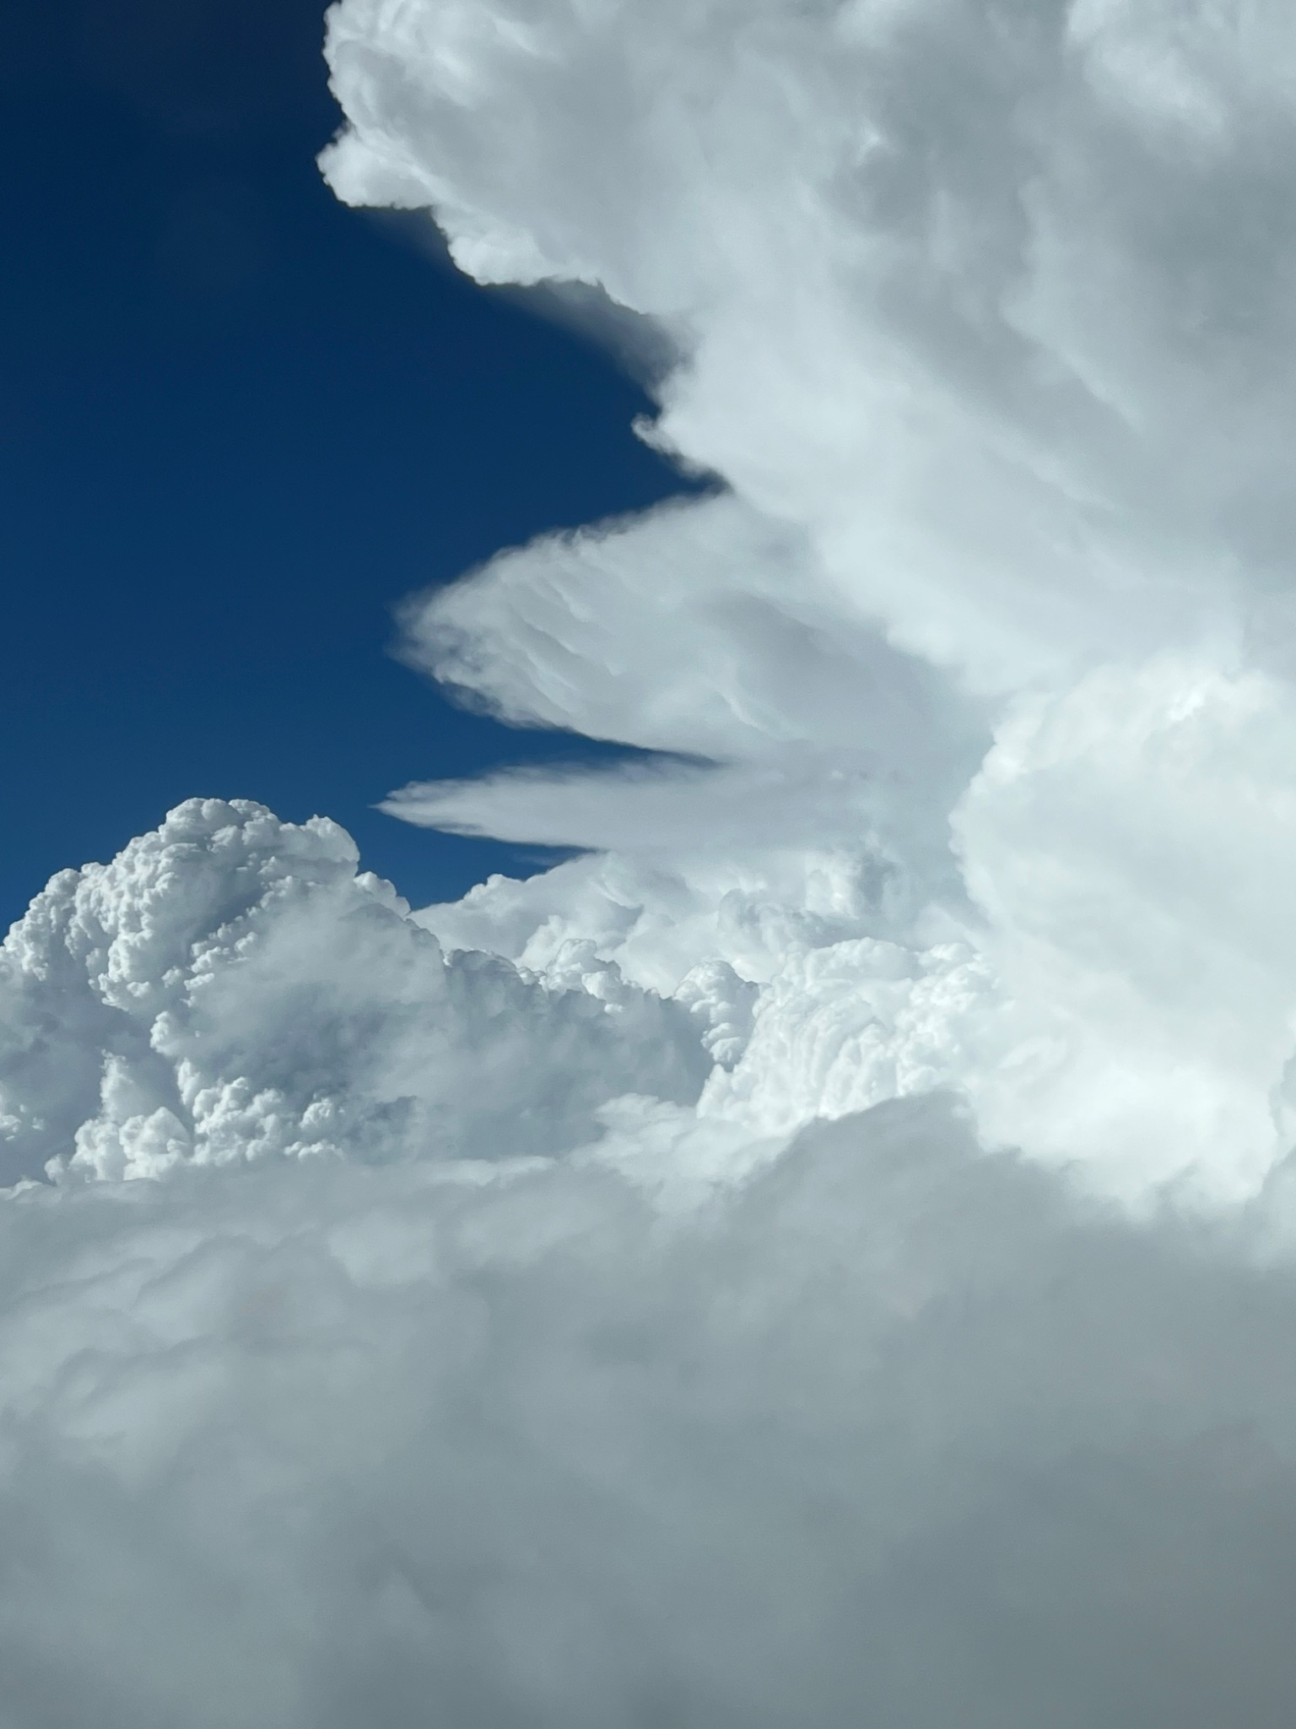
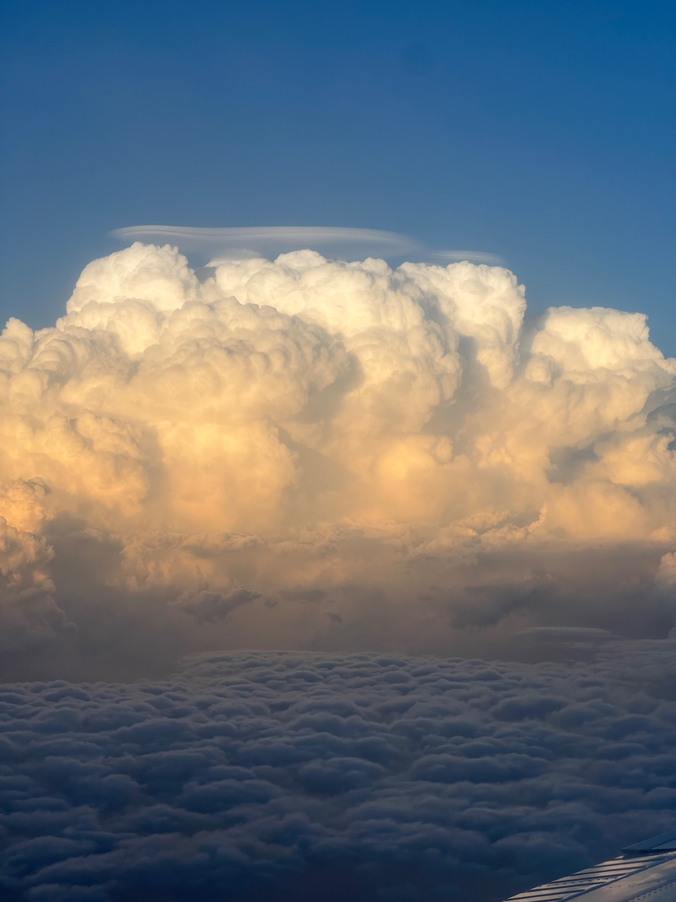

Slide 14
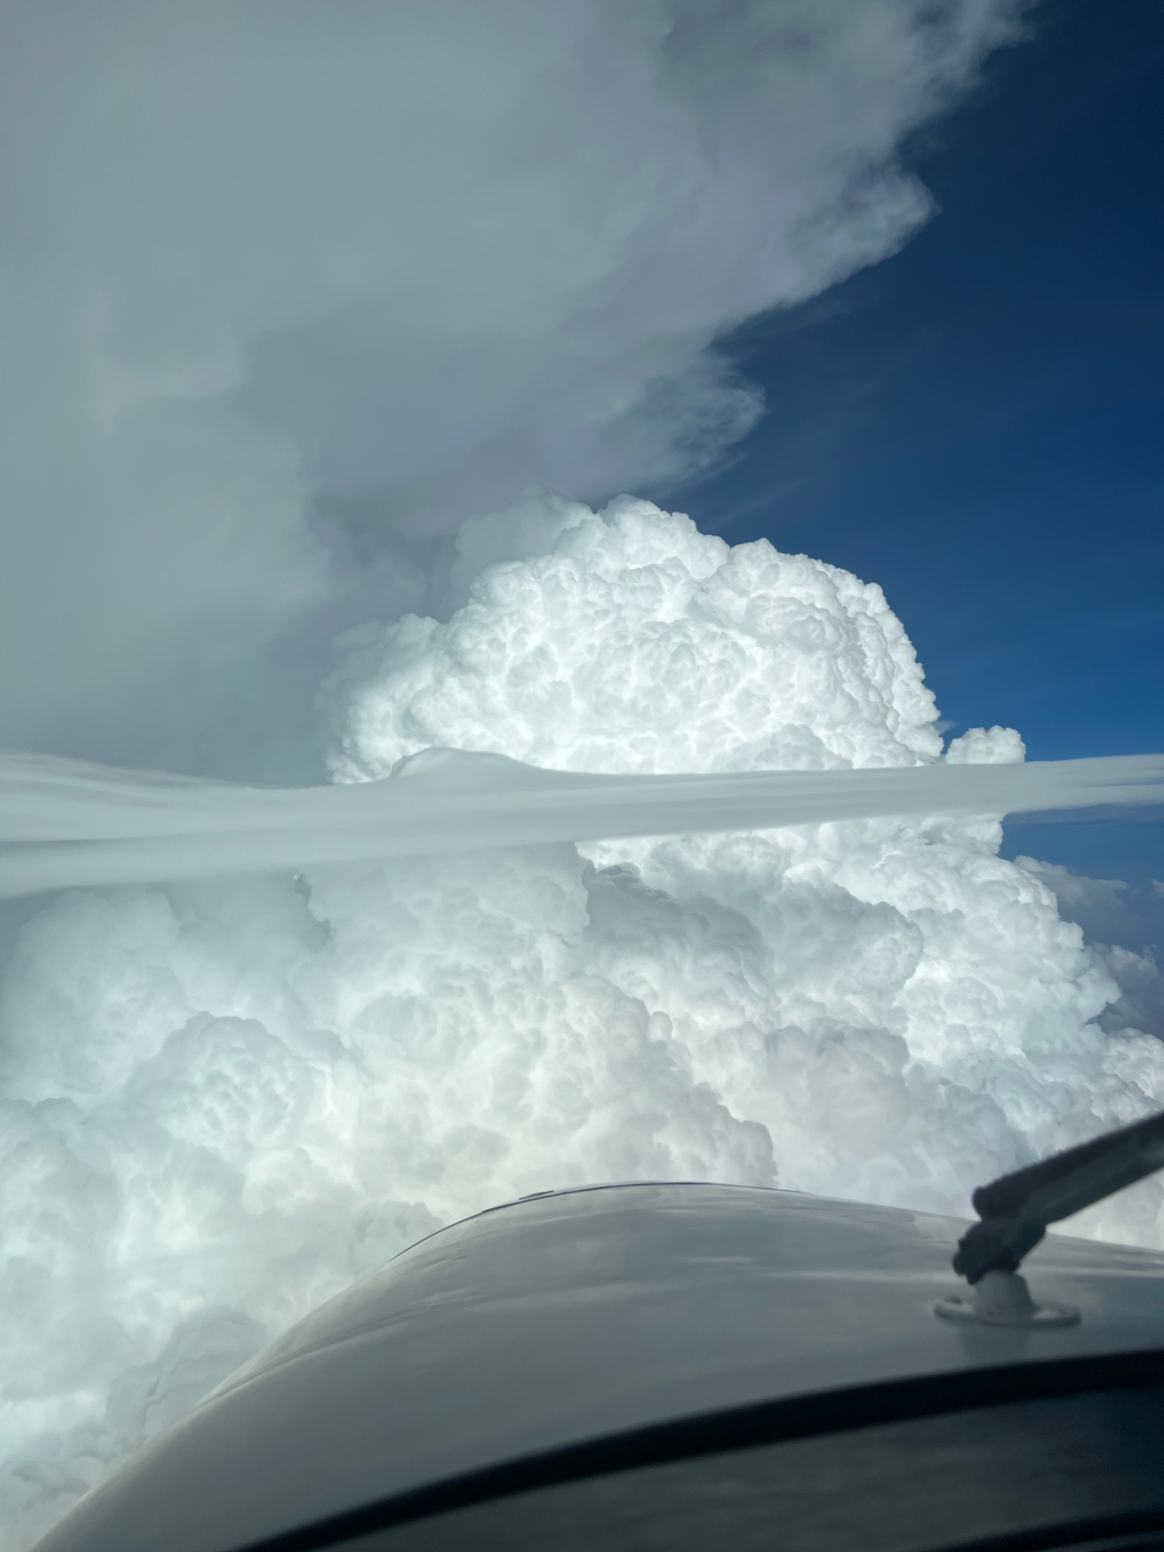

Slide 15
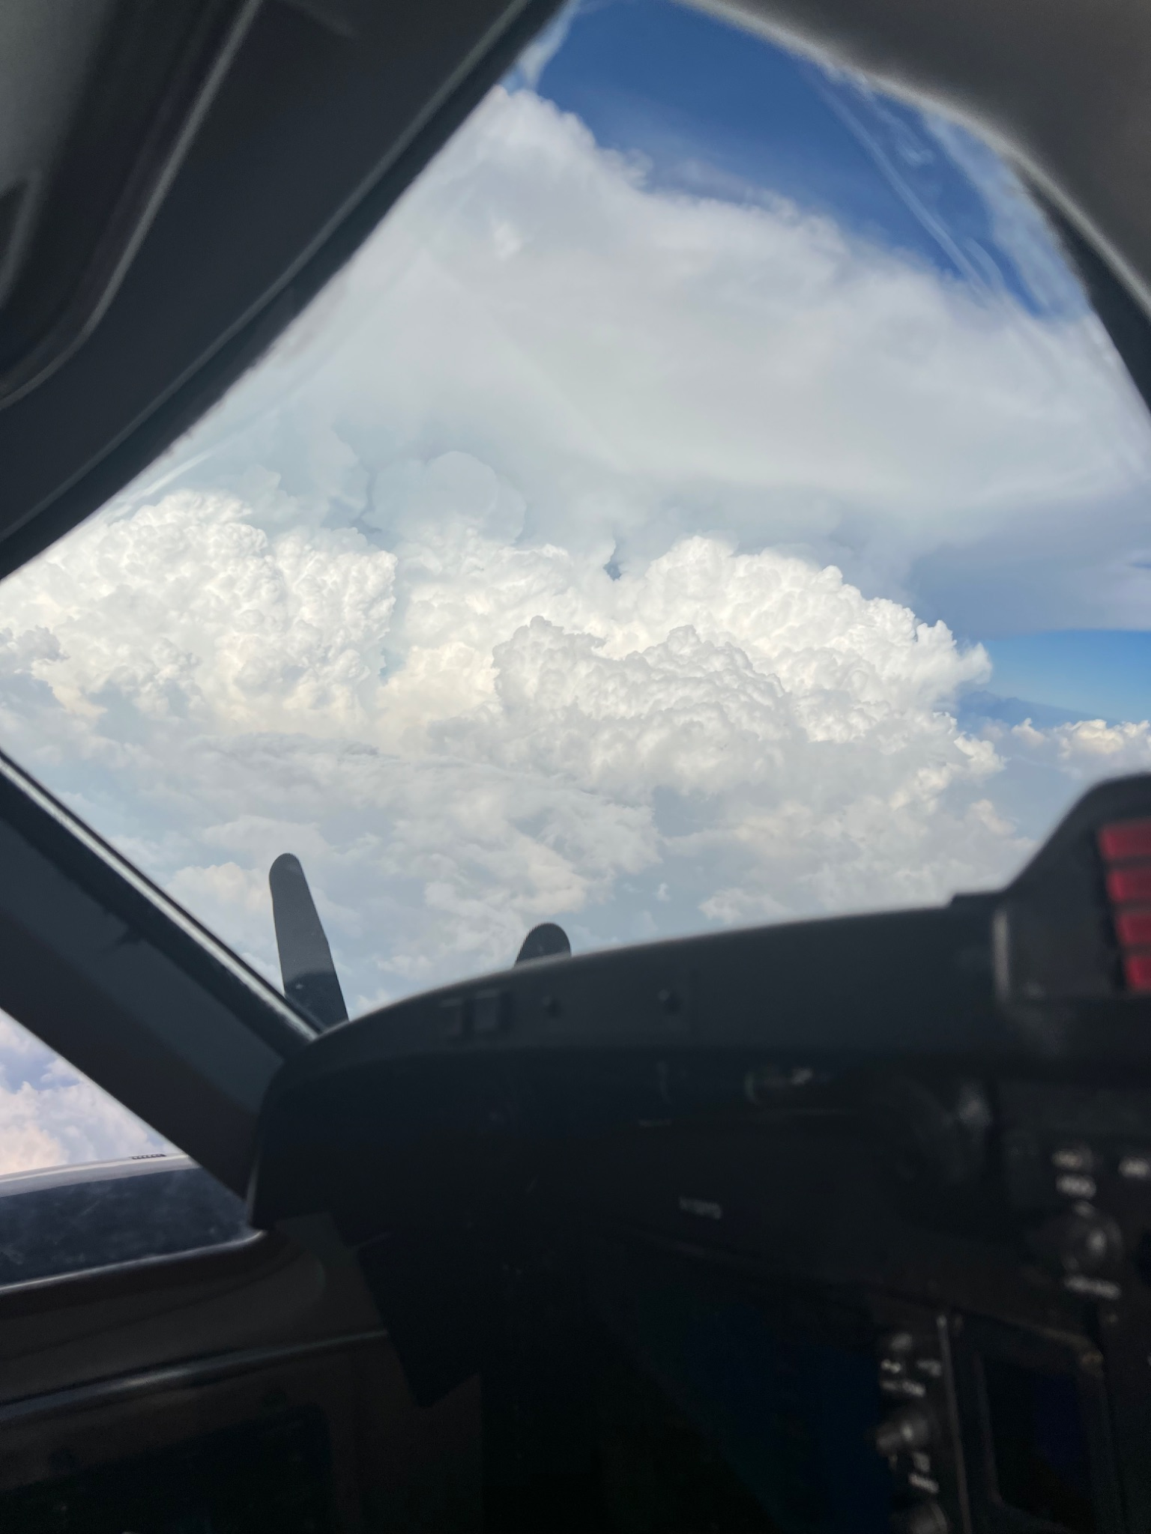
Notes:
Storm on the right had tops near 75,000ft. The feeders were at 25,000

