Slide 1
Characterization of Liquid Smoke by Size Distribution and Kappa Values
Alexa Otto
University of North Dakota
Atmospheric Science Senior Project
3/27/19

Slide 2
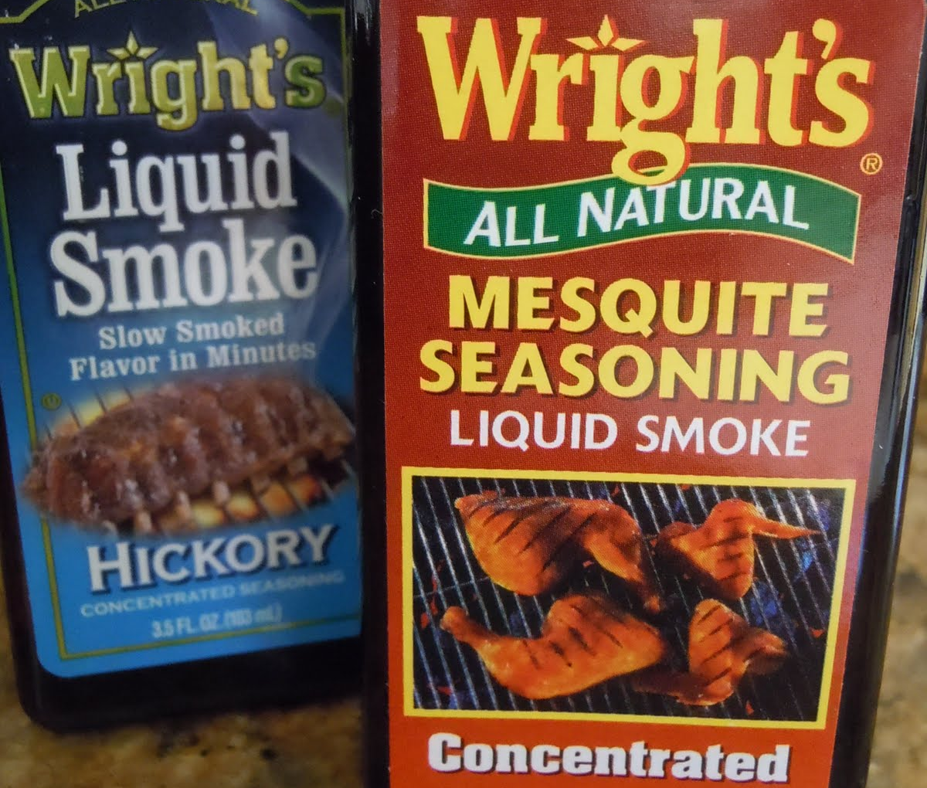
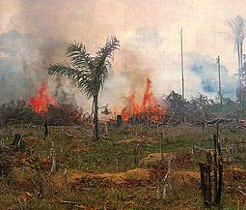
Motivation
No standard for biomass burning
Previous experiments had to burn actual biomass in lab to get results
Fresh biomass has complex hygroscopic behaviors.
Liquid smoke potential proxy

Slide 3
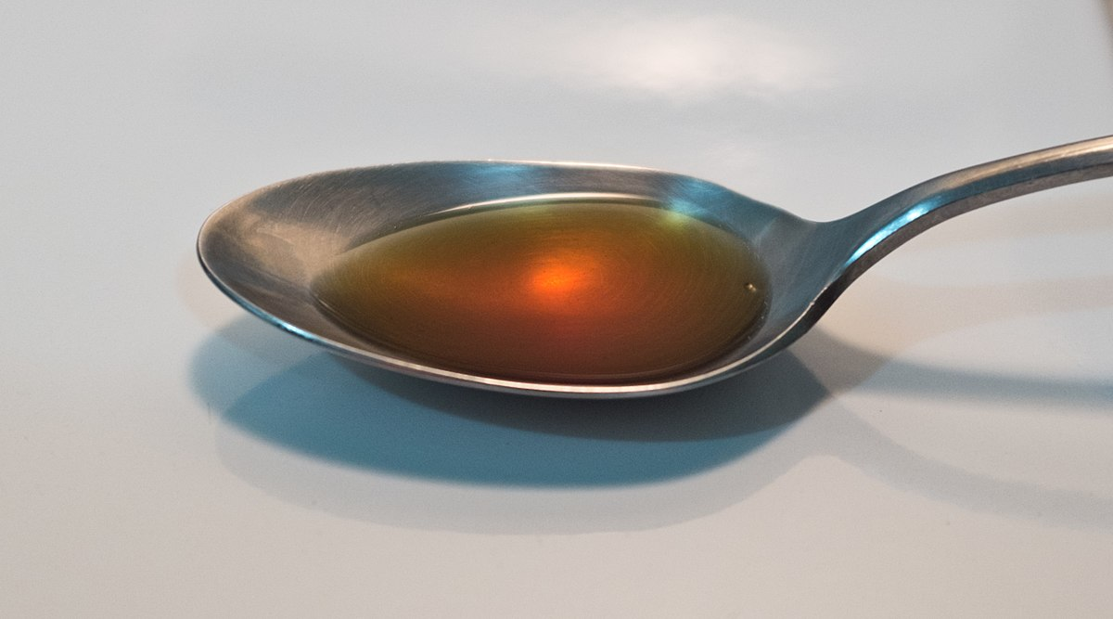
Background
Liquid smoke production
Uses
Flavor enhancer
Preservative
Brand used in this experiment: Wright’s Mesquite
Data collection at Michigan Technological University (May – June, 2018)
Notes:
Liquid smoke is made by burning biomass usually a type of wood with limited oxygen and the condensate is washed off of the walls in the burn unit and refined

Slide 4
Objectives for research
Determine the Size Distribution of Liquid Smoke
1

Slide 5
Objectives for research
Determine the Size Distribution of Liquid Smoke
1
Calculate the Kappa values for Liquid Smoke
2

Slide 6
What are kappa values?
A hygroscopicity parameter that relates dry diameter of a particle and the cloud condensation nuclei (CCN) activity
Compound | Kappa
Sodium Chloride (NaCl) | 1.28
Sulfuric Acid (H₂SO₄) | 0.90
3:7 Organic: Inorganic material | 0.62
Ammonium Sulfate ((NH₄)₂SO₄) | 0.61
Soot | 0.00

Slide 7
Methodology
Set up lab instruments
Solution of 0.03% liquid smoke and ultra purified water
Size distribution found first to determine sample diameters for kappa values
Sample diameters run at varying supersaturation set points on CCNC
Kappa values calculated and compared

Slide 8
Set Up Size Distribution
Atomizer
Diffusional Dryer
Filter and Metering Valve
Spectral Mobility Particle Sizer (SMPS)
Electrostatic Classifier
Condensation Particle Counter (CPC)
SMPS

Slide 9
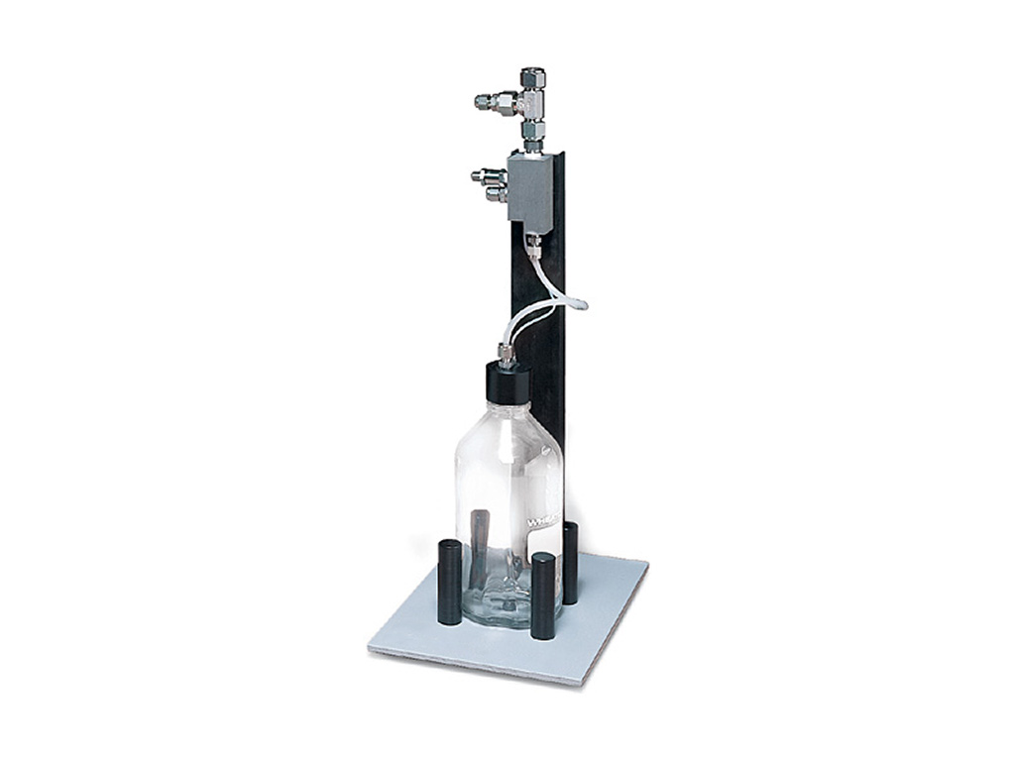
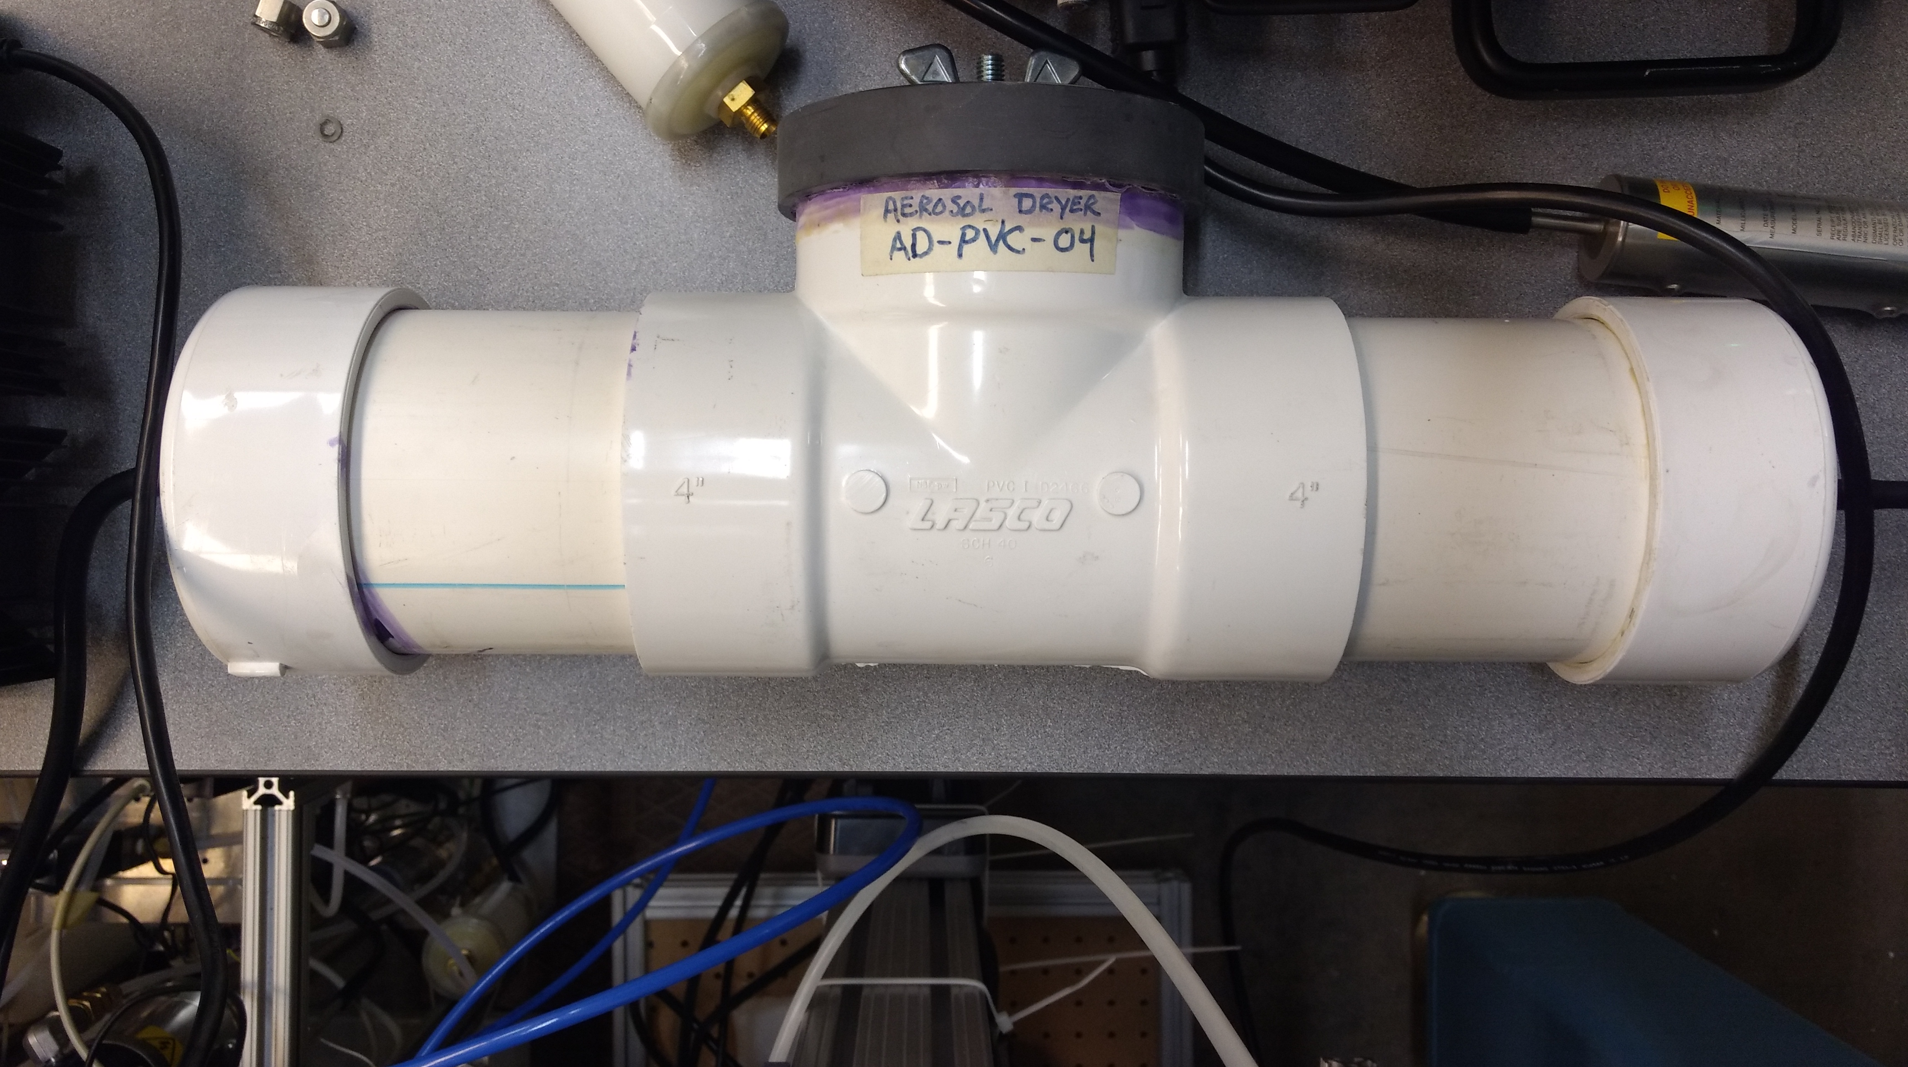
Atomizer and Diffusional Dryer
Atomizer
TSI Aerosol Generator 3076
Aerosolizes solution of liquid smoke and ultra pure water using compressed air
Diffusional Dryer
Uses Alfa Aesar molecular sieve 13X beads to dry aerosols.
Creates low relative humidity in dryer so water evaporates off of particle
https://tsi.com/aerosol-generator-3076/

Slide 10
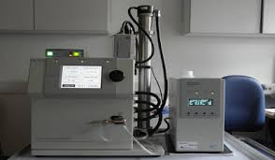
TSI Scanning Mobility Particle Sizer (SMPS)
Consists of TSI Electrostatic Classifier Model 3080
Separates particles by size using their electric mobility
https://docs.google.com/document/d/1rT6szXtwZgdUTVcDB13OgYgDgsf7aOVqElKqQKmoXkU/edit
Notes:
separates particles by size using their electric mobility, which is inversely proportional to the size of the particle and proportional to the number of charges on the particle
The CPC pulls the aerosol sample into a heated saturator where butanol vapor saturates the sample stream. A condenser cools the sample stream to create a supersaturated environment with respect to the butanol vapor. The vapor condenses onto particles and grows large enough to be counted by an optical particle counter system, which enables the model 3772 CPC to count all particles larger than 10 nm in diameter

Slide 11
TSI Scanning Mobility Particle Sizer (SMPS)
Consists of TSI Electrostatic Classifier Model 3080
Separates particles by size using their electric mobility
TSI Condensation Particle Counter (CPC) Model 3772
Counts particles larger than 10 nm diameter in sample stream
https://docs.google.com/document/d/1rT6szXtwZgdUTVcDB13OgYgDgsf7aOVqElKqQKmoXkU/edit
Notes:
separates particles by size using their electric mobility, which is inversely proportional to the size of the particle and proportional to the number of charges on the particle
The CPC pulls the aerosol sample into a heated saturator where butanol vapor saturates the sample stream. A condenser cools the sample stream to create a supersaturated environment with respect to the butanol vapor. The vapor condenses onto particles and grows large enough to be counted by an optical particle counter system, which enables the model 3772 CPC to count all particles larger than 10 nm in diameter

Slide 12
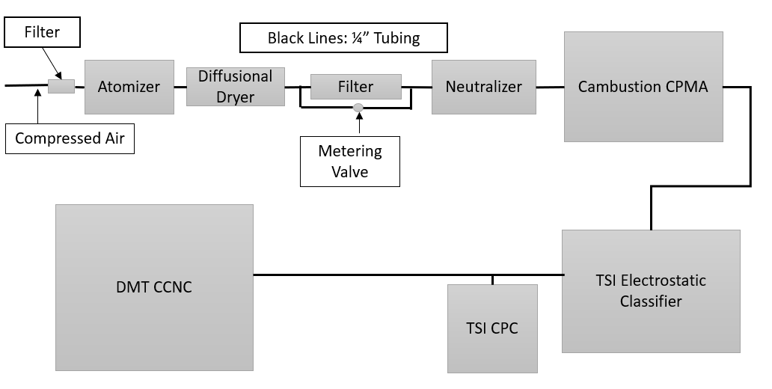
Set Up Kappa Values
ADDED:
Centrifugal Particle Mass Analyzer (CPMA)
Cloud Condensation Nuclei Counter (CCNC)

Slide 13
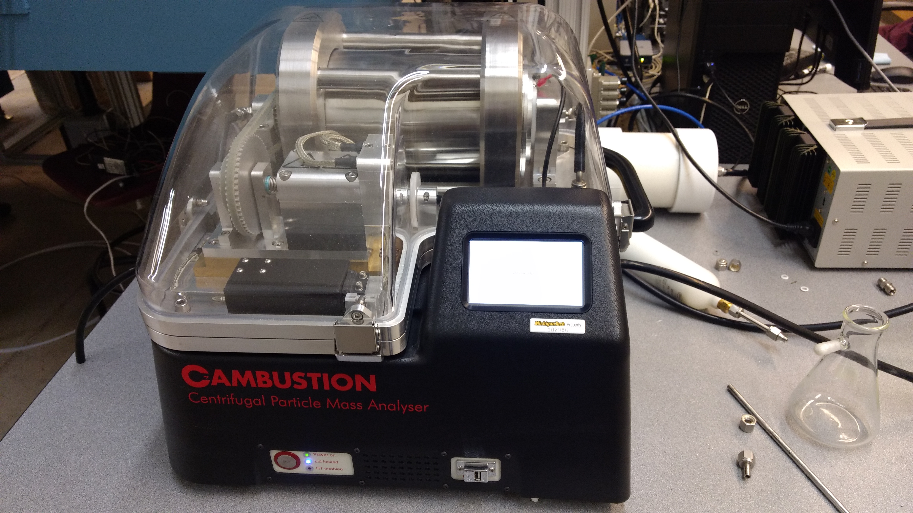
Cambustion Centrifugal Particle MASS ANALYZER (CPMA)
Classifies particles by their mass to charge ratio
Utilizes opposite electrical and centrifugal fields to classify aerosols
Notes:
To select different masses, the electrical field and rotation speed can be varied

Slide 14
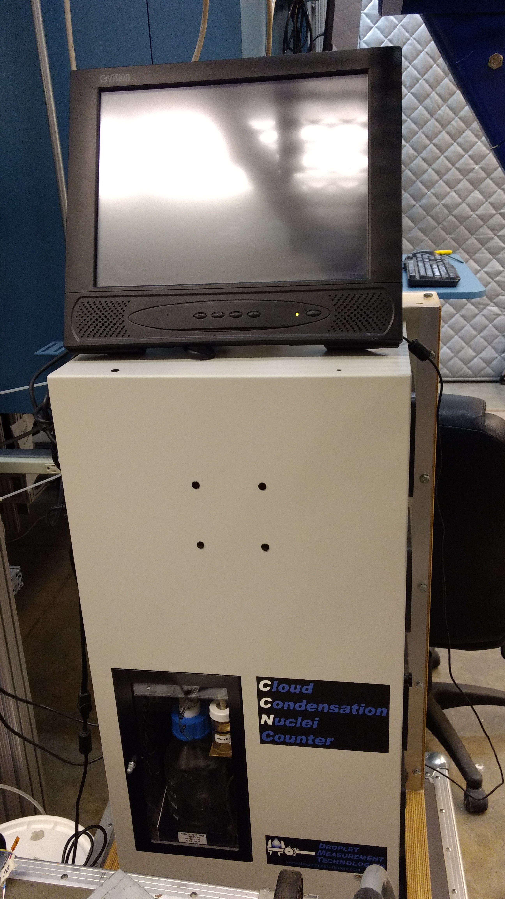
DMT Cloud Condensation Nuclei Counter (CCNC)
Measure cloud condensation nuclei (CCN) concentration
Creates a supersaturated environment using a temperature gradient in a vertical column

Slide 15
Size Distribution
Peak at 40 nm so set points determined to be: 40.0, 55.2, 71.0, 85.0, 98.2 nm

Slide 16
Supersaturation Set Points for Diameters
Diameter | Supersaturation% Set Points
40.0 nm | 0.10, 0.15, 0.24, 0.30, 0.34, 0.37, 0.45, 0.50, 0.52, 0.55, 0.57, 0.60, 0.70, 0.80, 0.90, 1.0
55.2 nm | 0.10, 0.15, 0.19, 0.24, 0.30, 0.34, 0.37, 0.40, 0.45, 0.50, 0.60, 0.70, 0.80, 0.90
71.0 nm | 0.10, 0.15, 0.19, 0.24, 0.30, 0.34, 0.37, 0.40, 0.45, 0.50, 0.60, 0.70, 0.80, 0.90
85.0 nm | 0.11, 0.15, 0.17, 0.18, 0.19, 0.24, 0.30, 0.34, 0.37, 0.40, 0.45, 0.50, 0.60
98.2 nm | 0.10, 0.13, 0.14, 0.15, 0.16, 0.18, 0.19, 0.24, 0.30, 0.40, 0.45, 0.50, 0.60, 0.70
Varying set points in order to catch activation point (where ratio of aerosols becoming CCN to those going in is 50%)

Slide 17
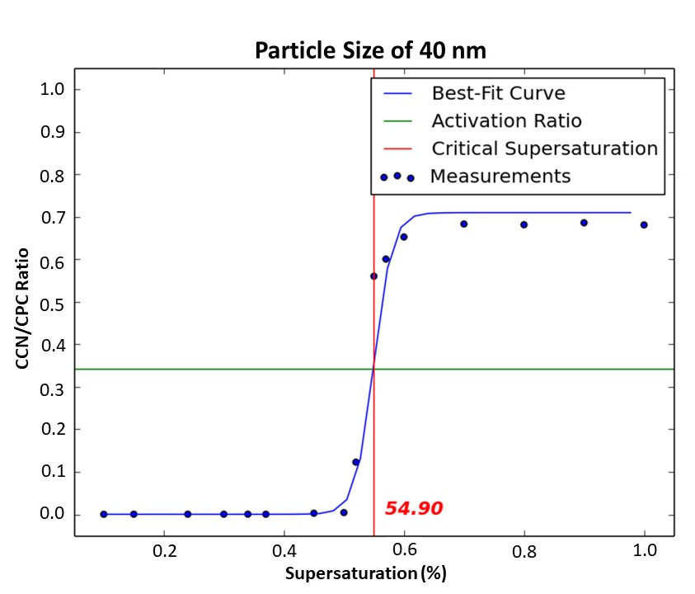
Kappa Value Analysis
Data processed using Airborne Data Processing and Analysis (ADPAA)
Sigmoid fit to data using ADPAA to get critical supersaturation (half point) for kappa calculations
0.549

Slide 18
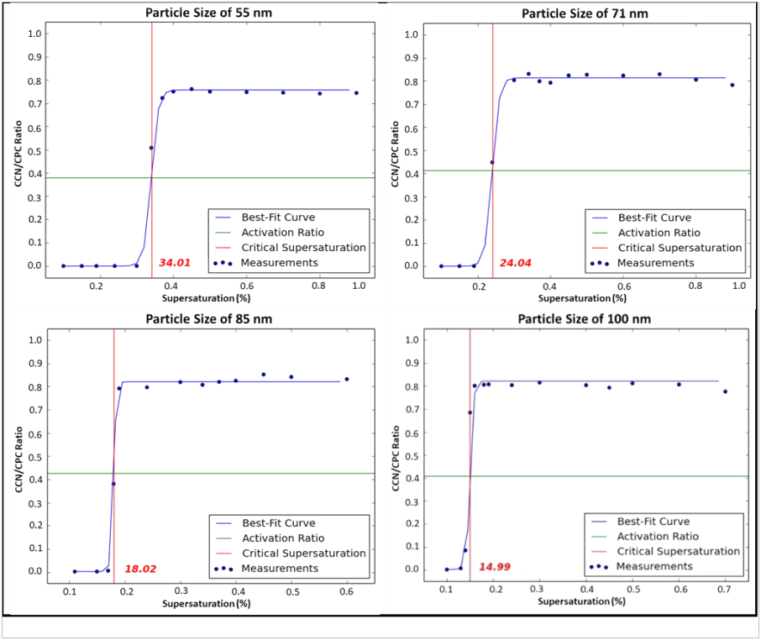
0.340
0.240
0.180
0.150

Slide 19
Kappa Value Analysis
Kappa value calculated using the dry diameter of the particle and critical supersaturation
$$\left.κ=\left(4A^{3}\right)÷(27Ds^{3}(\ln\left(Sc\right))^{2}\right)$$
κ$=Kappa$
$Ds=Dry Diameter$ (m)
$$T=Temperature (K)$$
$$Sc=Saturation Ratio of Critical Supersaturation$$

Slide 20
Kappa Value Results
Found the average kappa value for liquid smoke is 0.81 +/- 0.042
Diameter | Kappa
40.0 nm | 0.88
55.2 nm | 0.84
71.0 nm | 0.78
85.0 nm | 0.81
98.2 nm | 0.76

Slide 21
Kappa Value Results
Compound | Soot | Ammonium Sulfate ((NH4)2SO4) | 3:7 Organic: Inorganic Material | Liquid Smoke | Sulfuric Acid (H2SO4) | Sodium Chloride (NaCl)
Kappa | 0.00 | 0.61 | 0.62 | 0.81 | 0.90 | 1.28
Compared to other compounds it is more hygroscopic than ammonium sulfate but less than sulfuric acid.

Slide 22
Possible Errors
High kappa values from inefficient drying

Slide 23
Conclusion
Size distribution and kappa values successfully found
Kappa values range from 0.76 to 0.87
Average kappa value is 0.81 +/- 0.042
Slightly higher than expected kappa values
Further testing needs to be done

Slide 24
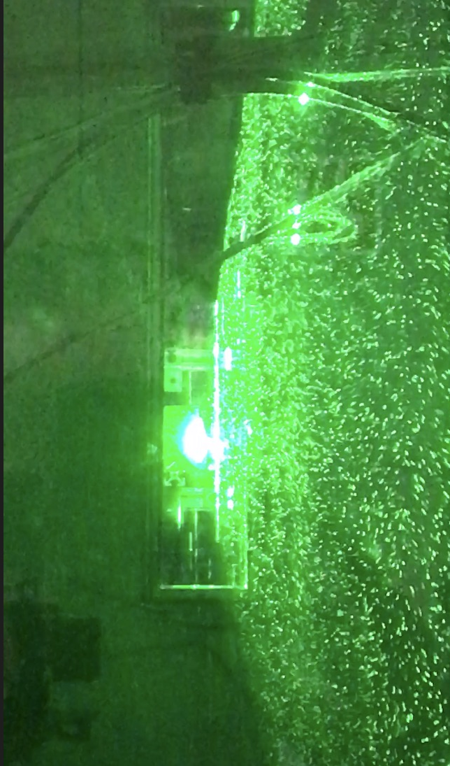
Future Research
Determine chemical composition of Wright’s Mesquite liquid smoke
Test in the PI Cloud Chamber to look at how it interacts with the “atmosphere”

Slide 25
Acknowledgements
Funding for this project provided by the National Institute of Health
Special Thanks to:
Senior Project committee advisors
- Dr. David Delene
- Michael Poellot
Project Advisor at Michigan Technological University
- Dr. William Cantrell

Slide 26
Selected References
Rose, D., S. S. Gunthe, E. Mikhailov, G. P. Frank, U. Dusek, M. O. Andreae, and U. Poschl, 2008: Calibration and measurement uncertainties of a continuous-ﬂow cloud condensation nuclei counter (DMT-CCNC): CCN activation of ammonium sulfate and sodium chloride aerosol particles in theory and experiment. Atmos. Chem. Phys., 27.

Slide 27
Questions?

