Slide 1
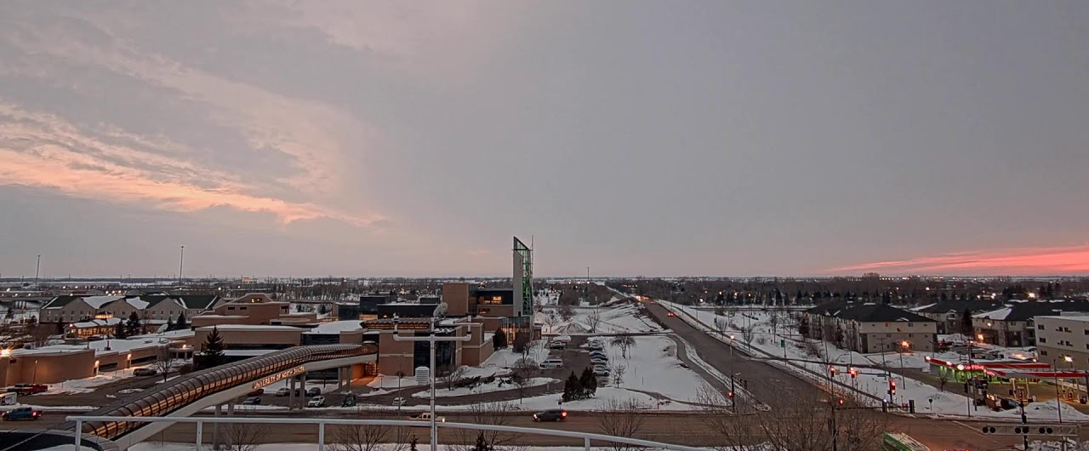
Measured Atmospheric Change In Lead Particulate Matter From UL94 Fuel Switch By Major Aerospace College
Alex Mendez
Advisor: David J. Delene, PhD

Slide 2
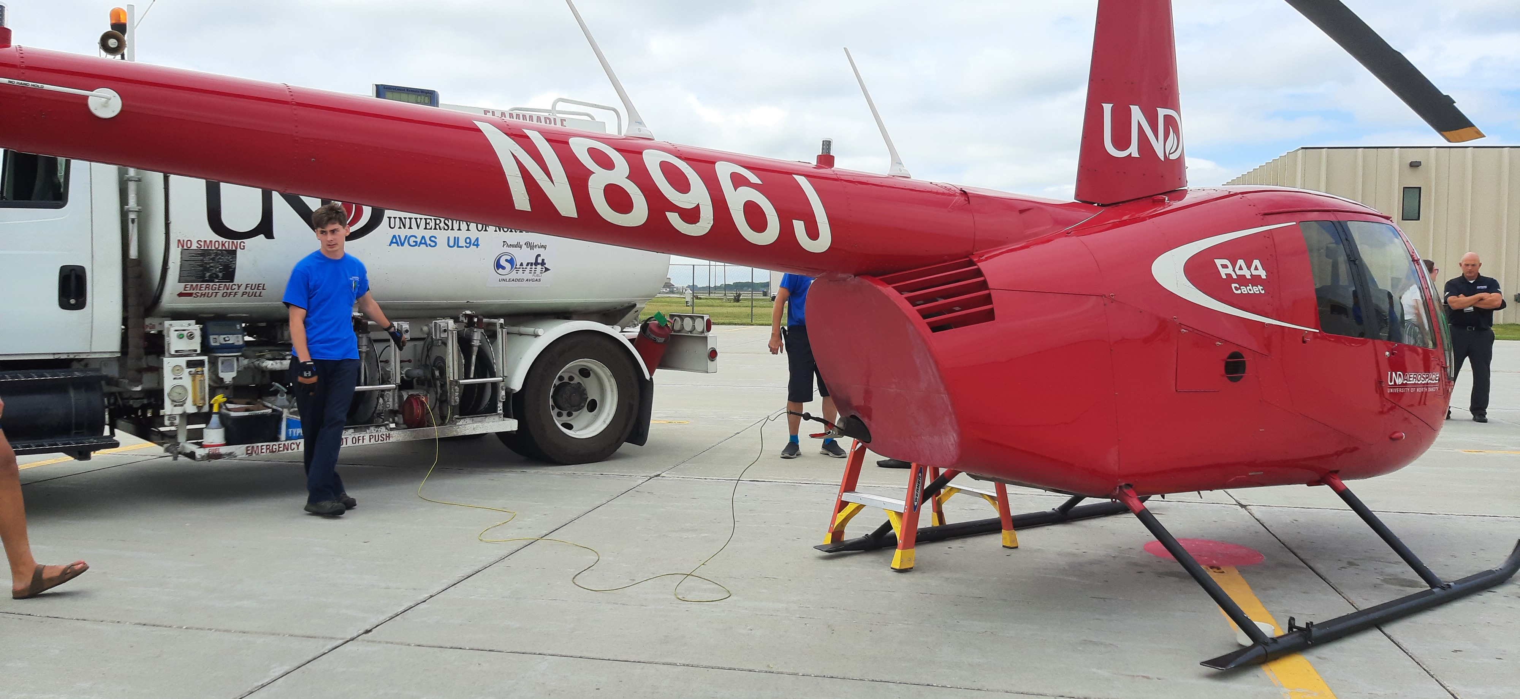
Objective
To observe lead particulate matter measurements before and after the switch from Low Lead 100 Octane Rated Aviation Fuel (LL100) to Unleaded 94 Octane Rated Unleaded Fuel (UL94).
To gain quantification of the amount of lead pollutants within local, airport environment in order to begin discussion on unleaded fuel adaption in general aviation.
Figure 1. Unleaded 94 Octane Rated Aviation Fuel being added to a helicopter at UND Aerospace.
2

Slide 3
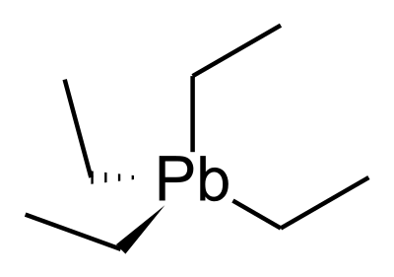
Low Lead 100 Octane Rated Aviation Fuel (LL100)
Most used leaded piston engine aircraft fuel.
Used due to its ability to increase octane rating; makes fuel more stable to resist compression and prevent spontaneous combustion.
Contains Tetra-ethyl-lead (TEL), an additive used to prevent engine damage at high power settings.
Tetra-ethyl-Lead (TEL)
3

Slide 4
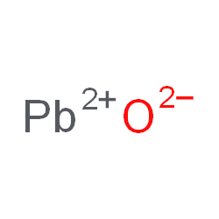
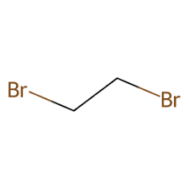
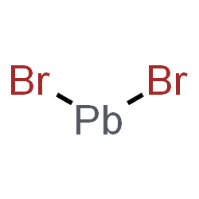
Tetra-ethyl-lead (TEL)
Naturally degrades to lead oxide as its burned.
Lead oxide is a solid up to 900 °C, deposits will form inside piston engine.
A leaded compound, Ethylene Dibromide, is added to the fuel to react with lead oxide in order to prevent these deposits from forming.
Lead oxide
Ethylene Dibromide
Lead oxide
Tetra-ethyl-Lead (TEL)
Lead (ll) Bromide
4

Slide 5
Lead Transport Within The Environment
Lead will evolve/exist into lead(ll) ion, as well as lead compounds will exist in atmosphere.
Will travel long distances in the air before going into the soil and possibly ground water depending on the lead compound and characteristics of the soil.
Sources of exposure is expensive to remediate.
Figure 2. Lead Transported and Deposited from source. Figure provided by Environmental Protection agency.
5

Slide 6
The Dangers Of Lead
Physiologically-relevant metal ions (e.g., Ca2+, Mg, Zn, Fe) are known be majorly involved within functions in biological systems.
When exposed to lead, lead ultimately interferes with such tightly regulated processes.
This ultimately leads to negative effects on the nervous system, cardiovascular system, other organ systems and much more.
Figure 3. Representation of the effects of lead in the human body. Figure provided by Environmental Protection agency
6

Slide 7
General Aviation
Direct emission of lead into the atmosphere is mainly caused by piston-powered engine aircrafts, fuel combustion, and industrial activities.
Piston engine aircraft (general aviation) produced 58% of lead emissions, which is around 550 tons.
Emissions were comprised of 254 tons of Pb from emissions at or near airports and 296 tons of Pb emitted in flight (i.e., outside the landing and take-off cycles).
Figure 4. Lead emission from stationary and mobile source (1990-2008). Figure provided by Environmental Protection agency
7

Slide 8
Why UL94 Hasn’t Been Used Yet?
The older piston powered engine aircrafts with low temperature sparkplugs systems are simply not able to operate on unleaded fuel.
Newer built aircrafts are built to operate with unleaded aviation fuel.
FFA has authorized the use of 100 and 94 Octane rated unleaded aviation fuel.
Yet, the lack of quantification on this matter prevents the transition of unleaded aviation fuel usage in general aviation.
https://www.faa.gov
8

Slide 9
Approach To The Issue
Aerospace college switched from 100LL to UL94 Transition period began June 23rd and lasted for a week.
Observed Lead particulate matter measurements before and after the switch by using particle filter samples.
University of North Dakota Aerospace College
9
Notes:
-A rare measurement opportunity to approach this problem is thanks to UND Aerospace.
-They will switch its entire aircraft and helicopter fleet to 94 rated octane unleaded aviation fuel.
-We will observe Lead particulate matter measurements before and after the switch to unleaded fuel by primarily using particle filter samples.

Slide 10
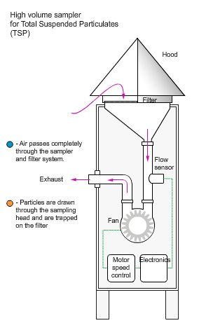
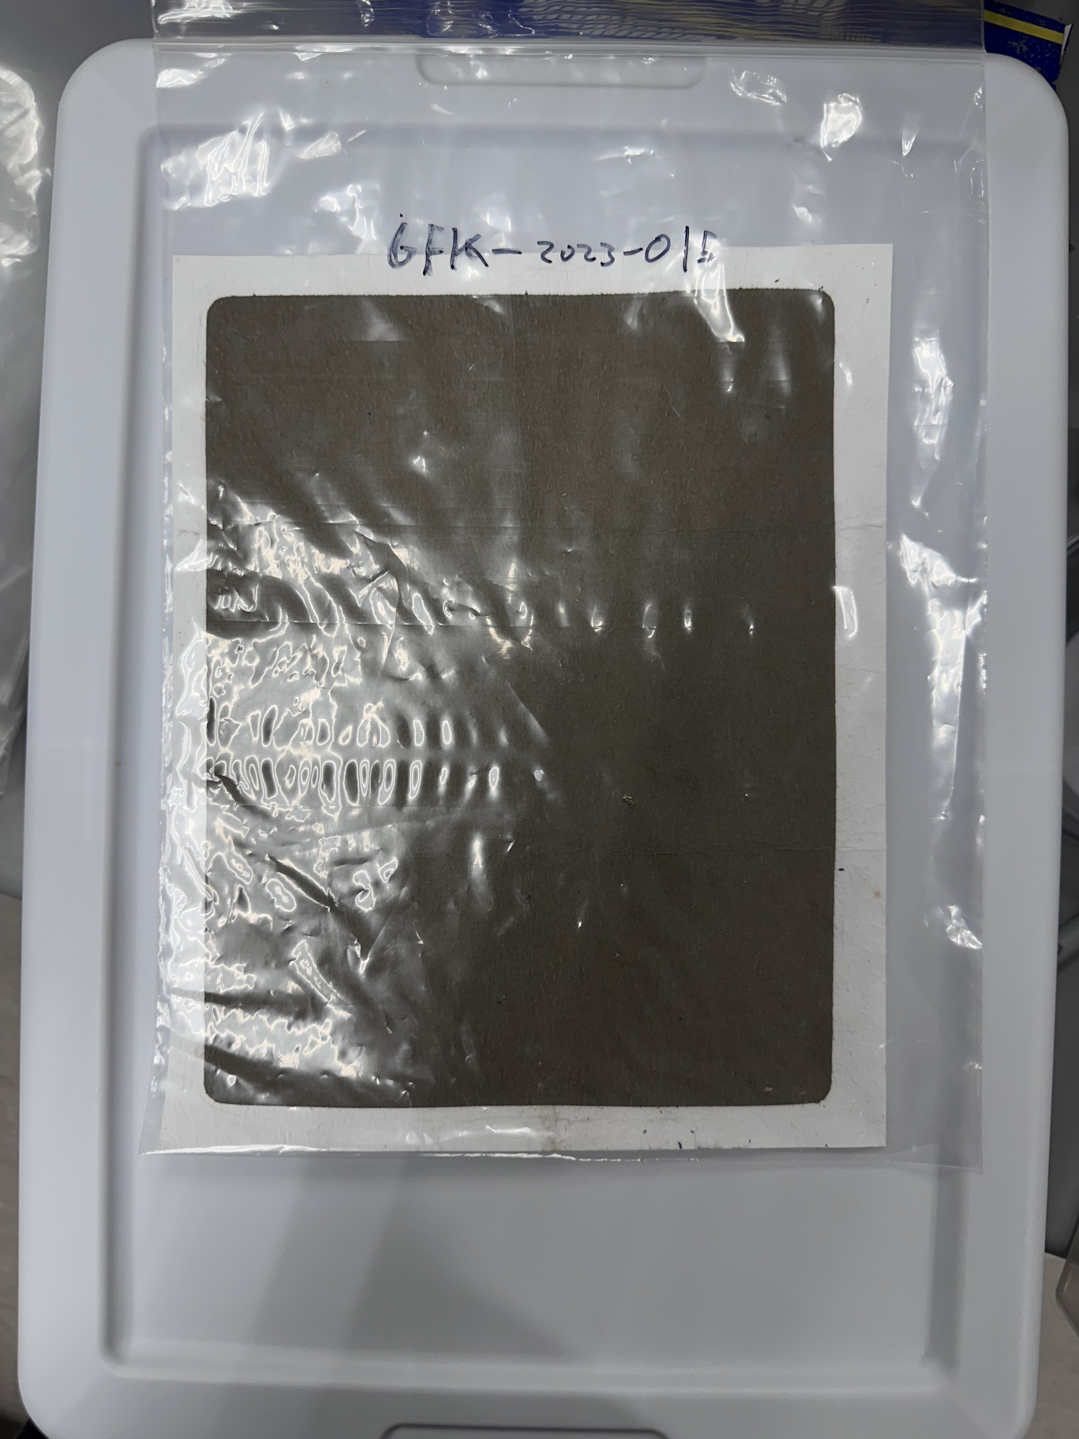
High Volume Sampler
Collects total suspend particulates (tsp) in the air.
The vacuum motors pulls ambient air onto the 8″ x 10″ glass fiber filter at a 40 cfm flow rate.
The glass fiber filters are pre and post weighed which is then used to determine the total suspended particulate matter.
Consist of 24-hour daily sample and weeklong samples.
Figure 5-6. Illustration of High-volume sample (Left). Sample with collected Aerosol mass from GFK Airport(Right).
Figure on left provided by TISCH Environmental.
10

Slide 11
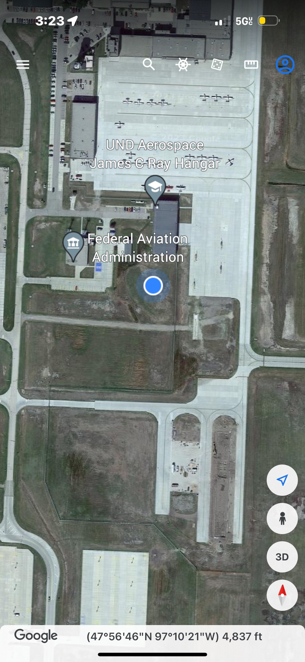
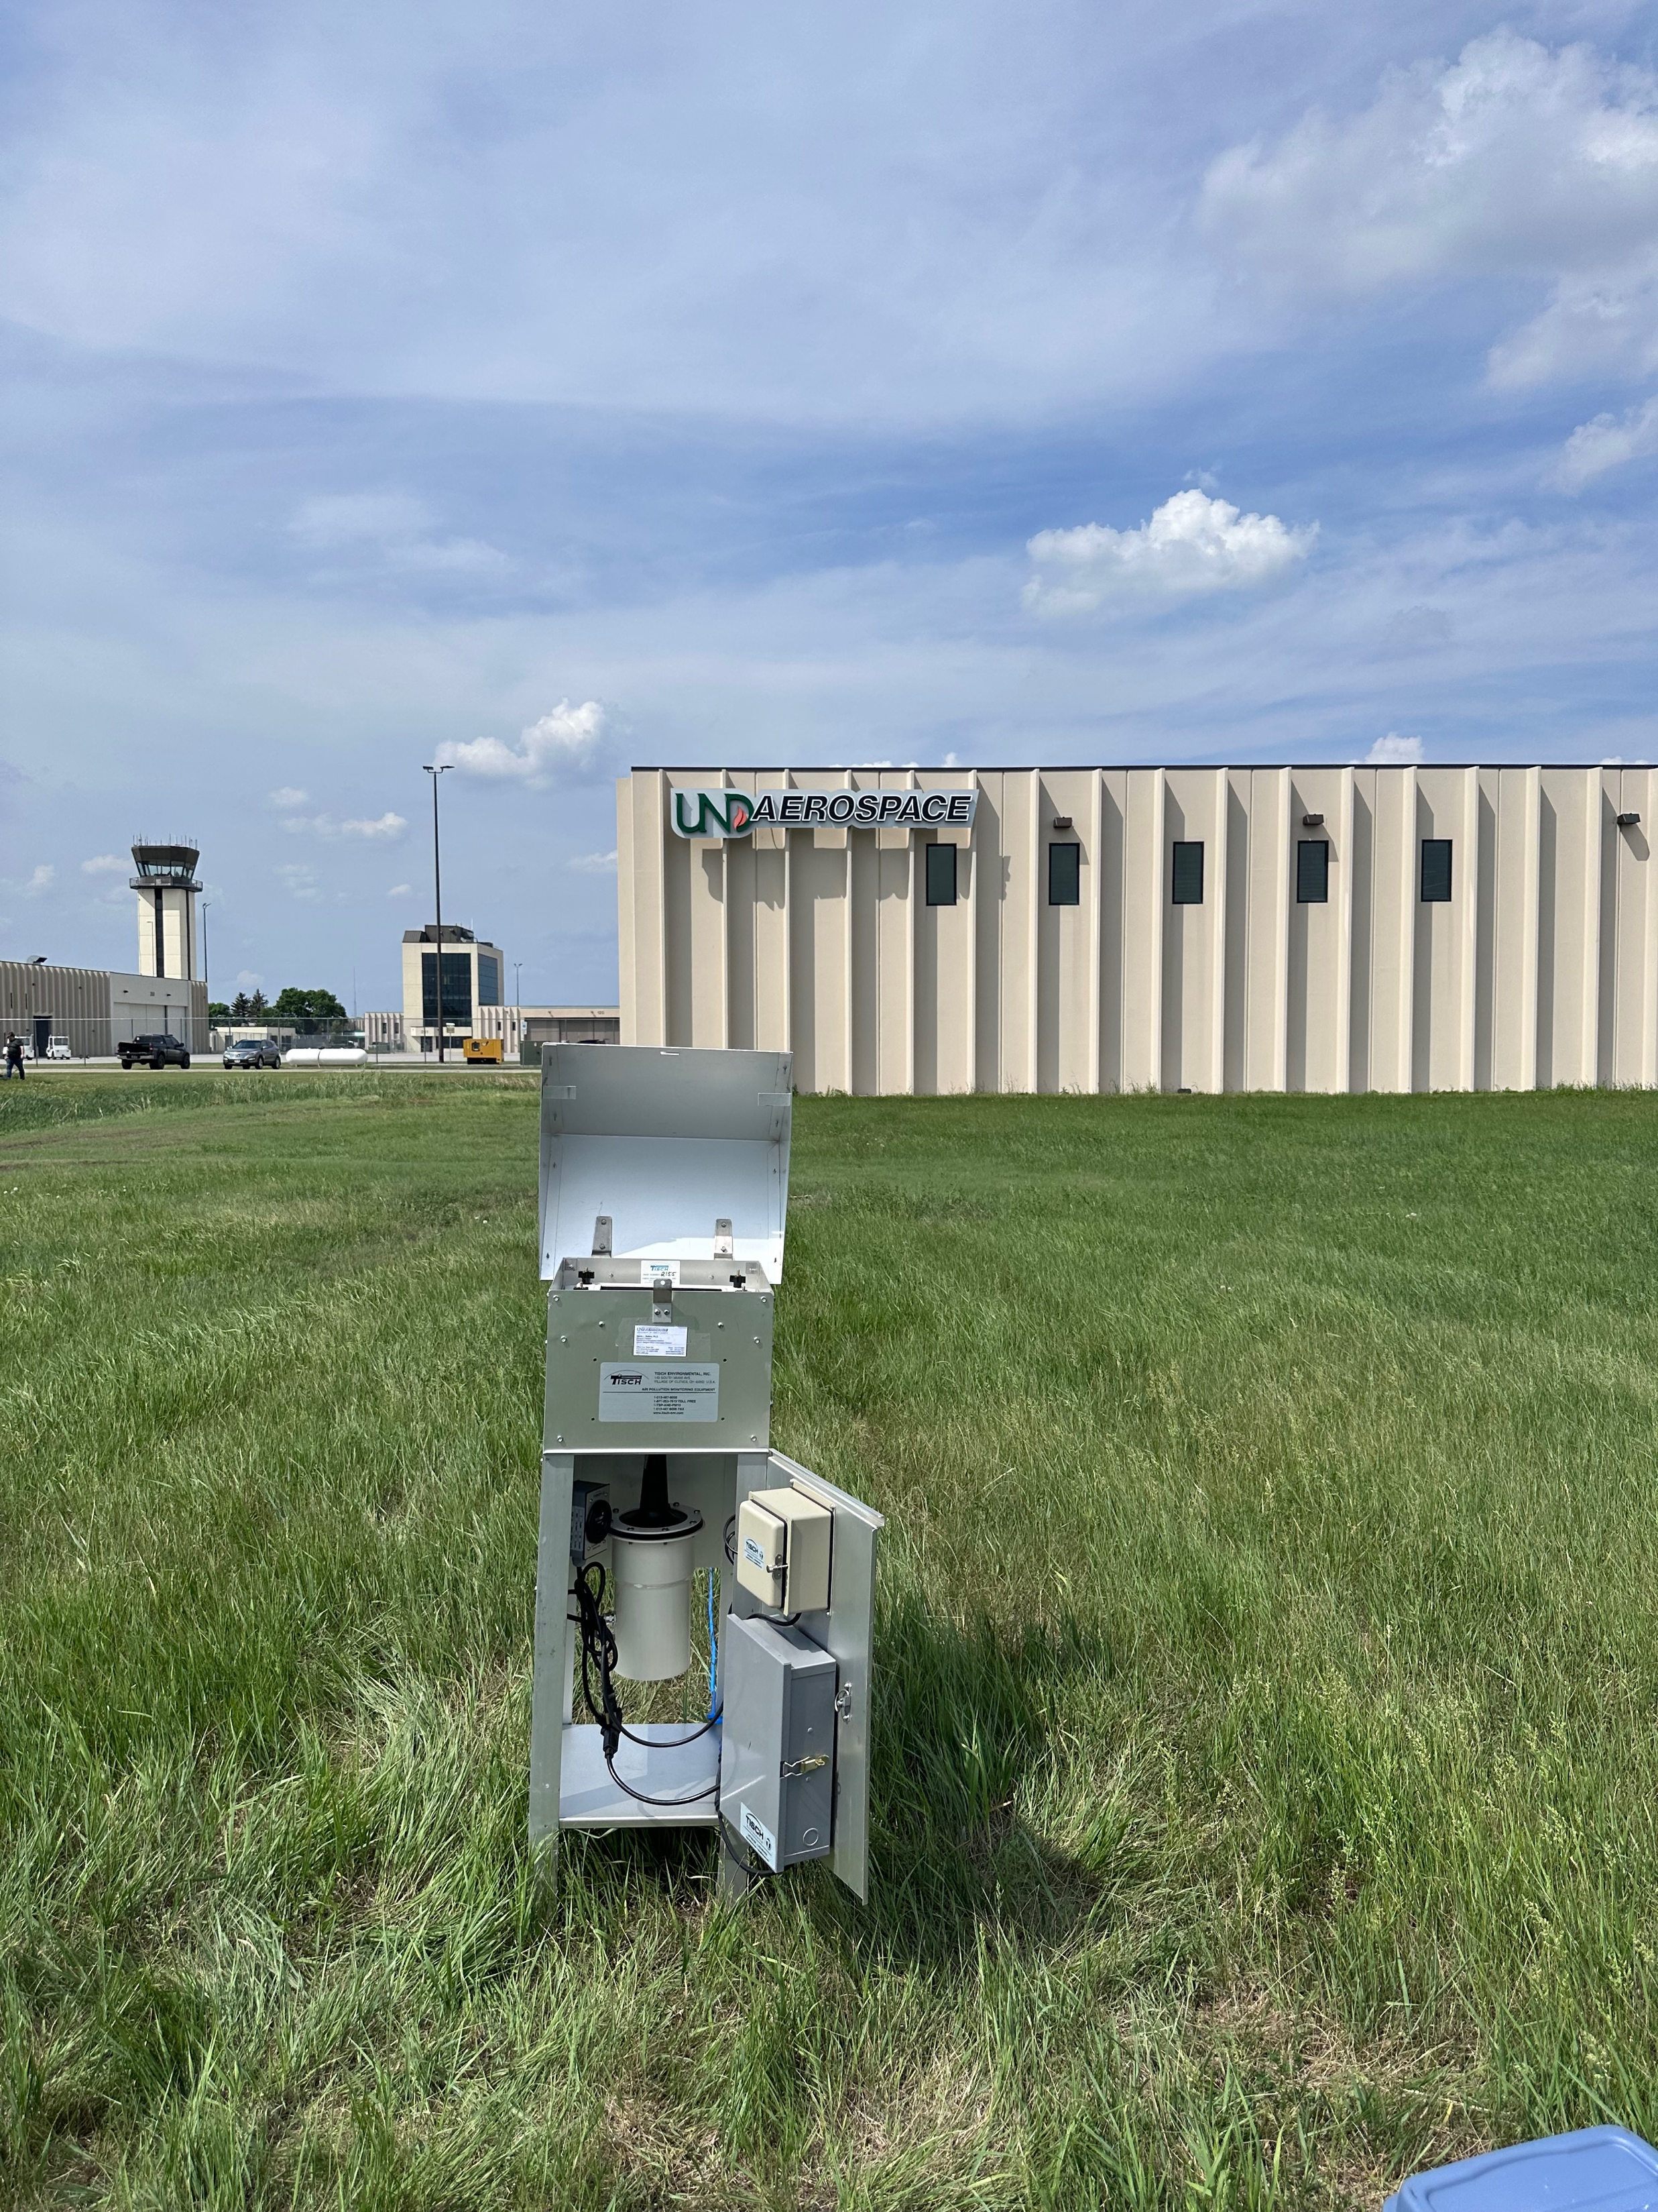
High Volume Sampler Location
Placed High Volume filter sampler close to the General Aviation airport at UND Aerospace where most of the liftoff and landing occurs.
Besides collecting filter samples, we performed initial analysis to obtain data such on the amount of "Fuel Burn" and "Fuel Burn at Max Power" per day. In 10x10 km box around the airport.
Kept track of data regarding of observed weather throughout the summer.
Figure 7-8 Location of High-Volume Filter sample at GFK Airport where samples are collected.
11

Slide 12
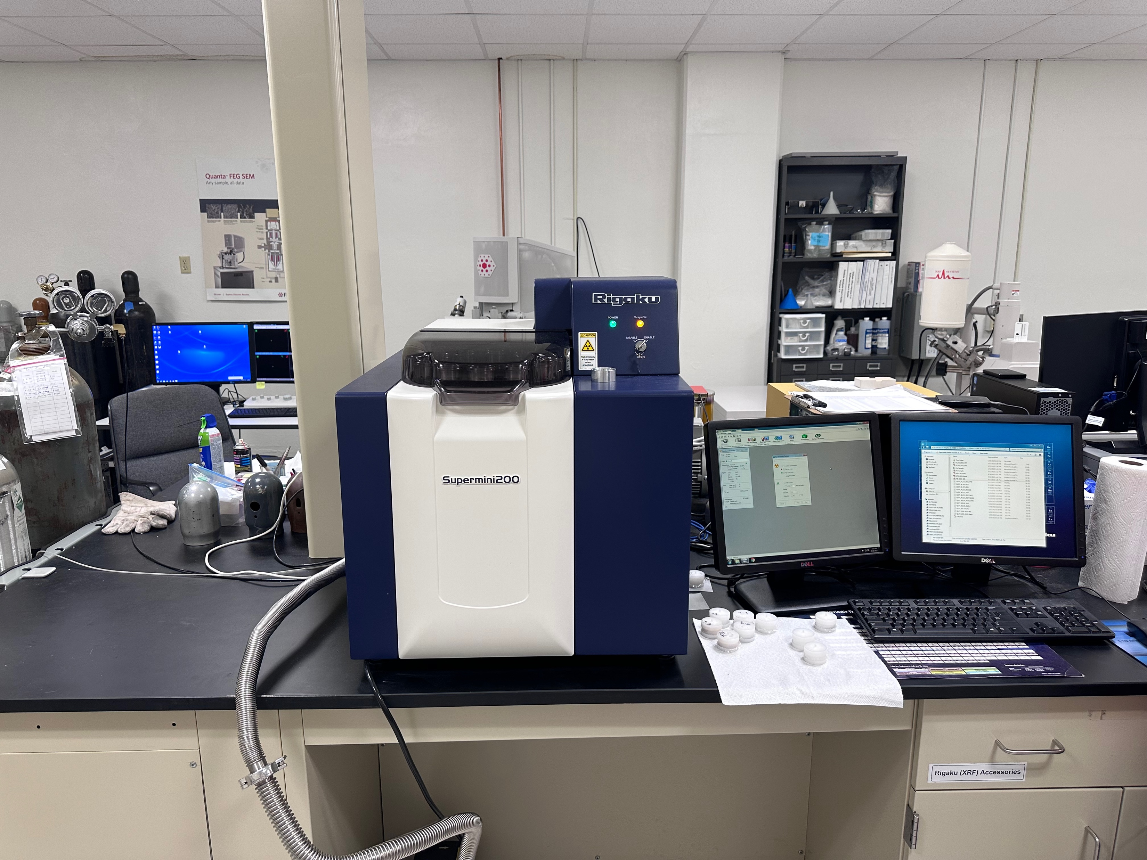
X-Ray Fluorescence
A non-destructive analytical technique used to determine the elemental composition of materials.
Determines the elements of a sample by measuring the fluorescent X-ray emitted from a sample when excited by a primary X-ray source.
Takes a circular 30-mm size cut from sample which is used to analyze.
Figure 9. X-Ray Fluorescence that is used to analyze the elements on our collected sample from airport.
12

Slide 13
Daily and weeklong samples
Figure 11. Bar chart of Mass Per Exposed filter area for each particle sample.
13

Slide 14
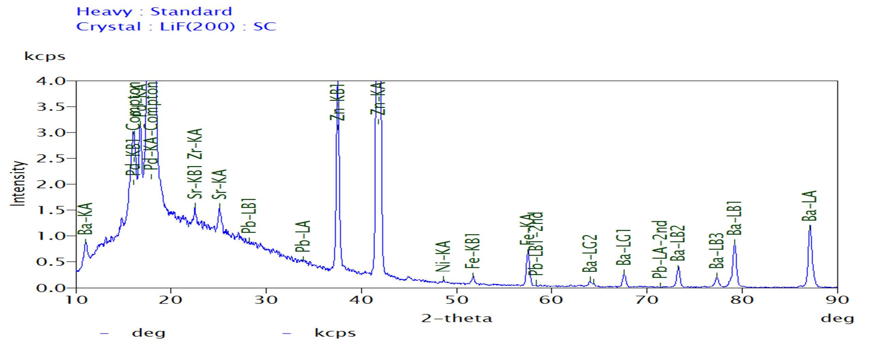
X-Ray Fluorescence Analysis
Figure 12. Our first successful attempt at detecting lead. Very low concentration of lead was observed on our daily sample.
14

Slide 15
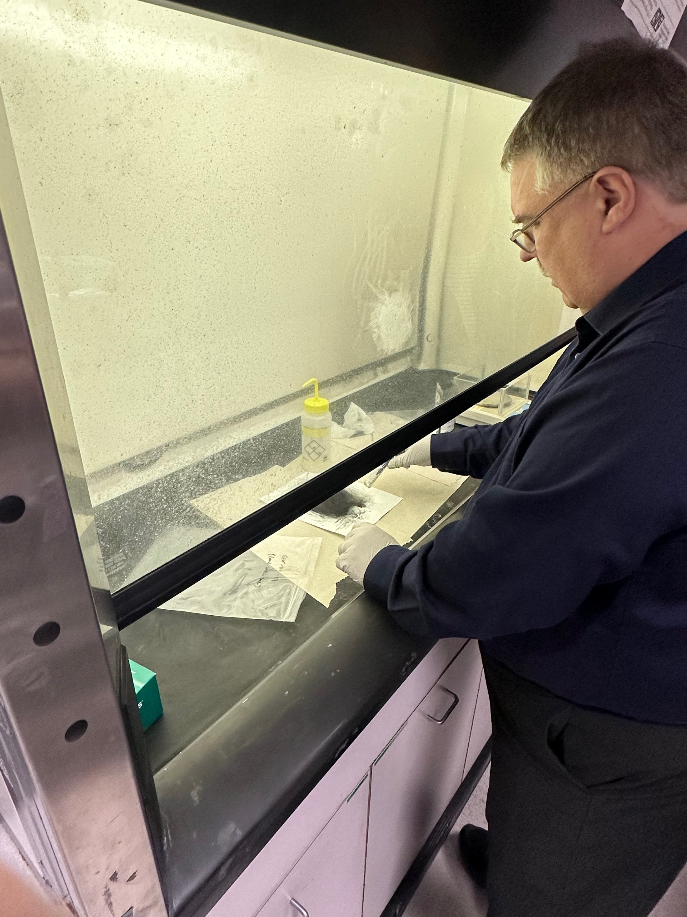
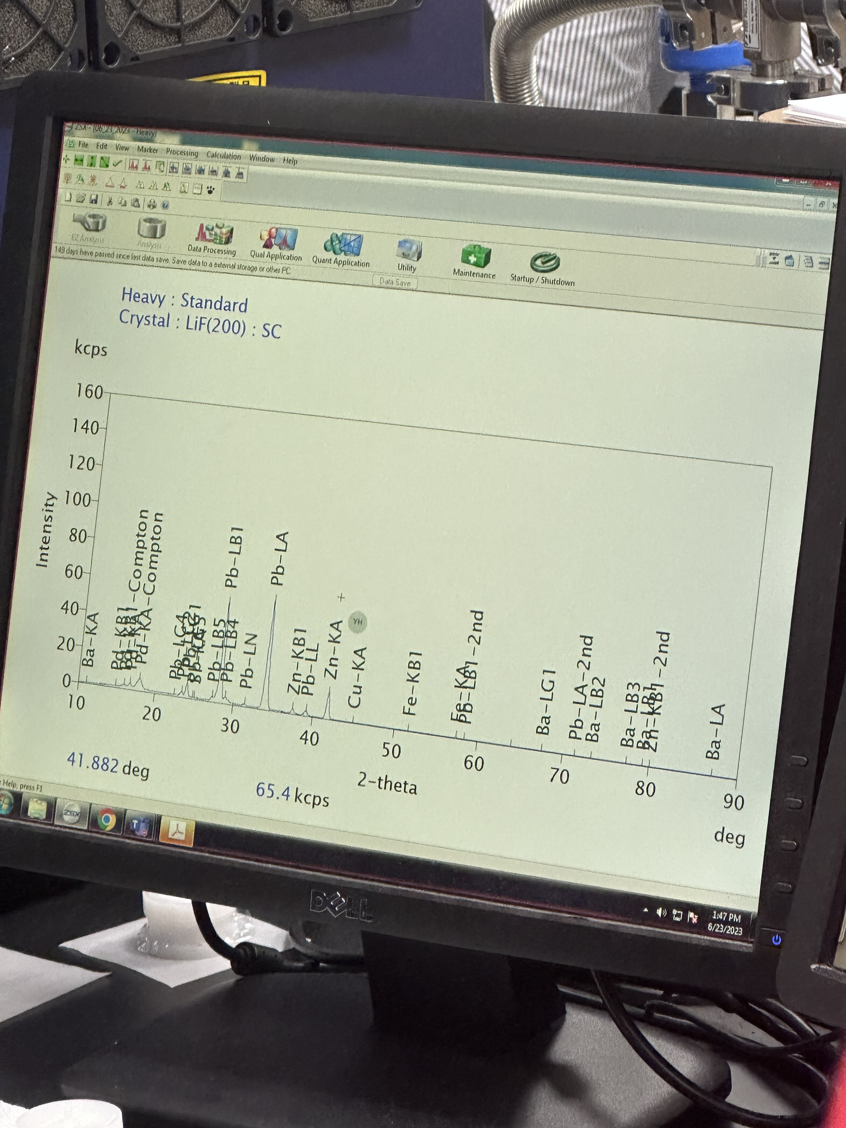
Lead sulfide experiment
Experiment to determine if XRF can detect high amounts of lead using a sample with high concentrated amount of lead sulfide.
Used 3.14 grams of lead sulfide and smeared all over a blank filter sample.
Test was successful. XRF detected high amount of lead on the sample.
Figure 13-14 . Dr. Delene adding Lead sulfide to a blank filter sample (Left). XRF results from sample; successfully found high amount of lead on sample (Right).
15

Slide 16
Next Steps
Based off low concentrations of lead in daily airport samples and lead sulfide experiment. Decided to start running weeklong samples beginning on the transition period (June 23rd).
Continue to review literature regarding lead emissions background, lignite combustion in Grand Forks.
Look in literature for elements in UL94 that pose a threat.
Perform XRF for upcoming weeklong samples that we are currently collecting.
Once results obtained, start working on comparing Lead levels before and after the switch.
16

Slide 17
Conclusion
UND Aerospace has switched entire aircraft and helicopter fleet to UL94.
Successfully detected lead on 24-hour daily samples, but at low amount.
Decided to run weeklong samples beginning June 23rd, which we will then see if lead is detected at a higher amount.
17

Slide 18
Acknowledgments
Funding:
We would like to acknowledge support from the National Science Foundation (NSF) under the IREC
REU program CHE-2244530. Any opinions, findings, and conclusions or recommendations expressed in this
material are those of the author(s) and do not necessarily reflect the views of the NSF.
Dr. David J. Delene
I would like to thank University of North Dakota Aerospace for allowing us to collect aerosol samples to help further our project.

