Slide 1

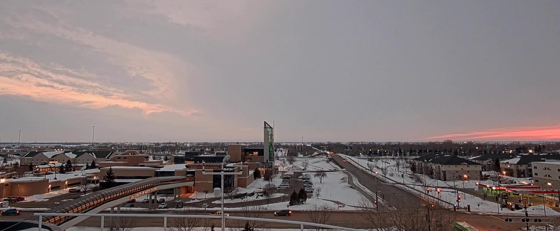



FAST Research Session
(Future Aerospace Strategic Thinking)
David J. Delene
Aerospace Research Fellow

Slide 2
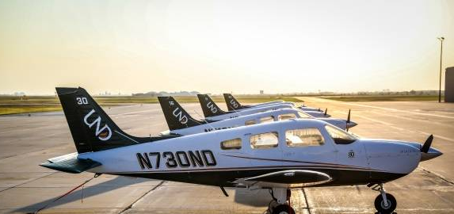
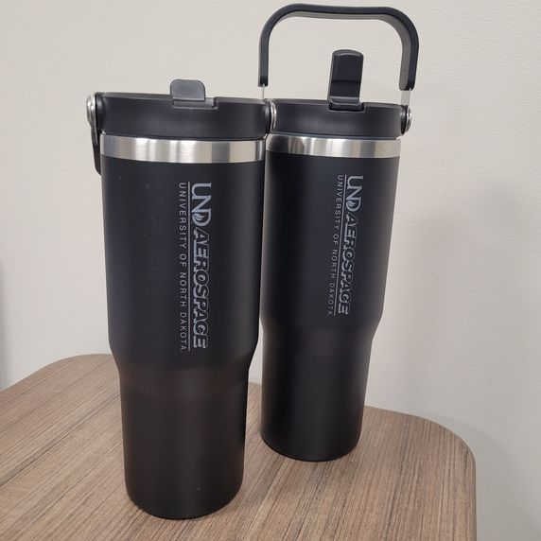
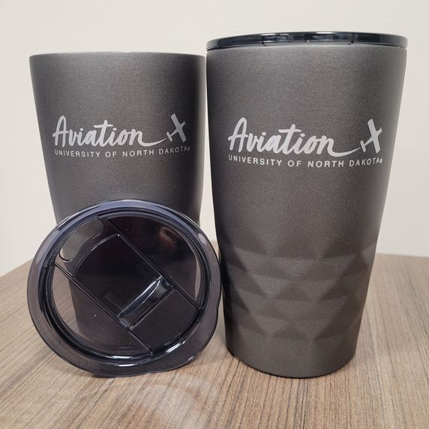
FAST Research Session Objectives
Future Research
    Not results from existing project.
Aerospace Research
    Involves aerospace personnel
    and facilities.
Strategic Planning
  FAST Presentation
  Project Discussions
  White Paper / Proposal
Thinking about the Whole Project
  Planning and Development.

Slide 3
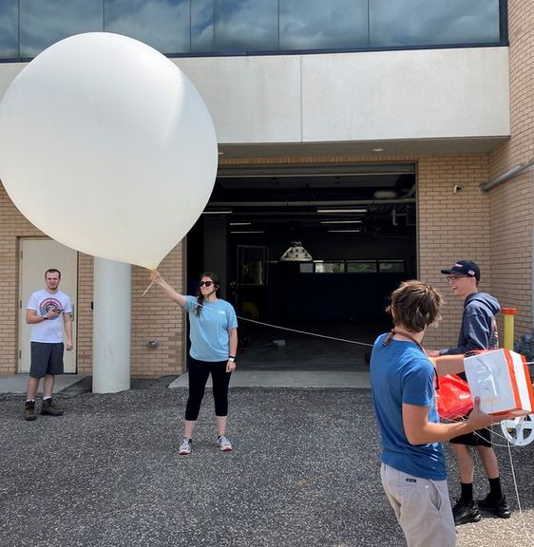
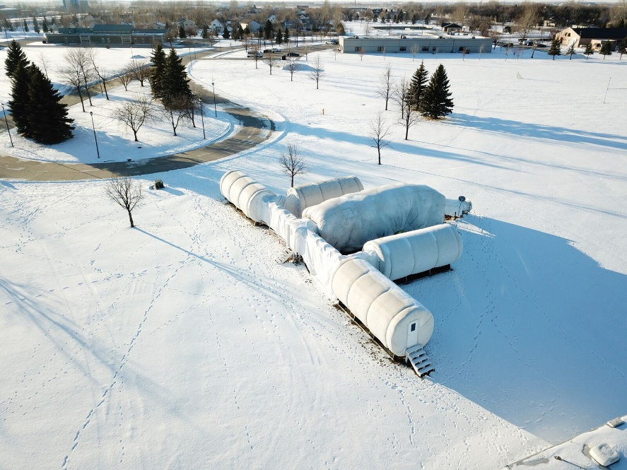
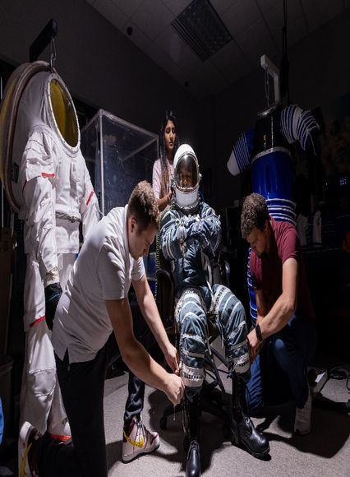
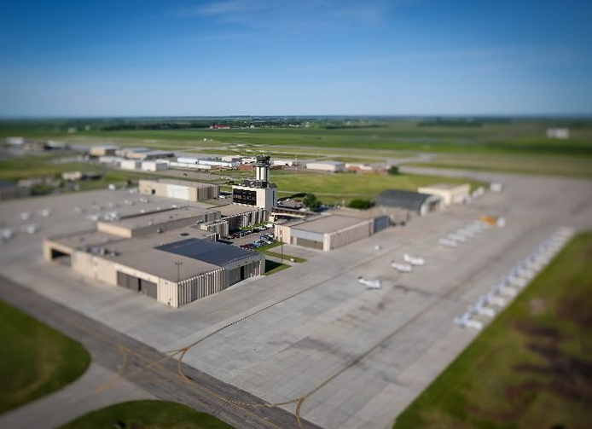
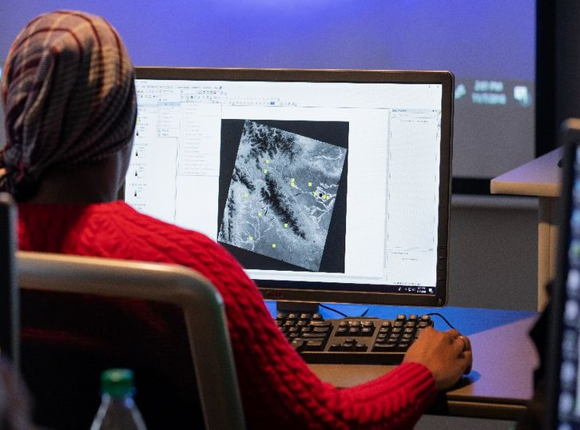
FAST Research Session Presentation Format
One Slide
  Need/Problem
  Concept
  Apparatus
  Objective
  Advancement
  End Users / Sponsor
3 Minute Presentation
3+ Minutes for Questions and Transition

Slide 4
FAST Research Session Slide Summary
Maximum of one slide.
  Slide with three main sections is good.
  Slide is somewhat similar to a conference poster.
  Slide could include a key concept figure.
  Only 3 minutes, do not cover everything.
    Covers material that would be in a White Paper.
    Cover problem, how to address and who benefits.
    What “End User” may fund the project.

Slide 5
Previous FAST Presentation Updates
Shawn Wagner - A Controlled Pylon System for Accurate Airborne Cloud Ice Crystal Sampling
Declined: UND 2025 Early Career Proposals
Submitted: ND EPSCoR FY26 STEM Research Seed Award
Mounir Chrit - A Controlled Pylon System for Accurate Airborne Cloud Ice Crystal Sampling
Declined: UND 2025 Early Career Proposals
Submitted: ND NASA EPSCoR Proposal
Jordan Christian, Predictability of Flash Drought in Subseasonal Forecasting Systems
Successful: UND 2025 Early Career Proposals
Francisco Del Canto Viterale, Space Studies, Building a Stronger North Dakota Aerospace Workforce
Reviewing Proposal Call: FY26 NASA Aerospace Skilled Technical Workforce Hubs (NAS_Hub)

Slide 6
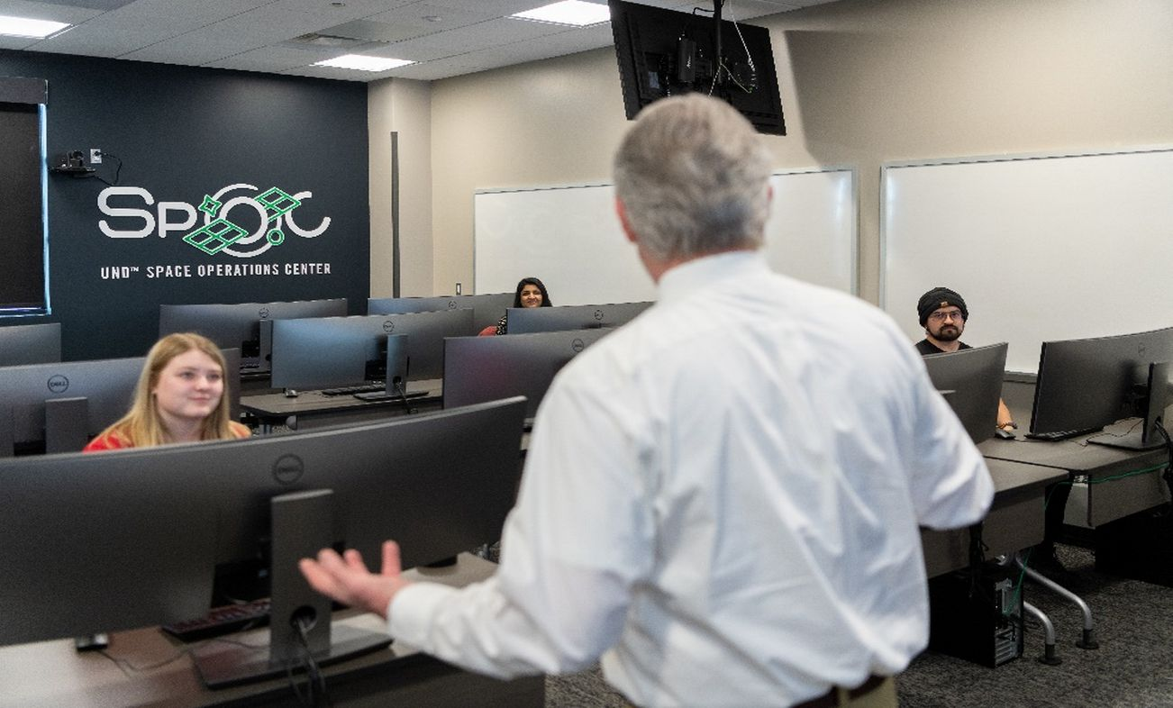
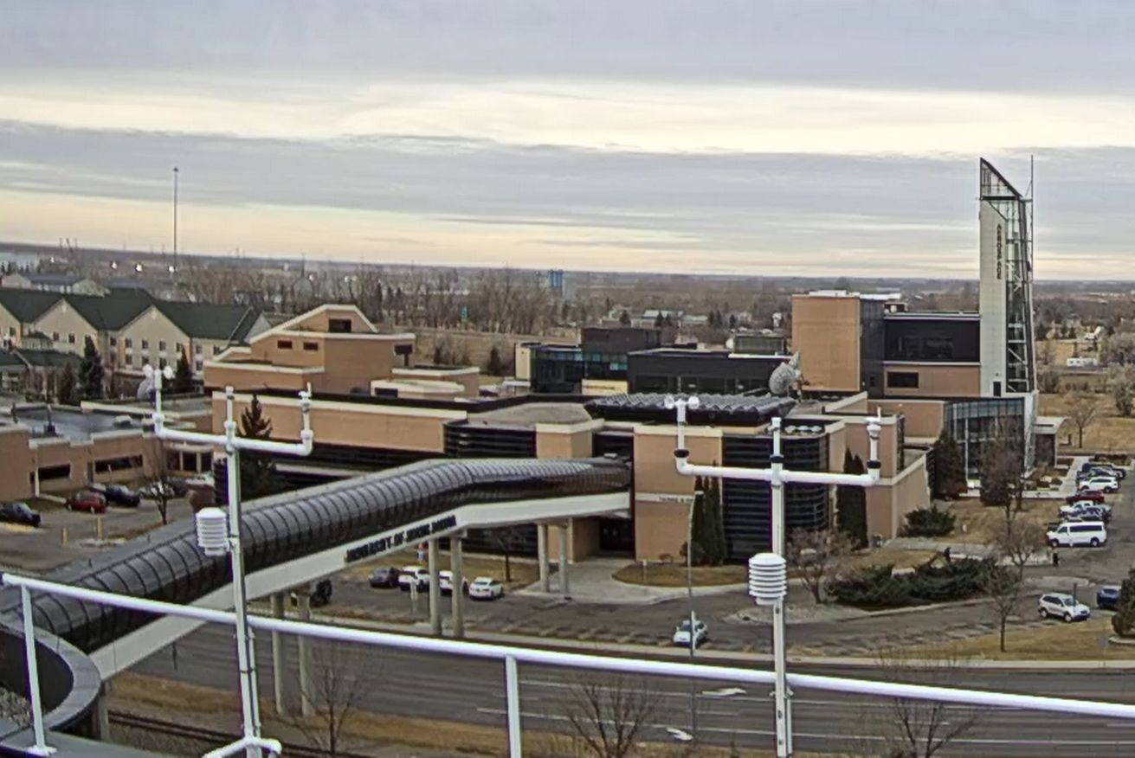
FAST Research Session Attendee Participation
Questions after each Presentation
    Ask questions about project details.
Research Topic Discussions Follow-on
  Discussions following all Presentations
Informal Project Idea Discussion
  Weds. 12-1 pm, Robin Hall Atrium
Present at Future FAST Sessions
  September 16, 2026 at 12-1 pm
  November 18, 2026 at 12-1 pm
  February 10, 2027 at 12-1 pm

Slide 7
February 11 2025 FAST Research Session
Elizabeth Bjerke, 2026 Aerospace College Seed Grant Program
Marwa Majdi, Atmospheric Sciences
  UND Data Skills Pathway: Call For Projects Ideas
Nicholas Wilson, Aviation
  Midwest Electric & Alternative Propulsion Aircraft Data Consortium
Jeffrey VanLooy, ESSP
  Potential Concentration of Glacial Meltwater Contaminants from Moraine Dammed Lakes
Naimul Hasan, Space Studies
  Reinforcement Learning Oriented Descent Modeling for a Mars Lander Using Physics-Based Simulation

