Slide 1
Analyzing Seasonal Fog Variability at North Dakota Airports and its Impact on Flight Delays
16 April 2025
ATSC 493 – Senior Project Avery Prelesnik University of North Dakota

Slide 2
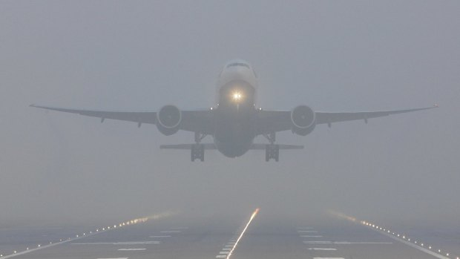
Introduction
General impacts of fog
The Midwest is prone to seasonal meteorological impacts (Goodman and Small Griswold, 2019).
In North Dakota, topography and climate show a seasonal variability of fog (Willette, 2023).
Aircraft landing in fog conditions
Adapted from The Sydney Herald
Notes:
As we all know and have experienced, the midwest experiences lots of different weather, and aviation is very sensitive to this of course being that the planes are in the air.
But, it also has an impact on ground operations.
We've all probably been in a situation where our flight has gotten delayed whether it was at our location specifically, or somewhere else down the line experienced some sort of weather.
North Dakota is lucky enough to have the topography and climate to support these conditions.

Slide 3
Introduction
Visibility Challenges:
Fog significantly impacts visibility, complicating airport operations (Gultepe et al., 2007).
Pilots must rely on Instrument Flight Rules (IFR) when visibility drops to 1-3 miles, and Low Instrument Flight Rules (LIFR) for visibility below 1 mile (Herman and Schumacher, 2016).
Operational Challenges:
Reduced visibility disrupts take offs and landings.
Delay defined as detainment of IFR traffic by air traffic control (ATC) for 15 minutes or more (FAA).
This disrupts the overall flow of air traffic, causing widespread delay and cancellations.
Notes:
Fog visually impairs pilots, atc, ground crews, and in these conditions, pilots must rely on instruments to take off and land rather than visuals.
This leads to delays which are defined by the FAA’s operations network as the detainment of IFR traffic for 15 minutes or more by air traffic control either at the gate, on taxiways, or on the runway.
Even one delay can cause a ripple effect throughout the entire network.

Slide 4
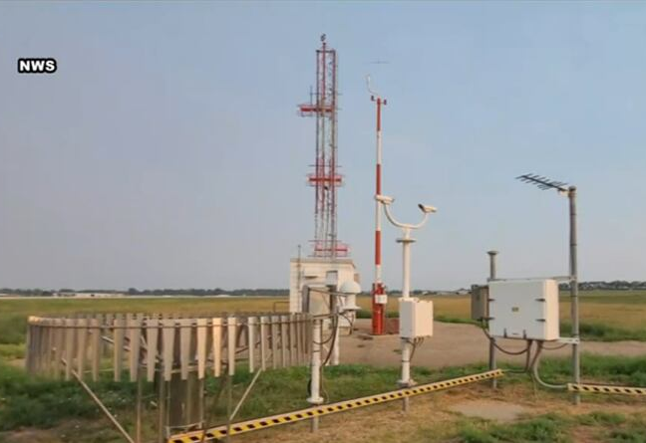
Efforts to Reduce Impacts
Localized Aviation MOS Program (LAMP)
Use of METAR, TAF, radar, NWP, and climatology.
Proved accurate for predicting ceiling trends, loss of accuracy for fog (Boyd and Guinn 2019).
High frequency ASOS data
More frequent than the standard hourly ASOS observations.
Proved beneficial for fog events since conditions change rapidly (Leyton and Fritsch 2004).
ASOS at BIS
Adapted from the National Weather Service
Notes:
Fog is very hard to forecast because it is so localized, but there have been previous efforts to improve forecast skill.
Localized aviation Model output statistic program or LAMP used METAR, TAF, radar, NWP and climatology records combined to increase forecasting of fog, ceiling, and visibility specifically for aviation.
While deemed successful for predicting ceiling trends, it was not as successful for predicting fog.
ASOS observations are output hourly with special weather reports when needed, so in another study, regular high frequency ASOS data was used to predict fog which did prove to be beneficial.

Slide 5
Motivation and Objectives
Research Gap:
Limited research exists of how fog affects airports in North Dakota.
Study Objectives:
What is the probability of flight delays due to fog by season at North Dakota airports?
How has the probability changed over time from 2000 to 2023?
How have flight delays due to weather changed over time from 2000 to 2023?
Notes:
The motivation behind this research is attributed to the fact that there is limited research on the effect fog has on airport operations, especially here in ND where we don’t have busy airports.
This study aims to answer these questions:______
By examining fog's seasonal variability, occurrence, and historical operational impact, operational strategies and safety measures can be developed and implemented to maximize airport efficiency.

Slide 6
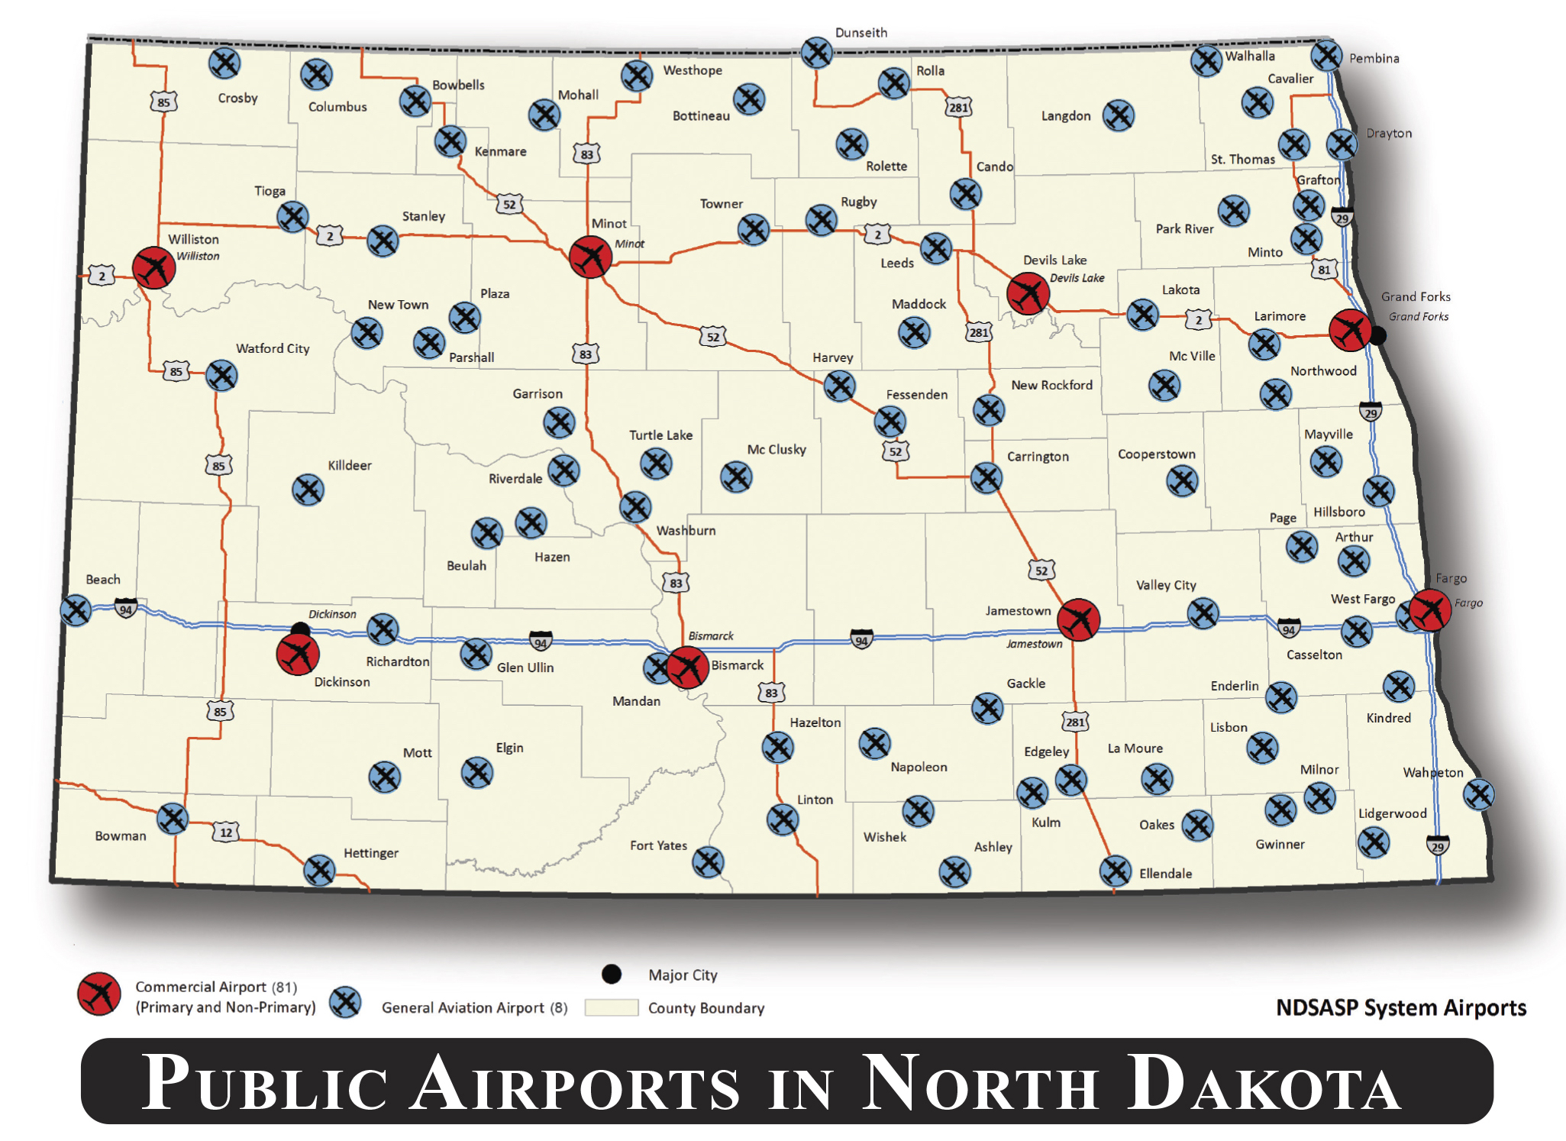
Methodology
METARs and flight delay statistics are examined for three North Dakota airports:
Grand Forks International Airport (GFK)
Hector International Airport (FAR)
Bismarck Municipal Airport (BIS)
1 January 2000 to 31 December 2023
METAR data from Iowa Environmental Mesonet
Delay information from the OPSNET
Adapted from ND Aeronautics Commission
Notes:
To answer these questions, I looked at METARs and flight delay statistics at three airports.
On the right, I have a map of all North Dakota airports, however I just focused on GFK FAR BIS
Data I looked at spans from 1 January 2000 to 31 December 2023
METAR data obtained from the Iowa Environmental Mesonet
Delay information obtained from the Federal Aviation Administrations Operations Network

Slide 7
Results – Low Visibility Occurrences (2000—2023)
Low visibility is caused by fog and mist.
Mist reports occurred more frequent than fog reports.
Notes:
We are going to look at the major causes of low visibility, those being fog and mist.
From ASOS observations (includes routine and special weather reports) from 2000-2023, these pie charts represent the total number of METARs.
Each airport had approximately 250,000.
The dark blue represents reports of fog, light blue represents reports of mist, and the gray is the remainder.
Mist was more frequent but generally reported with another weather code such as rain or snow.
GFK reported fog in 0.72% of METARs and mist 12.73% (out of 254,668)
BIS reported fog 0.53%, mist 10.44% (out of 258,753)
FAR reported 0.62% fog, 13.43% mist (out of 264,037)
GFK:
FG: 1830/254,668
BR: 32,423/254,668
BIS:
FG: 1377/258,753
BR: 27,007/258,753
FAR:
FG: 1632/264,037
BR: 35,465/264,037

Slide 8
Results – Hourly Fog and Mist (2000—2023)
Morning fog more frequent in winter months; earlier in summer and later in winter.
Notes:
To visualize the seasonal distribution, these heat maps show the UTC time on the y-axis, and the month of the year on the x-axis.
Across all three airports, fog and mist occurred most frequently from December to March.
June through September had the fewest
GFK: peaks in March (08Z-13Z) and December (06Z-15Z)
BIS: maximum in March where peak hours were between 09Z and 14Z.
FAR: peak in December between 12Z and 16Z
We can see an “arched” pattern on all three plots, shows the seasonal shift of diurnal patterns, earlier in summer, later in winter.

Slide 9
Results – Flight Delays at GFK (2000—2023)
4 weather-related delays recorded.
Low number of delays aligns with low traffic volume (~2 departures per day).
Aligns with seasonal fog occurrences.
2 delays recorded 7 April 2001
1 delays recorded 22 January 2009
1 delays recorded 17 February 2010
Historical decrease in delays, last weather-related delay was in 2010.
Weather-related delay frequency by month at GFK
Notes:
From 2000-2023, GFK only recorded 4 weather-related delays which is consistent with operational expectations given that GFK only has about two commercial departures per day.
Of the four delays, 2 were on 7 April 2001, 1 was 22 January 2009, and 1 was recorded 17 February 2010.
These delays are consistent with the seasonal variability since they occurred in the winter and spring.
Overall, we see a decrease in weather-related delays at GFK since the last one occurred in 2010.

Slide 10
Results – Low Visibility Impact at GFK
10
7 April 2001
Two dates show evidence of low visibility contributing to the delays.
7 April 2001 reported mist, rain, and overcast skies.
22 January 2009 reported freezing fog (FZFG) resulting in a major drop in visibility.
8
6
4
2
Visibility (miles)
10
8
22 January 2009
6
4
2
0
0 2 4 6 8 10 12 14 16 18 20 22
Hour (UTC)
Notes:
To check if they were caused by fog, the METARs were analyzed.
The METARs on 7 April 2001 reported mist, rain and overcast skies, but no fog reported.
looking at our time series, we have the visibility in miles on the y-axis and the UTC time on the x-axis.
Visibility started to drop at 08Z which corresponds to the beginning of the weather code reports, however never below 2 miles.
On 22 January 2009, visibility drops at 09Z, and another steep drop at 11Z where it stays consistently below 1 mile. This drop is associated with reports of freezing fog made at 11:53Z

Slide 11
Results – Low Visibility Impact at GFK
Delay on 17 February 2010 shows no evidence of fog impact.
17 February 2010
10.4
10.2
10.0
9.8
9.6
Visibility (miles)
0 2 4 6 8 10 12 14 16 18 20 22
Hour (UTC)
Notes:
The last delay at GFK did not show any evidence of fog or low visibility causing the delay because there were no significant weather codes reported, and the visibility stays consistent at 10 miles.

Slide 12
Results – Flight Delays at BIS (2000—2023)
25 weather-related delays.
BIS has ~9 departures per day.
Somewhat aligns with seasonal fog occurrences.
Most delays occurred in July, not likely linked to fog.
Historical decrease in delays, last weather-related delay was in 2009.
Weather-related delay frequency by month at BIS (2000—2023)
Notes:
BIS recorded 25 weather-related delays between 2000 and 2023, and they see around 9 departures per day.
Most of the delays occurred in July which remembering that fog occurs less frequently in the summer, these are likely a cause of convective events rather than fog.
We did see at least 1 delay during the winter and spring.
BIS also shows a downward trend in weather delays since the last one occurred in 2009.

Slide 13
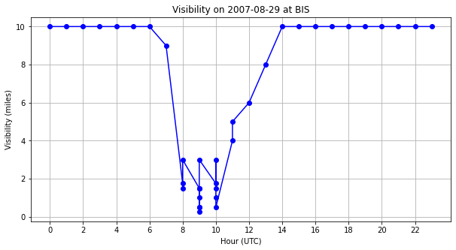
Results – Low Visibility Impact at BIS
29 August 2007
FG observations reported on 29 August 2007.
BR reported from 08:47Z to 12:52Z, FG reported from 09:17Z to 09:40Z.
Lowest visibility associated with second report of FG.
One delay logged, likely influenced by this event.
No other significant weather codes reported.
10
8
6
4
2
0
Visibility (miles)
0 2 4 6 8 10 12 14 16 18 20 22
Hour (UTC)
Notes:
One day of interest I focused on which was 29 August 2007.
There were reports of mist that started at 08:47Z and continued until 12:52Z
And there also was a few reports of fog which went from 09:17Z to 09:40Z. Looking at the visibility plot, there is a number of reports during the 09Z hour.
The lowest visibility observation within the METARs was associated with the second report of fog and was down to a quarter mile.
There was only one delay logged on this day, but it very likely was influenced by this since no other significant weather codes were reported.

Slide 14
Results – Flight Delays at FAR (2000—2023)
68 weather-related delays.
Delay peaks in March and June.
FAR has ~12 departures per day.
FAR had the highest amount of delays, suggests greater sensitivity to weather or higher traffic volume.
Continued relevance: FAR experienced delays 2021-2023.
Weather-related delay frequency by month at FAR (2000—2023)
Notes:
FAR recorded 68 weather delays on 44 different days, and 13 days had more than one delay.
FAR also has the most departures per day averaging at 12. This makes sense because of the higher volume but also may indicate that FAR is a little more sensitive to weather since there is quite a big gap.
March and June were tied for the maximum amount of delays, but December also had a high number remembering that March and December had the highest fog frequency.
The most recent delays occurred here with records of delays in 2021, 2022, and 2023, however prior to these delays there was a bit of a gap.

Slide 15
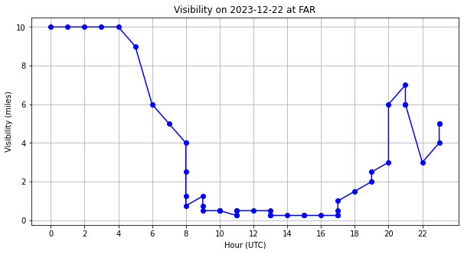
Results – Low Visibility Impact at FAR
22 December 2023
FAR experienced a major fog event on 22 December 2023.
BR reported continuously from 06:53Z, FG reported from 09:53Z to 17:42Z
Large drop in visibility associated with FG reports.
One delay logged, likely influenced by this event.
10
8
6
4
2
0
Visibility (miles)
0 2 4 6 8 10 12 14 16 18 20 22
Hour (UTC)
Notes:
At FAR we had a major fog event on 22 December 2023 where there were continuous reports of BR starting at 06:53Z, and fog reports from 09:53Z to 17:42Z.
Very large drop in visibility associated with the fog observations, visibility was consistently between a quarter mile and half a mile.
Ther was one delay recorded this day and it was very likely due to this event.

Slide 16
Conclusions
Seasonal fog trends present.
Winter months see more fog occurrences.
Diurnal fluctuation by season.
Weather-related delays varied by airport, GFK showed the least.
Weather delays have overall decreased in the last two decades, possibly due to better forecasting and operational changes.
Difficult to pinpoint exact cause of flight delays.
Flight delay reports lack timestamps for individual delays.
Notes:
Overall, there is a seasonal variability of fog in North Dakota. Fog is more frequent in the winter and spring, and less frequent in the summer.
Its also notable that there is a seasonal shift in the time of fog occurrences due to the sun rising earlier in the summer than it does in the winter.
The number of weather-related delays varied by airport, but for the most part were proportional to the flight volume, and we do see an overall historical decrease in weather delays.
The delay reports from the OPSNET don’t have timestamps for each delay which makes it hard to definitively link a flight delay to fog, but it does provide a reasonable guideline to make inferences.

Slide 17
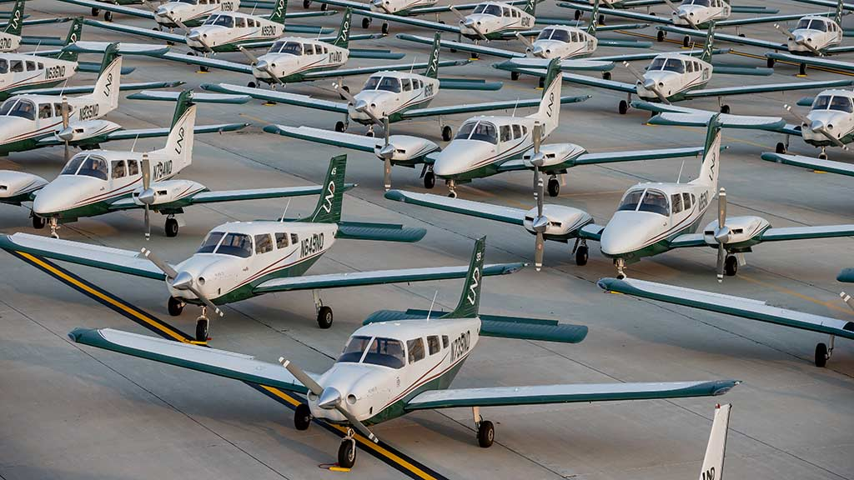
Future Work
Include data from general aviation activity.
Utilize UND’s high-volume flight program.
Analyze taxiing, ground delays, and cancellations.
These may be more affected by fog than records show.
Aircraft used by UND’s flight program
Adapted from the University of North Dakota
Notes:
Further expansion could be made on this topic by considering general aviation activity such as UNDs flight program since the three airports that were examined have low flight volumes. These flights are also generally more sensitive to low visibility conditions.
It would also be useful to analyze taxiing, ground delays, and cancellations since they may be more affected.

Slide 18
References
Boyd, D., and T. Guinn, 2019: Efficacy of the Localized Aviation MOS Program in Ceiling Flight Category Forecasts. Atmosphere, 10, 127, doi:10.3390/atmos10030127.
Gultepe, I., Tardif, R., Michaelides, S. et al. Fog Research: A Review of Past Achievements and Future Perspectives. Pure appl. geophys. 164, 1121–1159 (2007). https://doi.org/10.1007/s00024-007-0211-x
Goodman, C. J., and J. D. Small Griswold, 2019: Meteorological Impacts on Commercial Aviation Delays and Cancellations in the Continental United States. Journal of Applied Meteorology and Climatology, 58, 479–494, doi:10.1175/jamc-d-17-0277.1.
Herman, G. R., and R. S. Schumacher, 2016: Using Reforecasts to Improve Forecasting of Fog and Visibility for Aviation*. Weather and Forecasting, 31, 467–482, doi:10.1175/waf-d-15-0108.1.
Leyton, S. M., and J. M. Fritsch, 2004: The Impact of High-Frequency Surface Weather Observations on Short-term Probabilistic Forecasts of Ceiling and Visibility. Journal of Applied Meteorology, 43, 145–156, doi:10.1175/1520-0450(2004)043&lt;0145:tiohsw&gt;2.0.co;2.
Willette, Michael Douglas, "Conducting Fog Research And Abatement Using Unmanned Aircraft Systems (UAS)" (2023). Theses and Dissertations. 5711. https://commons.und.edu/theses/5711

Slide 19
Questions?
Thank you!

